Slide 1
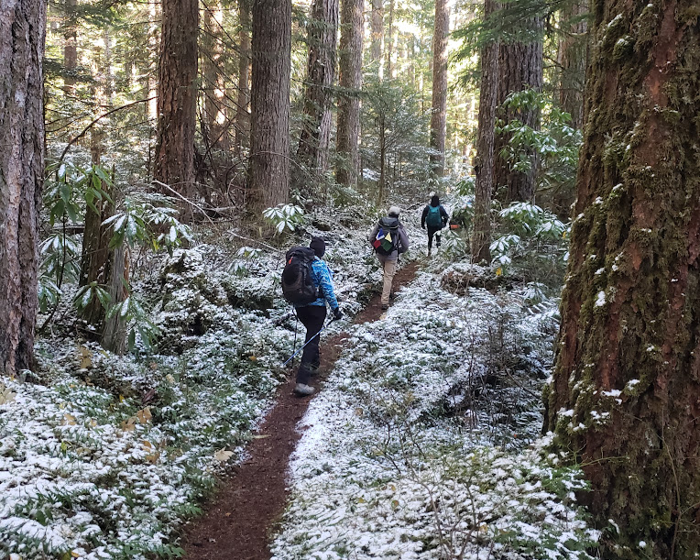
Winter Hiking Series
I-90 Alley and Beyond!
Notes:
This is my first course to run so be kind and helpful to me.... I am just a volunteer who wanted to help all hike year around!

Slide 2

Hike Leader Introductions PRIMARY LEADS
Will Tooker Stacey Wikle
David Judish Stephen Oliver
Lisa Elliot Rick Little
Jaye Sedlack David Hyde
Frank McCracken Melanie Mayock
Becky Jacobsen Jennifer Keller
Carolyn Carbajal Monte Windsor
Diann Sheldon Beth Lowe and myself!
Notes:
I now plan to let the Instructors present introduce themselves and tell you why they chose to volunteer for this series.

Slide 3
Please also "thank so much" these CO-LEADS
Sue Little Fletcher Tibert
Vera Ellich Francis Moore
Vanessa Phillips Brooke Roberts
Ted Burke Chris Nelson
Susan Conbere Vanessa Phillips
Nicole Hansen Gene Keltgen
Henrique Castro Sana Sakr
Jeryl Kolb
*Keep in mind how leader intensive this course is and THANK THEM!!!
Notes:
I now plan to let the Instructors present introduce themselves and tell you why they chose to volunteer for this series.

Slide 4
The philosophy of this course…..
3 rules in this order
SAFETY (physical and emotional)
FUN
GET THE JOB DONE

Slide 5
Why winter hiking?!?
Pros
Cons
Let’s keep in shape over the winter!
Be ready for the higher elevation hikes when the snow melts.
Difficult to find hikes that are “do-able”
Weather: if not raining it is snowing or maybe doing both; and then there is the wind….
Tread can be less safe
You carry more weight often.

Slide 6

Course and hikes in general …...
This is not a course for beginner hikers.
Almost all hikes are at least 6 miles and 1200 elevation with 1.5 to 2.5mph average moving speed.
Unlike CHS, there is no progression, and a few hikes are generally lower elevation and/or shorter than above, but there are a most hikes that are much longer and about 2800 feet or even more. Even some of the shorter hikes can be a big challenge.
LOOK AT EACH HIKE CLOSELY BEFORE SIGNING UP
Look closely at the length and distance since to get the distance in many hikes are not being done in a standard way.
Hike descriptions will give you a better idea of what to expect.
Many leaders changed the pace to better match their own.
EXAMPLE: Hike on Sunday 1/18/2026

Slide 7
What we are all REQUIRED to carry….

Slide 8
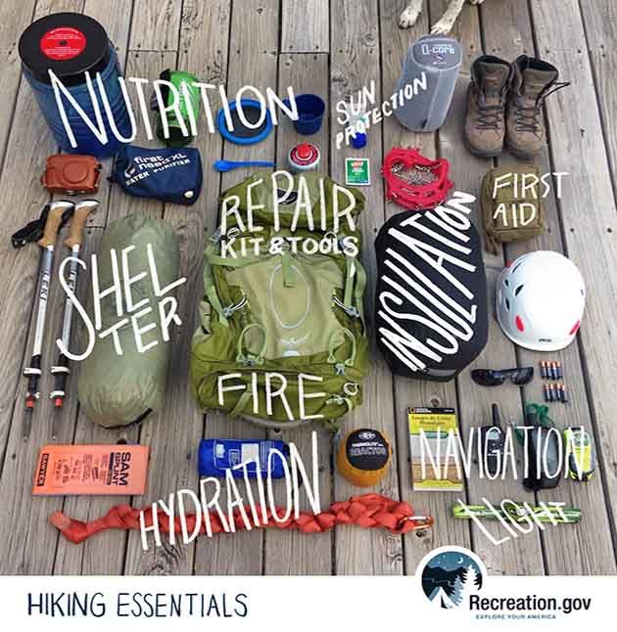
Ten Essentials ***for all weather hiking*** Mountaineers 10 Essentials
1. Navigation
2. Illumination
3. Sun Protection
4. First-Aid Kit
5. Repair Kit and Tools
6. Fire
7. Shelter
8. Hydration
9. Nutrition
10. Extra clothes
Notes:
LARA
1. Navigation - Map and compass are required as well. If you don't know how to use them, take a class () or ask some of your more experienced hiking companions to demonstrate.
2. Illumination - Bring along that flashlight or headlamp (and extra batteries); you may be delayed getting off the trail, and it's a lot easier with a light source. The benefit of the headlamp is that it leaves your hands free to use to use trekking poles, see a compass or administer first aid in the dark.
3. Sun Protection - Sunglasses and sunscreen to protect your eyes from bright sunlight or reflection off of snow and glaciers. A broad-brimmed hat and loose-fitting lightweight clothing with long sleeves and long pants legs can also help prevent sunburn.
4. First-aid Kit - Containing items for treating common trail injuries such as cuts, scrapes, blisters, etc.
5. Repair Kit and Tools - A pocket knife is handy for many uses such as preparing lunch, cutting bandages, preparing a fire, etc. Extra shoelaces, a bit of duct tape wrapped around a water bottle or trekking pole and perhaps some safety pins.
6. Fire -Waterproof matches and fire starter to start an emergency fire.
7. Shelter – A tarp or large garbage bag can be used as an emergency shelter in a pinch. If your return is waylaid for any reason and you are stuck overnight in the mountains, your shelter will help to keep you out of inclement conditions until help arrives.
8. Hydration - Bring plenty of water - at least a liter of water for a five-mile trip, more for a longer trip.
9. Nutrition - Bring plenty of food to fuel those working muscles and keep your body warm and comfortable.
10. Extra clothes - Bring along extra clothing for insulation. Remember you lose 3-5 degrees of temperature for every 1,000 feet of elevation gain. Remember the layering system for staying comfortable: base layer (against your skin to wick away moisture), insulation layer (to trap warm air near your body), and shell layer (when needed for protection against wind and/or rain).

Slide 9

But there are…. Winter hiking MUST HAVES in our pack or on our body
***MICROSPIKES***
(but NOT Yaktraks)
We do not cancel a hike because of a little snow
LAYERS, LAYERS, LAYERS and NO COTTONS AT ALL!!!
(Wear snowshoe or skiing layers)
Strongly Consider:
Trekking Poles

Slide 10
Microspikes....
REI sells what is Kahtoola microspikes and that or similar is what most people I hike with have.
Yaktraks are a big "No No"
Trail Crampons are something that is new and probably OK (brand Hillsound on Amazon)
SIZING?!? follow the sizing guides for what you have bought and understand they are supposed to be hard to get on at least for the first few times.
Do you have them?
Or do you have ice crampons?
Or do you have Yaktracs?
What is the difference?

Slide 11

*Other items to consider packing*
Car clothes for when you get really wet or muddy.
Hot drink or food item in a container to keep it warm.
Toe and foot warmers!

Slide 12
Now let’s talk weather!

Slide 13

Weather-Related Thoughts
Plans can change quickly, even on the morning of a hike. Before you leave:
Review weather reports; don’t depend on your leaders only since we do not know when you personally feel comfortable
Check email, texts and voice mail for last-minute leader communications
Hikes are not cancelled for miserable weather; they are cancelled for dangerous weather conditions.
Hikes can also be changed to other lower elevation sites in the area if the higher elevations are not safe.

Slide 14
When do we cancel or change the hike for weather?!?
****Unsafe driving conditions to the trailhead***
Snow so deep that the trip really should considered "snowshoe" General Rules: snow greater than 6 inches or above midcalf; or too much ice
Leader may change the hike to a lower elevation if possible, and/or modify the hike for group safety. (A hike will be considered a complete hike if there is a turn around for safety.)
Hike cancellation and/or change of hike site is up to the individual leader.

Slide 15
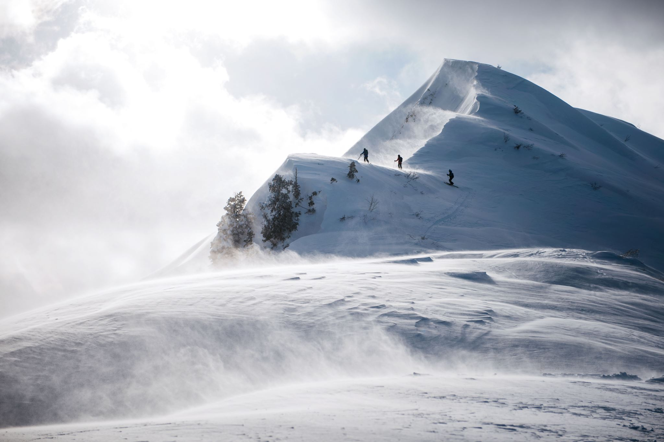
WEATHER!!!
So important to monitor while winter hiking
***IMPORTANT WEBSITES***
NOAA and MOUNTAIN FORECAST
Windy.com
NOAA
Issaquah: NOAA Issaquah
Bellevue: NOAA Bellevue
North Bend: NOAA North Bend
MOUNTAIN FORECAST: Mt Si as an example Also good site -
Mountain Forecast Mt. Si Windy.com (red app!)

Slide 16
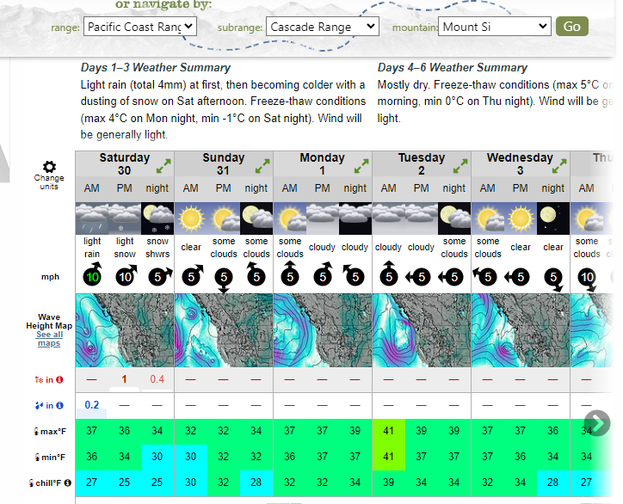

Slide 17
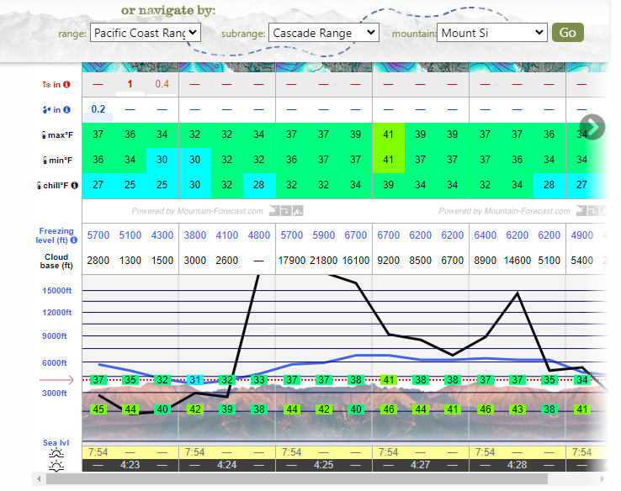

Slide 18
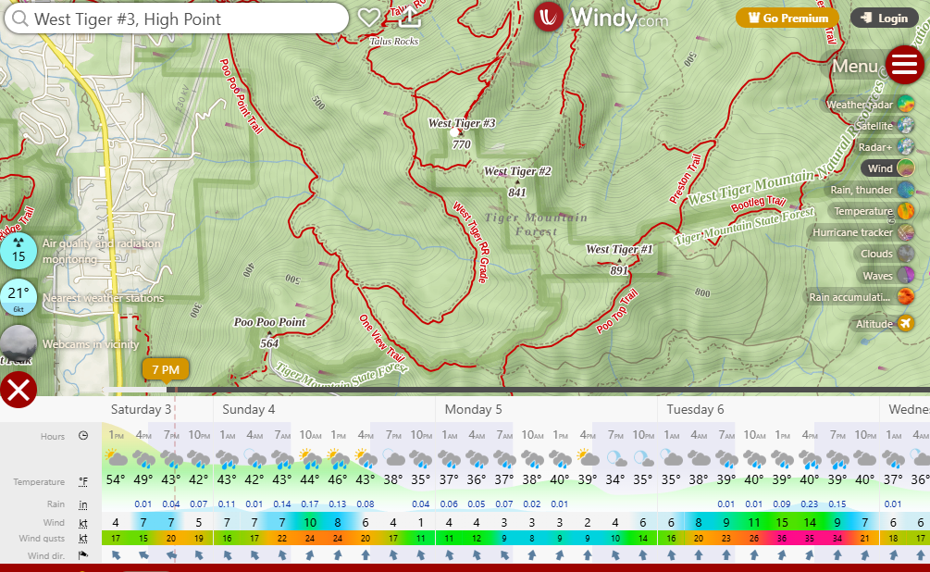

Slide 19
Do you want to learn these hikes?
Consider getting some maps and explore on your own and/or hike with others outside of the course.
GAIA and All Trails don't have all the trails on these mountains listed so sometimes you need a map to follow. (Maps do not have it all either and that is why hiking in these mountains is fun!)
Some of these hikes are great training hikes so you may want to do them again!
GREENTRAILS MAPS FOR THOSE INTERESTED: Cougar and Squak (203S), Tiger (204S), Rattlesnake (205S), Mt Si (206S) but tell us if one was missed.

Slide 20
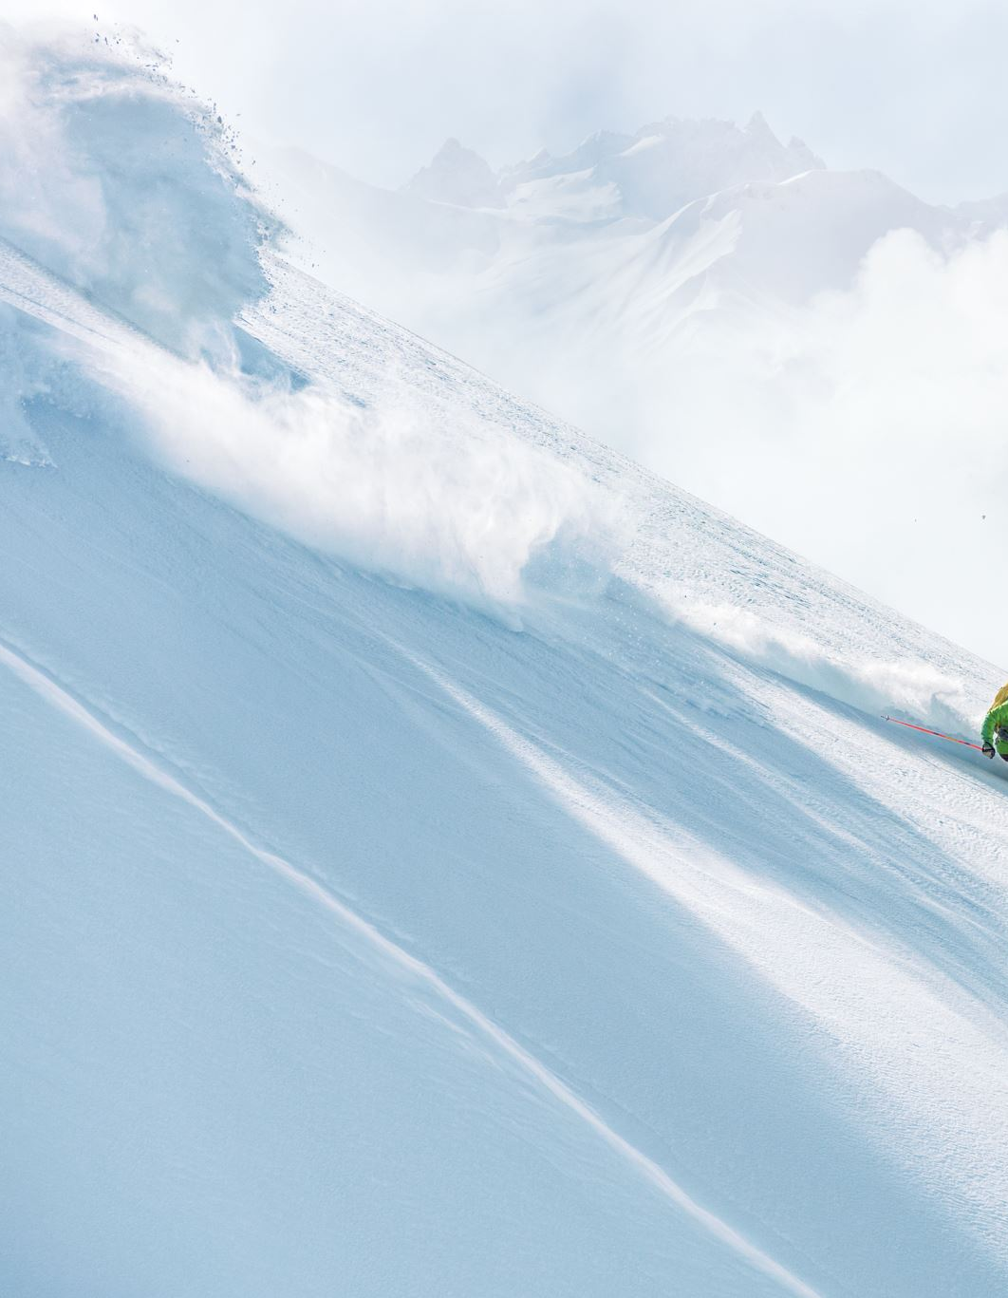
Consider avalanche education via the on-line course.
Winter hiking sites could also have some avalance risk so this education may be helpful for you to continue winter hiking.
The website for the on-line course free from Mountaineers:
Type in the Mountaineers search bar at the top:
Avalanche Awareness eLearning Access
It will be the first item that comes up in the search. To enroll, use your email and Mountaineers password and it should let you in to take the course.
***EXTRA CREDIT: What can you call a ski slope?!?***

Slide 21
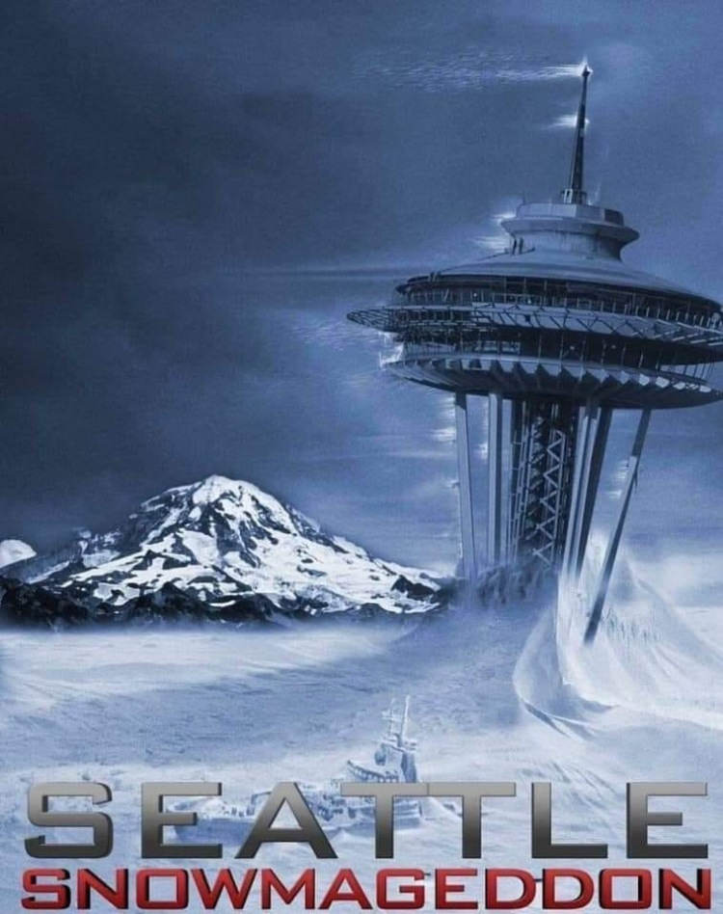
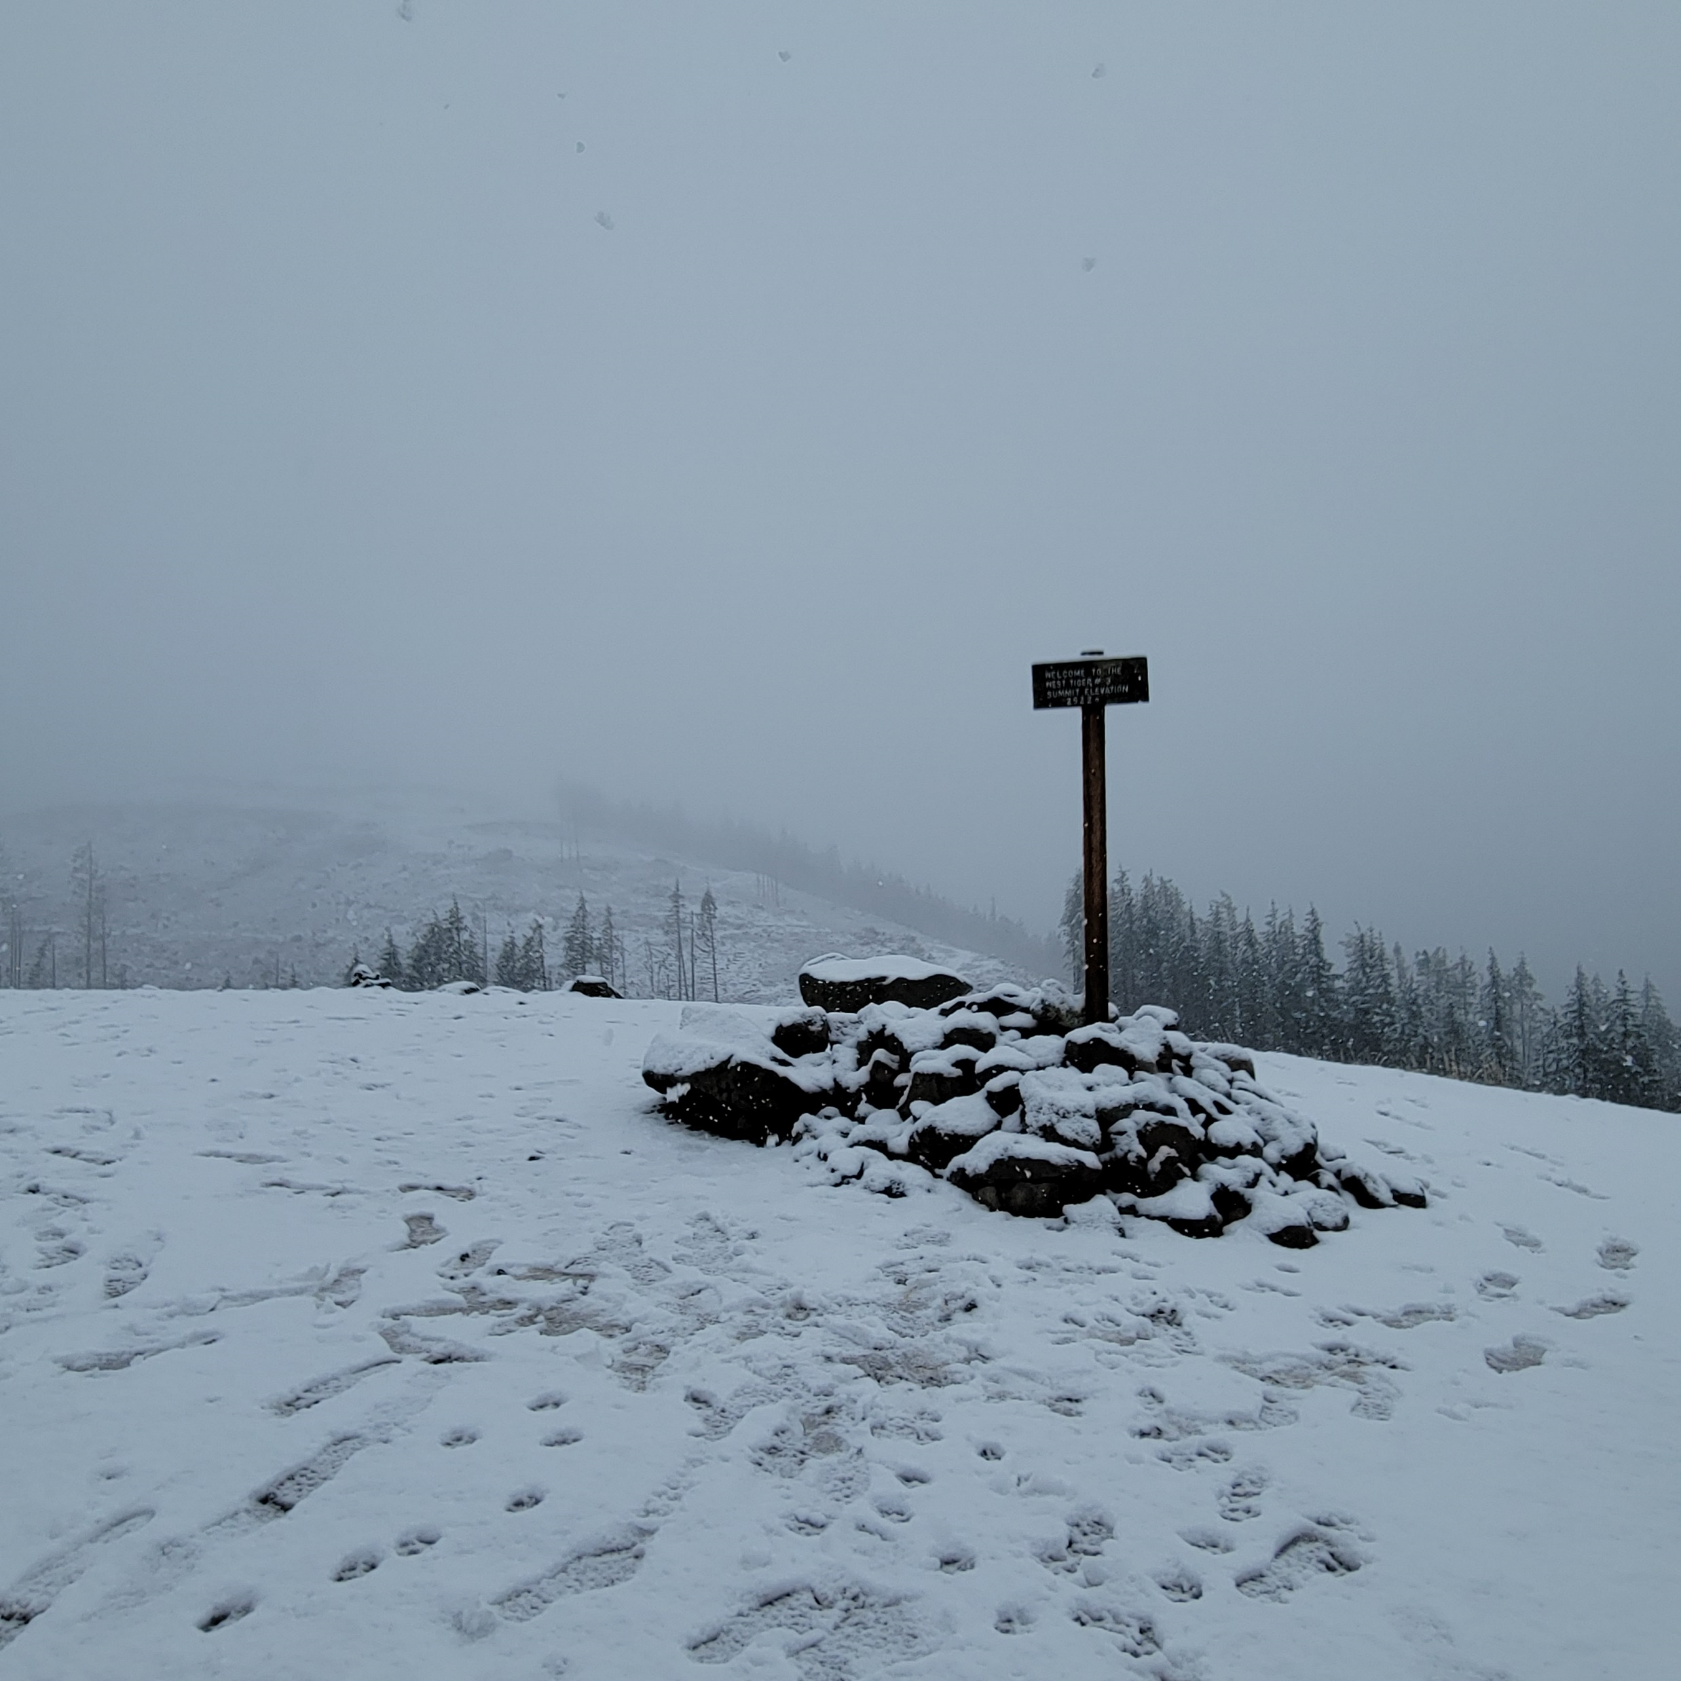
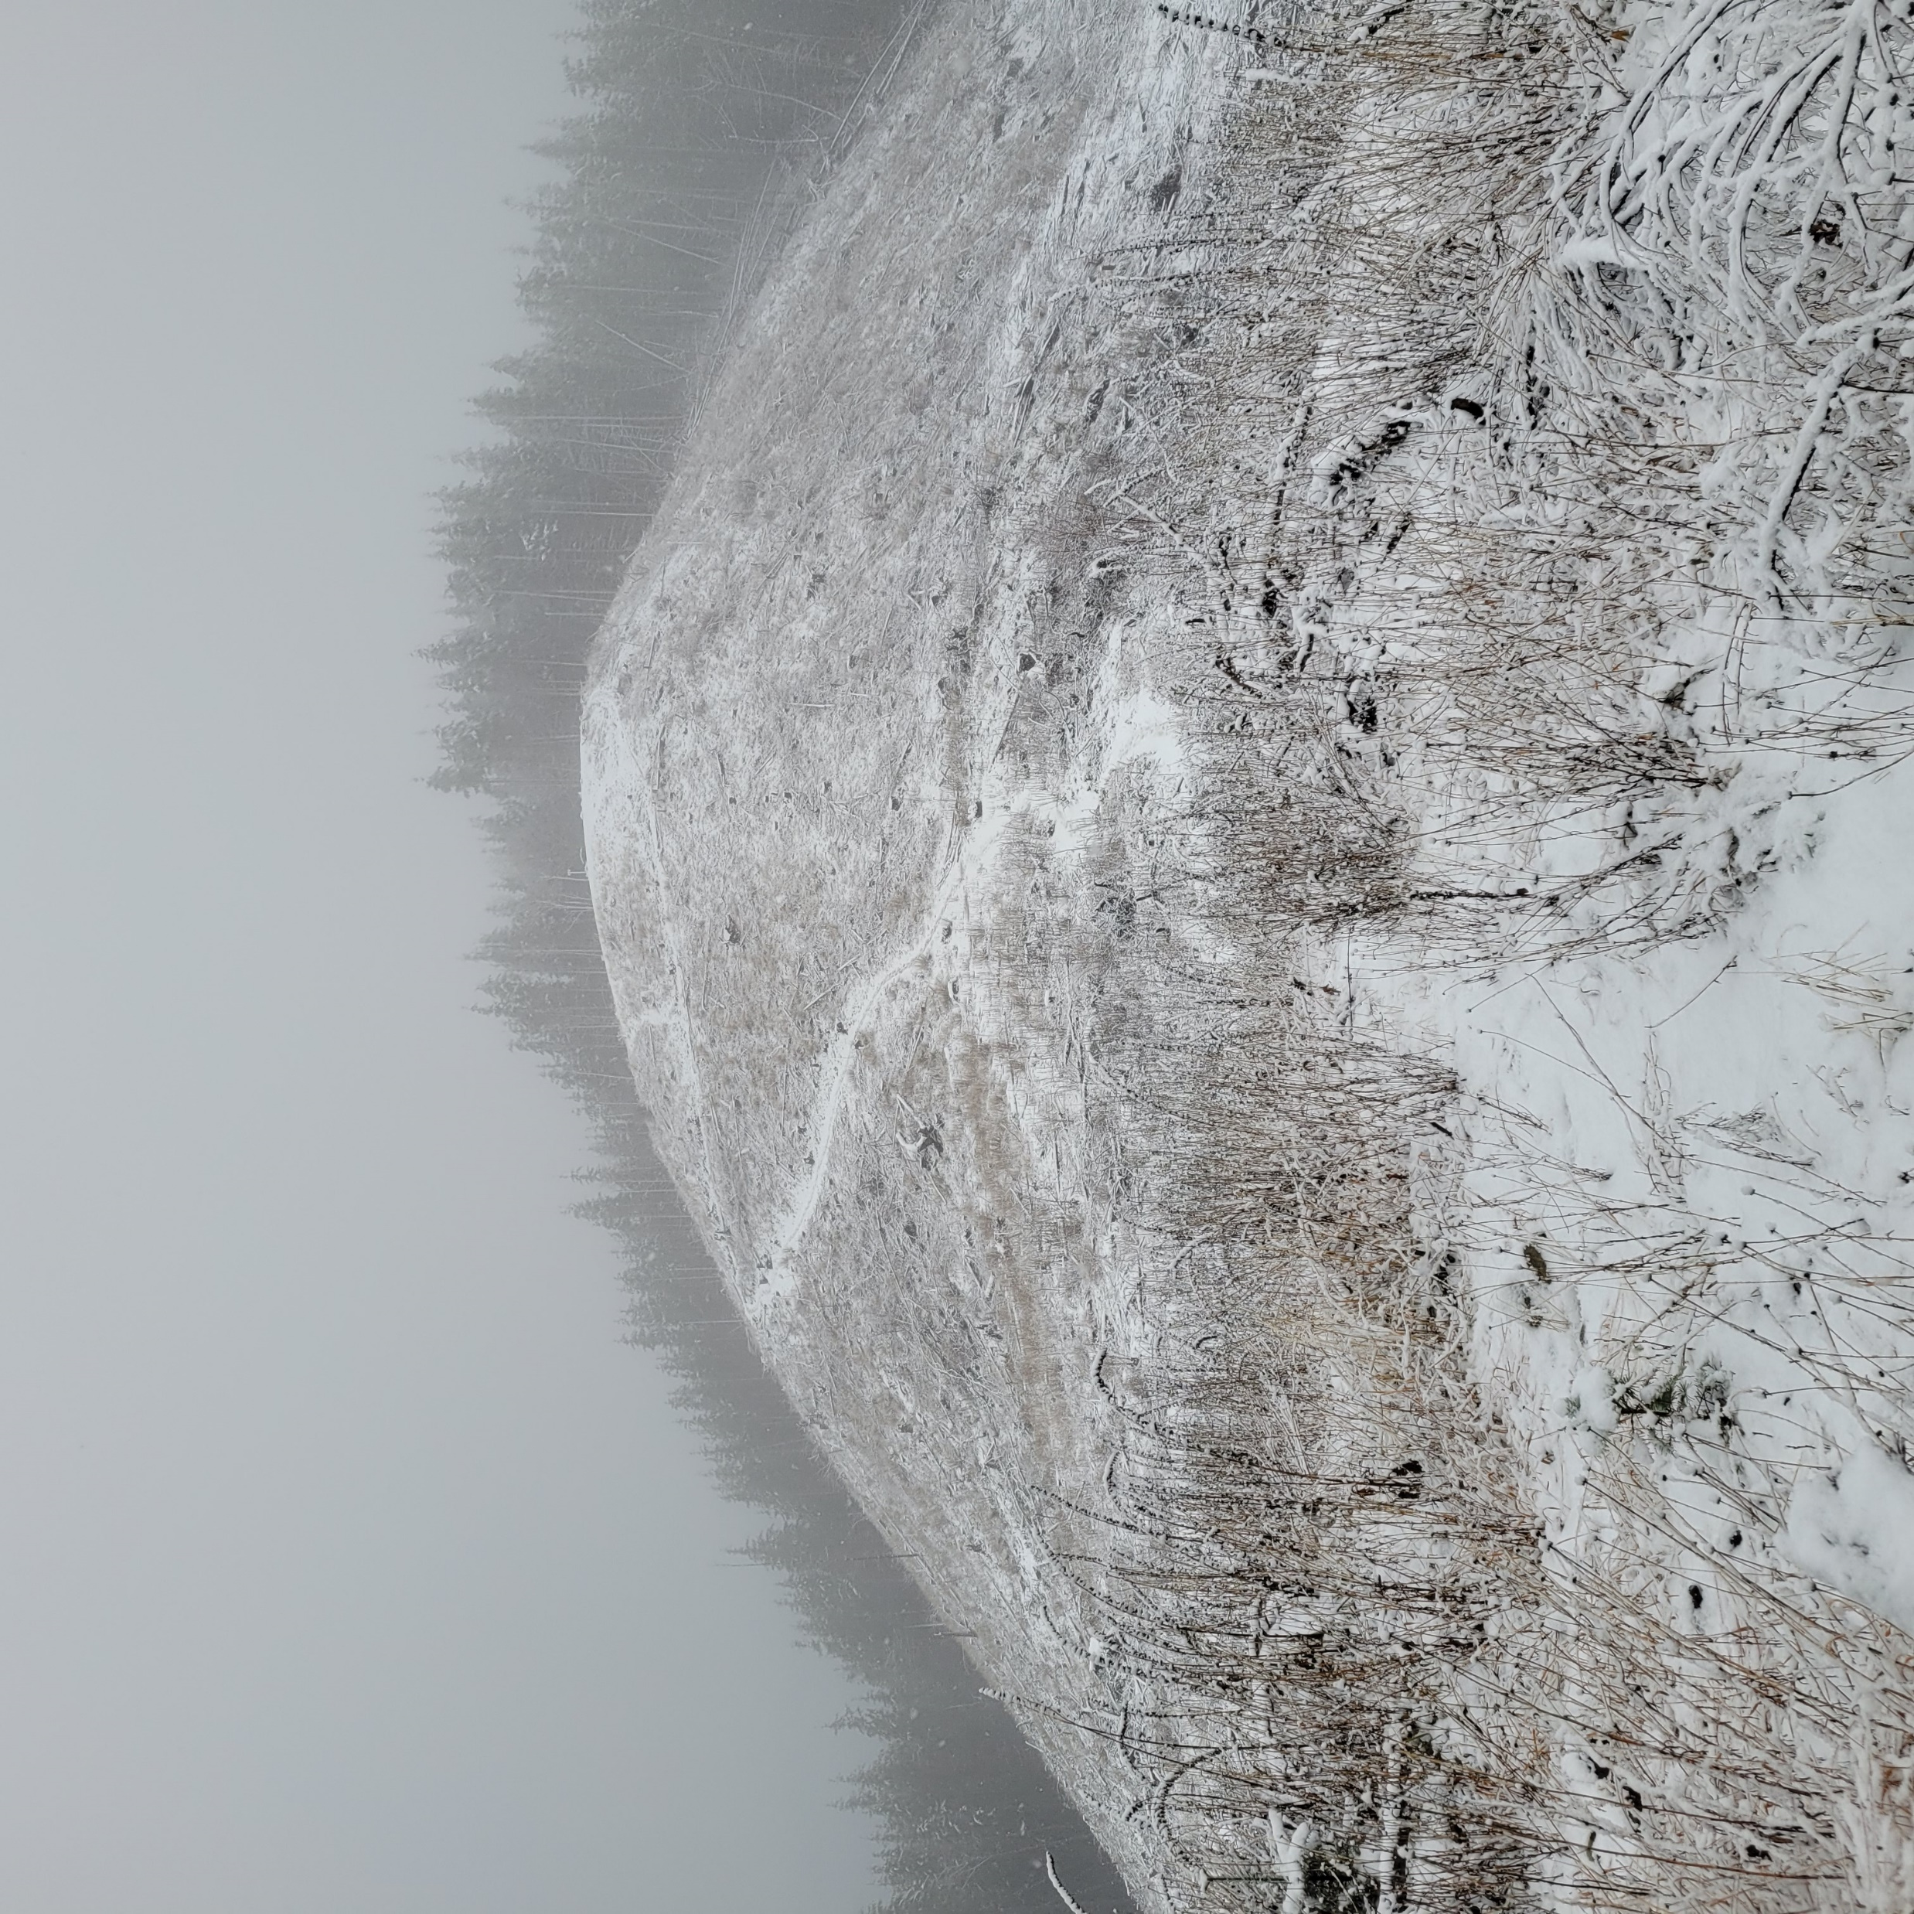
Lessons Learned: 2 hikes
December 22, 2023: What do you think was happening at the base of Tiger?
“Snowmageddon” Feb 2019

Slide 22
The boring part…. The nuts and bolts of the course…..

Slide 23
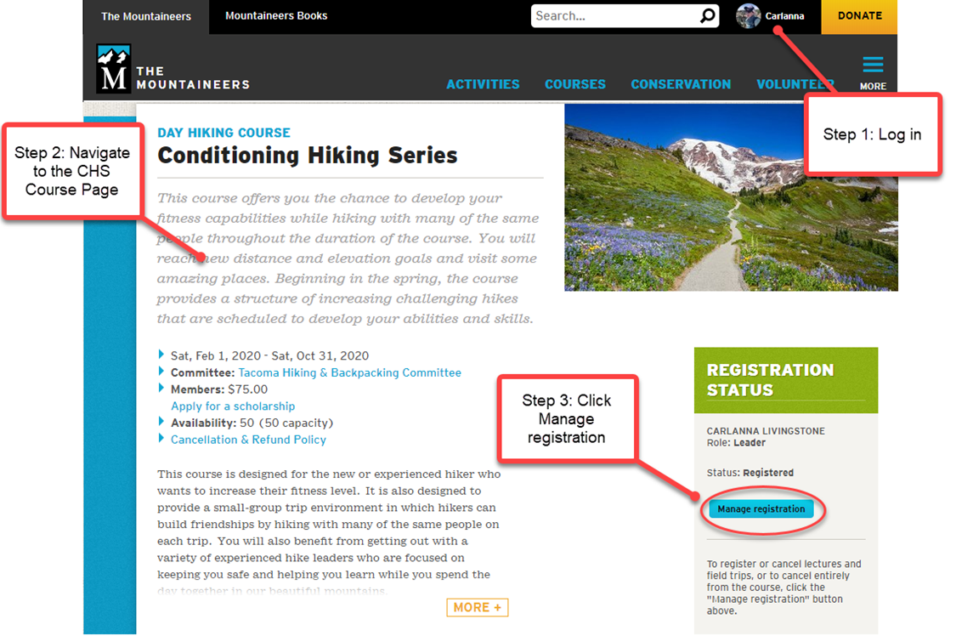
How to register….
Using the CHS slides but it’s the same except the course name. **So for Step 2 – go to the Winter Hiking Course Page**

Slide 24
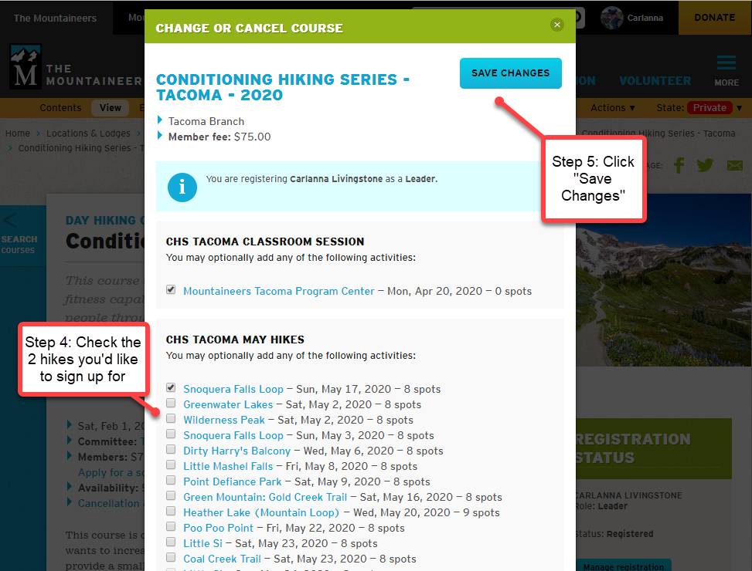
Again, using the CHS slides but it’s the same except the course name!

Slide 25
Written out instructions too! (on computer*)
Log into your account
Sweep over your icon on top right, go to - My Courses & Programs, and click on it to open
Then click to open up this course - Winter Hiking Series: I-90 Alley 2026
Under Registration Status on the right click on - Manage Registration
Click on the 2 hikes you would like to choose when registration opens up for January/February/March (see next slide)
Click “Save Changes” on top right and be patient.
*interface on your cell or mobile device looks REALLY different so will have to look for areas to click in different places; often at the bottom.

Slide 26
When can I register?
January Hikes
OPEN FOR YOU TO RESGISTER FOR 2 HIKES: Wed, Jan 7th, at 8:pm (TOMORROW!)
OPEN FOR YOU TO REGISTER FOR MORE THAN 2: Monday, Jan 12th at 8am.
EACH HIKE OPEN TO ALL IN MOUNTAINEERS: 7 to 10 days before each hike (except the 5 hikes on Jan 10 and Jan 11) will be moved Thursday AM so sign up for them tomorrow if you want on!
February and March Hikes
OPEN FOR YOU TO RESGISTER FOR 2 HIKES: Jan 16th at 8am for February hikes; Feb 16th at 8am for March hikes
OPEN FOR YOU TO REGISTER FOR MORE THAN 2 hikes: Jan 23rd at 8am for February hikes and Feb 23rd at 8am for March hikes
EACH HIKE OPEN TO ALL IN MOUNTAINEERS: 7 to 10 days before each hike
***ALSO LOOK FOR "LEADER'S PERMISSION REQUIRED"*** And do not sign up until this is obtained. A hard but good hike on 1/10/2026 by Will Tooker (4 days from now) requires this so send out your request NOW!

Slide 27
Cancellations
ONLY sign up for Hikes YOU INTEND TO DO.
If you’re thinking about signing-up for a trip that you know might be a stretch - contact the trip leader before registering.
Last minute cancellation by you affects both leaders and trip participants.
Volunteer leaders have made a commitment to you, and to The Mountaineers’ community by posting this trip - and they hope and expect that you will do the same!
Most Mountaineers’ trips take place rain or snow, unless otherwise noted by the leader. As stated prior, this notification can be the morning of the hike.
Notes:
Megan

Slide 28

Student Responsibilities:
Be on time
10 minutes early to carpool location/trailhead to leave on time
Be prepared
Ten Essentials, well fed, well hydrated
Be Flexible
Don’t schedule anything after a hike
Sign up for hikes you plan to do – Please limit Cancellations
Notes:
Megan

Slide 29

Carpooling
Be prepared; be a good rider.
Offer to pay driver
Suggested/Recommend amount is really up to the driver and is different for each driver so please ask them!!!
Ask before eating in vehicle
Bring a plastic bag for wet/muddy items
Hike leaders are not responsible for organizing carpools; each individual is responsible to request a carpool as they wish to all on the hike via the website.
Notes:
Megan
Current State
Carpooling with household members is encouraged. Carpooling with non-household members is not recommended.
Pre/Post Covid
Try to pre-arrange carpool
Be prepared
Offer to pay driver!
Recommend $0.12/mile 1-2 passengers
Recommend $0.24/mile divided by 3+ passengers
Ask before eating in vehicle
Bring a plastic bag for wet/muddy items

Slide 30
Trail Etiquette
Be nice to others and keep conversatoins lighthearted
Leave hotly contested and polarizing opinions at home
Yield to Uphill traffic
Step to the uphill side of the trail and face the trail
Stay to the right on wider paths
Pass on the left
Keep noise levels low
Practice “Low Impact Recreation”
Stay on the trail
Walk through puddles, unless you can avoid them without going off trail
Notes:
Megan
Be nice to others
Yield to Uphill traffic. Sometimes uphill hikers will prefer to stop and let you pass coming down so they can get a short break. The uphill hiker should get to make the call.
When yielding, step to the uphill side of the trail and face the trail for safety EXCEPT when yielding to horses or other pack animals – then step to the downhill side.
Stay to the right on wider paths.
Pass on the left.
Keep noise levels low
Practice “Low Impact Recreation”
Stay on the trail. Do not cut switchbacks or take shortcuts.
Walk through the mud or puddle and not around it, unless you can do so without going off the trail. Walking round the puddle may widen the trail.

Slide 31

Graduation Requirements
Pretty simple…….
*Attend this online session.
*Complete 2 hikes per month that meet the requirements (6 miles + 1200 ft elevation)
-At least 1 course hike per month
*If you complete a hike outside of the course whether a Mountaineer or private hike, please send an email including the track, elevation, and distance to your assigned course leader(Lisa McPeak or Beth Lowe – you will soon get an email with your assigned course leader)
This is the badge you will get upon completing all course requirements.

Slide 32

Communication and Questions
Ask Any questions!!
Ask your trip leaders about gear, techniques to use with hiking poles, elevation gain, boots, etc. They love it!
Ask your course and trip leaders any questions you have about winter hiking or their hike. Most of the primary leaders have been hiking in the winter for years.
Ask your fellow hikers questions – we all love to talk gear and share what we have learned!
Notes:
Marilyn

Slide 33

Course Feedback
During the course, If you have a concern about an individual – speak to your trip leader or contact the course leader.
If you have suggestions for improvement, please share with your course leaders.
If you have a wonderful experience, please share.
If there is something that needs improvement, please share.
After the course is completed, you will receive a request for your feedback. Please complete that. Your comments and suggestions are read and make a difference!
Notes:
Megan
During the course, If you have a concern about an individual – speak to your trip leader or contact the course leaders.
If you have suggestions for improvement, please share with your course leaders.
If you have a wonderful experience, please share.
If there is something that needs improvement, please share.
After the course is completed, you will receive a request for your feedback. Please complete that. Your comments and suggestions are read and make a difference!

Slide 34
Expectations:
Notes:
Megan
The Mountaineers does not allow harassment of any kind by one member towards another including harassment based on gender, sexual orientation, race, color, national origin, religion, age, disability, marital or veteran status.
The Mountaineers does not tolerate harassment by one member towards another whether the member is a leader, volunteer, trustee, or officer.

Slide 35
A few last thoughts about this hiking series……
In general, we all hike together and end together so when you can PLEASE HAVE FUN AND SOCIALIZE!!!
This is also your time to think about why you want to hike in the winter or if there is something you want to accomplish when you do these hikes. SO START THINKING!

Slide 36
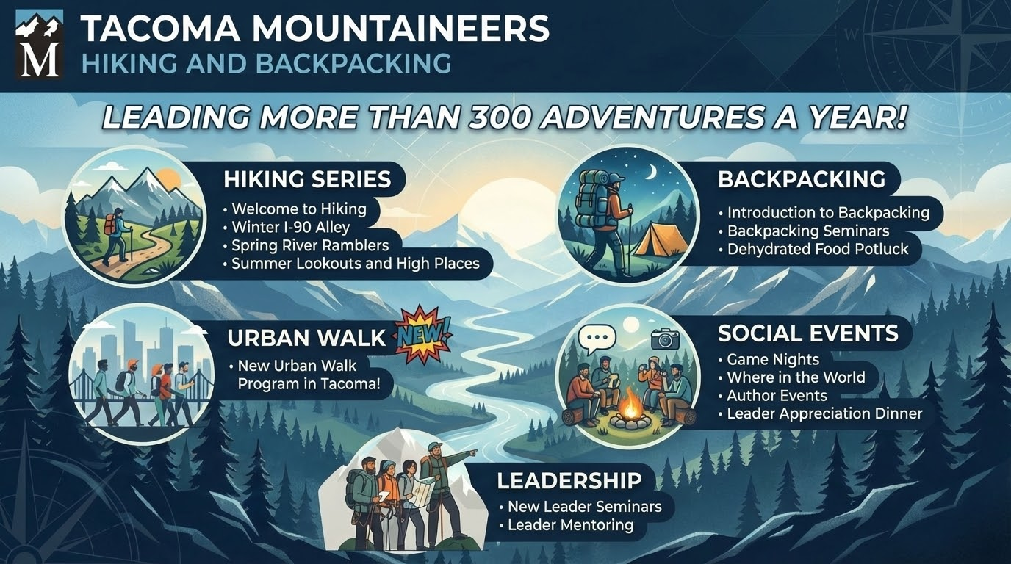

Slide 37
Thanks for signing up and we are so excited to hike with all!!! Lisa & Beth
QUESTIONS?!?

