Slide 1
Winter Hazards
What you should know about them.

Slide 2
Hypothermia Symptoms
At body temperatures below 95 F (35 C), shivering is seen. Heart rate, breathing rate, and blood pressure increase.
As the temperature drops further, pulse, breathing rate, and blood pressure all decrease. People may experience the “Umbles” Stumbles, Mumbles, and Fumbles.
As core temperature drops lower than 89.9 F (32.2 C), shivering stops and oxygen consumption begins to drop. The victim may be in a stupor. The heart rhythm may become irregular.

Slide 3
Hypothermia Prevention
Replace what you lose
Drink to replace what you use
Eat well-balanced meals and snacks
Dress for the weather
Dress in several layers of loose, warm clothing
Wear a hat or headband that fully covers your ears.
Wear mittens rather than gloves
Wear socks and sock liners that fit well

Slide 4
Dehydration Symptoms
Mild to Moderate Dehydration
Dry, sticky mouth
Sleepiness or tiredness
Dry skin
Headache
Severe Dehydration
Extreme thirst
Irritability and confusion
Sunken eyes
Dry skin that doesn't bounce back when you pinch it
Dehydration can accelerate conditions like hypothermia, frostbite and fatigue

Slide 5
Dehydration Prevention
Drink before you start and Replace What You Lose
Water exits the body through exhalation, perspiration and urination.
Match Your Drink to the Duration of Your Activity
If you're exercising for up to 1 hour, you can rehydrate with water alone. However, after an hour, add electrolytes and carbohydrates
Hydrate With Room-Temperature Beverages
Cold liquids are absorbed quicker. Warmer or room temperature drinks, on the other hand, are better at keeping your internal temperature optimal. Choose the latter when you're exercising in cold temperatures.

Slide 6
Frostbite Symptoms
Frost nip
The mildest form of frostbite that irritates the skin, causing redness, prickling and a cold feeling followed by numbness. Frostnip doesn't permanently damage the skin and can be treated with first-aid measures.
Superficial frostbite
Your skin feels warm, a sign of serious skin involvement. A fluid-filled blister may appear 24 to 36 hours after rewarming the skin.
Deep frostbite
You may experience numbness. Joints or muscles may no longer work. Large blisters form 24 to 48 hours after rewarming. Afterward, the area turns black and hard as the tissue dies.

Slide 7
Frostbite Prevention
Dress for the weather
Dress in several layers of loose, warm clothing
Wear a hat or headband that fully covers your ears.
Wear mittens rather than gloves
Wear socks and sock liners that fit well
Make sure snow cannot get inside of your boots or clothing
Stay hydrated and eat well-balanced foods
Recognize the symptoms

Slide 8
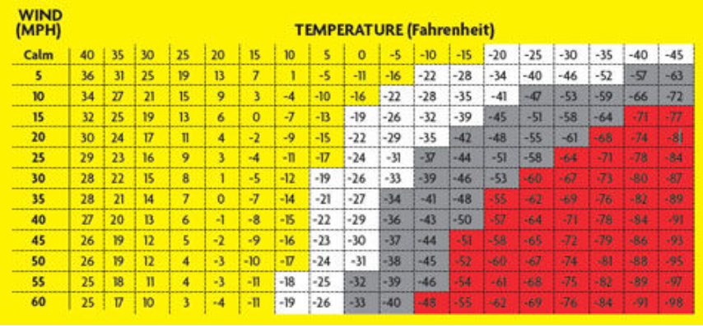
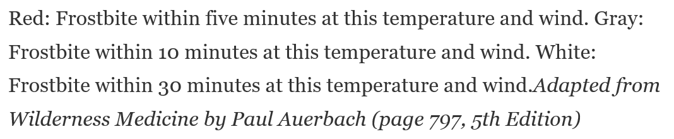

Slide 9
Raynaud’s Syndrome
If your fingers and toes are constantly cold or prone to frostbite, you may have Raynaud’s disease or Raynaud’s phenomenon, a condition where your body excessively restricts blood flow to the hands and feet in response to cold.
Raynaud’s disease can sometimes be very disabling. If you think you might have this, get checked out by your doctor. Certain over-the-counter cold medicines and beta blockers (drugs used to treat high blood pressure and heart disease) can aggravate this. Conversely, your doctor may be able to prescribe a drug to widen or dilate your blood vessels to improve blood flow.

Slide 10
Richard’s Wisdom
Wear a hat or have a hat handy
Buffs are GREAT!!
Eat lunch over a period of time
If you eat a big lunch - bundle up, your face and hands will become cold
Get out of the wind
Colds hands are part of winter travel – plan for it and get used to it (Channel Shackelton)

