Slide 1
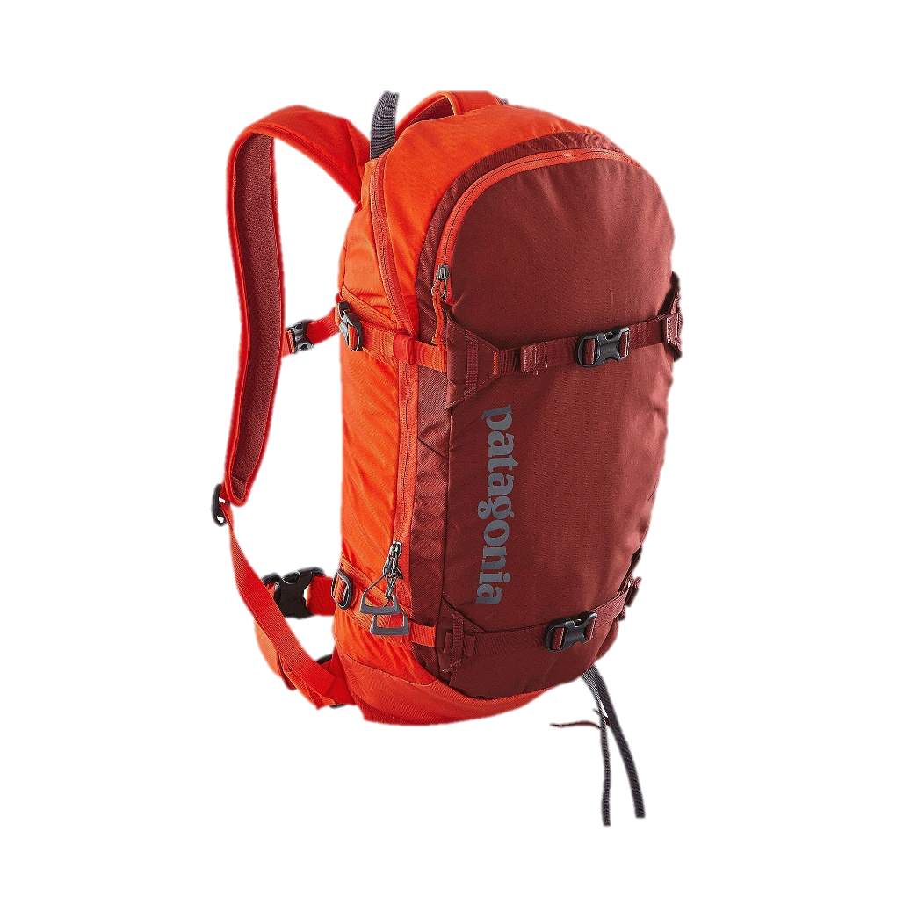
Ten Essentials
Tacoma Nordic Ski Class 2025

Slide 2
Why Ten Essentials?
Items that have been proven useful for every kind of outdoor trip
So you can respond to an accident or emergency
So you can safely spend a night out if you had to
Notes:
Whether you hike, climb, backpack, scramble or go cross country skiing, there is always some risk involved. Anyone heading outside should understand the risks and be prepared.
This is where the 10 essentials comes in. They are items that have proven to be useful and helpful for outdoor trips.
Please note, some of these items may not be as essential for you to have with you on the class field trips.

Slide 3
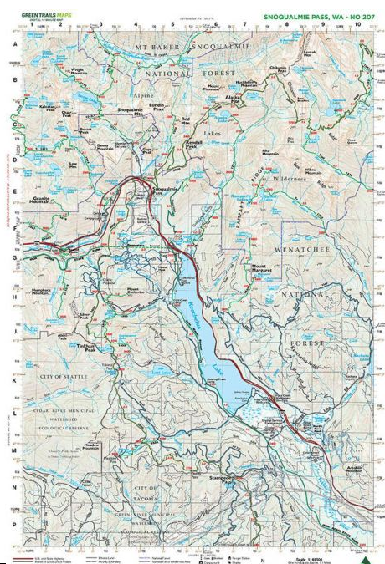
1. Navigation
Map
Compass
Other navigation such as altimeter, GPS

Slide 4
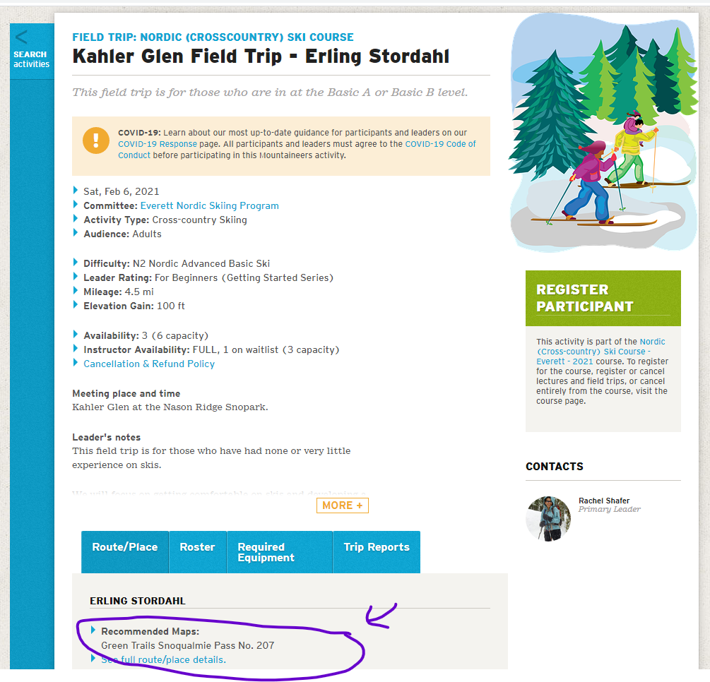
Maps and links can be found on Mountaineers website on the trip or activity

Slide 5
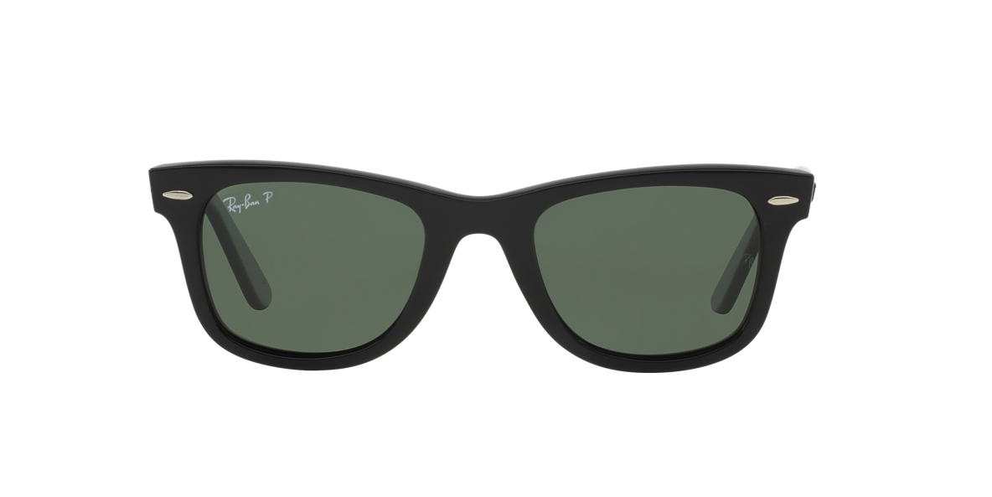
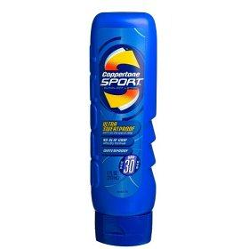
2. Sun Protection

Slide 6
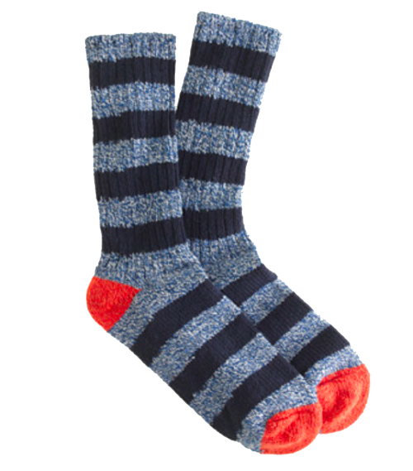
3. Insulation: Extra Clothing
Additional layers for unplanned night out
Extras for warmth
Extra socks
Raincoat

Slide 7
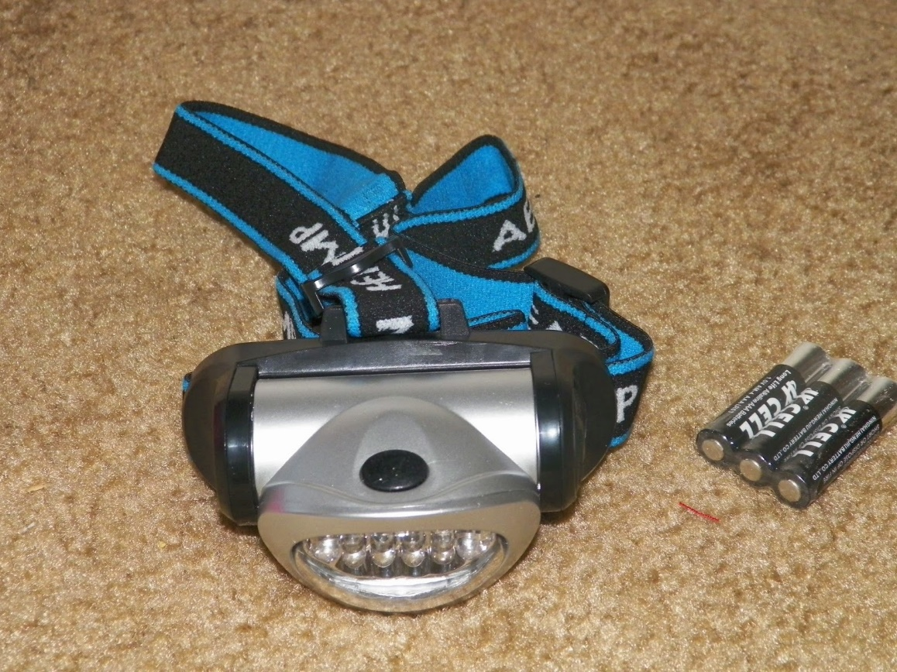
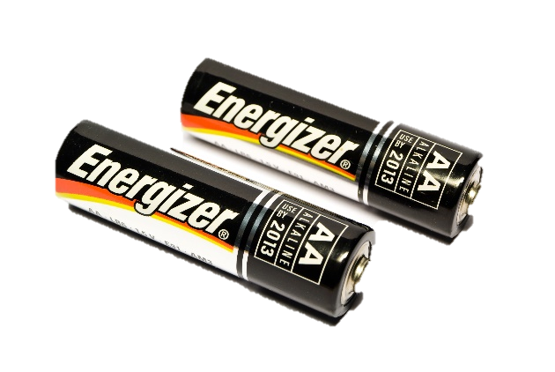
4. Illumination

Slide 8
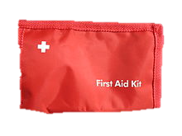
5. First Aid Supplies
When skiing consider including:
Blister treatment supplies and scissors

Slide 9
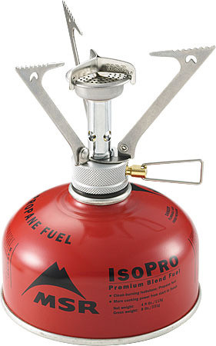
6. Emergency Fire Supplies
Matches or lighter
Candle/Firestarter
Consider bringing a backpacking stove if you are going where there is no firewood

Slide 10
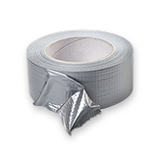

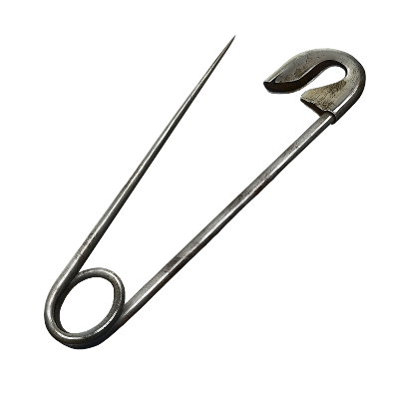
7. Knife and Repair Kit
Others:
cord
Needle & thread
Wire

Slide 11
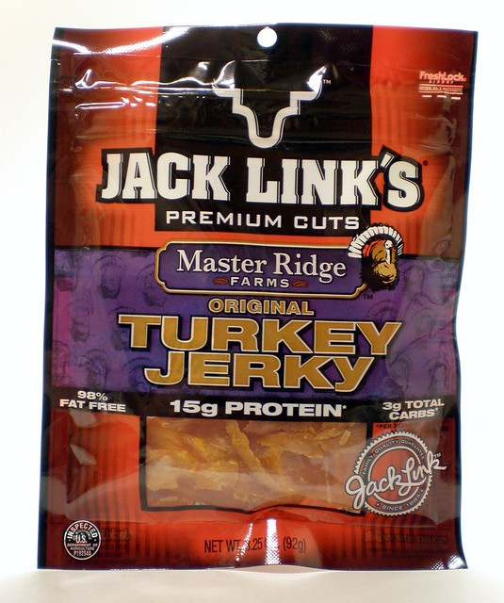
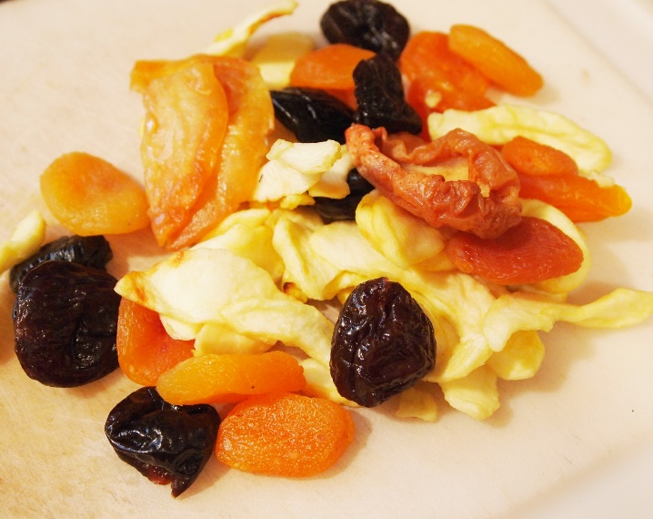
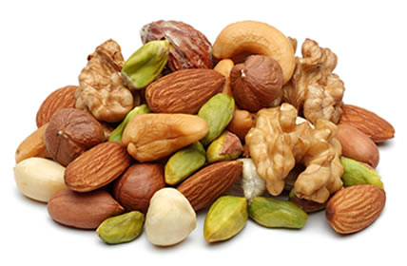
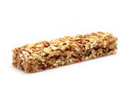
8. Extra Food

Slide 12
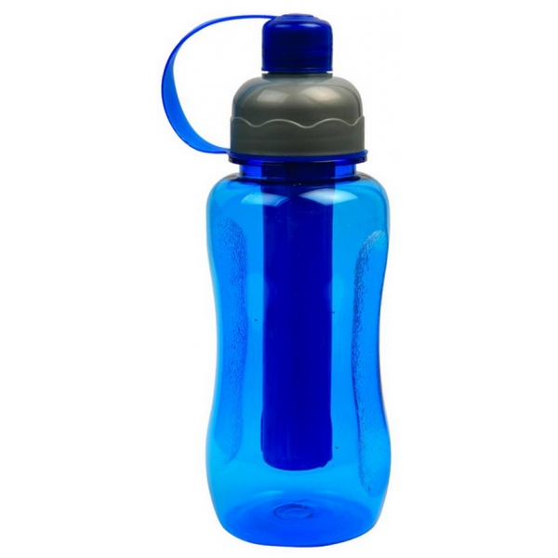
9. Extra Water
Plan to carry enough water for an active day when skiing
In cool weather it can be easy to underestimate how much you are sweating

Slide 13
10. Emergency Shelter
Shelter against wind and rain
Plastic tube tent
Jumbo trash bag
Reflective emergency blanket (can be used for shelter and for first aid)

Slide 14
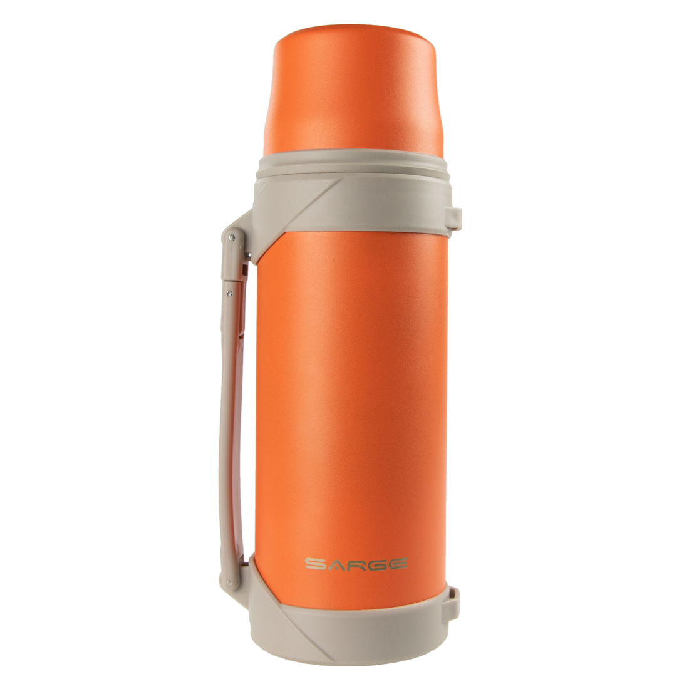
A few extras to have in the car…
Thermos of hot cocoa or soup
$ to contribute toward gas and snow park pass
Dry clothes
Plastic bag for wet gear

Slide 15
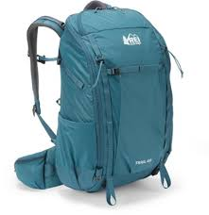
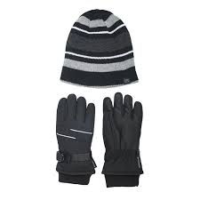
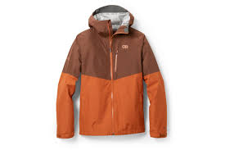
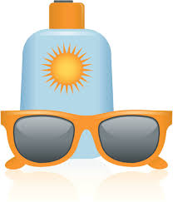
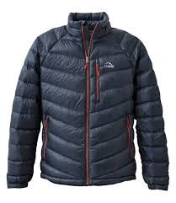
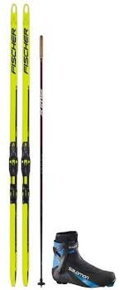

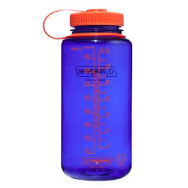
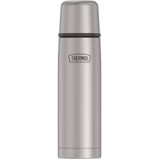
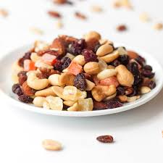
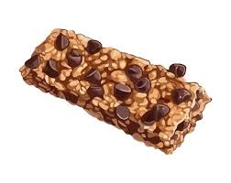
What to Bring for Ski Field Trips
Backpack and rain cover
Extra hat and gloves
Sit pad
Warm coat and rain jacket
Sun screen and
sun glasses
Boots, skis, poles
Lunch
High energy
snacks
water, electrolyte drink, hot drink

