Slide 1
Welcome to Tacoma
Cross Country Ski Class
Course Leader:
Richard Babunovic 425-890-1372
Notes:
Quick welcome by Rachel

Slide 2
Agenda:
Introductions Students and Instructors 15 min
Poles, Skis and Boots - Richad and Cheri 25 min
Clothing and Pack - Jody and Marilyn 20 min
10 Essentials – Jody 15 min
Cold Weather Hazards - Cheri 10 min
Field Trip Plans – Richard 15 min
Winter Driving – Don 20 min
Notes:
Rachel Introduces Stacey

Slide 3
Introductions:
Name
Experience skiing
Reason for taking class
Something fun or unique about you
Notes:
Stacey talks

Slide 4
Course Schedule:
Lecture 1 Thursday1/9
Field Trip 1 Sunday 1/19
Lecture 2 Thursday 1/23
Field Trip 2 Sunday 1/26
Field Trip 3 Saturday 2/1
Notes:
Stacey talks

Slide 5
Graduation Requirements:
Attend Lectures and 3 Field Trips
1 Mountaineers Ski Trip
Low Impact Recreation Course
Notes:
Rachel talks

Slide 6
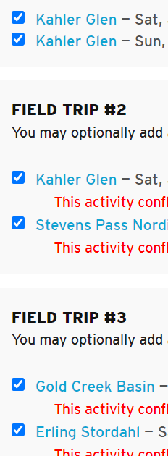
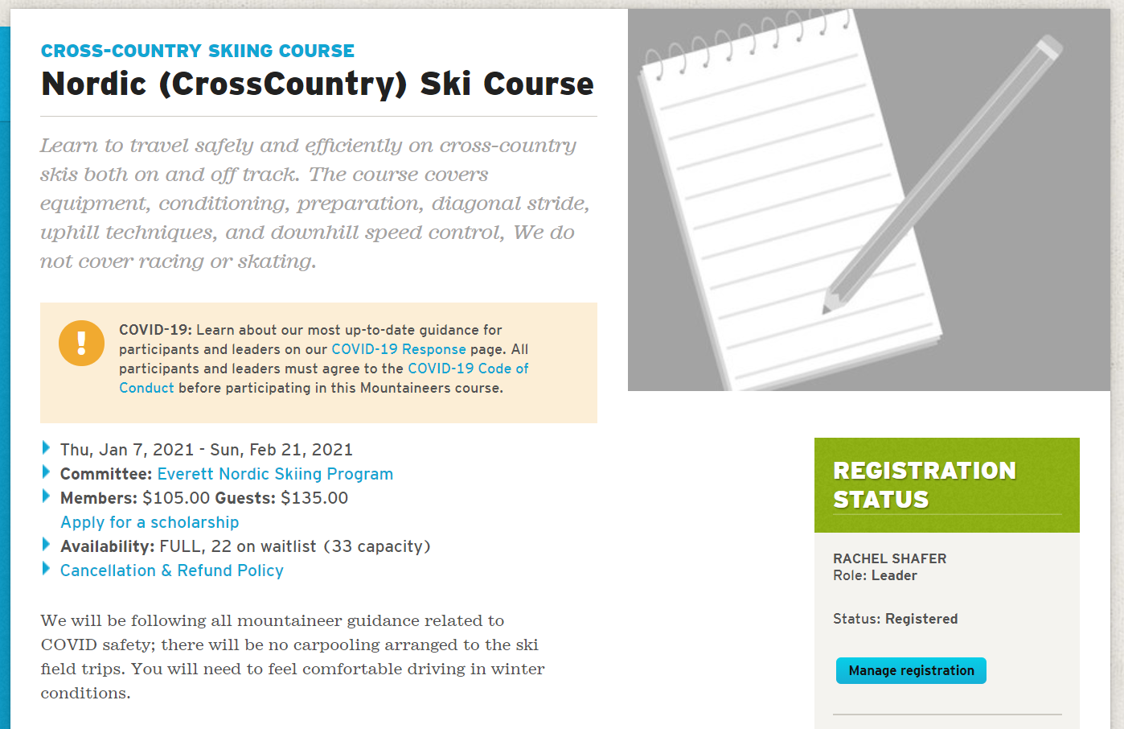
Manage Registration:
Notes:
Rachel talks

Slide 7
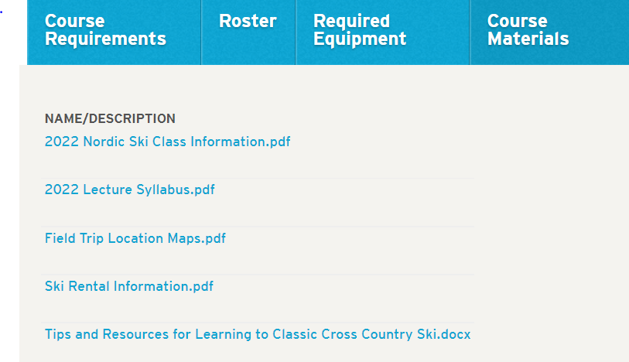
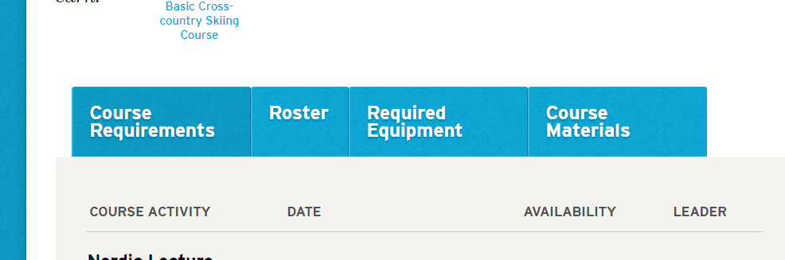
Course Materials:
Notes:
Rachel talks

Slide 8
Presentations:
Poles , Skis and Boots Richad and Cheri
Clothing and Pack Jody and Marilyn
10 Essentials Jody
Cold Weather Hazards Cheri
Field Trips Richard
Winter Driving Don
Notes:
Stacey introduces the presentation
Switch to Beth, Chris and Rin’s presentation media

Slide 9
Field Trips :
Field Trip 1 – 1/19
Crystal Spring Snow Park
Field Trip 2 - 1/26
Crystal Spring Snow Park
Field Trip 3 - 2/1
  White Pass Nordic Center
Notes:
Rachel talks

Slide 10
Field Trip 1
Field Trip Information
Location
Where: Crystal Springs Snow Park Exit 62 on I-90 east of the pass
When: 1/19 at time 9:00 AM
Snow Park Pass Required - $120 for season
Car pooling from North Bend Park and Ride - Meet at 8:00 AM
  Corner of E North Bend Way and E Part St
Rental Information
Look for trip check list in Class Info Document
Notes:
Rachel introduces leilani
(leilani decides if to add her slides her or make her own slidedeck)

Slide 11
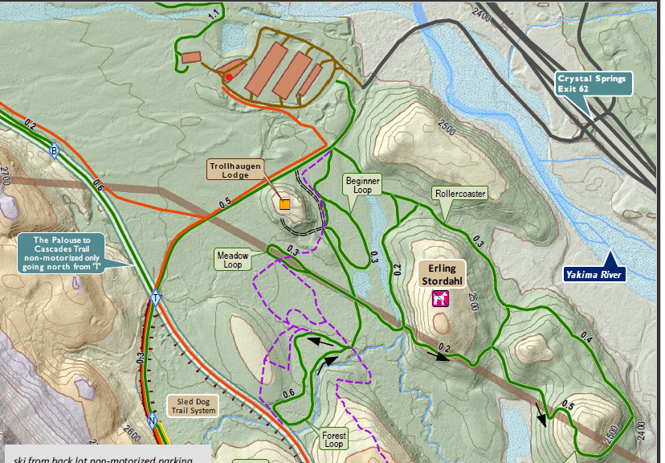
Field Trip 1 – Location
Meet Here
Notes:
Rachel introduces leilani
(leilani decides if to add her slides her or make her own slidedeck)

Slide 12
Field Trip 3 - Additional Info
Field Trip 3 - 2/1 White Pass Nordic Center
2.5 hour drive from Tacoma
Car pools will be arranged prior to field trip
Consider making reservations to stay in Packwood the night before
Notes:
Rachel talks

Slide 13
Rental Information:
How many are renting?
Where to rent from
Settle REI
Ascent Outdoor - Seattle
Pro Ski and Mountain Service North Bend
Enumclaw Ski & Mountain Sports
Sturtevant’s Ski Mart - Bellevue
Mountain To Sound Outfitters
Seattle Ski and Snow Board
Mountaineers Gear Locker
Other

