Slide 1
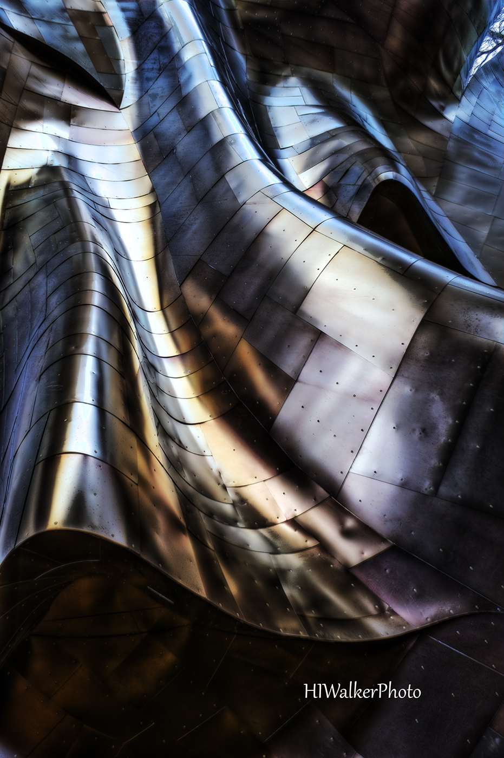
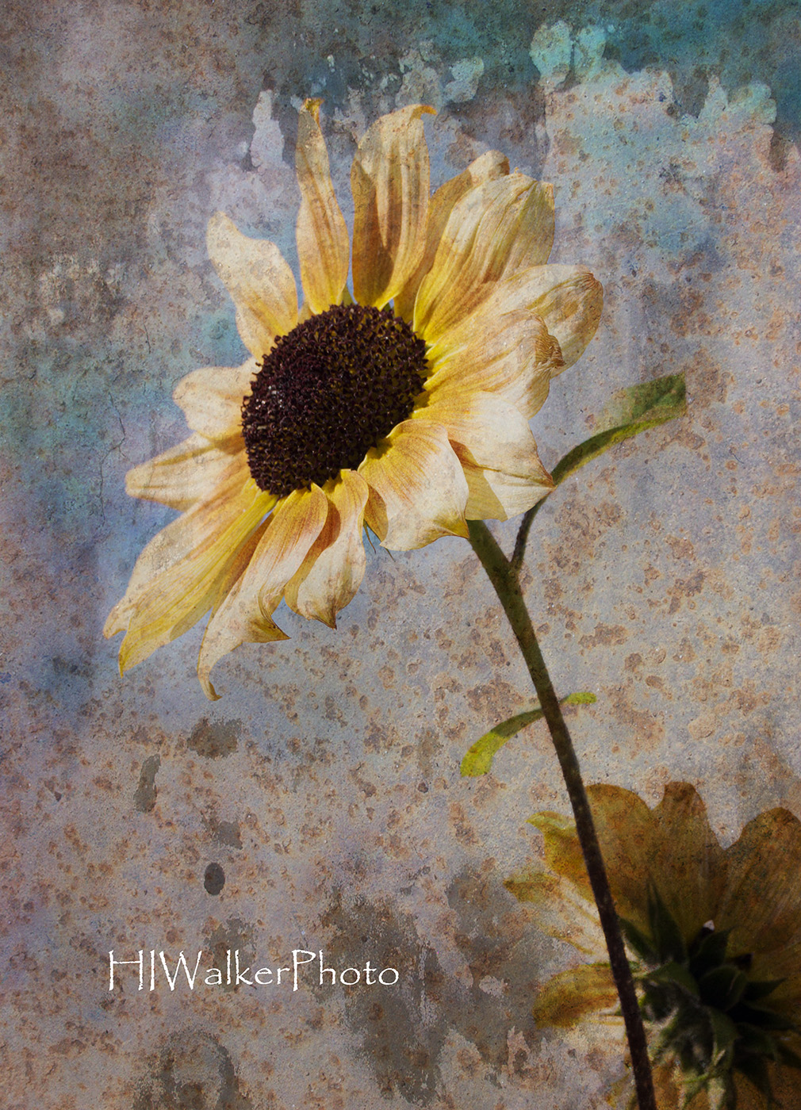
MONTAGES AND TEXTURES
Heidi Walker

Slide 2
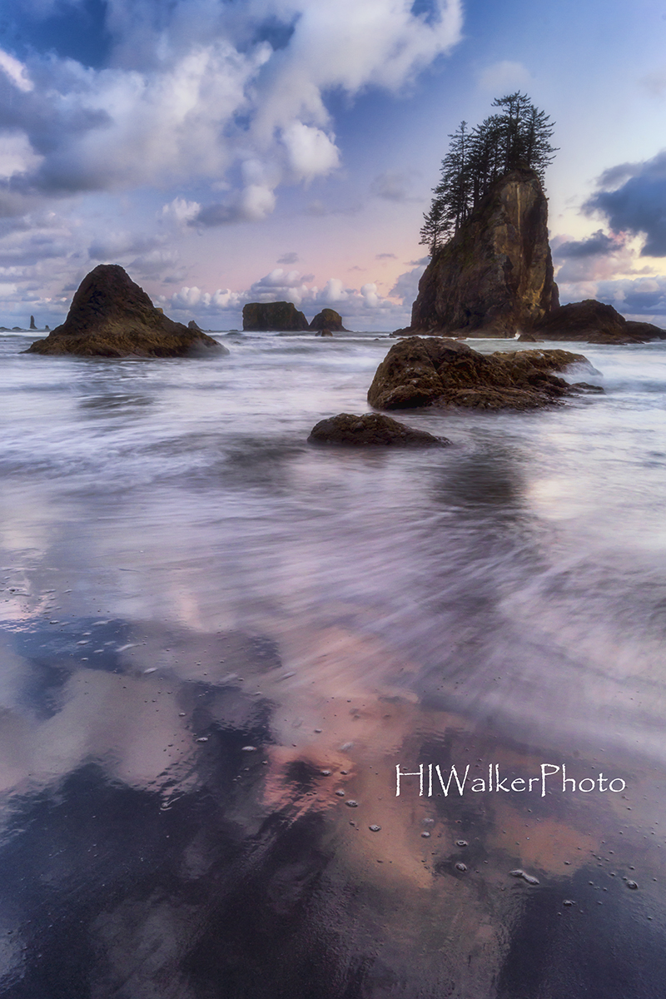
Montages and textures are all about creative playing in Photoshop. With the ability to use layers in Photoshop, you have the ability to control the look and emotion of your images. And if you don’t like something, you can easily adjust it or even throw it away without harming your original image.

Slide 3
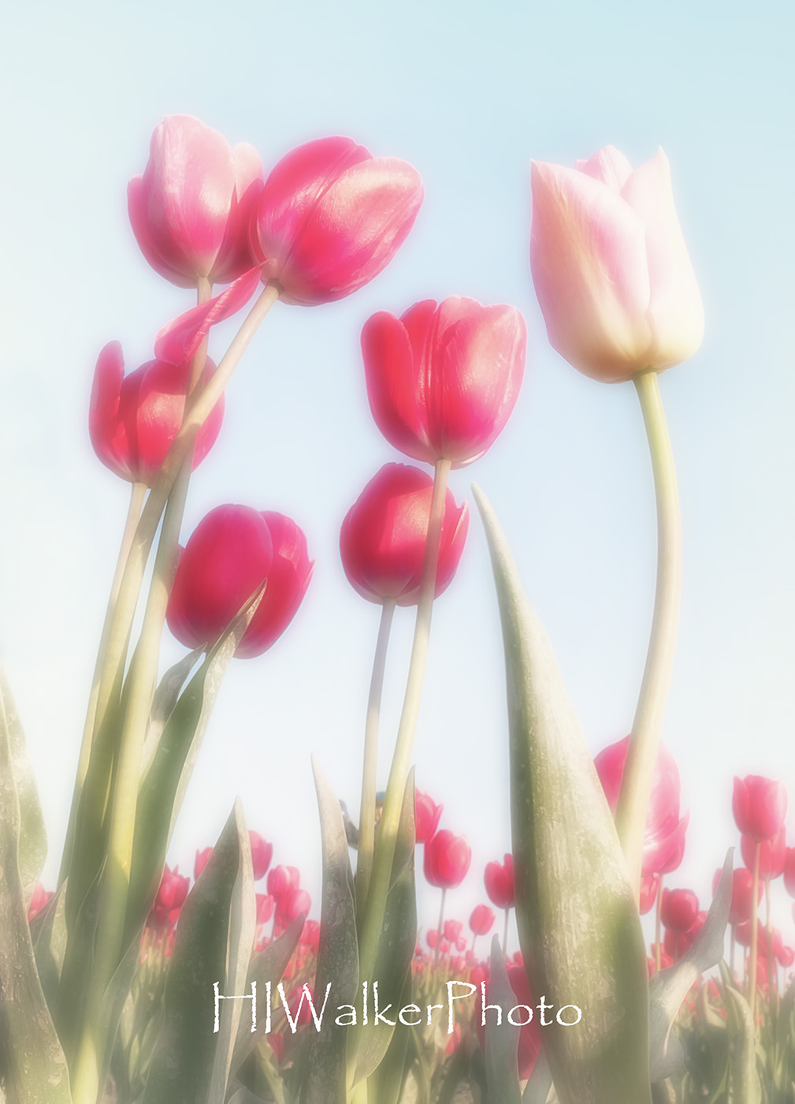
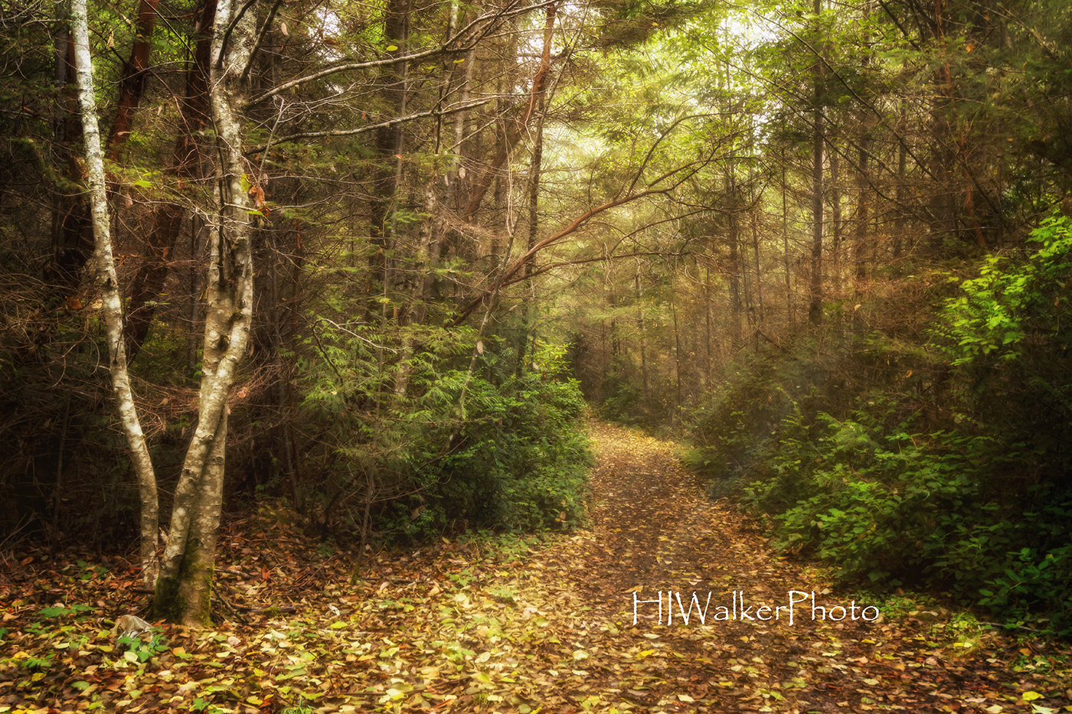
MONTAGES
Blends two images together – one properly exposed and in focus and the other “under-exposed” and out of focus to create a glow around your subject and intensify colors. It also adds an ethereal look to your image.

Slide 4
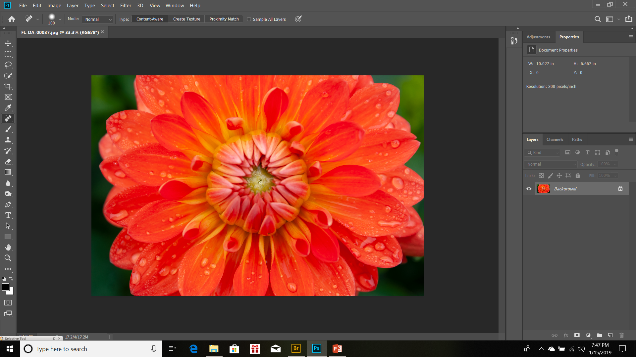
Open your image in Photoshop.
Choose an image that is evenly exposed – be careful of bright highlights and black shadows – and good detail
Make any needed corrections. (clone out distractions, tone down highlights and brighten dark shadows)

Slide 5
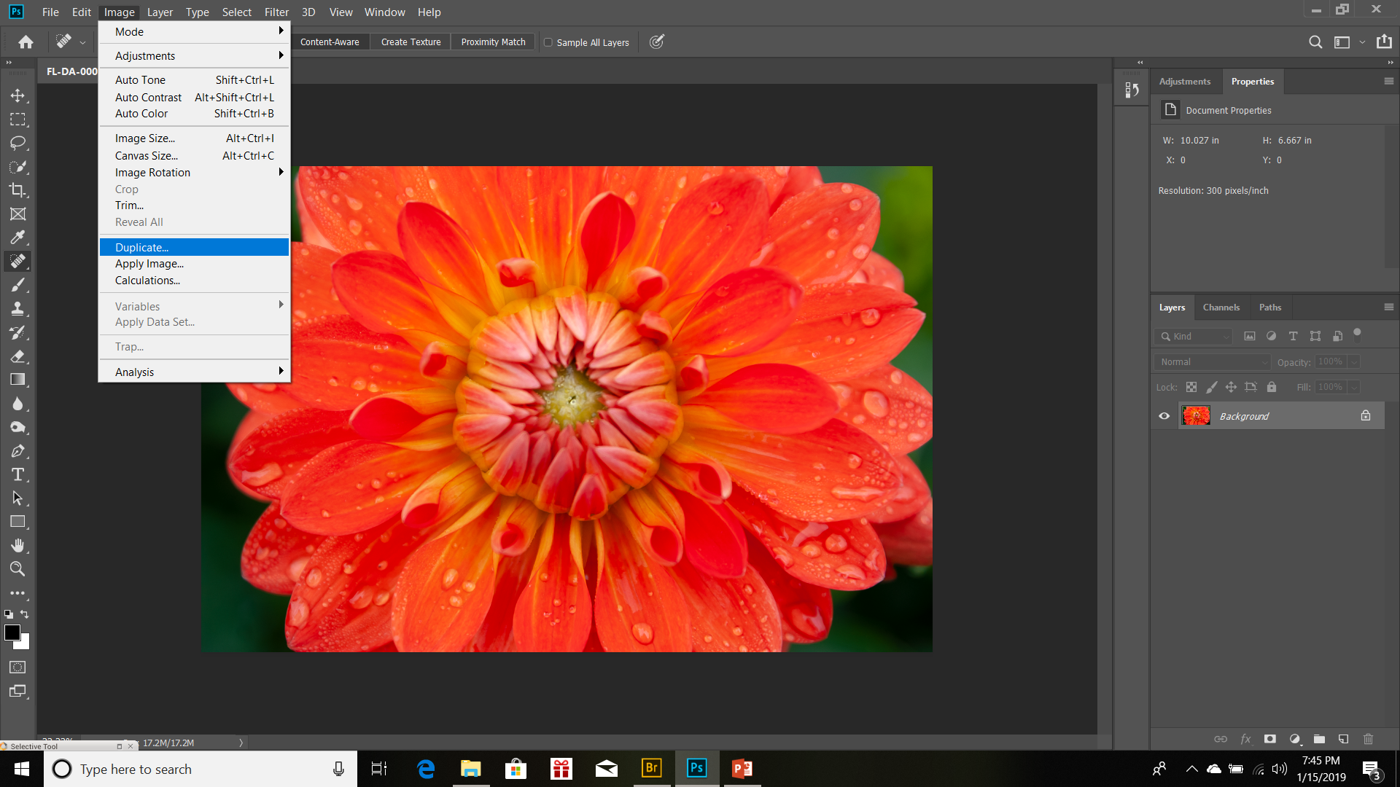
Duplicate image.
Drop down menu under Image

Slide 6
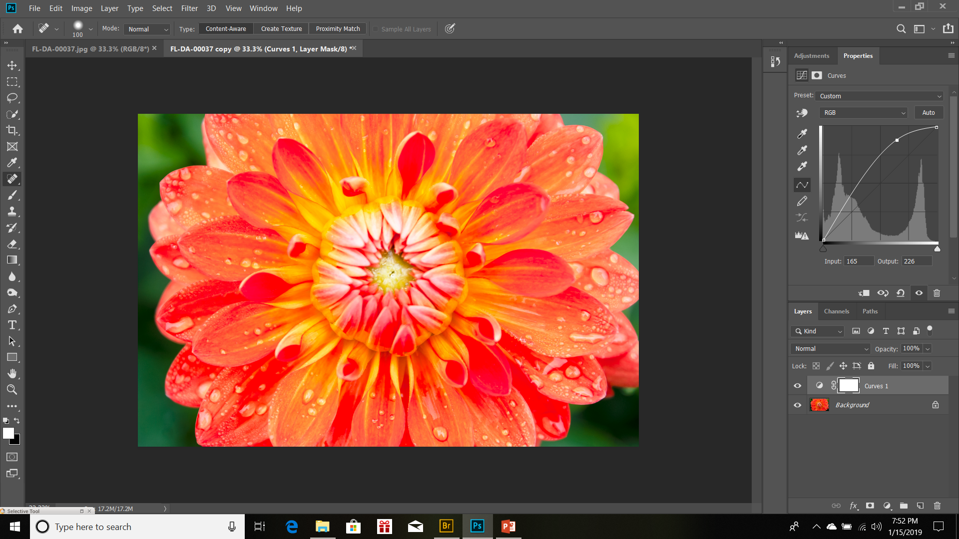
Create a curves adjustment layer. (On Adjustment Panel, click Curves)
Brighten the image by adjusting the diagonal line up to your liking, not too bright. Then adjust shadows back down slightly.

Slide 7
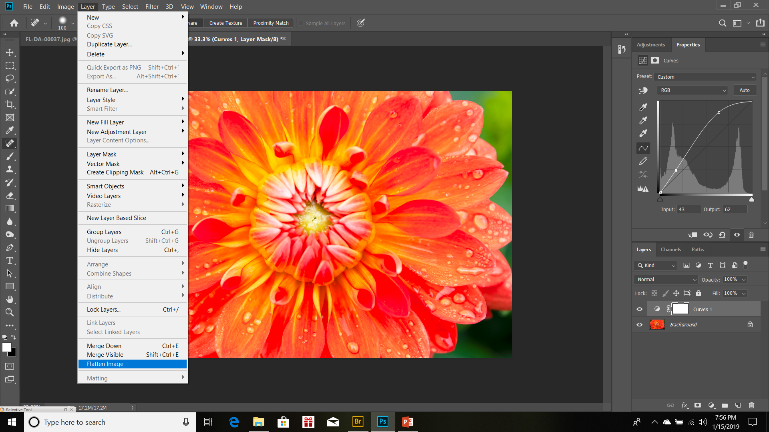
Once you have the curves adjustment to your liking, flatten the image.
Drop down menu under Layer

Slide 8
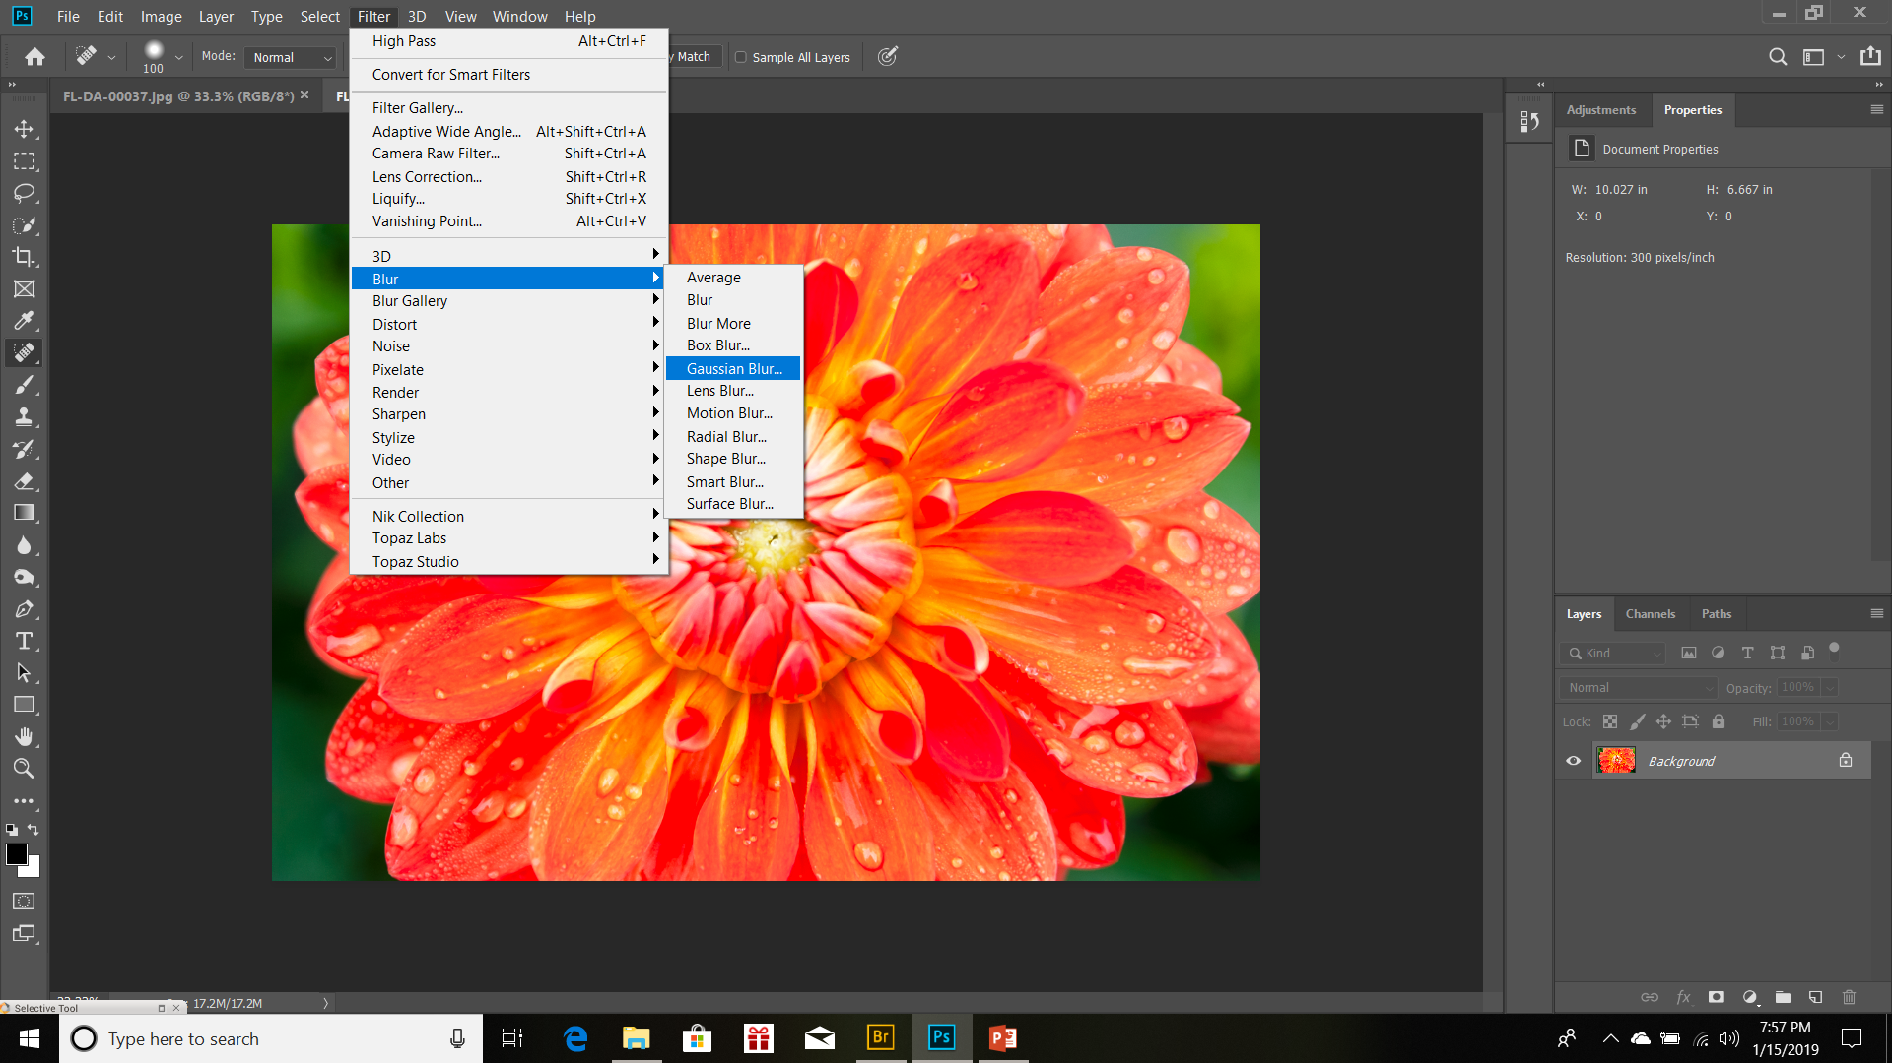
After you flatten the image, you’ll apply a gaussian blur.
Drop down menu under Filter, to Blur then Gaussian Blur

Slide 9
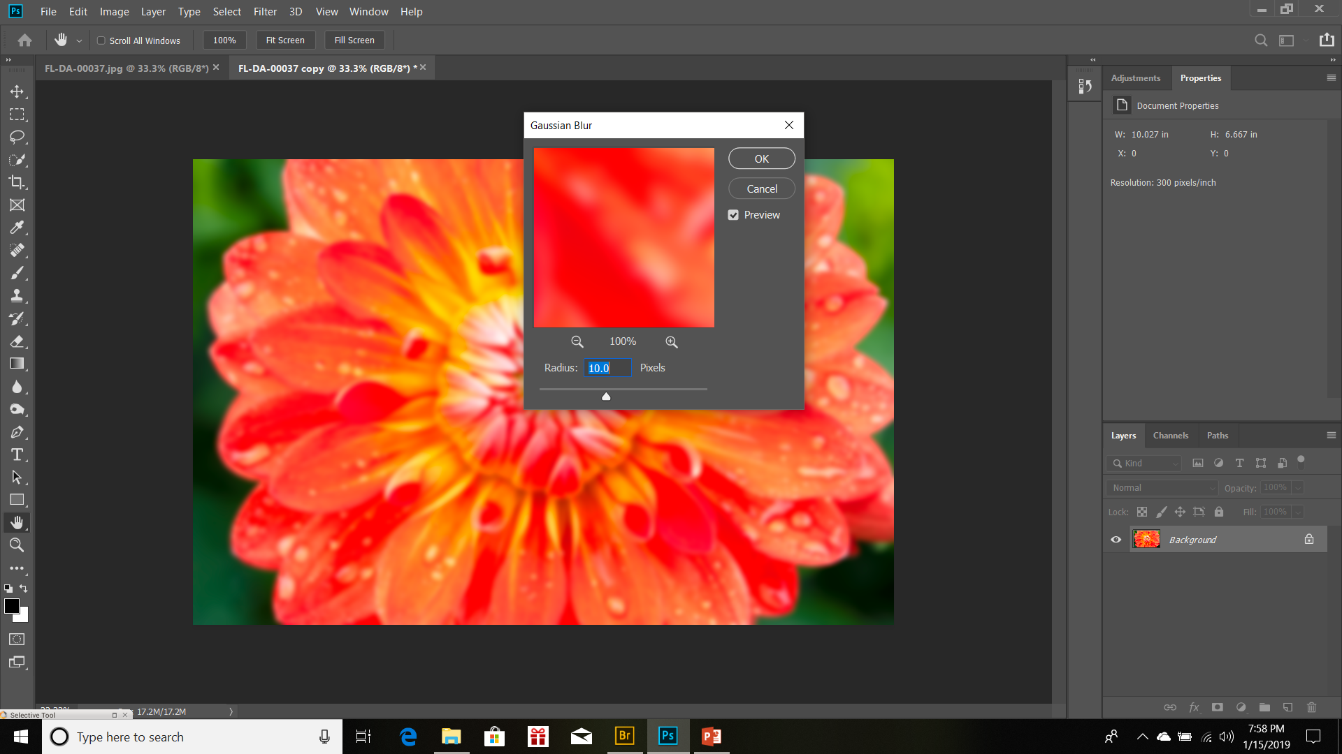
Again this adjustment depends on the image and your preferences. Use the slider to make the image blurry. You still want some detail in the image, but you want make it noticeably soft.

Slide 10
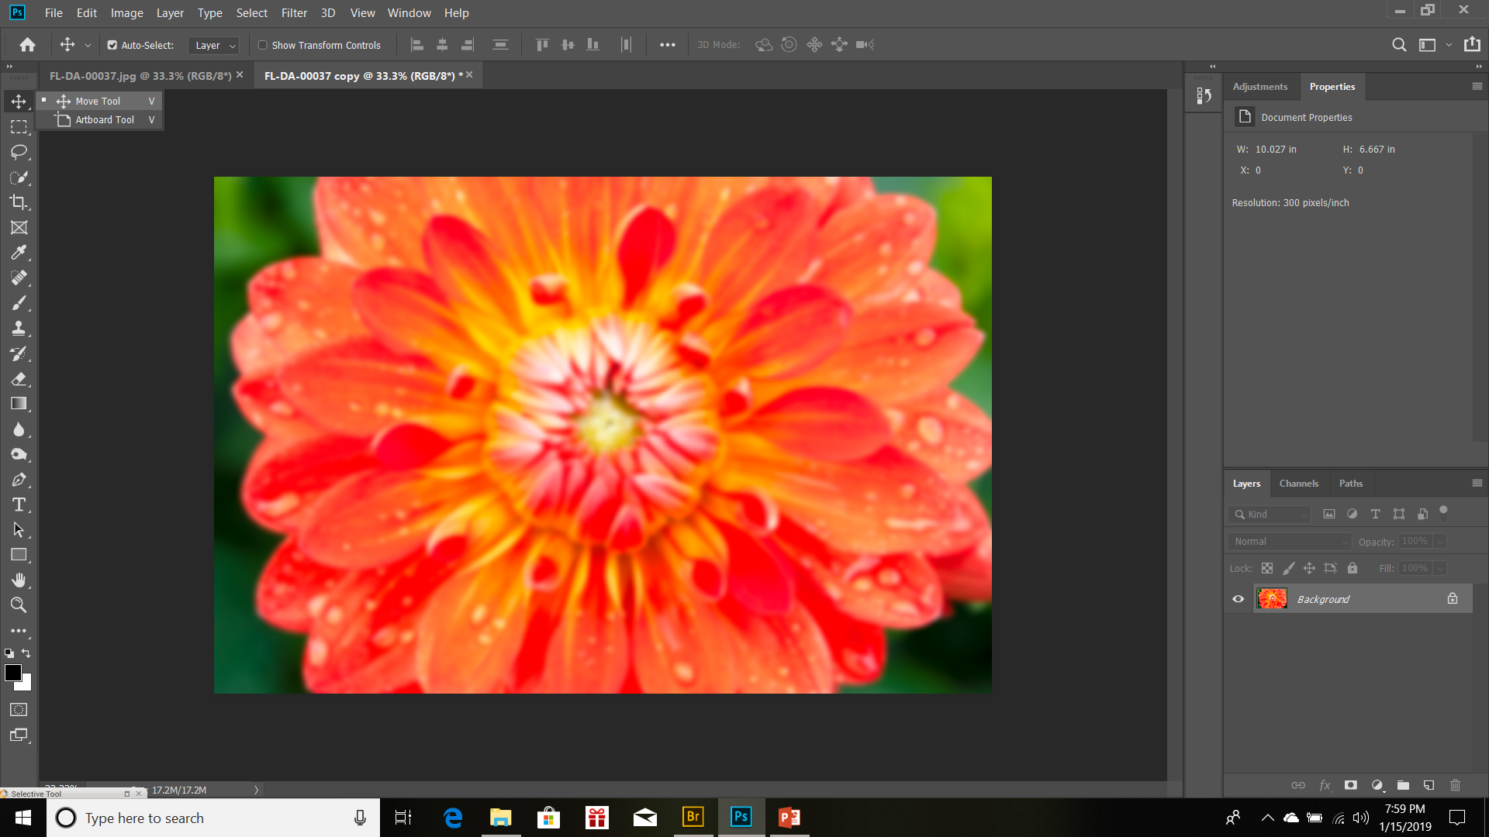
Select the move tool in the upper left. Then grab the tab of the image copy (the blurry one) and move it aside.

Slide 11
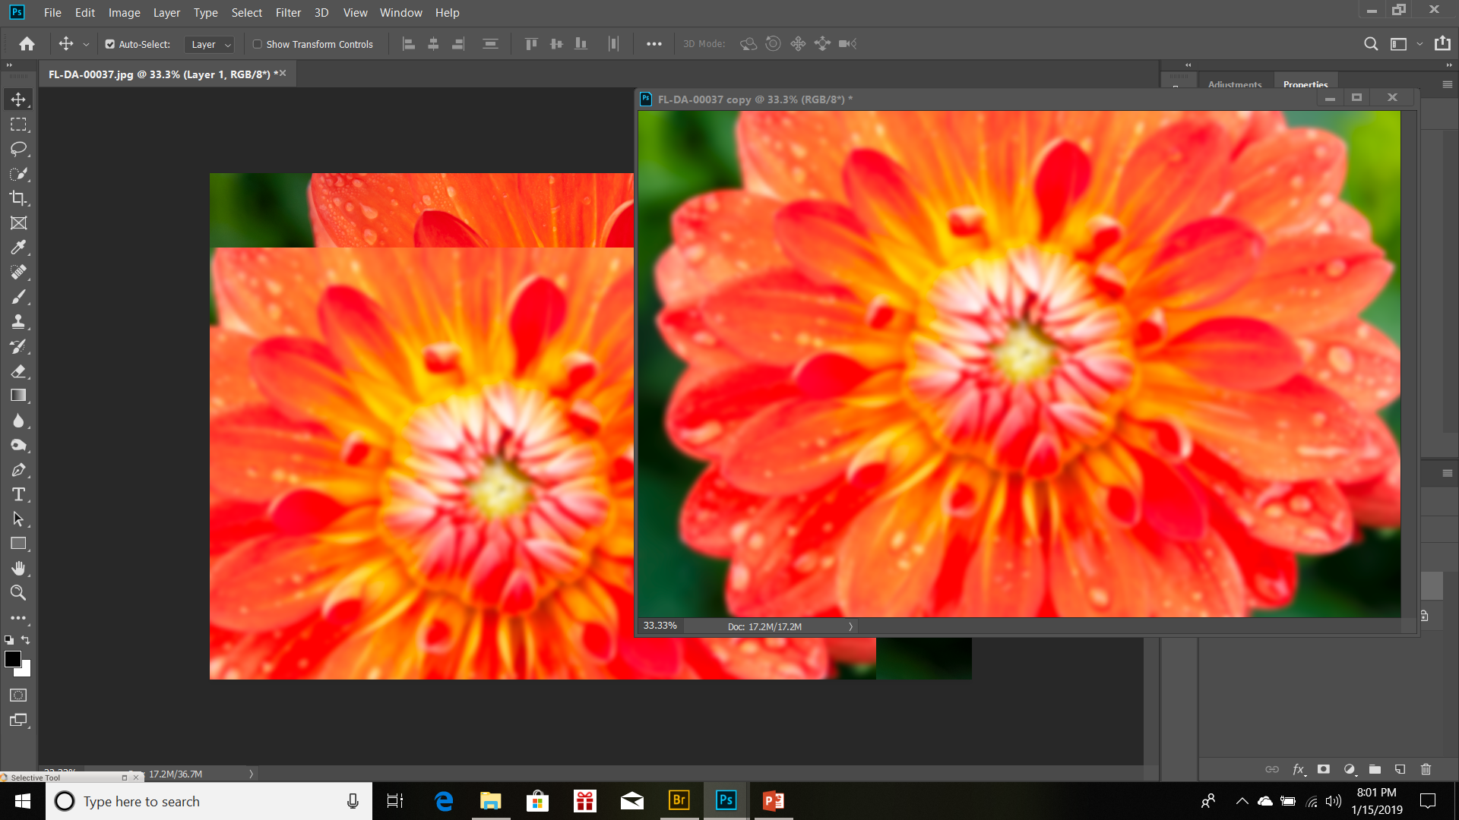
With the Move tool still selected, click anywhere on the image copy and drag the tool over to the original image and release. Close the image copy (with or without saving, up to you – I don’t save it).

Slide 12
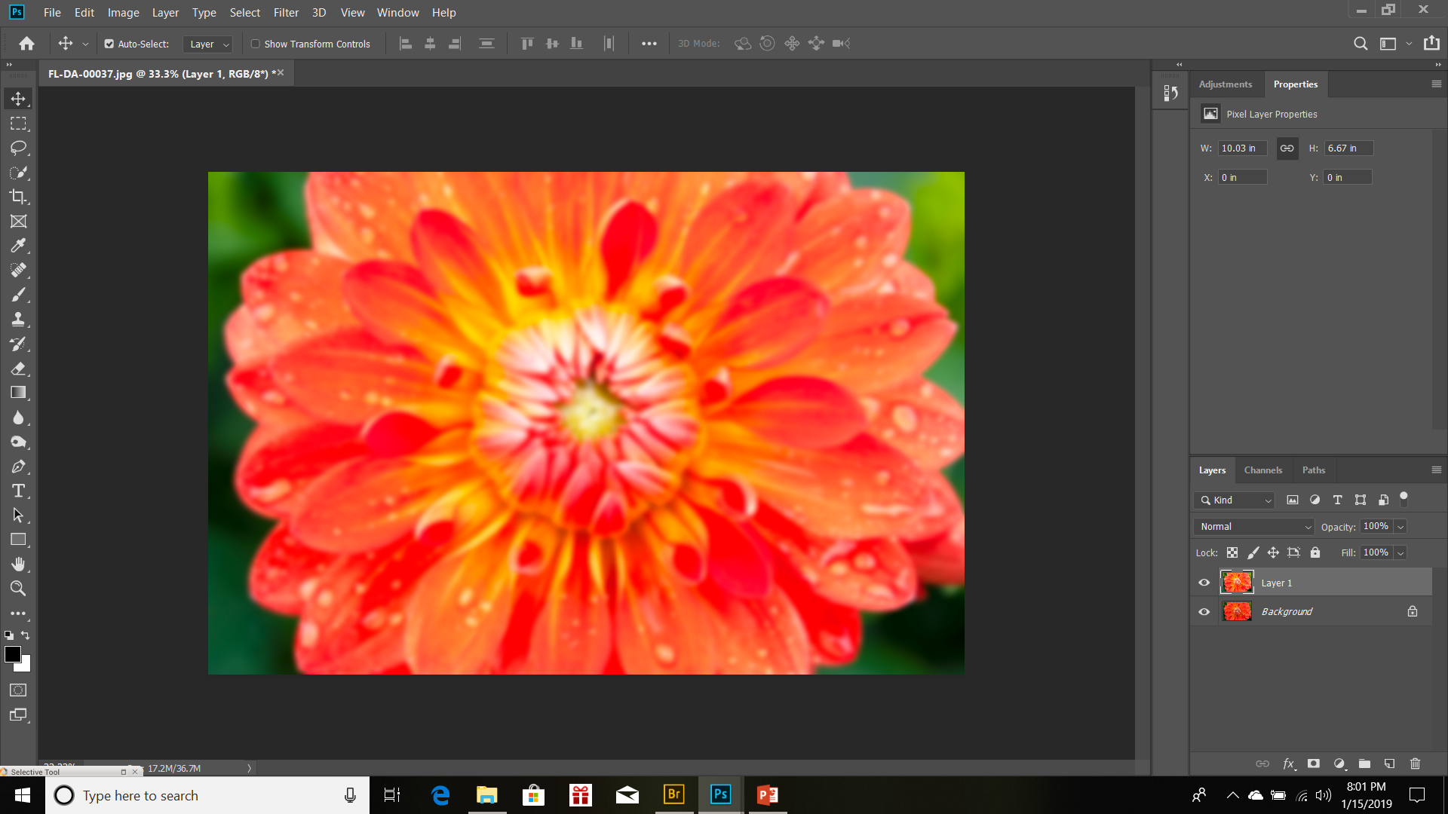
Once the copy is closed, align your images. The program will help you align edges. Notice in the lower right you now have 2 layers, the background layer and Layer 1. Above the 2 layers are a few other options that we’ll be playing with – the Blending Mode and the Opacity. These control how the layers blend together.

Slide 13
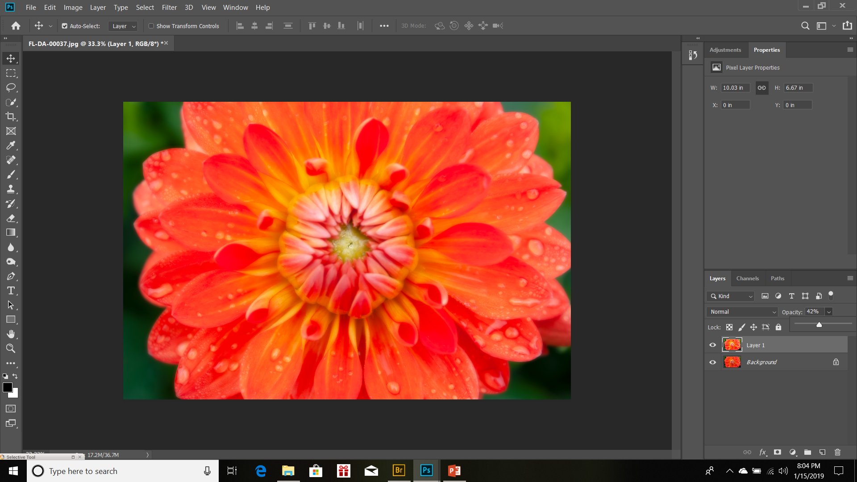
Now you get to play with the blending mode. On this one we’re choosing Normal, but then playing with the Opacity – how much of the background shows through Layer 1. Play with the other modes, see what they do to the image. There is no right or wrong, just what helps you explore your art.

Slide 14
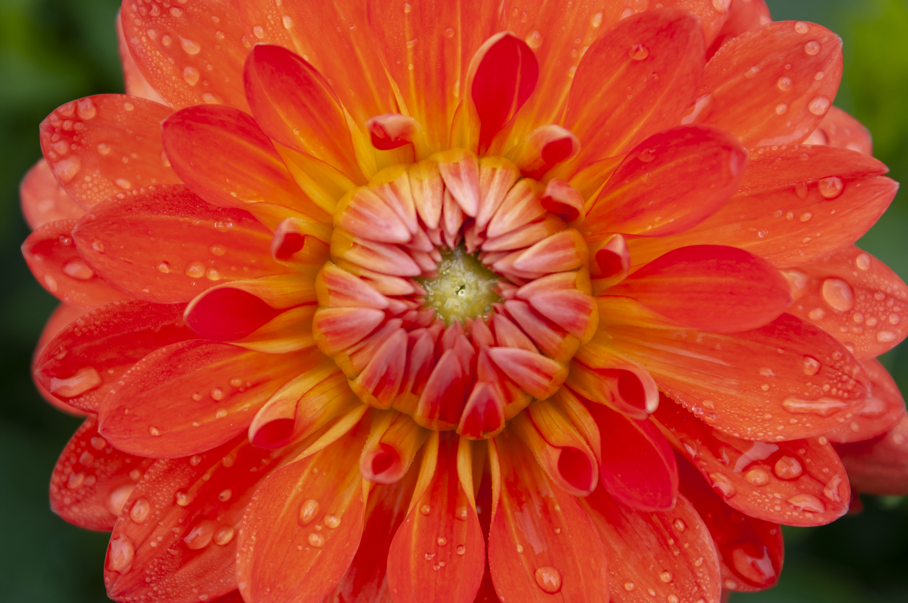
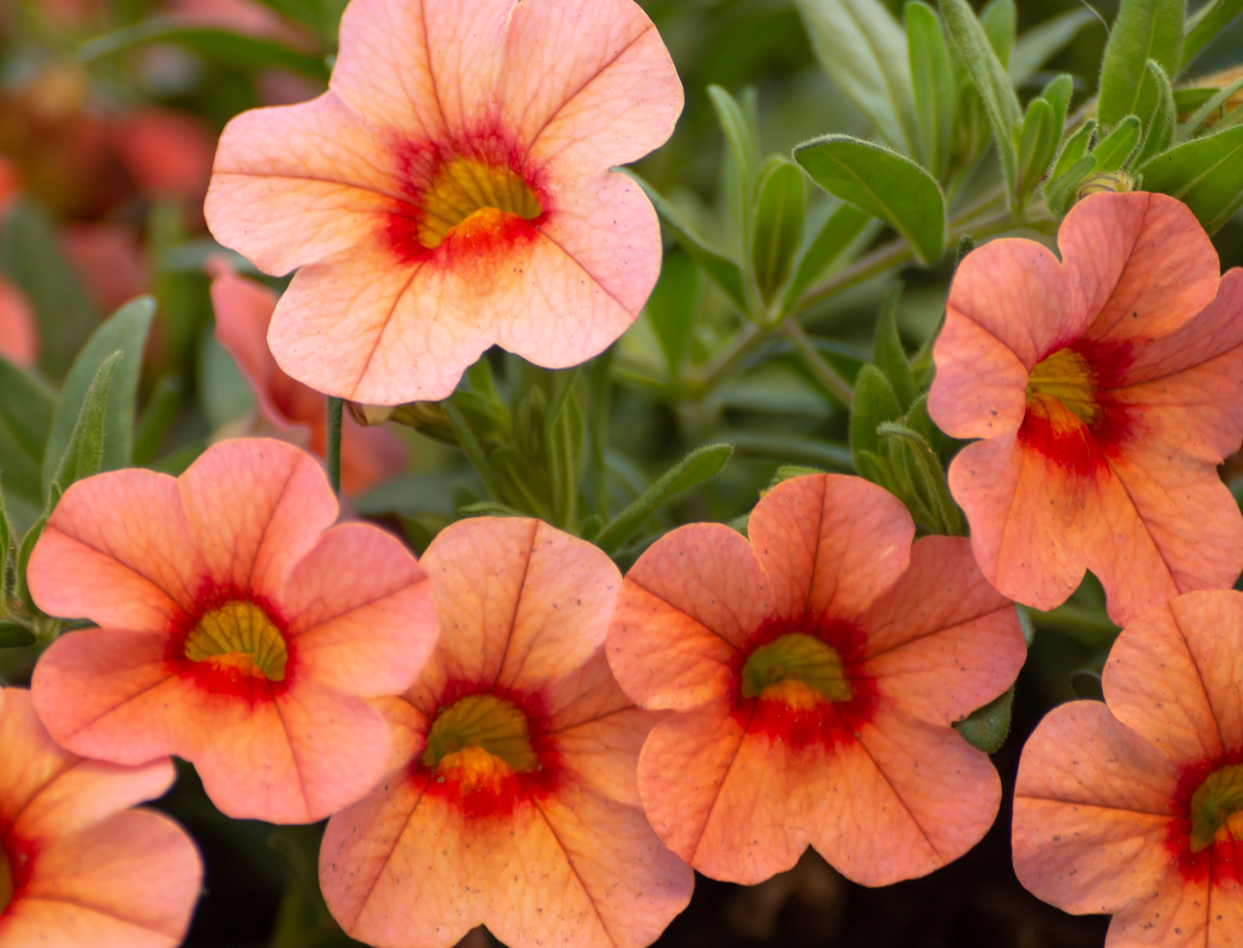
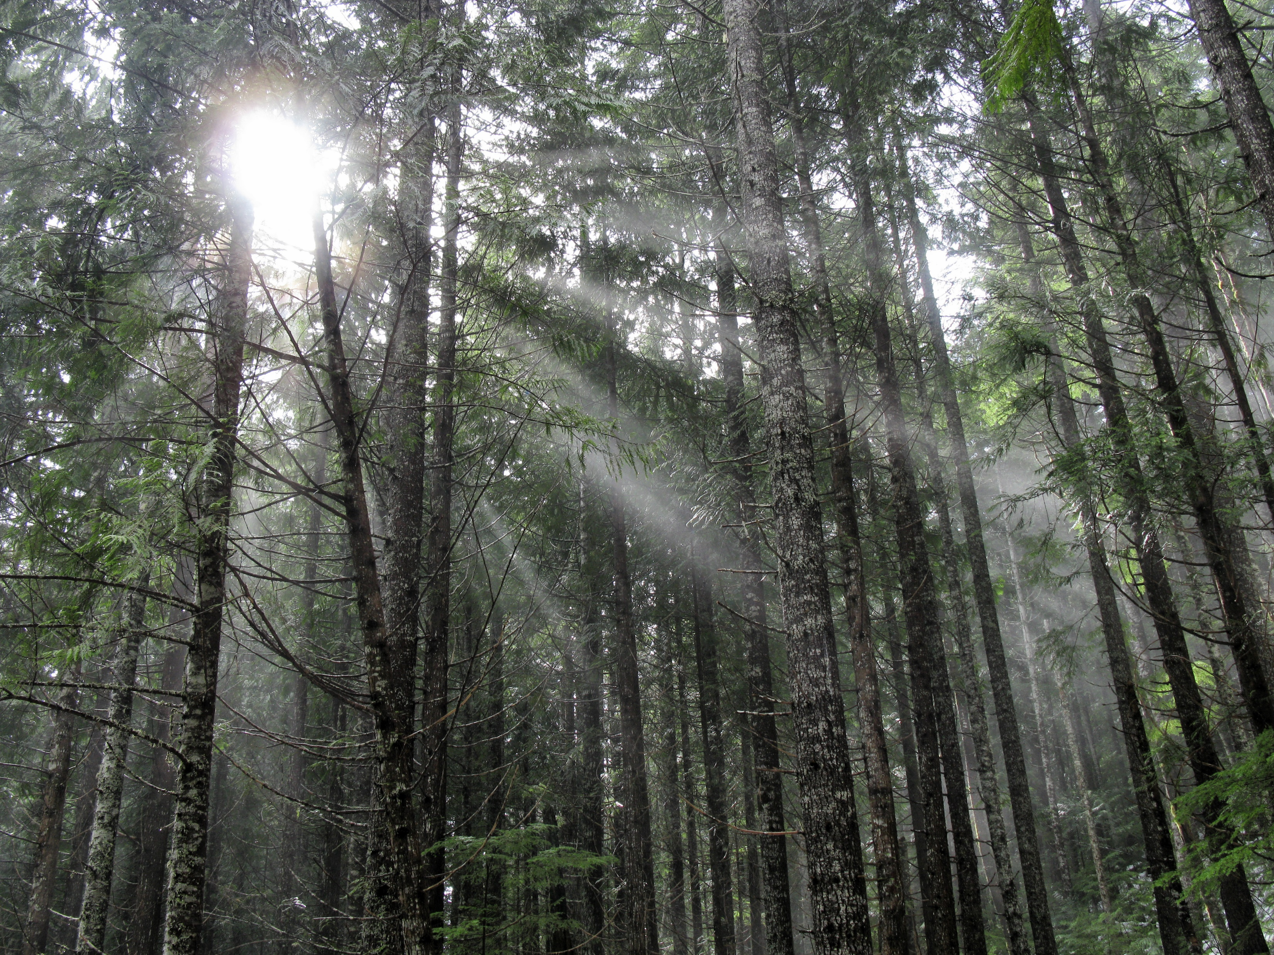
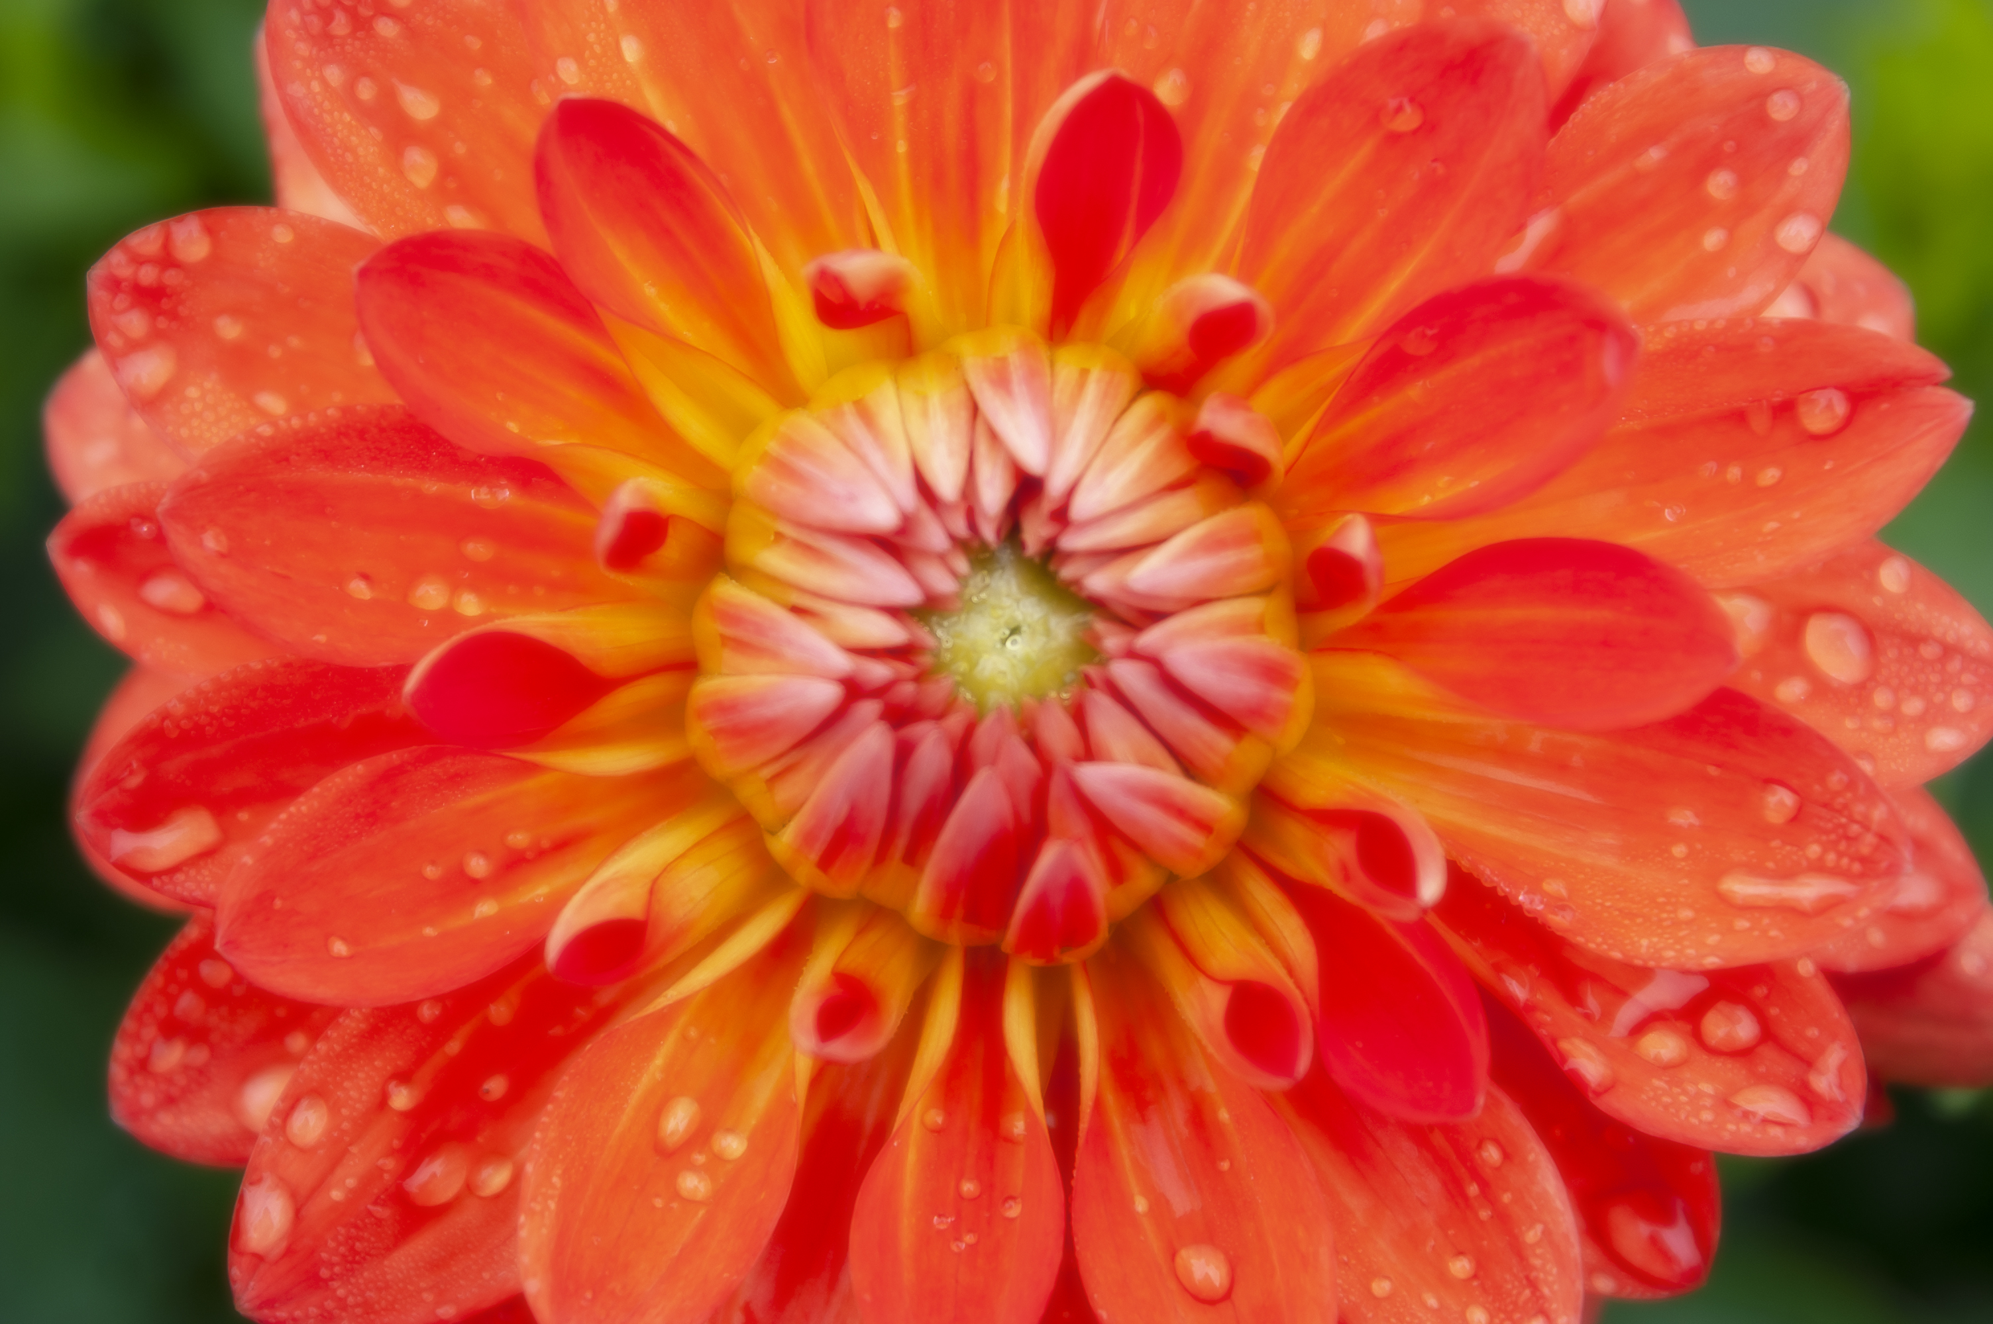
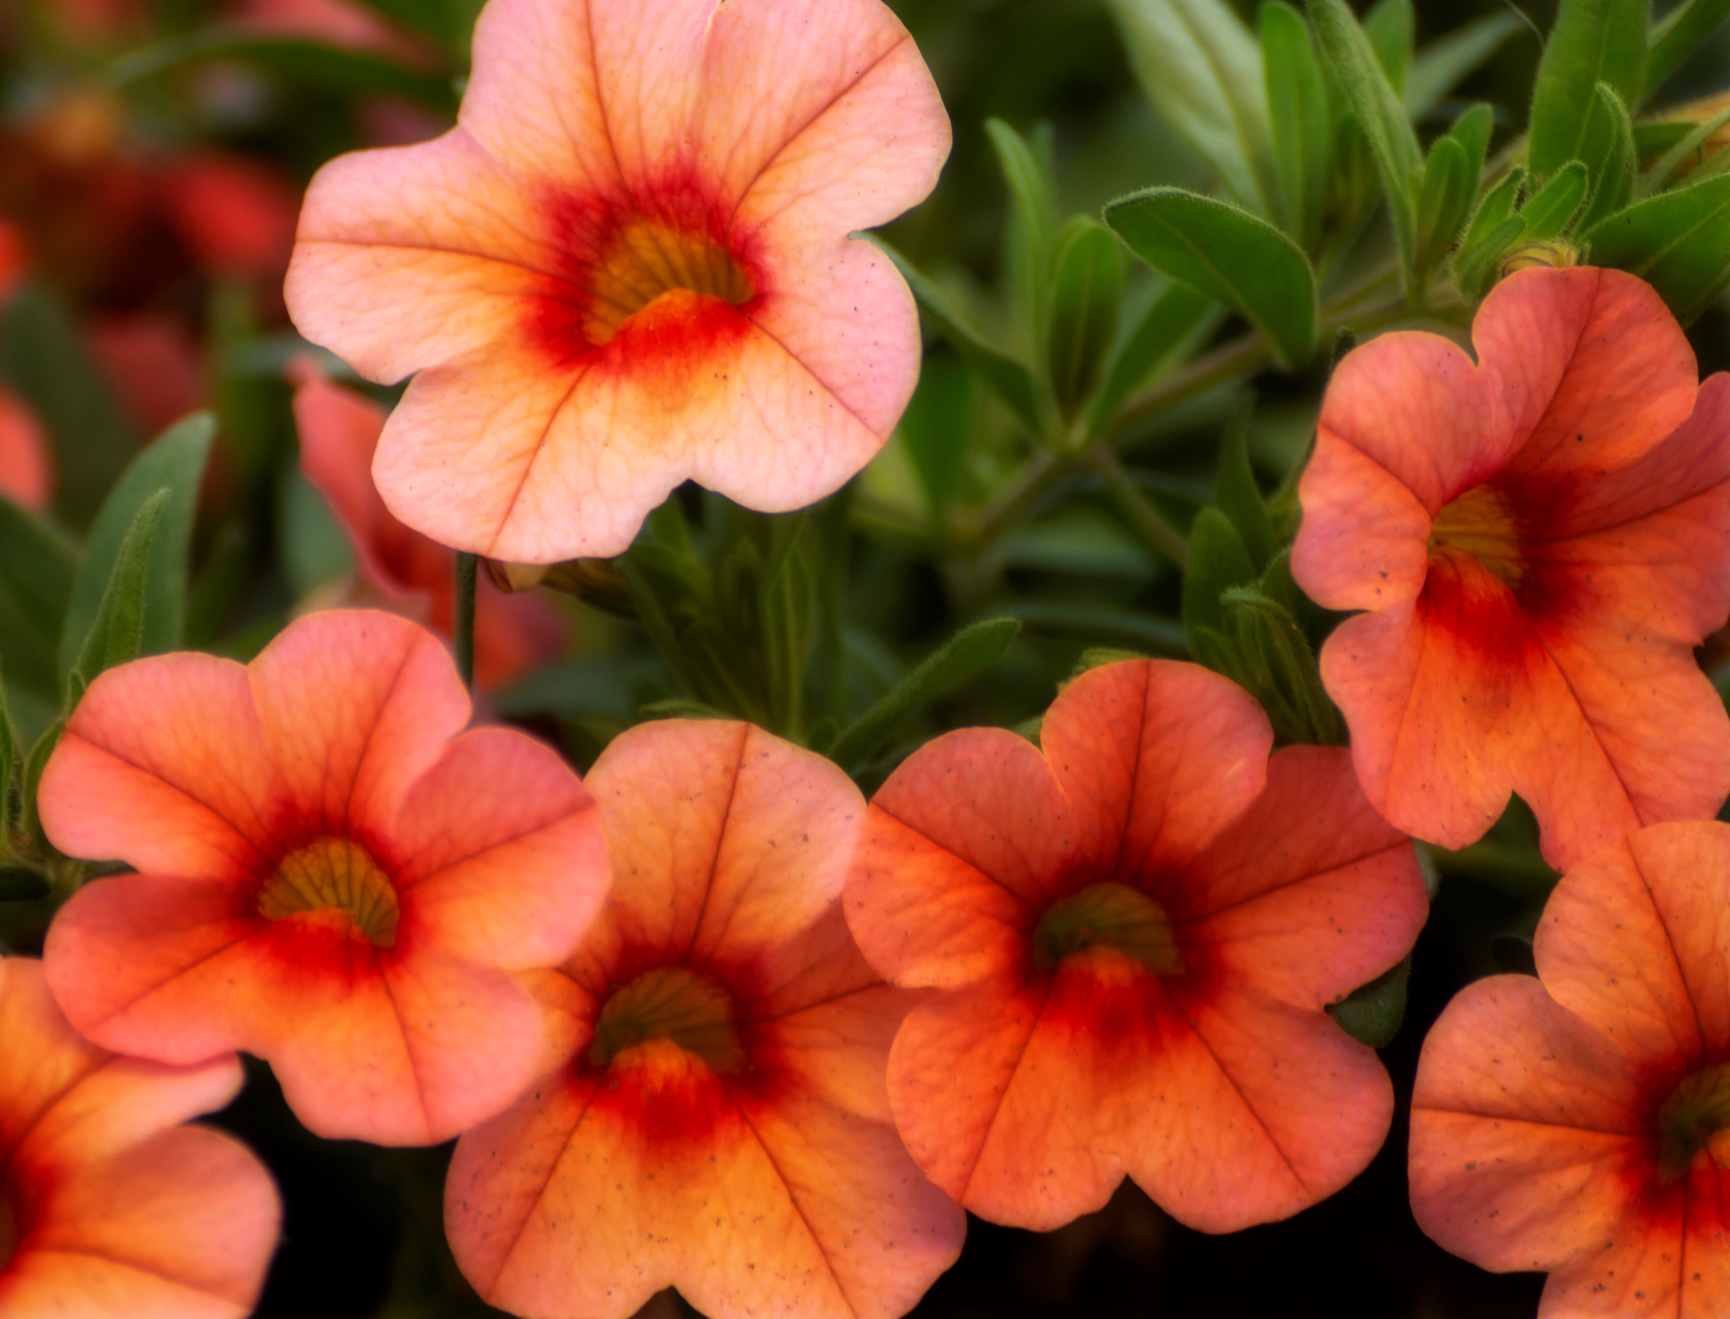
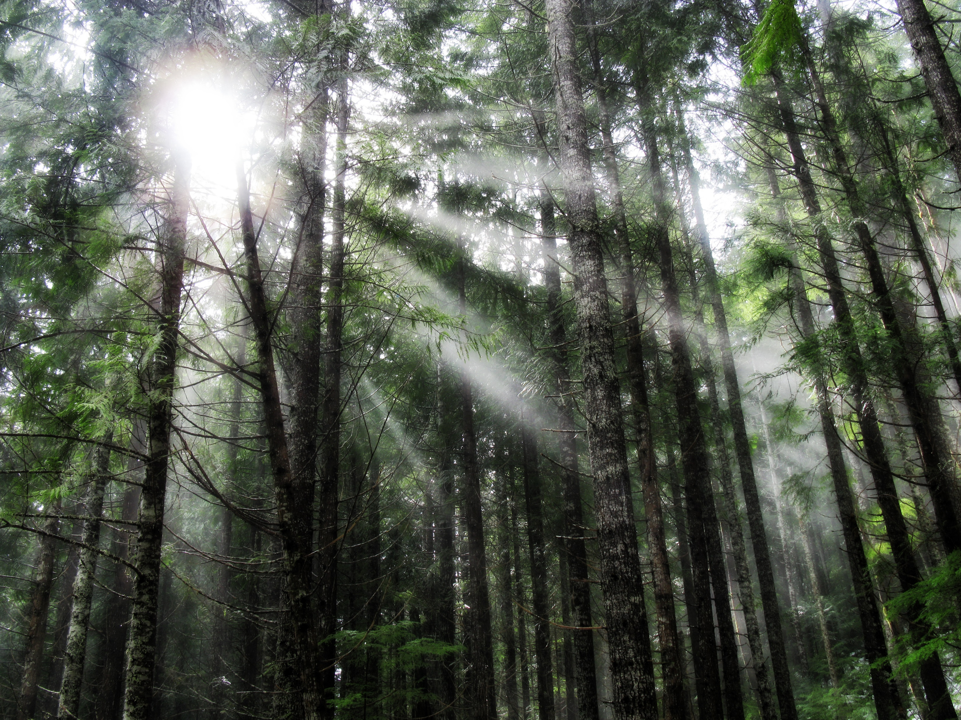
Normal
Multiply
Overlay
Lighten

Slide 15
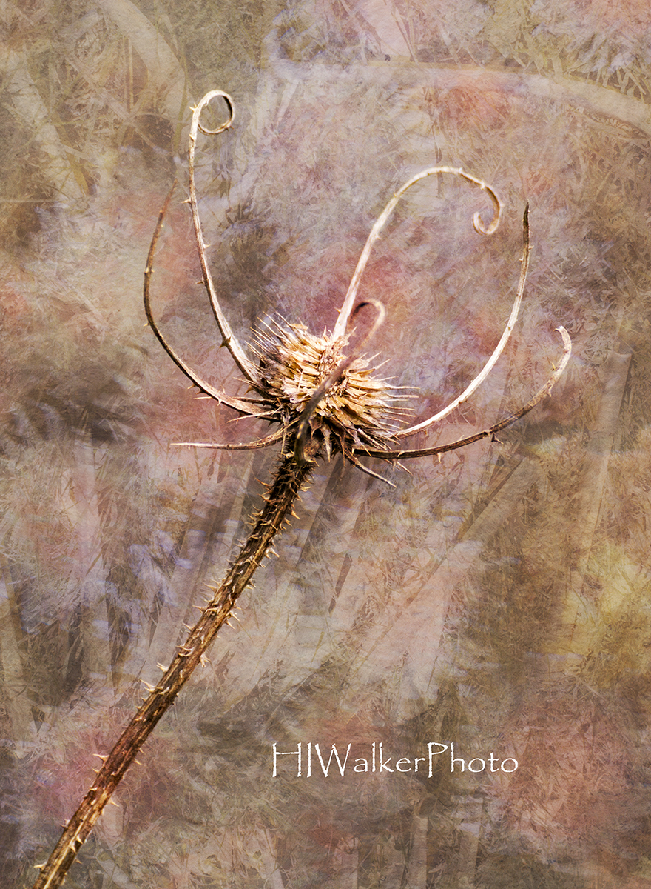
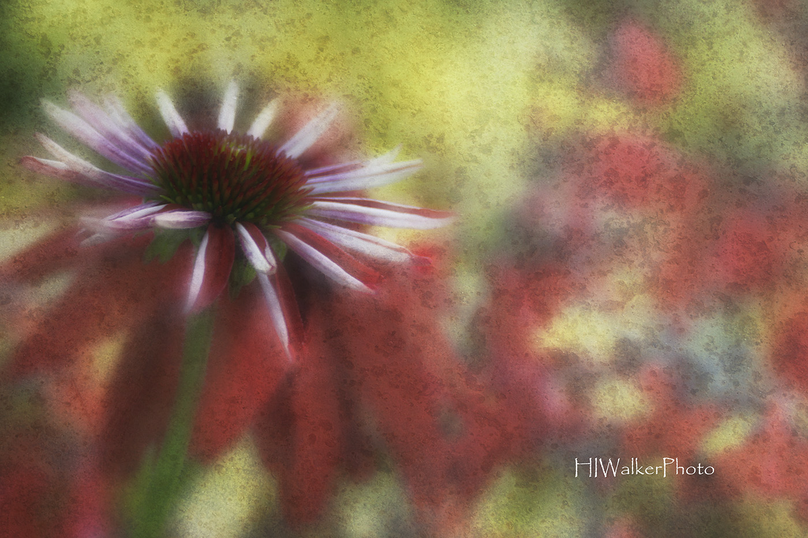
TEXTURES
Blending two or more images together to create a more artistic sometimes painterly image. Makes the boring, exciting. Use it to bring emotion to your images or just add a little extra something to your emotive image.

Slide 16
Selecting Images for Textures
Primary/Background image should have a defined subject of your choice. Look for subjects that stand out from the background through contrast, detail, or color.
Texture image are a matter of taste. Look at your primary image and listen to what it’s telling you. Is it asking to be made old? Is it a bubbly image? A painterly image? Does it feel dark & moody or light and joyous?

Slide 17
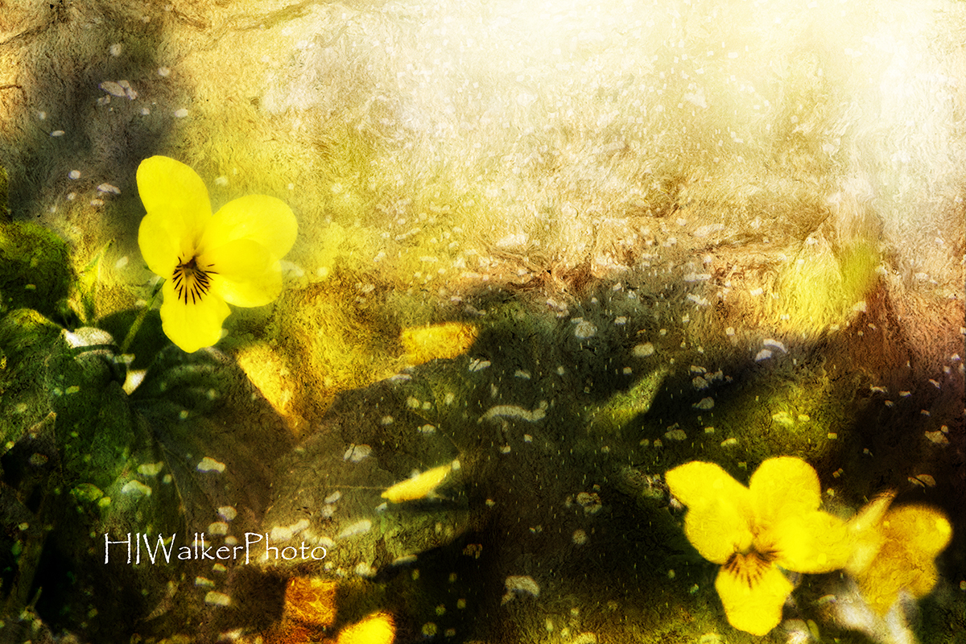
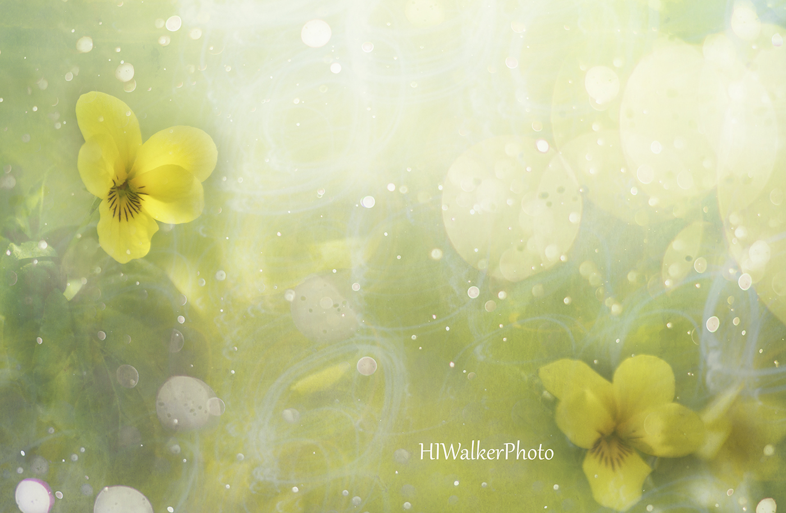
A Difference in Mood

Slide 18
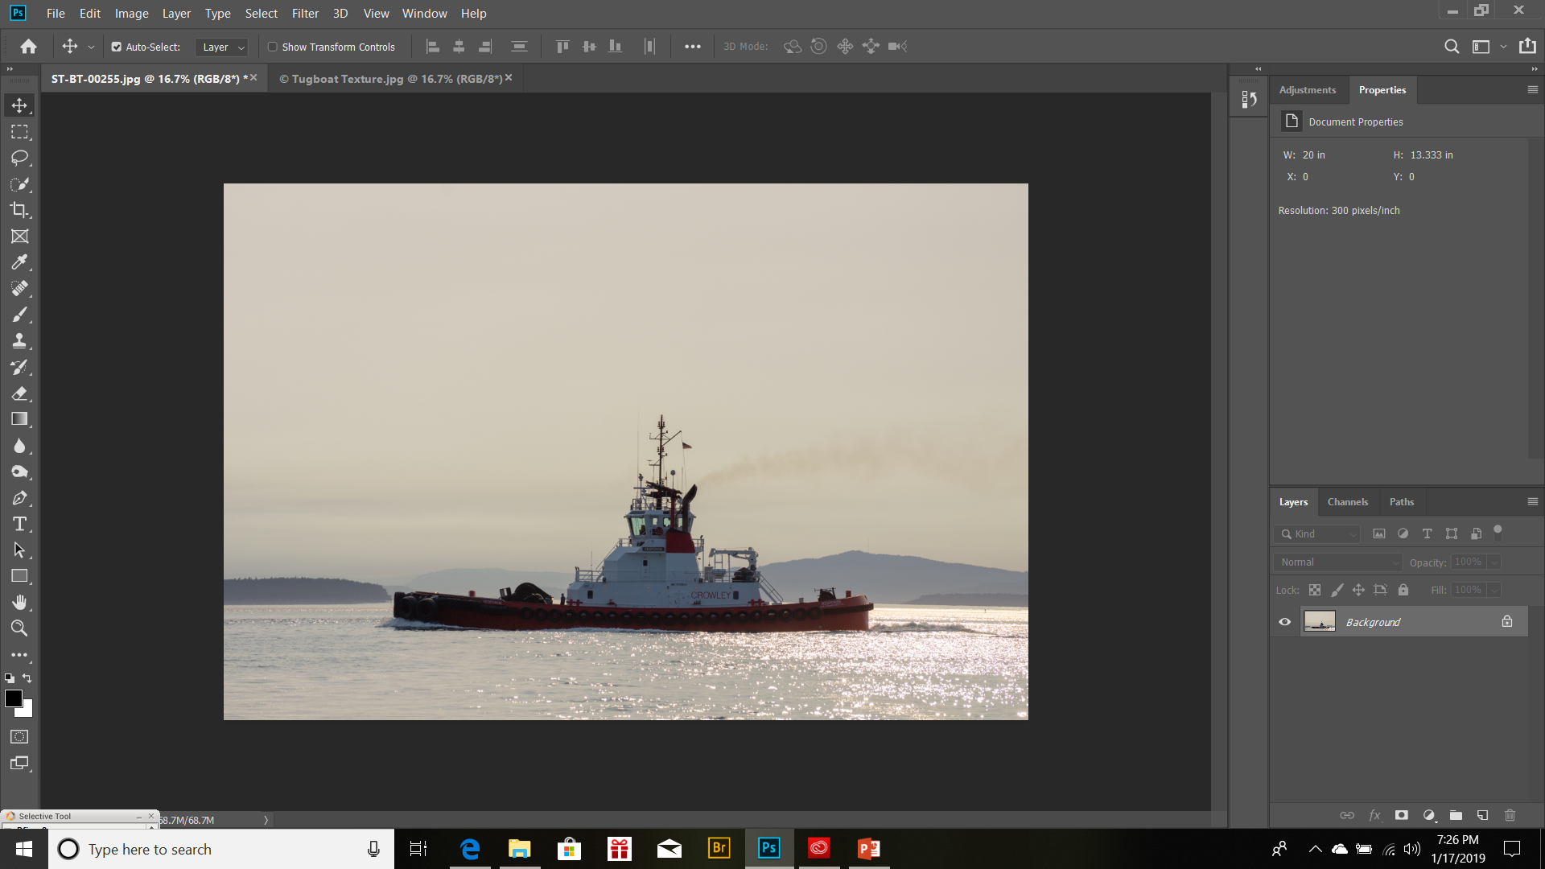
Overall Texture
Open your image in Photoshop.
Make any needed corrections. (clone out distractions, tone down highlights and brighten dark shadows)

Slide 19
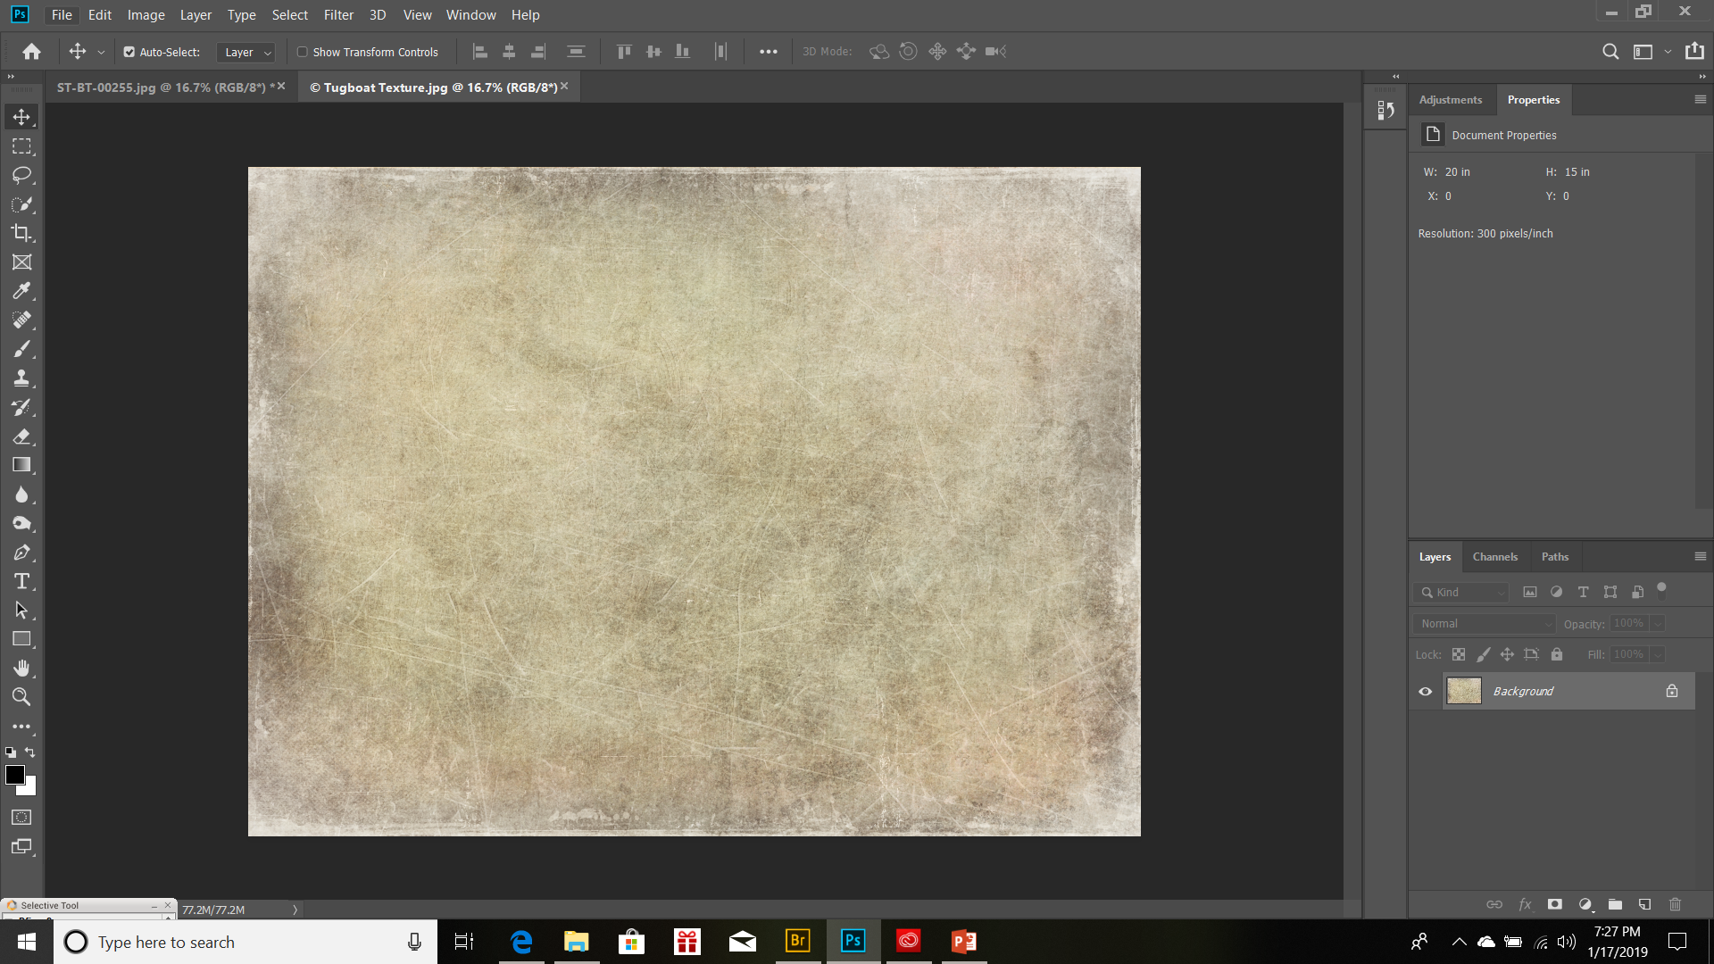
Open your chosen texture - it will appear in another tab. Make any needed adjustments with exposure or adding a blurred effect.

Slide 20
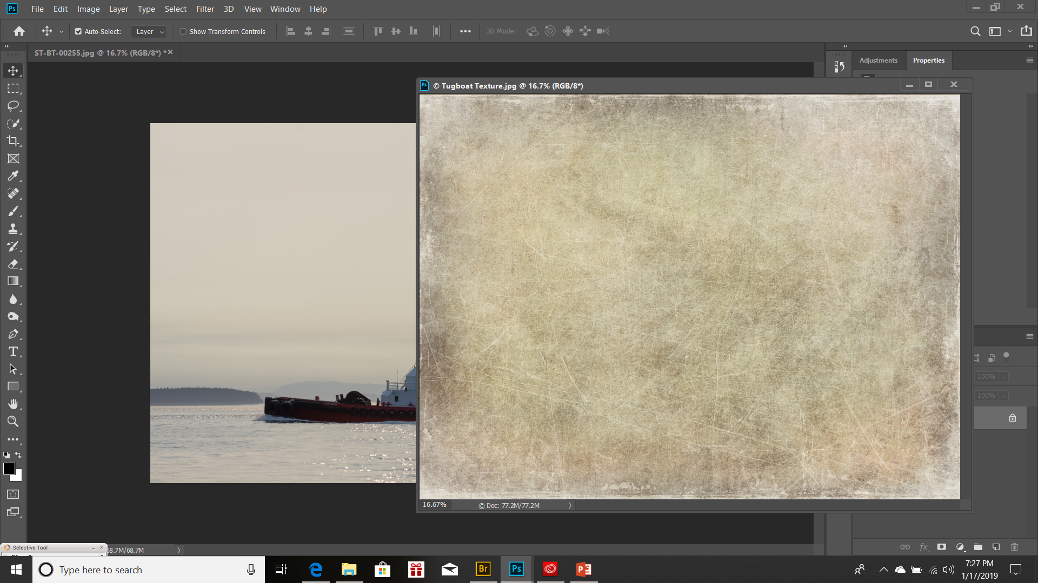
Choose the move tool in the upper left of your desktop. Grabbing the texture tab, pull it aside.

Slide 21
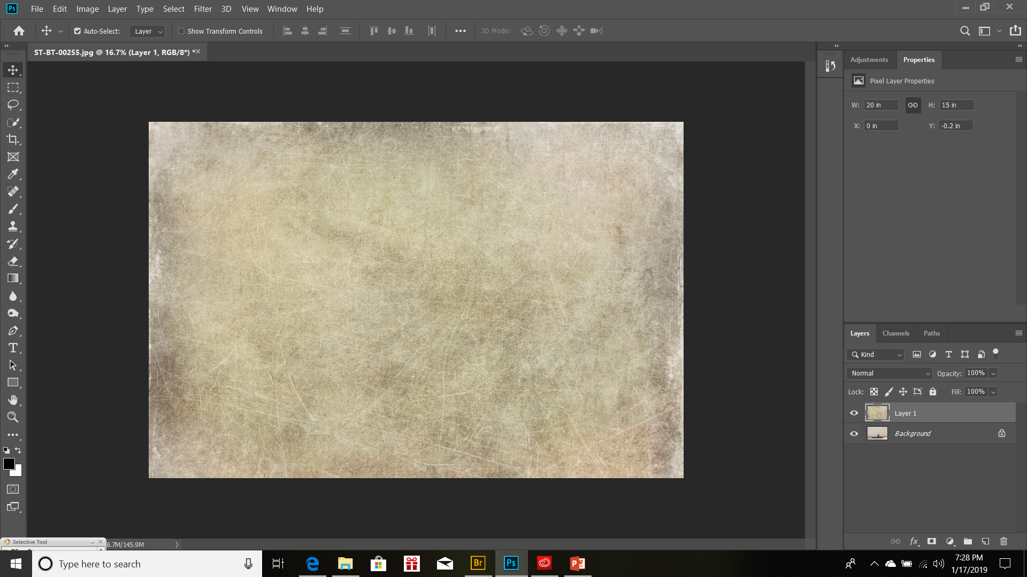
Then, like the montage, place the move tool somewhere on the texture image and move it to the primary image (notice you now have a background and layer 1). If the image is the same size, it will “snap” into place. If it is smaller or larger, you will need to resize the layer – which we’ll do on the next example.

Slide 22
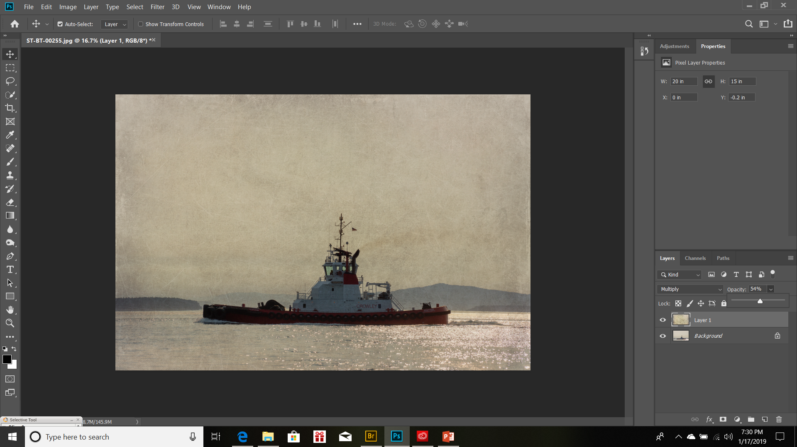
Now we get to play with the blending mode and opacity again. Once you find your image’s “happy place” save it.

Slide 23
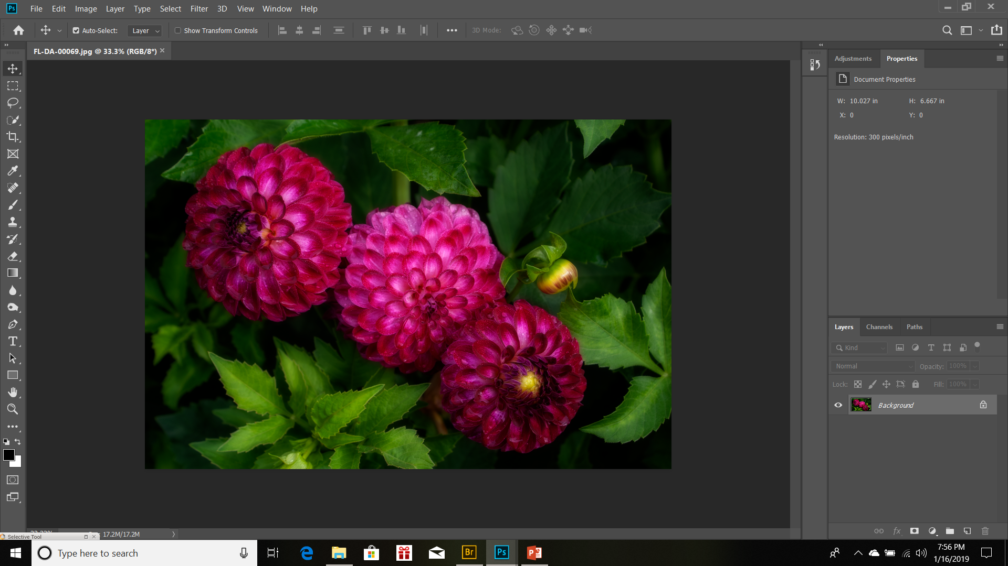
Selective Texture
Open your image in Photoshop.
Make any needed corrections. (clone out distractions, tone down highlights and brighten dark shadows)

Slide 24
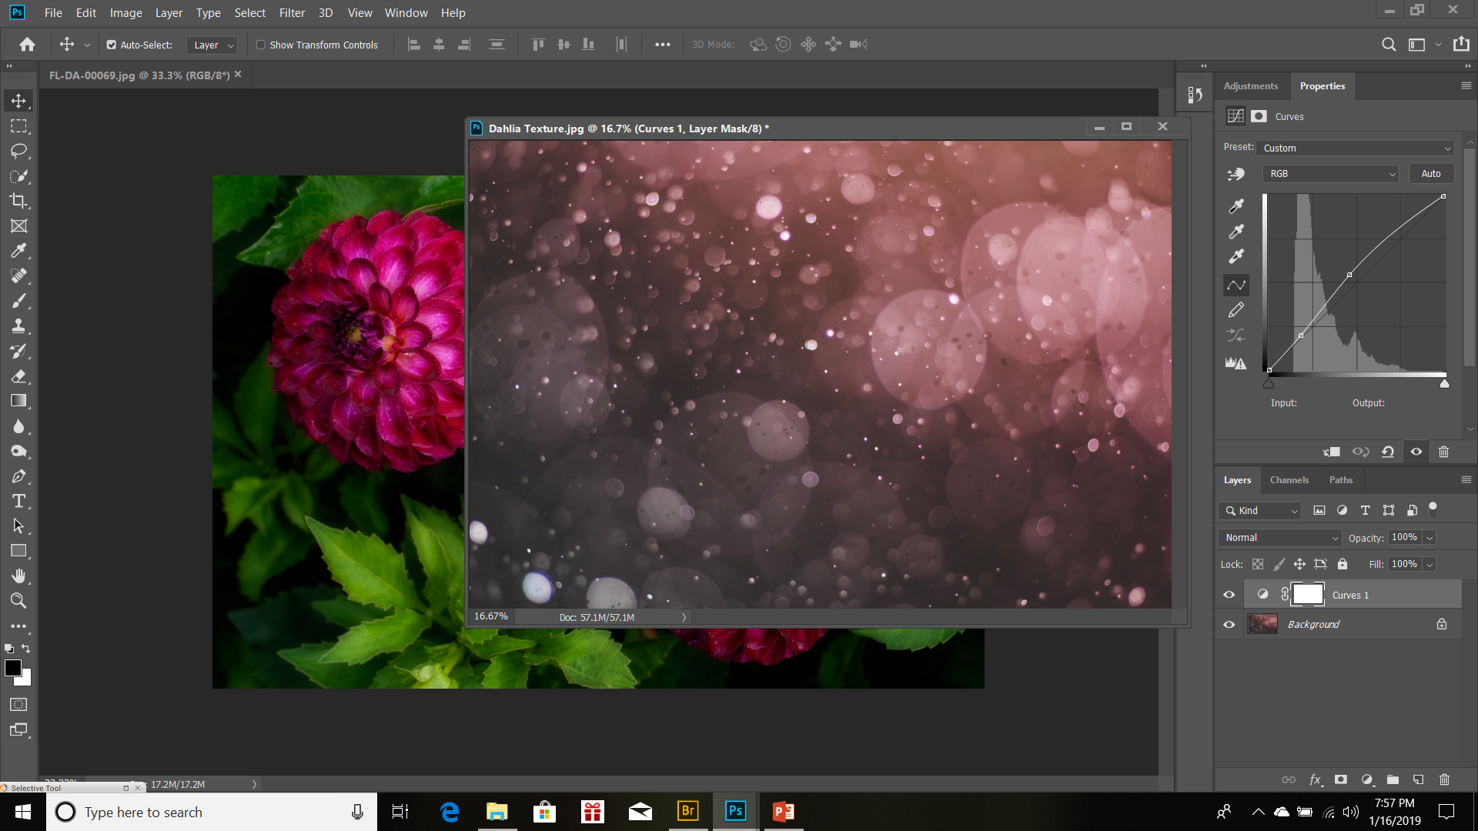
Then open up your texture and move it aside. For this one, I moved it aside before making any adjustments because I want to match the color tones more closely to the dahlias.

Slide 25
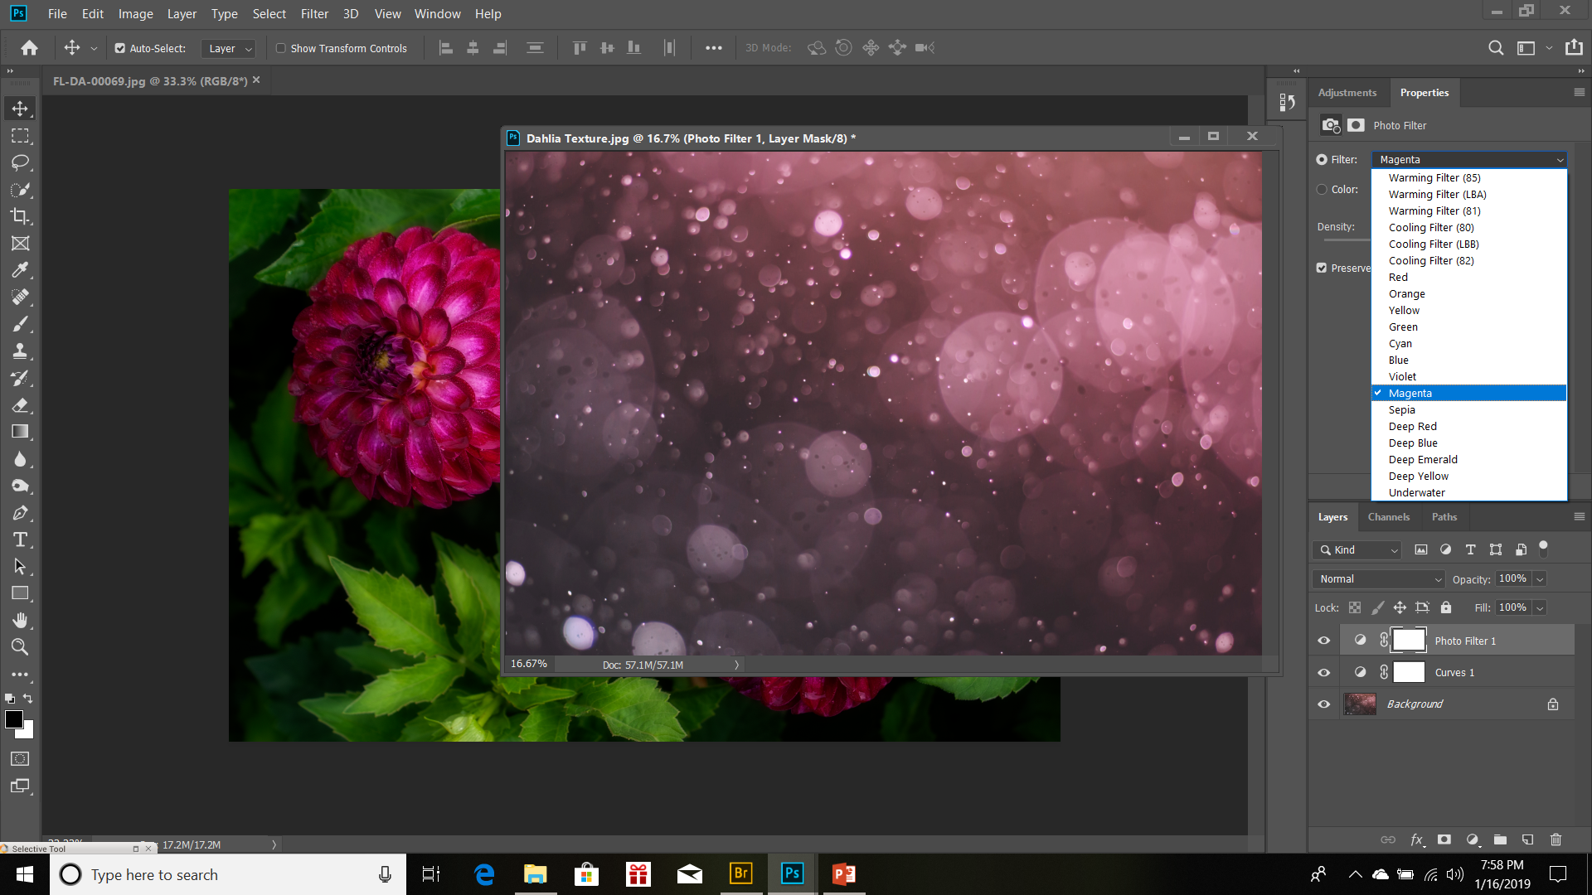
There are several ways to adjust color tones, but I’m using the Photo Filter adjustment because I find the color changes to be more subtle. Here I’m using the magenta photo filter. Now before moving the texture to the background, flatten the image.

Slide 26
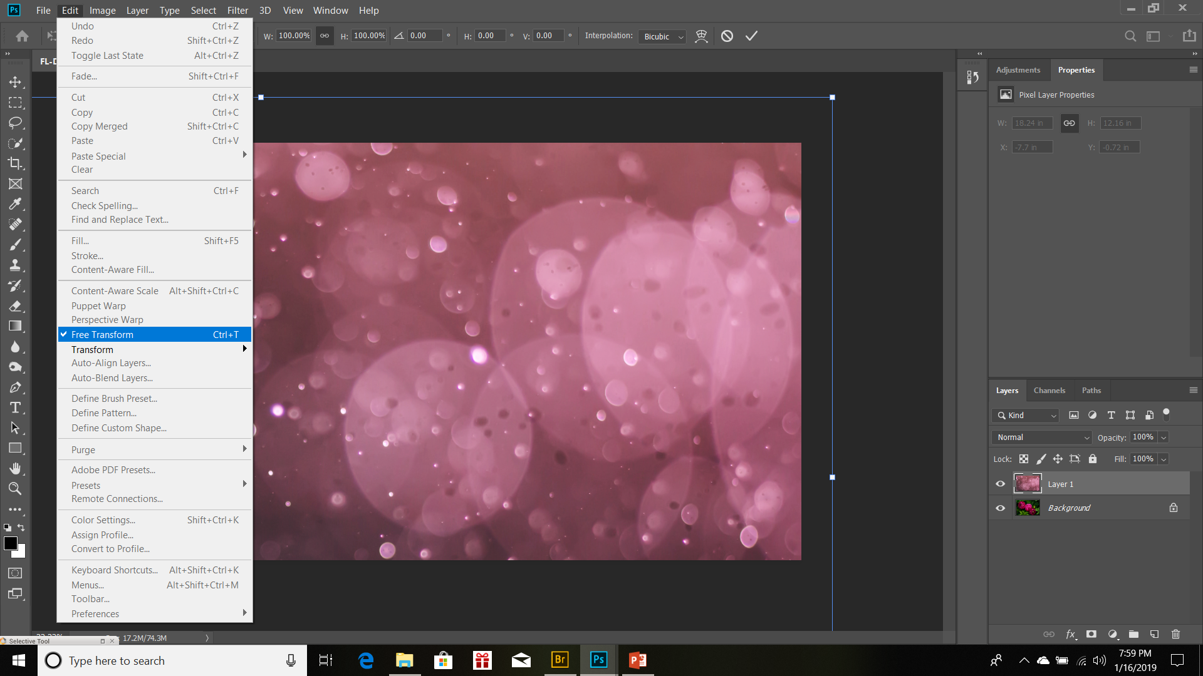
Now when we move the texture to the background, we see that this texture is much larger than our background. To fix this go to the drop down menu under Edit to Free Transform. See the little white squares? Place your curser over one and holding down the left button on your mouse or pad, start moving the squares in. (out if the texture is smaller)

Slide 27
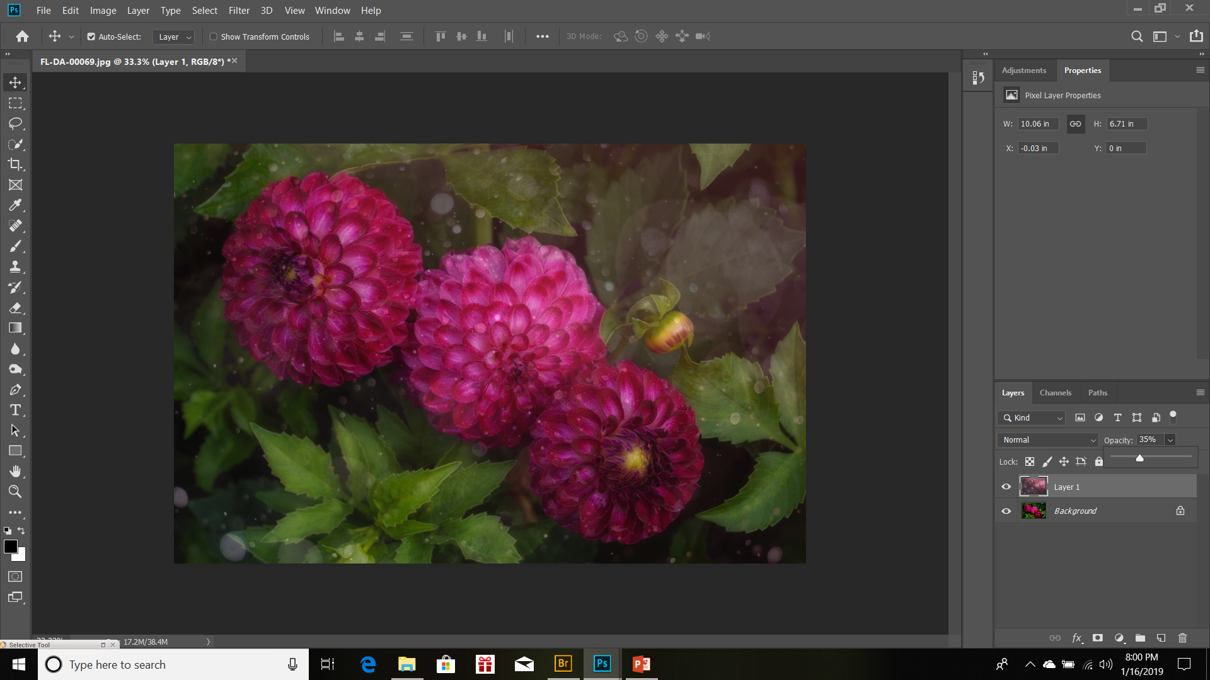
Once you have your texture resized, head down to the layers panel and reduce the opacity of the texture. You’ll want to see the background image clearly.

Slide 28
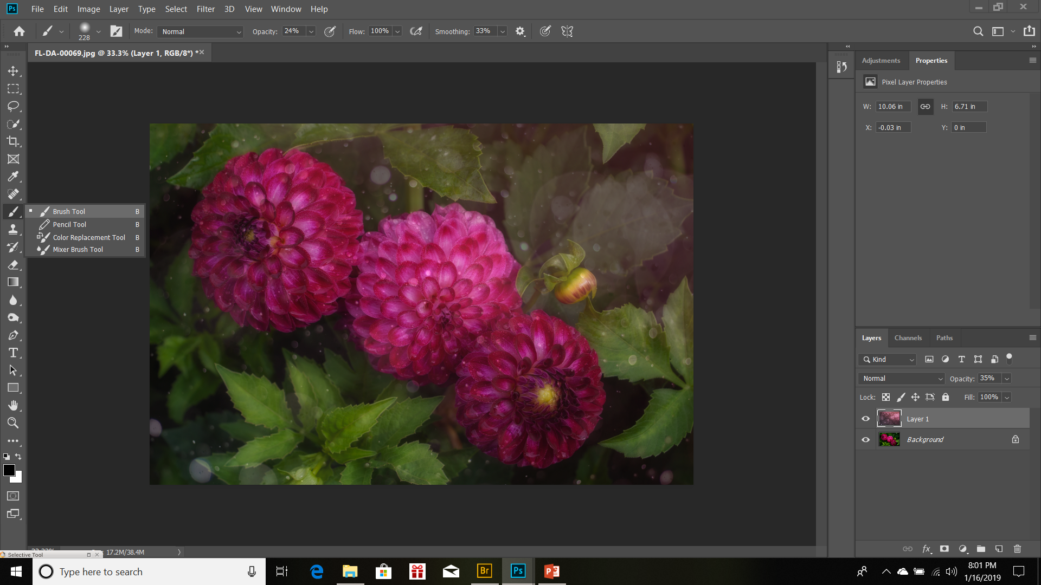
Select the brush tool from the list of tools on the left side of the work station.

Slide 29
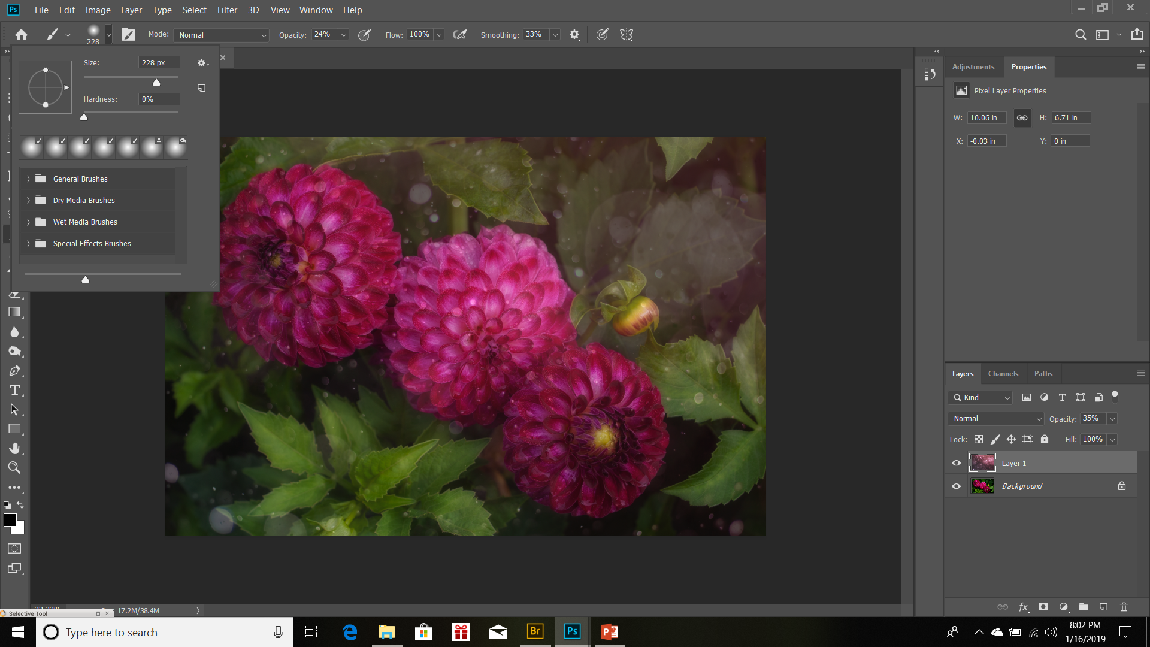
Notice at the top of the work station you have some other controls. First, lets select brush size and edge hardness. Don’t go too big on brush size, you don’t want to cover the entirety of your subject. Too big you lose control over finer details and too small takes forever.

Slide 30
Our next control to choose is opacity. This lets you choose how much of the background to reveal with each brushstroke. I start off at around 60% opacity then as I go along, I lessen the opacity to 20%-30%. This give you control over the edges. Hard edges makes it look like the subject was pasted, but softer edges makes it more painterly.

Slide 31
Finally, (but it doesn’t really matter what order you do this in) create a Layer Mask on Layer 1. Make sure Layer 1 is highlighted then select the white rectangle with the black dot on the lower layer panel. The layer mask will show white. In the lower left, you will see an black square overlapping a white square. If the black is not overlapping the white, they will nee to be switched by clicking the right-angled arrows.

Slide 32
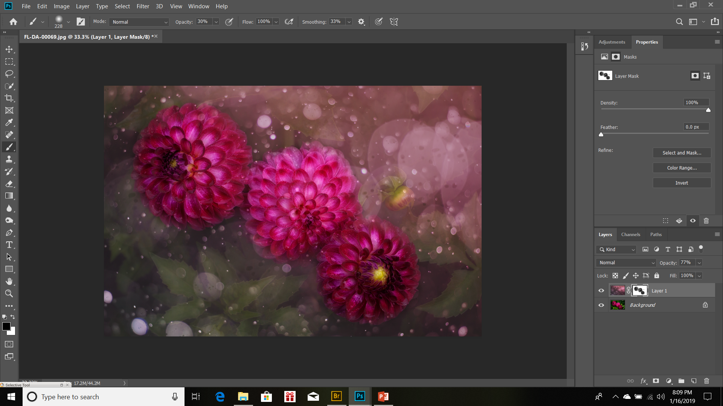
Now we start brushing. Holding the left mouse/pad button down, go over the area you want to show through the texture. As you work towards the edges, lower the opacity of the brush. Notice that you layer mask is beginning to show grey and black over the locations you’re brushed. Don’t worry about being precise, this is art.

Slide 33
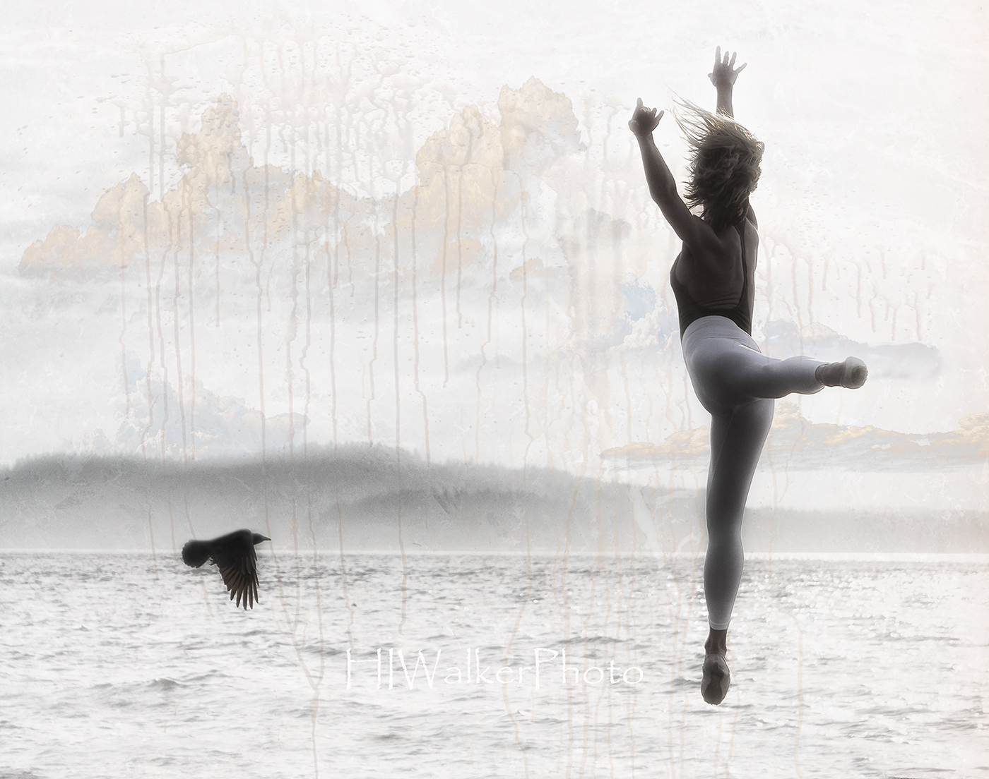
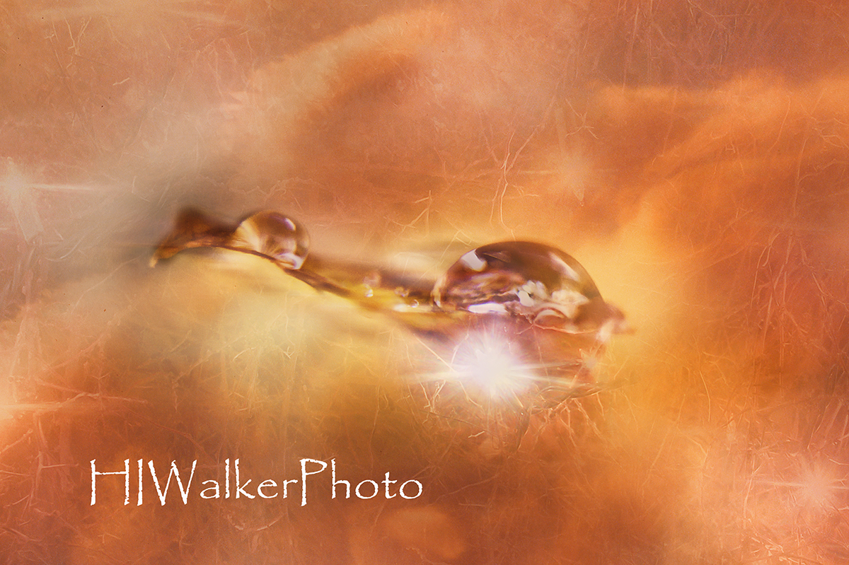
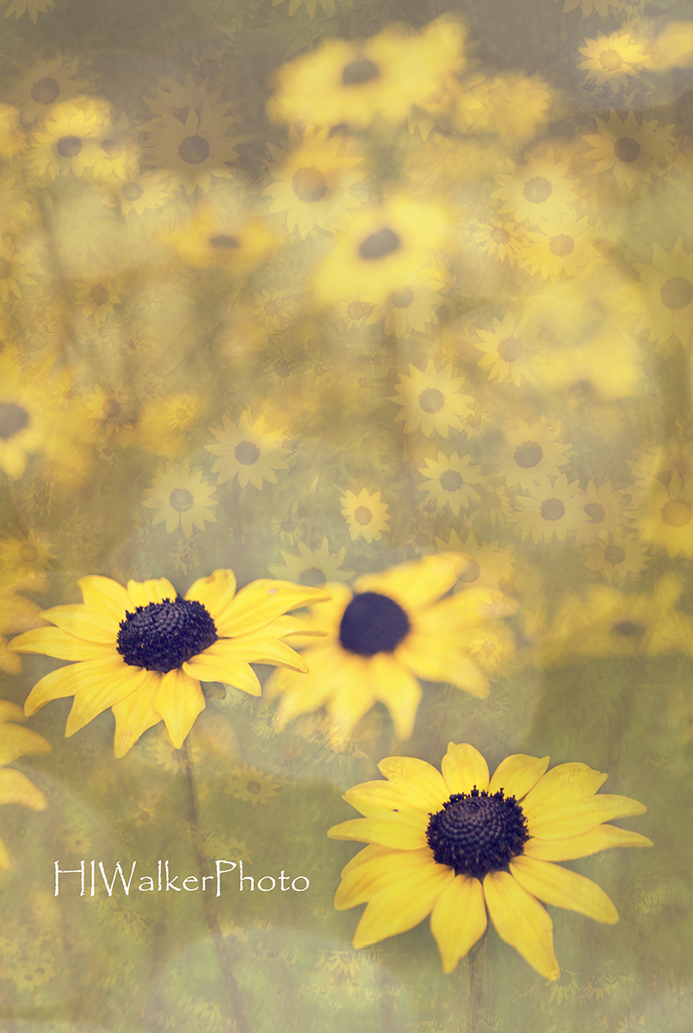
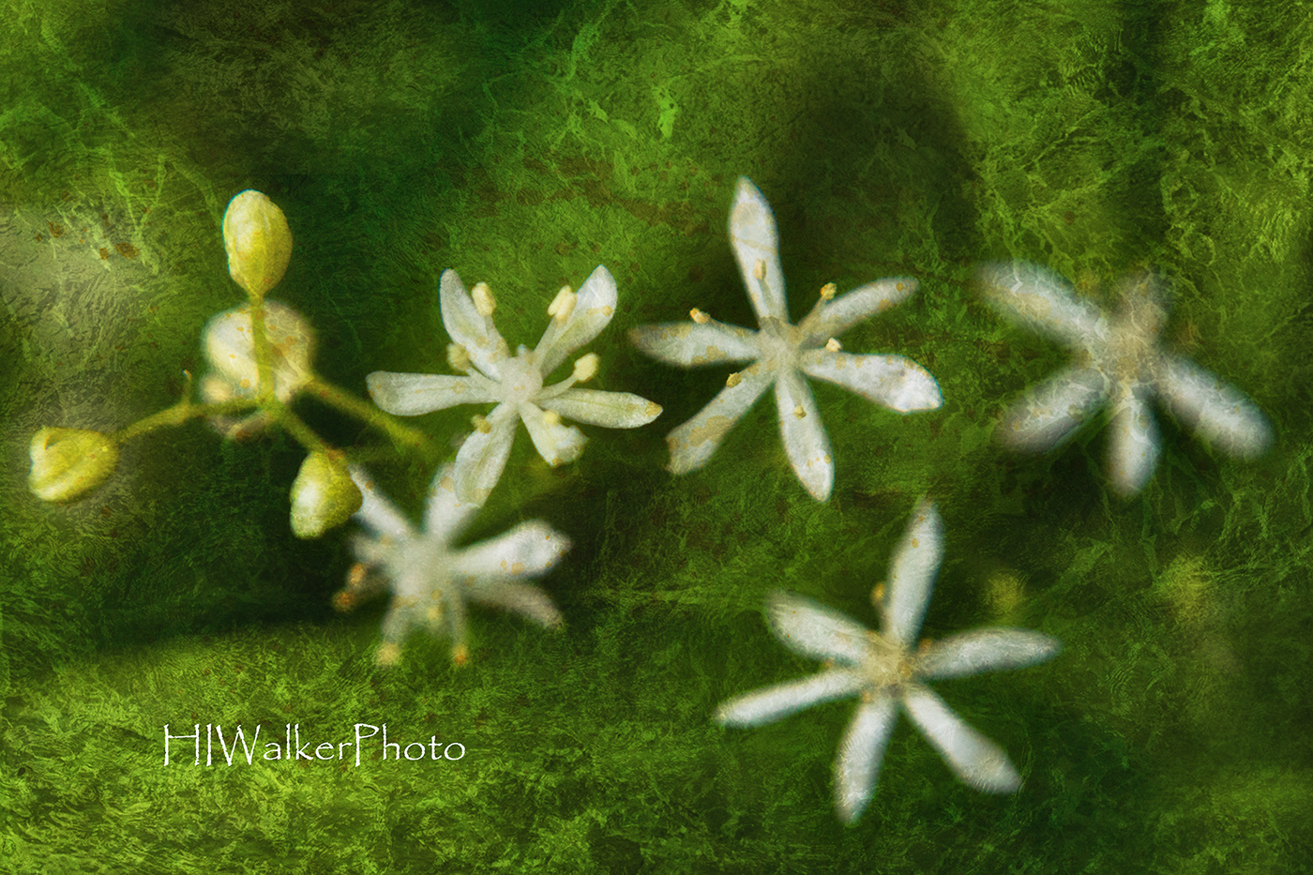
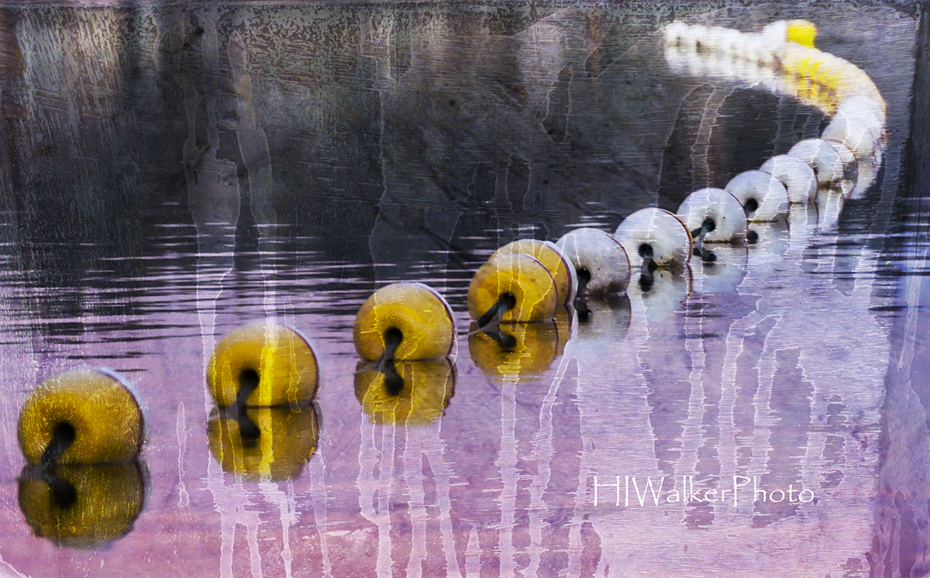
The possibilities are endless.

Slide 34
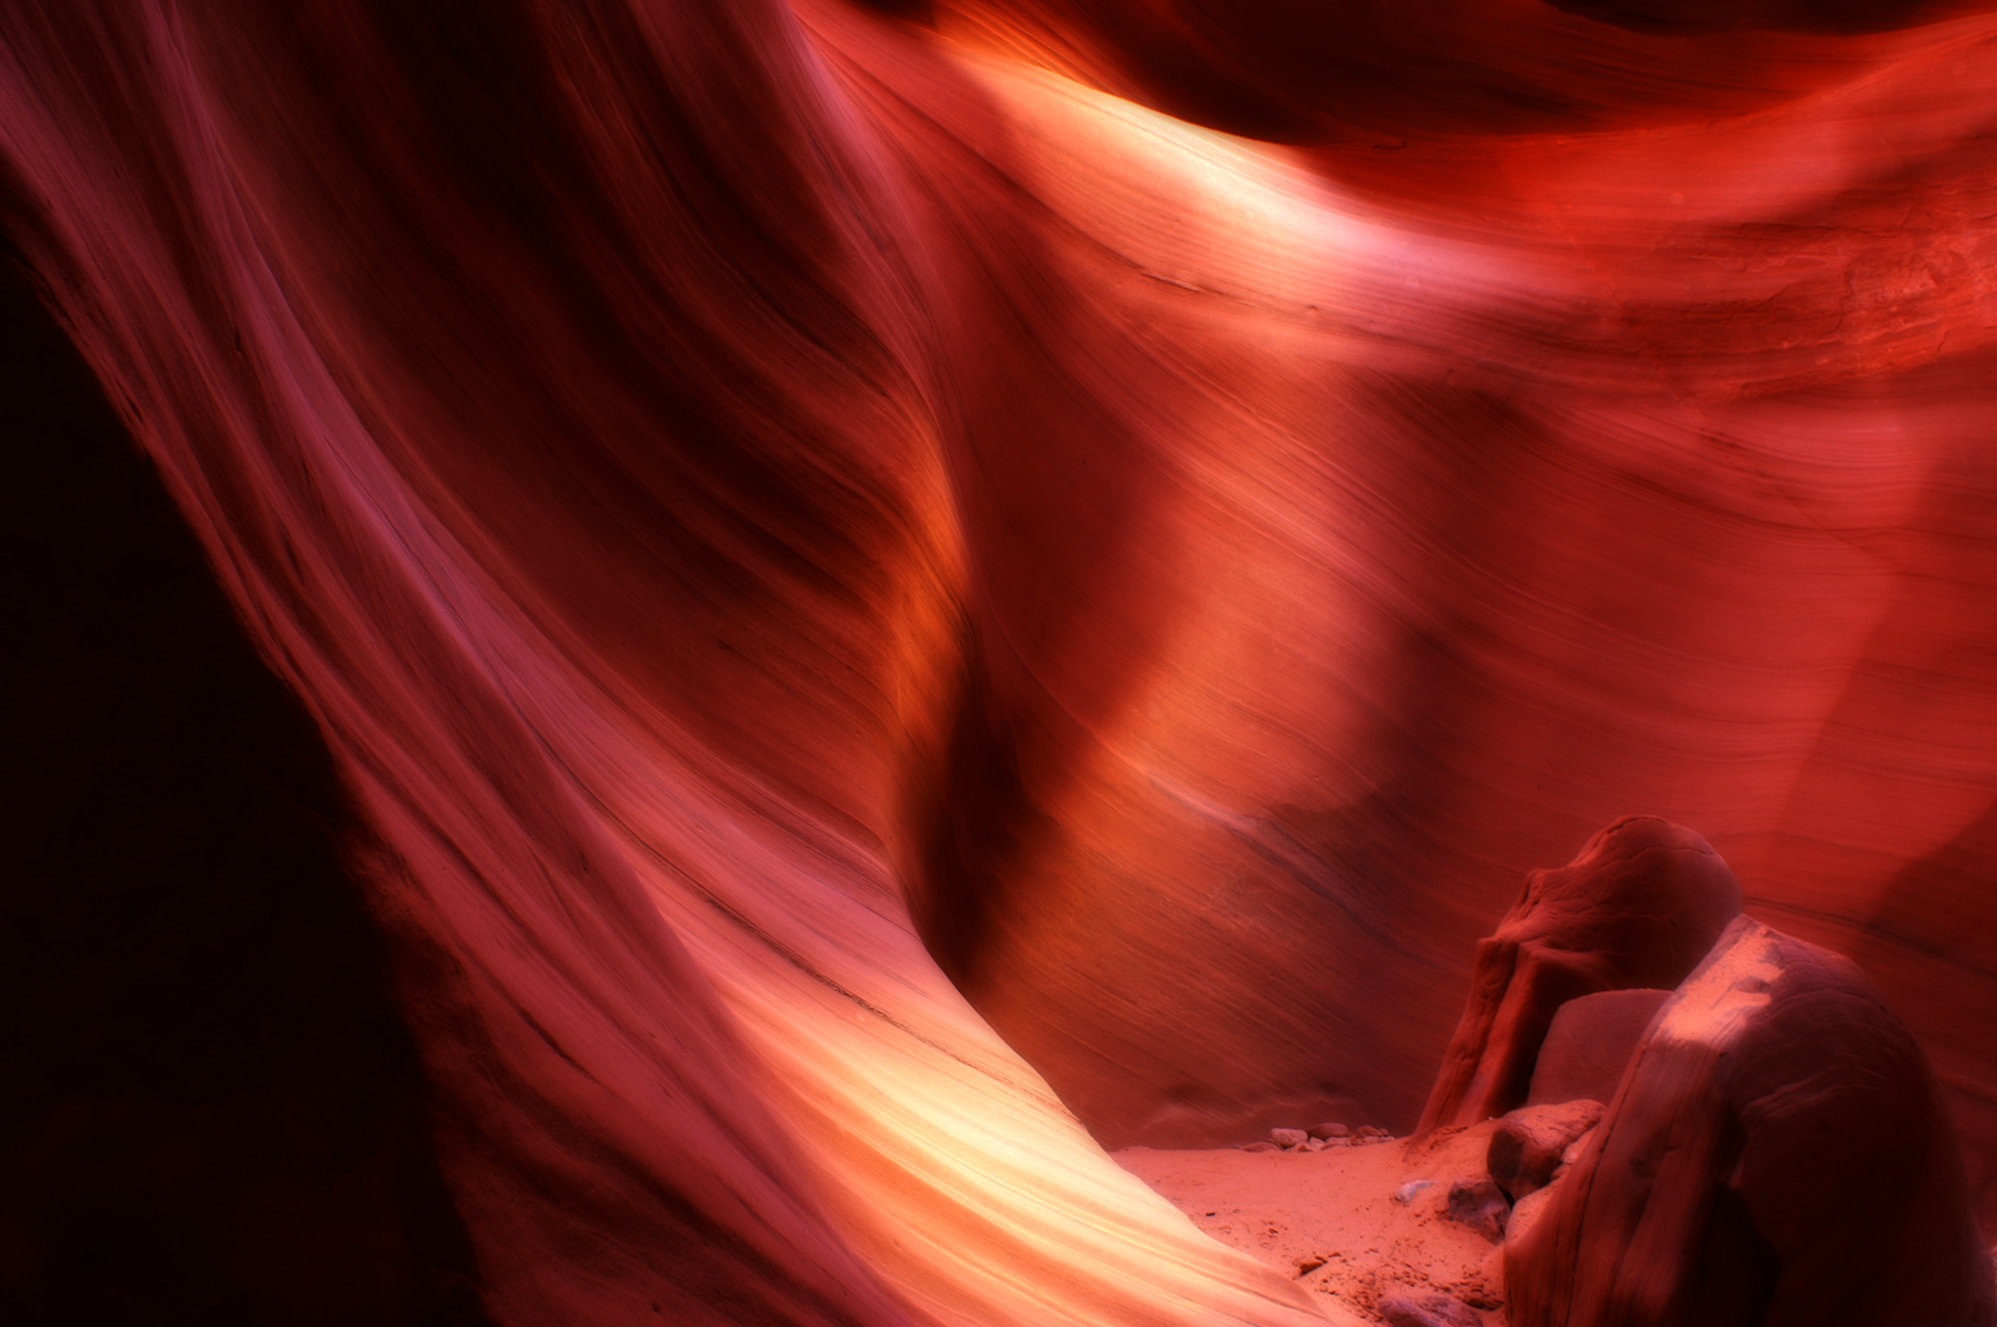
OTHER RESOURCES
Texture Sources:
www.shadowhousecreations.blogspot.com
https://freestocktextures.com/
www.textures.com
https://www.pexels.com/
Secondary Editing Software:
https://nikcollection.dxo.com/
https://topazlabs.com/
Heidi Walker
www.HIWalkerPhoto.com
Fotogirl.Heidi@gmail.com

