Slide 1
Manipulating Photos
In Photoshop

Slide 2
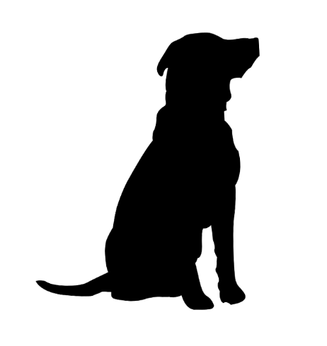
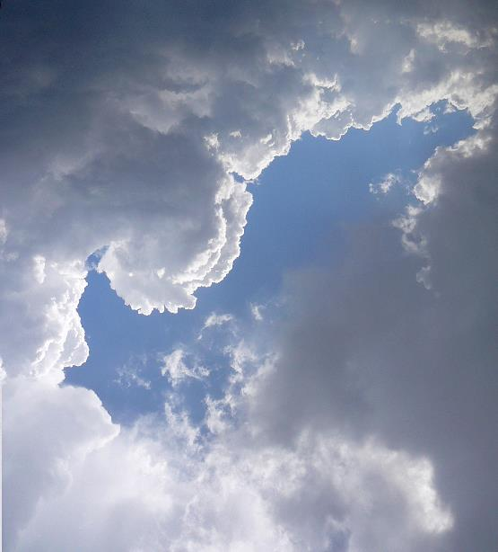
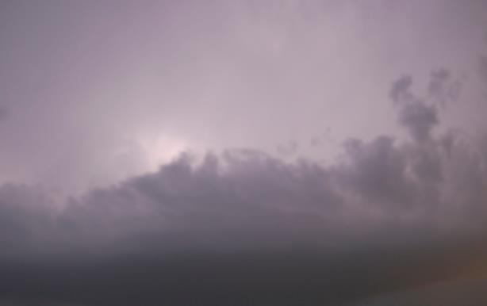
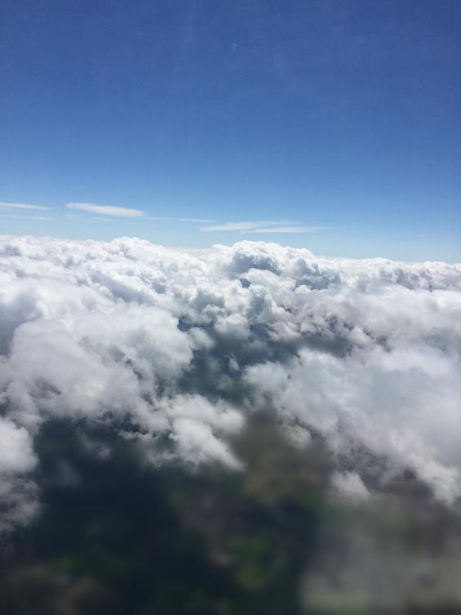
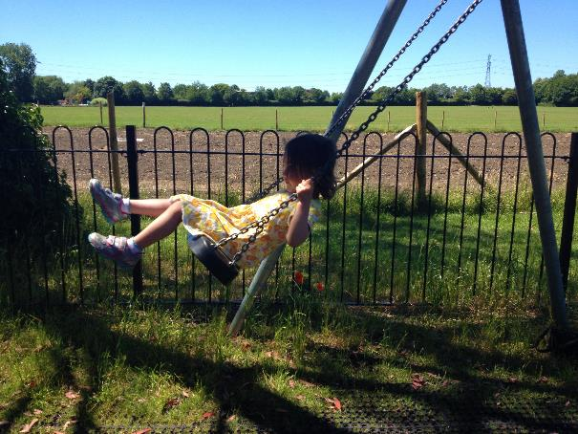
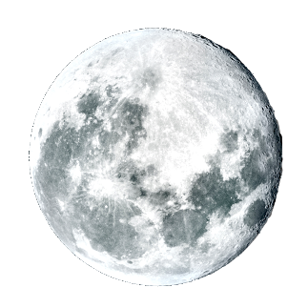
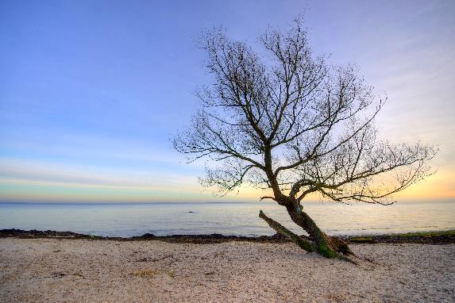
Turn Photos Into Silhouette Art
Gather photographs
Use your own photos
Use stock photos

Slide 3
Create a Background
Create a new document (Cmd/Ctrl+N) that is 8”x8” and 300dpi.
Select the Gradient tool (G), set to Linear, using colors R49, G250, B252 and R1, G193, B72
Save PSD (do this after each step)

Slide 4
Add The Floor
Select the Rectangular Marquee tool (M) and create a short rectangular selection across the bottom of the canvas.
Create a new layer and use the fill tool to fill the selection with black.
Press Cmd/Ctrl+D to deselect

Slide 5
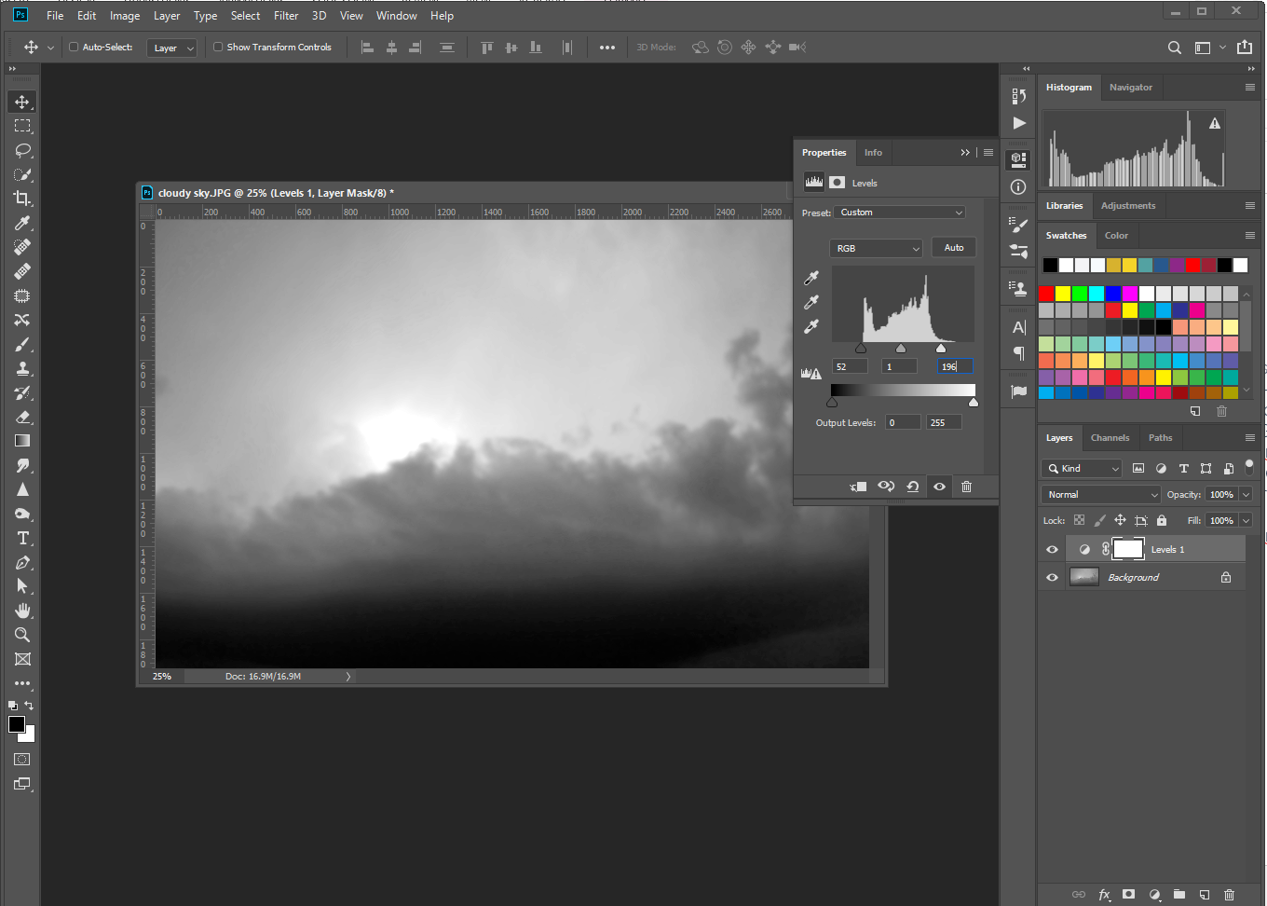
Bring In The Sky
Open cloudy sky.jpg.
Press Cmd/Ctrl+U, reduce Saturation to -100
Add a levels adjustment layer, move the sliders to Black: 52, Grey: 1.00, White: 196
Flatten layers
Press Cmd/Ctrol+A then Shift+Cmd/Ctrl+C to copy the image
In your background image, paste the clouds (Cmd/Ctrl+V)
Press Cmd/Ctrl+T to transform the image to fill the space

Slide 6
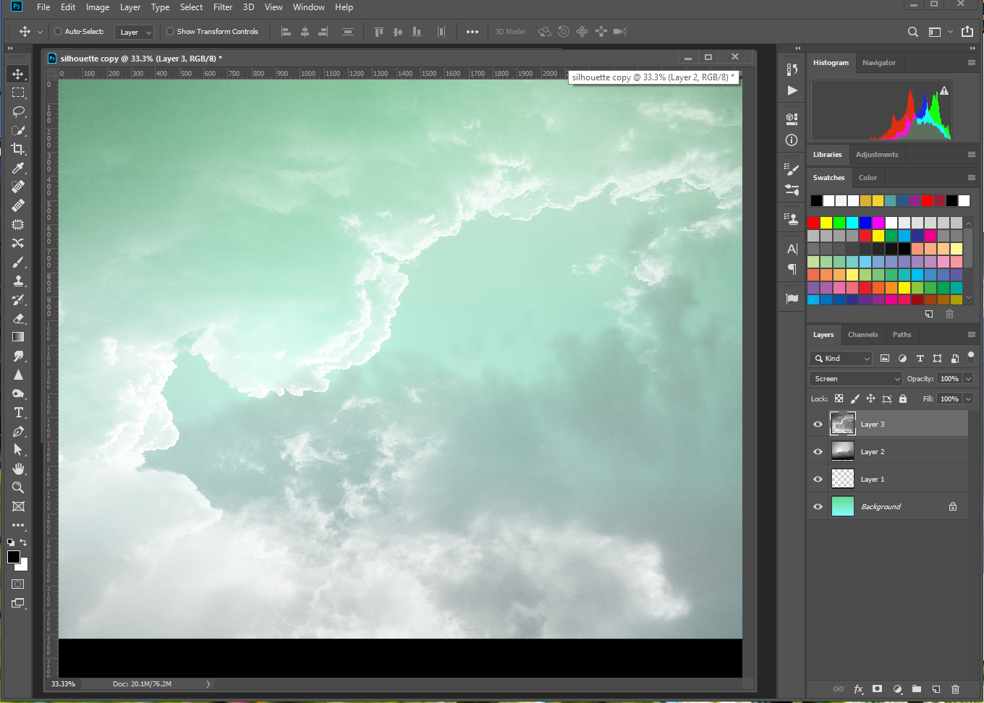
Add Some Clouds
Change the sky layer’s blending mode to Multiply and the opacity to 80%
Open fluffy clouds.jpg and press Cmd/Ctrl+U, change the saturation to -100
Copy and paste the image into your background
Resize to fit
Change blending mode to Screen

Slide 7
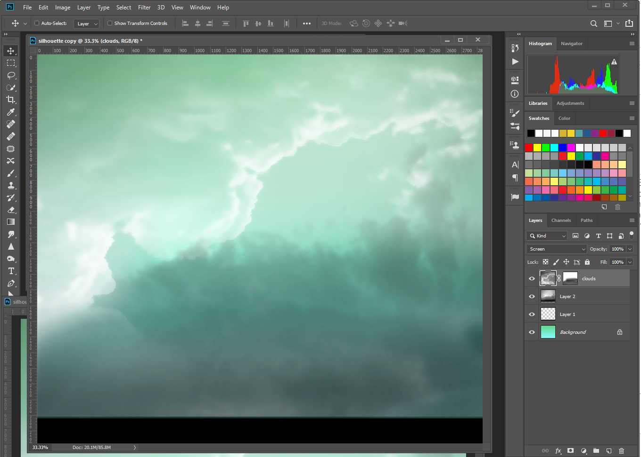
Blur and Mask
Go to Filter>Blur>Surface Blur; enter Radius: 18 and Threshold: 53, click OK
Add a layer mask and use a black brush at 75% opacity to gradually hide most of the bottom third of the layer

Slide 8
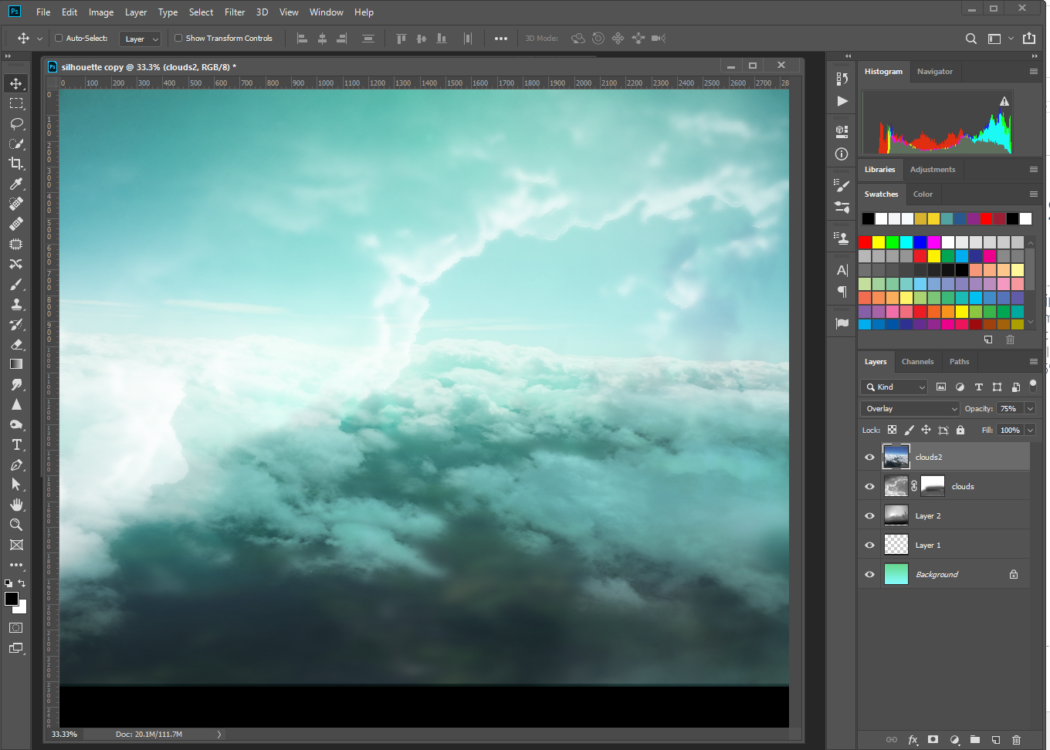
Bring In More Clouds
Open clouds.jpg, copy then past into the background image
Resize it to fit the space
Change the blending mode to Overlay and Opacity to 75%

Slide 9
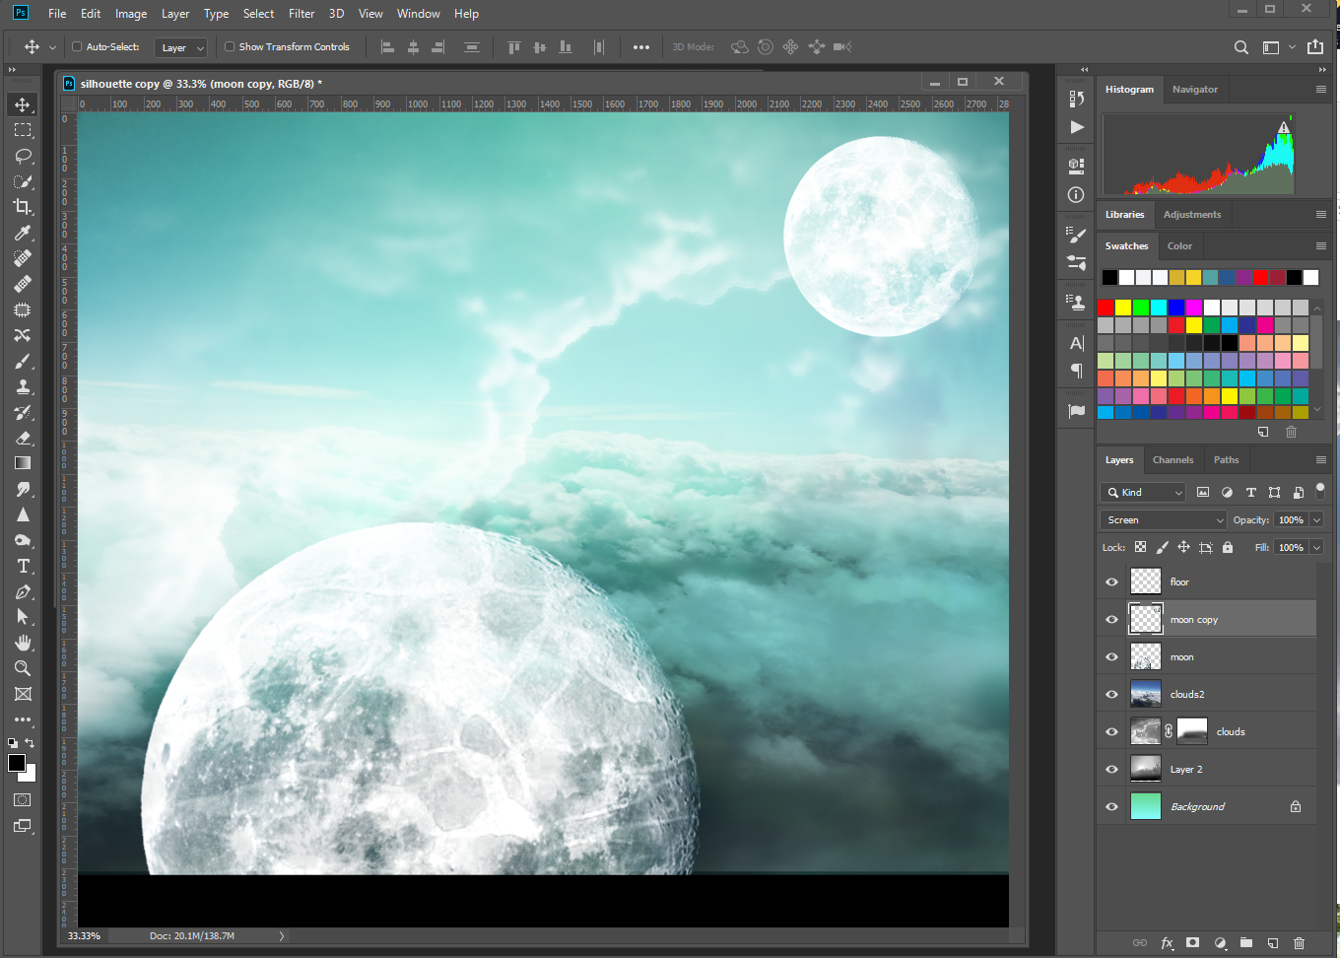
Bring In The Moon
Open the moon.png and copy/paste it into the background image
Change the blending mode to Screen
Transform and resize it, then move to the bottom of the artwork as shown
Duplicate the moon layer, make it smaller, and move it to the top right corner of the artwork

Slide 10
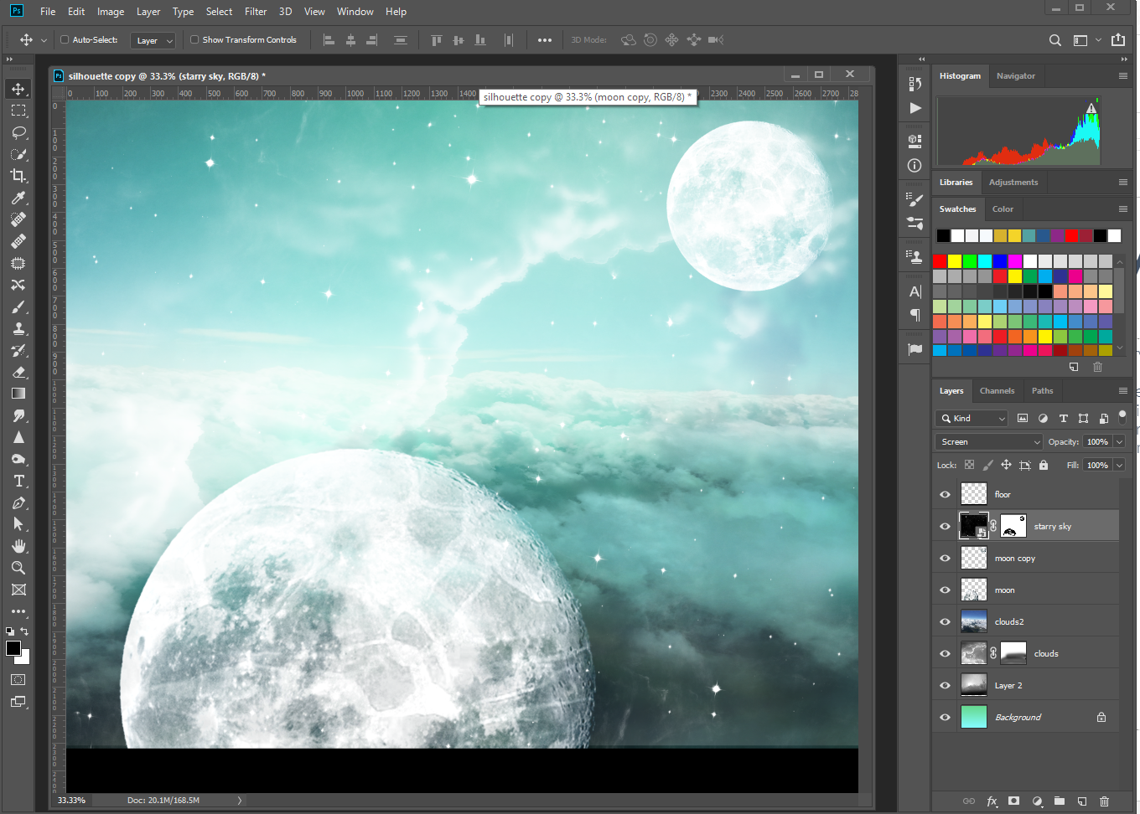
Make A Starry Sky
Open starry sky.png, copy/paste it into the artwork
Change the blending mode to Screen
Resize to fill the background
Add a layer mask and use a black brush to hide the stars on the moon

Slide 11
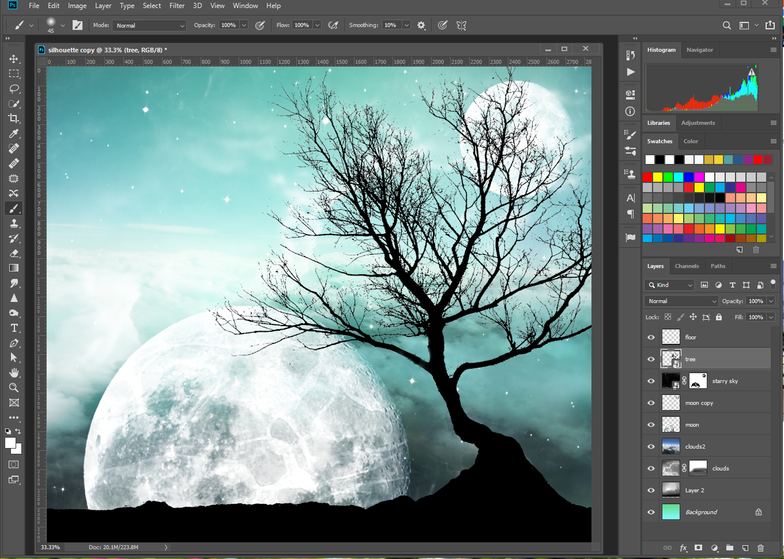
Create A Tree Silhouette
Open tree.psd
Press Cmd/Ctrl+U, reduce Saturation to -100
Press Cmd/Ctrl+L and move the sliders to Black: 120, Grey: 1.00, White: 122
Go to Select>Color Range, click the white background to select, click ok, and then press backspace to delete it
Use the Eraser tool (E) to remove the lower branches
Use the brush tool (B) with black to paint in any gaps on the tree and add an extra section on the left side of the base of the trunk
Copy and paste the tree into the artwork; change size, angle and position

Slide 12
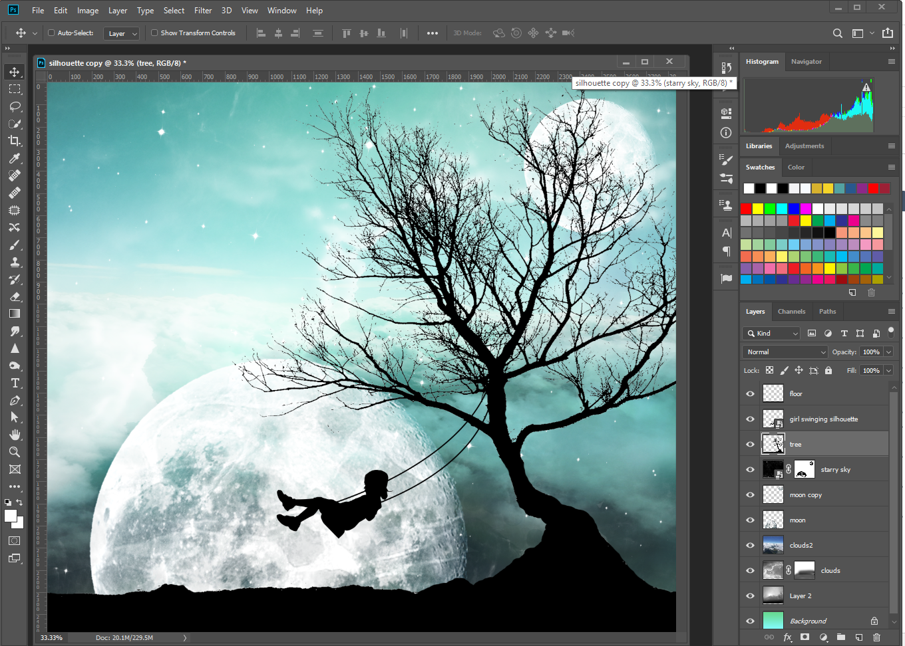
Take A Swing
Open girl swinging.jpg
Create a mask around the girl
Add a solid color adjustment layer, making it black and clipping it to the girl layer
Select both layers and convert the layers to a shape
Copy/paste the girl into the artwork
Resize girl silhouette and position under tree branch
Create a new layer
Use the pen tool to create a path from the swing to the branch
Select the brush tool with a black round hard-edged brush, size 10px
In the Paths palette, click the Stroke Path With Brush icon
Repeat the process to create a second rope

Slide 13
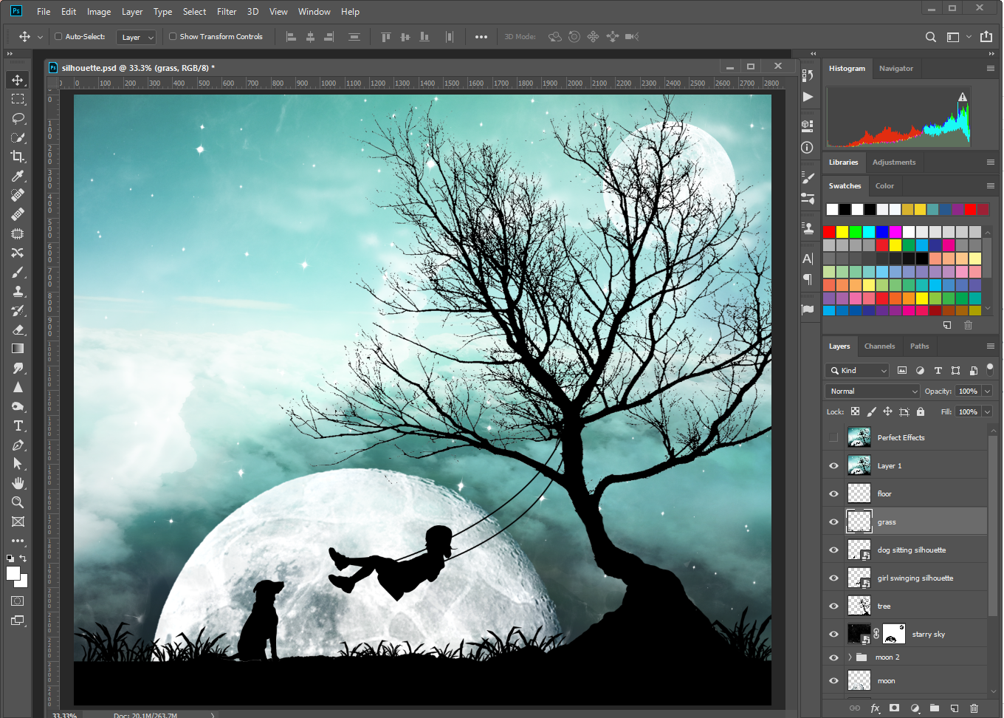
Add Dog
Open dog sitting silhouette.png, copy/paste it into the artwork
Resize and position
Create a new layer and use a brush to draw in clumps of grass
Add any other finishing touches you wish

Slide 14
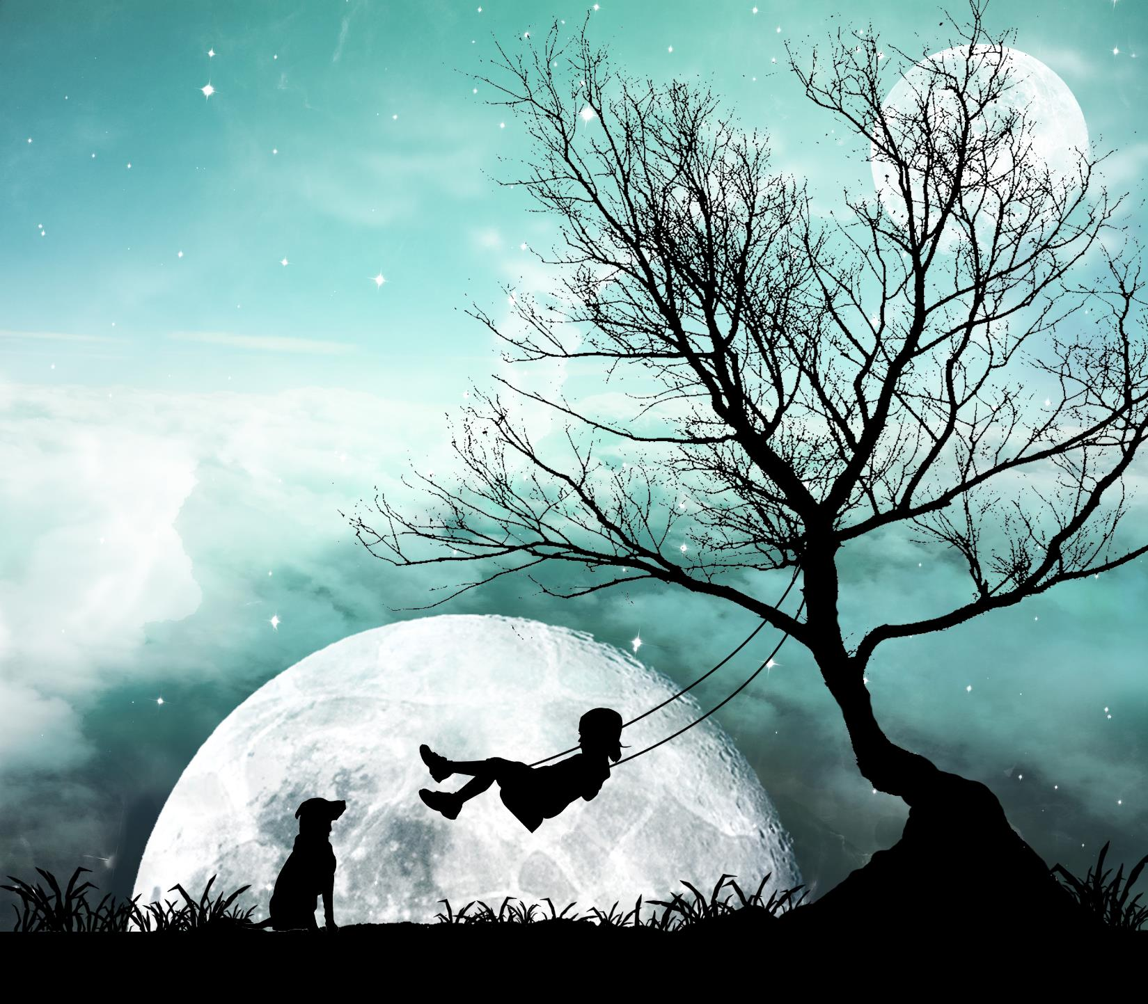
Final Image

Slide 15
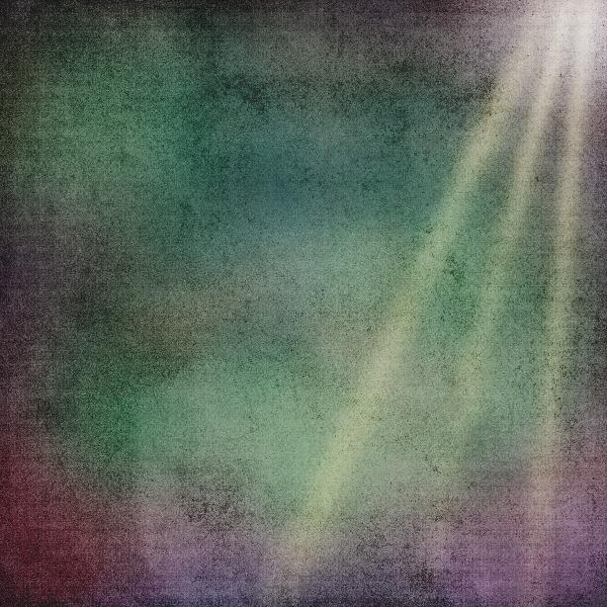
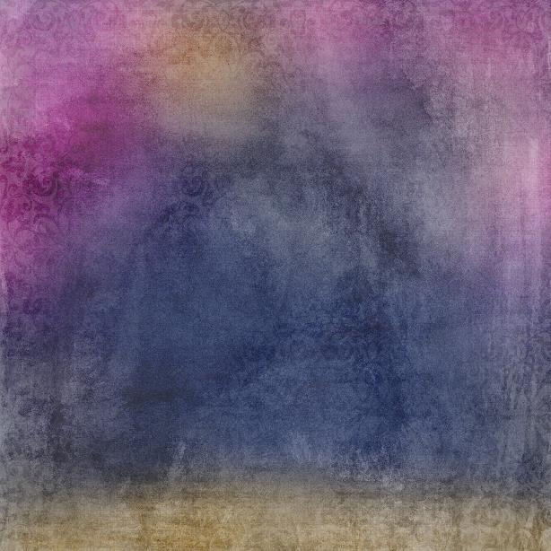
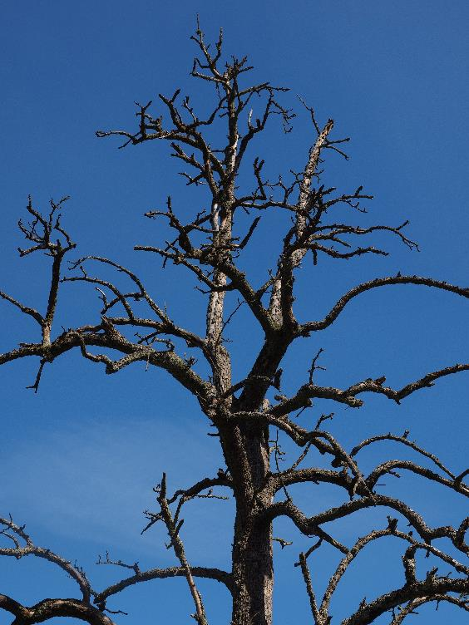
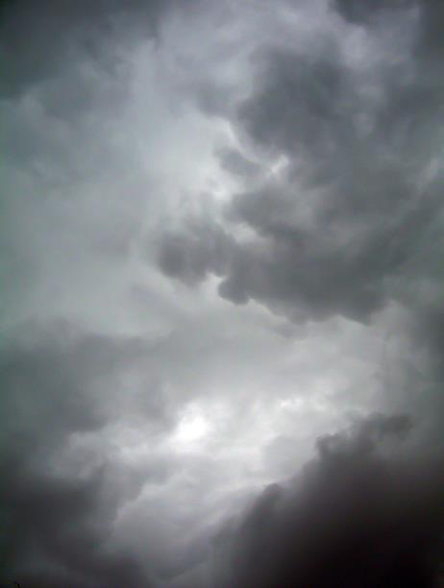
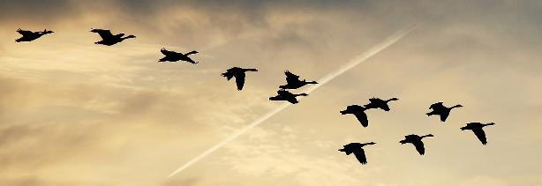
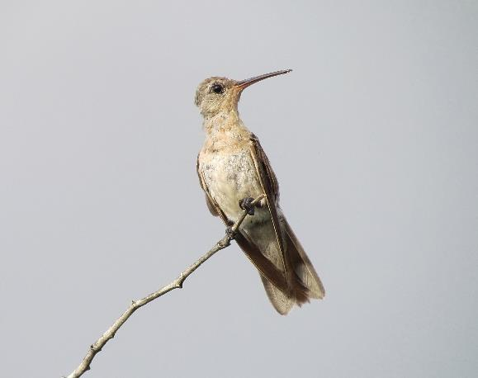
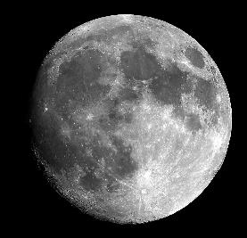
Wall Art
Gather photographs
Use your own photos
Use stock photos
Find a quote or poem you wish to use

Slide 16
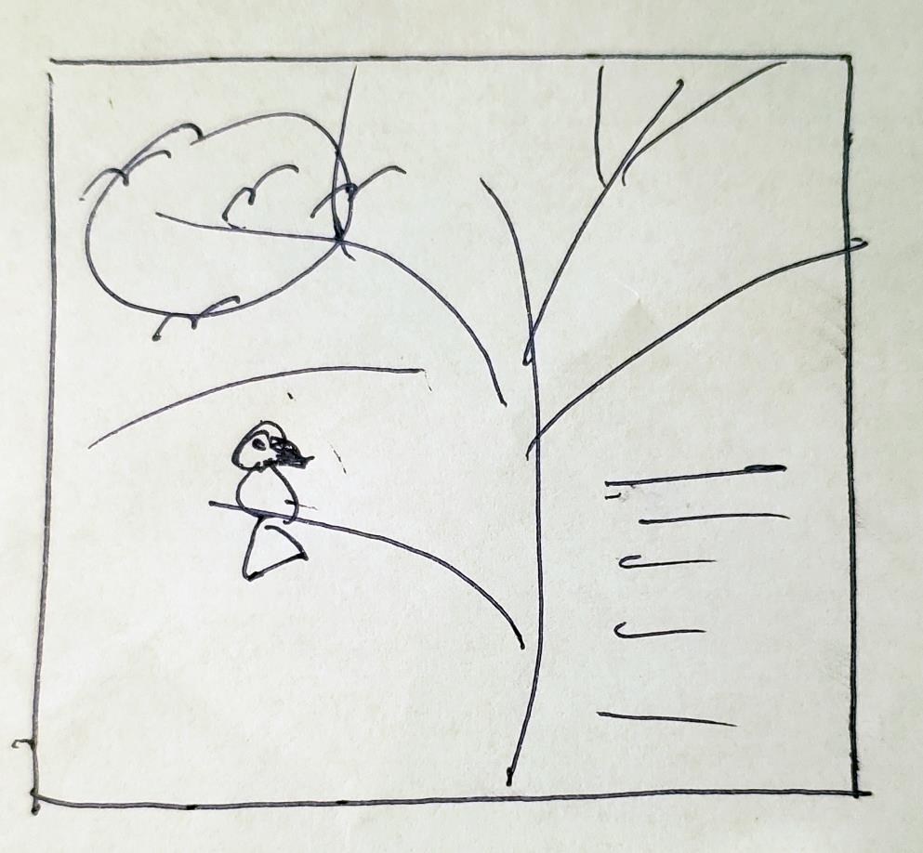
Planning
Sketch out your design on paper

Slide 17
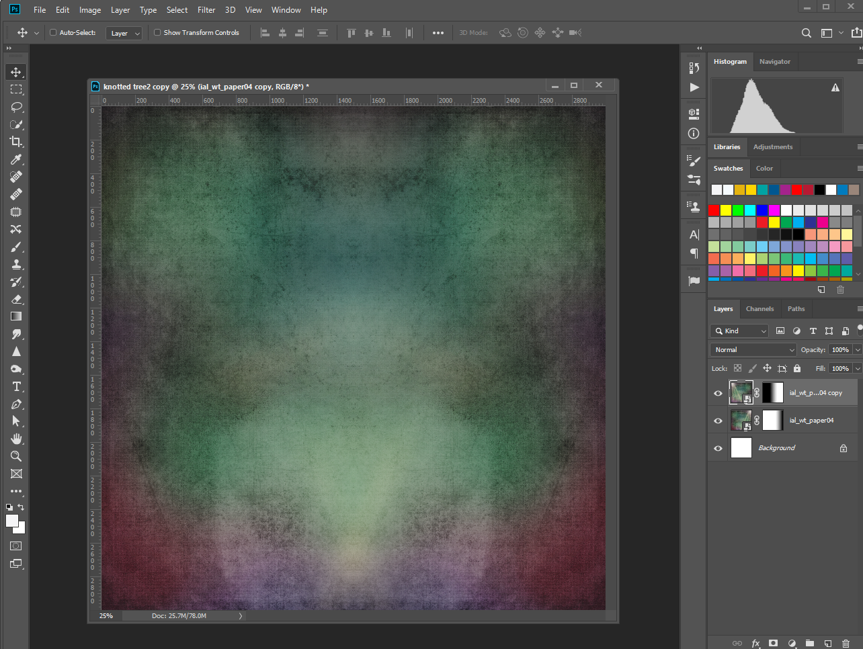
Background Image
Create your image size in Photoshop
For print, use inches instead of pixels
Set at 300 dpi for print resolution
Save as a PSD image to preserve all layers (be sure to save your work as you do each step)
Place the background image and apply gradient mask (duplicate and flip to fill space, if necessary)

Slide 18
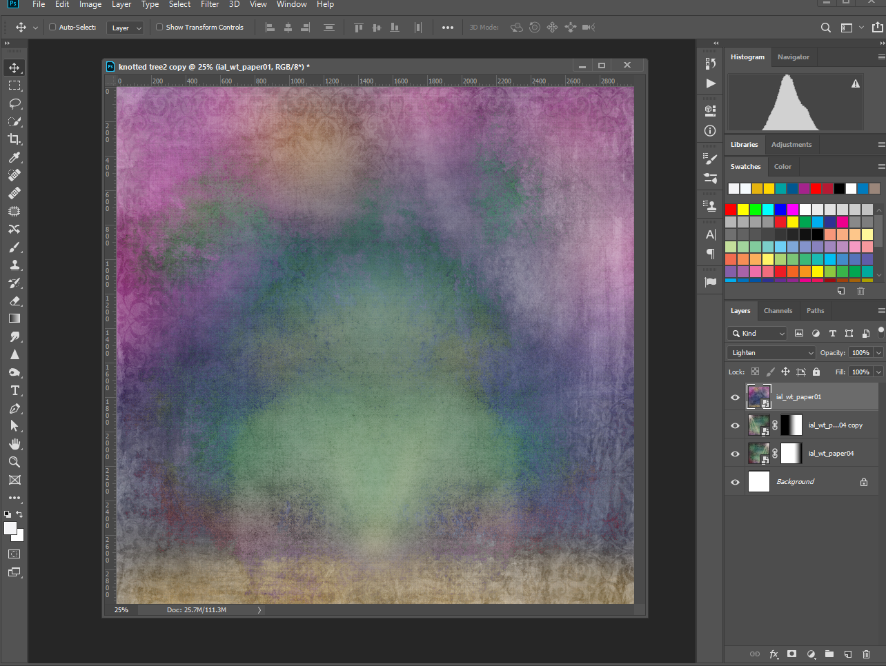
Additional Background
Add additional background, change blending mode to lighten

Slide 19
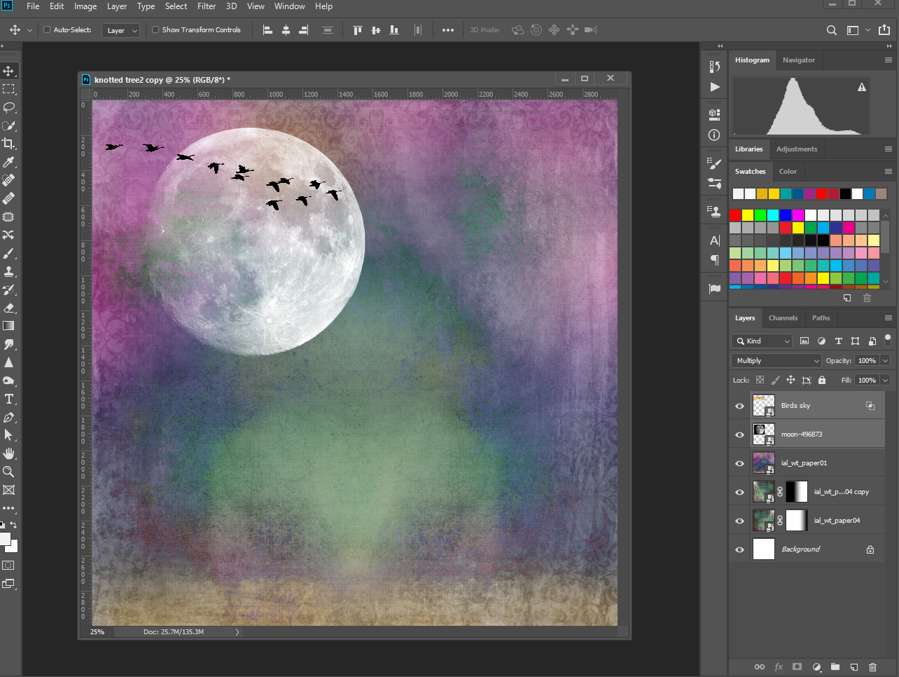
The Moon And Birds
Place Moon image; change blending mode to screen
Place bird silhouette image; change blending mode to multiply
Go into the blending mode options and slide markers to remove any remaining light background

Slide 20
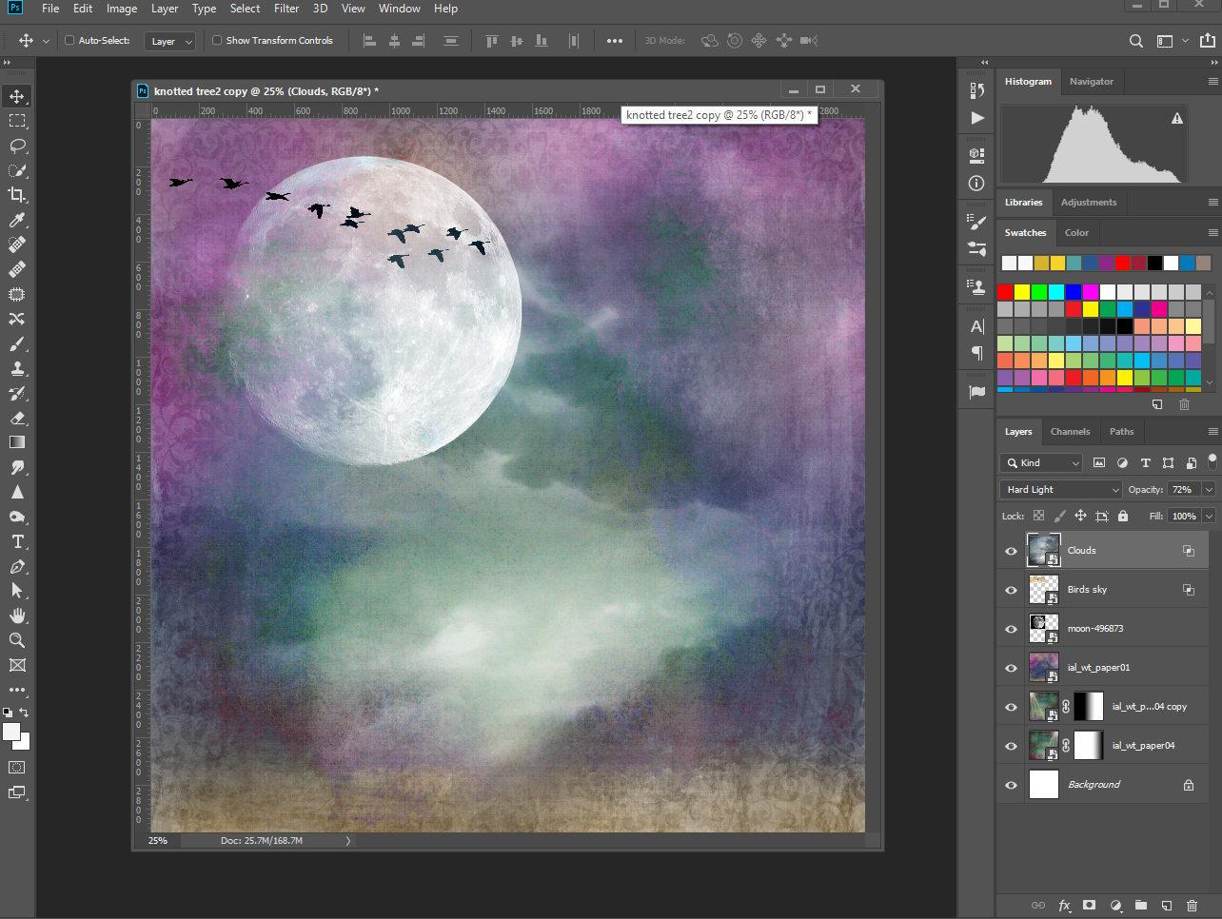
Adding Clouds
Add clouds image, change blending mode to hard light and opacity to 72%
Go into the blending mode options and slide markers to remove darker background

Slide 21
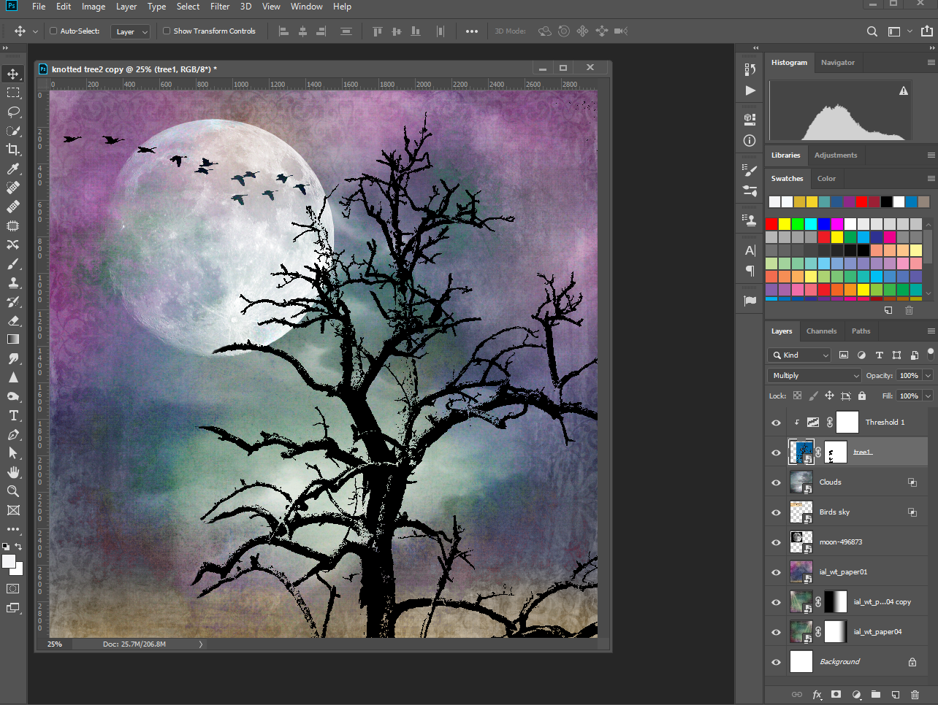
Placing The Tree
Place tree image; add mask to remove background edges using a soft brush; change blending mode to multiply
Add a threshold adjustment layer and clip it to the tree image; adjust levels to create a silhouette

Slide 22
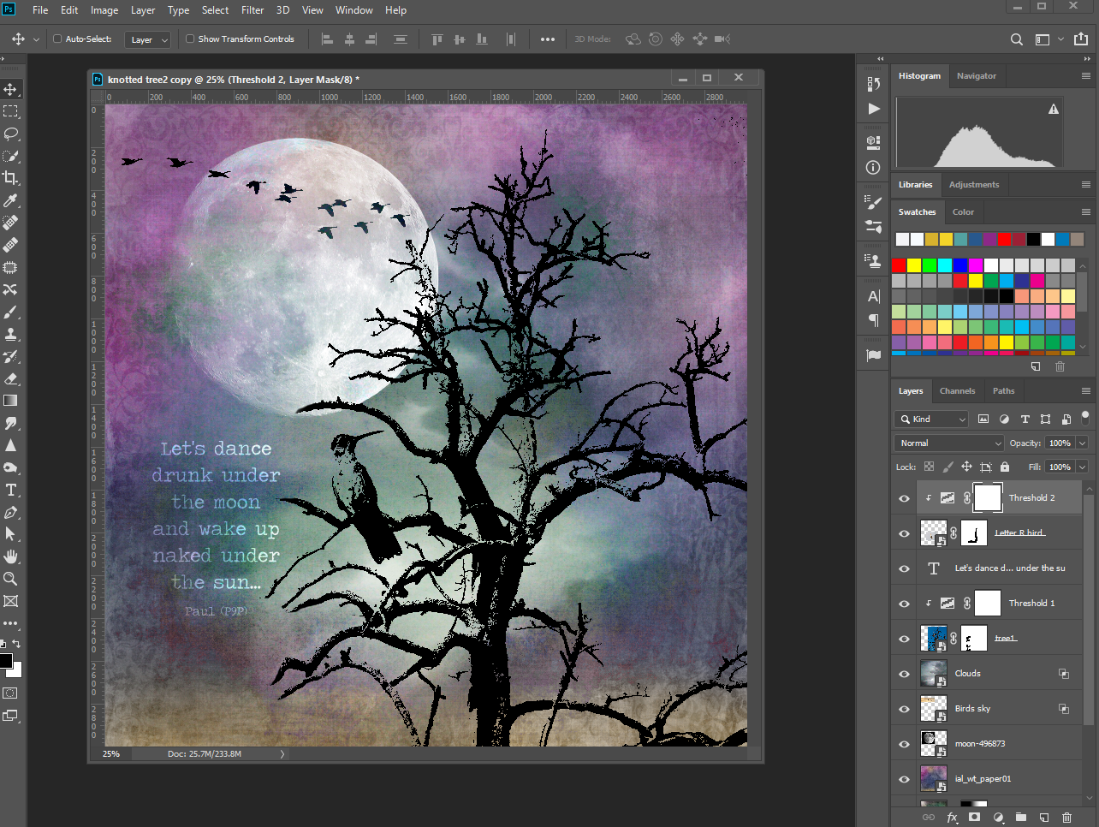
Adding Another Bird & Text
Add text of your choice in any font/color
Add bird image and mask out background
Add a threshold adjustment layer and clip it to the bird image; adjust levels to create a silhouette

Slide 23
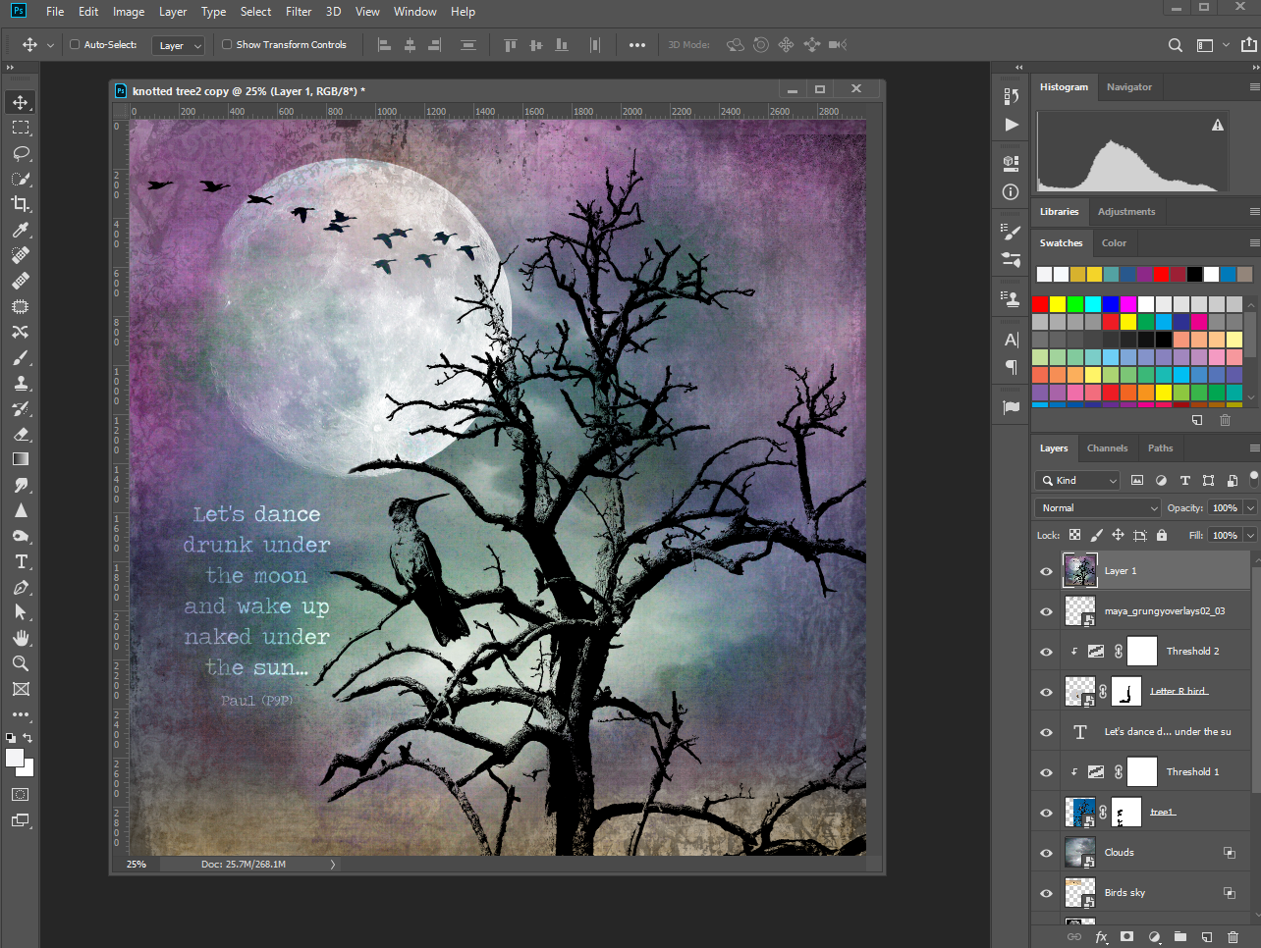
Grunge Up The Edges
Add grunge edges image and set opacity to your desired percentage
Control+Alt+E to create a new layer of everything visible
If desired, use On1 effects to further enhance the new piece of art
Save image as a .jpg and upload to favorite printing company

Slide 24
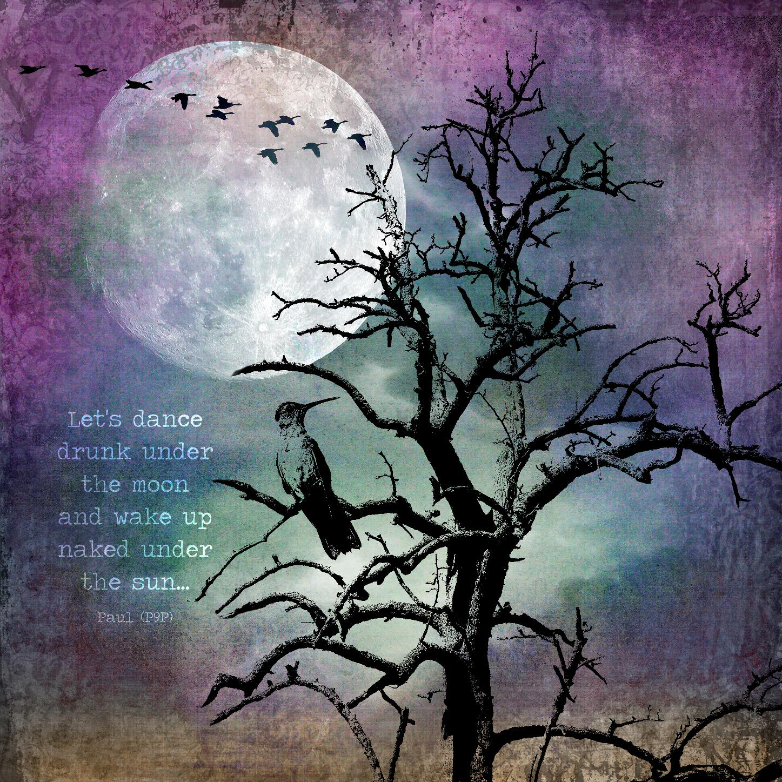
Final Image

Slide 25
https://unsplash.com
https://www.pexels.com/

Slide 26
GET IT IN TOUCH
Seattle Photography Committee
Anita L. Elder, Chair
Phone: (206) 832-1036
Cell: (206) 330-8124
anita@anitaelder.com
Social Media
facebook.com/groups/SeattleMtnPhoto/
flickr.com/groups/mountaineersphotography/

