Slide 1
Flowering Shrubs
East of the Cascade Crest

Slide 2
Practice Identifying these shrub species.
Use Washington Wildflower Search (Cle Elm or Ellensburg Area, 3500-4500 ft Elevation, and mid-June time period) – These are all Shrubs
Use Burke Museum UW Burke Herbarium image collection.
Use Books to flower Shrubs of East of the Cascade Crest
In Powerpoint, change to Outline View and the answers will be in the outline window.
Openoffice.org should give a free way of opening powerpoints.

Slide 3
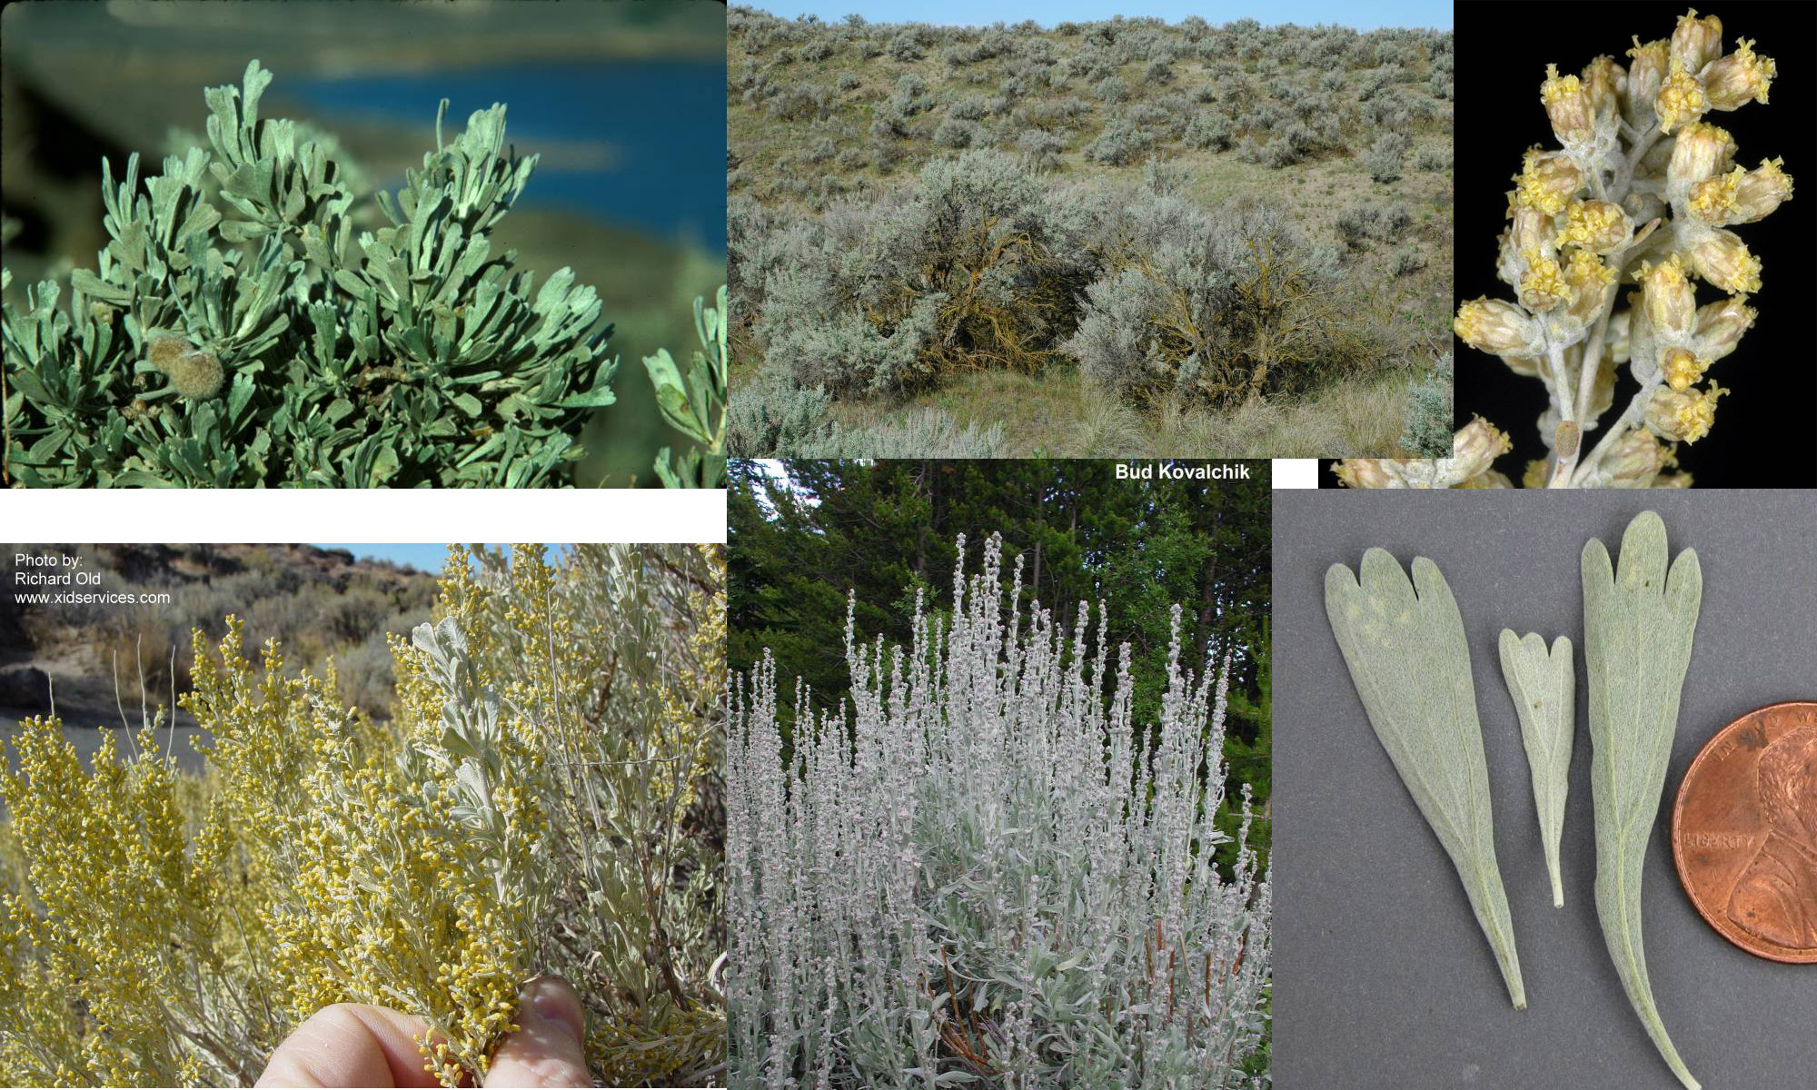
Big Sagebrush – Sunflower Family

Slide 4
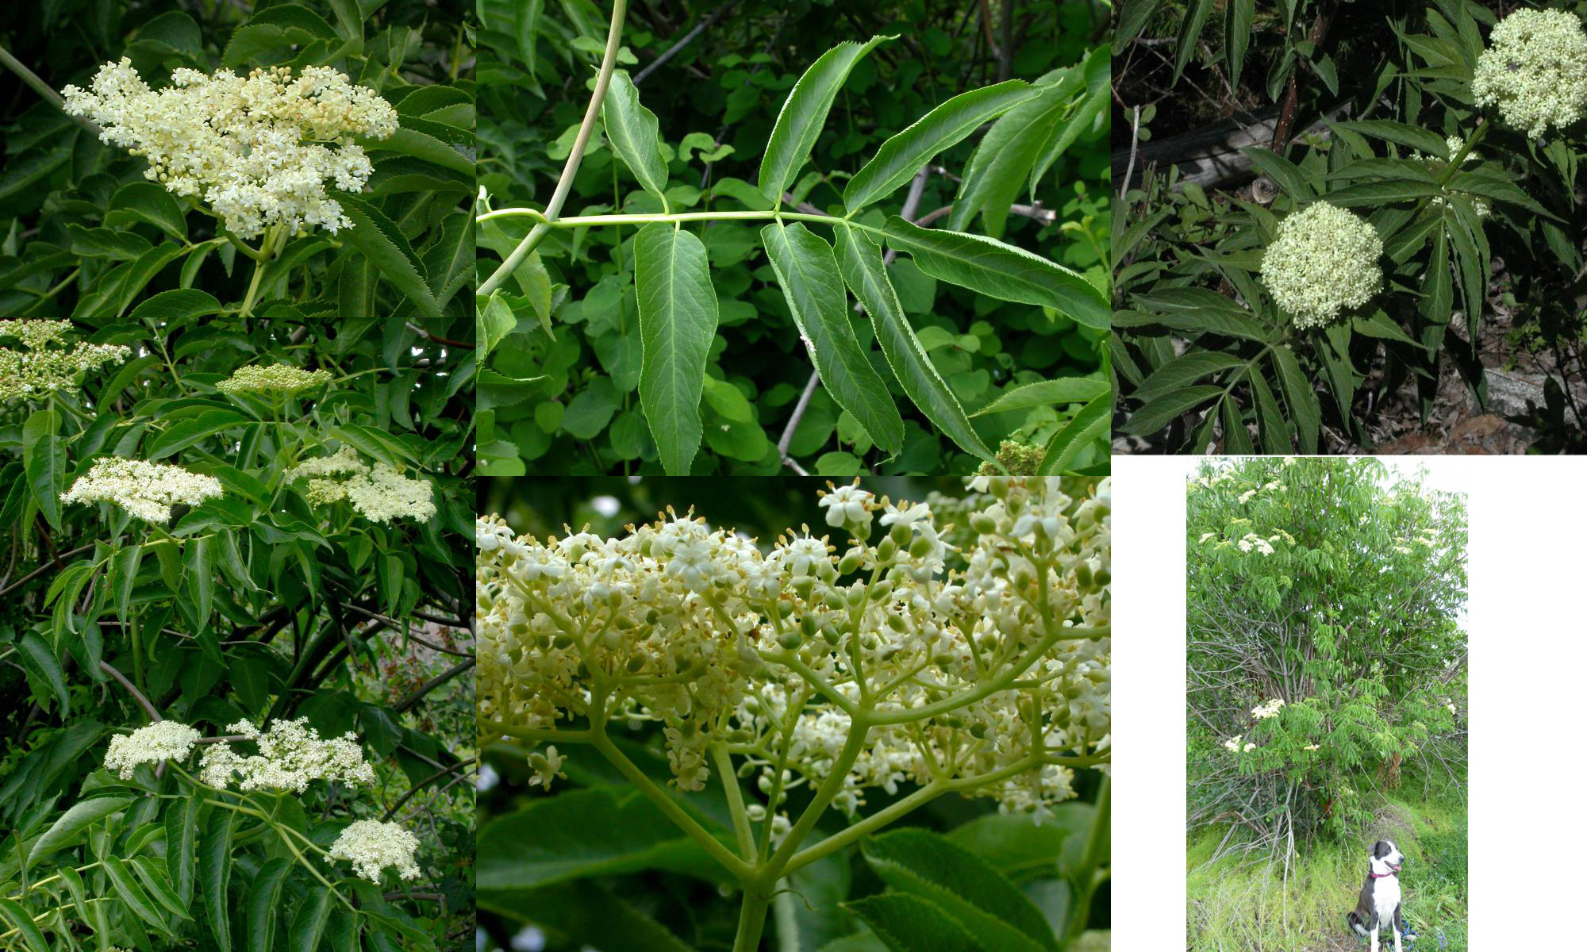
Blue Elderberry – Honeysuckle Family

Slide 5
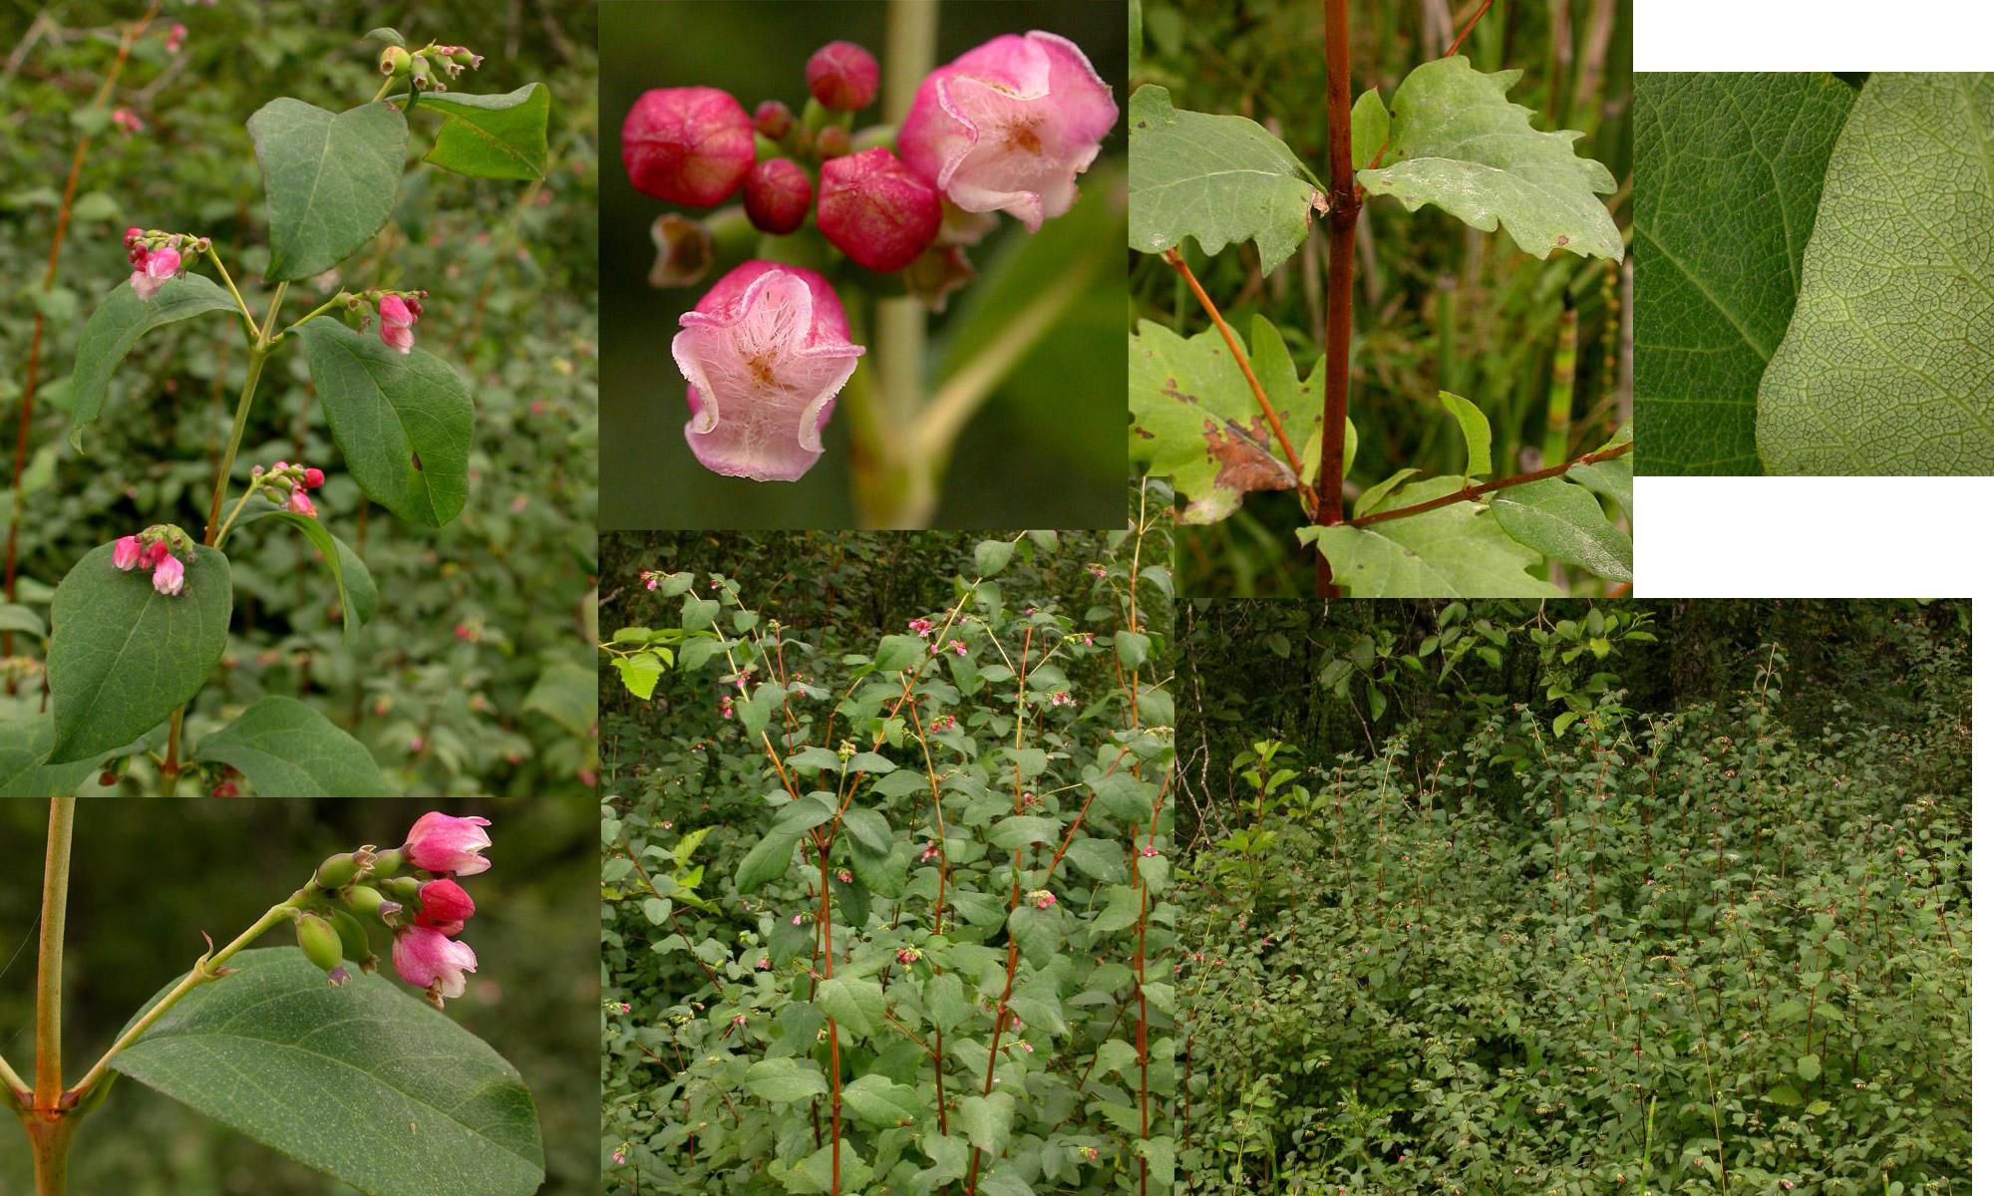
Common Snowberry – Honeysuckle Family

Slide 6
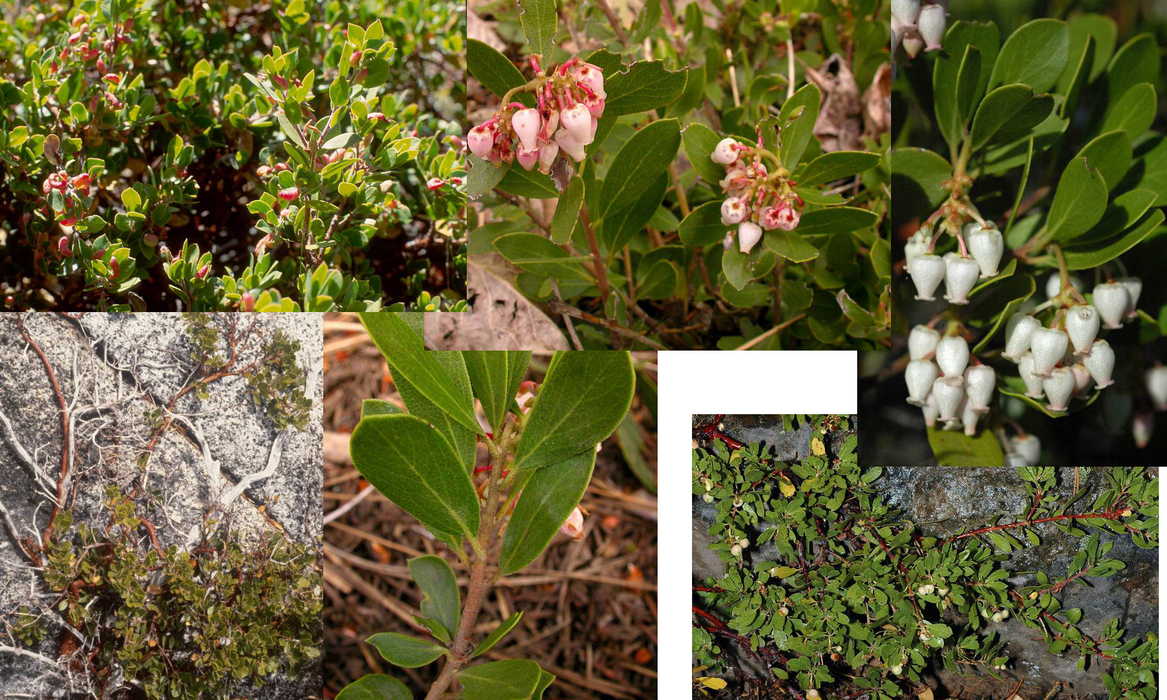
Kinnikinnik – Heath Family

Slide 7
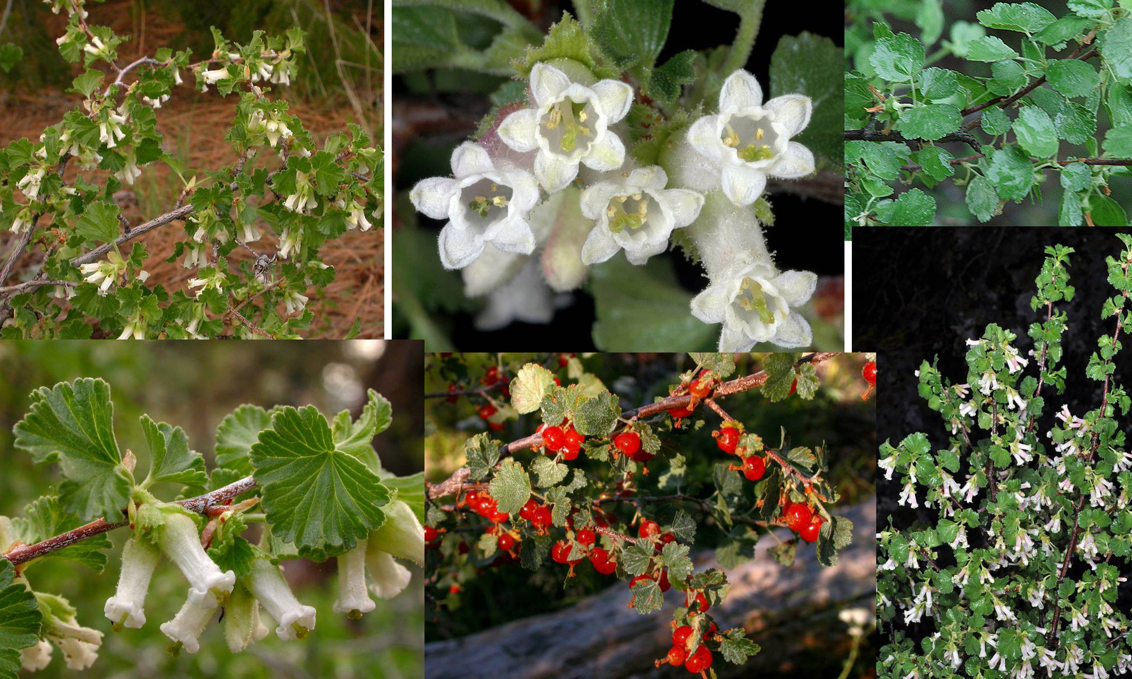
Wax Currant – Currant Family

Slide 8
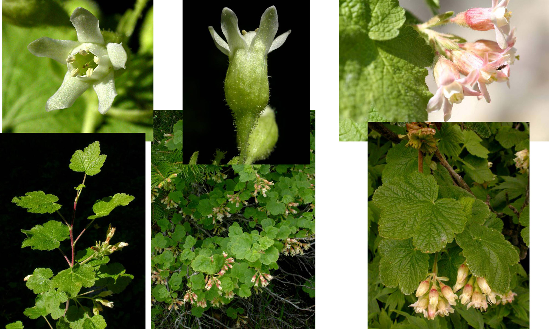
Sticky Currant – Currant Family

Slide 9
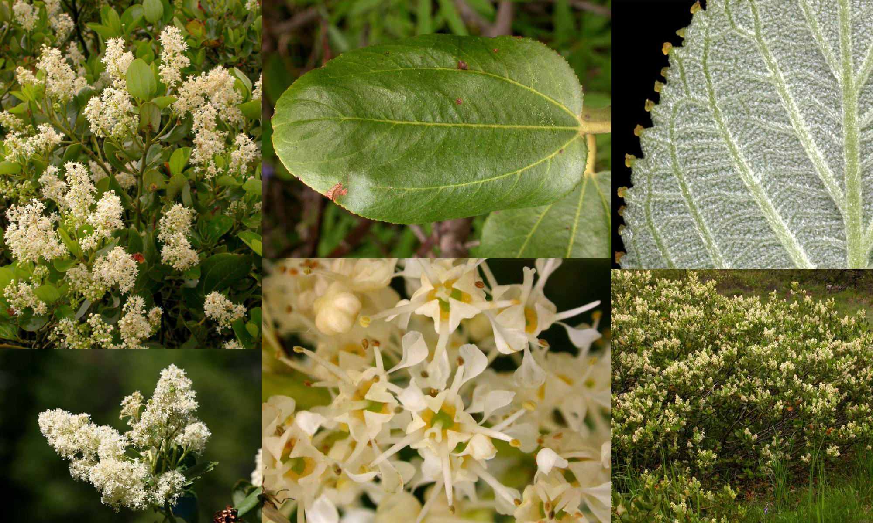
Snowbrush or Ceanothus – Buckhorn Family

Slide 10
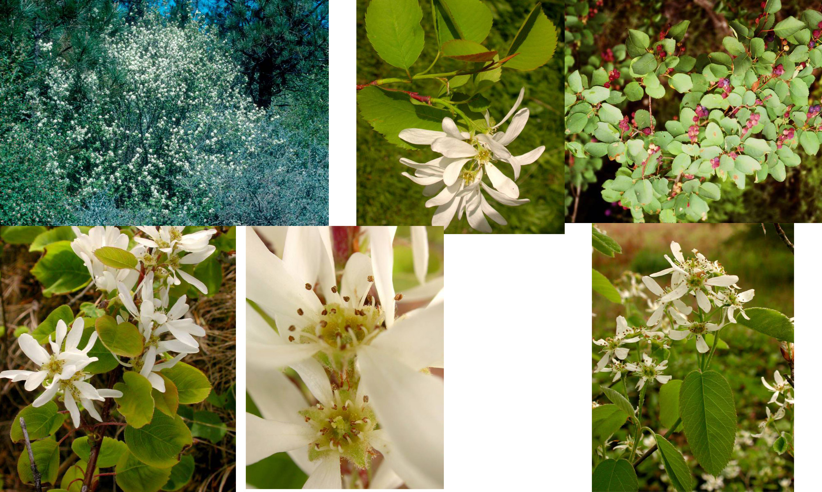
Serviceberry – Rose Family

Slide 11
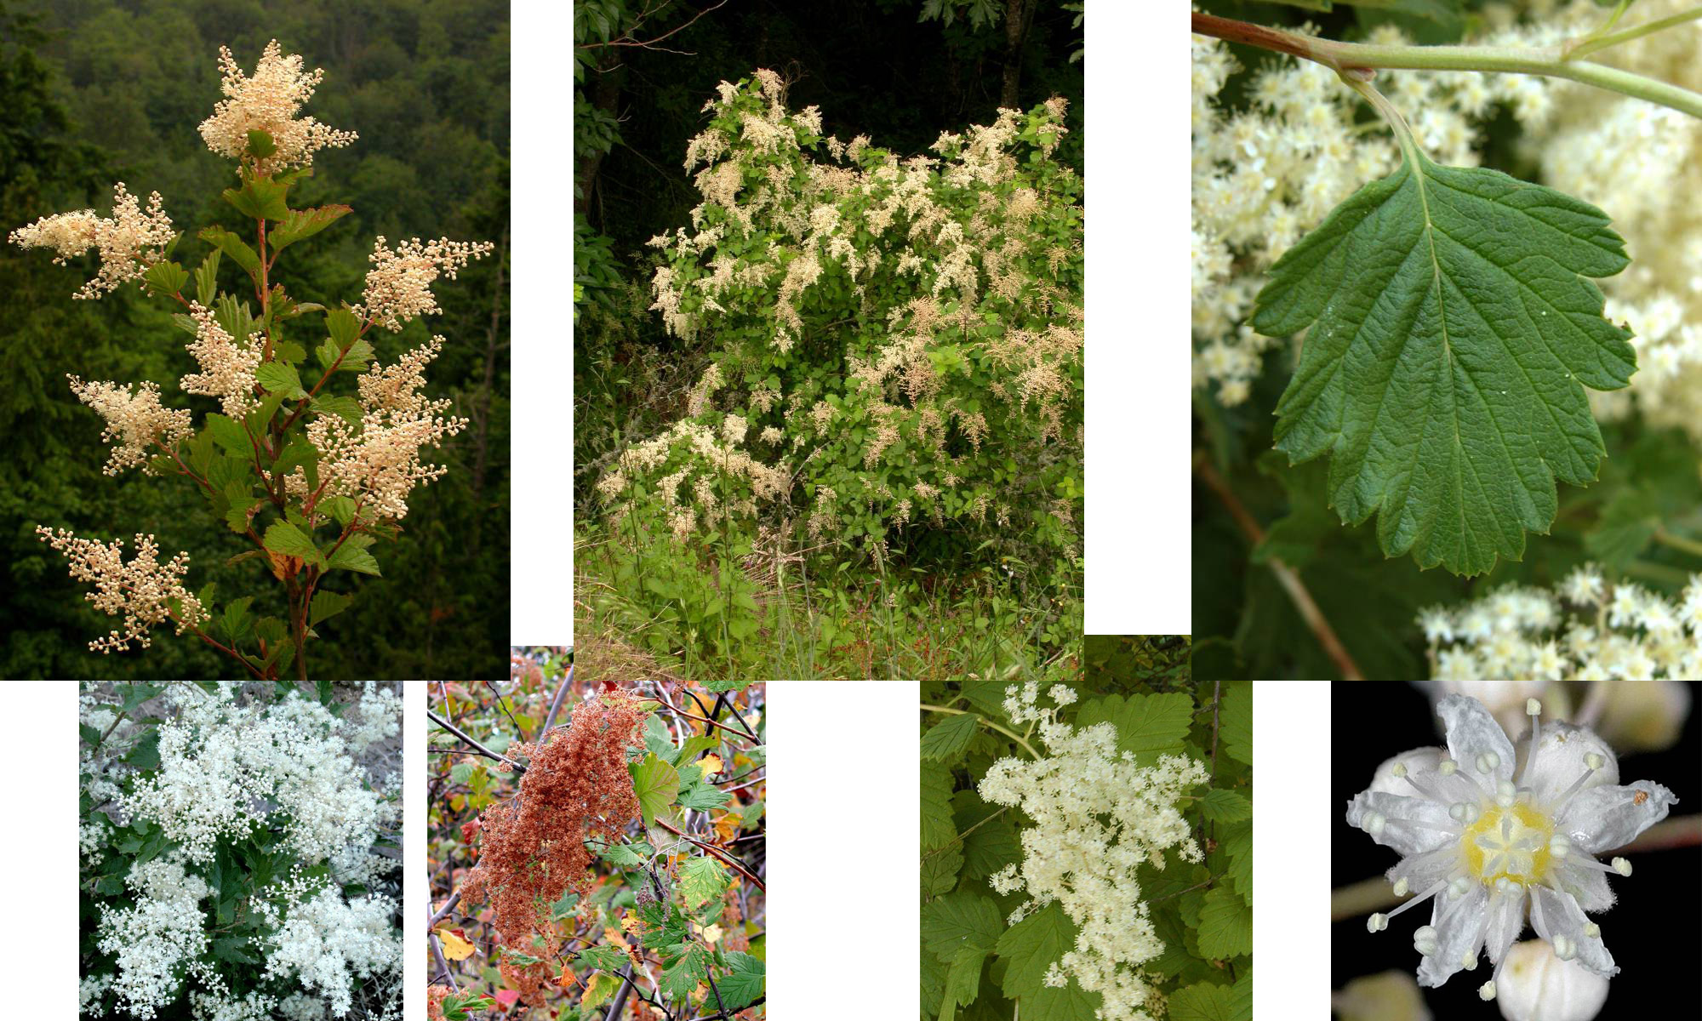
Ocean Spray – Roae Family

Slide 12
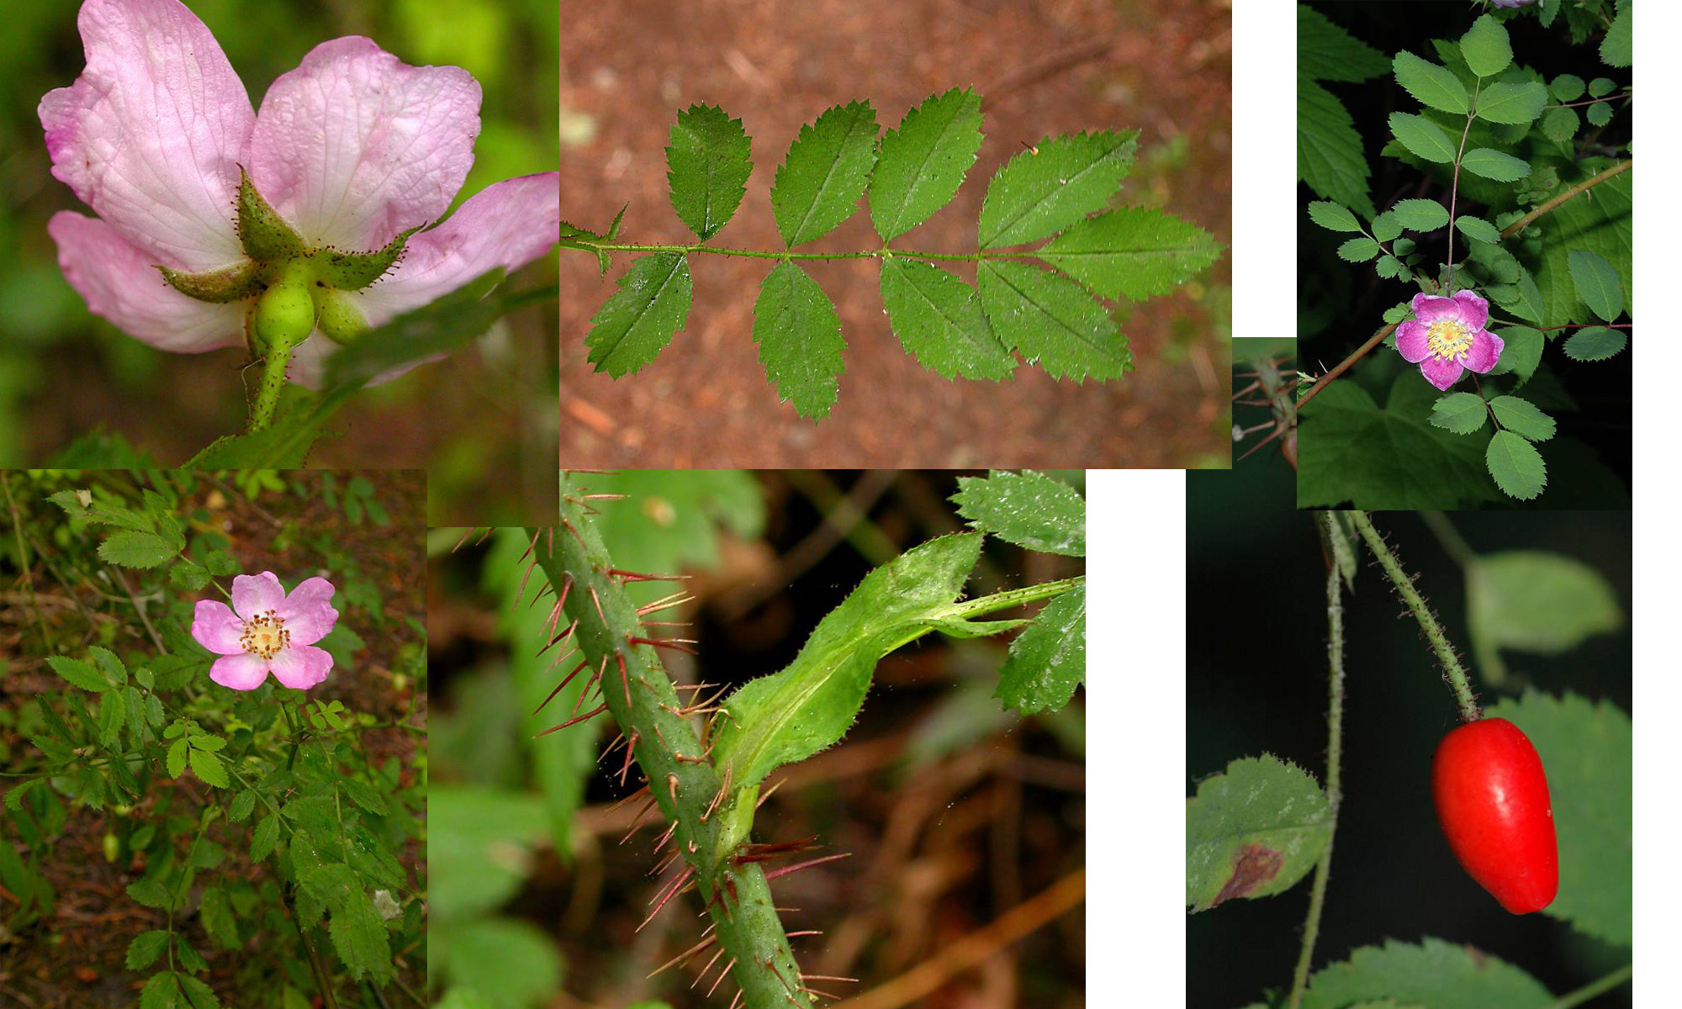
Baldhip Rose – Rose Family

Slide 13
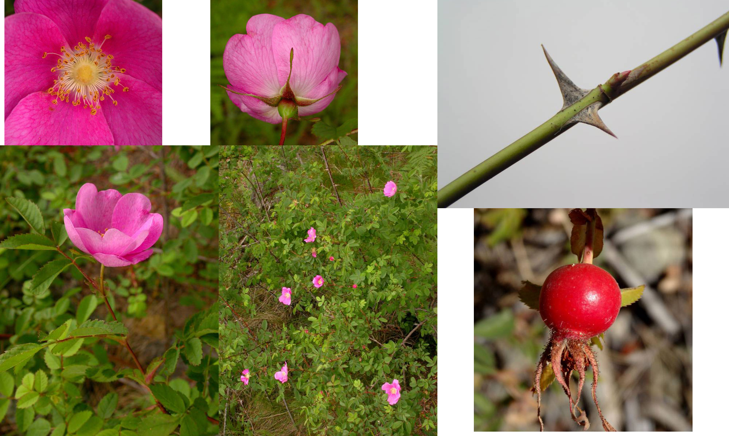
Nootka Rose – Rose Family

Slide 14
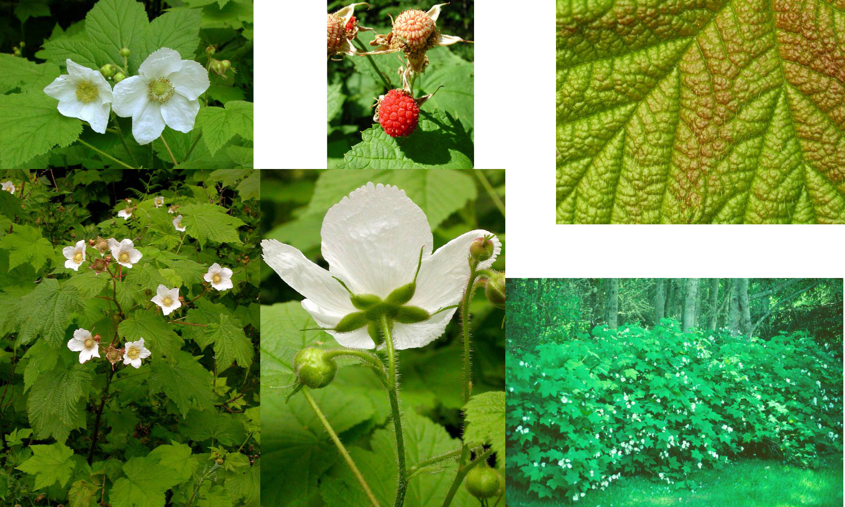
Thimbleberry – Rose Family

Slide 15
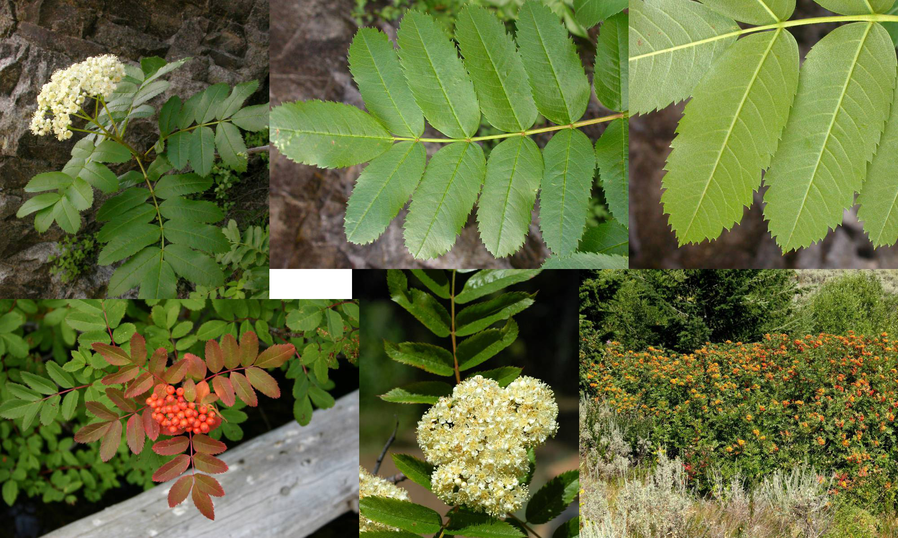
Cascade mountain-Ash – Rose Family

Slide 16
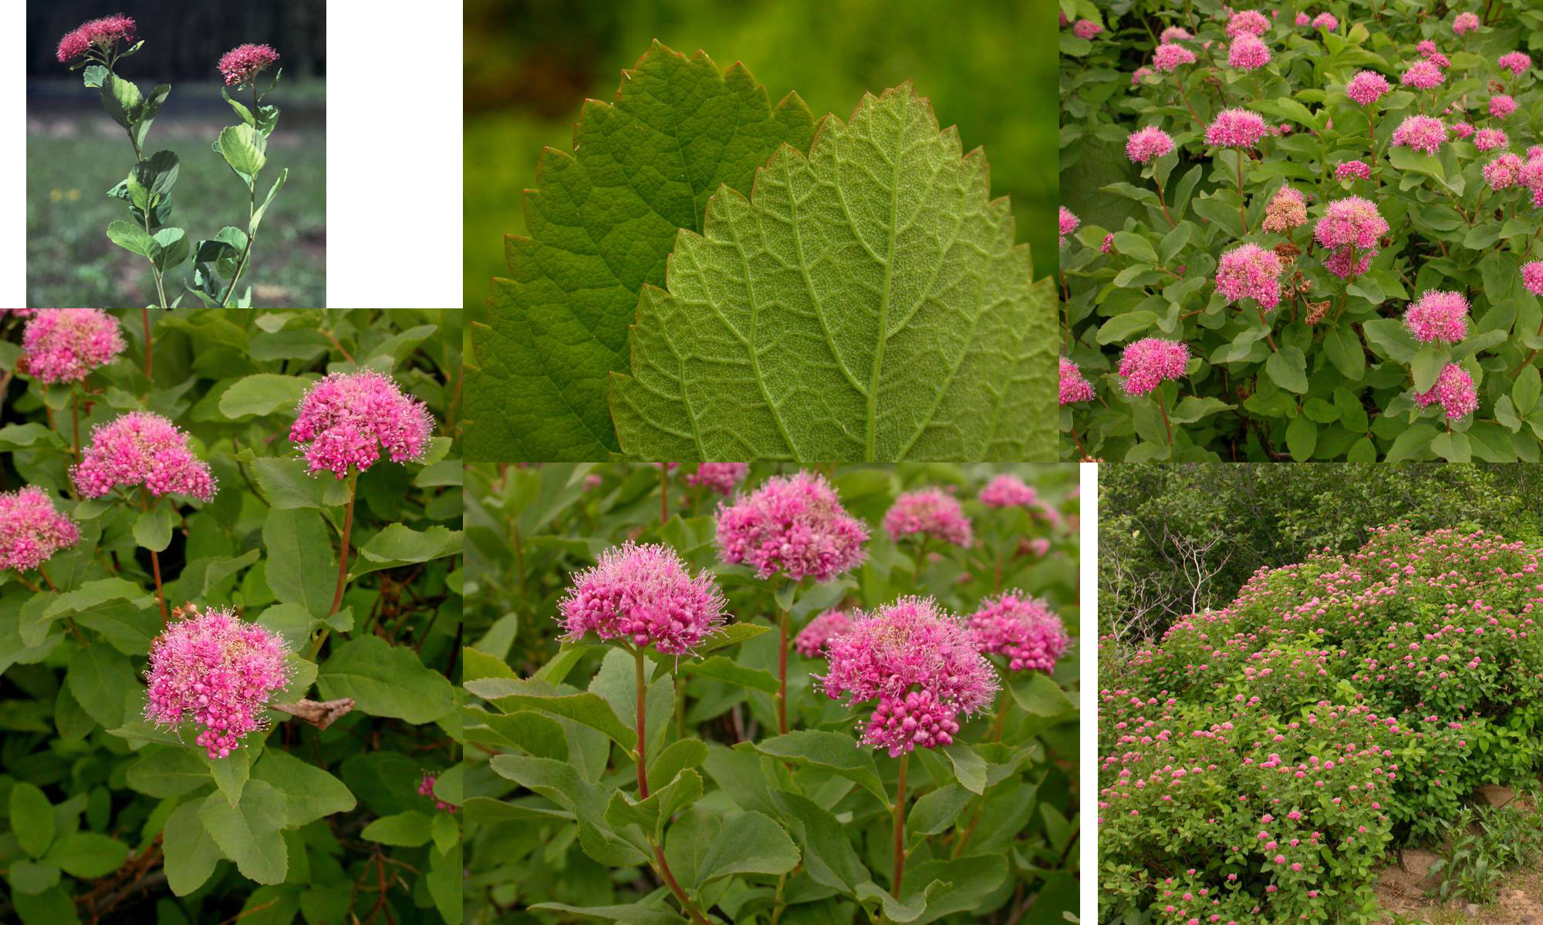
Subalpine Spirea – Rose Family

Slide 17
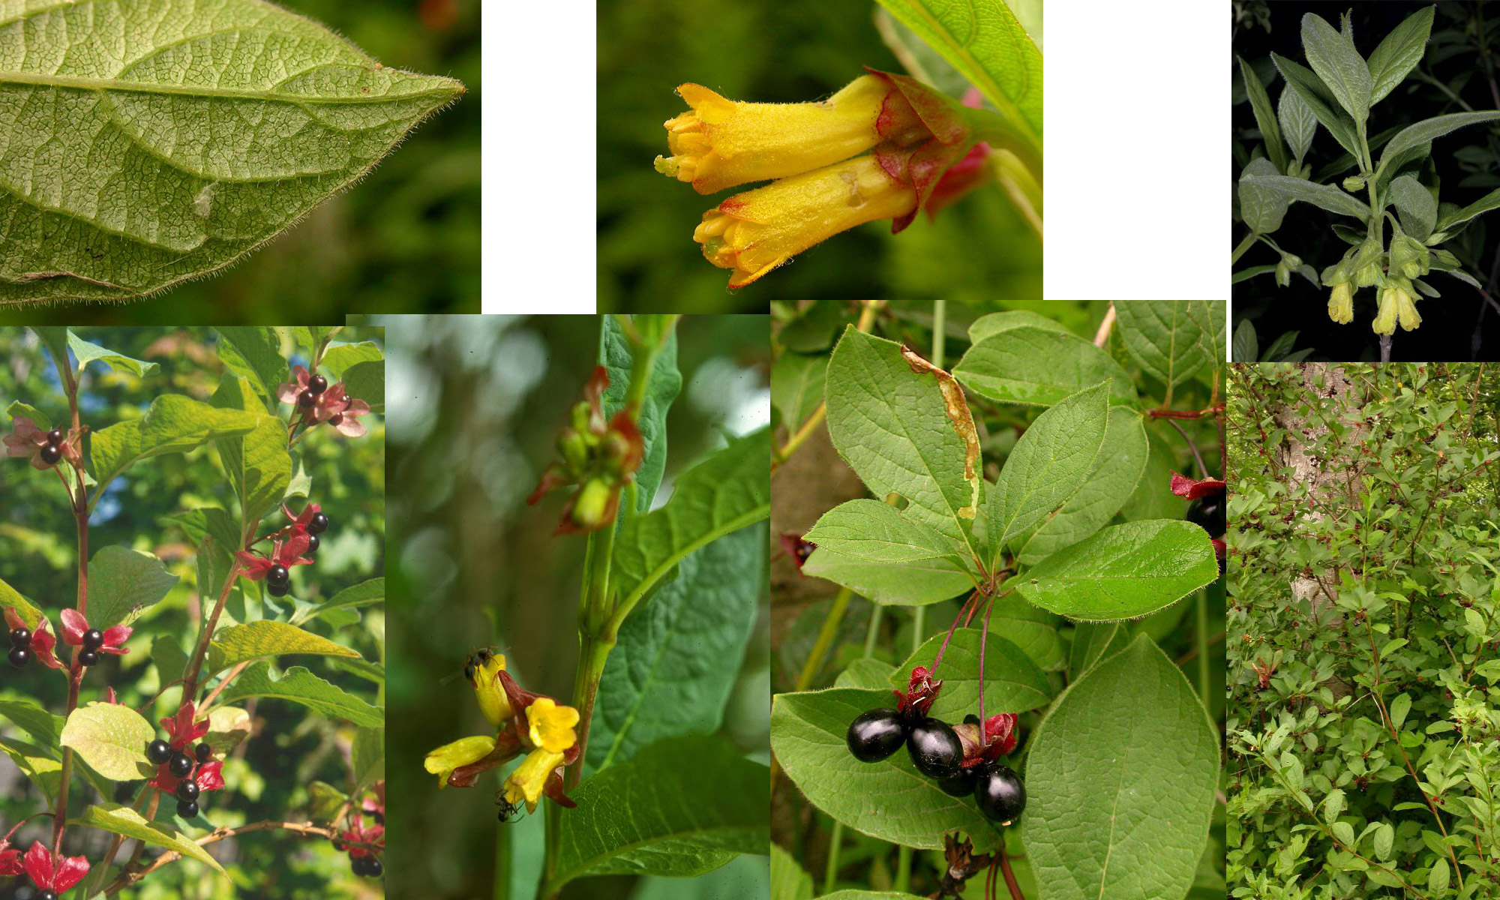
Black Twin-berry – Honeysuckle Family

Slide 18
Key to Shrub Species (in order of slides)
Big Sagebrush
Blue Elderberry
Common Snowberry
Kinnikinnik
Wax Currant
Sticky Currant
Snowbush or Ceanothus
Serviceberry
Ocean Spray
Baldhip Rose
Nootka Rose
Thimbleberry
Cascade Mountain-Ash
Subalpine Spirea
Black Twin-berry

