Slide 1
Herbacious Flowers
East of the Cascade Crest

Slide 2
Practice Identifying these species.
Identify the family
Use Washington Wildflower Search (Cle Elm or Ellensburg Area, 3500-4500 ft Elevation, and mid-June time period)
Use Burke Museum App (Washington Wildflower) or UW Burke Herbarium image collection.
Use Books of the flowers of East of the Cascade Crest
Many plants have multiple common names in use
In Powerpoint, change to Outline View and the answers will be in the outline window.
Openoffice.org should give a free way of opening powerpoints.

Slide 3
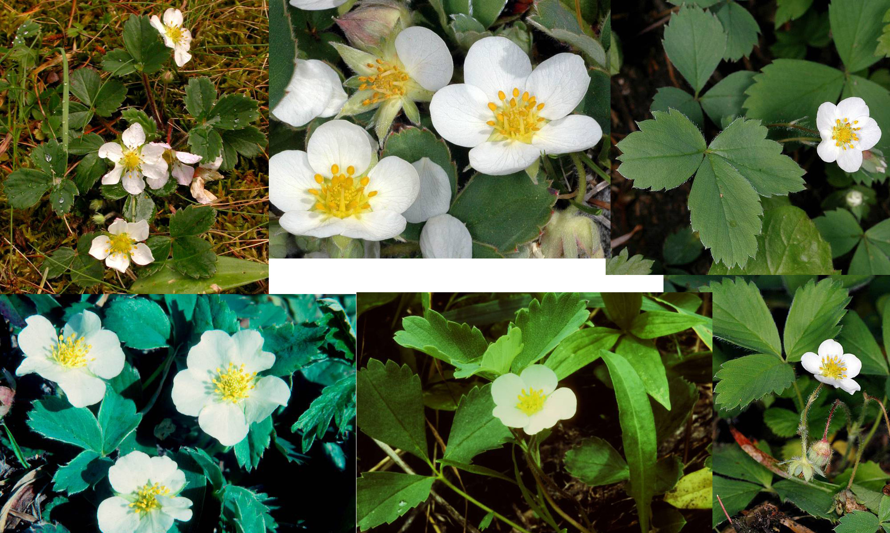
Woods Strawberry – Rose Family

Slide 4
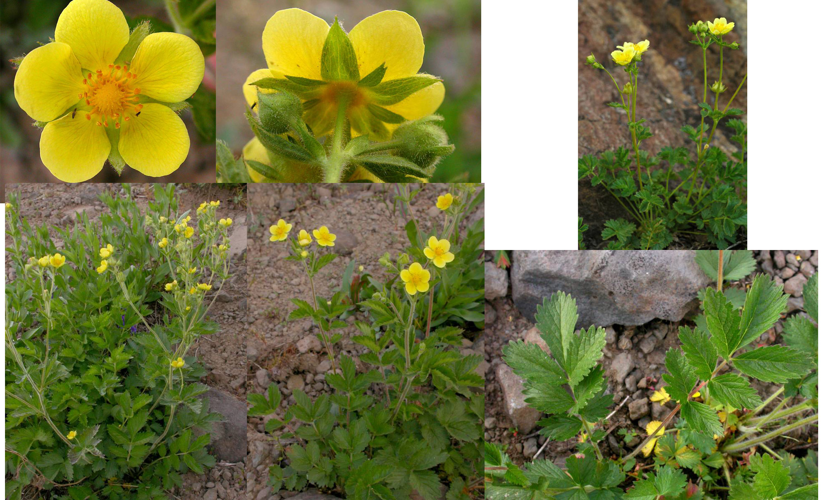
Sticky Cinquefoil – Rose Family

Slide 5
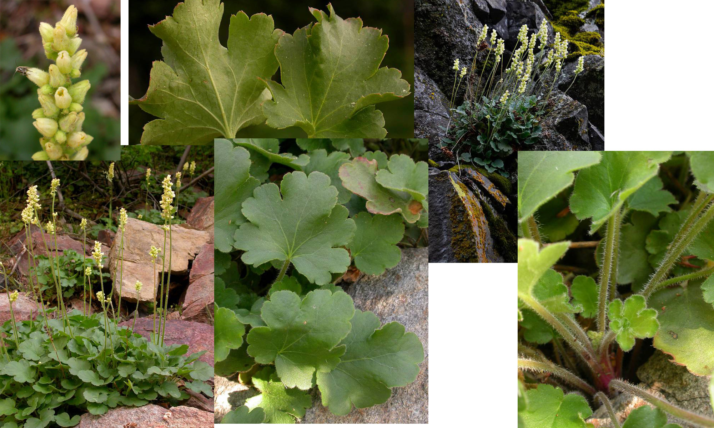
Lava or Round Root Alumroot – Saxifrage Family

Slide 6
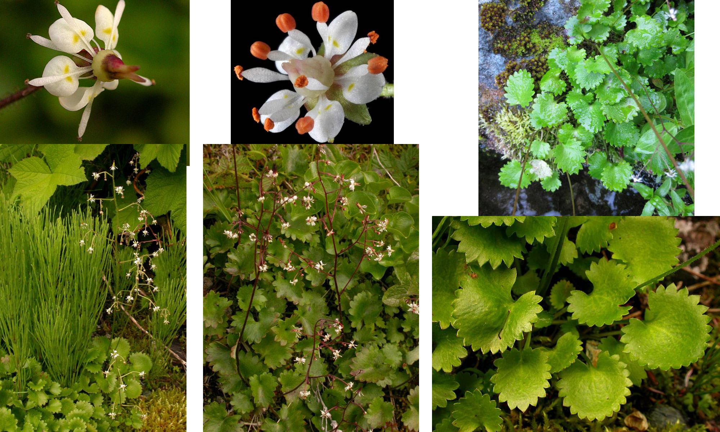
Brook Saxifrage – Saxifrage Family

Slide 7
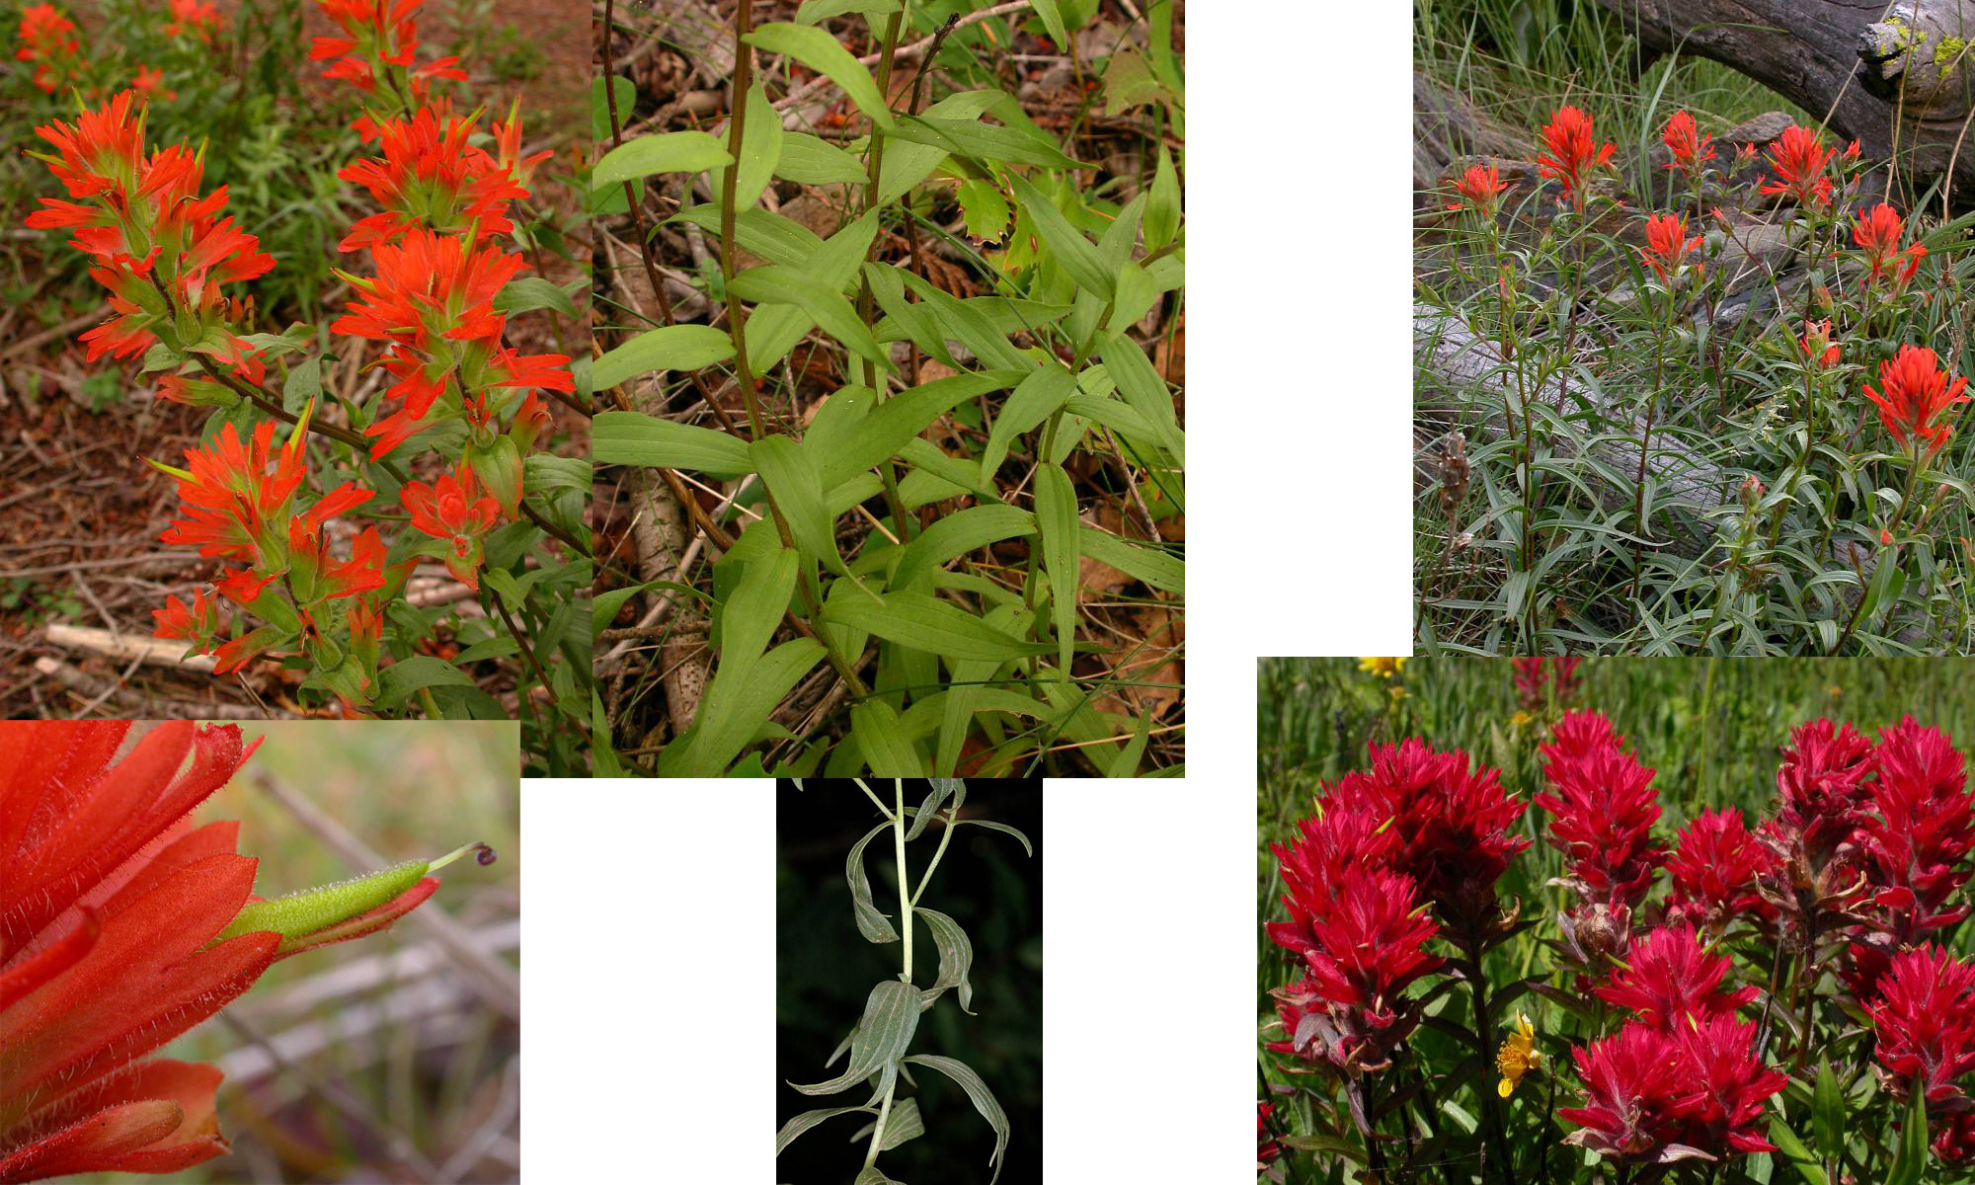
Scarlet Paintbrush -- Figwort Family

Slide 8
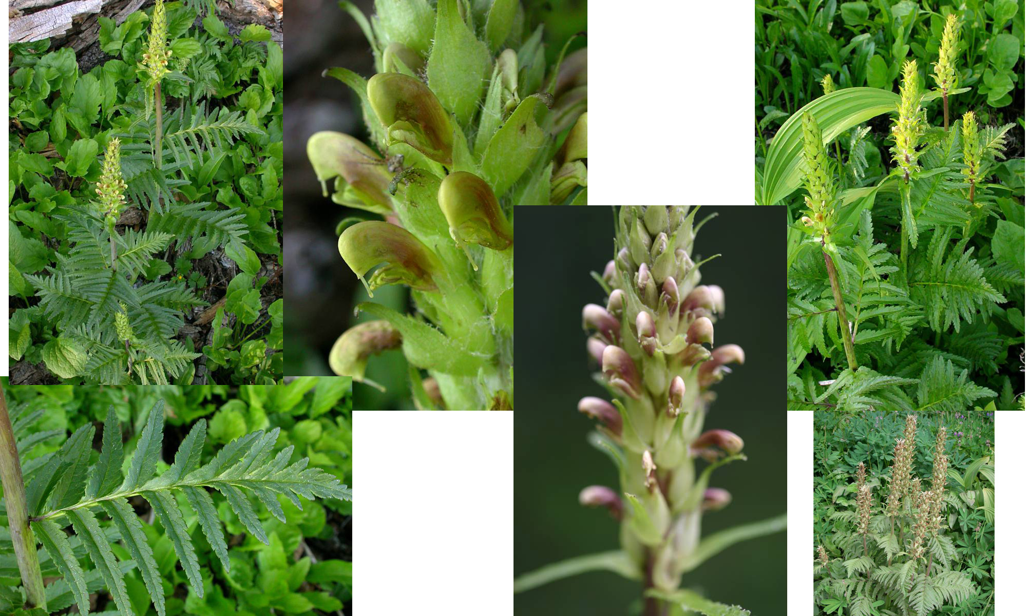
Bracketed Lousewort – Figwort Family

Slide 9
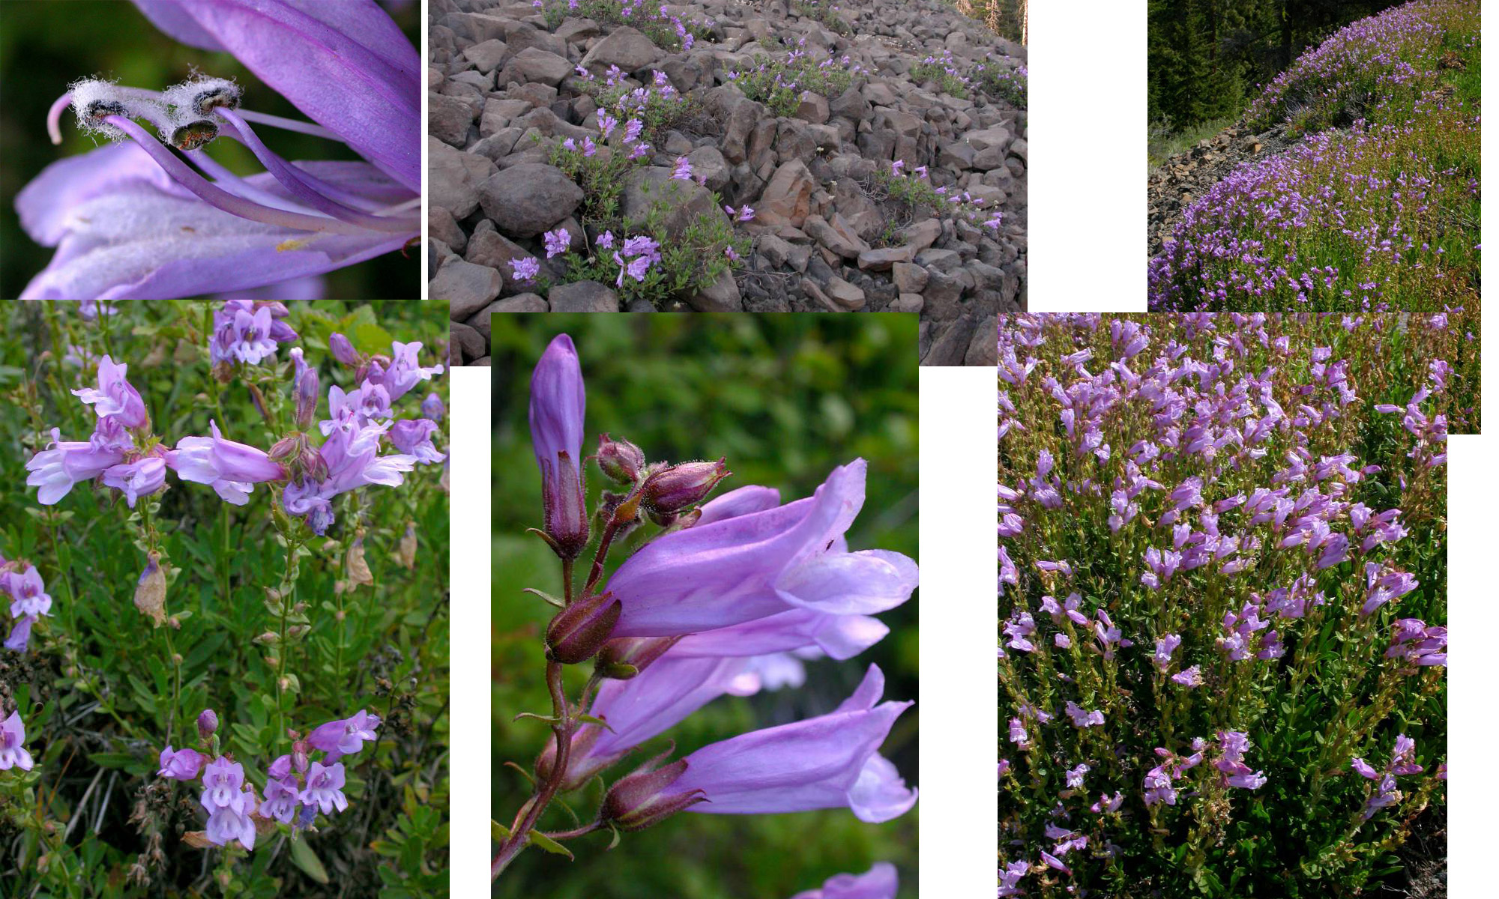
Shrubby Penstemon – Figwort Family

Slide 10
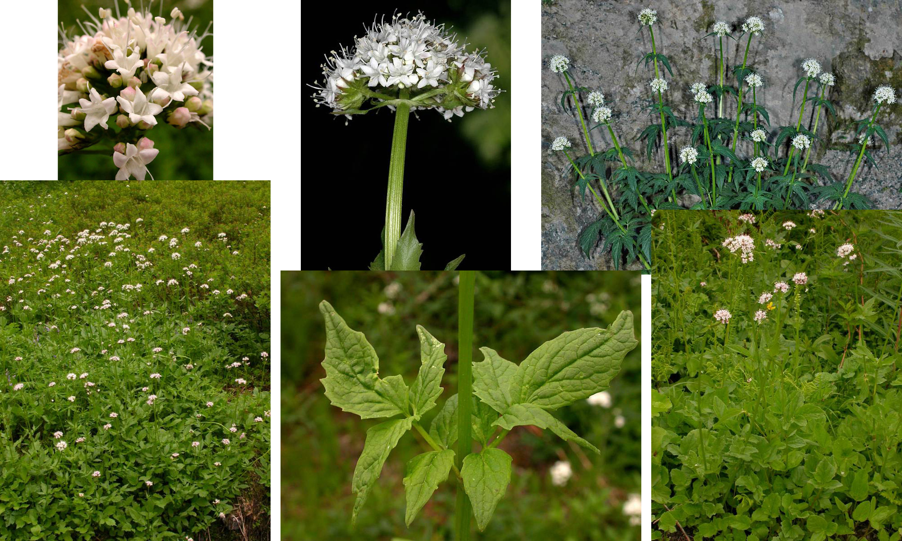
Sitka Valerian – Valerian Family

Slide 11
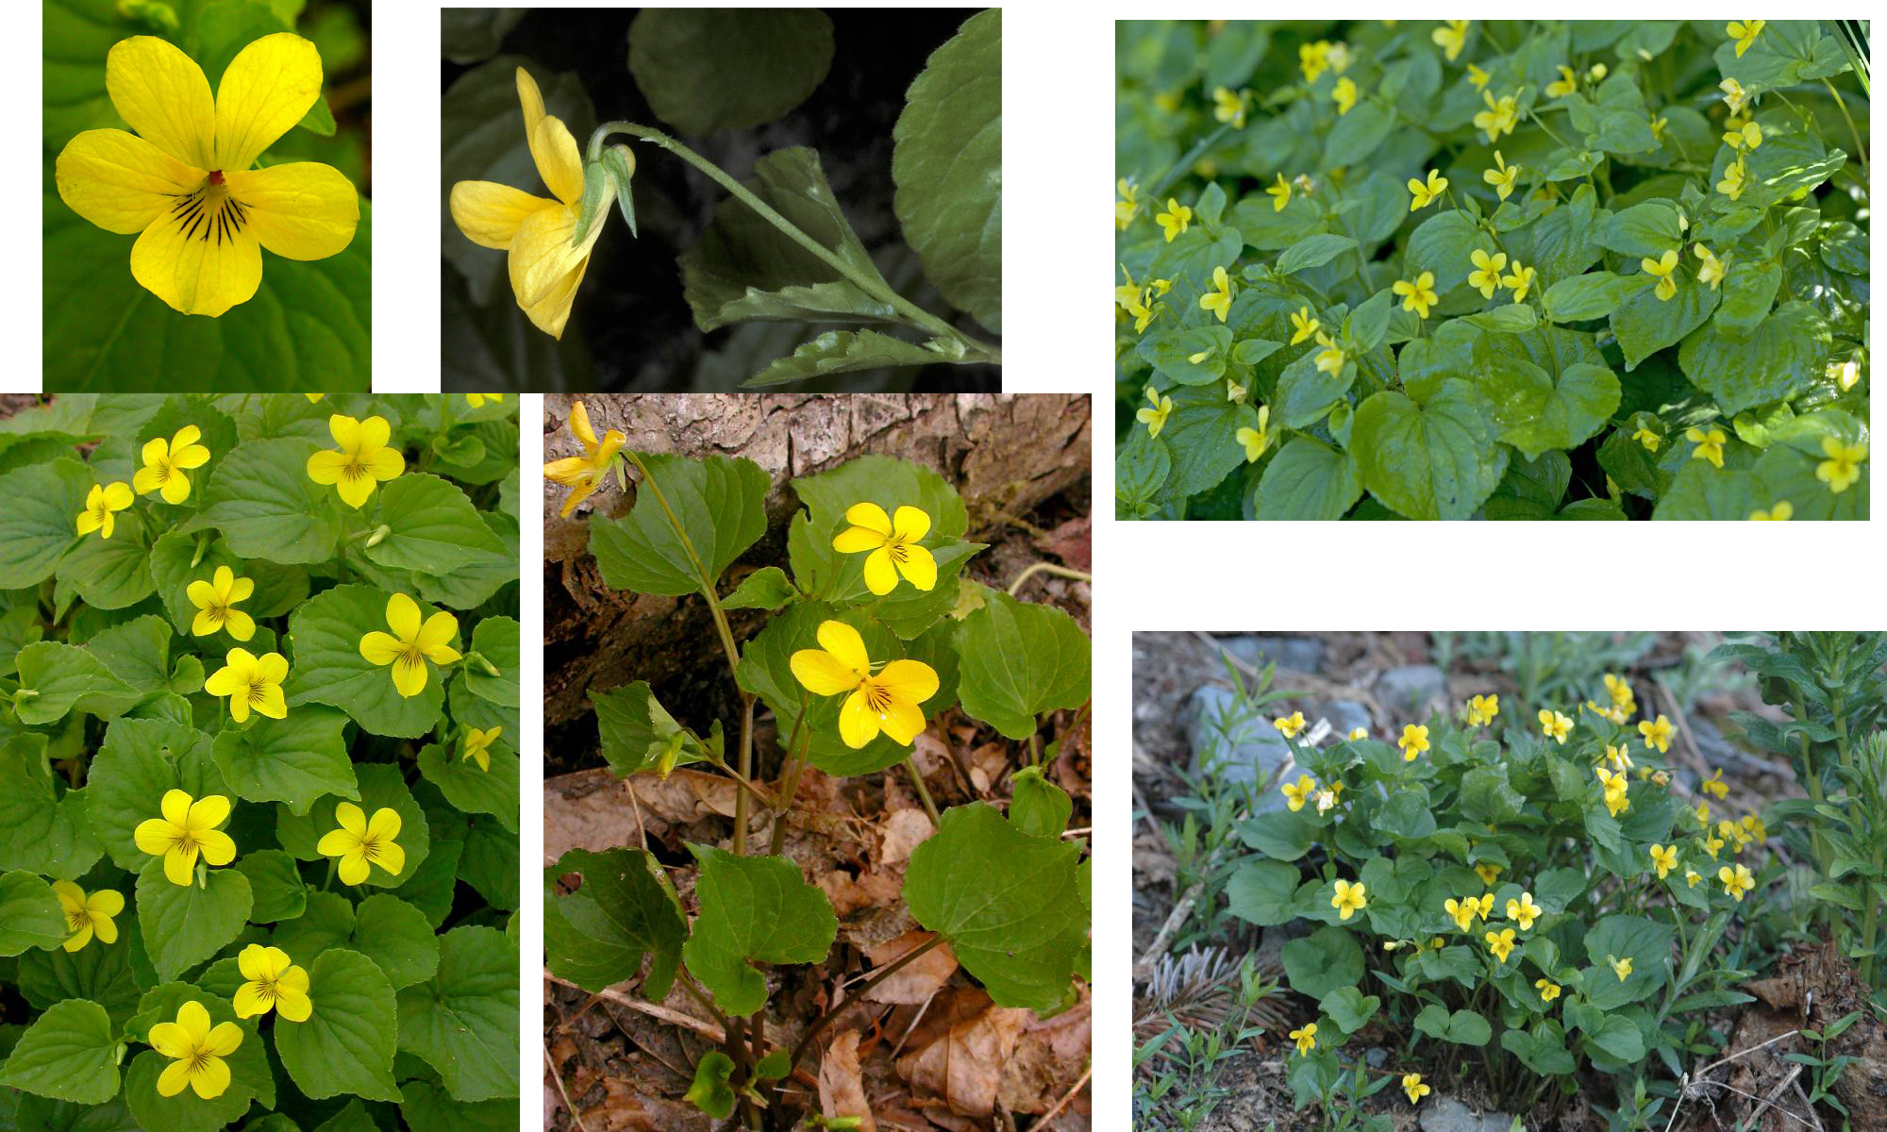
Stream Violet – Violet Family

Slide 12
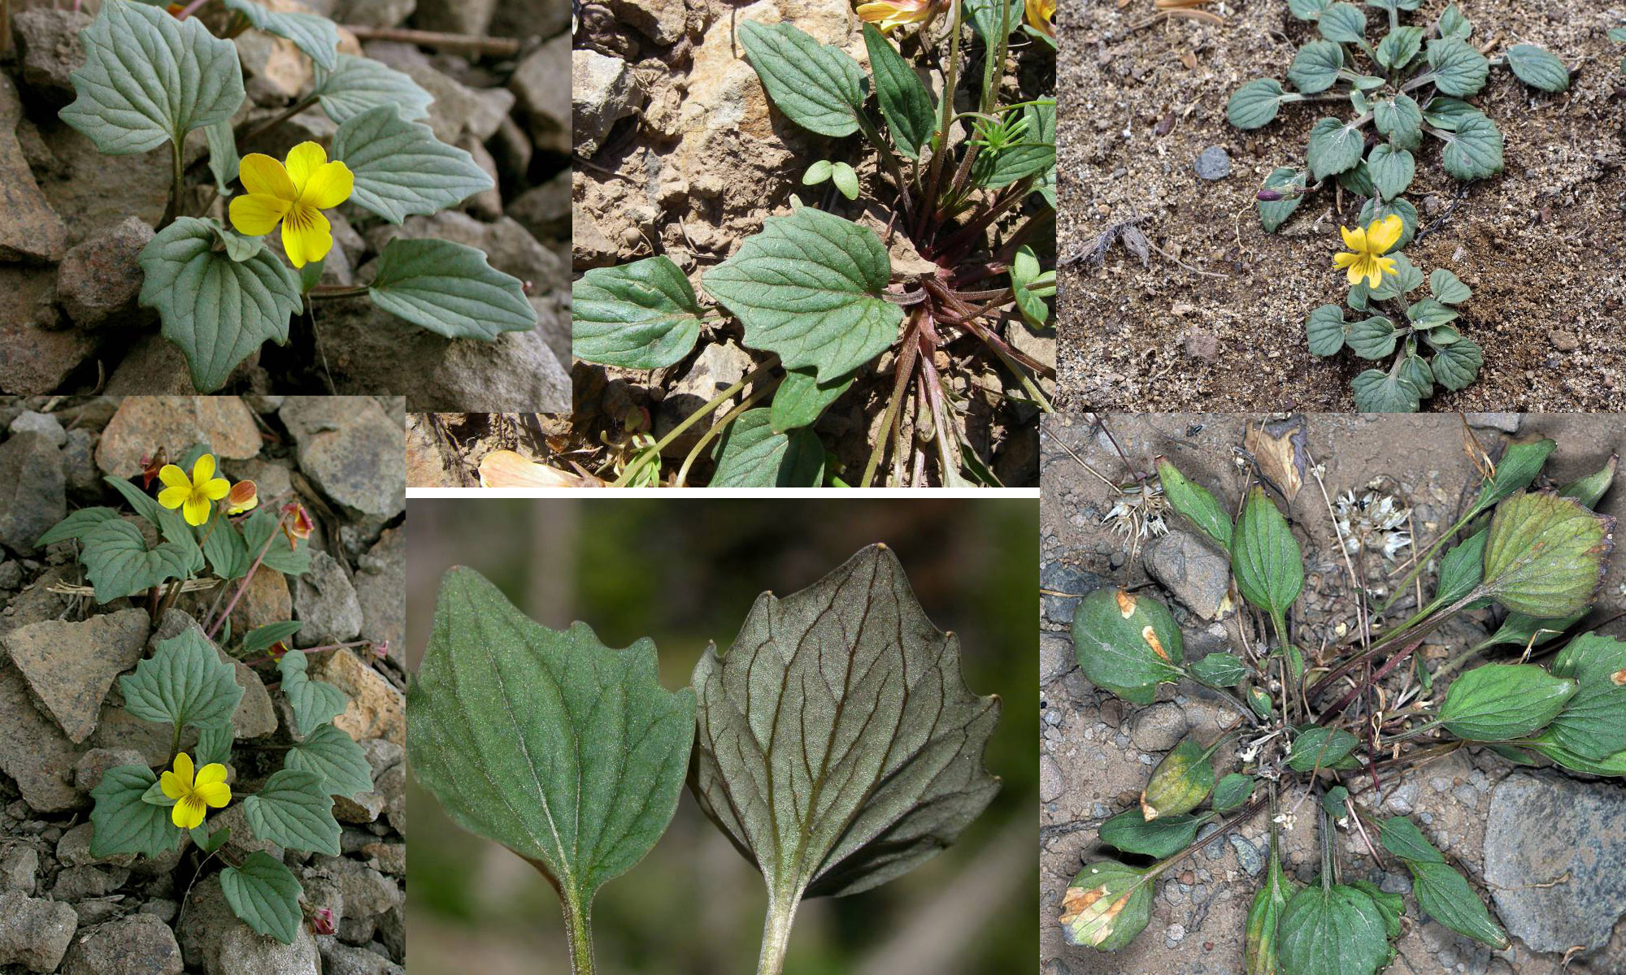
Goosefoot Violet – Violet Family

Slide 13
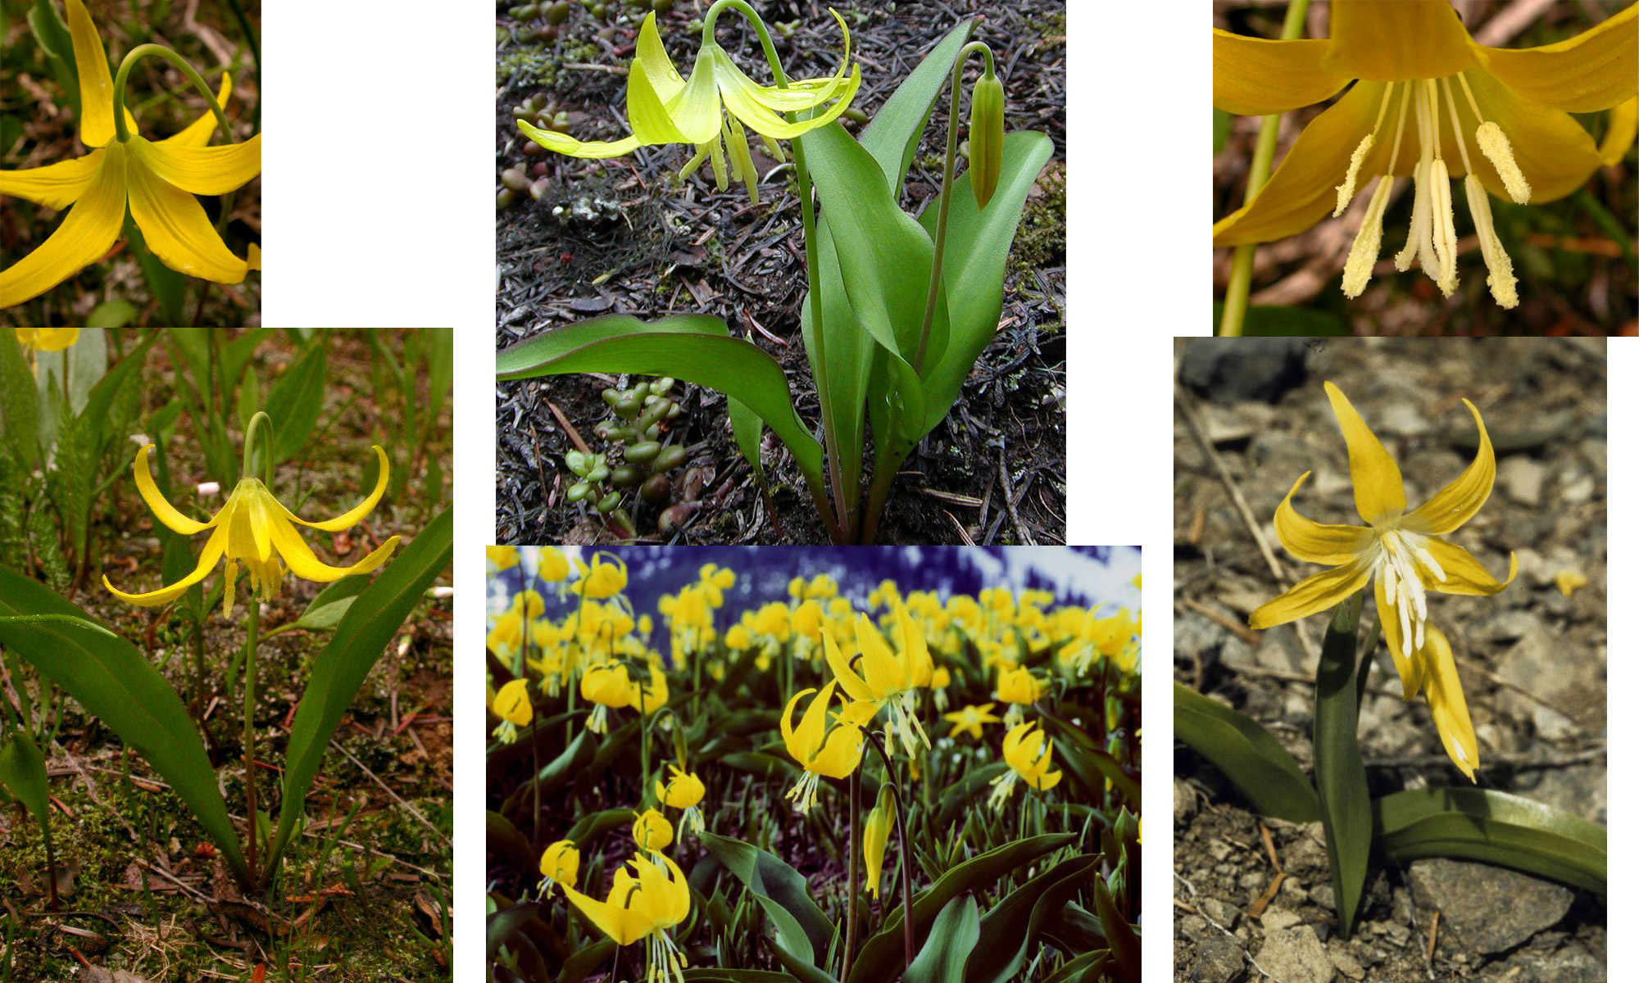
Glacier Lily – Lily Family

Slide 14
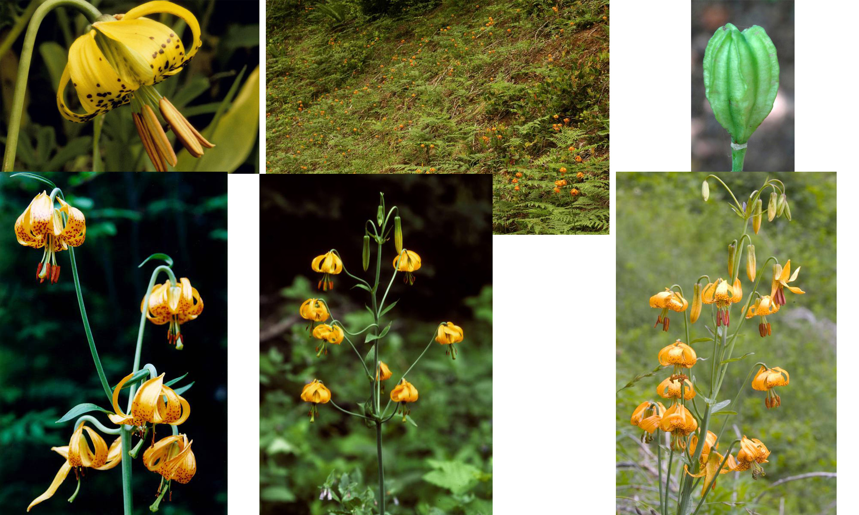
Tiger Lily or Columbia Lily – Lily Family

Slide 15
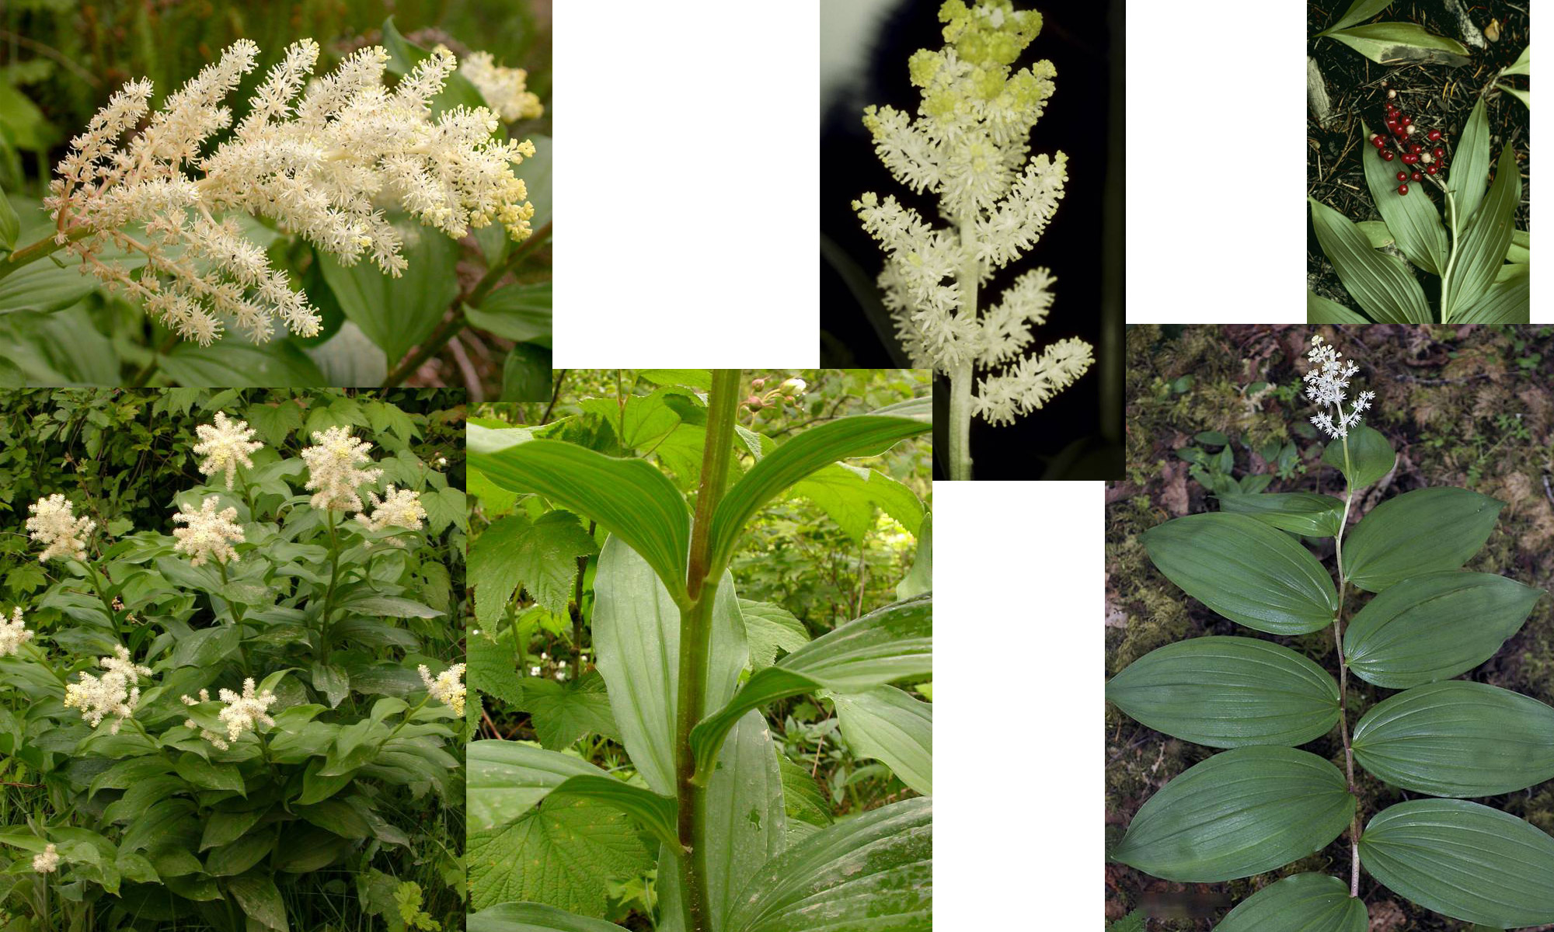
False Solomon’s Seal – Lily Family

Slide 16
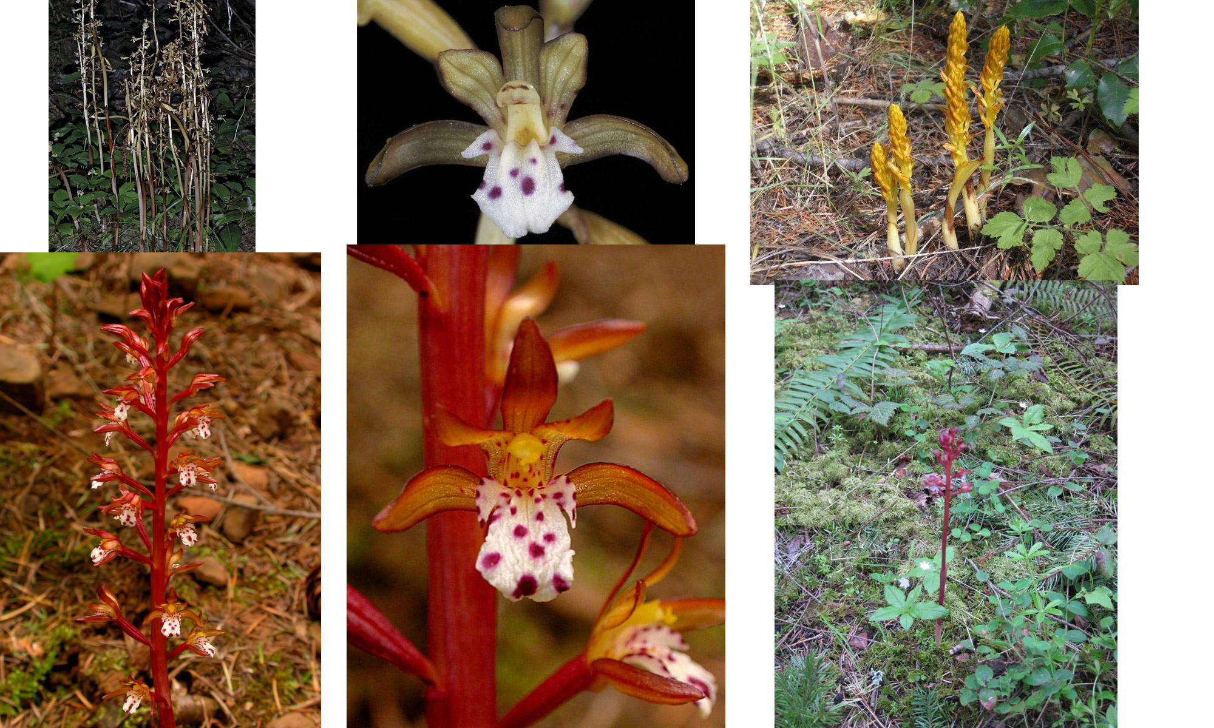
Spotted Coral Root – Orchid Family

Slide 17
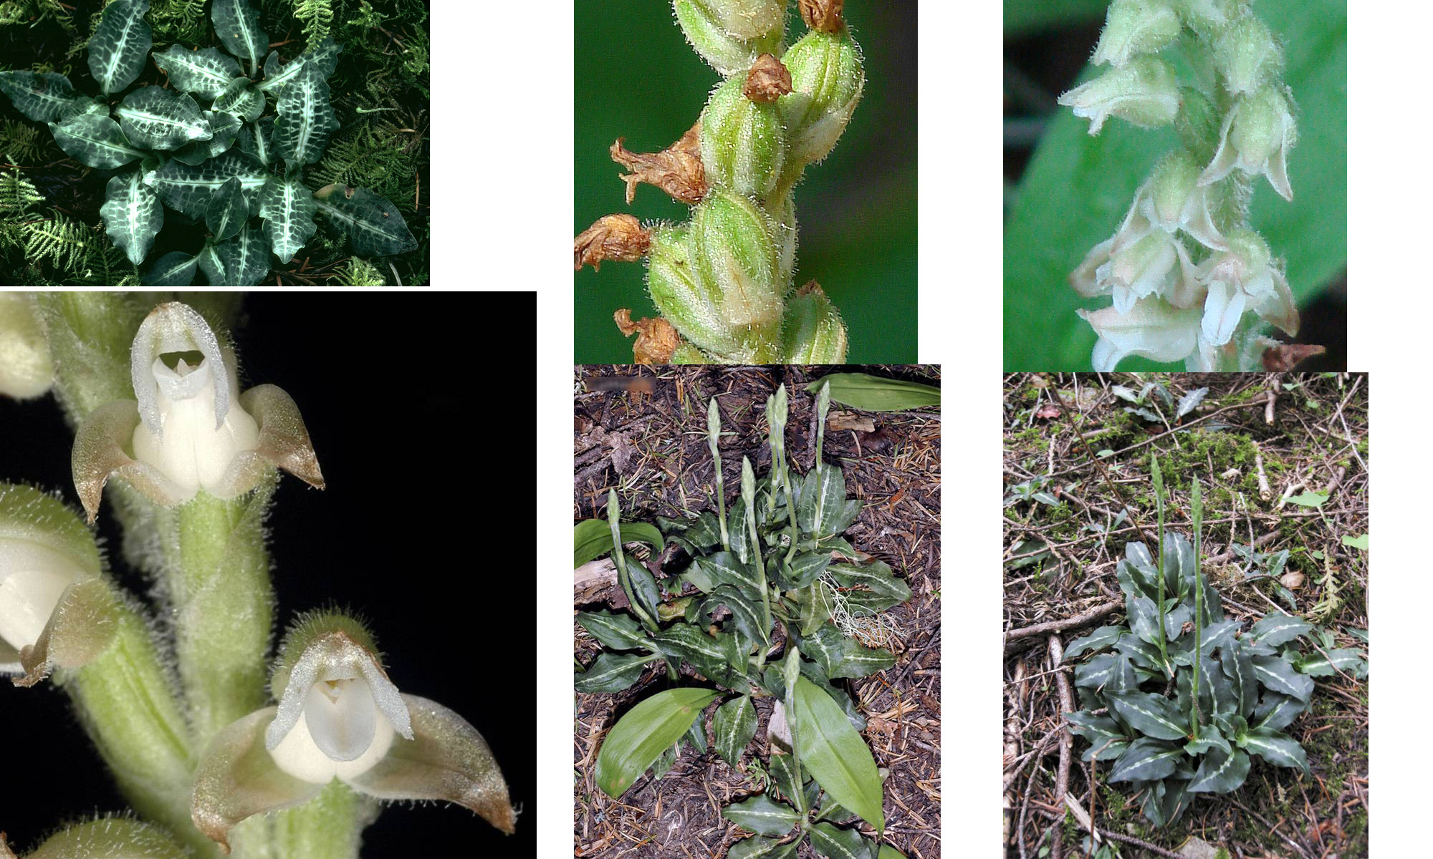
Rattlesnake-Plantain – Orchid Family

Slide 18
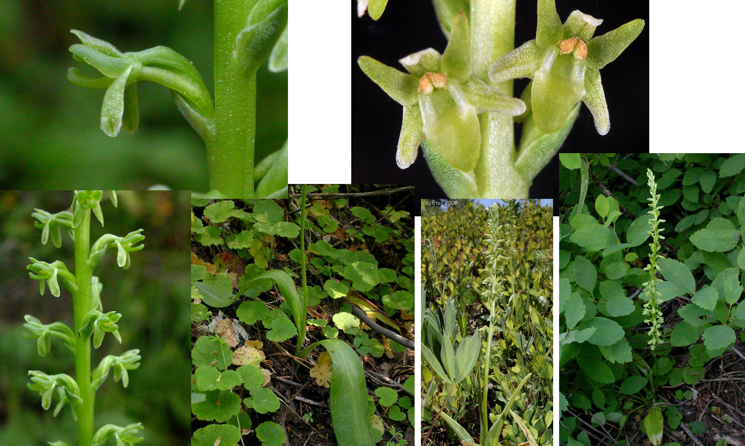
Alaska Rein-Orchid – Orchid Family

Slide 19
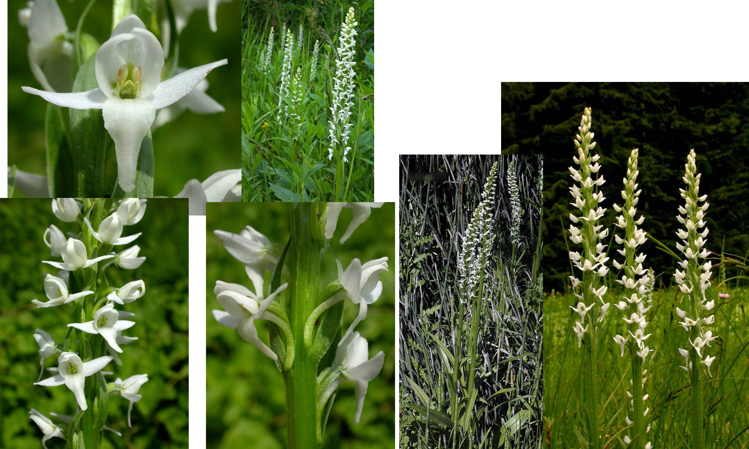
White Bog-Orchid – Orchid Family

Slide 20
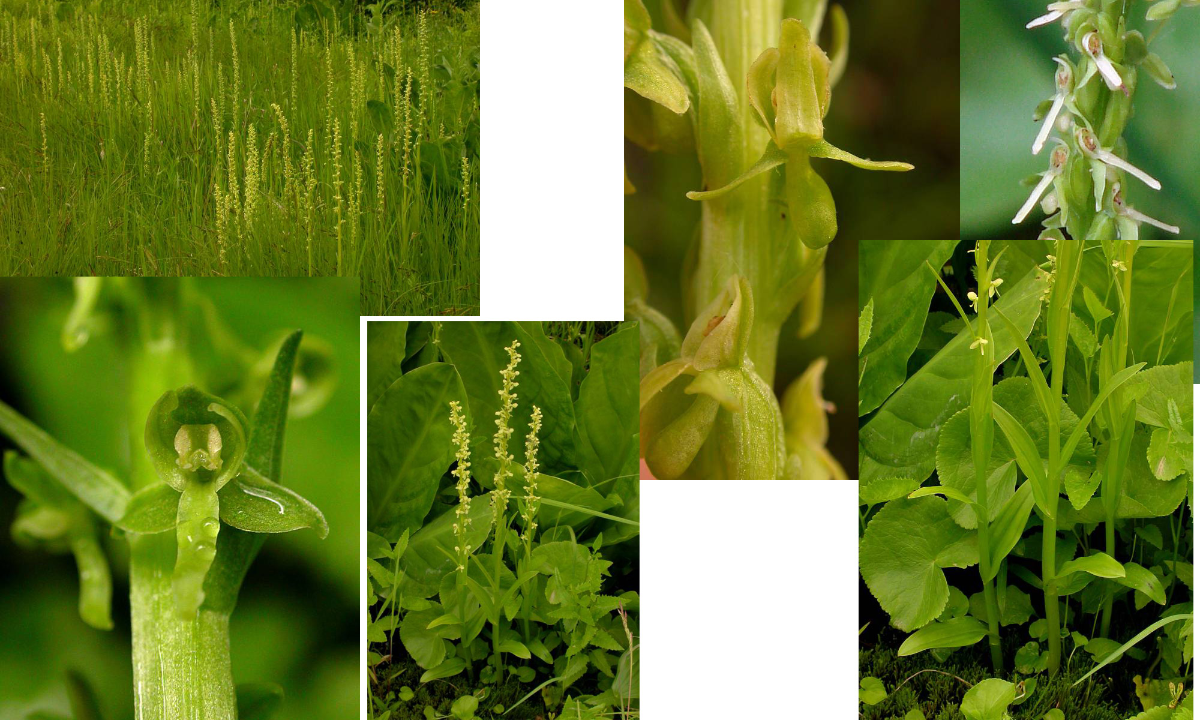
Slender Bog-Orchid – Orchid Family

Slide 21
Key to Plants (in order of slides)
Woods Strawberry
Sticky Cinquefoil
Lava or Round Root Alumroot
Brooks Saxifrage
Scarlet Paintbrush
Bracketed Lousewort
Shrubby Penstemon
Sitka Valerian
Stream Violet
Goosefoot Violet
Glacier Lily
Tiger or Columbia Lily
False Solomon’s Seal
Spotted Coral Root
Rattlesnake Plantain
Alaska Rein Orchid
White Bog Orchid
Slender Bog-Orchid

