Slide 1
Herbacious Flowers
East of the Cascade Crest

Slide 2
Practice Identifying these species.
Identify the family
Use Washington Wildflower Search (Cle Elm or Ellensburg Area, 3500-4500 ft Elevation, and mid-June time period)
Use Burke Museum App (Washington Wildflower) or UW Burke Herbarium image collection.
Use Books of the flowers of East of the Cascade Crest
Many plants have multiple common names in use
In Powerpoint, change to Outline View and the answers will be in the outline window.
Openoffice.org should give a free way of opening powerpoints.

Slide 3
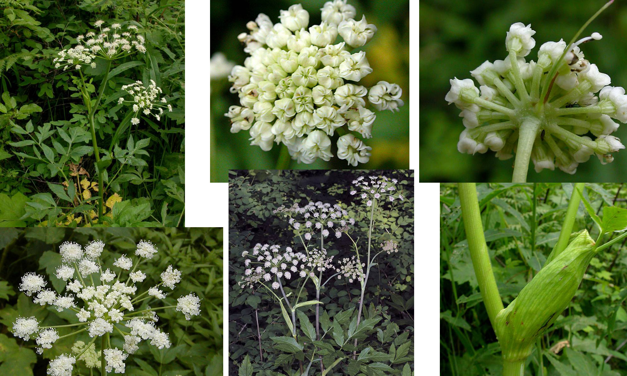
Sharp-tooth Angelica – Parsley Family

Slide 4
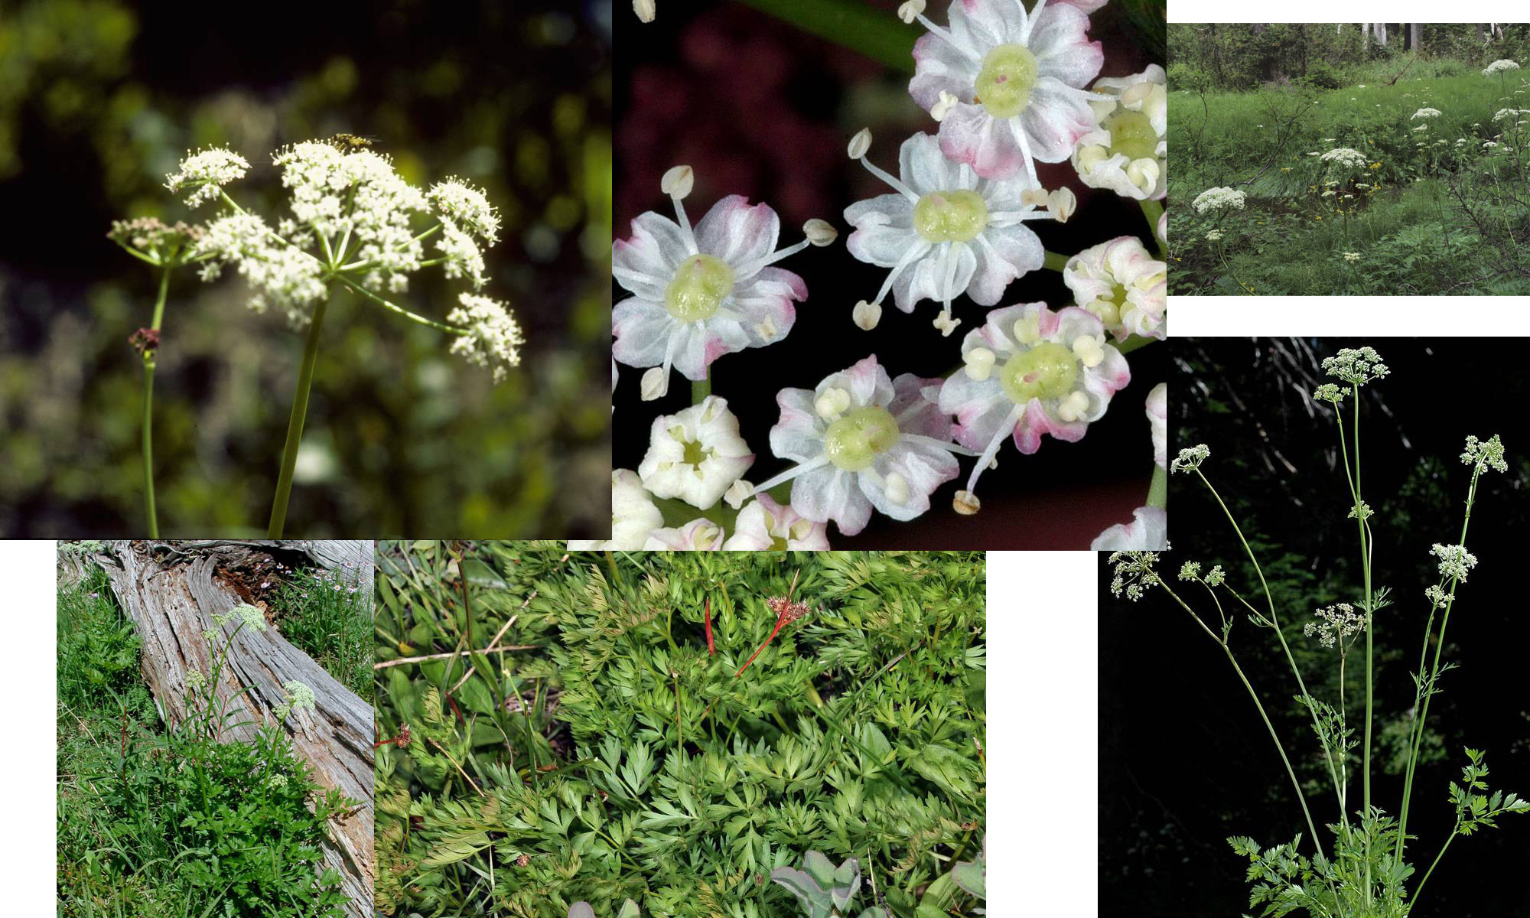
Gray’s Lovage – Parsley Family

Slide 5
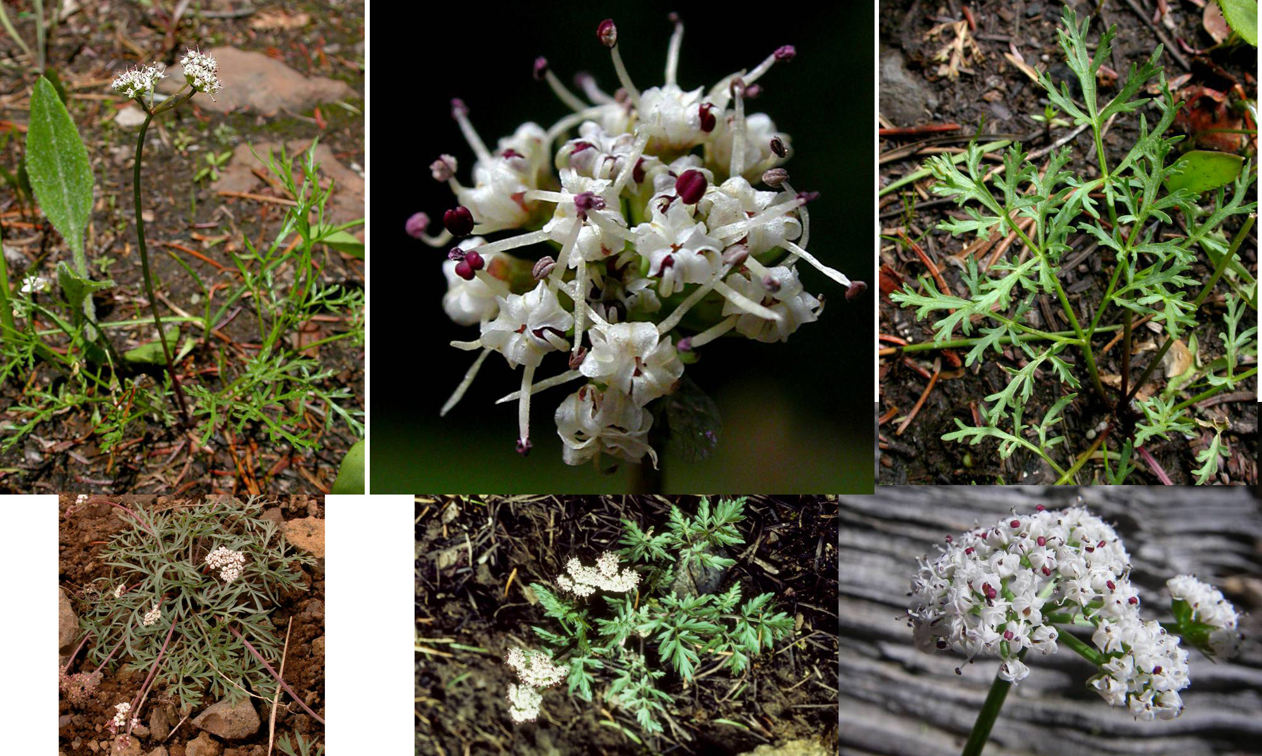
Geyer’s Desert-Parsley – Parsley Family

Slide 6
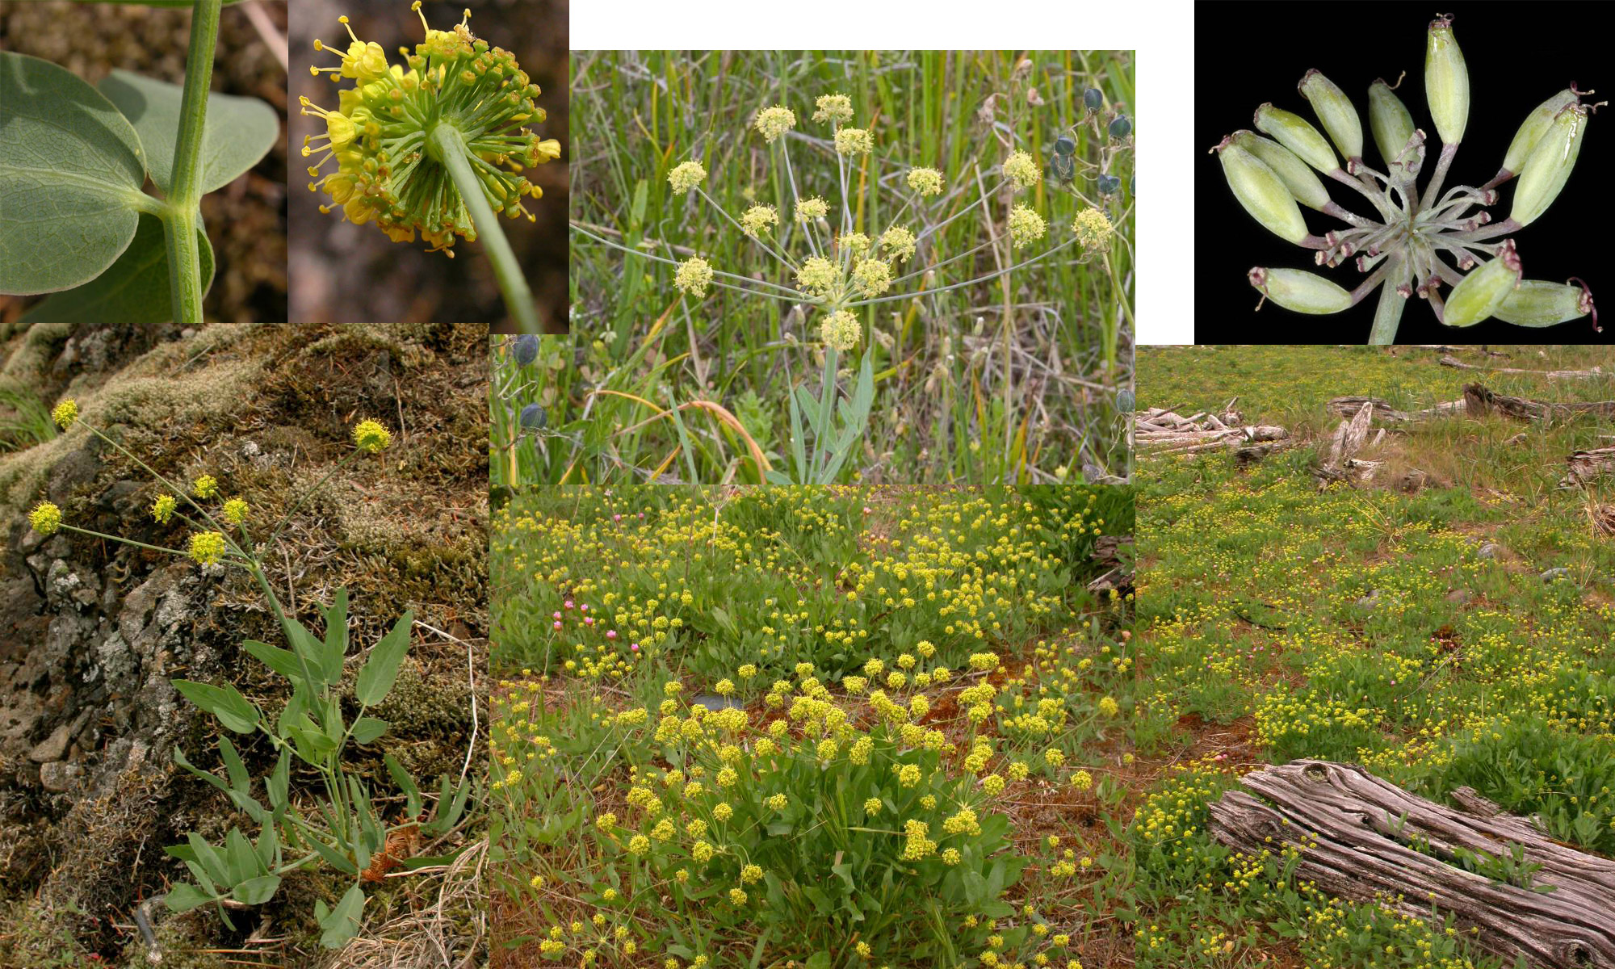
Pestle Parsnip or Barestem Biscuitroot – Parsley Family

Slide 7
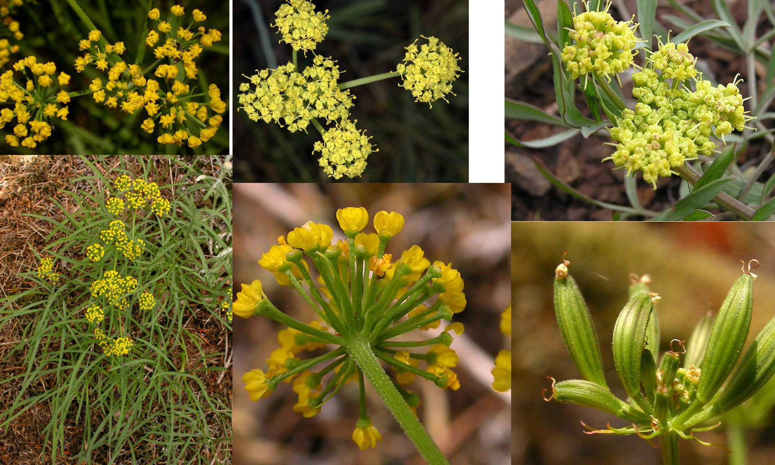
Nine-leaf Lomatium – Parsley Family

Slide 8
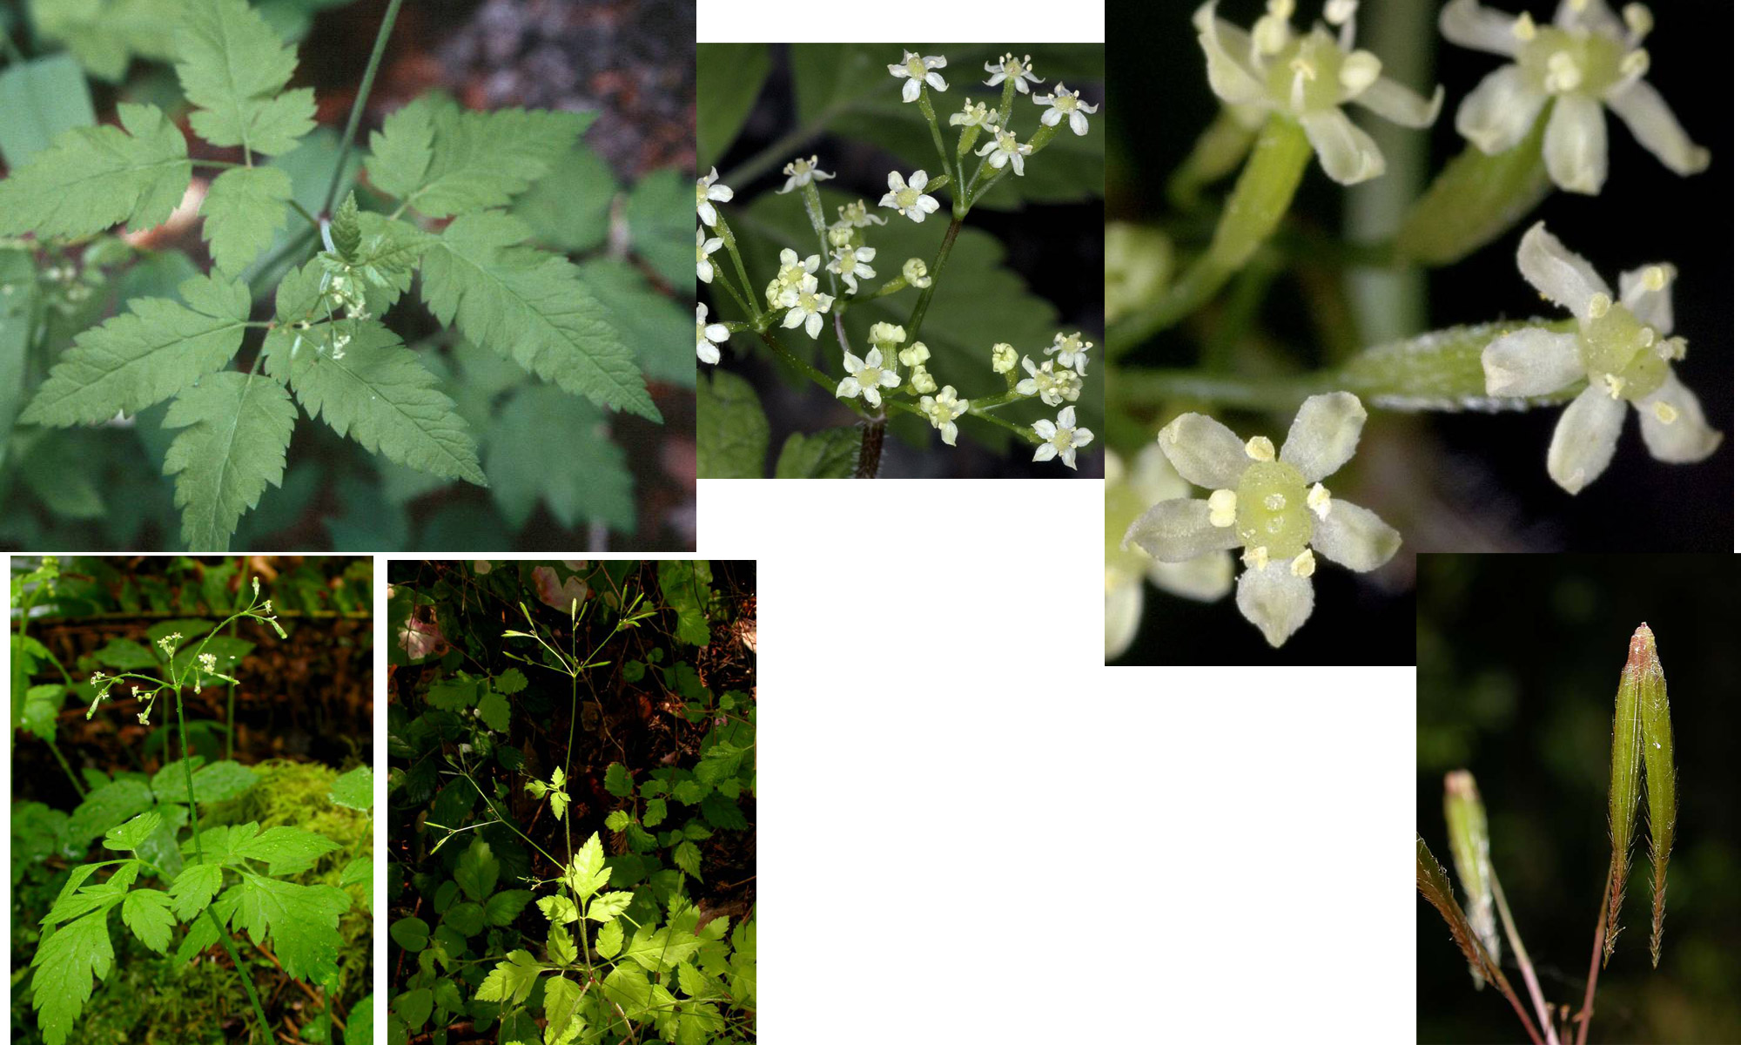
Mountain Sweet-Cicely – Parsley Family

Slide 9
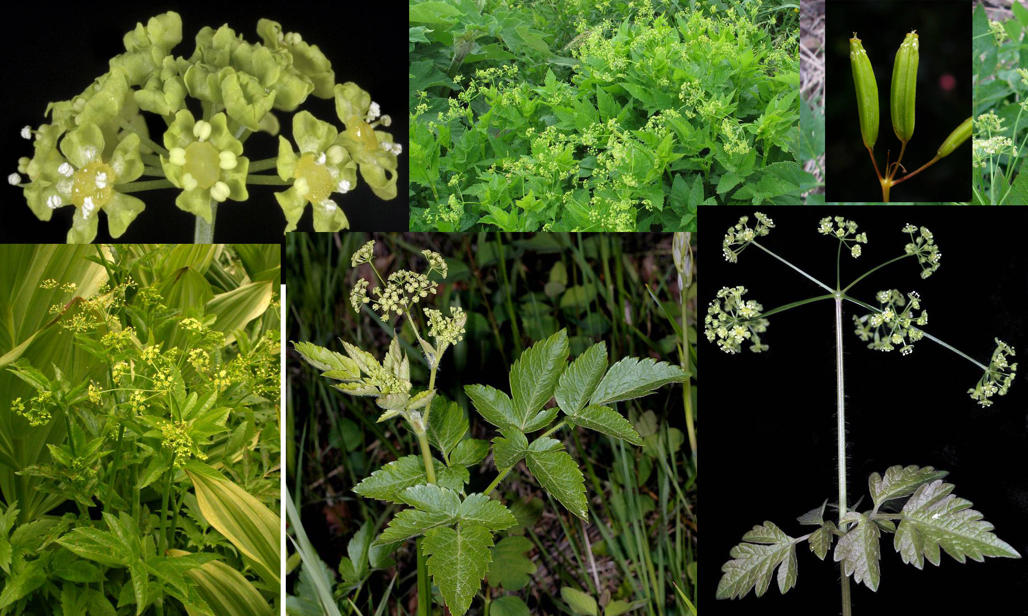
Western Sweet-Cicely – Parsley Family

Slide 10
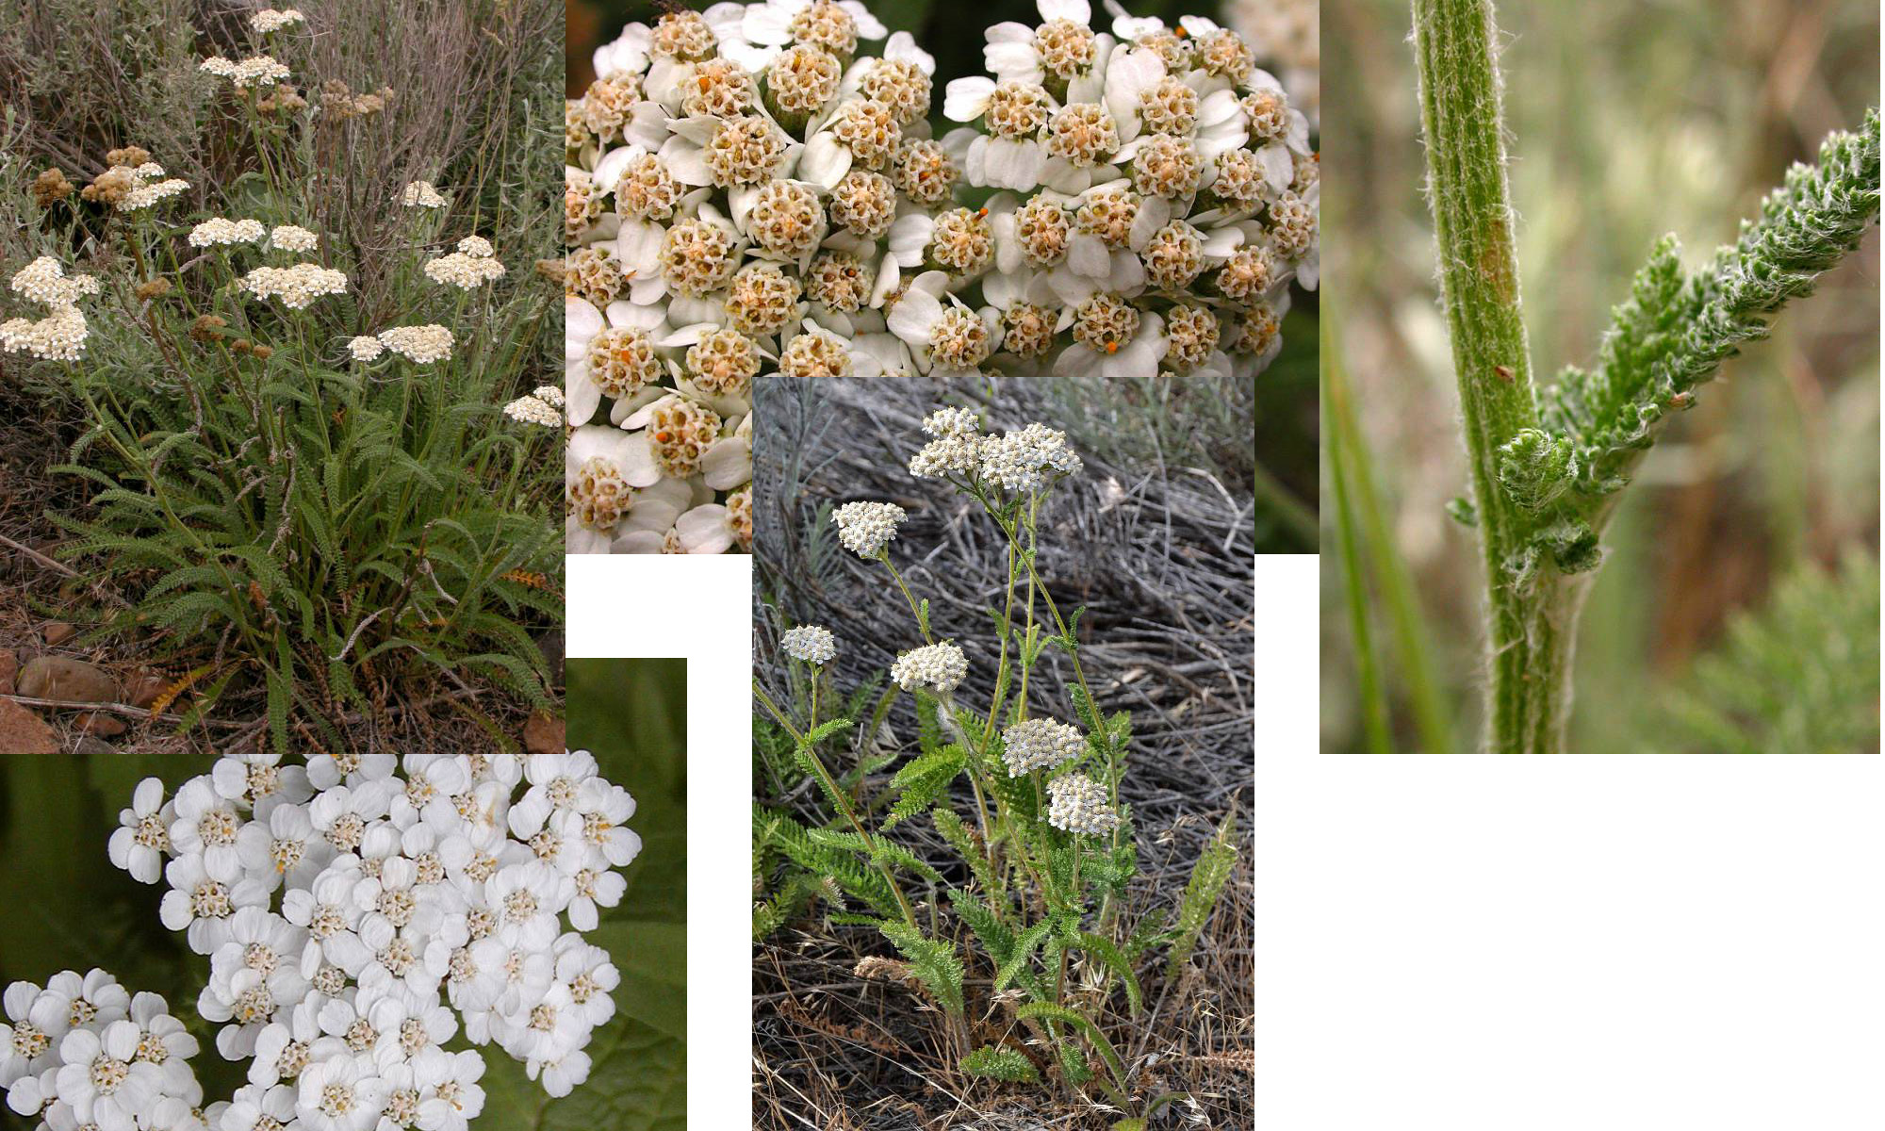
Yarrow – Sunflower Family

Slide 11
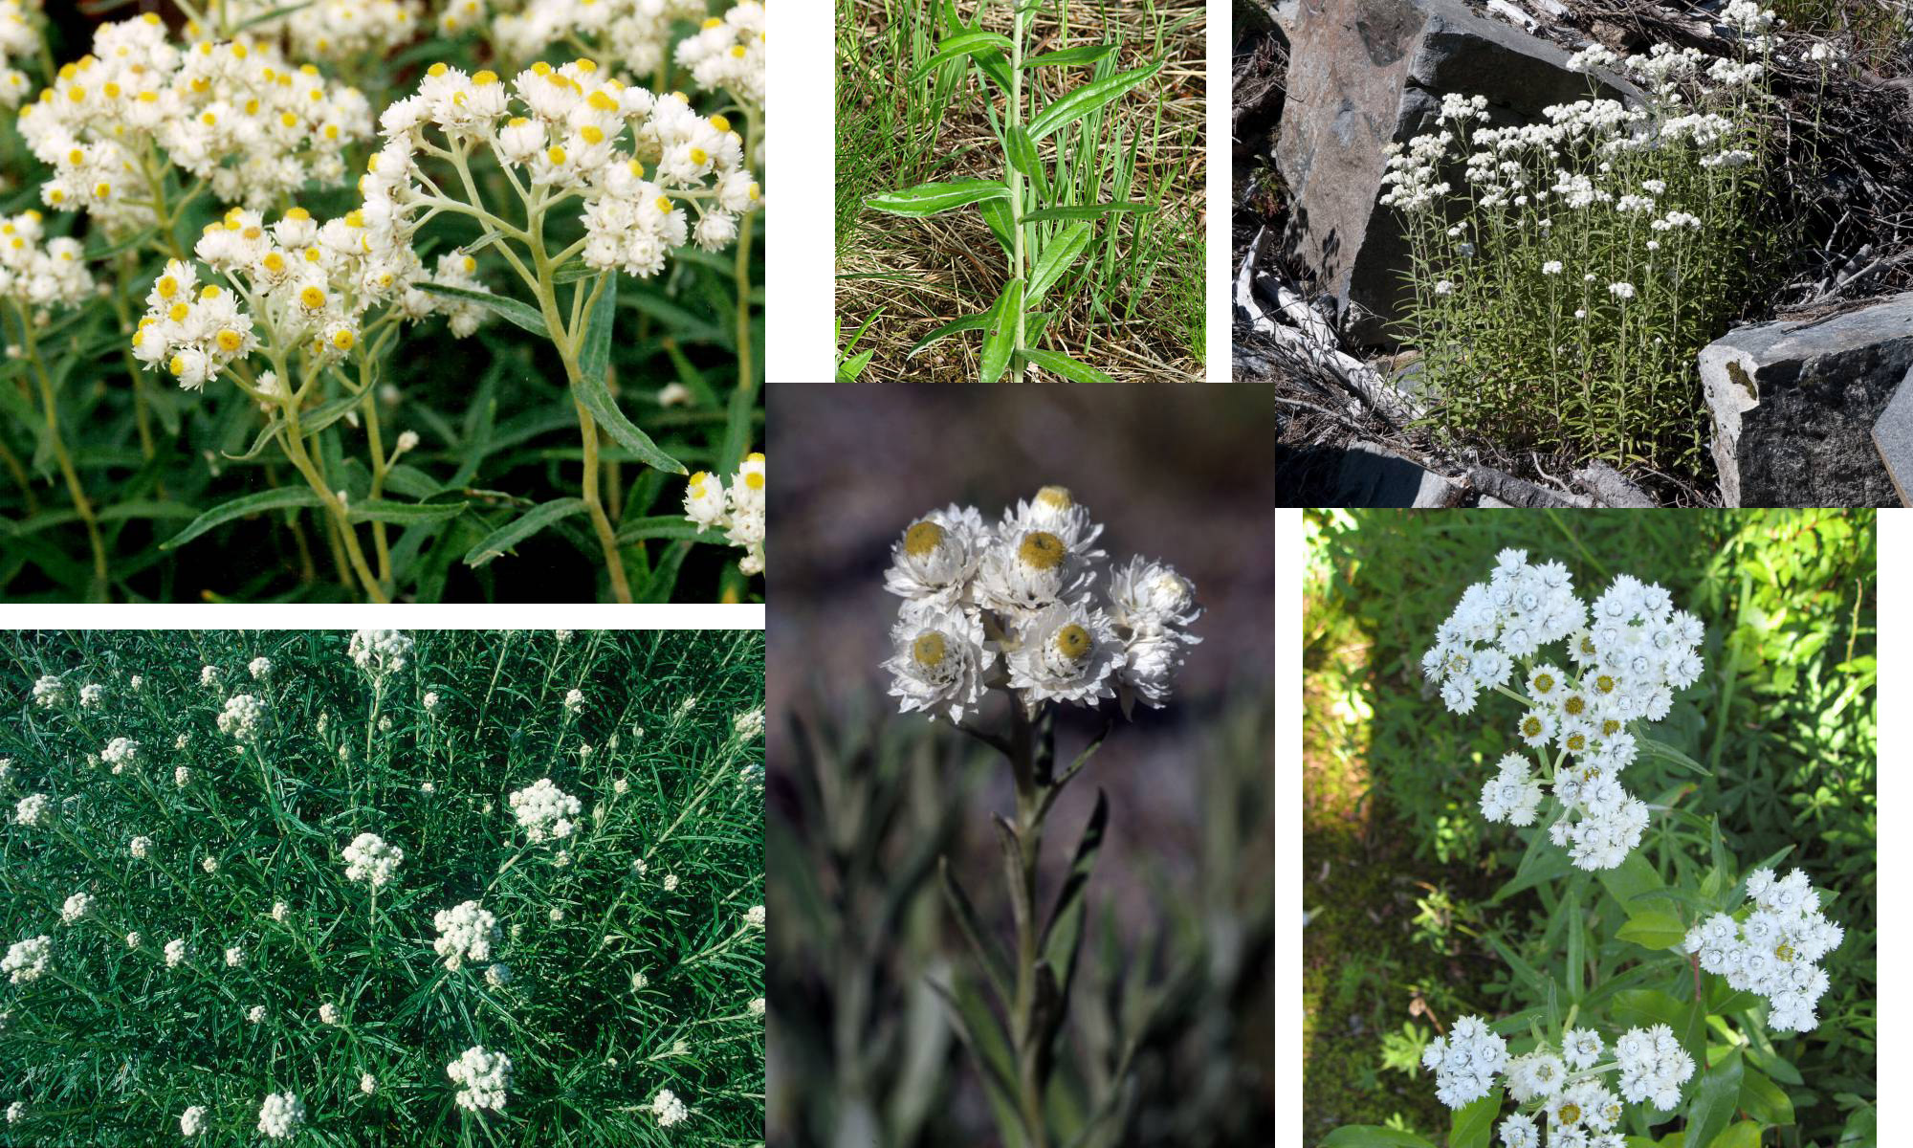
Pearly Everlasting – Sunflower Family

Slide 12
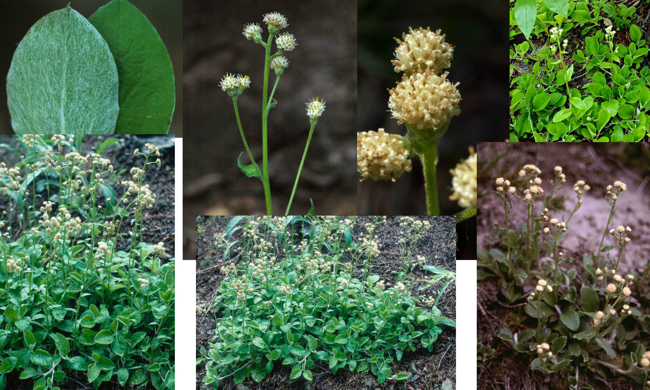
Raceme Pussy-Toes – Sunflower Family

Slide 13
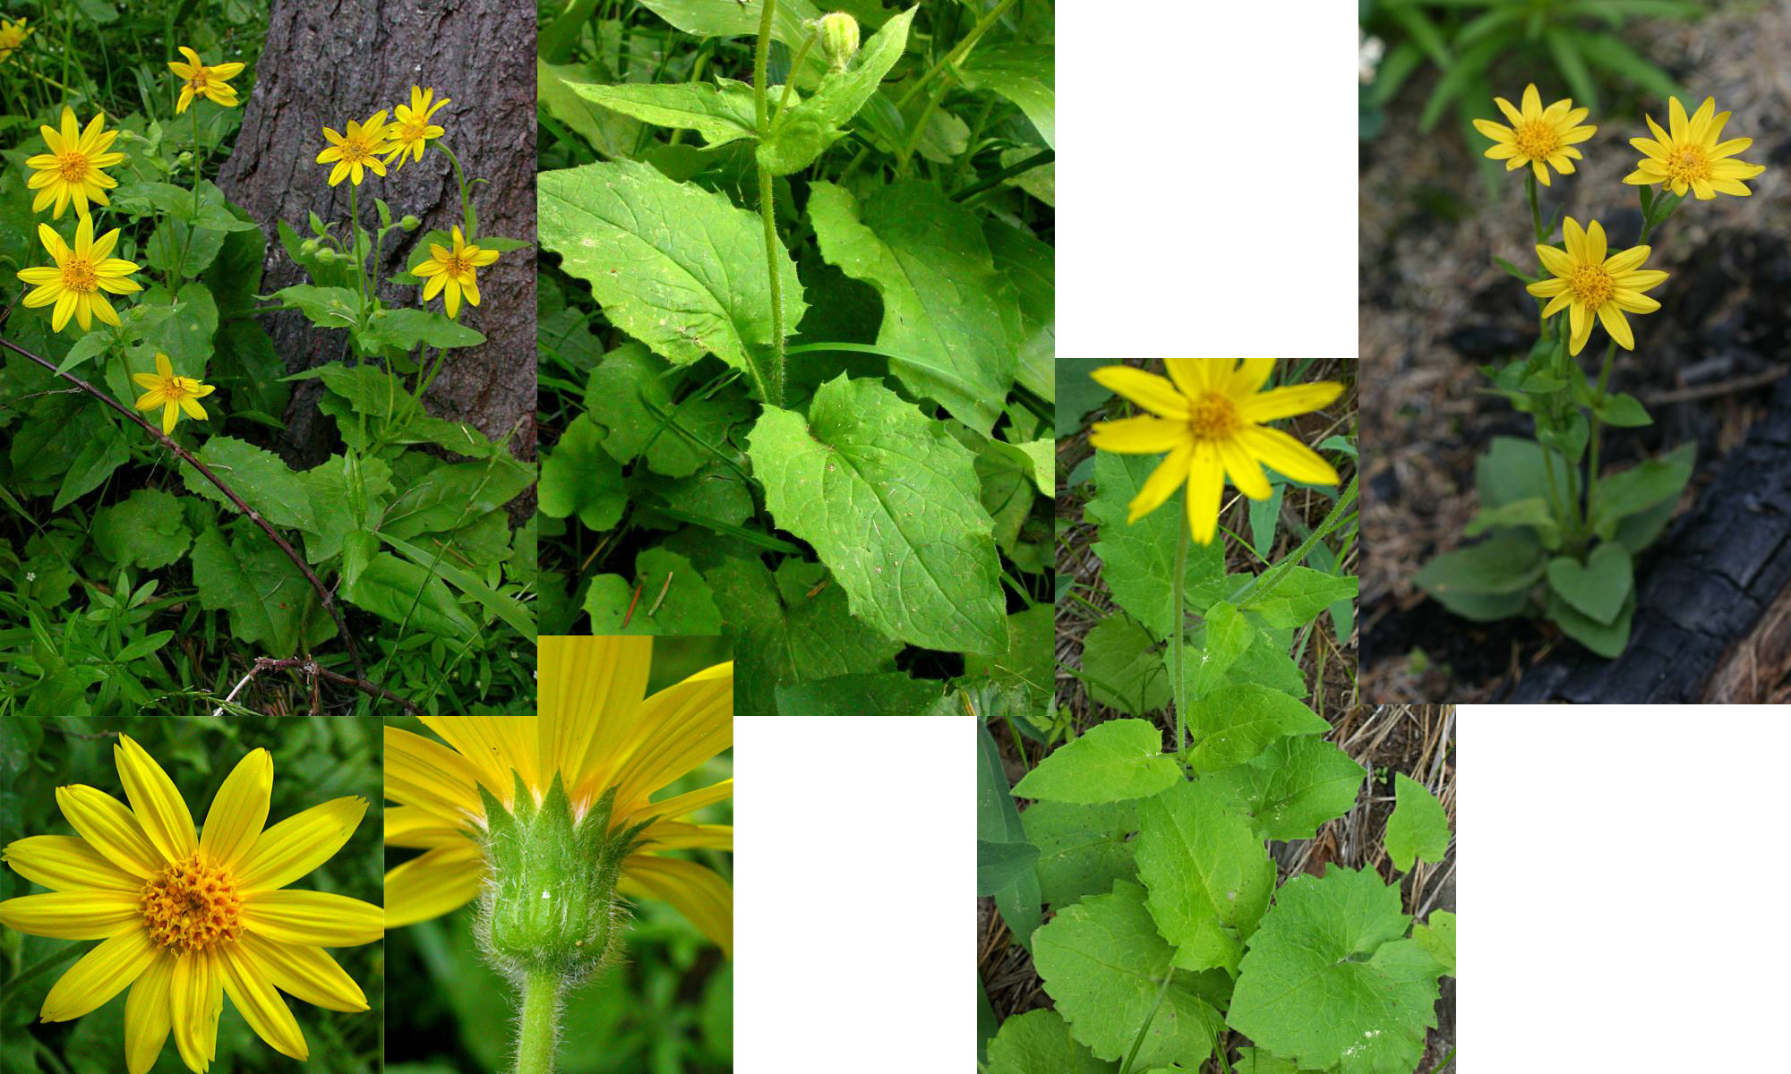
Heart-leaf Arnica – Sunflower Family

Slide 14
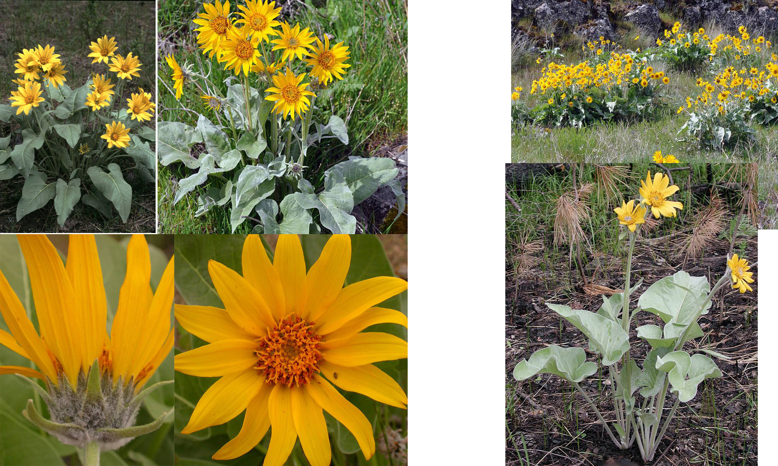
Arrow-leaf Balsamroot – Sunflower Family

Slide 15
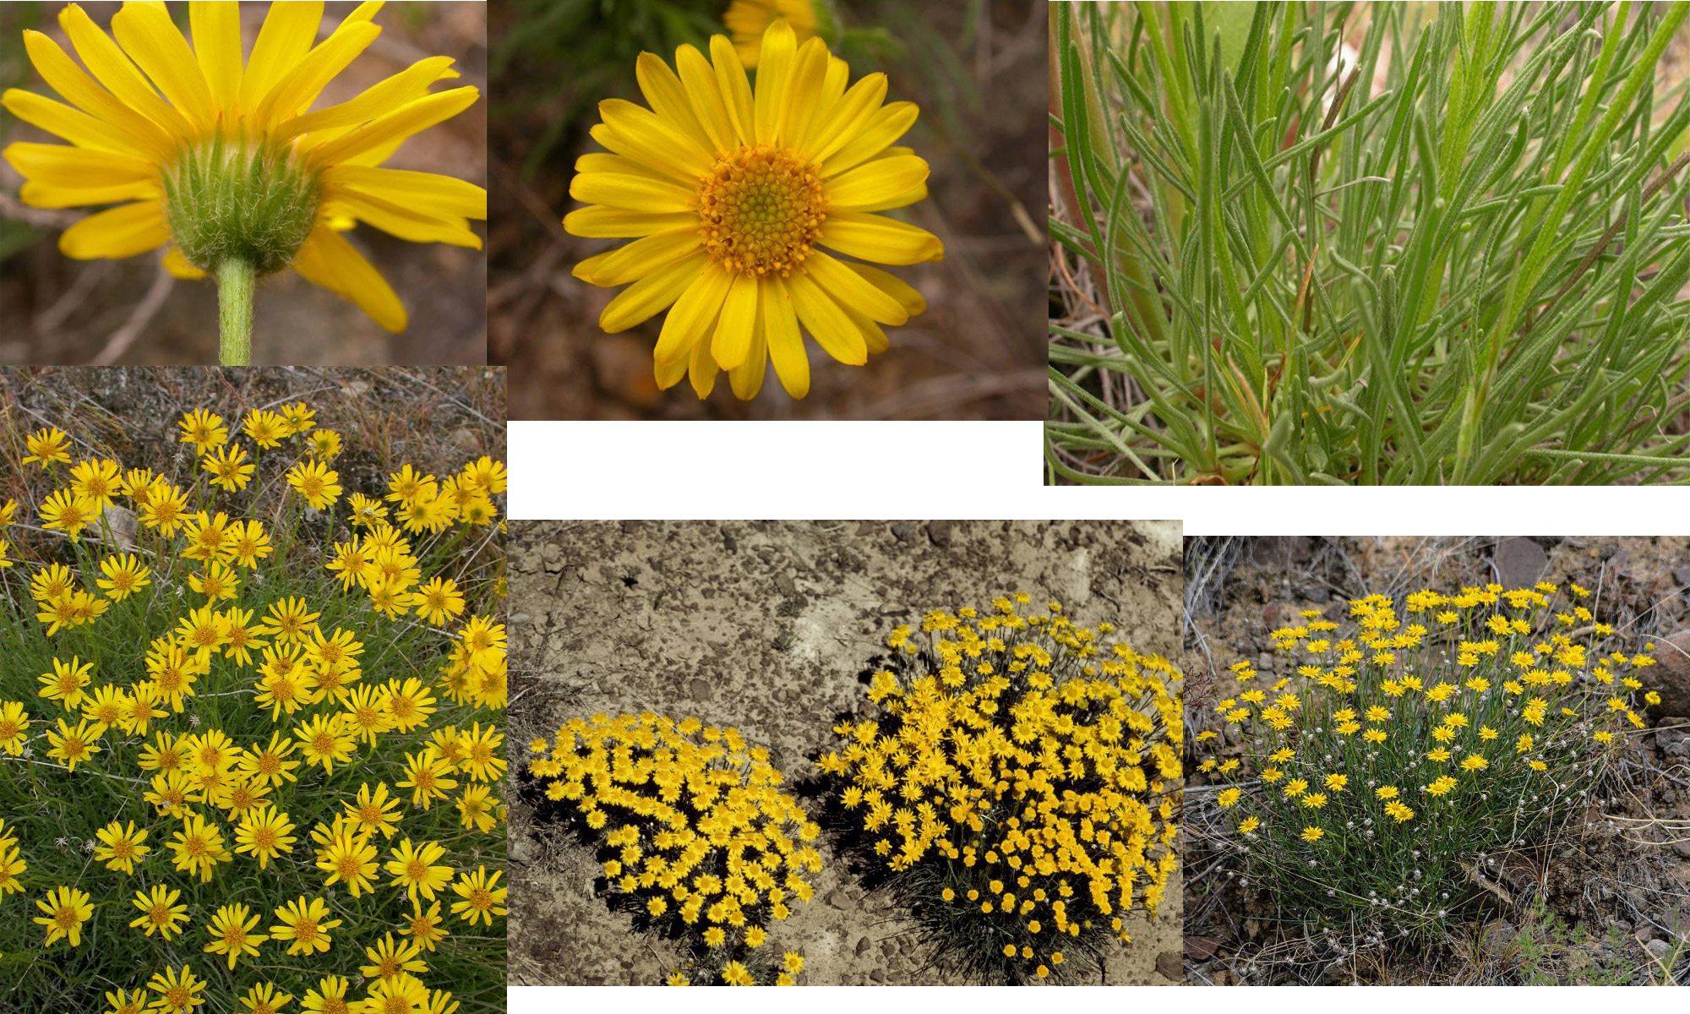
Desert Yellow Daisy – Sunflower Family

Slide 16
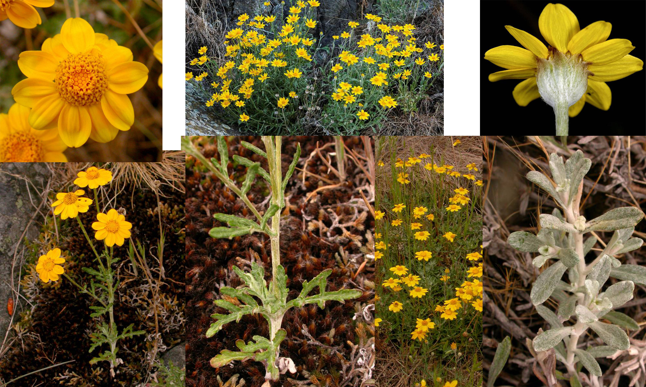
Oregon Sunshine – Sunflower Family

Slide 17
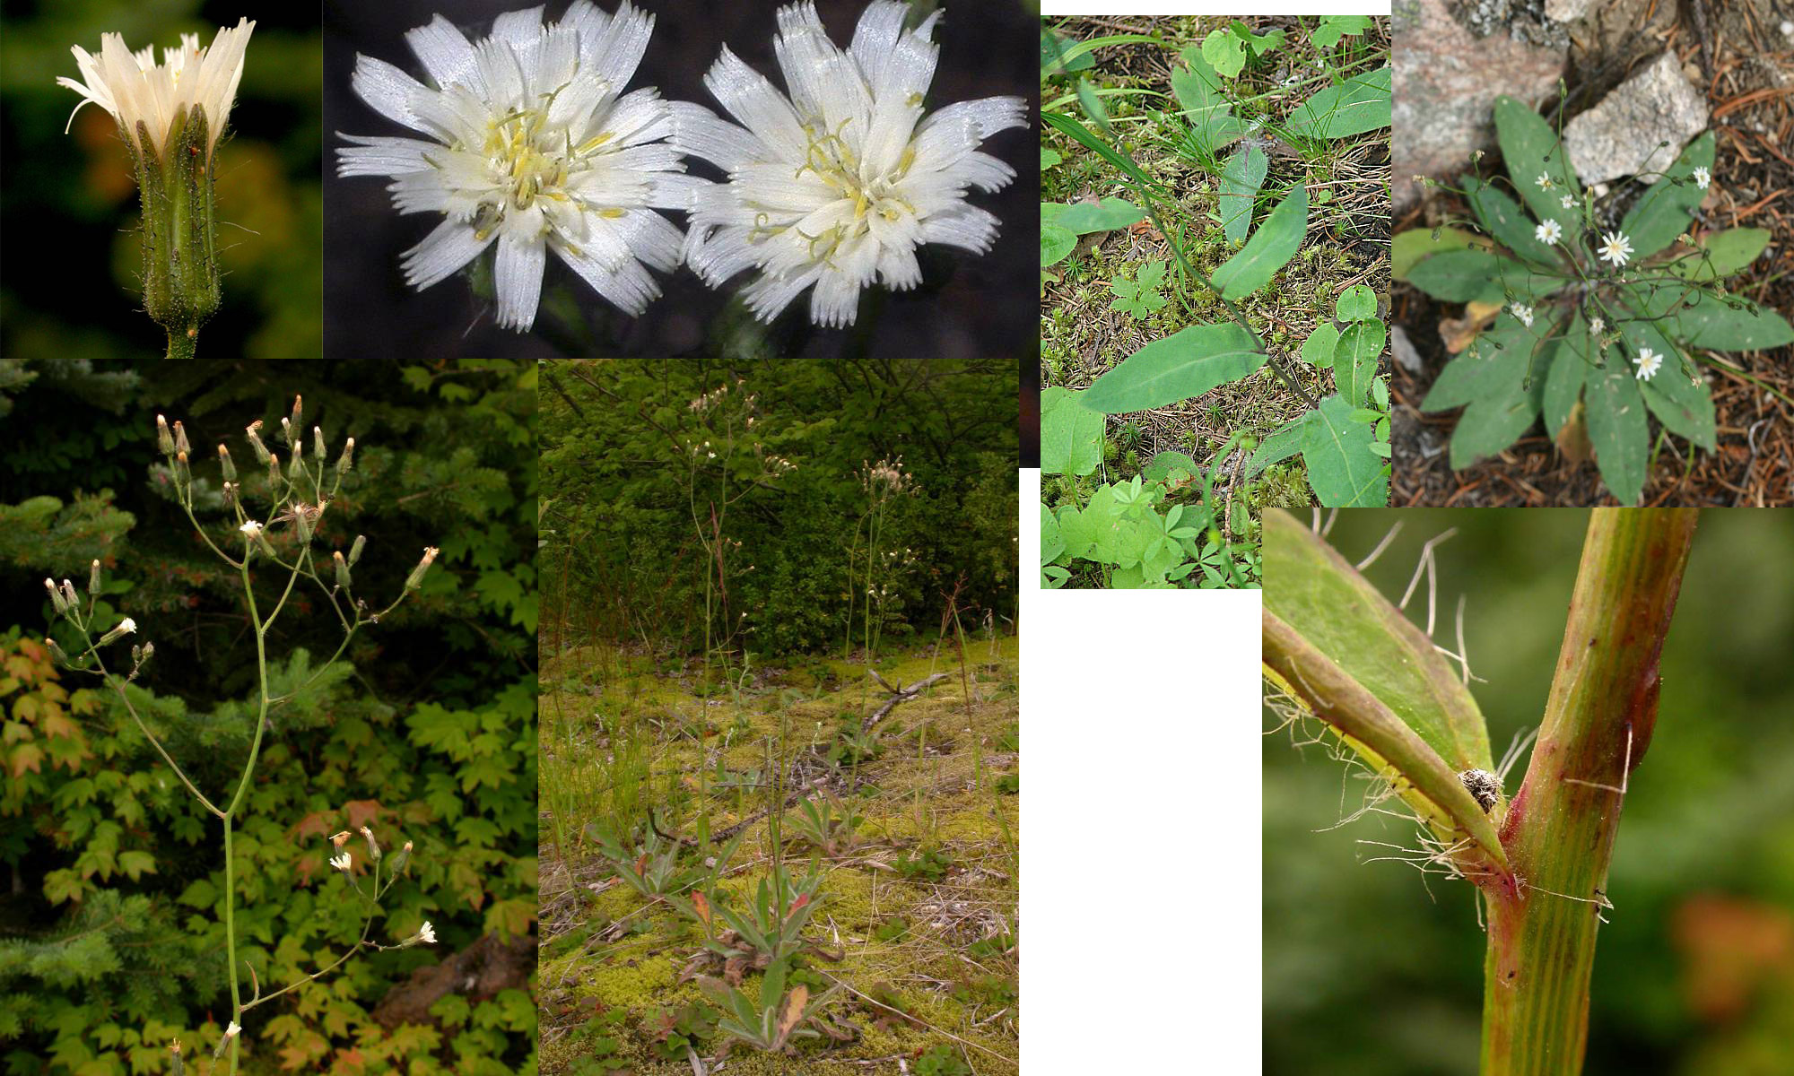
White-flowered Hawkweed – Sunflower Family

Slide 18
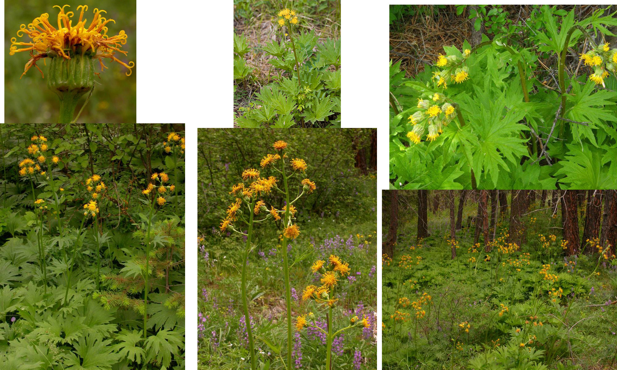
Silvercrown luina – Sunflower Family

Slide 19
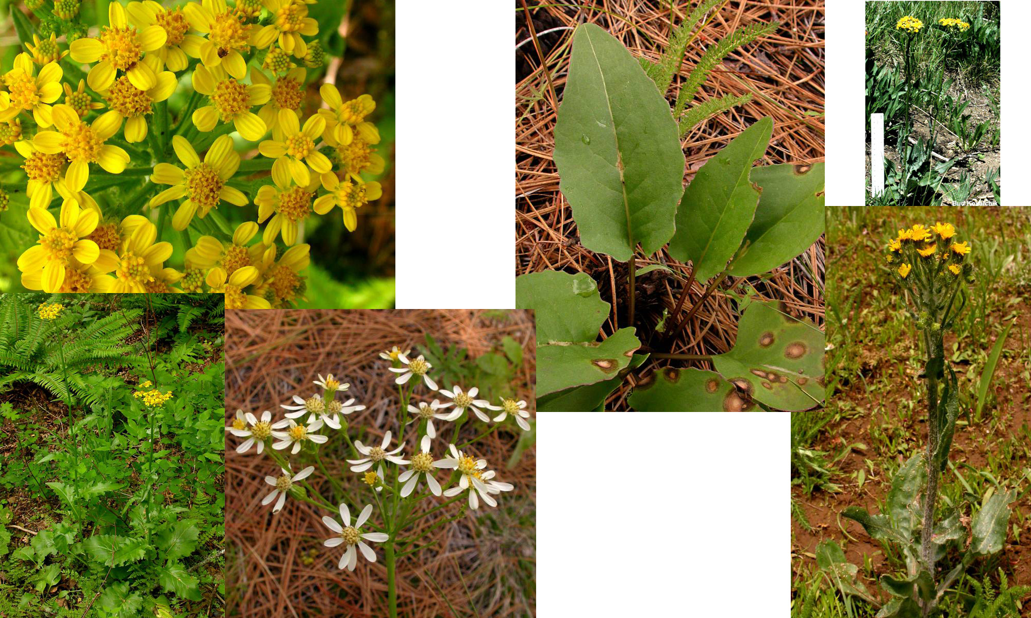
Western Groundsel – Sunflower Family

Slide 20
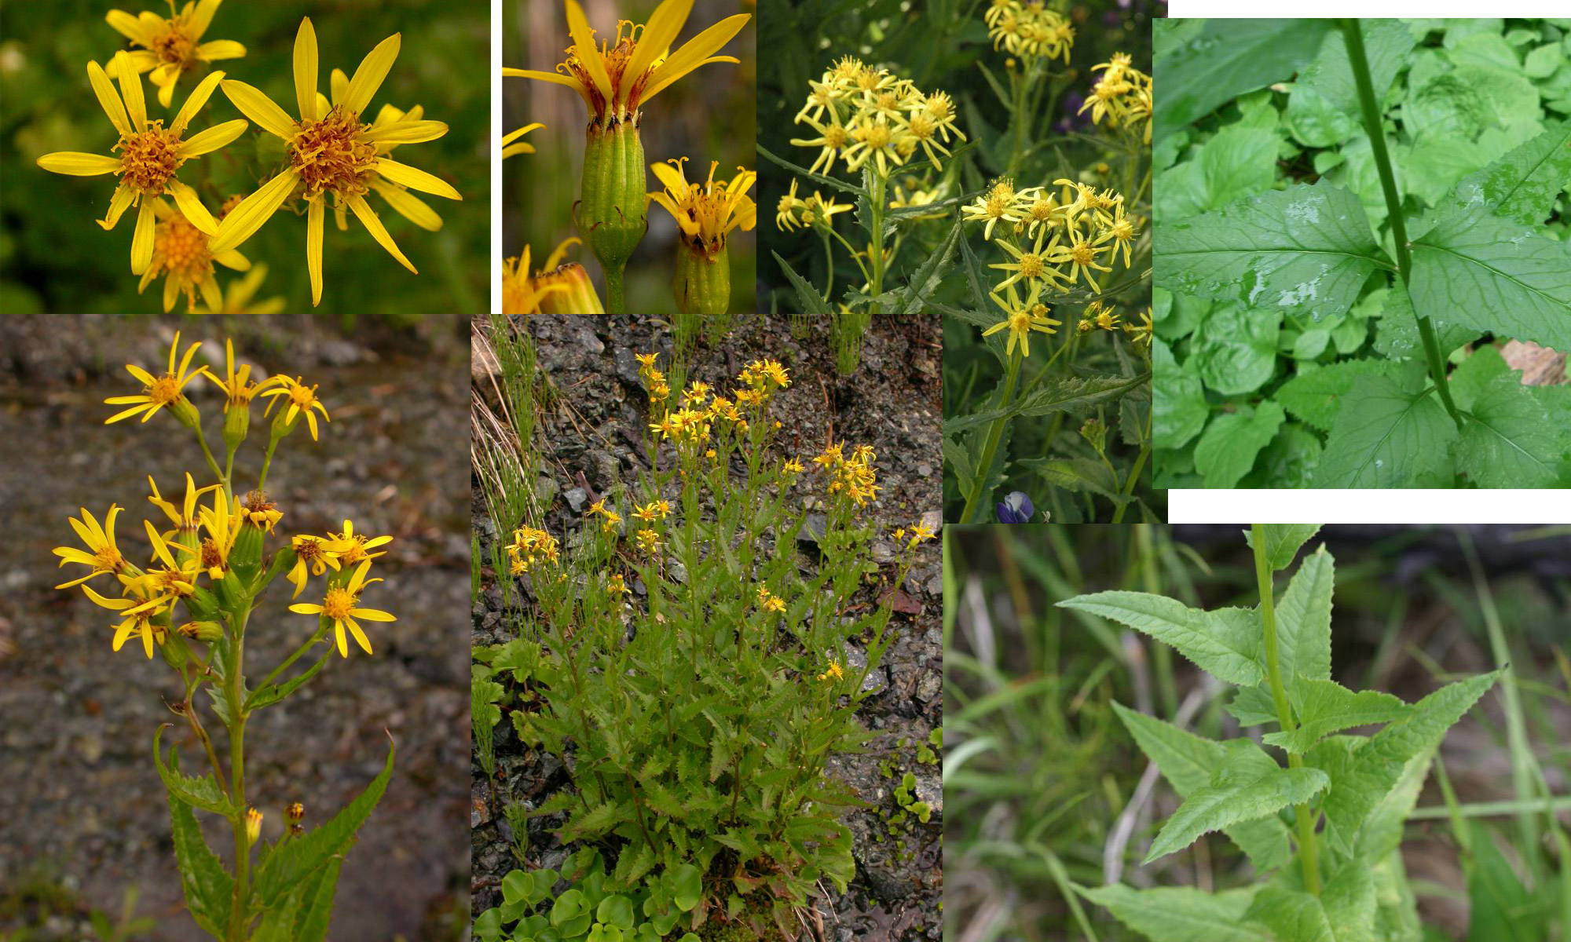
Arrowleaf Groundsel – Sunflower Family

Slide 21
Key to Plants (in order of slides)
Sharp-tooth Angelica
Gray’s Lovage
Geyer’s Desert-Parsley
Pestle Parsnip or Barestem Biscuitroot
Nine-leaf Lomatium
Mountain Sweet-Cicely
Western Sweet-Cicely
Yarrow
Pearly Everlasting
Raceme Pussy-Toes
Heart-leaf Arnica
Arrow-leaf Balsamroot
Desert Yellow Daisy
Oregon Sunshine
White-flowered Hawkweed
Silvercrown Lunia
Western Groundsel
Arrowleaf Groundsel

