Slide 1
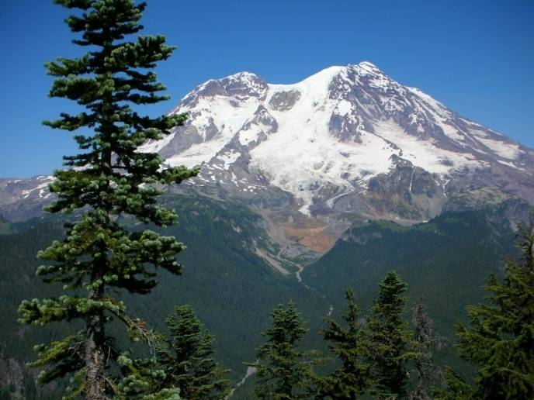
Life Zones in Washington
Notes:
The concept of life zones was first noted by Humboldt in 1800s and refined by Merriam in USDA work in 1890s. It depends on geology and climate. It has been described as areas with similar plant and animal communities.

Slide 2
What is a Life Zone?
Life zones are areas with similar plant and animal communities
Notes:
A life zone is similar to, but not identical with an ecoregion, a large unit of land or water containing a geographically distinct assemblage of species.

Slide 3
Why is understanding life zones important?
Each life zone has characteristic species:
Trees
Plants
Animals
Life zones provide a framework for predicting the flora and fauna of a particular ecoregion.

Slide 4
What makes a life zone ?
Precipitation
Temperature
Other Factors
Elevation, wind, fire, avalanche, flood, clear-cutting, soil type and nutrients, aspect, steepness, intensity of solar radiation (insolation)

Slide 5
Weather and Precipitation
The Pacific Ocean is the chief determinant of the NW weather pattern.
Source of precipitation via jet stream
Moderates temperatures all year round
Mountain ranges are also a major determinant of NW weather. They moderate weather coming in from the ocean and from the interior of the continent

Slide 6
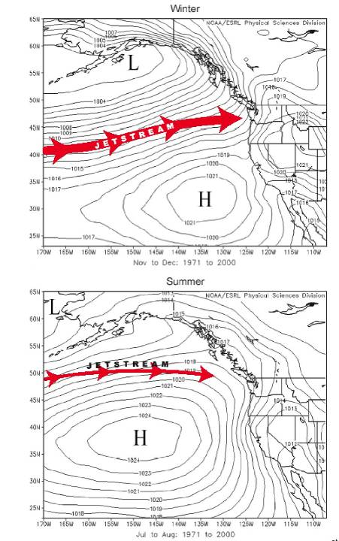
Pacific jet stream
WINTER
Strong, aimed toward Wa coast
SUMMER
Weaker, aimed north of Wa
Notes:
Storms are associated with the jet stream. Strength of jet stream is stronger in winter and farther south. Higher pressure dominates in the summer, lower in winter.

Slide 7
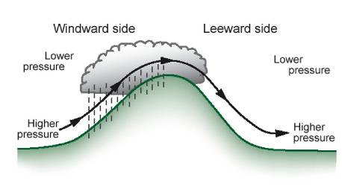
Moist Pacific air hits the west side of NW mountain ranges, rises, cools as it expands at lower pressure, and drops its moisture. The drier air then sinks and warms producing rain shadowing on the east side of both the Olympics and Cascades
Notes:
On windward side air is forced upward by mountains, encounters lower pressure causing air to expand and cool. When air is saturated we get rain. On leeward side air sinks, compresses and warms causing clouds to dissipate.

Slide 8
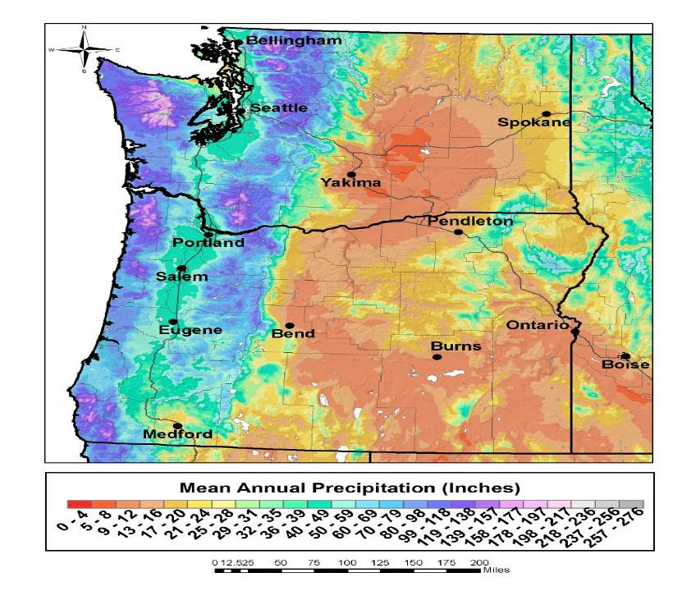
Mean Precipitation
Notes:
Rain shadowing occurs east of the Cascades as well as east of the Olympics. .

Slide 9
Temperature
Temperature decreases approximately 3 degrees for each 1000 feet of elevation gain.
Temperature in the Cascades decreases as you go from south to north. The same species occur at lower elevations as you go from S to N.

Slide 10
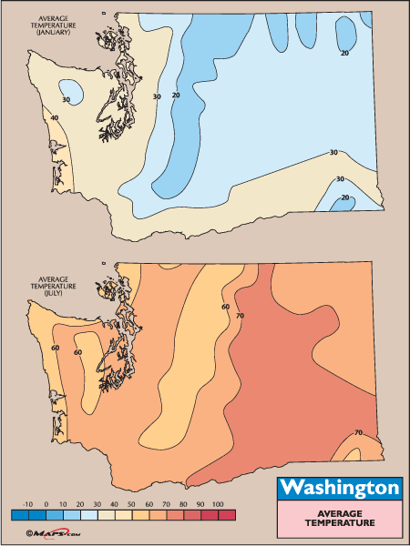
Washington Average Temperatures
January
July

Slide 11
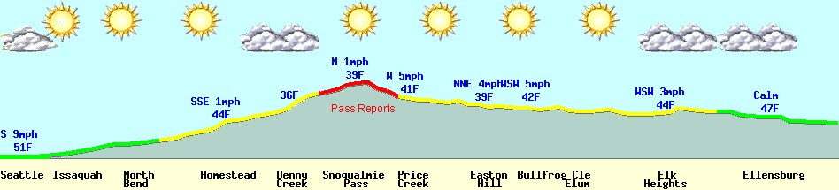
I-90 Cross State Travel
WSDOT
Approximate Elevation:
Seattle sea level Logged coastal forest
Denny Creek 2700 ft Coastal-Silver fir
Snoqualmie Pass 3000 ft Silver fir
Cle Elum 1900 ft Ponderosa
East of Ellensburg 1500 ft Shrub-Steppe

Slide 12
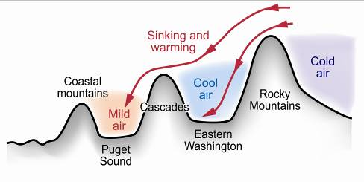
Cold intercontinental air is warmed as it
passes over the mountain ranges

Slide 13
PNW Life Zones
W to E
Intertidal
Coastal Forest - Olympic
Coastal Forest - Cascade
Silver Fir
Subalpine - west
Alpine
Subalpine - east
Interior Fir
Ponderosa Pine
Shrub - Steppe

Slide 14
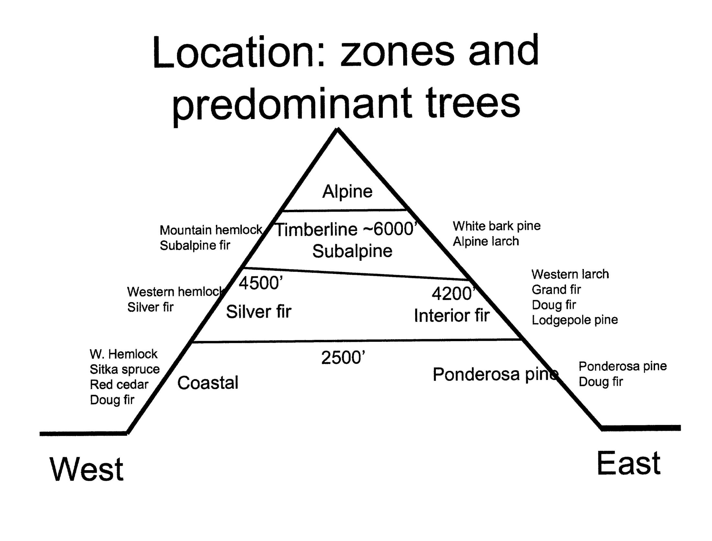
Notes:
Elevations are approximate and dependent on mean temperature. Mean temperature decreases with elevation (drop of 3 degrees for each 1000 feet of elevation gain.) Mean temperature also decreases as you move from south to north and the same species occur at lower elevations as you go north.

Slide 15
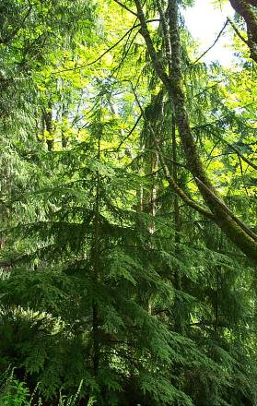
Coastal Forest Life Zone
Elevation: 0 – 2000 ft.
Dominant Conifers
Western Hemlock
Douglas Fir
Western Red Cedar
Olympic Coast – Sitka spruce
Notes:
Qualities: High rainfall, temperate climate (little or no snow), summer drought, acidic soils, summer fog (Olympic zone)
Forest succession – seral and climax species. Douglas fir seral, western hemlock climax (after abandonment, logging or fire)

Slide 16
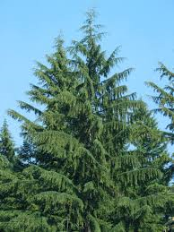
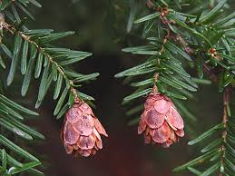
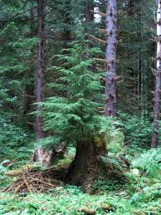
Western Hemlock

Slide 17
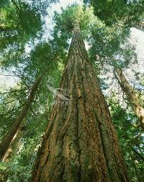
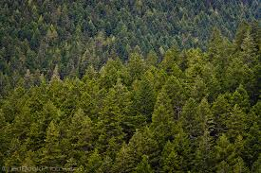

Douglas Fir

Slide 18
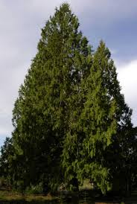
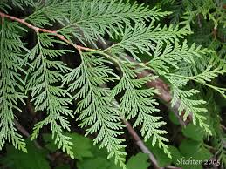
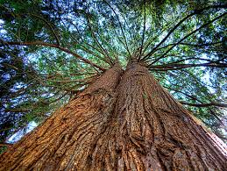
Western Red Cedar

Slide 19
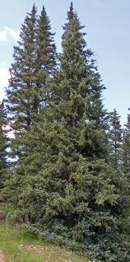
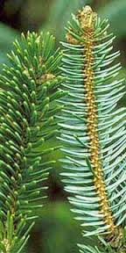

Sitka Spruce-Olympics

Slide 20
Coastal Forest
River valleys: Ohanapecosh, Hoh River
Copious rainfall
Trees: immense, huge biomass. rainforest
Dense canopy shades understory, except at edges
Plants: salmonberry, salal, devil’s club, moss, fern, lichens.

Slide 21
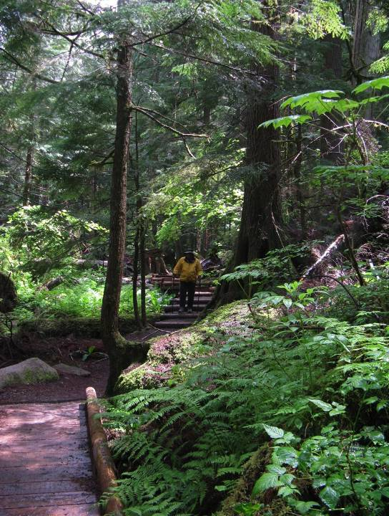

Slide 22
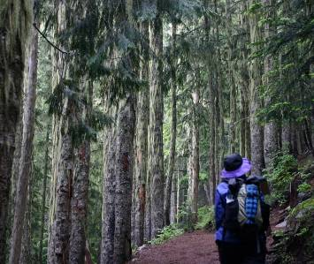
(W) Silver Fir Life Zone
Elevation: 2500-4500 ft.
Dominant Trees
Pacific Silver Fir
Western Hemlock
Notes:
Qualities: steep terrain, significant snowpack,, avalanche chutes
Silver fir is slow growing under canopy, takes advantage of blowdowns to shoot up.

Slide 23
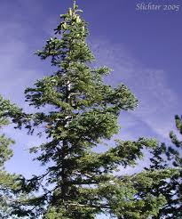
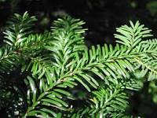
Silver Fir

Slide 24
Silver Fir
Mt. Rainier Paradise Road
Cold, heavy snow, soil poor & acidic
Plants: heath, huckleberry, vanilla leaf

Slide 25
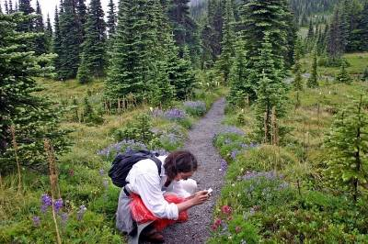
(W & E) Subalpine Life Zone
Elevation: 4000-7000 ft
(Up to treeline)
Dominant trees
(W) Subalpine Fir, Mountain Hemlock
(E) Whitebark Pine, Alpine Larch
Notes:
Qualities: highest temperature extremes (west), intense solar radiation, moderate precipitation (west), lower precipitation (east), park-like mix of meadow and tree islands.

Slide 26
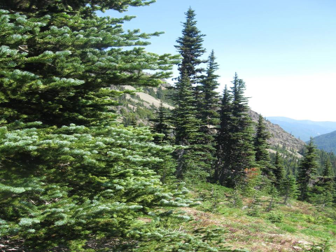
Subalpine Fir - spires

Slide 27
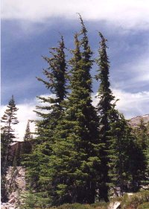
Mountain Hemlock

Slide 28
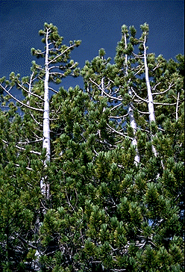
Whitebark Pine

Slide 29
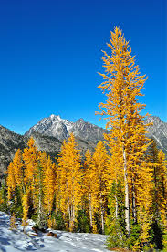

Alpine Larch

Slide 30
(W & E) Subalpine
Paradise, Heather Meadows, Hurricane Ridge
Cold, snow lingers late, growing season 8-10 weeks
West: lots of precipitation, mostly as snow
East: drier
Parklands: meadows with clustered subalpine fir
Plants: huckleberry, heather, bistort, valerian, glacier lilies, lupine, paintbrush. sedges

Slide 31
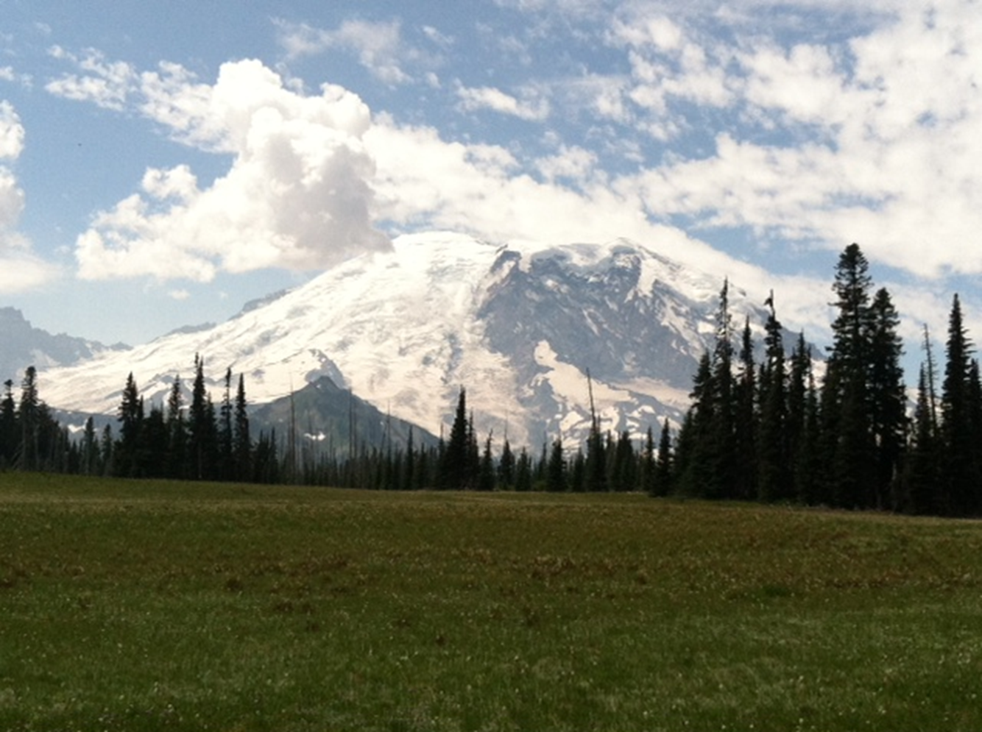
Grand Park - MRNP

Slide 32
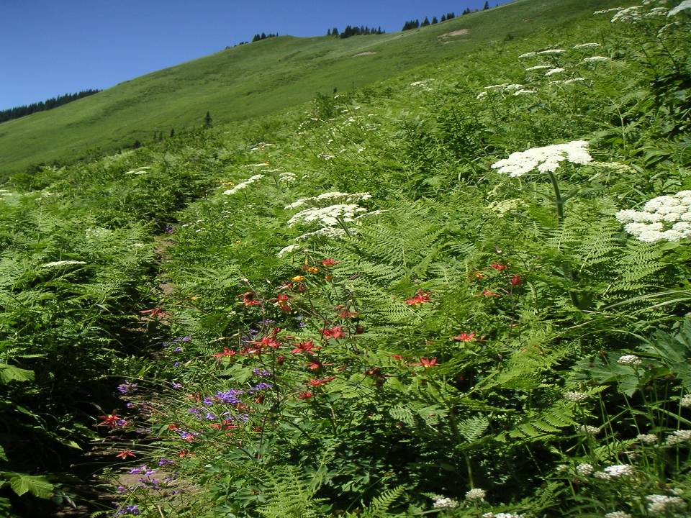

Slide 33
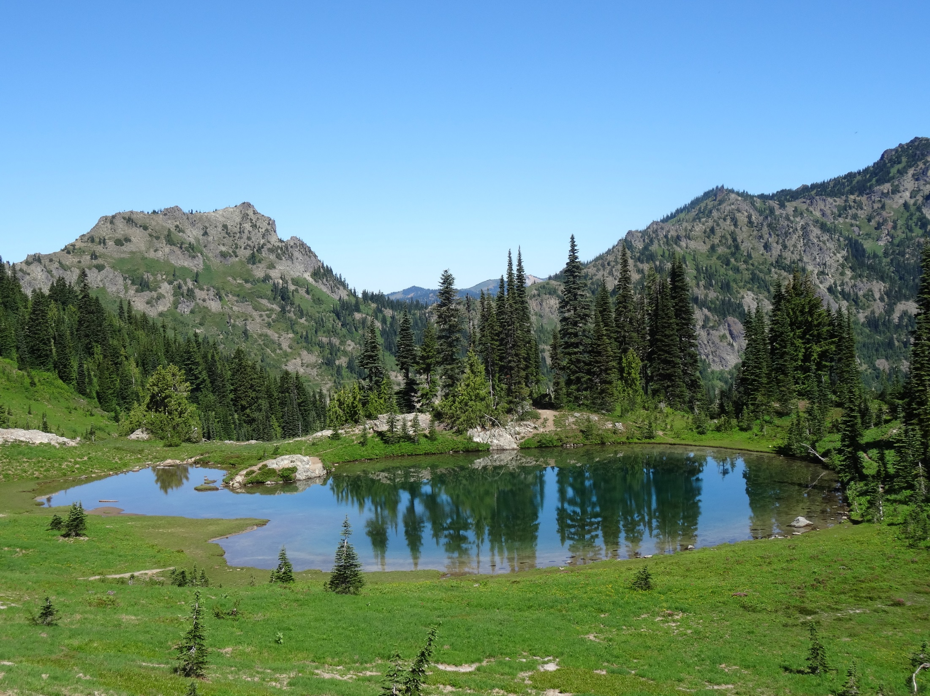
Naches Peak

Slide 34
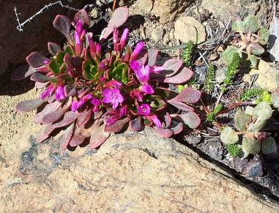
Alpine Life Zone
Elevation: treeline to 7500 ft
Dominant Trees:
No trees or stunted
(krummholz) trees
near timberline
Notes:
Qualities: rugged terrain, low rainfall and snowpack, windy with blowing ice, very thin soils, very high insolation and UV, generally dry climate (water conservation is important)

Slide 35
Alpine
Krummholz (crooked wood) : stunted and misshapen trees covered in winter by snow, hug the ground, flag appearance
Thin, rocky soil along crest
Snow lingers later, short growing season of 60 days or less. Continuous wind.
Plants are small, take cushion form for protection from elements
Moss campion, sedums, heather, pussy toes, spreading phlox

Slide 36
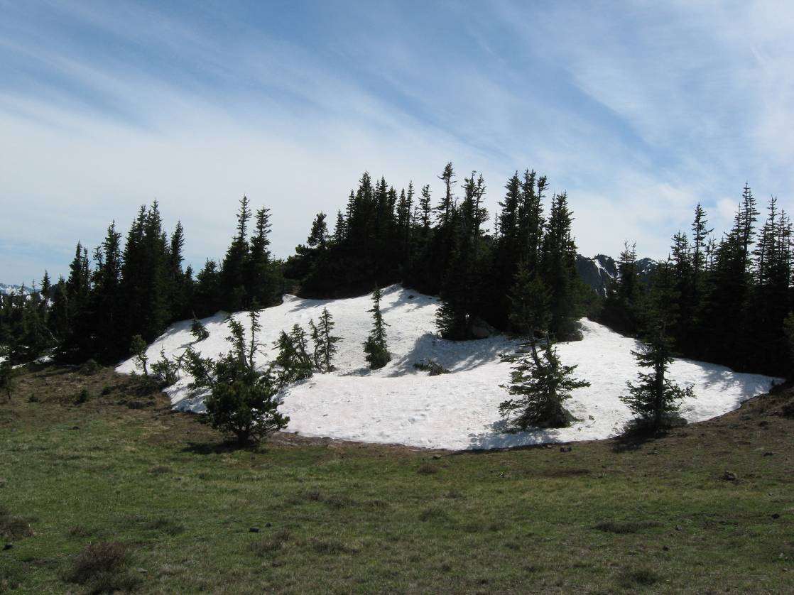
Krummholtz
Notes:
Many trees in the alpine/subalpine limits are stunted due to high winds and snowpack. Mt. Townsend

Slide 37
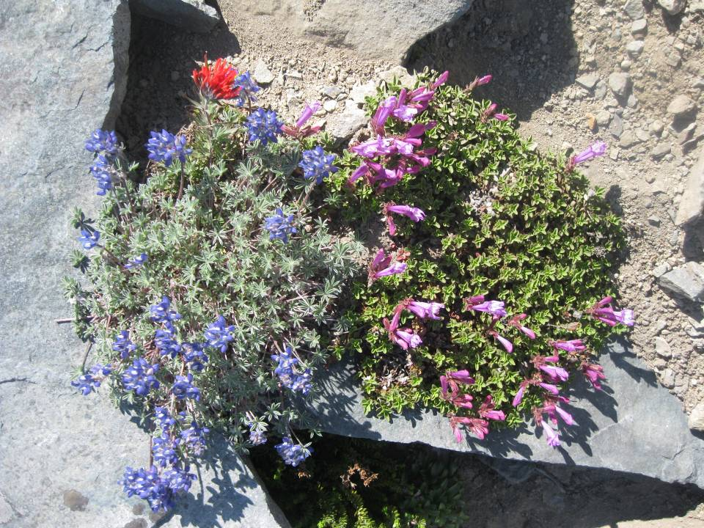
Notes:
Paintbrush, lupine, penstemon

Slide 38
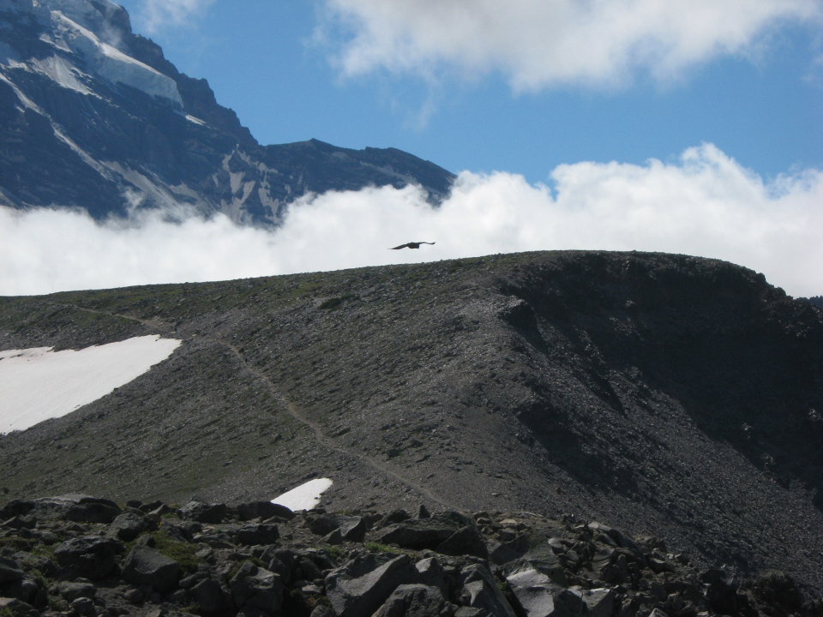
Notes:
Rocky, exposed, tiny plants grow in protected niches.

Slide 39
Notes:
Elevations are approximate and depend on mean temperatures.

Slide 40
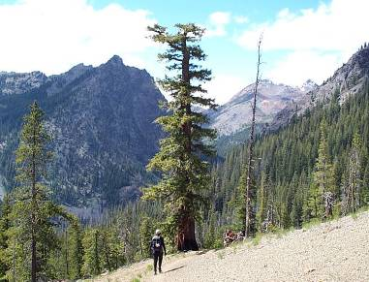
(E) Interior Fir Life Zone
Elevation: 2500-4200 ft
Dominant Trees
Grand Fir
Douglas Fir
Lodgepole Pine
Western Larch
Notes:
Qualities: low rainfall, significant snowpack, fire is important, intense solar radiation and hot summers, cold winters. High tree diversity. Note different douglas fir subspecies inland.

Slide 41
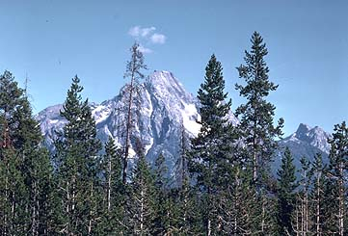
(E) Lodgepole Pine

Slide 42
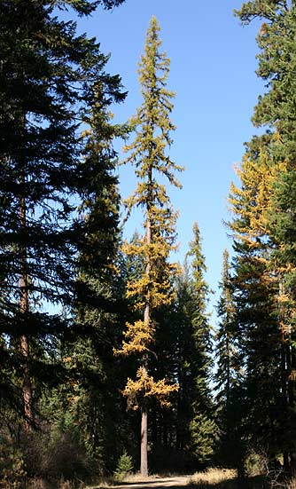
(E) Western Larch

Slide 43
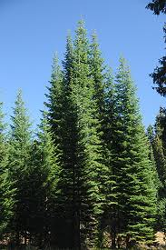
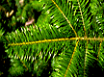
(E) Grand Fir

Slide 44
(E) Interior Fir
5-10 miles E of the crest on I-90
Douglas Fir and true firs, Lodgepole Pine
Plants: serviceberry, blueberries

Slide 45
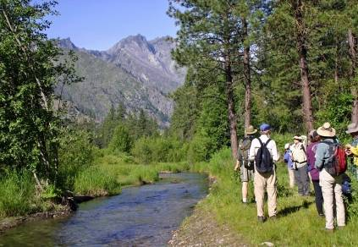
(E) Ponderosa Pine Life Zone
Elevation: 2000-4000 ft
Dominant Trees
Ponderosa Pine
Douglas Fir
Notes:
Qualities: more gentle terrain, high solar radiation and lots of sun, fire quite important, low rainfall,l low snow cover, winter drying (chinooks), summer drought

Slide 46
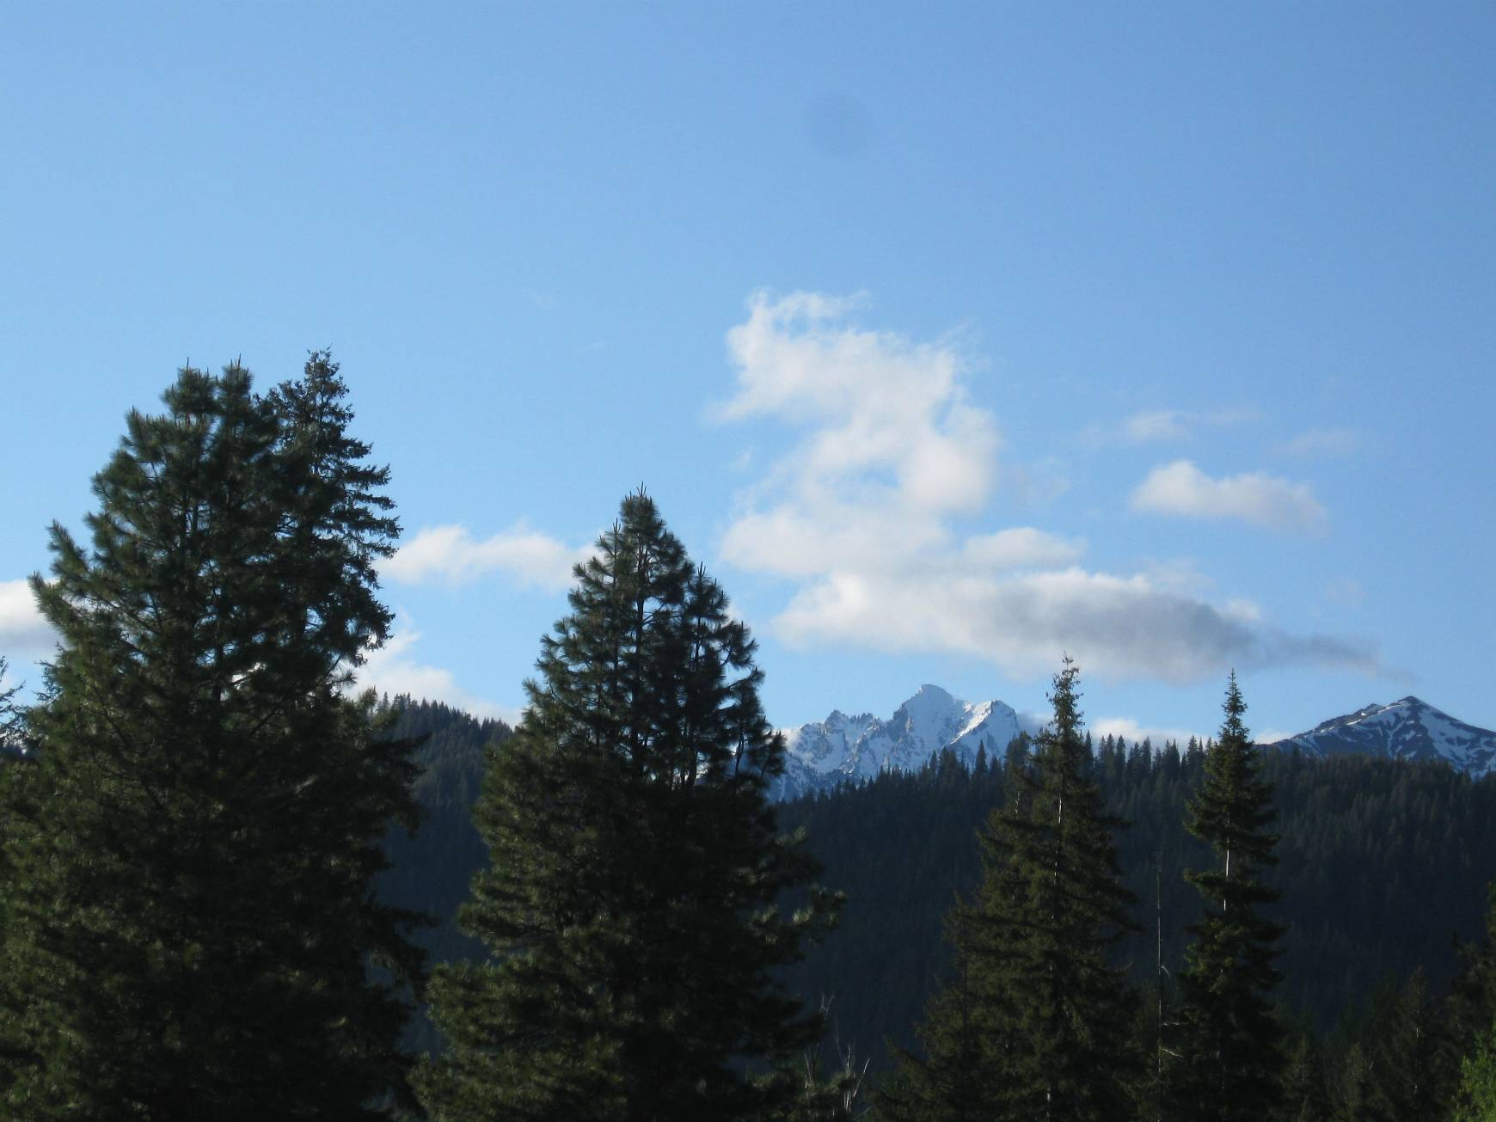
(E) Ponderosa Pine
Notes:
Teanaway near stafford creek

Slide 47
(E) Ponderosa Pine
I-90 20 miles E of Cascade Crest
Cle Elum, Teanaway
Long, hot, dry summers
Highly susceptible to fire
Balsamroot, asters, daisy, serviceberry, silvercrown luine

Slide 48
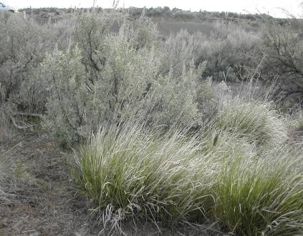
(E) Shrub-Steppe Life Zone
Elevation: 1000-2000 ft
Dominant trees: none
Shrubs: big sagebrush, rabbitbrush
Grasses
Notes:
Qualities: thick nutrient rich soils, very low rainfall and not much snowpack, windy, high solar radiation and sunny. Significant moisture stress.

Slide 49
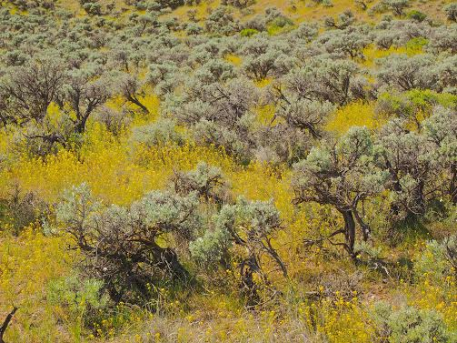

Slide 50
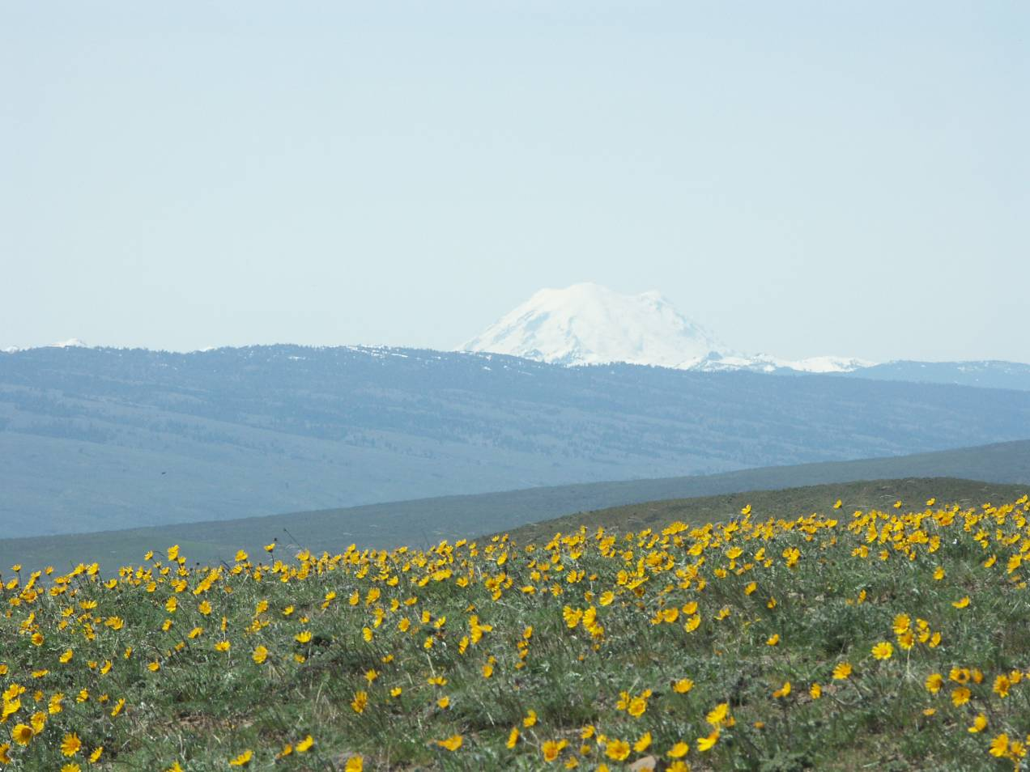
Notes:
Umptanum ridge. Rainier in background

Slide 51
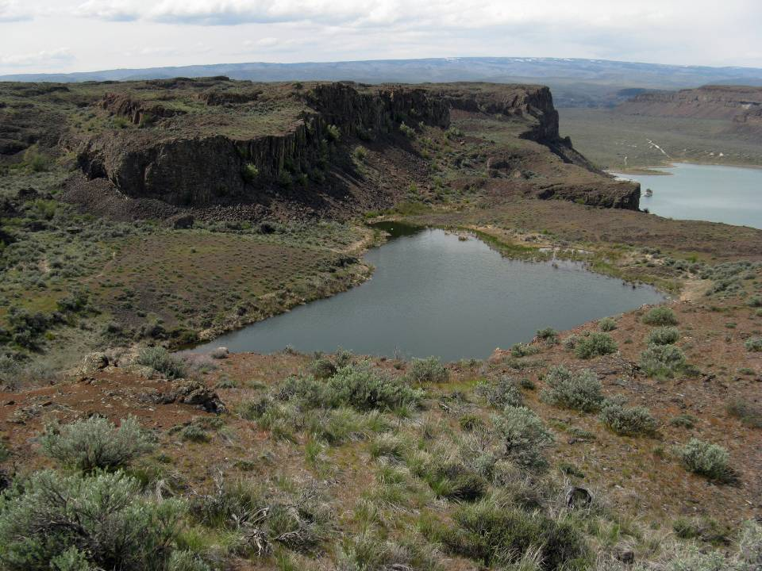

Slide 52
Shrub-Steppe
Columbia Basin, high plains of central and SE Oregon, ridges (Umtanum, Manastash) between Ellensburg and Yakima
Plants: big sagebrush, rabbitbrush, bunchgrasses, lomatiums, buckwheat, mosses, lichen, balsamroots and lupines, cheat grass (invasive)

Slide 53


Slide 54
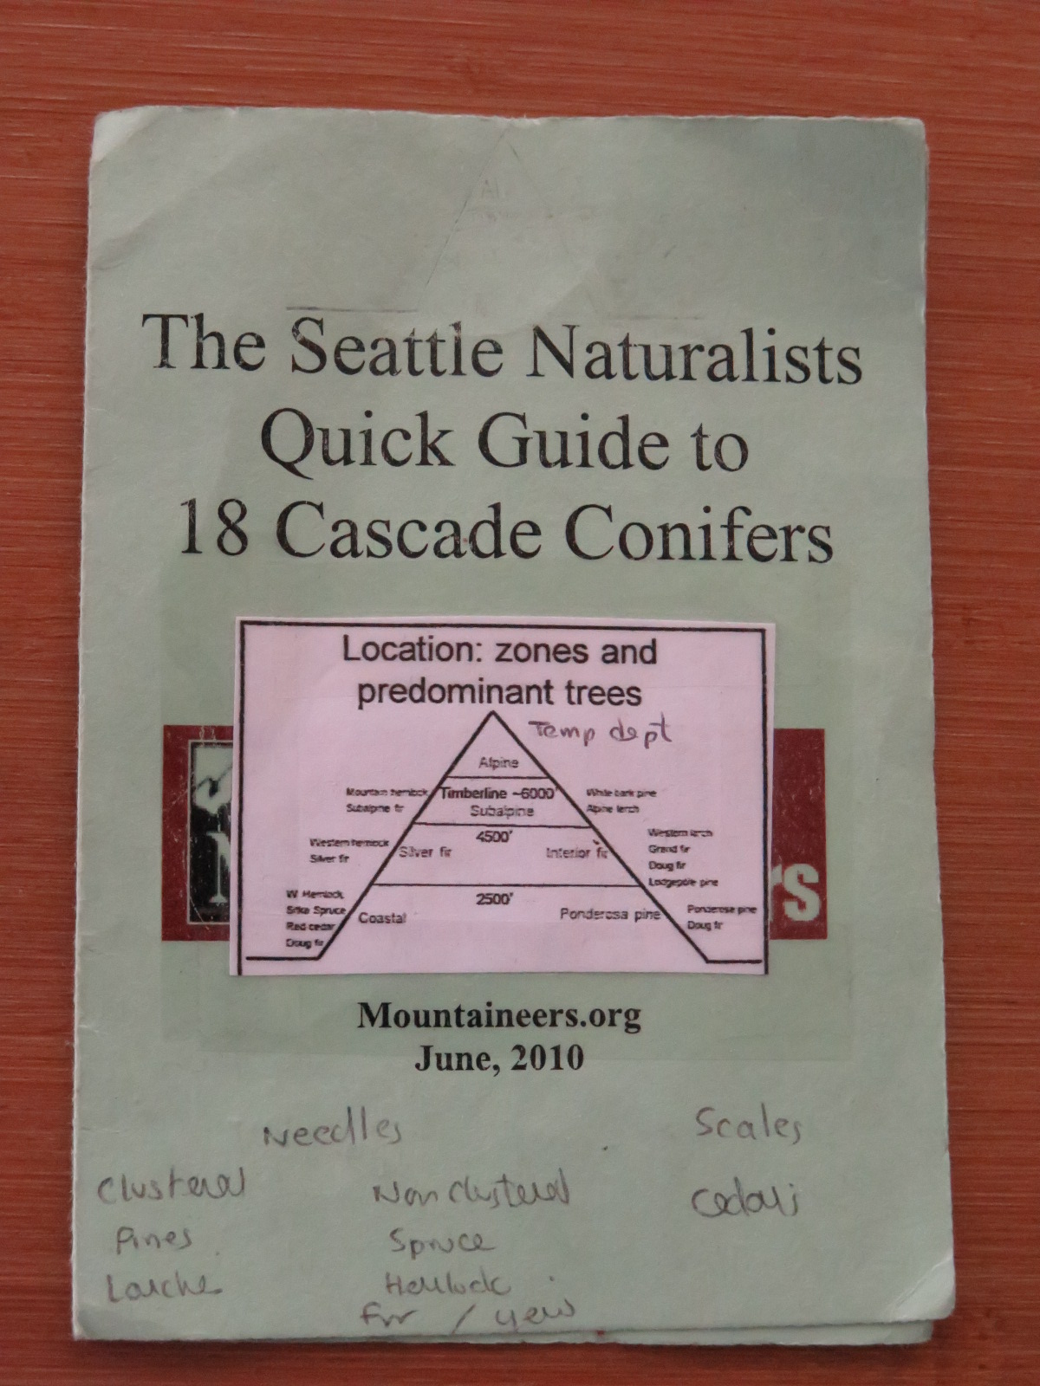

Slide 55
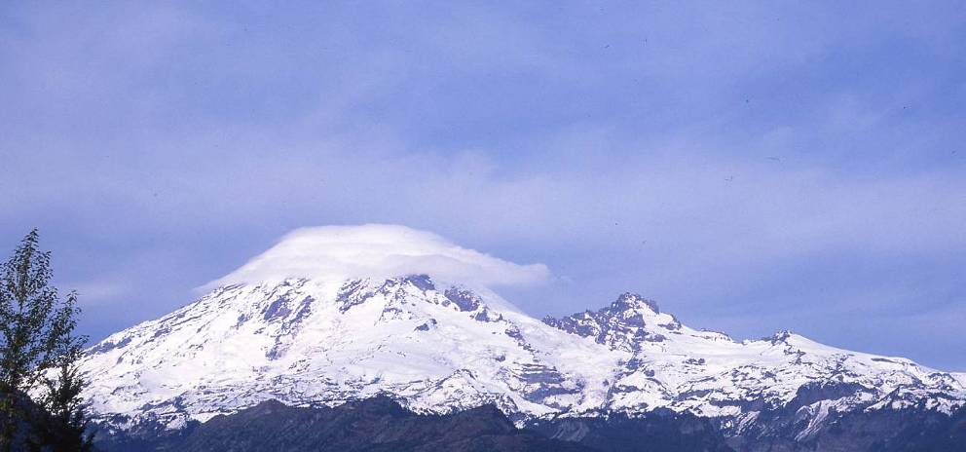
In every walk with nature one receives far more than he seeks.
John Muir

