Slide 1
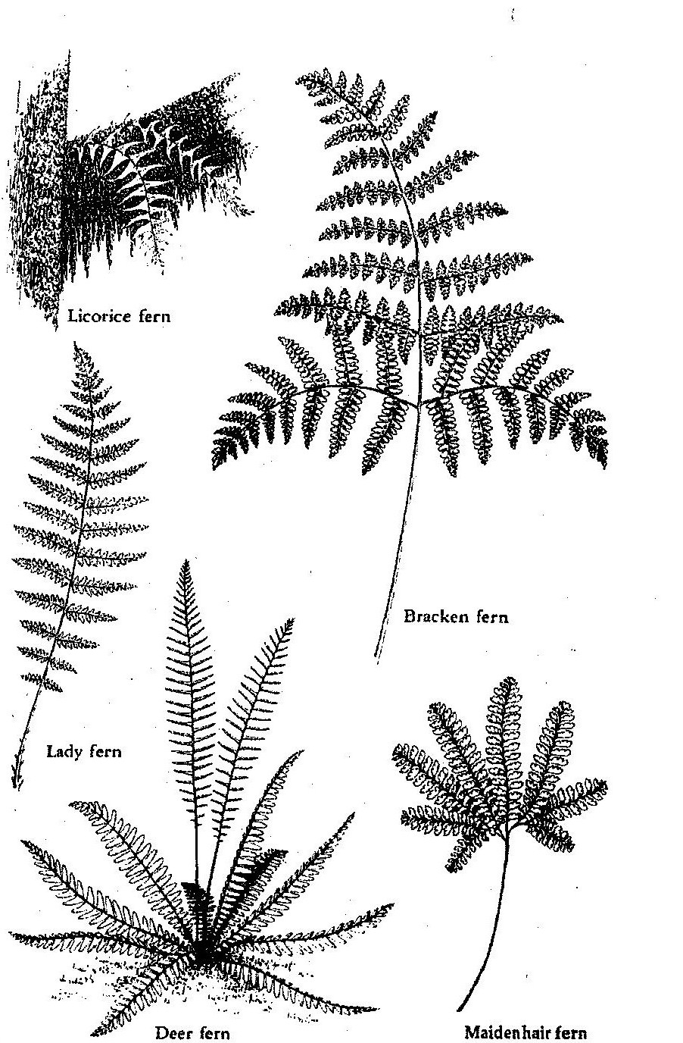
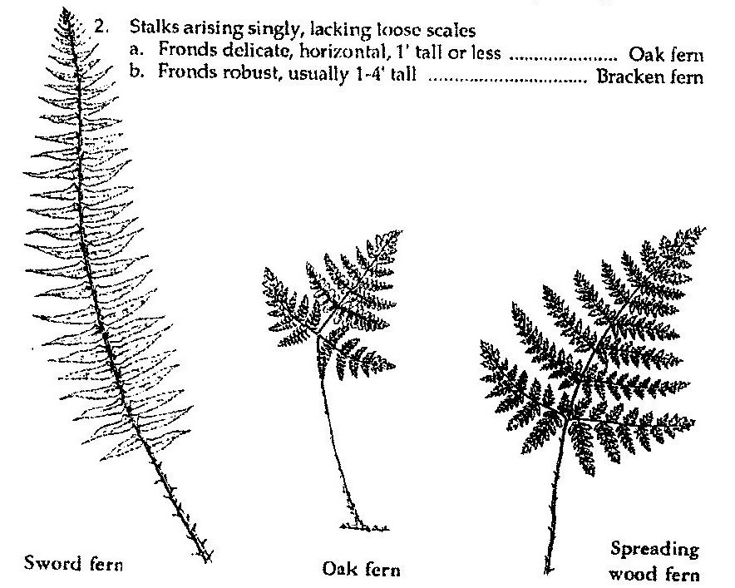
NW Ferns
The life cycle of a fern is an interesting one and involves two separate plants.
Ferns reproduce by means of spores which are borne in brownish clusters on
the undersides of the leaflets of fertile ferns. The ripe spores clusters dry and
spring open, dispersing thousands of spores. These spores develop into tiny intermediate plants called gametophytes. In this phase sexual reproduction
occurs. The fertilized egg then develops into a new fern.
Fronds divided into simple leaflets:
Leaflets toothed edges . . . . . . . . . . . . . . . . . . . . . . Sword Fern
Leaflets smooth on the edges
a) Grows on tree trunks, stumps sometimes rocks . Licorice Fern
b) Grows on moist forest floor . . . . . . . . . . . . . . . . . Deer Fern
Fronds divided into compound leaflets:
Fern stalk shiny BLACK . . . . . . . . . . . . . . . . . . . . . . . . Maidenhair Fern
Fern stalk not shiny black
a) Fronds widest at the middle . . . . . . . . . . . . . . . . . Lady Fern
b) Fronds widest at the base . . . . . . . . . . . . . . . . . . . Spreading Wood
Stalks arising singly, lacking loose scales
a) Fronds delicate, horizontal, 1 ft tall or less . . . . . Oak Fern
b) Fronds robust, usually 1-4ft tall . . . . . . . . . . . . . Bracken Fern
Licorice Fern
Bracken Fern
Lady Fern
Spreading Wood Fern
Deer Fern
Maidenhair Fern
Sword Fern
Oak Fern

Slide 2
Fern Parts
Fiddleheads
(uncurling fronds)
Frond
(twice divided)
Frond (once divided)
Stipe (leafstalk)
Scales
Rhizome underground stem
Roots

