Slide 1
The Making of Northwest
Landscape
Presented by Bruce Barcklow

Slide 2
Geological Processes
Volcanic
Glacial
Exotic Terranes (North Cascades, Olympics)
Batholiths (Mount Stuart)
Basalt Flows
Catastrophic Floods
Plate Tectonics and Continental Uplift are the major underlying forces

Slide 3
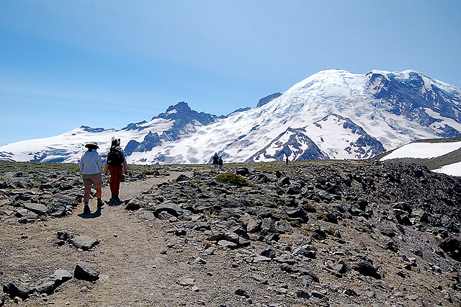
Mount Rainier from First Burroughs
Notes:
Most of the magnificent features that we see in our state are incredibly young geologically. Let’s focus first on the spectacular volcanic landscape. Mount Rainier is only a million and a half years old. But it sits on the ancient Cascade Volcanic Arc that has been spawning (now eroded) volcanoes for 37 million years. The Goat Rocks are the visible remains of one of those ancients. Notice the alpine terrain of extruded igneous rocks and pumice. Very specialized plants grow here that are able to bear the poor soil, short season, and the drying effects of the wind. We’ll be talking about “life zones” later tonight.

Slide 4
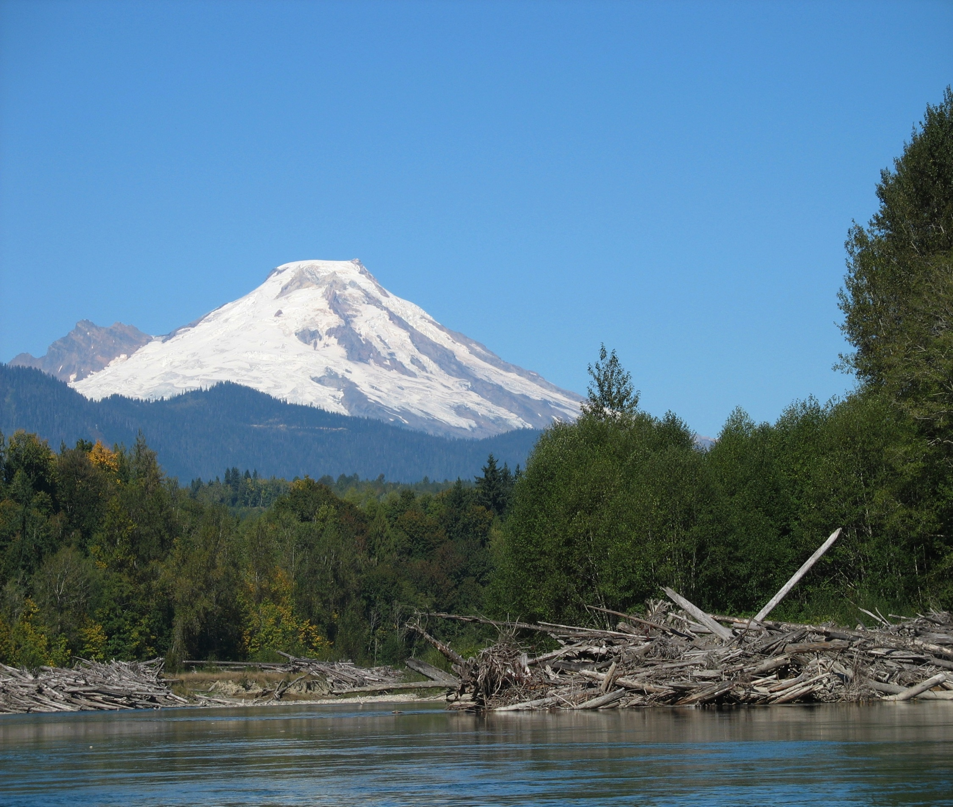
Mount Baker
Notes:
Mount Baker is much younger than Rainier – its present cone is only 80,000 years old. You might think that Mount Shuksan, visible on Baker’s shoulder, would also be volcanic – we’ll see that it’s not. The Nooksack River, like all Cascade rivers, is fed by snowpack and originates at a high altitude, so it brings great volume and velocity of water. Our rivers are a major influence on our landscape and make up a distinct ecosystem and habitat niche.

Slide 5
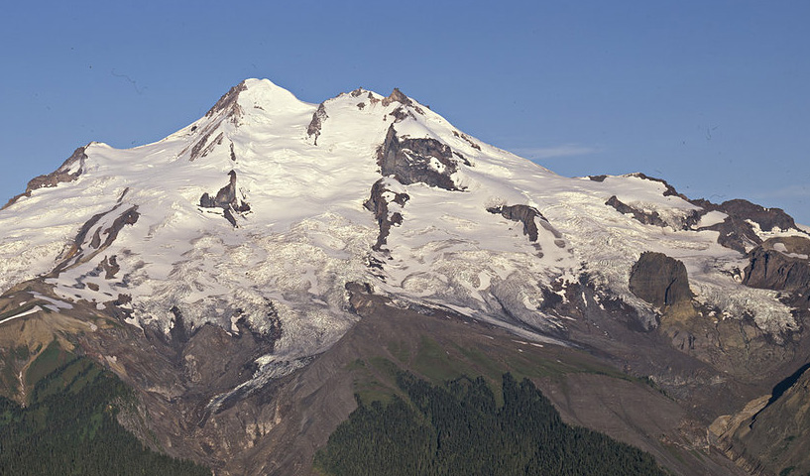
Glacier Peak – Chocolate Glacier in Center
Notes:
Glacier Peak is even younger than Baker. None of the Cascade volcanoes are extinct – they may not be presently active, but they are only dormant. Seven of the thirteen Cascade volcanoes from Mount Garibaldi in British Columbia to Lassen Peak in California have erupted in the past 200 years. This picture clearly delineates the extent of the treeline.

Slide 6
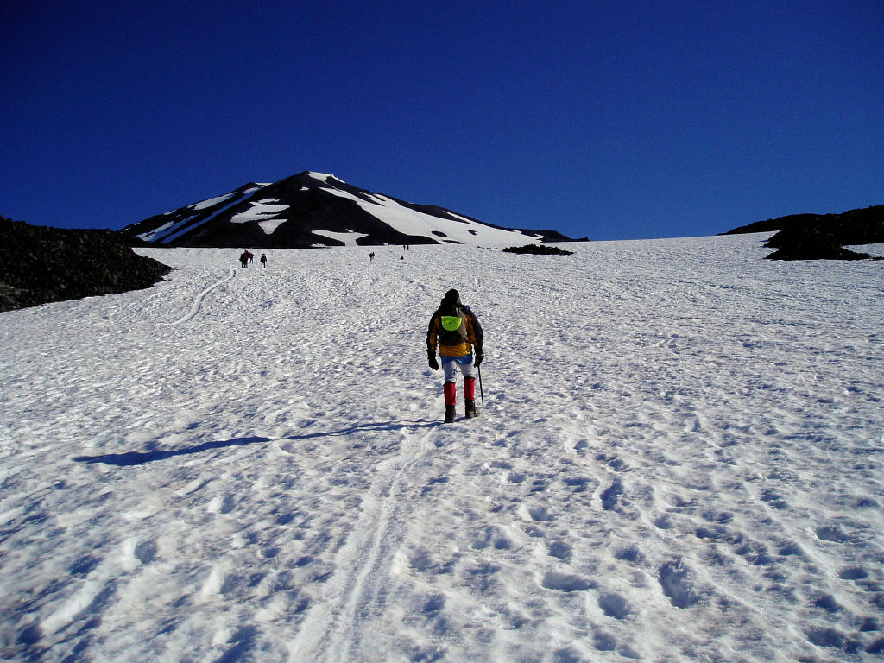
Adams False Summit from Lunch Counter
Notes:
Mount Adams and St. Helen’s are highly recommended, non-technical scrambles, yet they will make you feel like a mountaineer. Mt. Adams attained its present height only 25,000 years ago. The last eruptive episode was only 1,300 years ago. Is it any wonder that native peoples created their wonderful stories of these mountains out of awe?

Slide 7
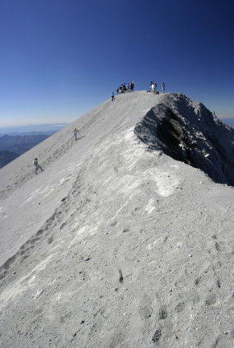
St. Helen’s Caldera
Notes:
This picture shows the distinctive St. Helen’s ash at the caldera. Every volcano has its own “signature” ash that is identifiable in layers of “tuff”. Everyone know that St. Helen’s erupted in 1981, as further evidence of our “living” geology and ever-changing landscape. You may not have known that ancient Mt. Mazama that created Crater Lake, and was as large as Mt. Adams, erupted only 7,700 years ago, covering most of Oregon in nine inches of ash. One only has to have experienced the 2001 Nisqually earthquake to have a concrete sense of the continuing geological activity beneath our feet.

Slide 8
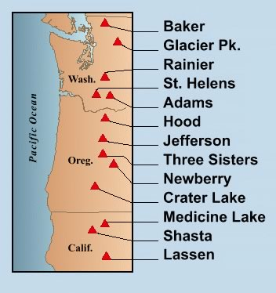
Notes:
You might have noticed that all of the Cascade volcanoes line up rather nicely. How do we explain that?

Slide 9
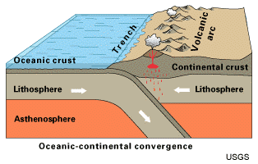
Notes:
You already may know the basics of plate tectonics – the earth discharges heat from its molten core through mid-ocean ridges that continually generates a dense crust 4-5 miles thick. This spreading sea-floor acts like a conveyer belt and migrates to the nearest continental land mass. In our case, this is the North American Plate, which is also travelling west at the rate of 3 inches a year to meet the conveyer belt that the new crust is on, which is also a plate. When the dense and heavy oceanic crust and the lithosphere, or upper mantle, meets the lighter continental crust, it subducts, or is diverted underneath it. When it subducts to a depth of about 60 miles, the heat generated by the pressure is released in the form of magma plumes, which find weaknesses in the continental crust and begin to form volcanoes.

Slide 10
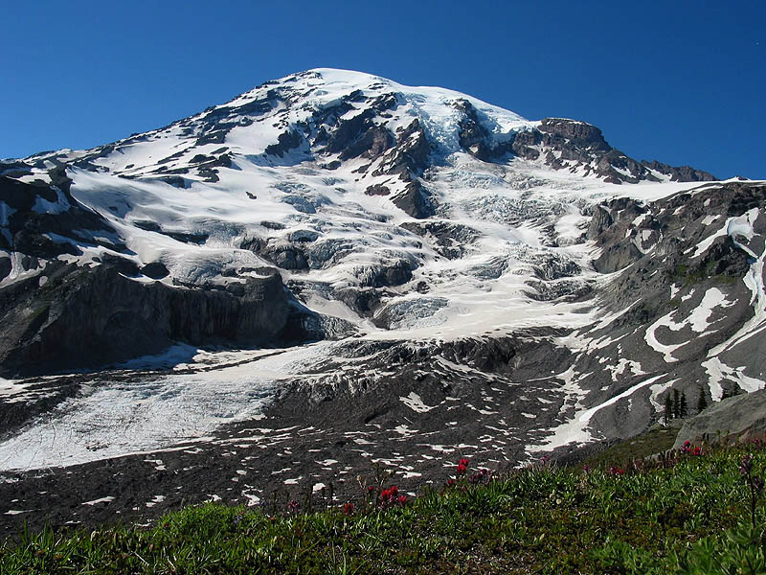
Wilson and Nisqually Glaciers at Rainier
Notes:
Glaciers may be retreating at an alarming rate, but we can still see their power, most graphically, where they still hold out. Besides Alaska, we are the most glaciated state. Glacial till – the sand, gravel and boulders carried by the glacier-can be seen in the bluffs of Discovery Park, the gravel pits of Vashon Island, and the glacial erratics in your neighborhood.

Slide 11
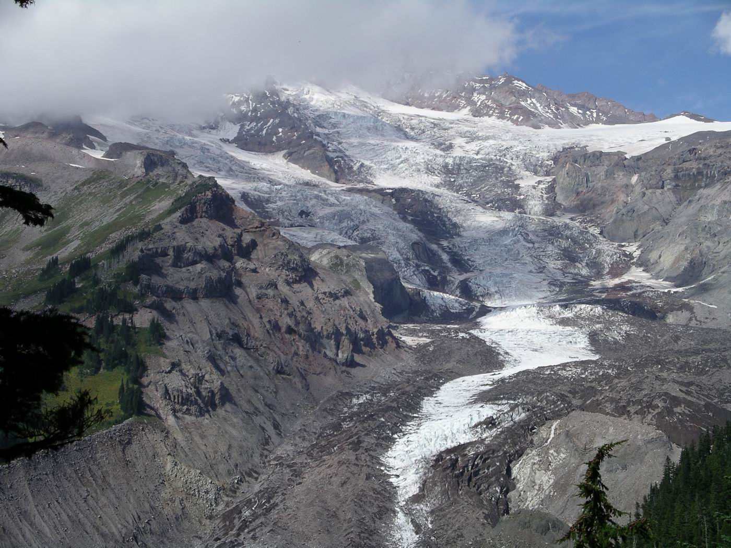
Nisqually Glacier
Notes:
A different angle of the Nisqually glacier shows the lateral moraine wall on the left

Slide 12
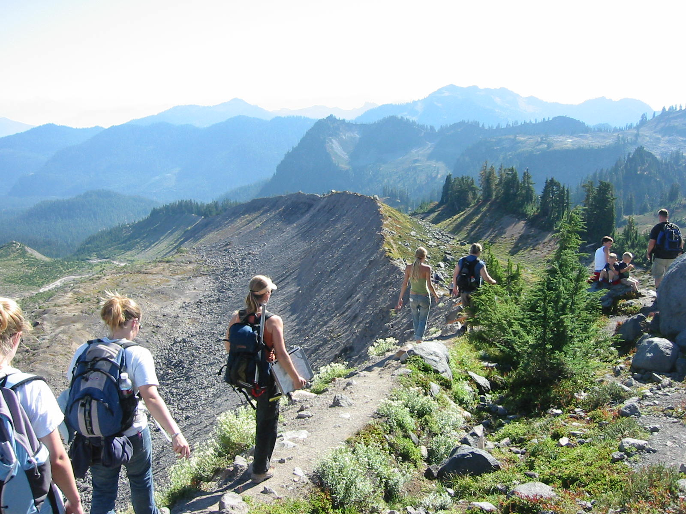
Glacial Moraine – Easton Glacier, Mt. Baker
Notes:
Another view of the massive carving power of the glaciers. The end, or snout of a glacier can often be identified by the terminal moraine that has been plowed to its furthest extent.

Slide 13
Rattlesnake Ridge and Snoqualmie
Valley from Mt. Si
Notes:
The Snoqualmie Valley is the result of the Puget lobe of the huge Cordilleran ice sheet that stretched into Montana. There were probably at least six glacial events in Washington in the last two million years, but the last one retreated only 11,000 years ago. At the time, Puget Sound was under a mile of ice which also excavated Lake Washington and Sammamish. Hood Canal is a also a glacier carved fjord.

Slide 14
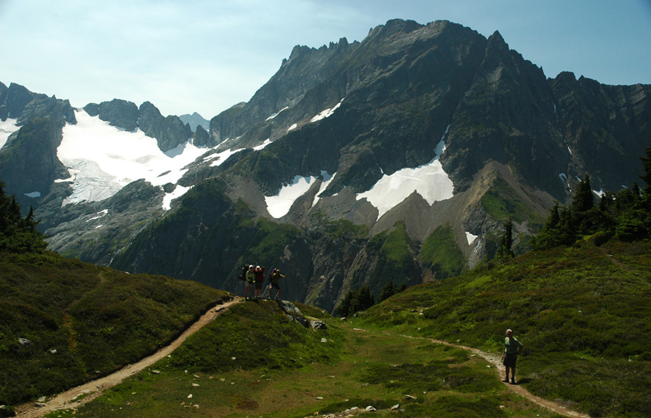
Trail to Sahale Arm – North Cascades
Ptarmigan Traverse on Left
“Exotic Terrane”
Notes:
Cascade Pass gives you a 360 degree view of the North Cascades, which are not of volcanic origin. Put the term “exotic terrane” into your vocabulary. At one time, 195 million years ago, Spokane was the west coast. Everything that has been added to Washington since that time has come from somewhere else, often thousands of miles away, on the conveyer belts of plates or faults. The North Cascades is one of those exotic terranes. It arrived and accreted to the continent from 50 to 75 million years ago. The North Cascades are heavily glaciated and in the occasional rockfall one can hear the ongoing forces of erosion and mountain breakdown.

Slide 15
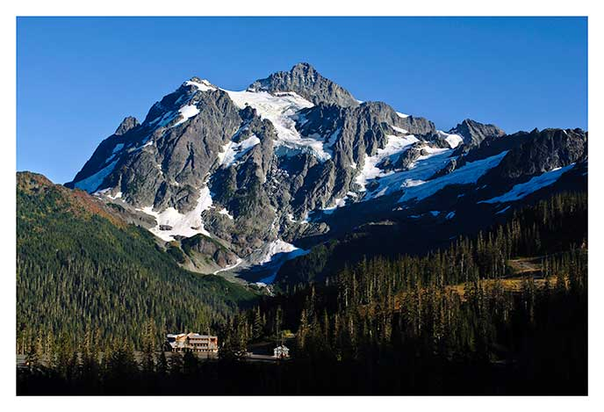
Mount Shuksan
Notes:
Mount Shuksan is another example of an exotic terrane. It migrated here from California 85 million years ago as part of a “melange” terrane. Looking at it, you can easily see that it is not volcanic, and its rocks are indeed chaotic-looking. An exotic terrane subducts in the same way that a plate does, creating a “suture” of magma or granite.

Slide 16
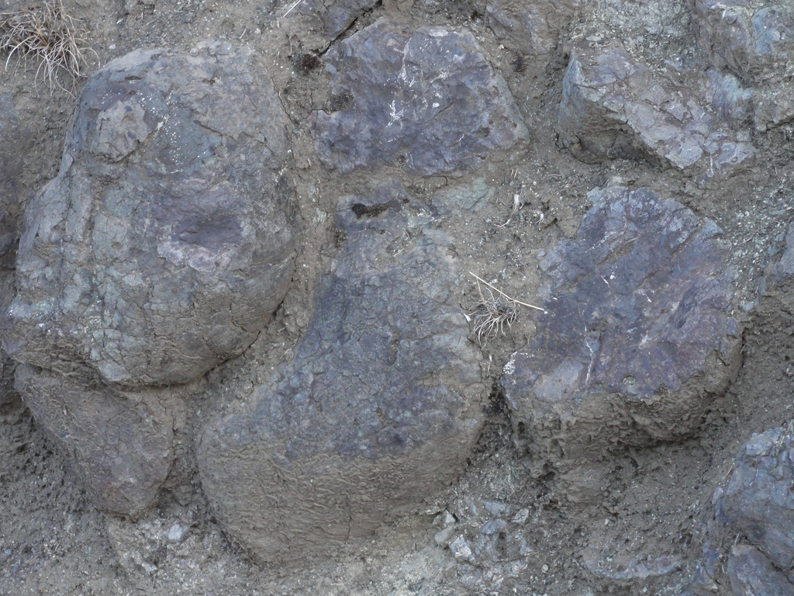
Pillow Basalts exposed on Olympic Coast
Notes:
The Olympics only broke the ocean surface about 5 million years ago when they were uplifted along with the Cascades by the subducting Juan de Fuca plate. The pillow basalt was cooled almost immediately by the frigid ocean temperatures, resulting in a much less dense rock, though still having the physical properties of basalt.

Slide 17
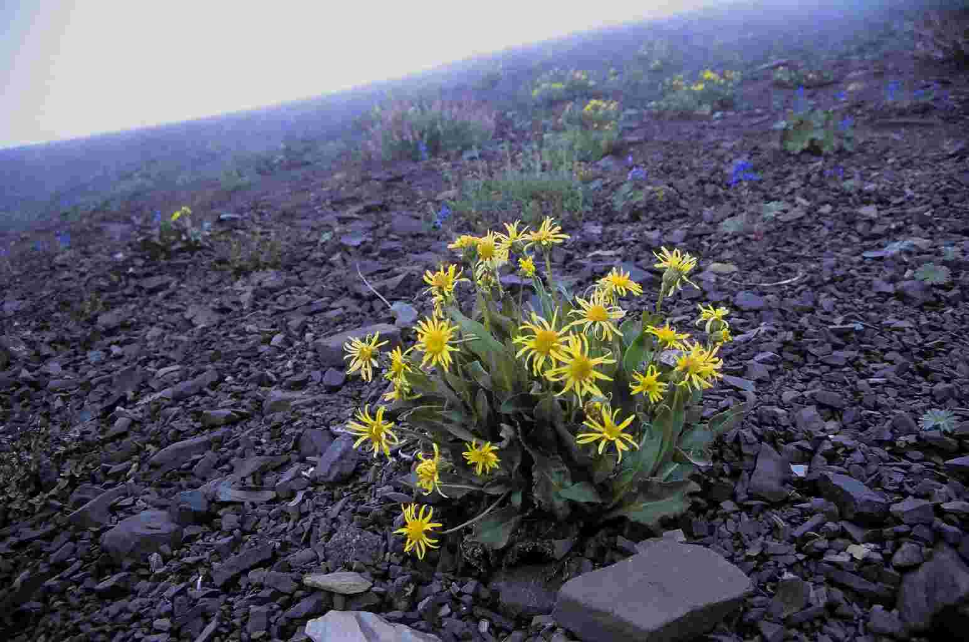
“Rotten Rock” of the Olympics
Notes:
The Olympic Range is another offshore terrane, though closer to home. It originated as a breach between the east-west fracture of the oceanic plate at what is now Oregon, about 55 million years ago. The breach exuded a tremendous amount of basalt that was rapidly cooled by the ocean. This was not the stately columns of basalt that cooled over hundreds of years and resulted in huge polygons of crystal. This was lumpy, amorphous “pillow basalt” that was transported by a fault along with vast amounts of sedimentary rocks like sandstone, slate and shale to be lodged between what is now Vancouver Island and the continental shelf.

Slide 18
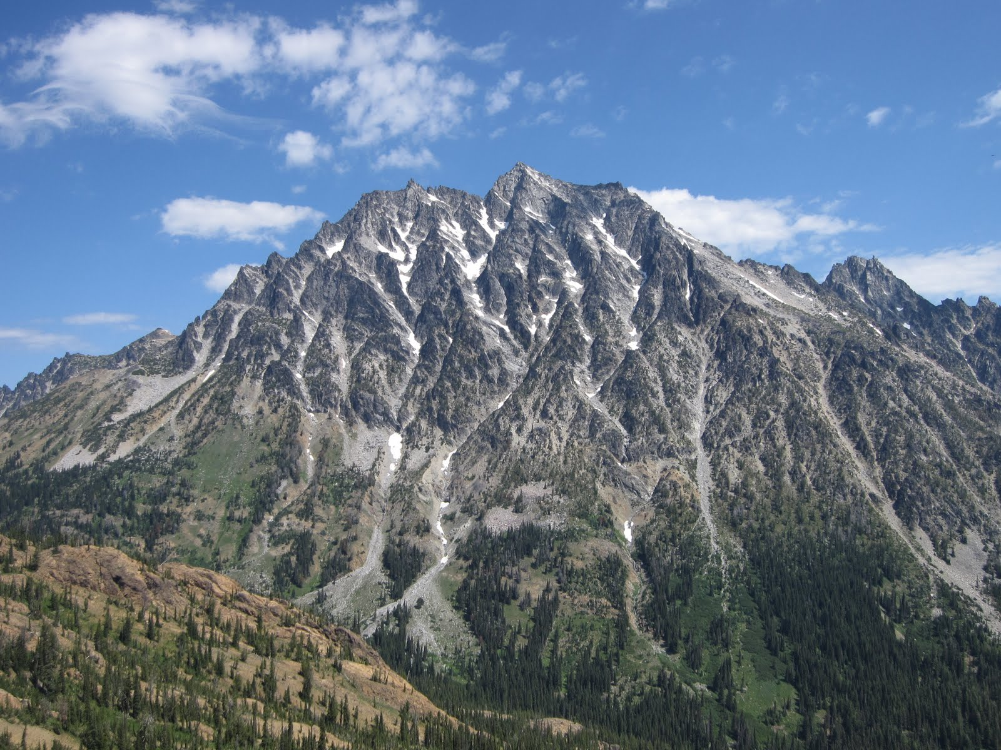
Mount Stuart – Cascadian Couloir on right
“Batholith”
Notes:
Mount Stuart, is yet another exotic terrane but of much different origin than the Olympics. It is a granite batholith formed by a magma pluton – that is, magma underneath a volcano ascending like a bubble that was never allowed to surface and cooled very slowly . It is a very hard, crystalline rock. The 95 million year old Stuart batholith is about 16 by 13 miles and was likely transported on a fault and docked 50 million years ago, to be exposed in the Cascade uplift within the past 5 million years.

Slide 19
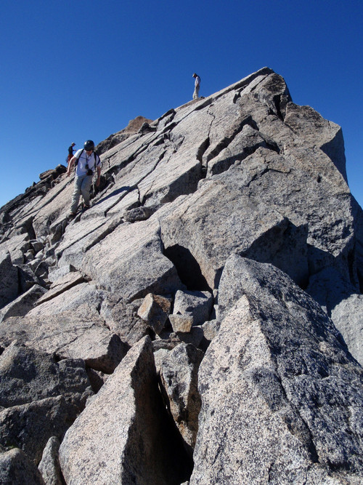
Granite Blocks on Stuart Summit
Notes:
Climbers love granite. It’s easy to see how weathering affects granite so differently than sedimentary rocks, with fractures but greater overall integrity.

Slide 20
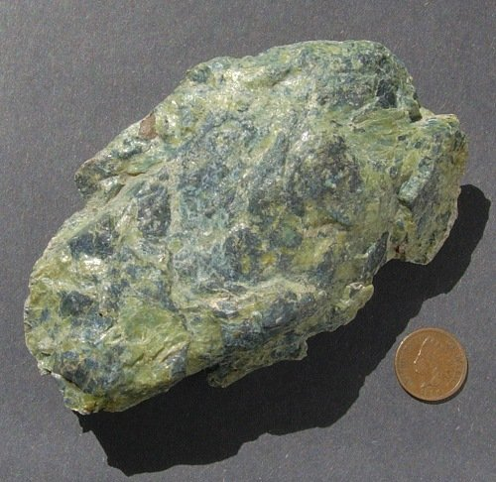
Serpentinite
Notes:
Serpentinite is a deep ocean metamorphic rock that is common in the Teanaway mountains. As it erodes, it separates into minerals and heavy metals like cobalt, chromium, and nickel and the resulting soil is notably scarce in essential minerals for plant growth like phosphorus and nitrogen. This is a very unfriendly environment for plants. However, there are plants that have adapted to the limitations of the soil, some of which are only endemic to the Teanaway and attract botanists from all over the world. One of my favorite flowers, Douglasia nivalis, is one of these, as well as Tweedy’s ivesia and Drummond’s anemone. The upside is that there is very little competition. Most of the serpentinite in the Teanaways is either a weathered orange color, or black; but some pieces may have the mottled green that resembles the snakeskin from whence it received its name. If you go on the field trip you may want to pick some up – they are supposed to have mystical properties and are good for clearing chakras.

Slide 21
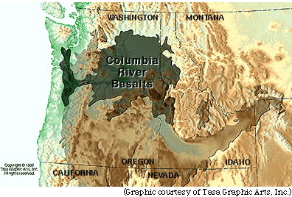
Yellowstone Hotspot
Notes:
You may have heard of a “hotspot” as it relates to geology. A hotspot is an upwelling in the earth’s mantle that breaks through the crust – most volcanoes that aren’t the result of plate subduction are from hotspots, like the Hawaiian Island chain. 17 million years ago the Yellowstone hotspot was on the Oregon-Idaho border. It hasn’t moved since then – the continent has. The Yellowstone hotspot may have sent a “plume” that caused a series of hundreds of tremendous flows of magma through fissures in Washington and Oregon that crystallized into the familiar basalt columns of eastern Washington and the Columbia River.

Slide 22
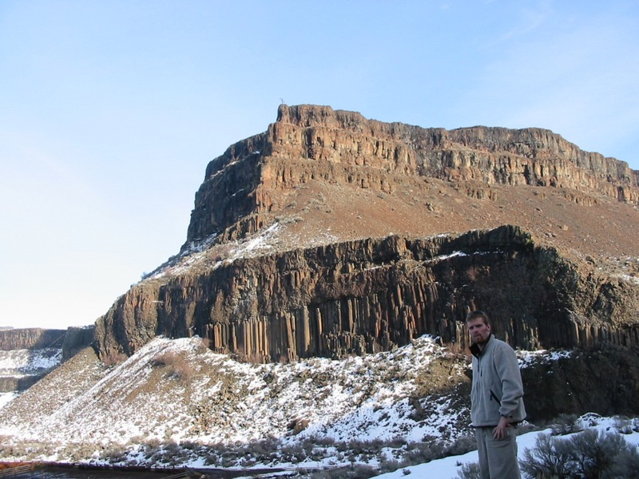
Columbia River Basalt – Moses Coulee
Notes:
There is evidence of many flows above ground. But there are other layers piled underground from 2000 to 16,000 feet thick.

Slide 23
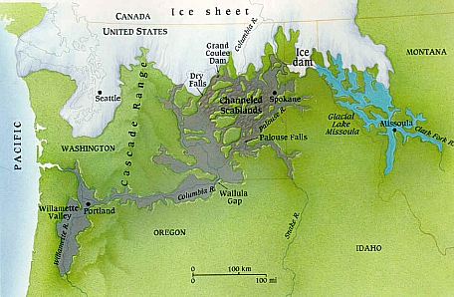
Notes:
Harlan Bretz, a former Seattle high school teacher, first proposed this explanation in 1923 and was scorned by his peers. His “catastrophism” was seen as a cartoonish dramatization. Now he’s regarded as a scientific hero almost in the same class as Galileo – except he didn’t have to recant his theory in the face of being burned at the stake. The great Ice Age floods are now known as the Bretz floods.

Slide 24
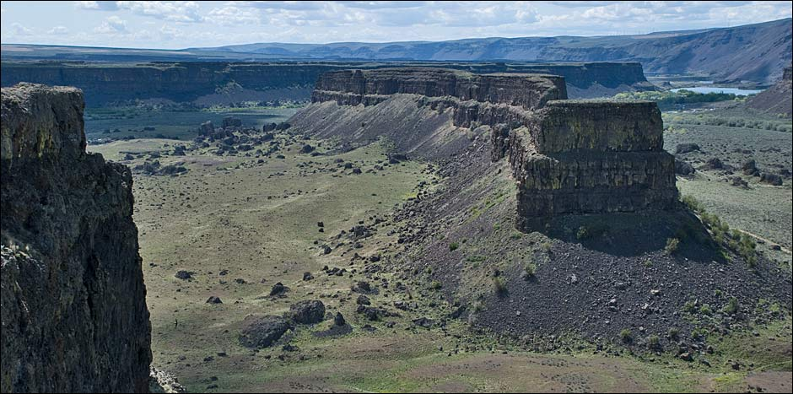
Umatilla Rock from Dry Falls
Notes:
Another spectacular occurrence, or rather, occurrences, coincided approximately with the maximum extent of the Cordilleran ice sheet. These were the ice age floods that were unleashed within days of the rupture of an ice dam holding back the combined volume of the waters of Lake Superior and Lake Michigan. Glacial Lake Missoula was formed by the damming of the Clark Fork River in Montana. It created the most violent flood in the world, slicing, splitting, and toppling the Columbia River Basalt monuments on its way to the Pacific Ocean.

Slide 25
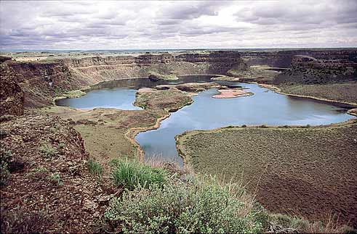
Dry Falls
Notes:
A landscape that might appear to have been formed over hundreds of thousands of years was created in weeks and days.

Slide 26
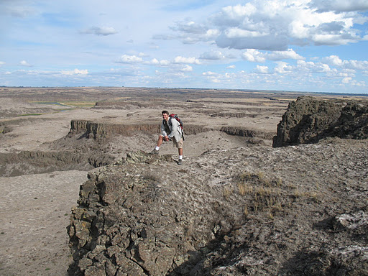
Potholes Coulee- Channeled Scablands
Notes:
The events may have been repeated many times – the scablands are aptly named.

