Slide 1
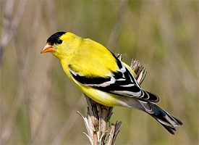

Notes:
American Goldfinch – State Bird of Washington – small, thick bill – feeding on seeds - distinctive call in song and flight – oh, yes, yellow & black in summer

Slide 2
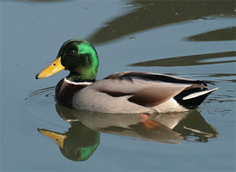
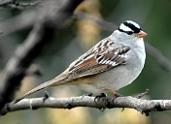


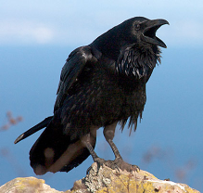
Basic Bird Classification
Jeffrey Nystuen
Natural World Class
Goal: Identify 30 species of local birds
Notes:
White-crowned Sparrow, Mallard, Hummingbird silhouette, American Crow, Hawk (Buteo) Silhouette

Slide 3
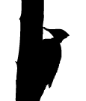
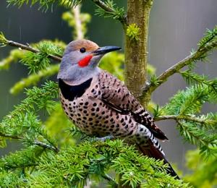
Images and recordings from
Cornell Laboratory of Ornithology
  Macauley Library of Natural Sounds
  www.allaboutbirds.org
Northern Flicker

Slide 4
Grouping categories of birds
Major groups: shorebirds, sea birds, wading birds, raptors, song birds, waterfowl, game birds, …
Bird families: sandpipers, gulls, herons, woodpeckers, swallows, thrushes, sparrows, …
Specific species: Song Sparrow, Great Blue Heron, Western Tanager, Barn Swallow, ….

Slide 5

Methodology of Classification
Size
Silhouette (shape)
Behavior
Habitat
Sound*
Plumage pattern (feathers, bill, legs, …)

Slide 6




SIZE
Very large: heron, eagle, swan, raven
Large: duck, goose, crow, hawk, pigeon
Medium: robin, blackbird, starling, towhee
Small: sparrow, warbler, finch, swallow
Tiny: hummingbird, kinglet, chickadee, bushtit

Slide 7








Family Silhouette

Slide 8


Behavior
Soaring overhead: hawks, swallows, swifts, …
Swimming on water: ducks, grebes, …
Eating seeds on ground: sparrows, doves, quail, …
Jumping quickly from branch to branch: warblers, kinglets, …
Climbing up the trunk of a tree: woodpeckers, creepers, …
Running on ground: quail, sparrows, …
Flycatching: flycatchers, hummingbirds, bluebirds, …

Slide 9
Habitat
Offshore (ocean): puffins, shearwaters, …
Seashore (estuary, beach, …): sandpipers, sparrows, …
Riparian (stream bed, river, …): tanagers, flycatchers, kingfisher …
Marsh (grass, reeds, ponds, …): wrens, sparrows, ducks, blackbirds, herons …
Forest (mature, regrowth, edge, …): kinglets, thrushes, woodpeckers, …
Mountain (meadow, rocks, ice, …): bluebirds, finches, grouse, hawks, …

Slide 10
Habitat: Probability
What birds use a particular habitat?
special needs (food, nesting, safety, …)
season (winter, migration, breeding, …)
Consult checklists and range maps
  abundance (habitat and season)
    Common 80% chance, should be present
    Uncommon 30% chance, might not be found today
    Rare 5% chance, but occurs annually
    Vagrant not every year, but possible
    Accidental has been recorded (or extripated)

Slide 11
Sound
Songs
Calls
Other (wings, beak snapping, tail, …)
Often species specific: Belted Kingfisher, Song sparrow, Canyon Wren, Chipping Sparrow, …

Slide 12
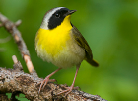
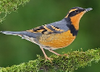
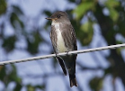

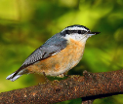

Distinctive Songs & Calls
Marsh
Common Yellowthroat
Dense forest
Varied Thrush
Open forest
Olive-sided Flycatcher
Brushy canyon
Canyon Wren
Red-breasted Nuthatch

Slide 13
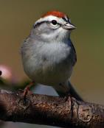
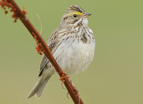
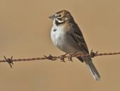
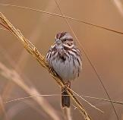
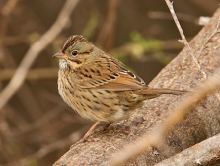
Plumage Pattern
Head, wings, beak shape, tail, belly, breast, …
Species specific – time to consult the bird book! Actually, it is better to take notes and then consult the bird book back in the car
Notes:
Chipping, song, lark, Lincoln, savannah sparrows

Slide 14
Review
associate Size, Silhouette, Behavior with specific bird families
wild card: use Habitat, range and season to assign a probability
field characteristics: Song and Plumage Pattern to identify species

Slide 15

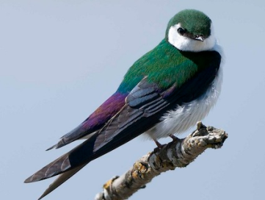
Violet-green Swallow
Habitat: small pond on ranchland, trees nearby
Detection: small birds swooping and gliding over the water,
Occasionally landing on thin bare tree branches (or wire lines)
Reject: Hawks, Ducks, Warblers, …
Maybe: Swallows? or Swifts?
Swallow Family Field Characteristics:
tail shape , belly color (white?), rump patch?
head and throat pattern, nest

Slide 16
Improving Birding
Buy a bird field guide
Learn silhouettes of bird families
Buy a bird finding book
Get a checklist for the area you are visiting
(Ask at visitors’ centers or search on the internet)
Start a “life list”
Go birding (especially with people more knowledgeable than you)
Take a course/field trip with your local Audubon chapter
Learn to recognize bird songs and call

Slide 17
Homework
Get some binoculars
Get a field guide (lots of good ones – The Nature Shop)
Get a check list for your area
Use the field guide (or go online) to identify the bird family silhouettes.
Go for a walk around your neighborhood/park/bird feeder, BUT leave the field guide at home and take a notebook instead!
Detect a bird (sound, motion, silhouette …)
How big? What shape? What’s it doing? Any sounds? Identify family if possible.
Move closer - Use binoculars – Plumage patterns, bill shape, wings, tail shape …
Take notes before it flies away!! A photograph is an excellent idea.
Detect another bird - Repeat five times.
Return home and use your notes to identify species

Slide 18
Notes:
These bird family silhouettes are in the handbook for the course.

