Slide 1
2018 Intermediate Alpine Climbing Package
Tess Wendel
Stefanie Schiller

Slide 2
Overview
January 7: Intermediate Social Hour at the Bergschrund
January 15: Last day to cancel from the package for a full refund
January - February: AIARE 1
January - March: Intermediate Glacier Travel
February - May: Intro to Single Pitch Trad
March 4: Teaching and Leadership Workshop
April - May: Self Rescue 1
May - July: Intro to Multi Pitch Trad
July - August: go climbing
September - October: Intro to Alpine Ice
October - November: Self Rescue 2
Notes:
Is everybody signed up for AIARE?
Few students signed up for Teaching and Leadership Workshop - participation is mandatory

Slide 3
Intermediate Glacier Travel
Objectives
  Become a competent rope lead on a Basic Glacier Climb
  Swap leads on a Winter Mountaineering Climb
One module with multiple instances of the same lecture and field trips
  January 31 - March 31
  Sign up for module and for lectures
  Sign up for field trip with your mentor group
Module structure
  Lecture and evaluation - pick one day
  Trip planning lecture - pick one day
  Technical skills practice at the PC - pick one day
  Overnight FT with mentor group - sign up with your mentor

Slide 4
Intermediate Glacier Travel (cont.)
Prerequisites
  Basic knots
  Crevasse rescue (Z-pulley or C-pulley)
  Ability to ascend the rope with friction hitch
  Must have AIARE 1 before the FT
Contact: Nick Hunt

Slide 5
Intro to Single Pitch Trad
Objectives
  Lead single pitch routes on traditional gear
Three stand-alone modules
  SPT A February 25 - March 31 - 17 sign-ups
  SPT B March 18 - April 21 - 4 sign-ups
  SPT C April 3 - May 12 - no sign-ups
  Sign up for one module and attend all lectures and field trips
Module structure
  Kickoff Meeting - one evening at PC - all students attend
  Workshop at PC - two evenings at PC - all students attend
  FT 1 - weekend FT to Tieton - all students attend
  FT 2 - 1 day FT to Tieton - pick one day

Slide 6
Intro to Single Pitch Trad (cont.)
Prerequisites
  Ability to lead 5.7 sport consistently and comfortably
  Ability to set up an anchor on bolts
  Ability to clean a sport anchor and rappel
Contact: Gabe Aeschliman

Slide 7
Teaching and Leadership Workshop
Objective
  Become a more effective leader and educator
  Learn how to handle difficult situations with empathy and without getting derailed
One evening March 4 at 7pm - sign up required
Students will work in groups through a variety of scenarios
Required for all intermediate students and prerequisite for becoming a rope lead
  No alternative offerings at this point
  Email Stef or Tess if you cannot attend

Slide 8
Self Rescue 1
Objectives
  Learn fundamentals of self rescue
  Learn to rescue an injured follower
One module with multiple instances of the same lecture and field trip
  April 2 - May 12
  Sign up for module and for lectures and FTs
Module structure
  Lecture and evaluation - pick one day
  FT 1 - 1 day at the PC - pick one day
  FT 2 - 1 day at the PC - pick one day

Slide 9
Self Rescue 1 (cont.)
Prerequisites
  Basic knots
  Ability to set up anchor on bolts
  Ability to ascend the rope with friction hitch
  Ability to go hands-free
Contact: Nick Hunt

Slide 10
Intro to Multi Pitch Trad
Objectives
  Learn to build gear anchors
  Learn skills for more efficient belay station transitions and rappel transitions
  Swap leads on multi-pitch routes on traditional gear
Two stand-alone modules
  MPT A May 8 - June 9
    Leavenworth
    Focus on alpine rock climbing
  MPT B June 3 - July 4
    Squamish
    Suited for students who can follow 5.9
  Sign up for one module and for lectures and FTs

Slide 11
Intro to Multi Pitch Trad (cont.)
Module structure
  Kick-off meeting - 1 evening at the PC - all students attend
  Skills review - 2 evenings at the PC - all students attend
  FT 1: weekend FT to either Leavenworth or Squamish - all students attend
  FT 2: one day FT to either Leavenworth or Squamish - pick one day
Prerequisites
  Successful completion of Single Pitch Trad module or equivalent
  Successful completion of Self Rescue 1
  Ability to lead 5.6 on gear
Contacts
  MPT A: Jacob Wolniewicz
  MPT B: Peter Gonda

Slide 12
Intro to Alpine Ice
Objective
  Swap leads on a moderate multi pitch alpine ice climb
One module with multiple instances of the same field trip
  Sign up for module and for lecture and field trips
  Will be offered in September - October
  Registration will open July
Module structure
  Lecture with demos - all students attend
  FT 1: overnight FT - pick one weekend
  FT 2: one day FT - pick one day
Notes:
Registration for Alpine Ice is the deadline for you to get your volunteering done!

Slide 13
Intro to Alpine Ice (cont.)
Prerequisites
  AIARE 1
  Successful completion of Mulit Pitch Trad module or equivalent
  Completion of Self Rescue 1 recommended
Contact: Stefanie Schiller

Slide 14
Self Rescue 2
Objectives
  Learn to rescue a fallen leader with one rescuer
One module with multiple instances of the same lecture and field trip
  Will be offered October/November 2019
  Registration will open August/September
Module structure
  Lecture and evaluation - pick one day
  FT 1: 1 day at the PC - pick one day
  FT 2: 1 day at the PC - pick one day
Prerequisites
  Successful completion of Self Rescue 1 or equivalent skills
  Completion of Multi Pitch Trad or equivalent skills recommended
Contact: Matthew Palubinskas

Slide 15
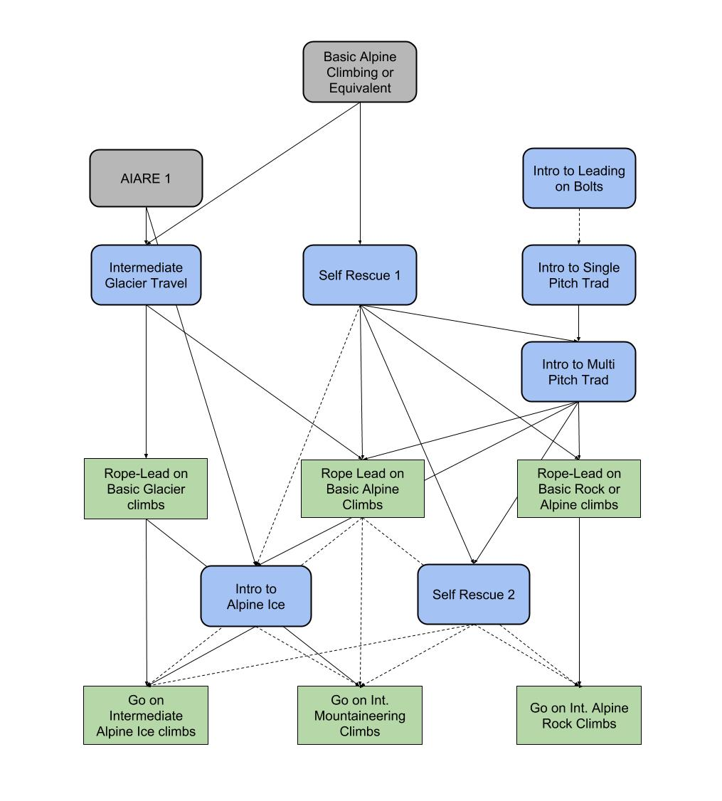
Course Flow
Basic Alpine Climbing or Equivalent
AIARE 1
Intro to Leading on Bolts
Intermediate Glacier Travel
Self Rescue 1
Intro to Single Pitch Trad
Intro to Multi Pitch Trad
Rope-Lead on Basic Glacier climbs
Rope Lead on Basic Alpine Climbs
Rope-Lead on Basic Rock or Alpine climbs
Intro to
Alpine Ice
Self Rescue 2
Go on Intermediate Alpine Ice climbs
Go on Int. Mountaineering Climbs
Go on Int. Alpine Rock Climbs
Notes:
Is everybody signed up for AIARE 1?

Slide 16
Sign-Up Process for Modules
Teaching and Leadership Workshop, Intermediate Glacier Travel, Self Rescue 1 and Trad Modules have been posted and you should be signed up
All modules require you to sign up for the module and for specific lectures and FTs within that module
Intermediate Glacier: Your mentor will run the FT for your group
Alpine Ice and Self Rescue 2 will be posted by late spring
  There will be an application process for Alpine Ice and Self Rescue 2 asking for volunteer history
  You will receive a discount code before registration opens
Notes:
Apologize for glacier travel shenanigans
Double check that you are signed up for a) the modules, the lectures and FTs within the modules and c) the teaching and leadership workshop
Stick with the Glacier Travel FT your mentor offers if possible at all - you don’t want to discourage your mentor

Slide 17
Evaluations
Every module will have an evaluation or review at at the beginning of the module
There are no make-up sessions for evaluations - you pick your date and show up
You have to pass the eval for each module or you will be held back till the next instance of that module is offered which might be 2019
Your mentors cannot make up for missed or failed evaluations
Notes:
Evaluations are nothing to fear

Slide 18
Volunteering Requirements
We are a volunteer organization - all of our instruction is done by volunteers
We expect our students to be enthusiastic volunteers who actively contribute to our community
All students need to volunteer 1 day for each module at a minimum
  Six modules = 6 days of volunteering
  Evening sessions count as .3 days
  Volunteering for the same FT more than once does not count
  All six days need to be completed before applying to Intro to Alpine Ice
  Strongly recommend to keep track of volunteer hours

Slide 19
Volunteering Requirements (cont.)
There will be an application process for Alpine Ice and Self Rescue 2 asking for volunteer history
  Students not meeting their volunteer requirements won’t be allowed to sign up
Volunteering for the following Seattle courses is specifically encouraged
  Basic Alpine Climbing
  Intro to Alpine Rock
  Intro to Rock
  Glacier Course
  Leading on Bolts Course
  Everybody here is qualified to volunteer for all of the above!
Helping out with SIG groups also extremely appreciated!

Slide 20
Role of the Mentor Groups
Mentors are a resource for questions and problems
Mentors should
  Create community
  Review and practice prerequisite skills before each module
  Lead conditioner hikes including mandatory test hike
  Lead Intermediate Glacier FT
  Offer a cragging weekend to practice leading on gear
  Practice Self Rescue skills after completion of each module
  Lead climbs for mentor group
Make sure to attend offerings of your mentor!

Slide 21
Code of Conduct
Be humble
  Overconfidence shortest way to get in trouble in the mountains
  We have accidents every year because students think they are better climbers than they really are
Everybody deserves to be treated with dignity and respect
Be patient and respectful when instructing
No bullying
Absolutely no isms: racism, sexism, ageism etc.
Keep it All Audiences

Slide 22
Know your limits!

Slide 23
Contacts
Intermediate Co-Chairs: Stefanie Schiller and Tess Wendel
Staff Contact: info@mountaineers.org
Intermediate Mentors: Susan Shih, George Reynya, Alex Byrne and Jay Hoover, Ed Palushock
Teaching and Leadership Seminar: Abby Hunt
Intermediate Glacier: Nick Hunt
Single and Multi Pitch Trad: Gabe Aschliman
Self Rescue 1: Nick Hunt
Self Rescue 2: Matthew Palubinskas
Basic Chair: Allison Swanson
Basic FTs: Jan Abendroth
Basic SIG Contact: Diane Gaddis - if you want to be added to a SIG
Climbing Chair: Takeo Kurashi
Navigation Chair: Brian Starlin

Slide 24
Resources
Intermediate Facebook Group
Local AIARE 1 courses
2018 Intermediate Alpine Climbing Handbook (will be updated soon)

