Slide 1
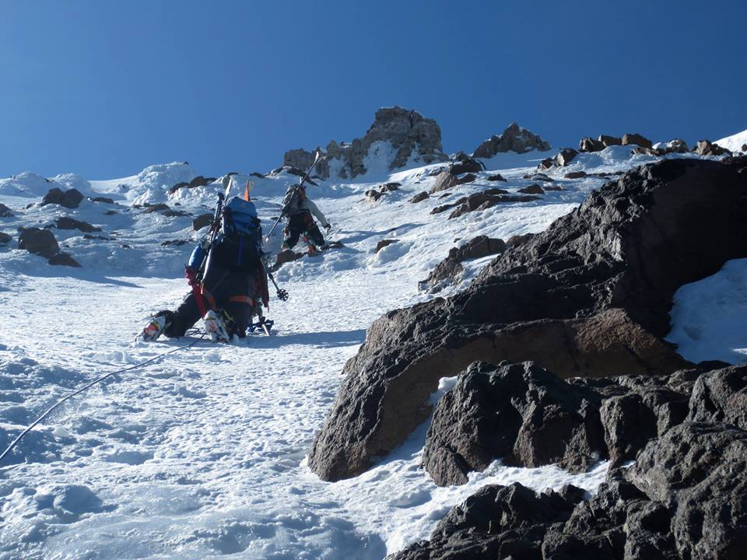
ICE
Alpine Ice Climbing Course 2024
[Mt Hood/ Sandy Headwall]

Slide 2
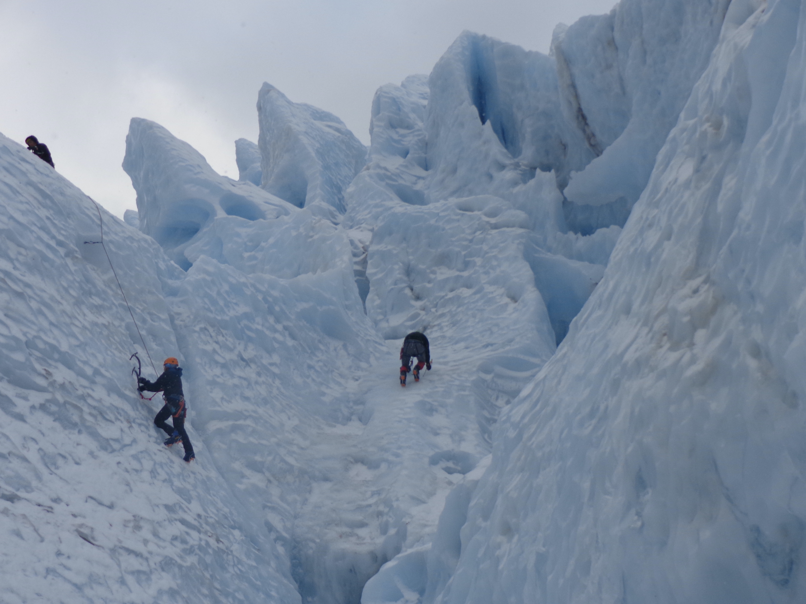
Course Overview
Alpine Ice Lecture
  Mon, Aug 5
Field Trips (Mt Baker Lower Coleman Seracs)
  Sat/ Sun, Sept 7-8
  Sat/ Sun, Sept 14-15
  Sat/ Sun, Sept 21-22
[Mt Baker/ Coleman Glacier – Lower Seracs]

Slide 3
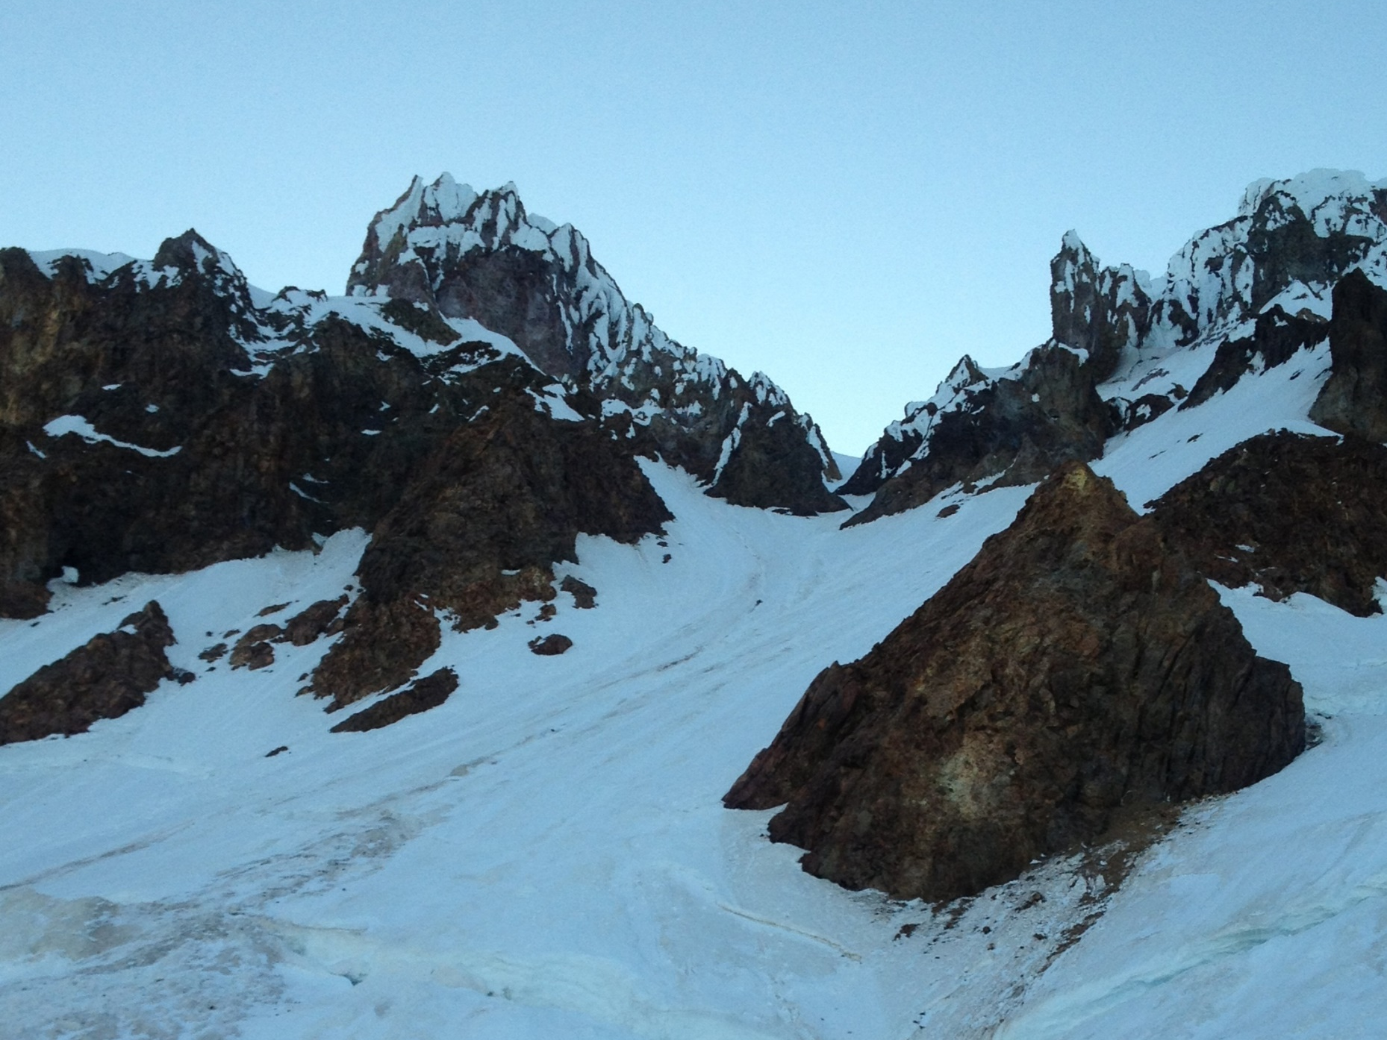
Alpine Ice
Variety of forms under combined effects of pressure, heat, frozen precipitation, time, snow, etc. into alpine ice of glaciers, ice fields, and couloirs.
Little distinction between alpine ice and hard snow.
[Mt Hood/ Leuthold Couloir]

Slide 4
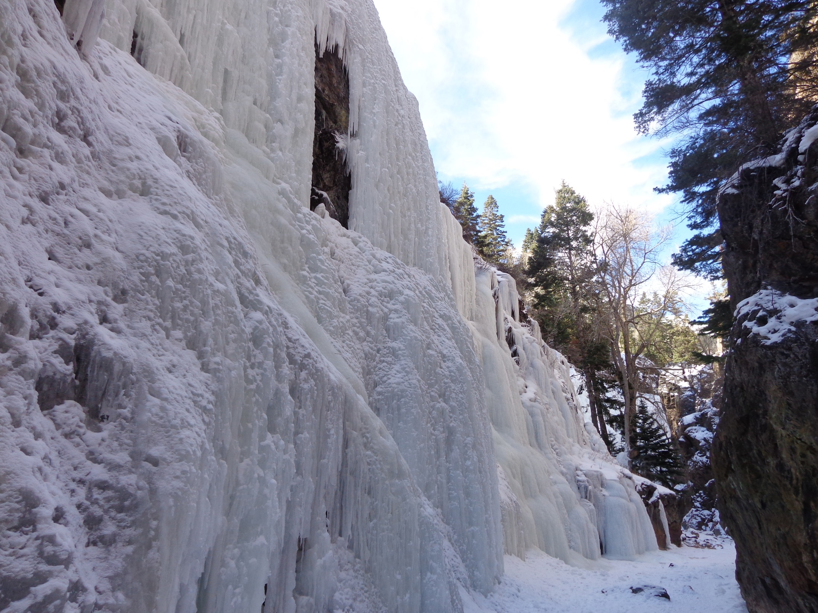
Water Ice
Liquid water freezes to form water ice.
Dramatic as waterfalls, thin as clear coating over rock surfaces.
Water ice usually harder, steeper, and more brittle than alpine ice.
[Ouray Ice Park, CO]

Slide 5
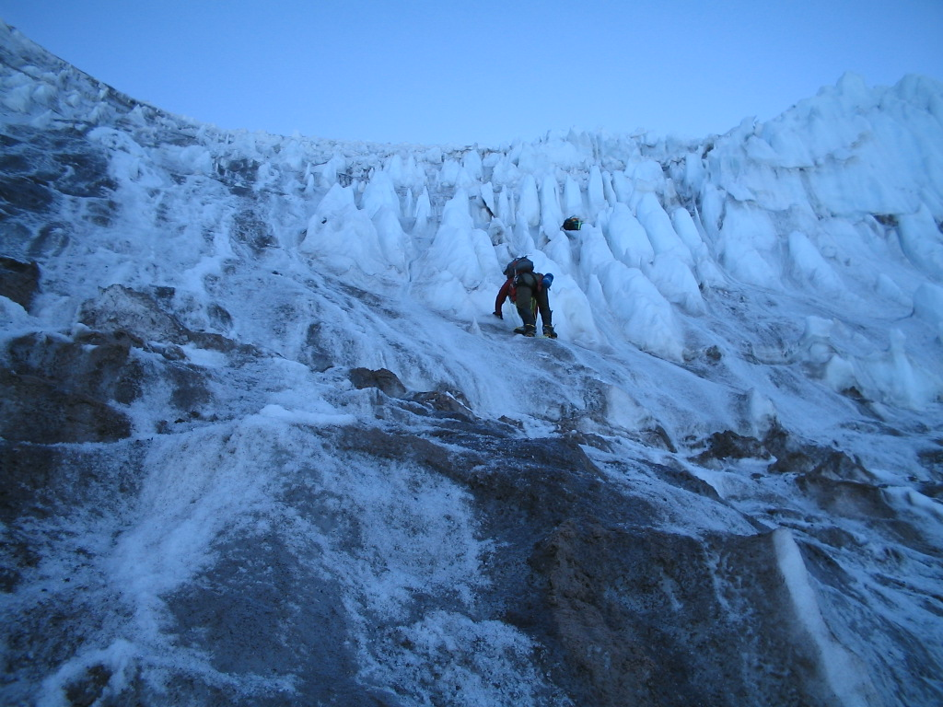
Characteristics of Ice
[Mt Rainier/ Kautz Glacier]

Slide 6
Characteristics of Ice
Ice Quality = Weather
Ice formed directly from water freezing; or indirectly through metamorphosis of neve (permanent snow).
Ice is distinguished from hard snow when its mass is airtight.
OPAQUENESS denotes softness.
Soft, plastic snow can lead to good tool placements; too soft and weak can lead to weak protection.
COLOR indicate hardness.
Blue ice (ice relatively pure) vs black ice (old, hard ice mixed with dirt, pebbles, debris)
CLARITY equals brittleness.
Can require extra time to plant a tool without ice shatter.
Cracks and fractures can mean weakness
“Dinner plates” mean temperatures are changing (tends to happen later in day as air warms), surface of ice becomes softer and more aerated, breaks away in plates

Slide 7
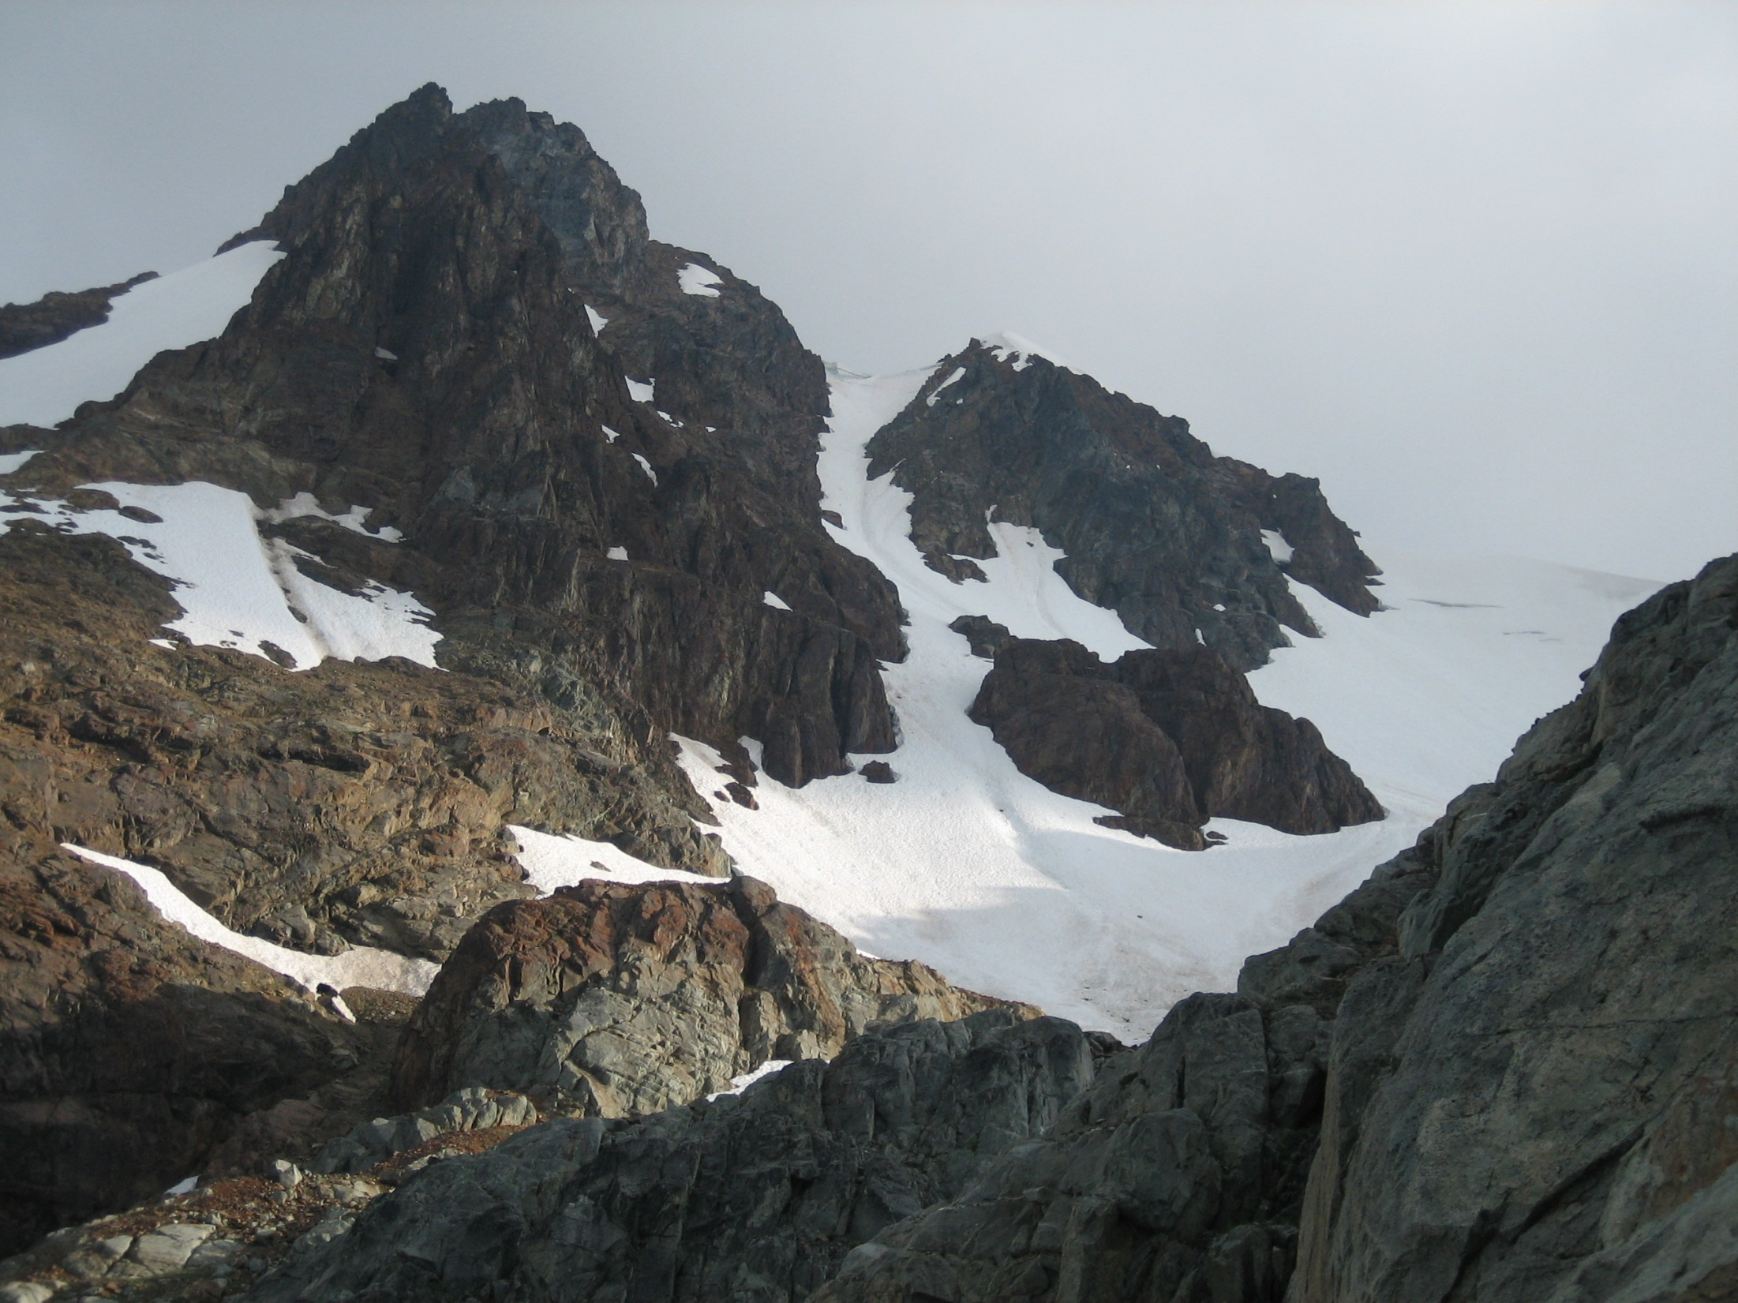
Mitigating Hazards
[Fissile Peak/ Northwest Face, British Columbia]

Slide 8
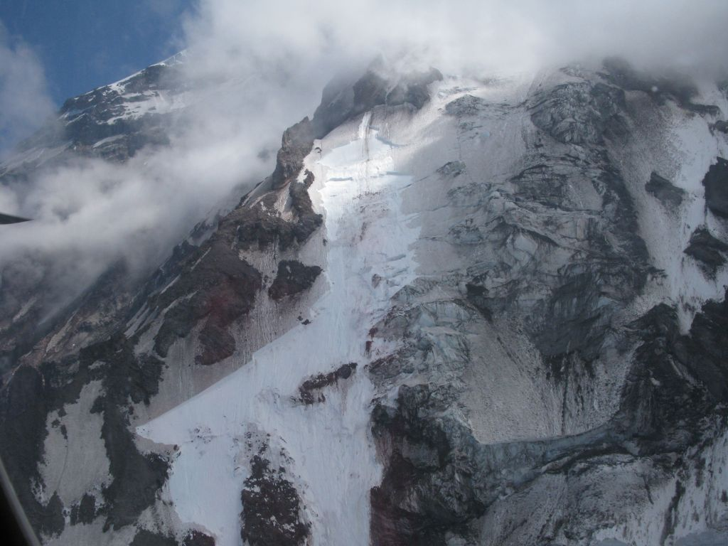
Objective Hazards
Loose rock, hidden ice, crevasses on approach
Falling ice and rock
Avalanche/ weather conditions
Ice quality
[Mt Rainier/ Liberty Ridge – July 17, 2010]

Slide 9
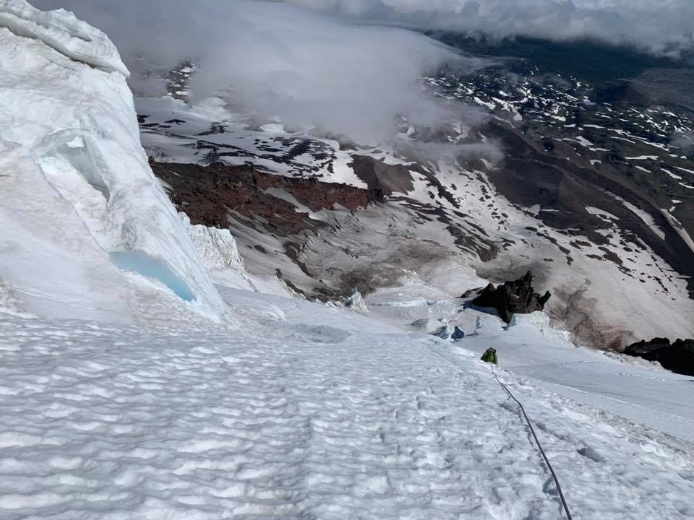
Hazards You Control
Loose clothing
Inappropriately racked gear
Sharpness of tools and crampons
Poor crampon & travel technique
Fatigue
Slips/ falls
Timing of attempt
[Mt Adams/ Lyman Glacier]

Slide 10
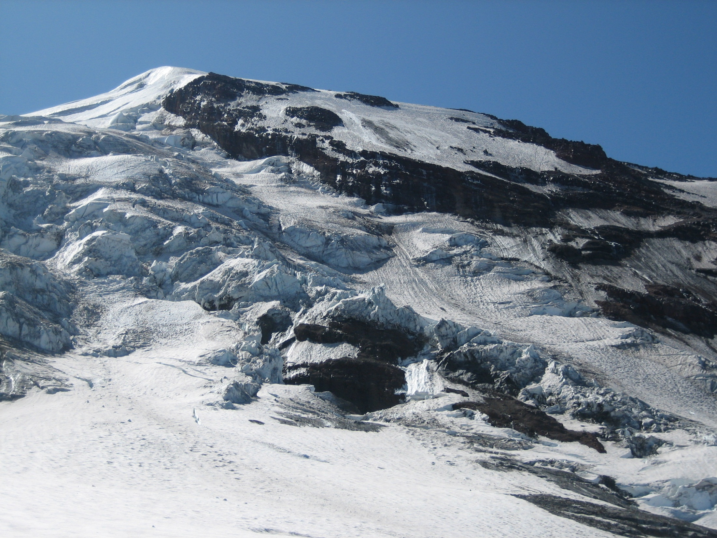
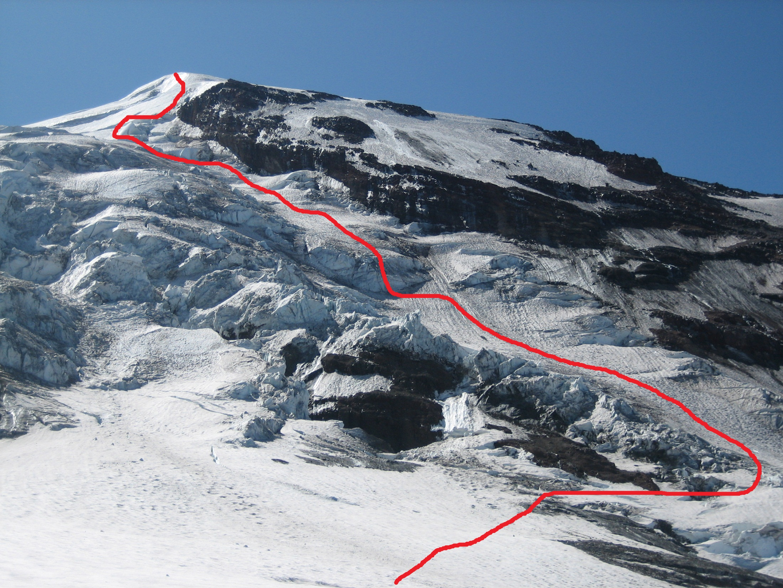
Bergshrund
Crevasses
Rock Fall Hazard
Serracs/ Ice Fall
Moats
Orientation to Sun
[Mt Adams/ Adams Glacier]

Slide 11
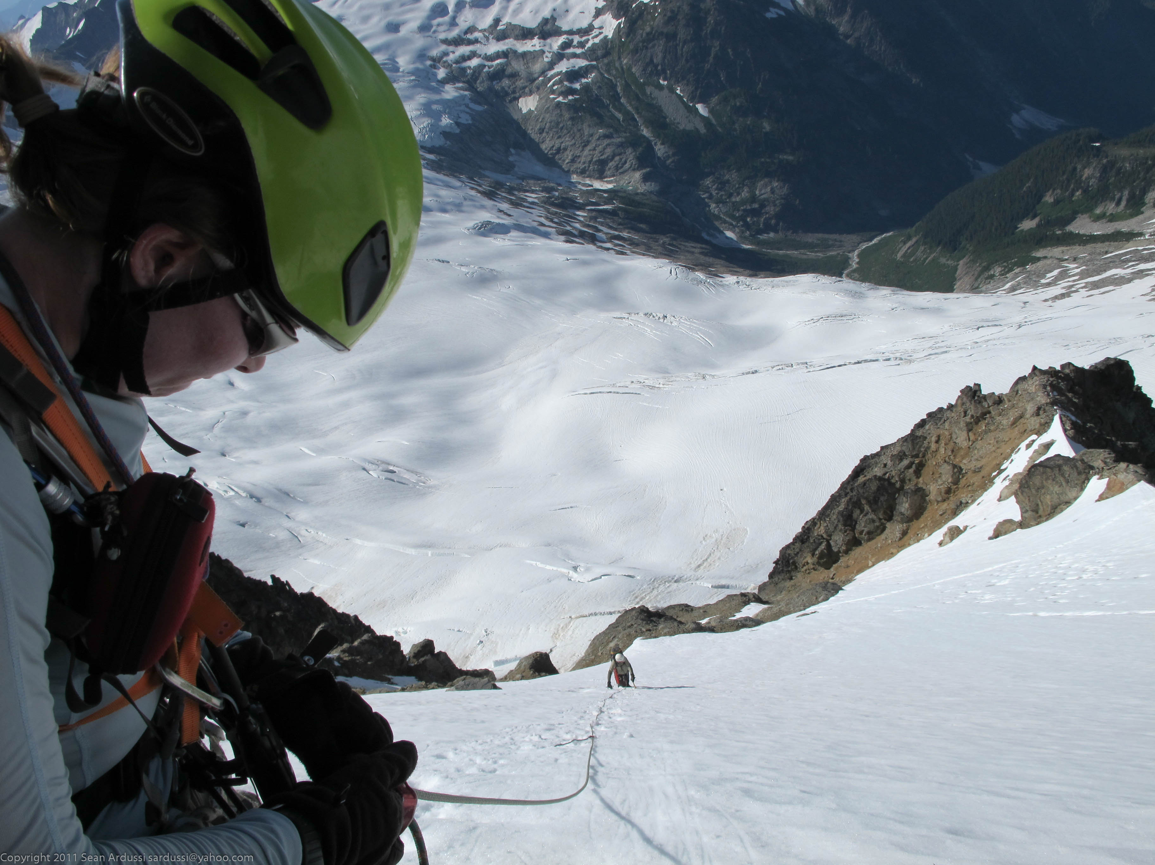
Condition Factors
Cold/ warm temps
Cloud cover
Aspect; when the sun lights up a slope
Storm cycles
Avalanche conditions
Timing of the trip
[Mt Buckner/ North Face]

Slide 12
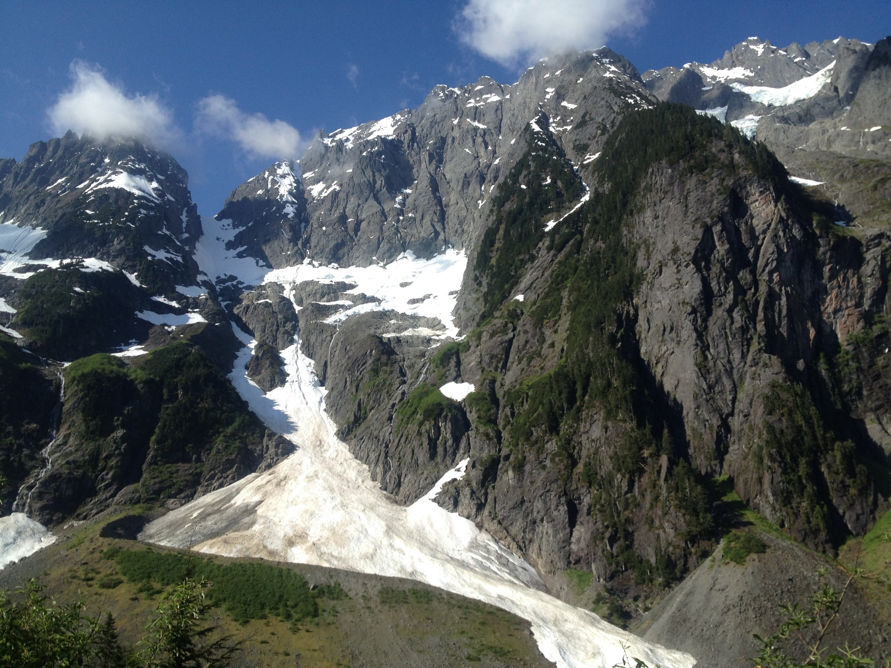
Safety and Speed
Speed/ efficiency is safety
Time is against you
Ice trips have limited forgiveness of error, strong potential for injury
Route finding is important
Know when to turn back
[Johannesburg Mountain/ Cascade-Johannesburg Couloir]

Slide 13
Efficiency
Desire to move faster
Stay fit
Know the weather
Memorize ascent/ descent routes
Early starts absorb contingencies
Adopt a steady pace
Let the strongest lead all the way through, or block lead
“Draft” by hooking leader’s pick holes, to save time & energy
Eat & drink frequently to save energy- carry warm drinks instead of brewing up
Carry light packs and be strict about contents
Don’t place screws too high to interfere with your next tool placement
The best way to deal with getting pumped, is not to get pumped

Slide 14
Efficiency
Arrange packs with most useful stuff on top
Use longer ropes
Avoid complicated gear
Use chocks and natural protection; use bollards instead of deadmen and ice pitons
Use longer axe- axe/ second tool combo is good for alpine ice
Cut steps instead of putting on crampons in short sections
Learn to put on crampons on fast
Keep tools SHARP
Crampon quickly across dangerous areas- crab across with both tools deployed in piolet panne
Your ice tool is also a nut tool
Carry the hex key you need to tighten your pick
Use ice features for foot placements when possible

Slide 15
Efficiency
If really pressed for time, follow on tension using nothing but hands, or use the rope as handline
Don’t drive in axe for self belay when following in steps; use balance instead
Avoid cutting long ladders of steps
Don’t use piolet traction if axe only will do; use hands instead of tools where possible
Swing the second tool with the lead; swing the belay jacket with the belayer
Stop and belay only if necessary; avoid rope of three
Know the snow conditions and travel on stable wind pack
Down climb when possible; rappel only when necessary
“Chicken clip” to place a screw if you are in an unsettled position
Face outward when descending whenever possible. Face inward as last resort

Slide 16
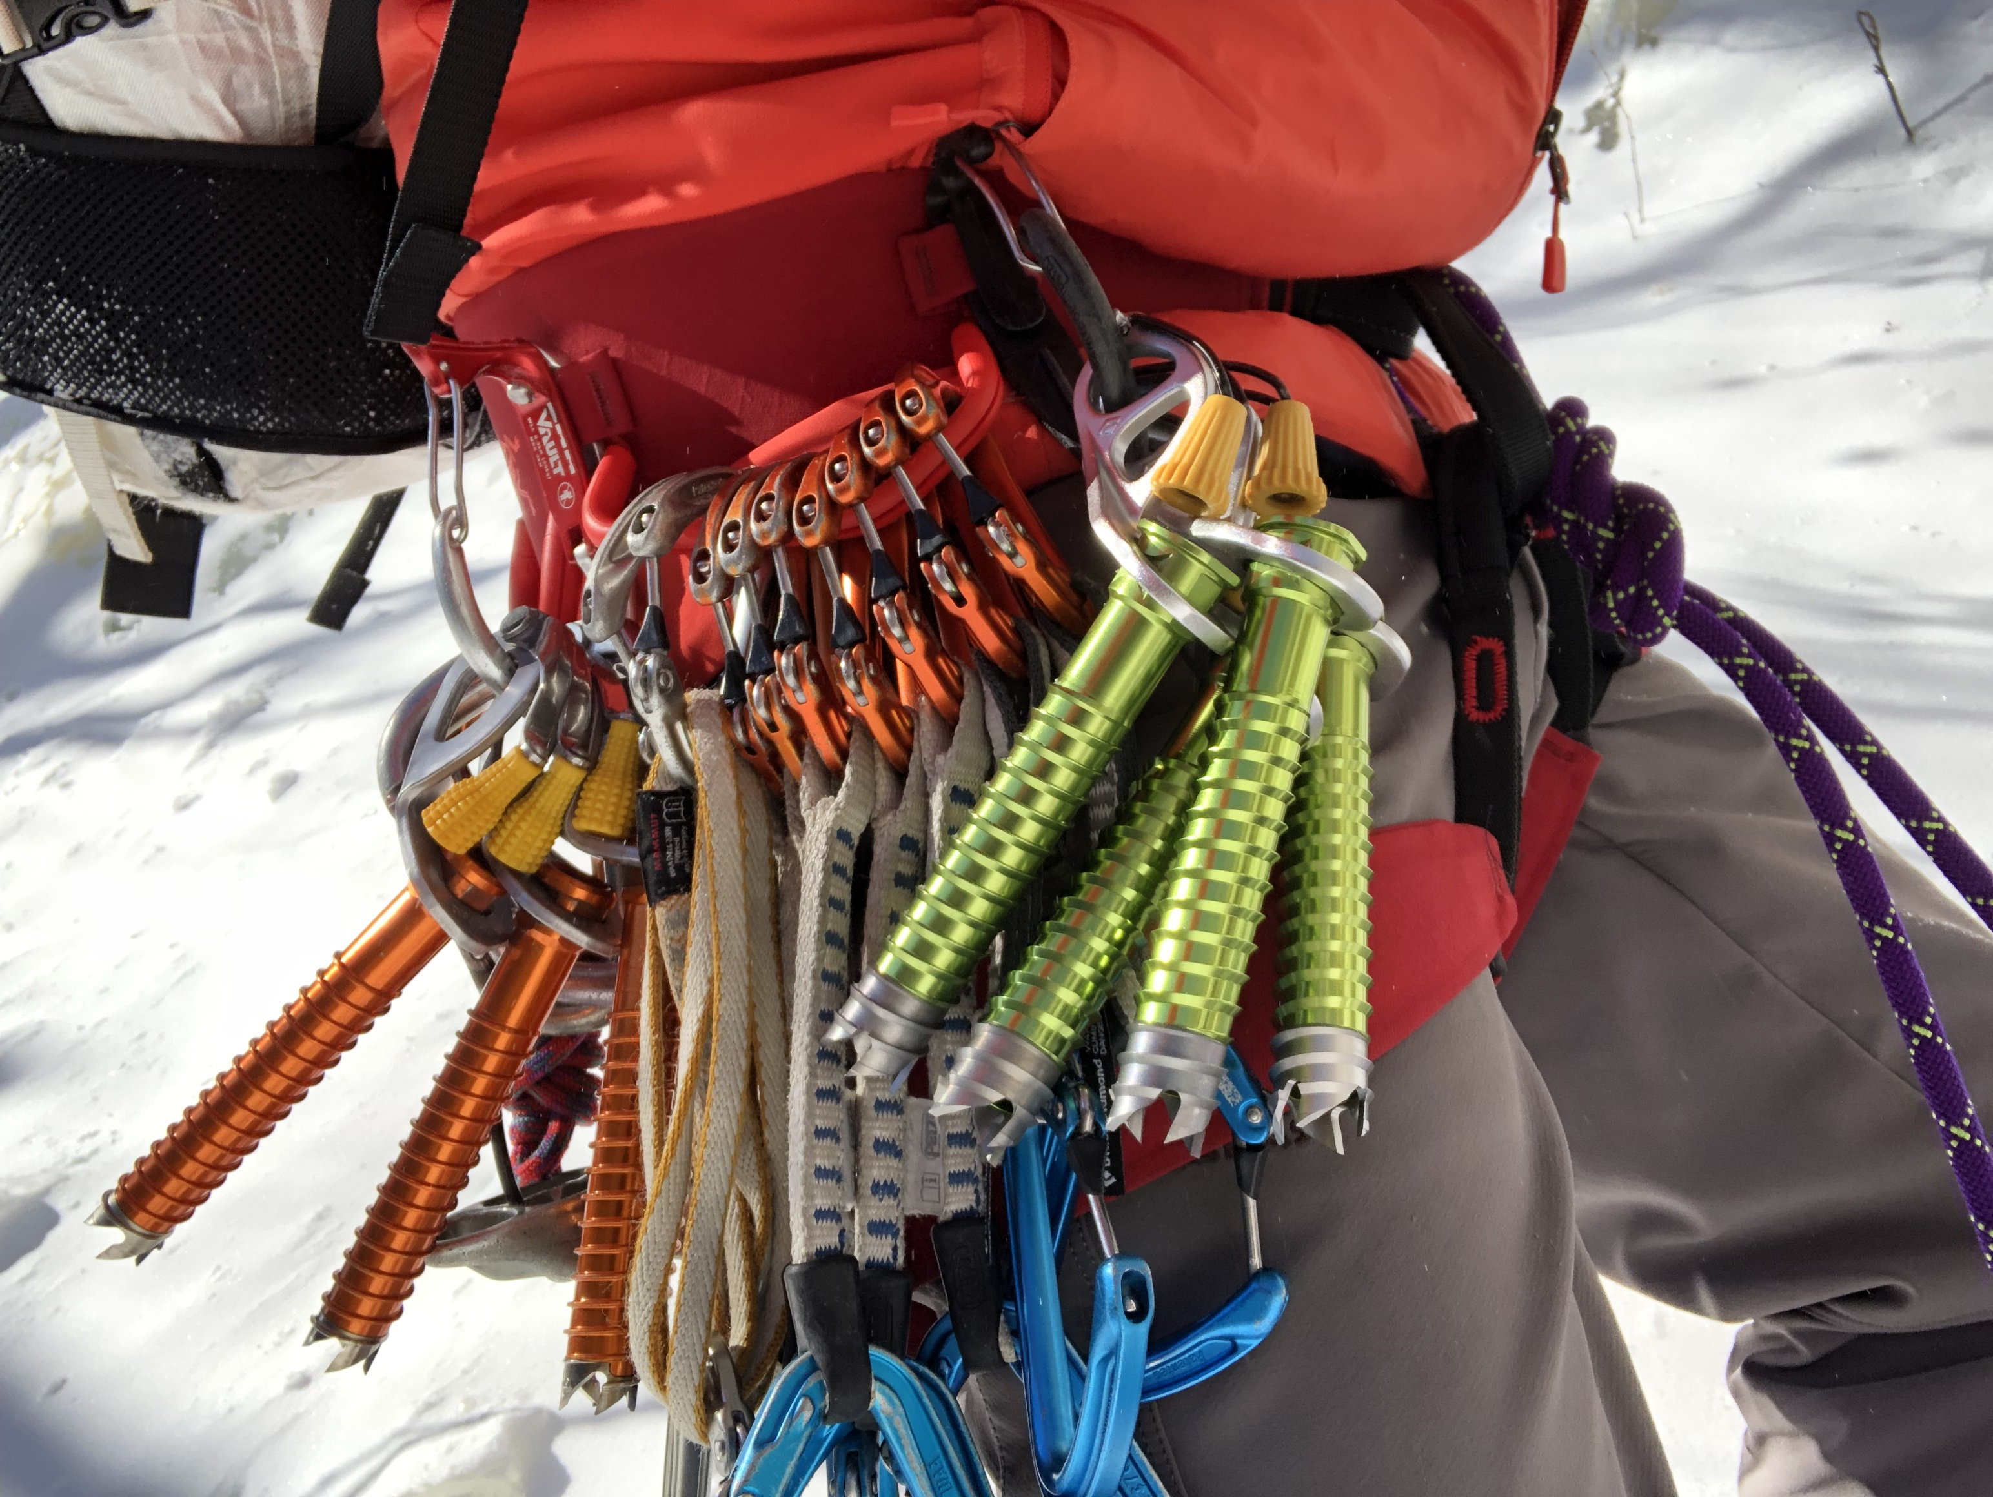
Gear

Slide 17
Necessary Clothing + Gear
Warm, fitted clothing
Sunscreen, Sunglasses
Climbing helmet
Stiff mountaineering boots (leather, plastic, hybrid)
Advantages/ disadvantages to each
Gators
Climbing harness
Single & double runners with carabiners
Cordelette
Standard glacier travel gear
10 essentials

Slide 18
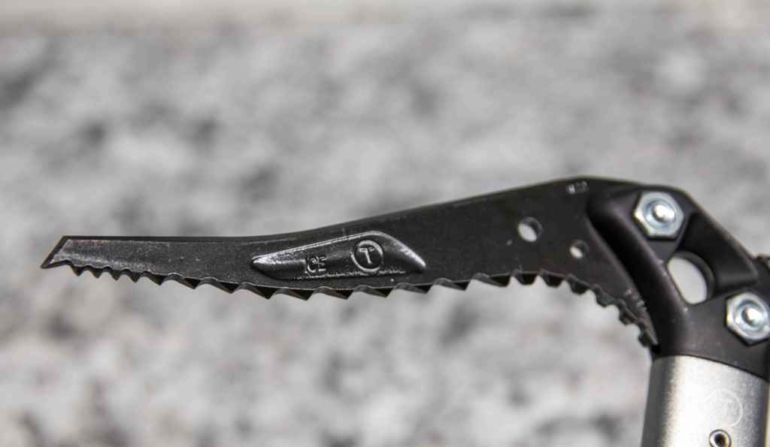
CE Safety Certifications
Comité Européen de Normalisation
B (Basic) - General Mountaineering Axe
Generally lighter & less durable
NOT strong enough for technical climbing
T (Technical) – Technical Ice Axes & Ice/ Mixed Tools
Picks and shafts are rated separately
Not uncommon to have CE-T shafts with CE-B picks
CE-T picks are thicker and better suited for mixed routes

Slide 19
Ice Climbing Hardware
SHARP 12-point crampons w/ front points- compatible with your boots
NO ALUMINUM
Preferably with anti-bot plates
Ice axe (60+cm)
Verify pick will stick in the ice
Second ice tool with hammer (55cm)
Leashes (spinner, hand, runner)
Tool protection (keep things sharp)
Ice screws, variety of lengths (eg- 19, 22 cm and smaller)
Pickets
V thread tool

Slide 20
Ice Climbing Hardware
Optional (but nice to have)
Tool holster
Load limiting protection
Helmet visor or goggles
Waterproof gloves, or multiple pairs of gloves
Quick draw
Trekking poles
Rap ring & extra perlon
Pitons and/ or Rock Pro (for mixed climbs)

Slide 21
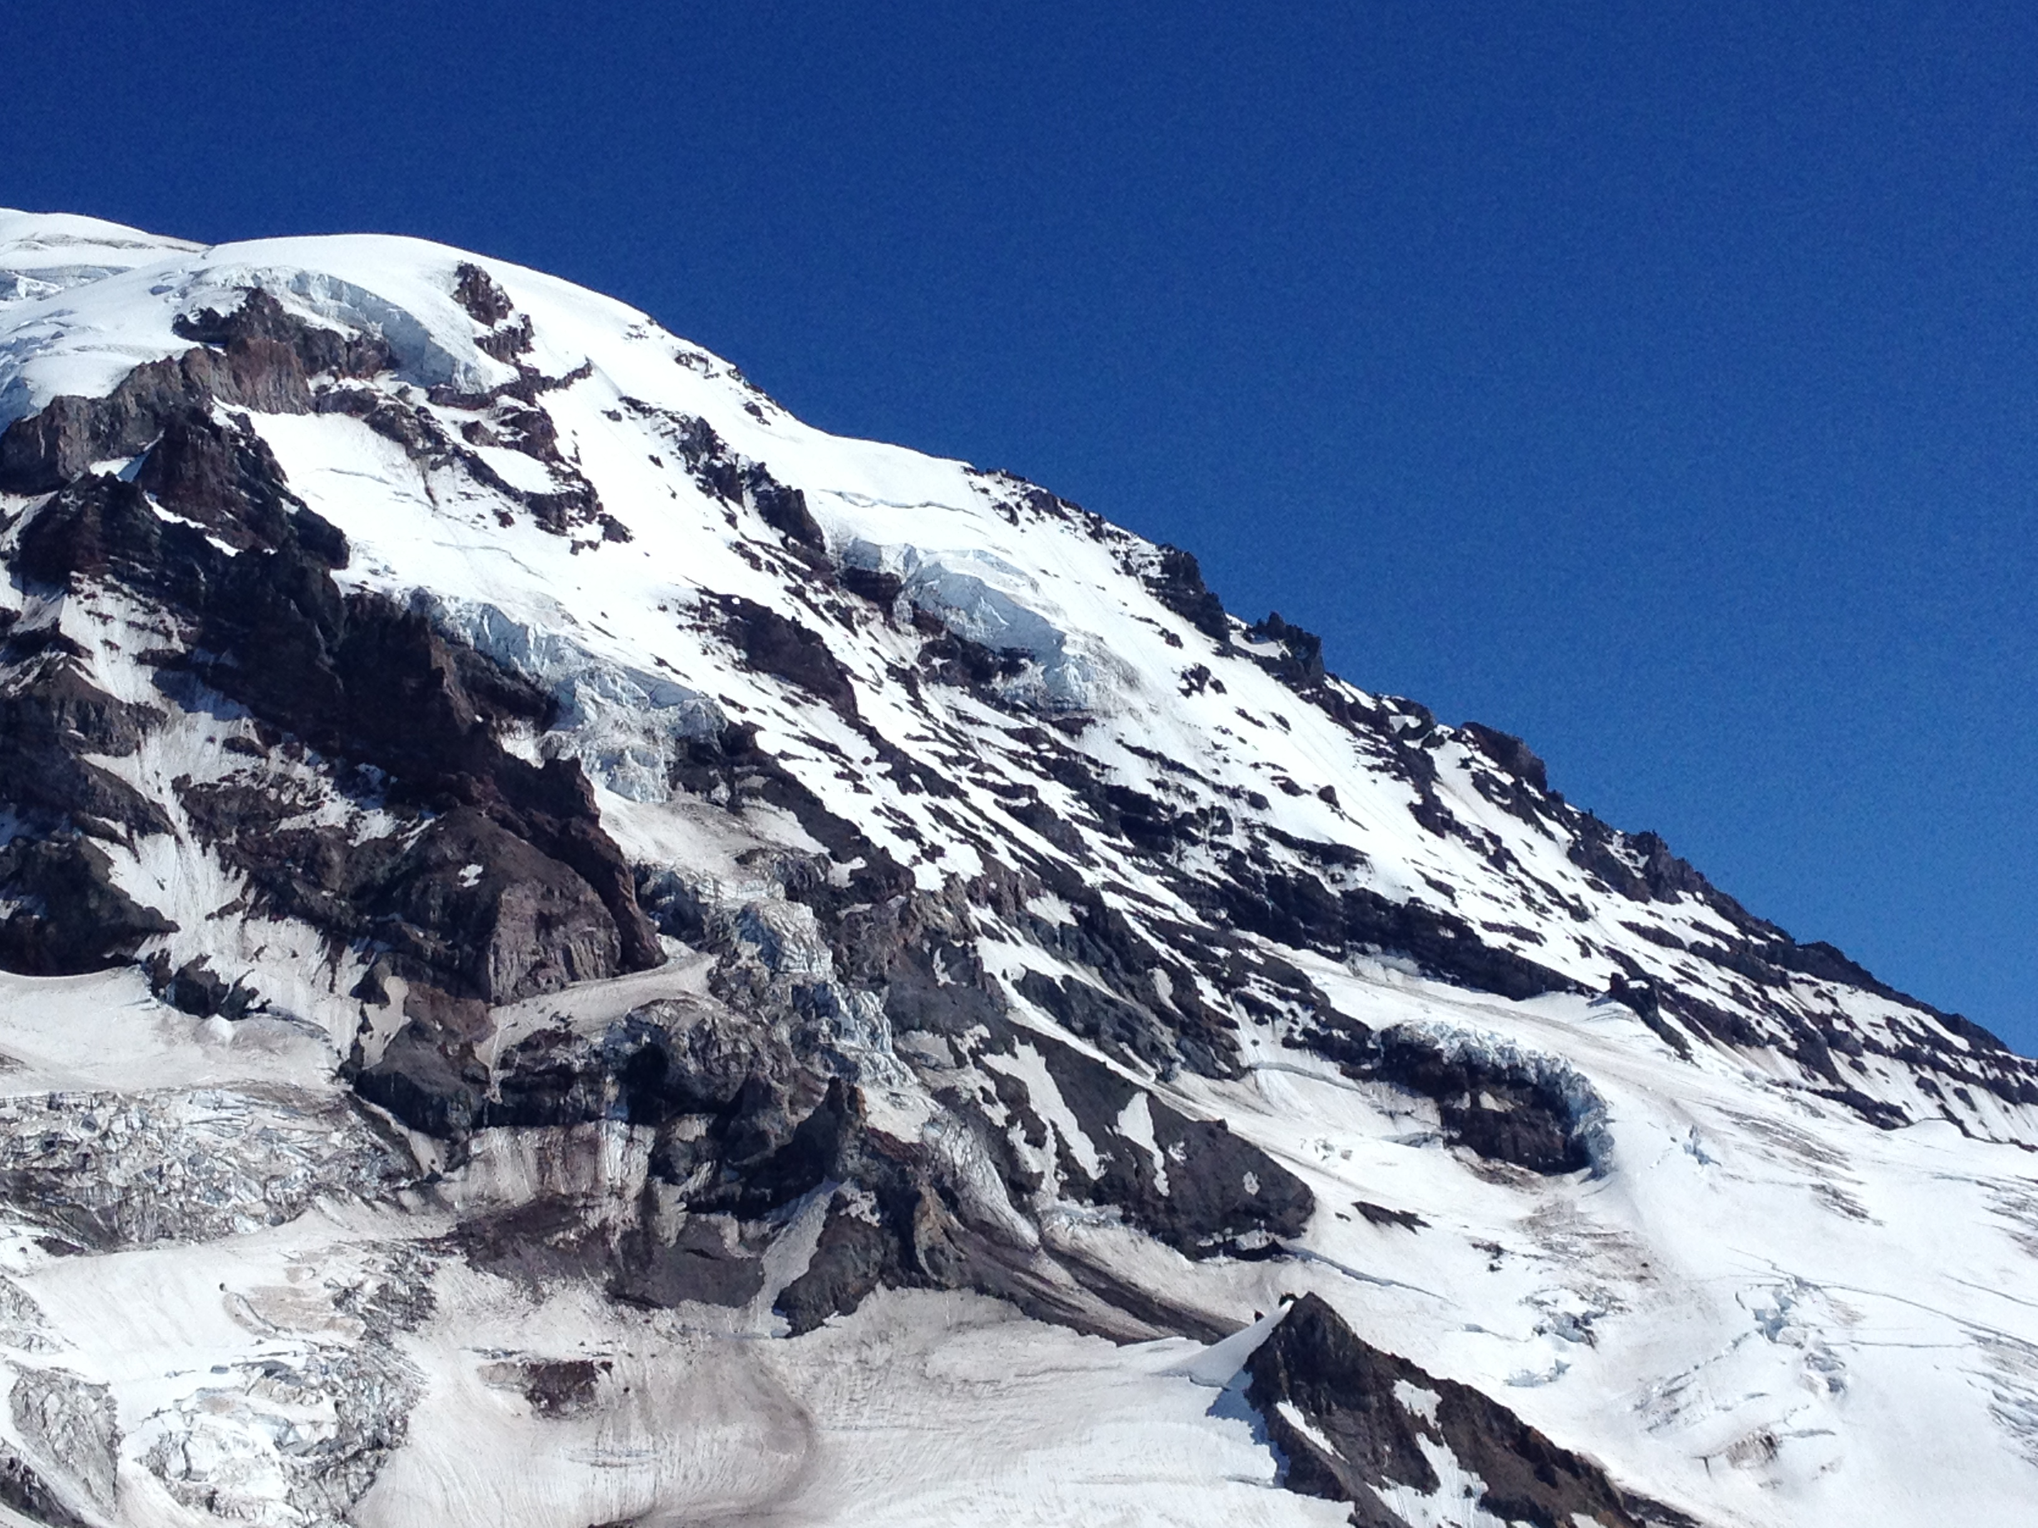
Tool & Crampon Maintenance
[Mt Rainier/ Mowich Face]

Slide 22
Sharpening Tools and Crampons
Better kicks and sticks!
Sharp equipment and tight bolts — picks, head weights, etc. — should be part of your pre-flight check.
Always carry the necessary hex key(s) to tighten your tools.
Sharp points moving fast enter the ice more easily and disturb it less, saving you energy and preserving the medium.
Swan dive versus belly flop.
More important for water ice than for glacial ice.
Everything that touches the ice should be sharp, i.e., at least tool picks, primary front points, and secondary front points.

Slide 23
Sharpening Tools and Crampons
Shaping by subtracting material.
For tools and crampons, use a “mill bastard file”. Readily available from Amazon.
The goal is to make the pick and front points into the shape you want.
  Do not use a bench grinder. It will heat up the metal.
  Gently clamp the pick in a vice or brace the tool against your leg. Be careful of furniture and flesh.
  First, shape the cross-section of the tip to match the shape when it was new. (E.g., if it gets “beaked” from hitting rock…)
  Next, shape the edge with smooth, even strokes in the same direction on each side.
Sharpening removes metal, so think about that as you work.
E.g., don’t sharpen the front side of your secondary front points, as that will alter the profile of your crampons.

Slide 24
Sharpening Tools and Crampons
Be gentle with your screws.
Sharpening screws is an involved process that requires skill, care, and additional kinds of files.
The best way to keep your screws sharp is to not dull them. Keep your screws capped when not in use and be careful around rock.
Video about sharpening tools and crampons: https://www.youtube.com/watch?v=TelFz1cSdQU
Video about sharpening ice screws: https://www.youtube.com/watch?v=L-CQbOM35oY

Slide 25
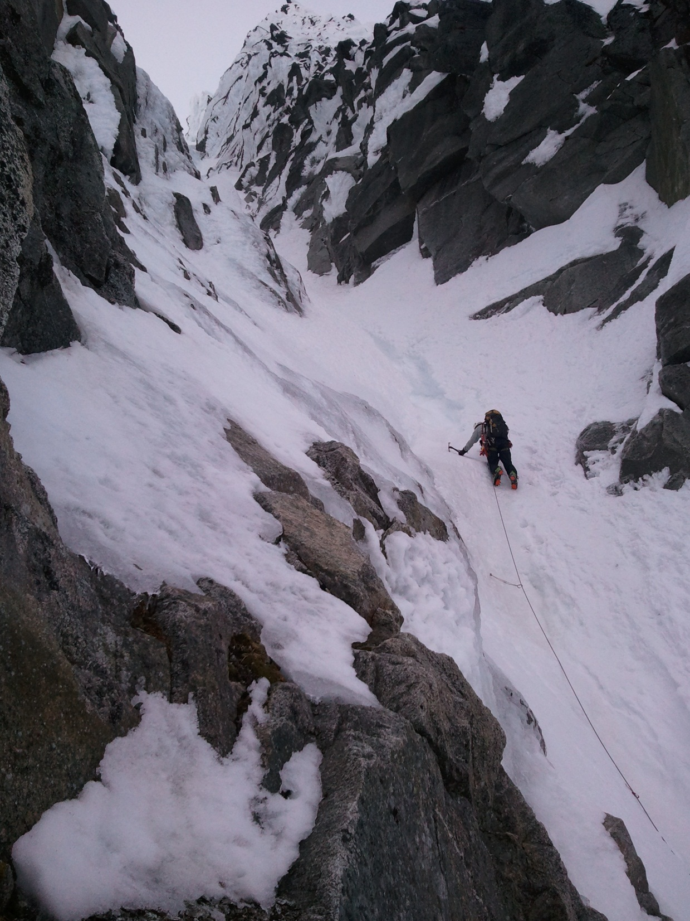
Common Anchors
[Eldorado/ NW Couloir]

Slide 26
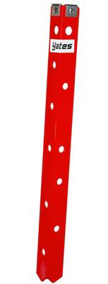
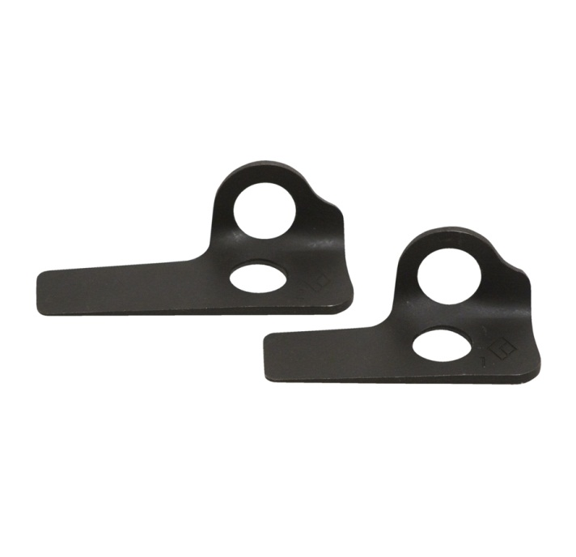
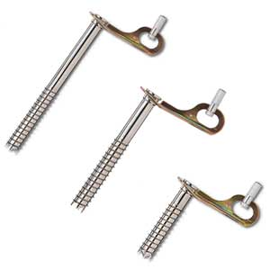
Common Anchors
Ice Screws
Pickets
Pitons (Mixed Routes)

Slide 27
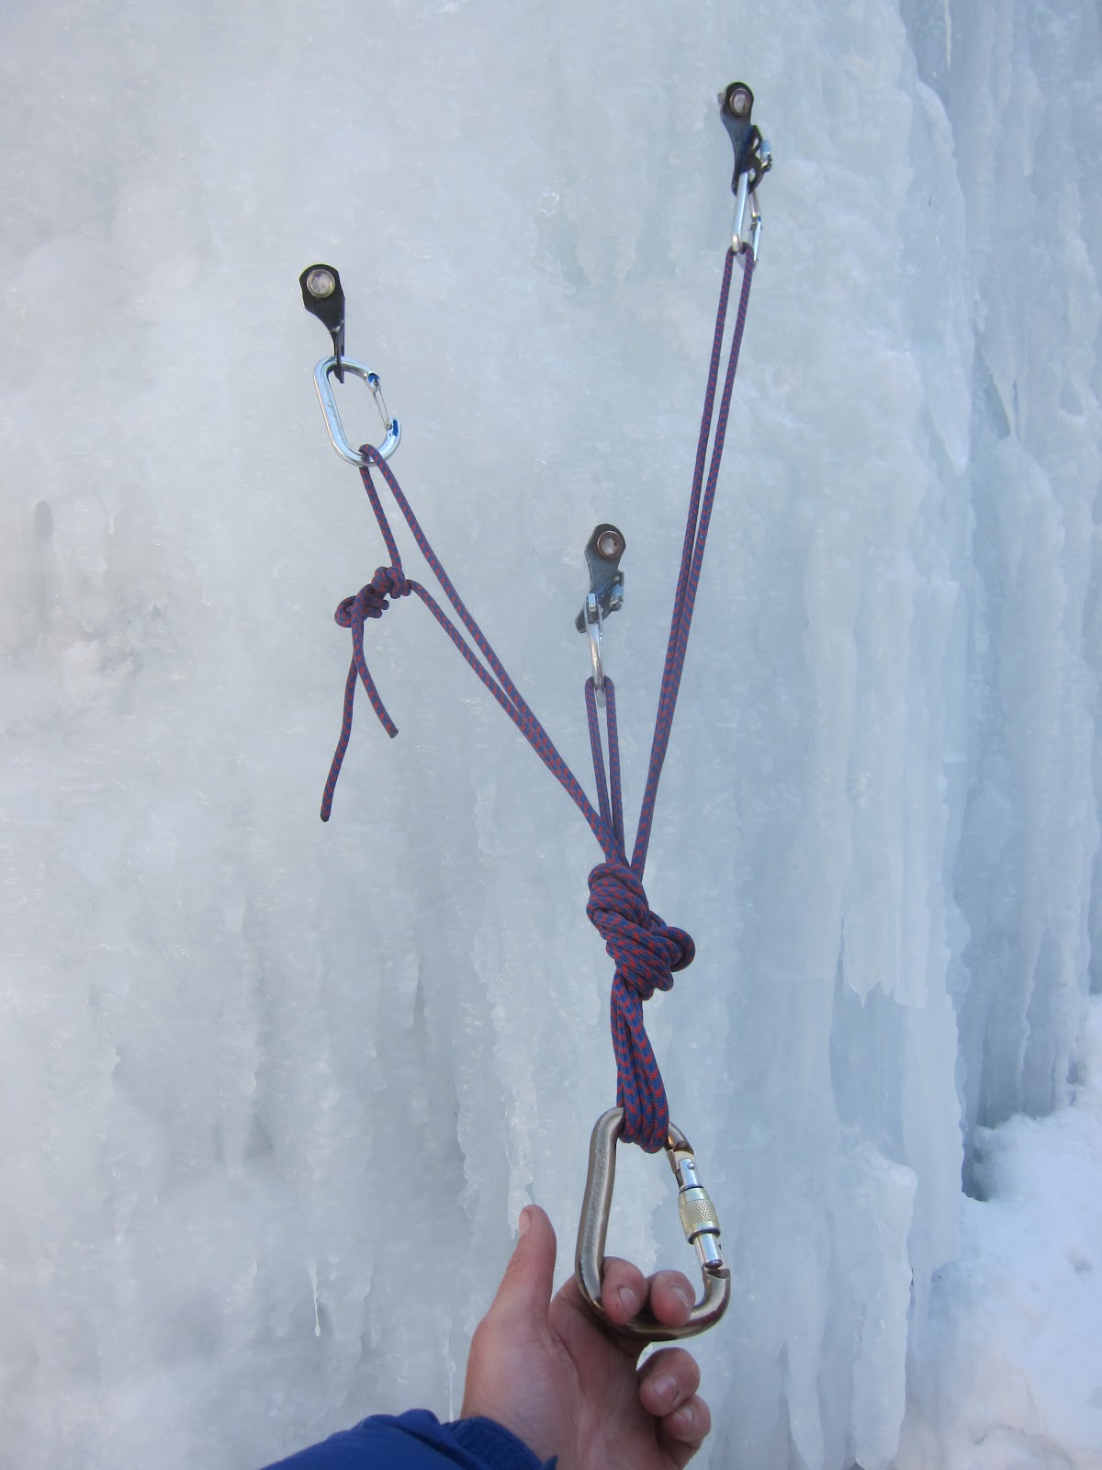
Belay Anchor
Three Ice Screws
Placed staggard
Equalized Cordellette
Belay Follower off Anchor

Slide 28
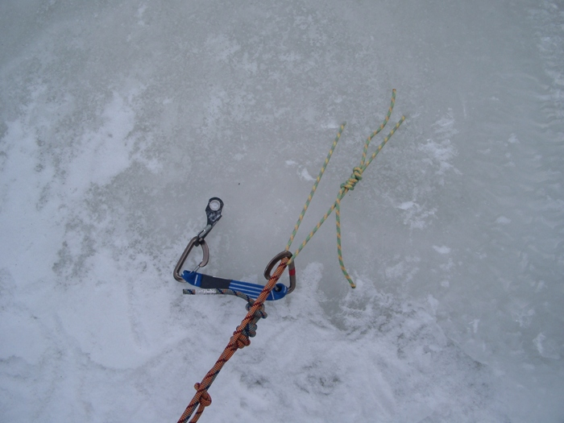
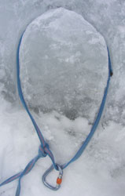
Common Anchors
Abakalov / V-threads
Ice bollards

Slide 29
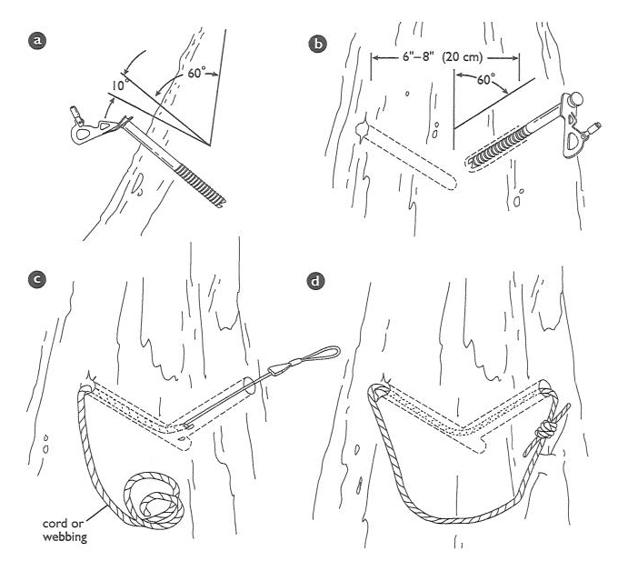
Making a V-Thread Anchor

Slide 30
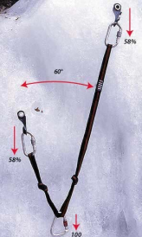
Ice Screw Top-Rope Anchor
Two Ice Screws
Placed staggard
Equalized Runner
Extend as necessary
Use Locking Carabiners
Place Snow atop Ice Screws
To mitigate screw melt-out over
time, not shown for clarity

Slide 31
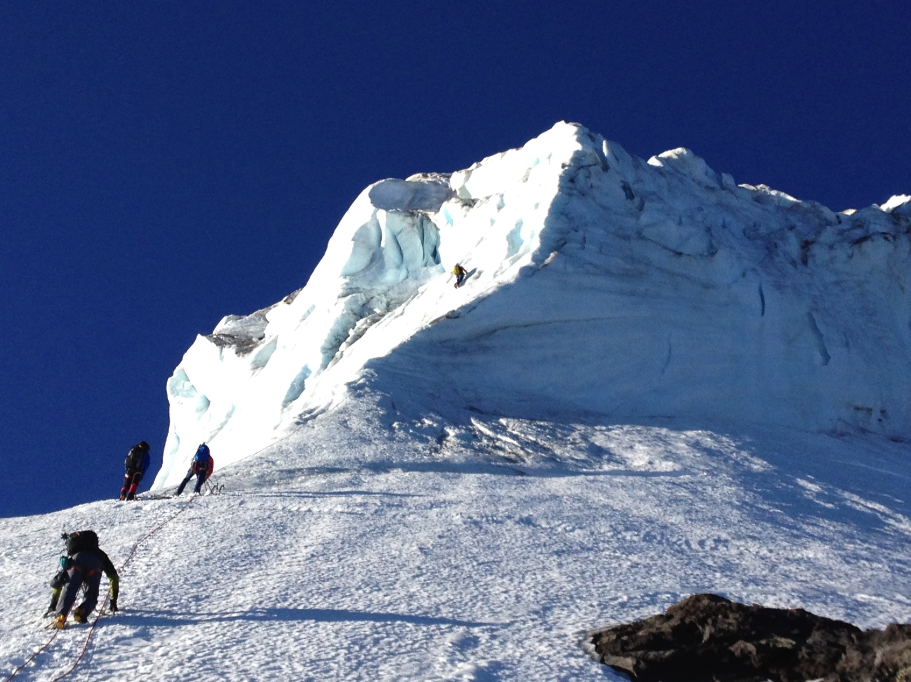
Climbing Technique
[Mt Baker/ North Ridge]

Slide 32
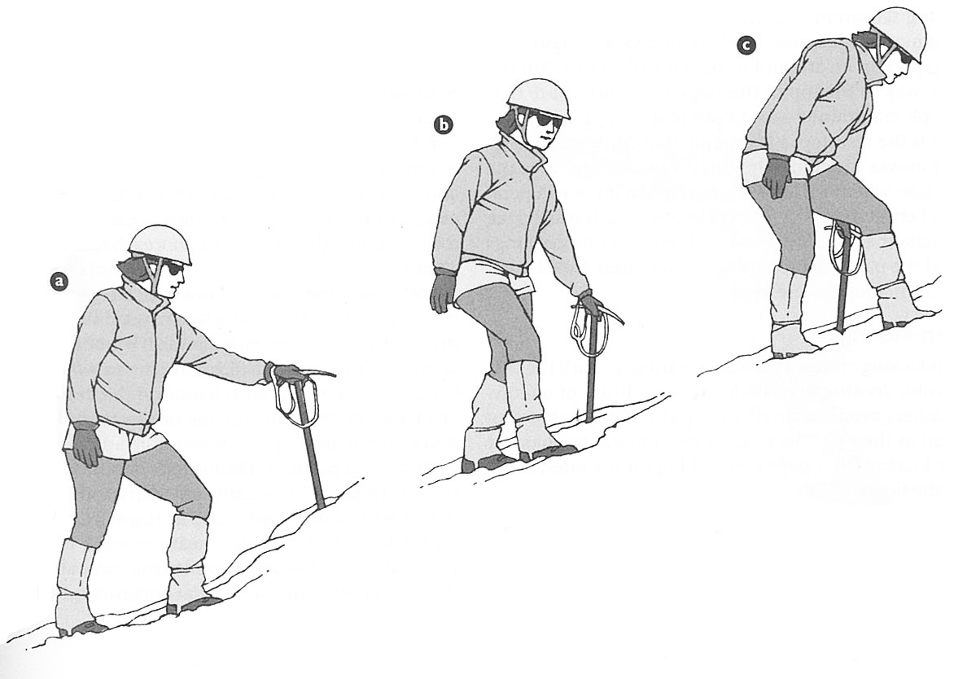
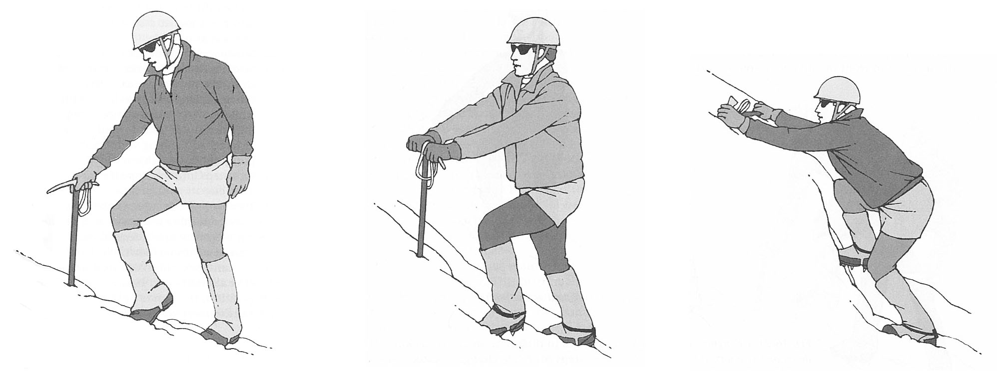
Low Angle Technique
Walking in Balance
Ascent- cane position
Ascent- stake position
Ascent- Ax in horizontal position

Slide 33
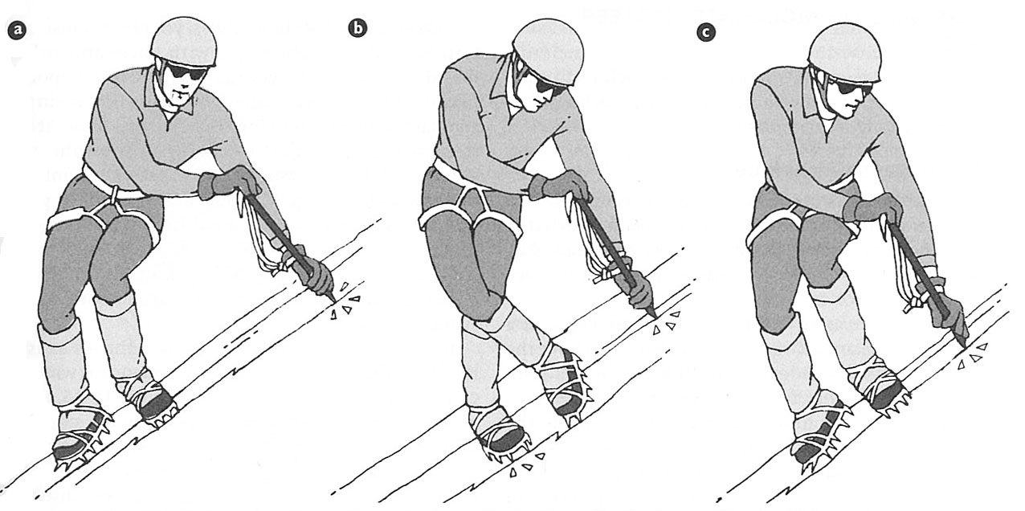
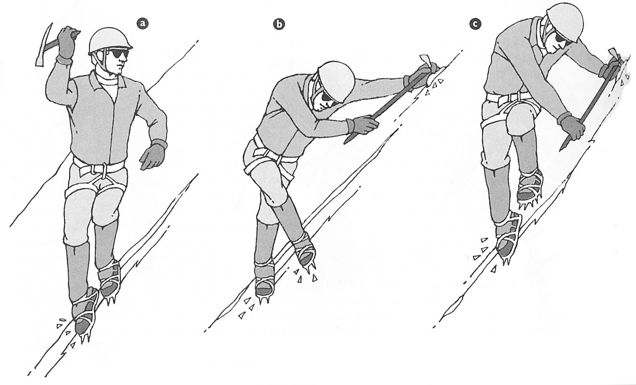
Moderate/ Steep Angle Technique
French Technique/ Ax in Cross- Body Position
French Technique/ Ax in Anchor Position

Slide 34
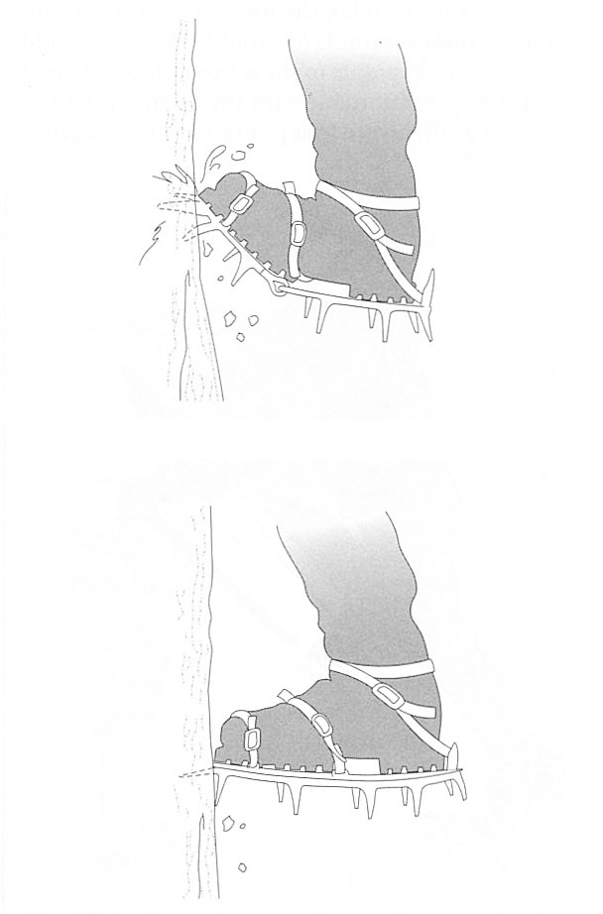
Front-pointing
NOT CORRECT
Correct

Slide 35
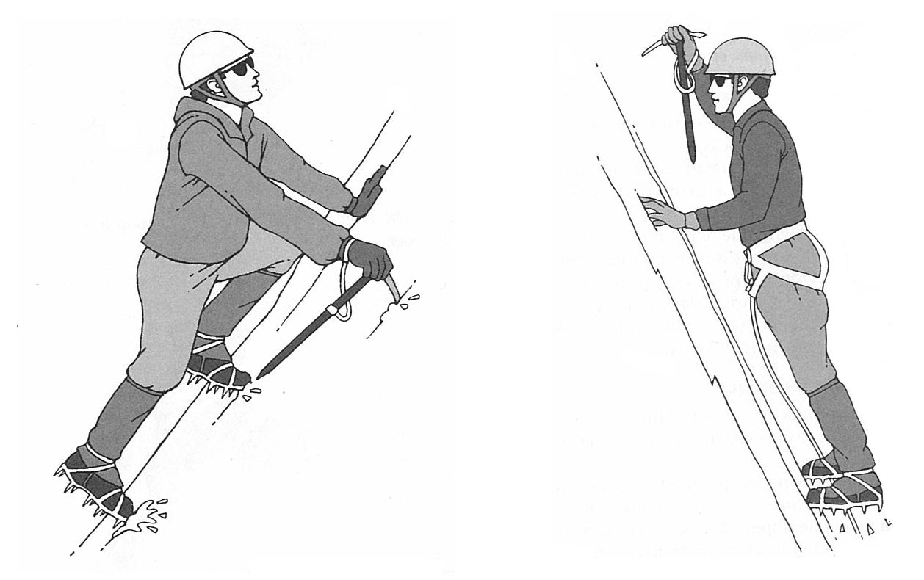
Ax Position- High/ Low Dagger
Front-pointing/ Ax in low dagger position
Front-pointing/ Ax in high dagger position

Slide 36
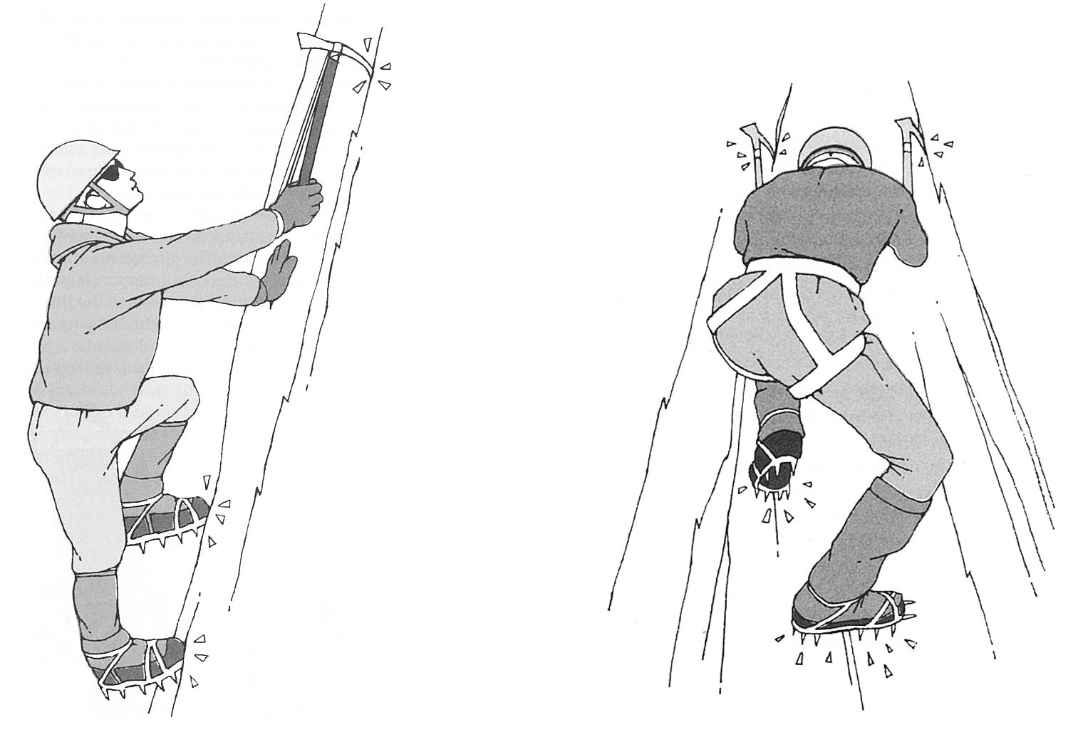
Ax Position- Traction
Front-pointing/ Ax in overhead traction
Three-O’Clock position/ Ax in overhead traction

Slide 37
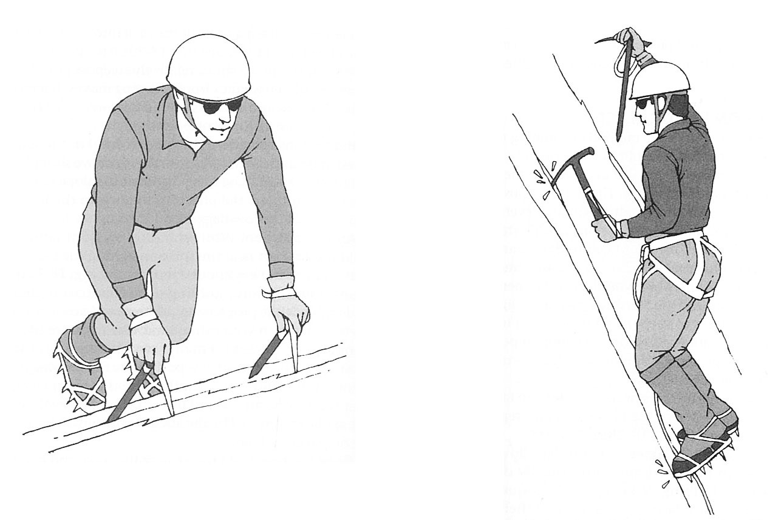
Ax Position- High/ Low Dagger
Front-pointing/ Ax in low dagger position
Front-pointing/ left Ax using traction with right Ax in high dagger position

Slide 38
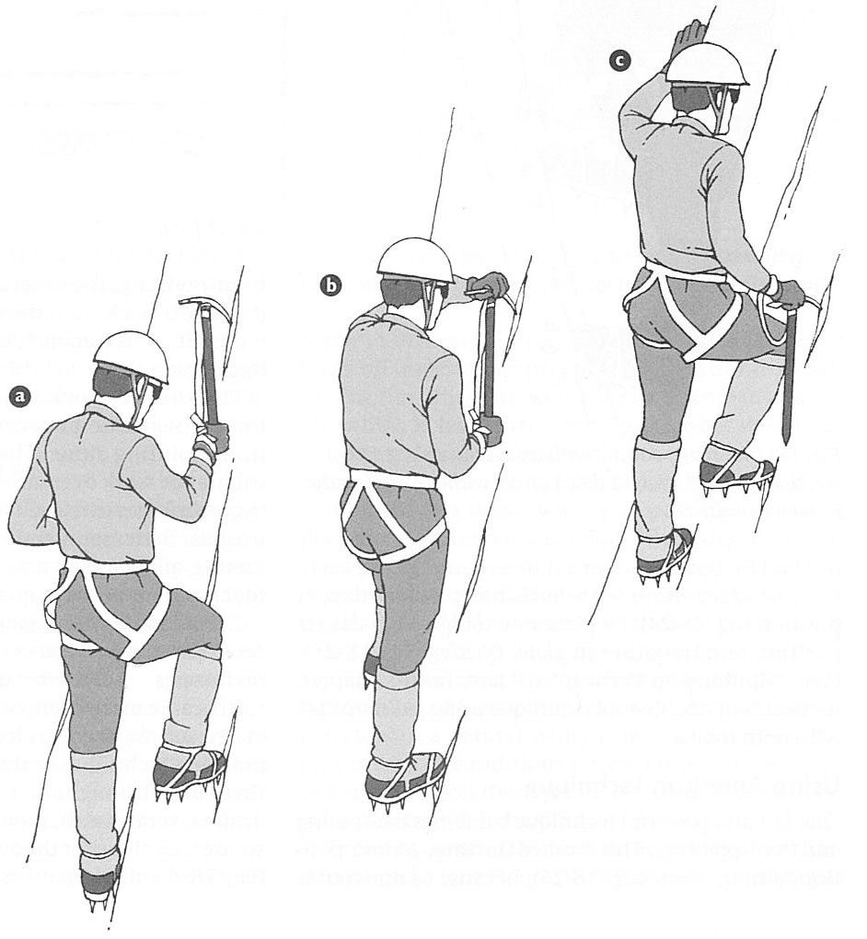
Ax Position- High/ Low Dagger
Front-pointing/ Moving with Ax in High and Low Dagger Position

Slide 39
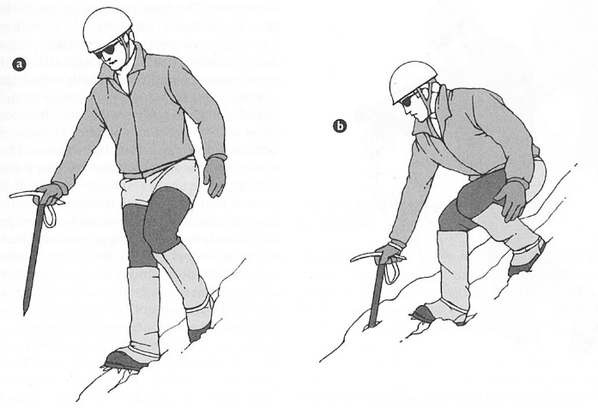
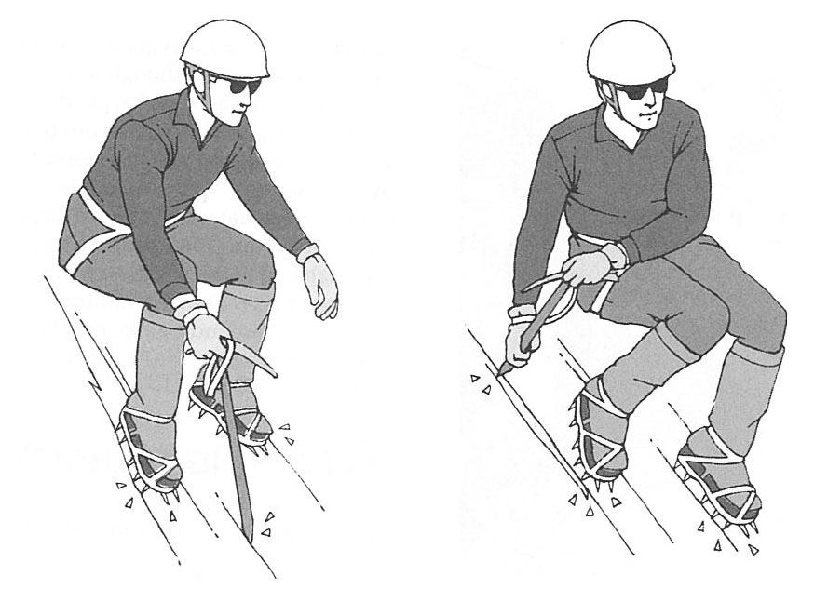
Descending
Plunge stepping
Flatfoot/ Ax in cane position
Flatfoot/ Ax in cross-body position

Slide 40
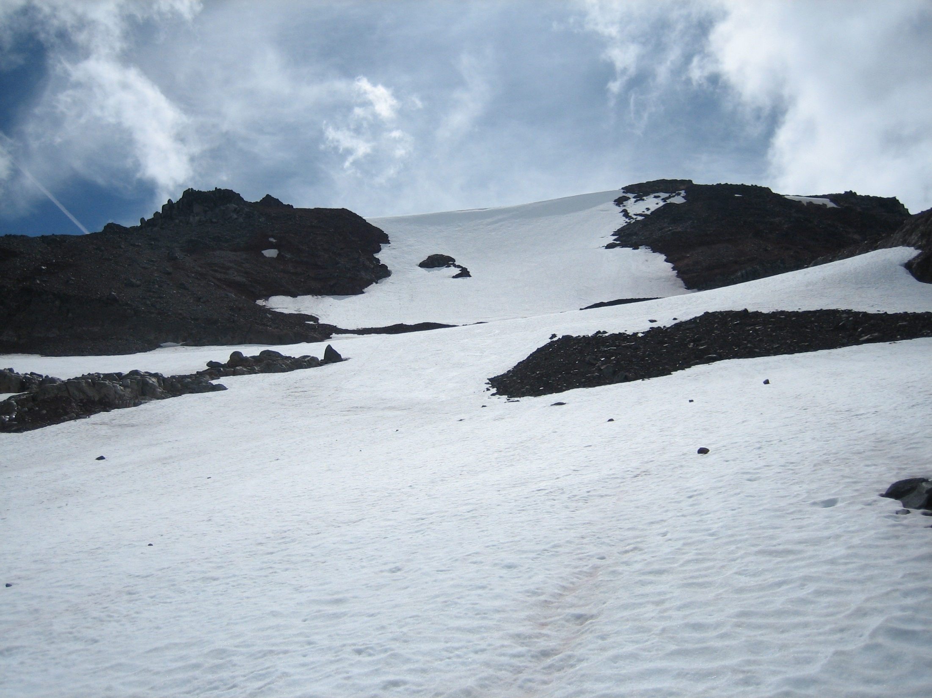
Movement on Ice
[Observation Rock/ North Face]

Slide 41
Prior to the Ice Climb
Know your route, what to expect for the desired climbing day
Know the recent weather history & forecast, including avalanche forecast if applicable
Review team composition, party size
Perform tool maintenance & sharpening as necessary
Establish a Climbing Plan

Slide 42
While Ice Climbing…
Assess route & weather when you arrive
Is it what you expected?
Go/ No-Go Decision prior to starting
Use proper footwork
Climb in balance, move efficiently
Use proper tool work
Relaxed swing, when to employ techniques for efficiency, avoid overdriving tools
Properly carry and stow tools as conditions permit
Use safe travel technique across ice falls, moats, bergshrunds, crevasses
Running belays/ simul-climbing vs Swinging Leads
MAKE INFORMED DECISIONS

Slide 43
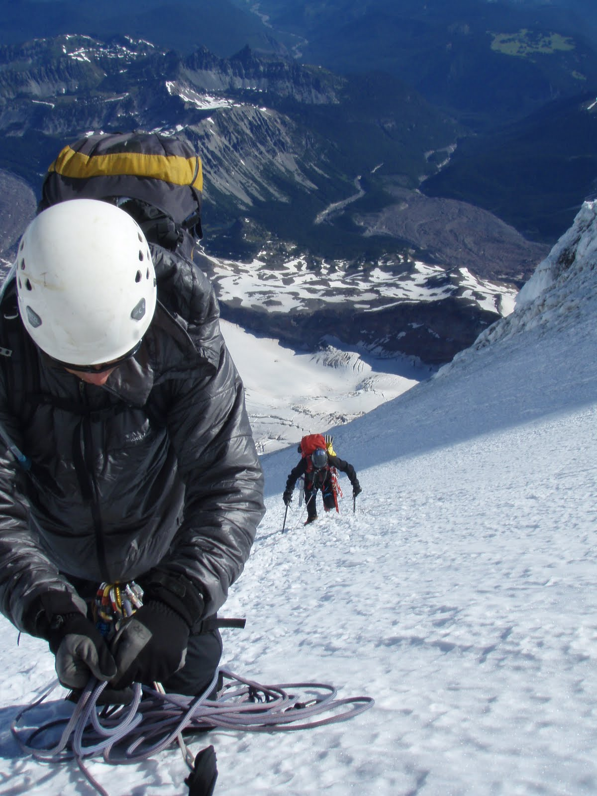
Questions
[Mt Rainier/ Liberty Ridge]

