Slide 1
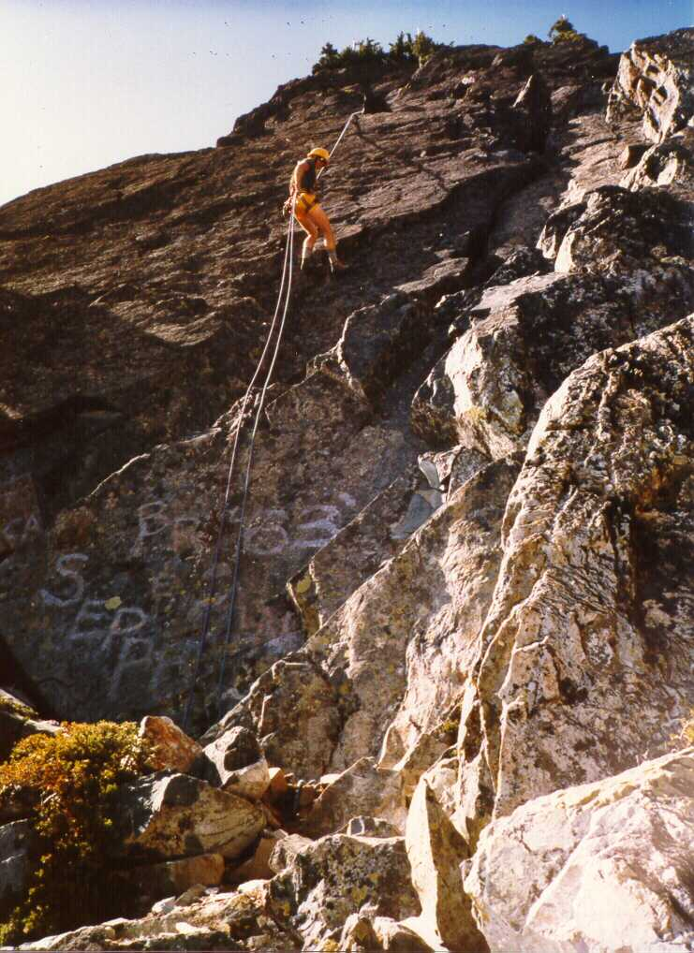

Slide 2
Rappelling
What it is
What can go wrong
Rappelling safely
Accident case studies
-- Dave Shema

Slide 3
What is a rappel?
Trusted anchor
Trusted rope and slings
Trusted braking system (often includes autoblock)
Trusted harness
Trusted technique

Slide 4
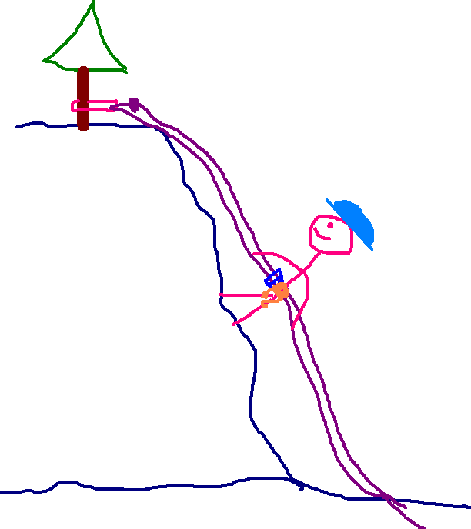
What is a rappel?
Anchor
Sling with well-tied knot
Rope, with well-tied knot
Rappel device attached to harness
or extension
Climb leader
All components MUST work

Slide 5
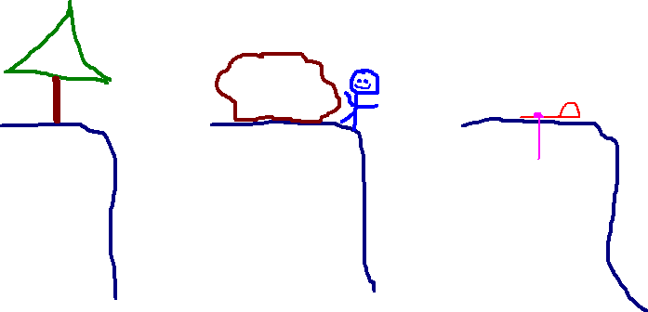
The anchor
  can’t break
  can’t move
  can’t permit slings to slide off
Tree
Big boulder
Artificial anchor

Slide 6
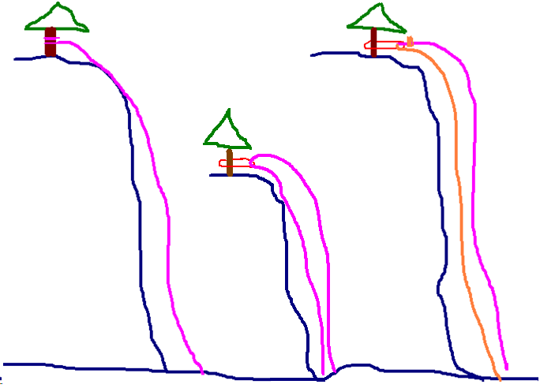
Rope and Slings
  strong knots
  good condition
  long enough
Retrievable single rope threaded thru
sling.
Retrievable double rope
thru sling
Fixed single rope
tied to tree

Slide 7
Brake Systems
  Enough, but not too much friction
  Need to be carefully assembled
  Many different types available
  All depend on bends of rope around metal

Slide 8
Experienced climbers “prefer to downclimb” whenever possible
  Why?
  Climbing up - skill
  Rappelling down - equipment

Slide 9
A Belay is tested ONLY if the climber falls
The Rappel set-up is tested from start to finish.
Screw up a belay, you might never know.
Screw up a rappel, you’re toast.

Slide 10
Rappelling
What can go wrong?
  You can get stuck
  You can fall
  You can get hit

Slide 11
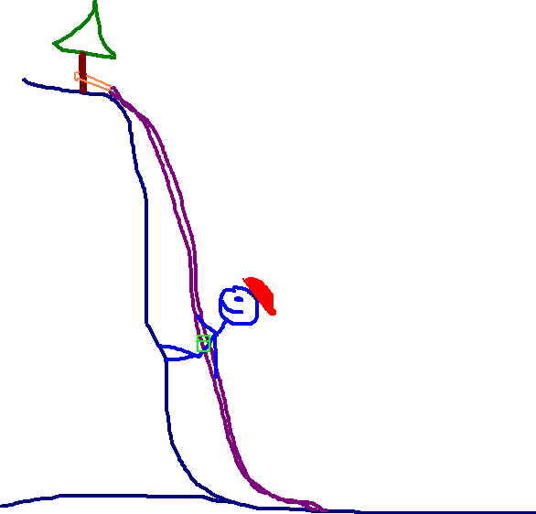
What can go wrong?

Slide 12
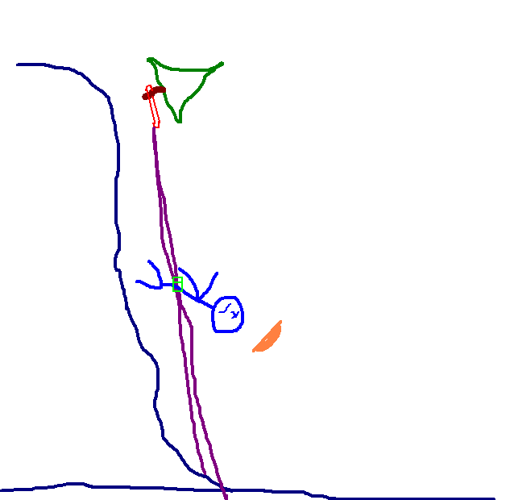
Anchor failure
Toast

Slide 13
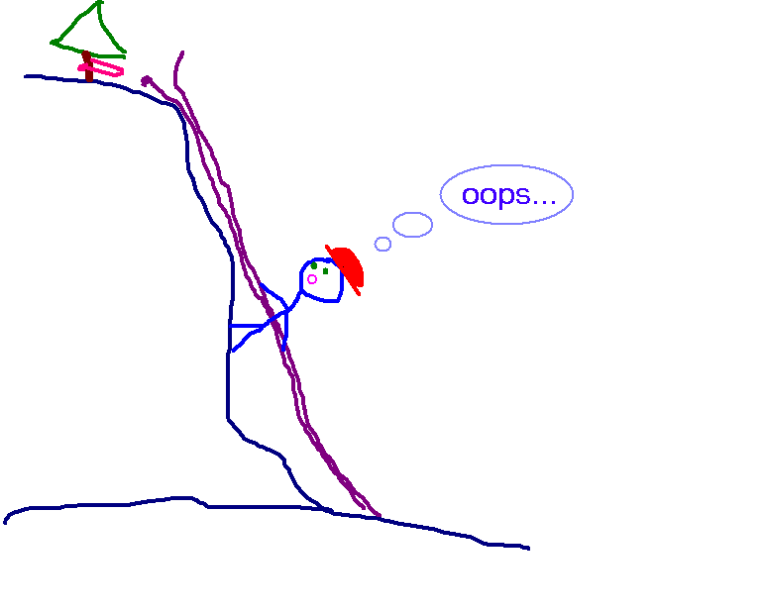
Knot failure
  sling
  rope

Slide 14
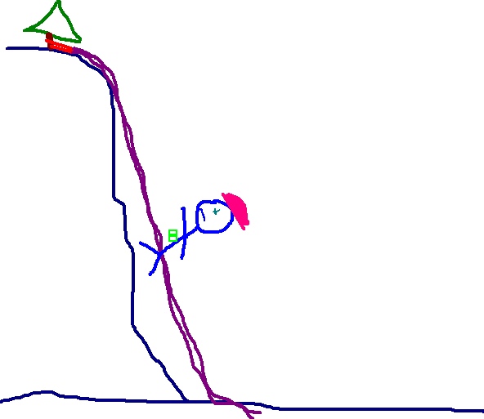
Brake failure
  not properly attached to rope

Slide 15
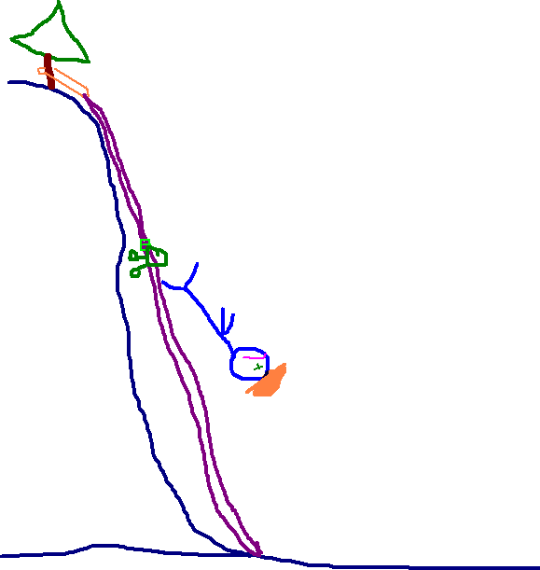
Harness failure
Toast

Slide 16
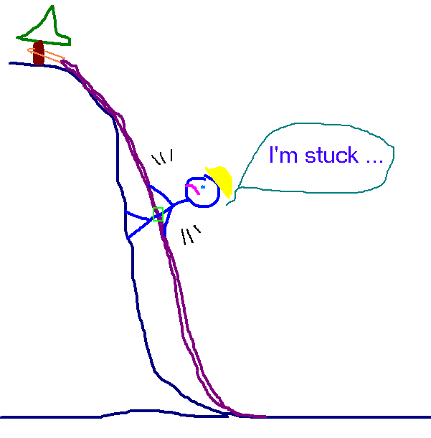
Equipment jammed in brake

Slide 17
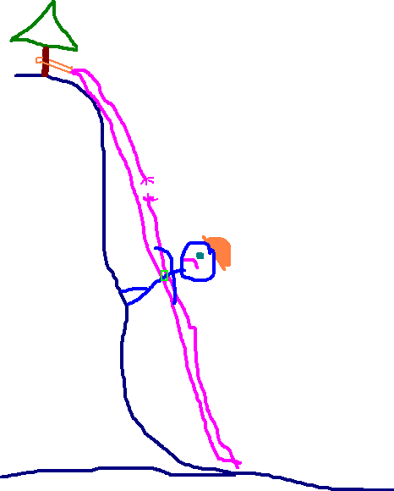
Rope failure
This is not good

Slide 18
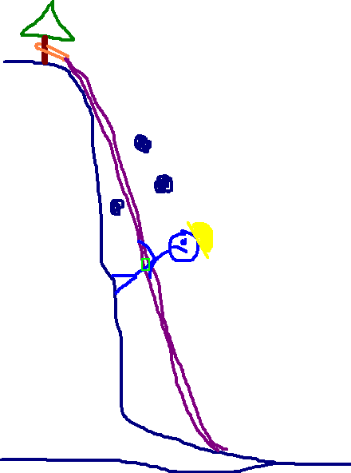
Rockfall
Toast

Slide 19
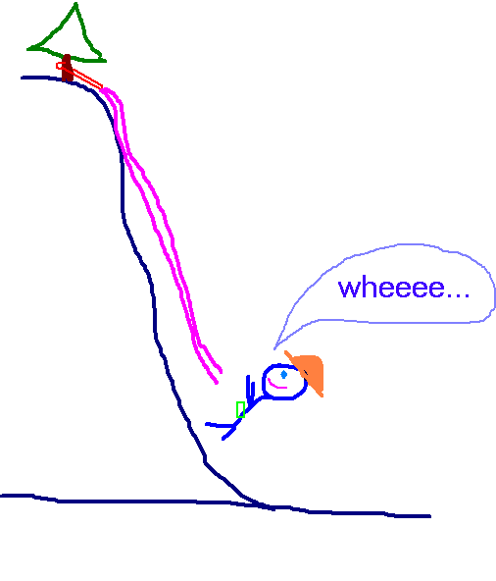
Rappelling off the rope

Slide 20
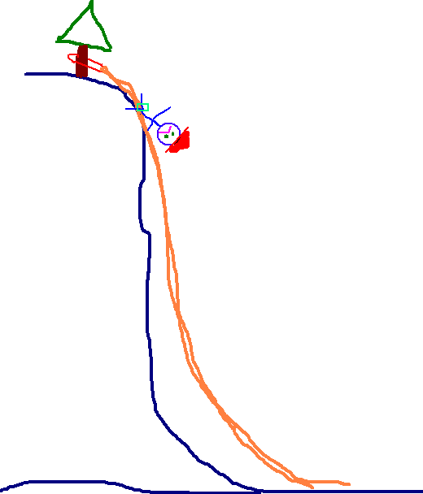
Technique failure
  out of balance
  letting go of rope
Toast

Slide 21
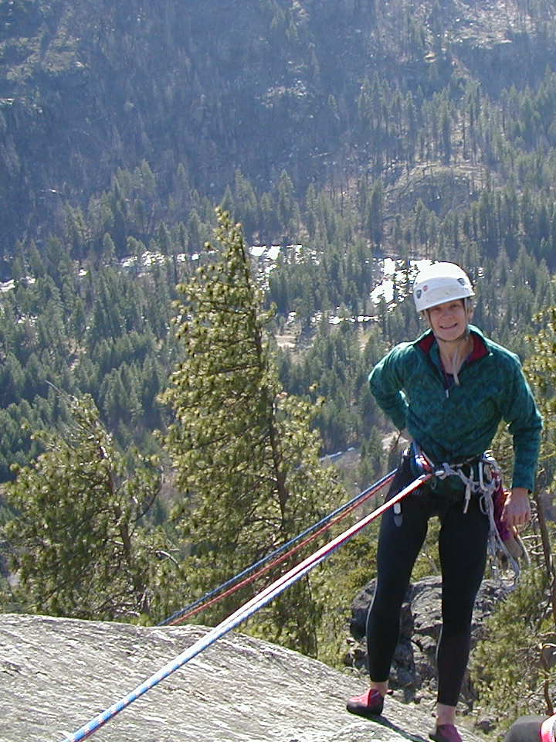

Slide 22
Rappelling Safely
Check down the rope!
Anchor
Anchor slings
Rope
Rappel Device (and often extension)
Harness
Rope side uncluttered
Terrain
Ends of rope

Slide 23
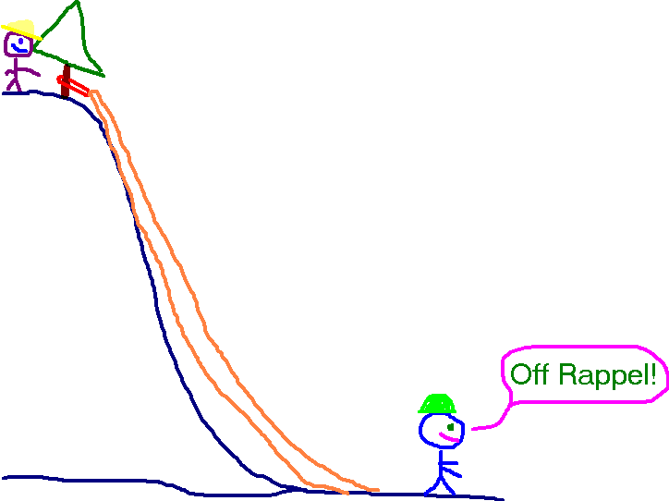

Slide 24
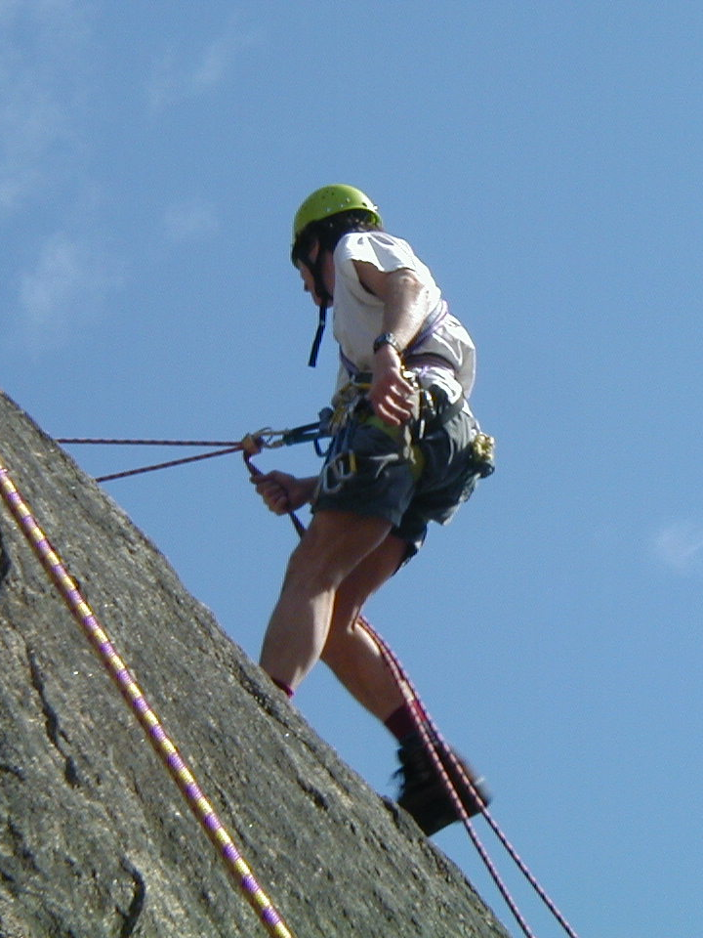

Slide 25
USA statistics from “Accidents in North American Mountaineering”
1951-2014
6841 – injuries or deaths
294 – rappel failures
3518 – fall on rock
1106 – slip on snow/ice

Slide 26
Rappel Accident Case Studies
What can go wrong, HAS gone wrong
Icicle Creek, Wa
Gretchen G. fell 20 m, breaking neck, elbow, L & R wrists, collapsed lungs
Sling knot untied (anchor failure)

Slide 27
Squamish, BC
Shawn K 20+ m fall
13 Fx:
feet
legs
hip
ribs
arm
shoulder
One side of rope was not in rappel brake. (Pre-autoblock days.)
She was wearing a parka shell and could not clearly see rappel device.

Slide 28
Smuggler’s Notch, Vermont
7 climbers required rescue - 4 stuck at top of pitch.
Teaching situation
Female climber stranded with hair caught in rappel device.
Female climber did not know rappel rope did not reach bottom.
One party member attempted free climb to assist, and fell.
Two climbers attempted “carabiner wrap rappel”. 1st zoomed by female climber, but swung onto ledge before rope ended.

Slide 29
Mount Shuksan, WA
Duane M
sprained ankle, scraped knee
Anchor failure
5th rappeller off same anchor
Rock horn fragmented
180 foot tumble
Was able to walk out

Slide 30
Mix Up Peak, North Cascades, WA
Lindsay B 100 foot fall
Fx: L wrist
R elbow
pelvis
punctured lung
head injury
Anchor failure
She was tied off to rappel anchor while partner rappelled.
She was “launched” when anchor failed.
(Partner had only a short drop.)

Slide 31
Millcreek Canyon, Utah
"Jim"
Fell 20' after rope broke
Fx ankle, abrasions, lacerations.
Setting up a sport rappel.
Used old cotton rope from Kirk's toolbox.
Halfway down, Jim bounced hard, breaking rope.
Rope later tested. Breaking strength 352 pounds. Great for an old cotton rope!
A rappeller can easily generate double body weight tension by bouncing.

Slide 32
Grand Teton National Park
David L
smashed hand
Loss of control
Practicing on overhang, panicked, and let go with braking hand.
L hand pinned between rock and rope. Suspended by hand.
Climber weighed ~220 lb.

Slide 33
White Tank Park, Phoenix, Arizona
Name: A.M.
Solo climber set up single strand rappel by tying two climbing ropes together. Apparently unable to move past the knot while on rappel, so he took off his harness. He fell 175’.
A.M. said to be quite experienced. Perhaps he was attempting to scramble to a ledge.

Slide 34
Magnuson Park, WA
Basic Climbing Field Trip
Rappeller not properly tied in prior to setting up for rappel
After climbing to top of climbing wall, student not anchored prior to untying from rope and setting up for rappel.
Instructor was assisting another student.
Situation caught, and corrected by another student.
Near miss ? Lesson – Climbers need to watch out for each other.

Slide 35
Magnuson Park, WA
Basic Climbing Field Trip
Munter Rappel System Disappears
Student sets up Munter Rappel system for RIGHT hand at top of south climbing wall.
Instructor checked the system – All OK.
Student switched to LEFT hand.
1) Rope unlocks carabiner.
2) Rappeller stops intentionally.
3) Rope opens gate as rappel resumes
4) One loop of Munter escapes.
5) Wheee ….! (almost Toast)

Slide 36
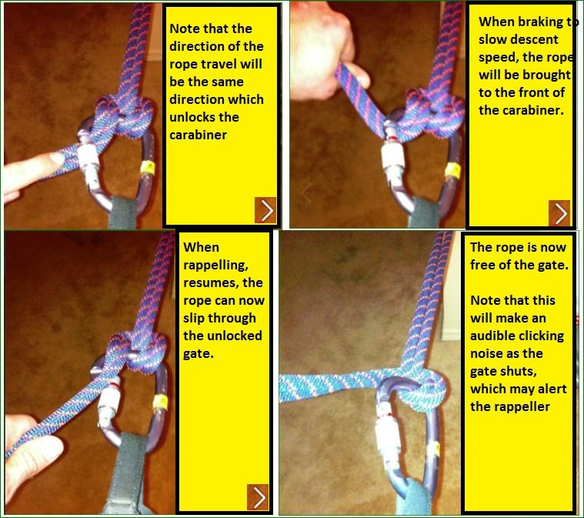
In Photos
Munter Rappel System Disappears

Slide 37
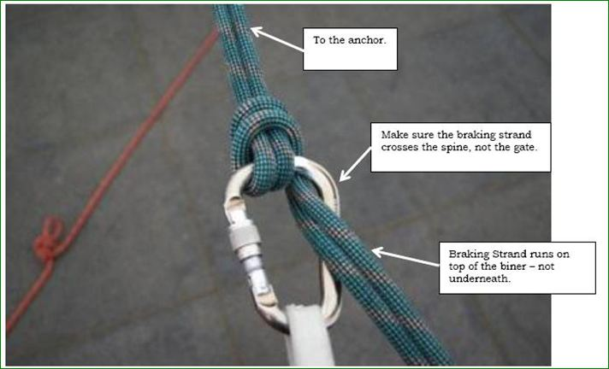
What a Munter Rappel System Should look like
To the
Anchor
Make sure the breaking strand cross the spine, not the gate
Braking Strand runs on top of biner – not underneath

Slide 38
Index Town Wall, WA
Greg Child - cut lip
Rappel off unequal ropes.
Had made same rappel a dozen times in recent weeks.
Cleaning routes.
~20’ fall
Tumbled down steep gully for a few hundred feet.

Slide 39
Greg Child
World Class Climber
  K2
  Gasherbrum IV
  Trango Tower
  Broad Peak
  1st ascents on El Capitan, Yosemite
In previous 10 years before accident:
3733 rappels
410,000 feet (77.5 miles)

Slide 40
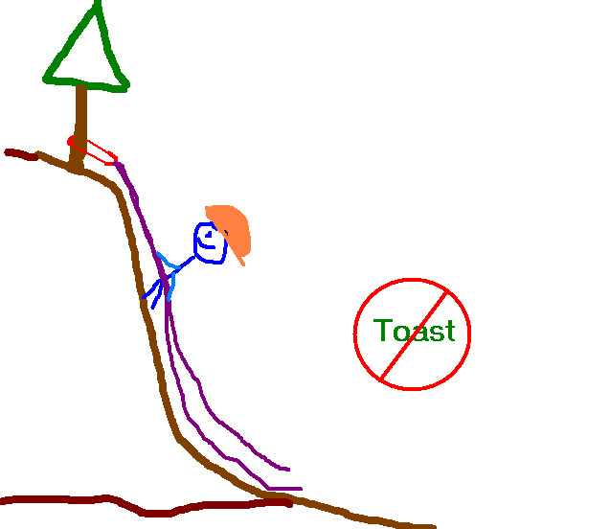
The good news
Rappelling is fun!
When set up properly, your system won’t fail you.

Slide 41
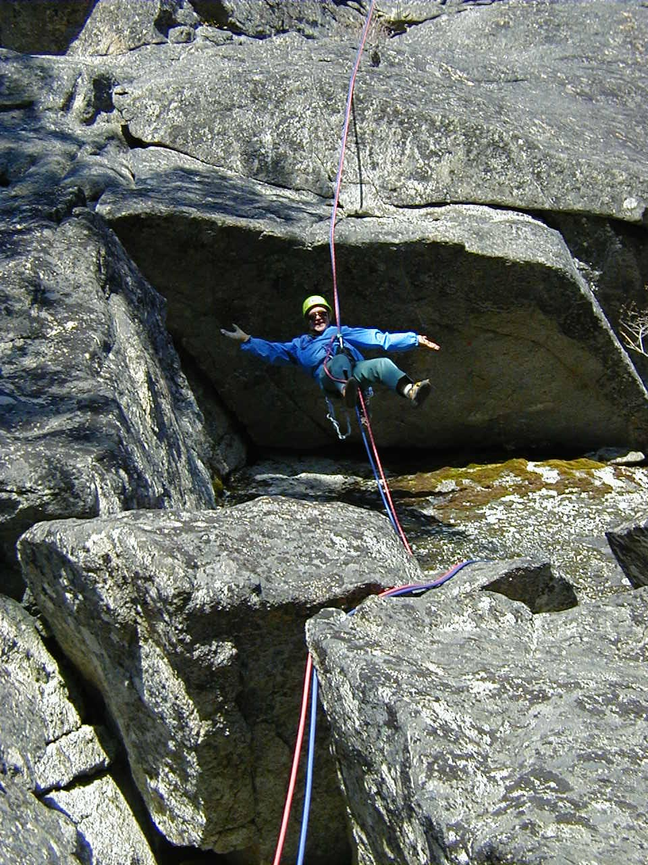

Slide 43
Tohasket Crags, WA
Gary H plummeted 12 m
Fx: L & R legs, heels
Rope knot parted
Too much of a hurry

Slide 44
14 Sept 1998
Devils Lake St Park, WI
Kelly H - rockfall
Fx: ankle
Dislodged rock while on rappel

Slide 45
10 July 1995
Mount Stuart, WA
Kris S
Fell 150’ - fatality
Anchor failure
Waited out a storm, then set anchor around rock the size of a car.
As Kris leaned back, rock broke loose, rolling over him.
“Rock should have been there for another 100,000 years.”

Slide 46
22 September 2003
Outer Space, Snow Creek Wall, WA
William T (28)
Shoulder injury due to a 15’ fall while leading. Lowered part way down, then set up rappel. Only had 30’ to go to partner.
Fell 400’ while rappelling.
Probably did not center the rope at the anchor and rappelled off the short end.
No knots at end of rope. Autoblock likely not of much value once unknotted end passes through brake hand.
Injury likely was distracting.

Slide 47
7 May 1989
Rocky Mtn National Park, Co
Robert J. 12 m fall
Injuries: head
back
abdomen
loss of consciousness: 5 min
Anchor was single hex left by previous climber on lead. Upon weighing anchor, hex pulled.

Slide 48
27 August 1994
Mount Minsi, PA
Doug M and Mark H
Stranded on a ledge
Rappelled to a ledge 120’ above ground and then were unable to pull ropes completely down.
Rescue needed.
Next day found knot had stuck in dirt on way down.

Slide 49
16 October 1999
Shawangunks, NY
Scott R
Fell 80’ - fatality
Webbing Anchor Not Tied
Scott set up an extended anchor using webbing.
As Scott started his rappel, rope dropped through the 25 foot webbing. He probably thought the webbing was tied.

Slide 50
1 May 2000
Prentice Cooper State Park, TN
Chris C
Fell 80’ while setting up rappel
Fx: face, pelvis, L & R feet, L arm, compression fracture neck C-5.
Getting dark fast
Hurry to get back to camp
As Chris was setting up the rappel, he “mis-stepped” - right off the edge of the cliff.
No helmet.
Not tied in.

Slide 51
20 October 2002
Clear Creek Canyon, Colorado
Mike (28)
Fell 50’ after losing grip on single rope rappel during edge transition. Injuries ?
Needed to lower himself 3 feet below edge to reach rappel anchor below edge.
Attached 30 pound pack to harness, and set up rappel using ATC device.
Used sling to "hand-over-hand".
When holding sling and moving down to rappel anchor, he lost control.
Without brake hand on rappel rope, he fell to bottom.

Slide 52
21 May 2002
Zion National Park, Utah
Roeslain T. (35)
Fell 60 meters when knot tying rappel ropes failed. - Fatality
Roeslain set up double-rope rappel, using Figure-8 knot to join the ropes.
Partner's view partially obstructed – no checking was done.
Was found with both ropes properly threaded through rappel device, but no evidence that ropes had been securely tied together.
Figure-8 knot known to be able to "roll" off end of rope when used for rappelling

Slide 53
1May 2003
Moose’s Tooth, Alaska
Kevin C and Ryan J
Fell 1000’ after rock block pulled away Injuries R tib/fib fx, L knee injury
Reminder of difficult of determining anchor security in alpine environments.
Above average temperatures causing a freeze-thaw cycle which loosened the block from its position.
Rescued by Rainier Climbing Rangers Mark Westman and Joe Puryear.

Slide 54
25 July 2005
Rainbow Falls, Great Smokey Mnt National Park, NC
Non-climber hiked to top of falls just to rappel down.
9mm rope, Figure-8 device.
He took very long bounds down the cliff, shock-loading the system
Rope severed. 30’ fall to boulder field.
Fx: femur, lower back vertebra, wrist
Military surplus Kevlar rope.
Rope had melted/frayed cut where it crossed over sharp rock.

Slide 55
27 May 2006 Table Rock Mtn – North Carolina
3 different teams of climbers at top of 1st pitch. One climber, Som, was cold and wished to descend.
Som (weighed 90 #) rappelled past initial slab, before fully weighing rope. Something “popped”. Fatal 130 ft. fall.
Lots of “chatting” as rappel was set up by multiple, and experienced, climbers.
Anchor made from 3 pitons equalized to a master point. Double rope rappel, with very long tails on rope
Rope bight (with knot) thru the 2 locking carabiners at master point. Knot pulled thru upon weighing the system.

Slide 56
Sharkfin Tower – North Cascades, WA.
Basic Rock Climb - team of 6 off-route.
3 fatalities, 1 injured.
Leader struck by rock during attempt to regain route – facial injuries.
Deteriorating weather, so team decided to do an “assisted” rappel to get leader down. 3 climbers on simultaneous rappel. 4th climber tied to anchor.
Anchor was refrigerator-sized rock, on down-ward slope. Anchor rolled/slid.
No other good anchors in vicinity.

Slide 57
Incidents - Basic Climbing Course
Rock 1
    Loss of control at start of rappel. Flipped upside-down.
Rock 2
    Loss of control, fell on moderate slab, cracking helmet
    Gear stuck in brake
Basic Climbs
  Fatalities when anchor pulled and carried 4 climbers down the hill. Climbers were engaged in a self-rescue.

