Slide 1
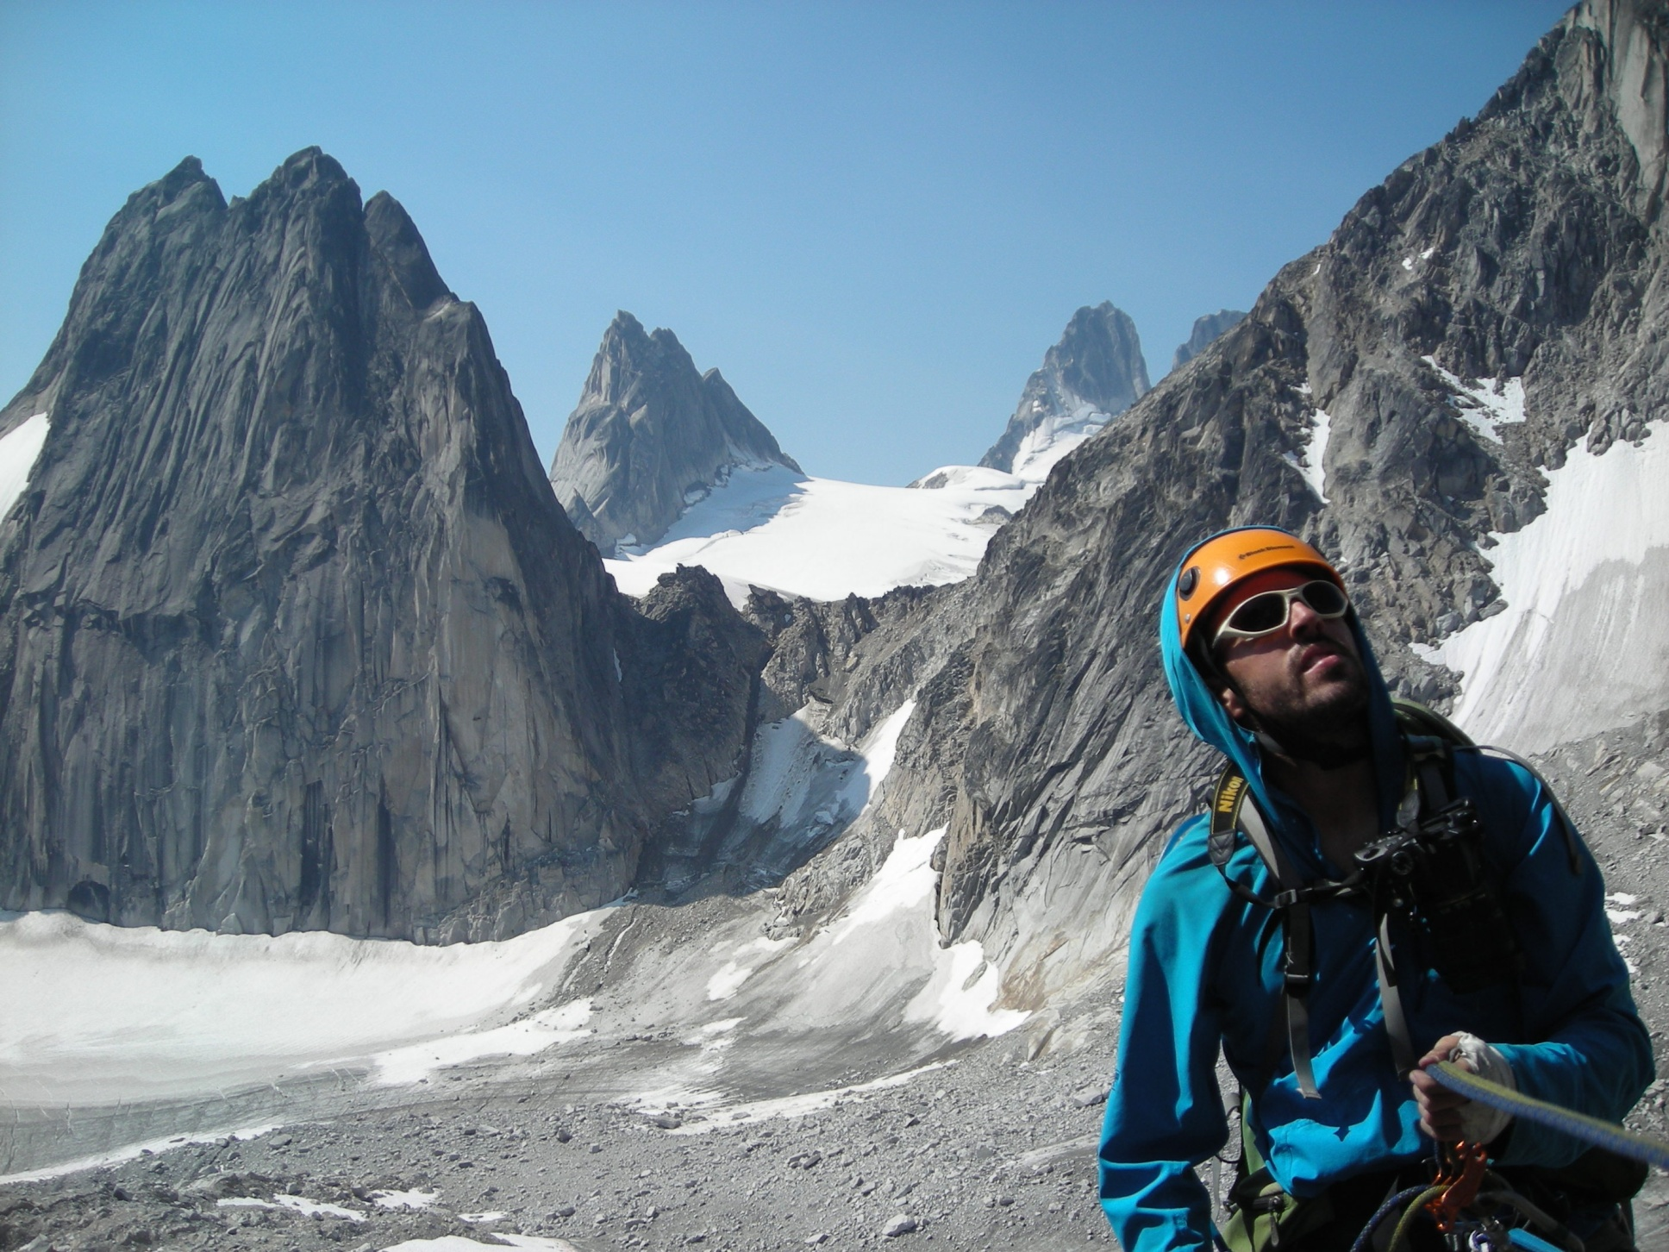
Welcome to Lecture 2! Have a seat and get to know your future climbing partners!

Slide 2
Oh, hi!
Please note, if you are looking over these slides because you missed the lecture, then some of this might not make sense. This presentation was designed for a live audience. Read FOTH chapters 9, 10, and 11 for full explanations.

Slide 3
Perspective
Lecture 1 (Course Intro., Knots, Top-rope Belay, Rope Ascending)
Lecture 2 (Anchors, Belays, Belay Escape, Rappel)
Lecture 3 (Alpine Rock)
Lecture 4 (Snow Travel, Avalanche)
Lecture 5 (Glacier Travel)

Slide 4
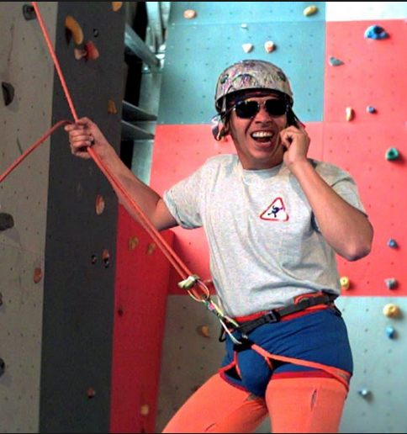
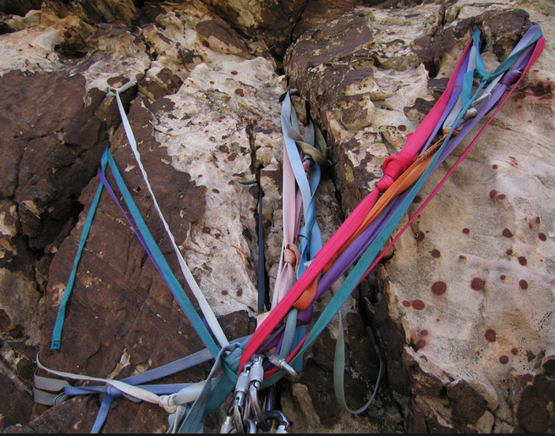
Lecture 2 Learning Targets The prepared and engaged student will begin to understand (conceptually) how to...
--Prepare for Field Trip 2
--Evaluate belay and rappel anchors for rock
--Lead Belay
--Escape the belay
--Rappel safely

Slide 5
Bivy Spot?

Slide 6
Are you prepared?
HW: Freedom 8, chapters 9, 10, 11, 22

Slide 7
Pop Quiz!
If you have a smart phone or a computer, please get it out now and go to www.kahoot.it

Slide 8
Field Trip 2
Just like a climb…
Be on time and be present
Bring food, water, and clothing appropriate for the
weather conditions
Gear: Helmet Harness
Carabiners
120cm sewn nylon sling
Belay/rappel device
Pack
10 essentials
Do your HW and pay attention at tonight’s lecture!

Slide 9
Lecture 2 Learning Targets The prepared and engaged student will begin to understand (conceptually) how to...
Prepare for Field Trip 2
Evaluate belay and rappel anchors for rock
Lead Belay
Escape the belay
Rappel safely

Slide 10
Belay and Rappel Anchors for Rock
When are they necessary?
-Exposed terrain that is beyond
“safe” un-roped climbing ability
-To protect the belayer from being pulled into something
-Belay escape vs. extra people to assist
Reason for not anchoring (or anchoring in tight)
-Freedom to move for adjusting belay position,
or dodge falling rocks
-Chossy rock
-You are Alex Honnold

Slide 11
Belay and Rappel Anchors 101
Solid (or Strong)
Equalized
Redundant
Efficient
No…
Extension
Other acronyms exist, e.g. Equalized
Angle Redundant No Extension Solid (or strong) Timely
Solid
Redundant
Equalized
No
Extension

Slide 12
Solid and strong

Slide 13
Equalized

Slide 14
Redundant
2
1
3

Slide 15
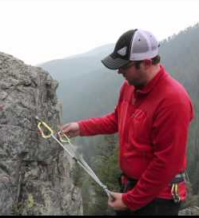
Efficient
Study, learn, practice, practice, practice

Slide 16
No Extension
How far would the anchor extend if the left arm were to fail?

Slide 17
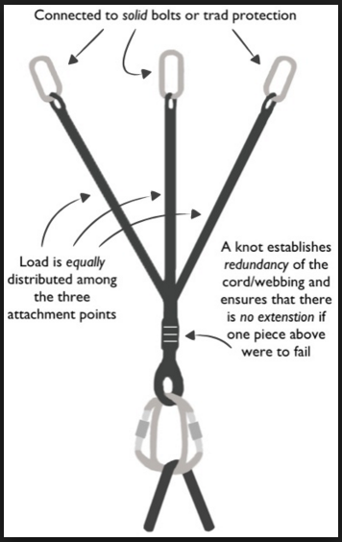
Recap
Strong or Solid
Equalized
Redundant
Efficient
No
Extension
Questions?

Slide 18
Anchor Activity
Efficiently tour the anchors setup along the perimeter of the room.
Evaluate them. Are they all SERENE?
Would you trust your life with them?
Discuss with peers, take notes, take pictures, add questions to the bivy spot!

Slide 19
Anchor Activity Review American Death Triangle

Slide 20
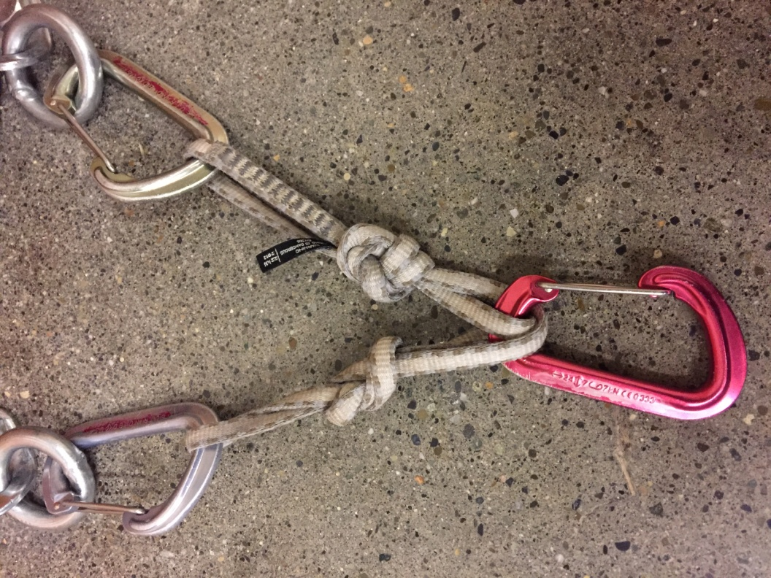
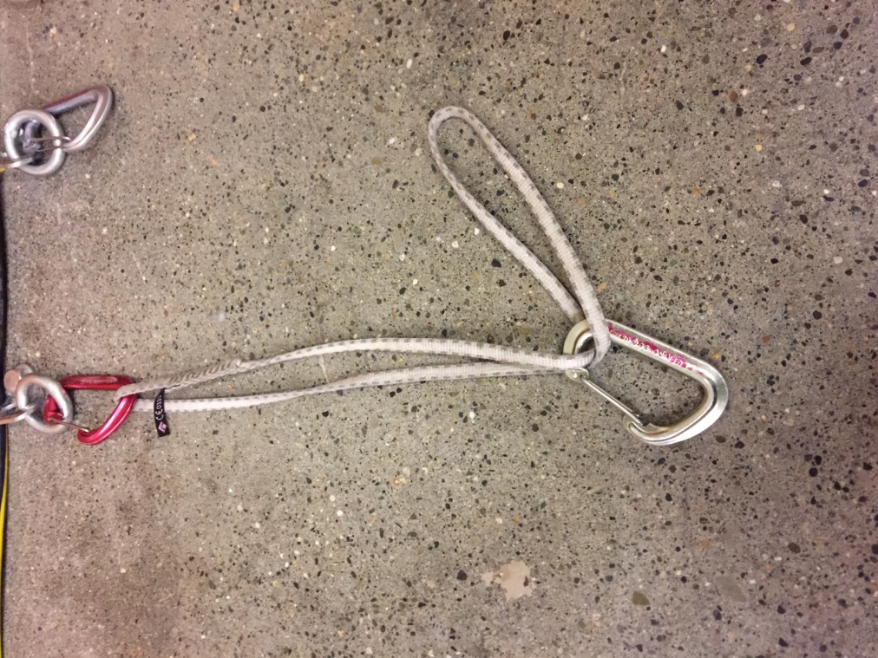

Slide 21
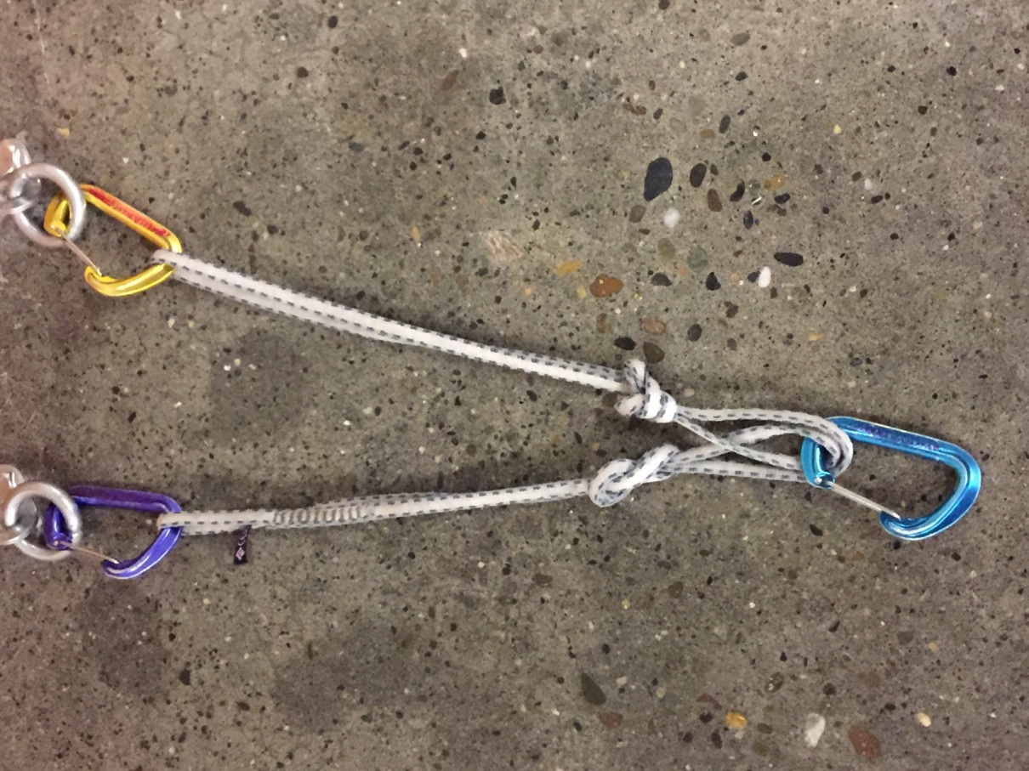

Slide 22
Anchor Activity Review A good quad anchor

Slide 23
Anchor Activity Review An equalized cordelette

Slide 24
Anchor Activity Review

Slide 25
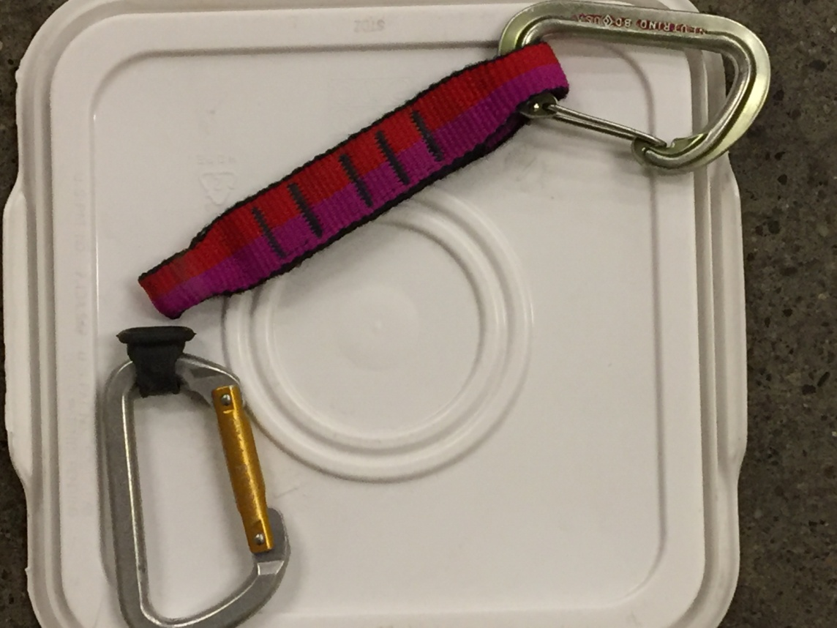
Know Your Gear!

Slide 26
Know Your Knots!

Slide 27
Questions?
Notes:
Is our bivy man cold and lonely? ☺

Slide 28
Lecture 2 Learning Targets The prepared and engaged student will begin to understand (conceptually) how to...
Prepare for Field Trip 2
Evaluate belay and rappel anchors for rock
Lead Belay
Escape the belay
Rappel safely

Slide 29
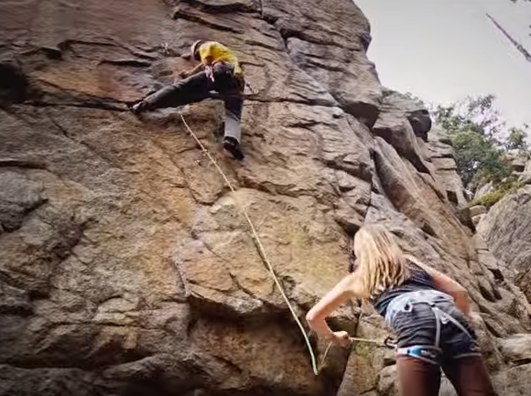
How to Lead Belay
https://youtu.be/YvEQrKOtUZg?t=1m5s

Slide 30
Basic Lead Belay Setup
Observations
-Anchor at comfortable belay stance
-Helmets
-Neatly flaked dynamic rope
-Glove on brake hand
-Non-brake hand is feeding out rope
-Belayer is watching lead climber
*This scene is of a multi-pitch trad climb;
the climbers are on an exposed ledge

Slide 31
Lead Belaying feeling hand and braking hand

Slide 32
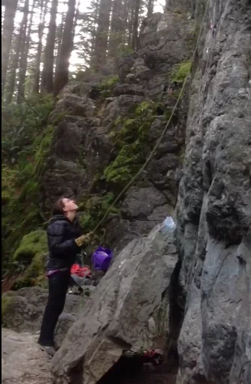
Lead Belaying--terrain and style of climbing will dictate nature of the belay
Observations
-Anchor at comfortable belay stance
-Helmets
-Neatly flaked dynamic rope
-Glove on brake hand—even w/ grigri
-Non-brake hand is feeding out rope
-Belayer is watching lead climber
https://player.vimeo.com/video/127939980
How was the force absorbed?
See page 157—stopping distance

Slide 33
Which climber would you trust with your life?
https://youtu.be/XeL5NC7Mp0o?t=8s

Slide 34
What would you do differently?

Slide 35
Review--Basic Lead Belay Setup
Observations
-Anchor at comfortable belay stance*—why?
-Helmets—why?
-Neatly flaked dynamic rope—why?
-Glove on brake hand—why?
-Non-brake hand is feeding out rope—why?
-Belayer is watching lead climber—why?
*This scene is of a multi-pitch trad climb; the
climbers are on an exposed ledge

Slide 36
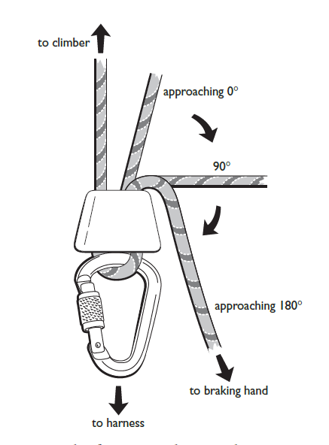
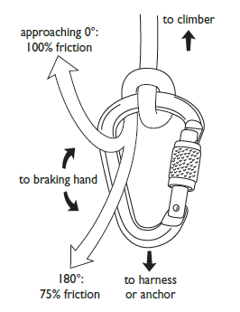
Numerous ways to belay…
Munter
tubular device
body belay

Slide 37
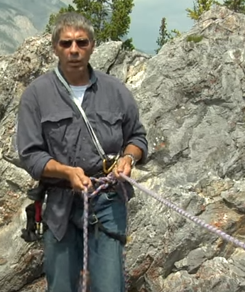
Belaying a follower with a body belay
Advantages
-Efficient set up
-Rope can be taken in quickly
-Allows for a dynamic belay—
important for some terrain and
anchor situations, e.g. snow
Considerations
-Not intended to hold massive forces
-Exposure of terrain
-Difficult to escape
https://youtu.be/Tw6CHiFHXZI?t=1m11s

Slide 38
Belaying a follower with a Munter off of the anchor
SERENE Anchor
Tied in w/ clove
Munter hitch
Brake hand on

Slide 39
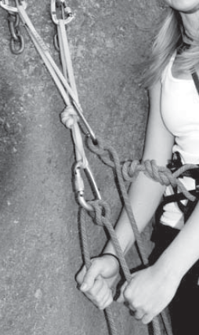
Good
BAD

Slide 40
Belaying a follower off the body with a tubular device
Advantages
-Efficient set up
-Rope can be taken in quickly
-Allows for a dynamic belay—
important for some terrain and
anchor situations, e.g. snow
Considerations
-Not intended to hold massive forces
-Exposure of terrain
-Difficult to escape

Slide 41
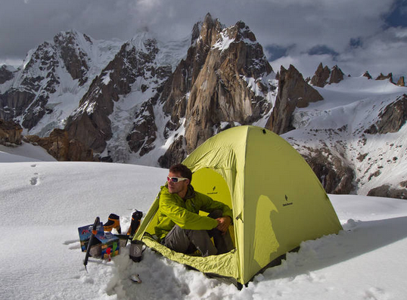
Questions?
Munter
off anchor
tubular device
body belay

Slide 42
Lecture 2 Learning Targets The prepared and engaged student will begin to understand (conceptually) how to...
Prepare for Field Trip 2
Evaluate belay and rappel anchors for rock
Lead Belay
Escape the belay
Rappel safely

Slide 43
Belay Escape—DISCLAIMER!!!
There are multiple ways to escape the belay. The Basic course will show you a fundamental way. As you continue with your climbing, there will be additional methods to learn.
Included here are clips from two videos.
This first video does a great job showing you how to go hands free. https://youtu.be/4JtcxIQGKBs?t=50s Stop at 2:18
This second video has a few lapses and should not be studied in full. I am showing it to you tonight so that you have a complete picture of how to tie off the load in its most simple and basic way—note this way is arguably not the *best* way. It all depends on the scenario. https://youtu.be/wetMWQEbPC0?t=1m47s Stop at 3:56

Slide 44
Belay Escape—Step 1: Go Hands Free (when belaying with a device)

Slide 45
Belay Escape—Step 1 Go Hands Free (when belaying with a Munter)

Slide 48
Questions?

Slide 49
Lecture 2 Learning Targets The prepared and engaged student will begin to understand (conceptually) how to...
Prepare for Field Trip 2
Evaluate belay and rappel anchors for rock
Lead Belay
Escape the belay
Rappel safely

Slide 50
Rappelling
Factors to Consider
-Anchor quality
-Terrain hazards
-Where does the rappel end?
-Gear management
-Agreed upon plan
-Backup

Slide 51
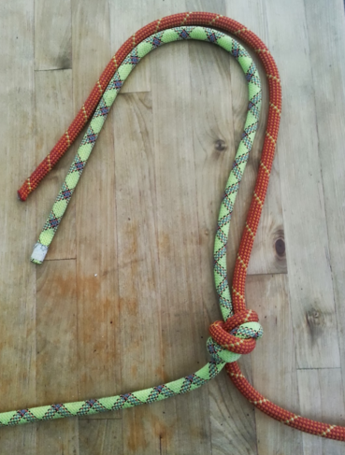
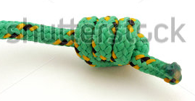
Rope Management
Length of Rappel?
-one 60m rope=30m rappel
-does the rope have a middle mark?
-two 60m ropes=60m rappel
tie ropes together with
an overhand (aka EDK)
Close the system!
triple barrel or tie in

Slide 52
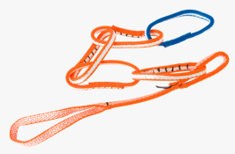
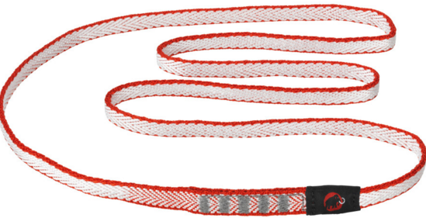
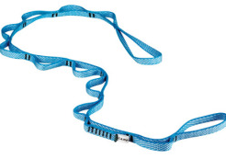
Your Personal Tether
NYLON=GOOD
PAS=OKAY
DYNEEMA=BAD
DAISY=BAD

Slide 53
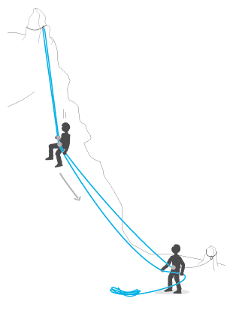
Efficiency and Safety Points
-Tidy loose ends
-Agree upon a plan
-Double Check everything
-Stay anchored in unless on rap
-Resist the childlike urge
to bounce ☺

Slide 54
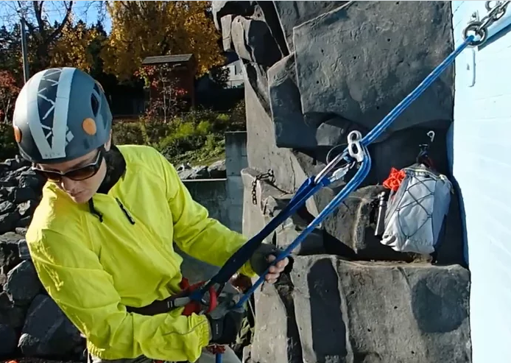
Overview of the extended rappel
https://player.vimeo.com/video/113362076
Key Points
-Must have good anchor
-Connect yourself to anchor
-Set up rappel
-Back up?
-Test your system
-Communicate

Slide 55
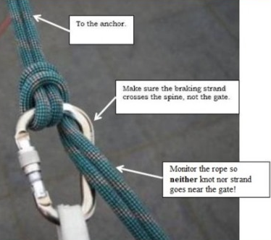
Rappelling off the belay loop
If your rappel is off of your belay loop, then where is your backup?

Slide 56
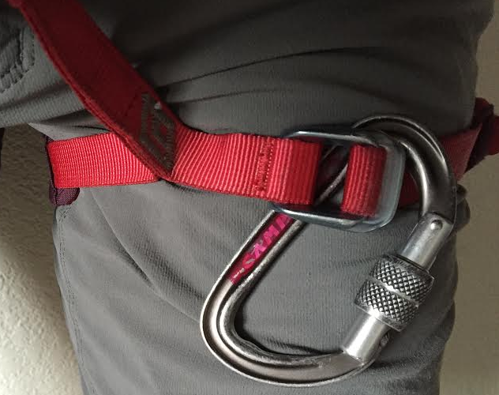
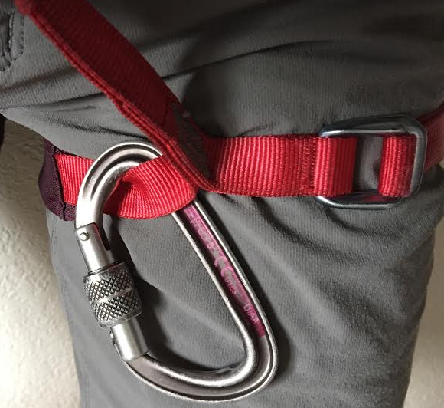
Backup options for rappel off of belay loop
Three options: Fireman’s belay, autoblock, or…
Good?
Any concerns?
Much safer!

Slide 57
Rappelling off of the belay loop with an autoblock
Look closely:
What advice would you give?
We learn from our mistakes--question dated practices
Gear and how we use it is constantly evolving!

Slide 58
Questions?

Slide 59
Lecture 2 Learning Targets The prepared and engaged student will begin to understand (conceptually) how to...
Prepare for Field Trip 2
Evaluate belay and rappel anchors for rock
Lead Belay
Escape the belay
Rappel safely
So now what? Pop Quiz Part 2!

Slide 60
Climb on!

