Slide 1
THE STUFF
SEA KAYAKING EQUIPMENT
Notes:
It can be overwhelming when starting out in sea kayaking. We hope to reduce this by explaining how to organize your equipment for safe kayaking that won’t overwhelm the wallet.

Slide 2


Slide 3
TEN ESSENTIALS
1. Navigation (Chart and compass – deck or orienteering type)
2. Water
3. Food
4. First aid supplies
5. Lighter or waterproof matches
6. Sun protection (sun screen, hat, sunglasses with retainer strap)
7. Illumination (flashlight or headlamp , including a white light sufficient to satisfy waterway regulations at night).
8. Spare clothing in a dry bag
9. Emergency shelter appropriate for the trip (space blanket, tarp, or tent)
10. Repair kit appropriate for trip and gear
Notes:
Some of you may be familiar with these 10 essentials from other courses. These are items one would need for hiking, scrambling, climbing, etc. Highlighted are points more specific to sea kayaking.

Slide 4
SEA KAYAK ESSENTIAL EQUIPMENT
1. Sea kayak with flotation in both ends
( Flotation can be compartments separated from the cockpit by bulkheads or bags specifically designed to provide the kayak flotation. A sea sock is not adequate flotation without float bags ).
2. Paddle
3. Bilge pump
4. Paddle float
5. Spray skirt
6. USCG approved PFD
7. Whistle
(Flares as required by the USCG – between sunset and sunrise, in locations where the path from the ocean has not yet narrowed to 2 nm)
8.. Appropriate attire for the conditions (Immersion Protection)
Notes:
A true Sea kayak has flotation, separate storage compartments that act when sealed and dry as extra flotation. If your craft doesn’t have separate storage areas you will need to add 2 airbags. The sea kayak should have deck lines for ease of rescue. One should look for a kayak that is 16-18 feet in length and 22-24” abeam. If you don’t yet have a boat try renting a boat for the class and also trying out instructors boats to get a feel for what you like.

Slide 5
Required Equipment for Leaders
9. Chart
Tide and current data for the trip
10. Waterproof watch
Notes:
We recommend everyone on the trip bring a chart. It adds to your enjoyment of exploring an area to use the chart to better know what you’re looking at. Tide and current data can be critical on certain trips (Nisqually delta). A watch lets you know what the tide and currents should be doing at that time of day.

Slide 6
Required Equipment for the Party
(carried by any person)
Spare paddle
Towing system
Duct tape for boat repairs
Pliers, screwdriver (Phillips and spade) and knife or “Leatherman” type tool
Weather or VHF radio
Toilet paper and plastic bag

Slide 7
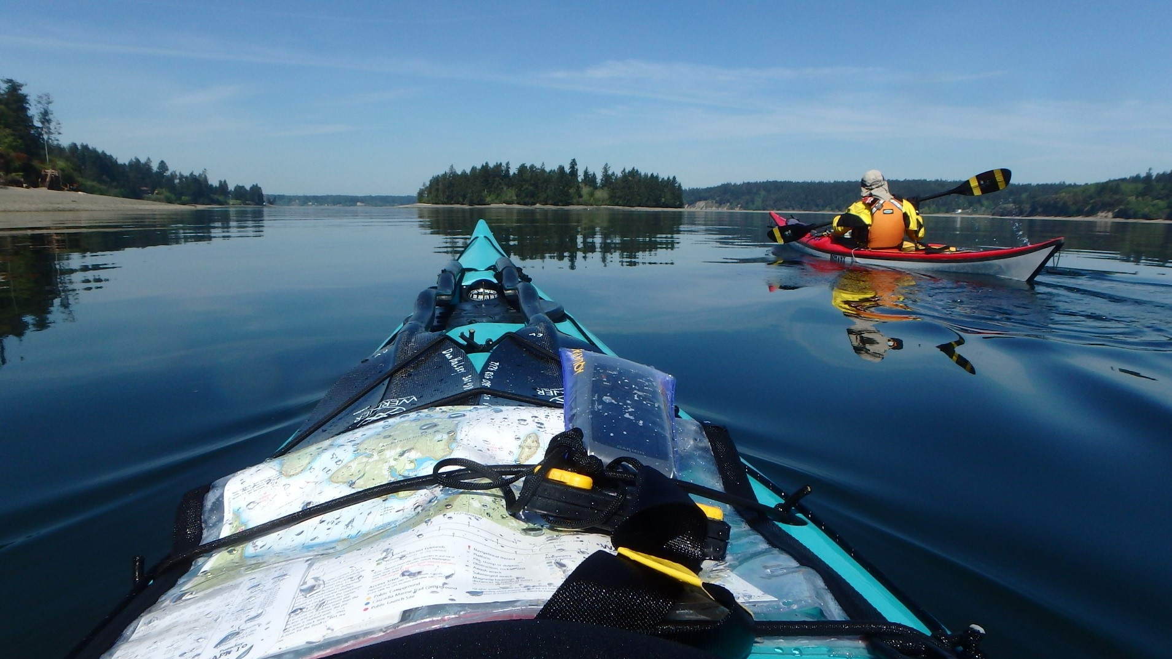
Notes:
See what items you can spot in this photo.

Slide 8
Immersion Protection
Drysuit: seals neck, wrists allowing for “dry” clothing underneath. Most protection, most cost.
Wetsuit and paddling jacket, drytop: sweater under. Adequate protection for some of year, less cost.
Paddling pants and paddling jacket : thick insulating clothing under. Least comfortable, least protection, least cost. For the summer only.
Dress to Swim
Dress per water temp. ,
not air temp.
Remember: Head, hands, feet warmth are important
Notes:
Here is more specific descriptions of “immersion protection” You can expect to at least bring this with you on very warm summer days.

