Slide 1


Slide 2
10 / 20 ESSENTIALS

Slide 3
Mountaineer Ten Essentials
Navigation
Sun Protection
Insulation
Illumination
First aid supplies
Fire
Repair kit and tools
Nutrition
Hydration
Emergency shelter

Slide 4
Sea Kayaker Additional “10”
Sea kayak with floatation in both ends
USCG approved PFD
Paddle
Spray skirt
Pump with floatation
Paddle float
Signaling device
Neck strap for glasses
Appropriate clothing
Waterproof bag for extra clothing

Slide 5
Sea Kayaker’s Highly Recommended
Spare paddle
Rescue sling
Emergency signaling device
Chemical light stick
Waterproof chart case
Waterproof watch
Wet suit or dry suit
Waterproof jacket
Gloves or pogies
Towing system
VHF radio
Weather radio
Advanced repair kit
Deck bag
Paddle tether
Flares
Toilet paper and plastic bags
Hat with visor

Slide 6
Clothing

Slide 7
Clothing
No cotton
Layering
Carry plenty of extras
Rain gear
Hats
Footwear
Gloves

Slide 8
Trip Planning

Slide 9
A Few Tools
NOAA Tides & Currents
DeepZoom.com
Tides, currents, route planning, some weather
Windy.com
Detailed weather
Coastal Atlas (apps.ecology.wa.gov/coastalatlasmap)
Boat launches, public access beaches

Slide 10
Two Approaches
Destination Priority
Date Priority
You know the route you want to paddle
Check for the best date for acceptable tide and current conditions
Consider prevailing weather for date selected
You know the date that you want to paddle
Check for the best route/destination that works with the tides and currents for that date
Consider prevailing weather for the route selected

Slide 11
Goal: Low Tide Paddle - Hope Island Area
Want to do it in June
Must be on a weekend day
Looking for the lowest tide
Looking for (mostly) favorable currents
Want to paddle about 7-10 nautical miles (nm)

Slide 12
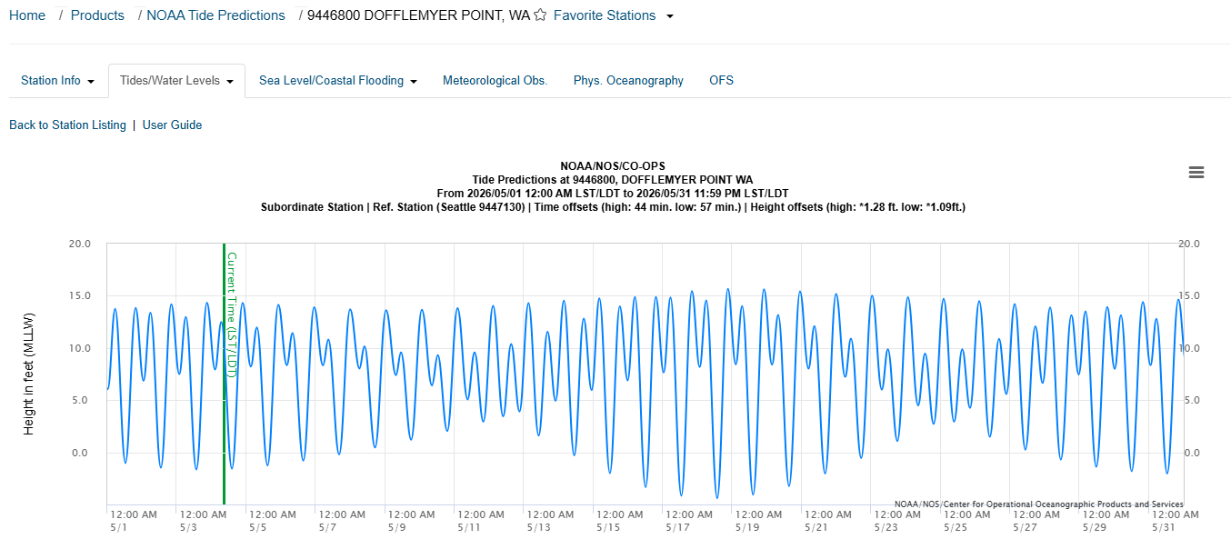
Tides

Slide 13
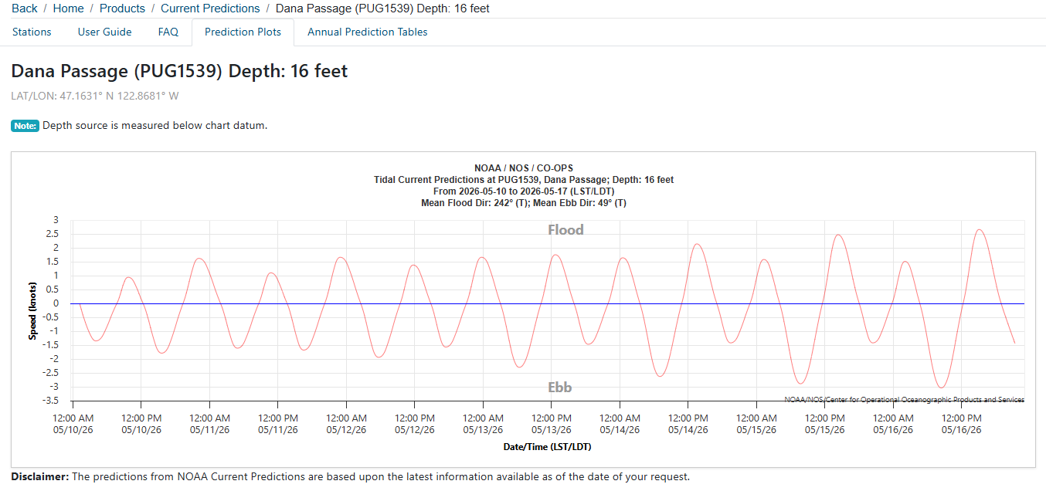
Currents

Slide 14
Hope Island Area from Arcadia Saturday June 14, 2026
What are the tides doing?
What are the currents doing?
What is the normal weather for the time of year?
What is the actual forecast?
Route to take?
Distance?
Breaks?
Timing? (when to start, expected return)

Slide 15
First Aid
What to be prepared for

Slide 16
More Common Injuries
What do you think would be the more common injuries associated with sea kayaking?

Slide 17
More Common Injuries
Hypothermia
Seasickness
Sunburn
Tendonitis
Shoulder dislocation
Foot/ankle injuries
Back strain
Poison oak
Barnacle & shellfish cuts
Numb feet/legs
Dehydration
What should be in your first aid kit?

Slide 18
Trips and Rating System

Slide 19
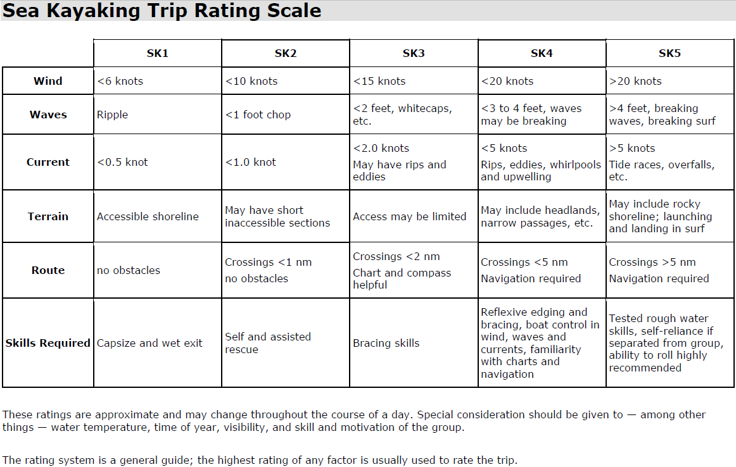

Slide 20
Group Paddling – Your Team
Arrive promptly
Come prepared
Be aware of own motivations/limitations
Listen to the weather; protect own limitations
Stay in hailing distance of others
Stay aware of position of all group members
Don’t break away from group
Don’t “string out” the group
In worsening conditions, fight the “everyone for himself” instinct – stay closer together

Slide 21
Experience Paddles
Saturday, May 16 – Hope Island Area
Memorial weekend – TBD
Sunday, June 21 – Eld Inlet
Saturday, June 27 – Potlatch State Park
Sunday, July 5 – Hope Island
Saturday, August 1 – Hammersley Inlet

Slide 22
Wet Paddle – Boston Harbor Boat Ramp
Arrive by 9:00am
Car pool if possible – parking is limited
Discover Pass is required for parking at ramp.
Bring all 10 essentials
Be ready to discuss weather, tides and currents

Slide 23
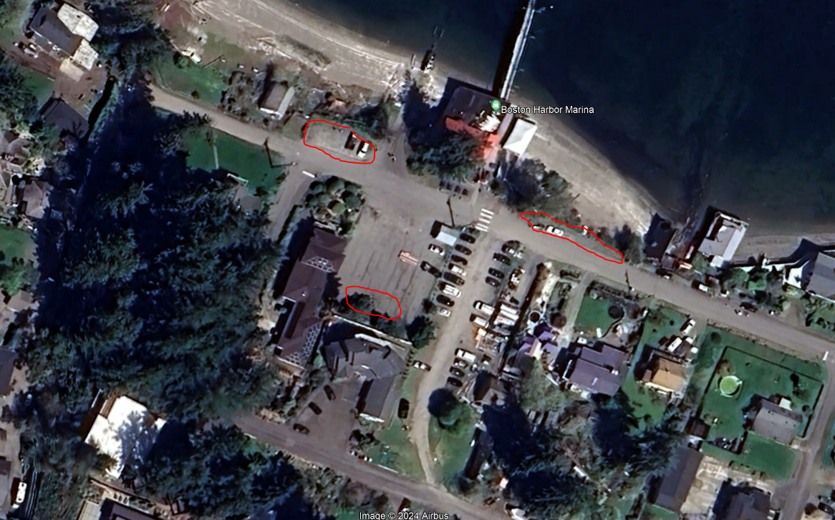
Boston Harbor Parking

