Slide 1
Maps
A representation of the whole or a part of an area.
Notes:
Webster’s New Collegiate Dictionary (1979)
Consider def. No. 2: something that represents with a clarity suggestive of a map
But maps themselves are not always clear!!
Planimetric vs. Topographic
Many TYPES/Variations - focus on topographic
GOAL:
Learn to read the maps that are most useful for wilderness travel.
TOPOGRAPHIC

Slide 2
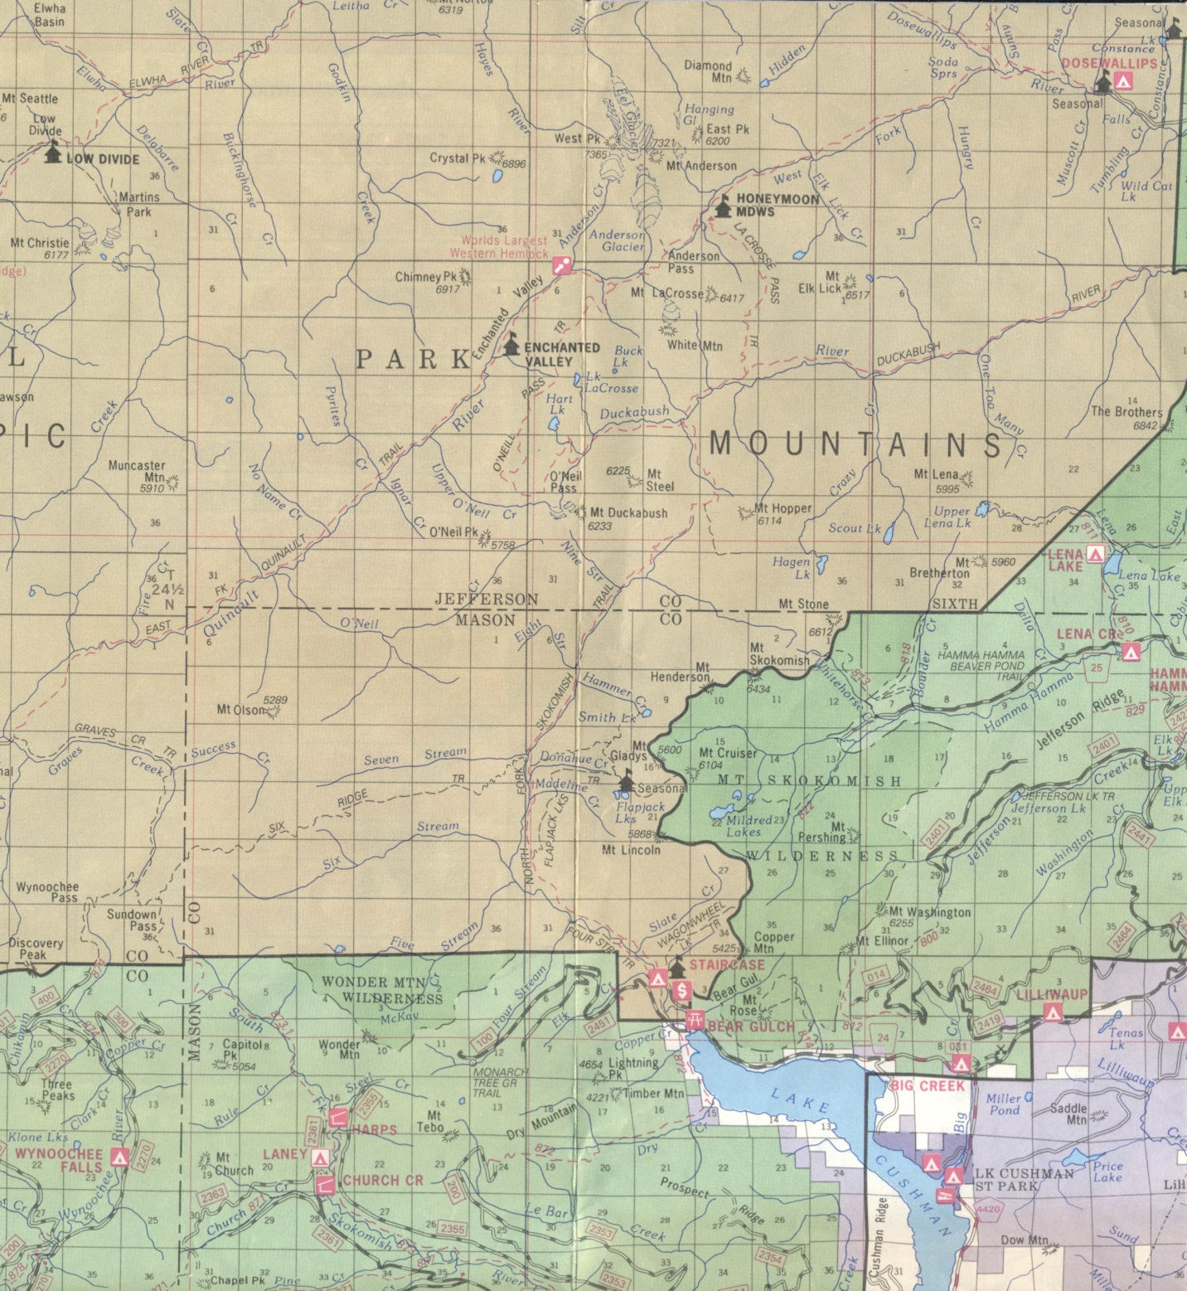
Planimetric No contour information
Notes:
Travel to trailhead
380,000 miles in Forest Road System (2000)
47,000 miles of Interstate
1.4M miles unpaved in US
2.6M miles paved in US
https://www.cia.gov/library/publications/the-world-factbook/fields/2085.html

Slide 3

Topographic Maps
Coverage
Colors
Contour Lines
Symbols
Scale/Distance
Direction
Marginalia
https://pubs.usgs.gov/gip/TopographicMapSymbols/topomapsymbols.pdf
Notes:
Convey TONS of useful info
Mostly symbolic - some text
GOALS:
Identify individual features
Learn to anticipate character of the terrain

Slide 4
Topographic Maps
Define: 7.5 Min. Series
7 ½ min.
Longitude
Latitude
7 ½ min.
60 minutes per degree
4/16/2018
4
Notes:
7 ½ Minute maps: ~6 mi. W-E
~9 mi. N-S
Mt. Rainier East: 6.25 mi W-E
8.5 mi N-S

Slide 5
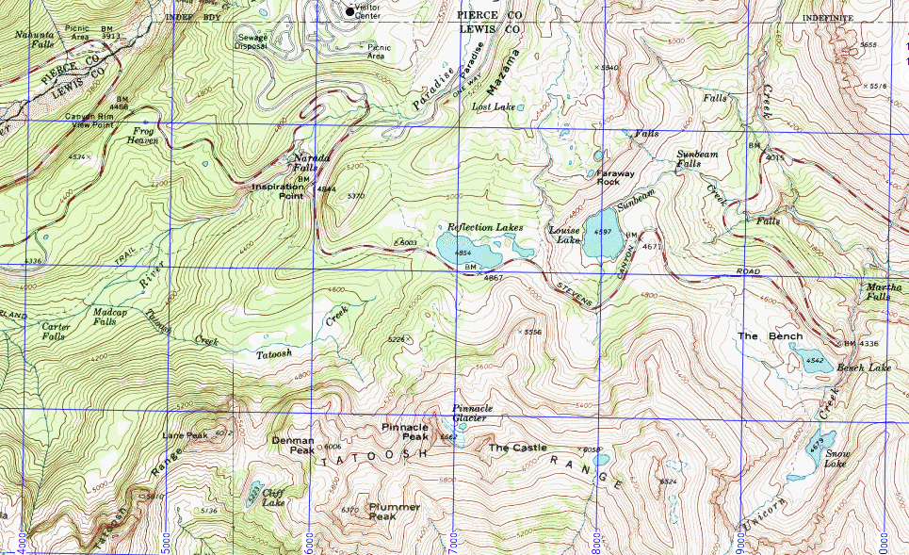
Maps Features
Notes:
Colors
Contour Lines
Symbols
Distance
Direction

Slide 6
Topographic Maps
Colors
Contour Lines
Symbols
Scale/Distance
Direction
Marginalia
Tell what is on the surface
tree cover
open area
water
man-made
Notes:
COLORS
Obvious, hence color is…
Most immediate indicator of terrain type and cultural features
Brown = contours
Red/black = major/minor roads and trails
Green = forested
Blue = water
White = open terrain; glaciers/snowfields

Slide 7
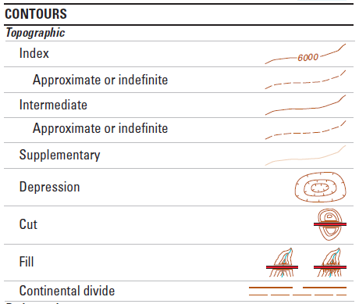
Topographic Maps
Colors
Contour Lines
Symbols
Scale/Distance
Direction
Marginalia
Notes:
Terrain SHAPE and ELEVATION
→ Single contour = constant elevation
→ Several adjacent Lines describe …
terrain shapes
steep / gentle slopes
saddle – look at adjacent line shapes
→ “Straight up / straight down”
perpendicular to contours
→ “Traverse”

Slide 8
Contour Lines (Shape) Shape of Lines = Shape of Terrain
curved =
rounded
abrupt V =
gully, ridge
line
spacing
gentle steep cliff
adjacent line
shapes
ridge
Notes:
“Shape…”
→ Contour lines describe Shapes of Landforms
Different attributes …
curved: can be convex hill or concave basin
line spacing …
adjacent line shapes – note ridge especially

Slide 9
Contour Lines (Shape) Shape of Lines = Shape of Terrain
curved =
rounded
abrupt V =
gully, ridge
line
spacing
gentle steep cliff
adjacent line
shapes
saddle
ridge
x
Notes:
(notes are on previous slide)

Slide 10
Contour Lines (Elevation)
4400′
4400
4200′
4200
Contour Interval = 40 ft
Notes:
INDEX vs. INTERMEDIATE

Slide 11
Contour Lines (Elevation)
4400
4200
Contour Interval = 40 ft
Notes:
What is happening in the circled zones?

Slide 12
Topographic Maps
Colors
Contour Lines
Symbols
Distance
Direction
Identify useful details
springs
5807T
footbridges
surveying data
roads, trails
trailhead
Notes:
Symbols provide useful details
Tell you what you may find
Can help check where you think you are
<click1> < “springs …”>
<click2> < footbridge >
Footbridges – spring hiking & high creeks
<click3> < survey point >
May NOT be at high point
<click4> < road, trail >
<click5> < trailhead >
Some features are implied … trailhead
<click Next Slide> Exercises

Slide 13
Topographic Maps
Colors
Contour Lines
Symbols
Scale/Distance
Direction
Marginalia
Terminology:
Map Size
Map Scale
4/16/2018
13
Notes:
Distance and Direction = 2 Important Items from Maps
Scale = ratio between measurements on the map and in the real world
Distance measured using the SCALE

Slide 14
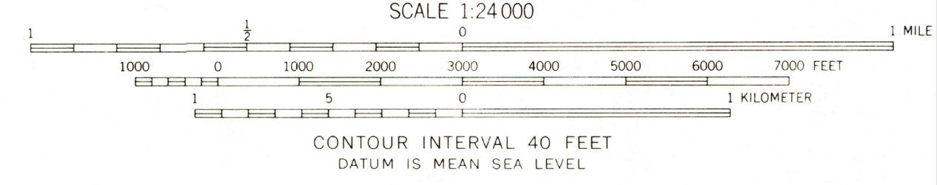
Topographic Maps: Scale
1′′ = 24,000′′ = 2000′
Notes:
1 of any unit of distance on map is 24,000 units on the ground
Keep a fraction in mind when considering scale:
1/24000
Larger scale ⇒ greater detail shown

Slide 15
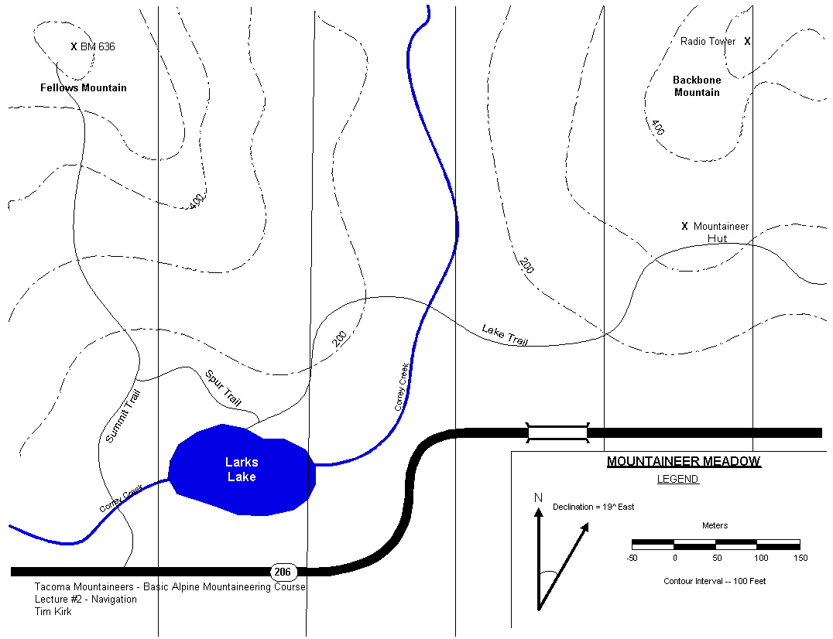
1
.5
0
1
“As the crow flies”
distance from
Correy Creek at Lake Trail,
to Fellows Mountain?
Map courtesy of Tim Kirk
Measurement Animation – K Welton
4/16/2018
15
Notes:
Straight Line Distance
1. Measure with ruler
2. Lay distance measured against map scale bar
Interpolate for the distance.
Fractional scale segments
helps estimating

Slide 16
+ 0.07
+ 3/10
1.0
1
.5
0
1
1.37
“As the crow flies”
distance from
Correy Creek at Lake Trail,
to Fellows Mountain?
Map courtesy of Tim Kirk
Measurement Animation – K Welton
4/16/2018
16
Notes:
(previous slide has notes)

Slide 17
1
.5
0
1
Trail distance from
Correy Creek at Lake Trail,
to Mountaineer Hut?
Map courtesy of Tim Kirk
Measurement Animation – K Welton
4/16/2018
17
Notes:
String? Use compass lanyard, or …

Slide 18
1
.5
0
1
string
Trail distance from
Correy Creek at Lake Trail,
to Mountaineer Hut?
Map courtesy of Tim Kirk
Measurement Animation – K Welton
4/16/2018
18

Slide 19
1
.5
0
1
Trail distance from
Correy Creek at Lake Trail,
to Mountaineer Hut?
Map courtesy of Tim Kirk
Measurement Animation – K Welton
4/16/2018
19

Slide 20
1
.5
0
1
Trail distance from
Correy Creek at Lake Trail,
to Mountaineer Hut?
Map courtesy of Tim Kirk
Measurement Animation – K Welton
4/16/2018
20

Slide 21
1
.5
0
1
Trail distance from
Correy Creek at Lake Trail,
to Mountaineer Hut?
Map courtesy of Tim Kirk
Measurement Animation – K Welton
4/16/2018
21

Slide 22
1
.5
0
1
Trail distance from
Correy Creek at Lake Trail,
to Mountaineer Hut?
Map courtesy of Tim Kirk
Measurement Animation – K Welton
4/16/2018
22

Slide 23
1
.5
0
1
1.12
Trail distance from
Correy Creek at Lake Trail,
to Mountaineer Hut?
Map courtesy of Tim Kirk
Measurement Animation – K Welton
4/16/2018
23

Slide 24
Topographic Maps
Colors
Contour Lines
Symbols
Scale/Distance
Direction
Marginalia
4/16/2018
24
Notes:
Datums (Horiz and Vert.)
Dates
Scale
Declination
Contour Interval
Abbreviated Legend

Slide 25
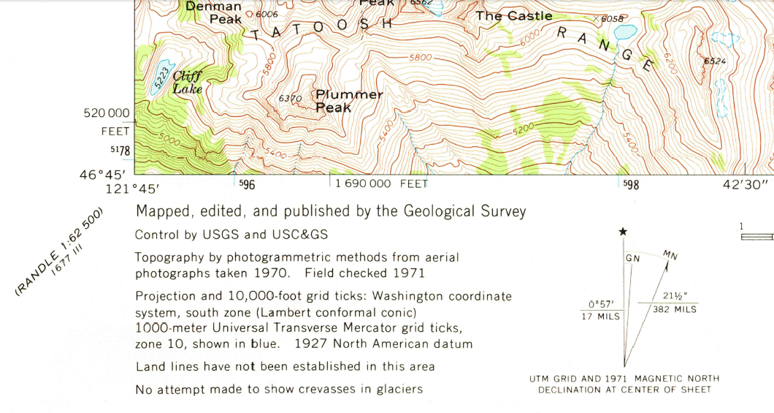
Topographic Maps: Marginalia (LHS)
Notes:
NAD27 CONUS = 1927 North American Datum, Continental United States.
Declination (outdated)
Reference Line tick marks

Slide 26
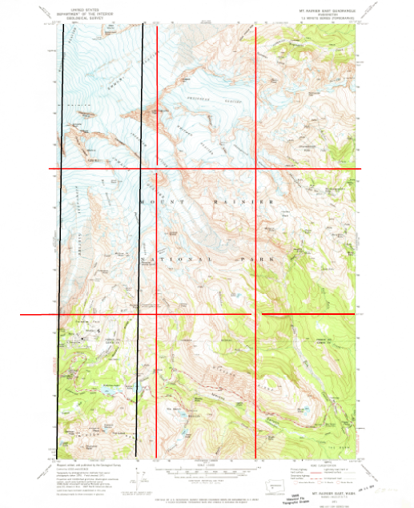
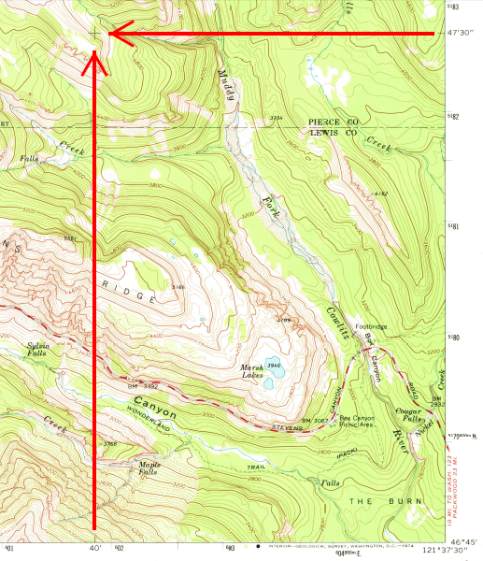
Topographic Maps: Reference Lines
2.5 min
UTM Generally not North-South
2.5 min
Notes:
Okay to use UTM as N-S lines if less than 1° from TN.

Slide 27
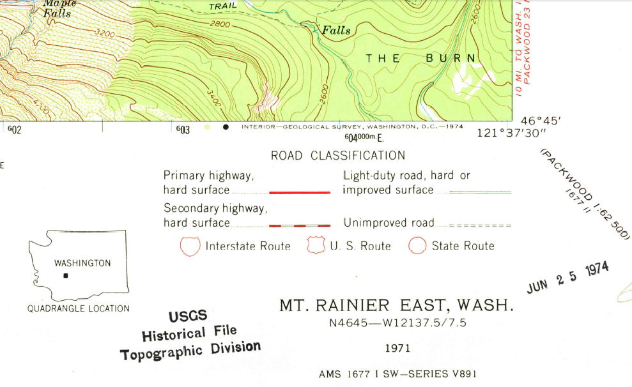
Topographic Maps: Marginalia (RHS)

Slide 28
Questions?

Slide 29
Extra Slides

Slide 30
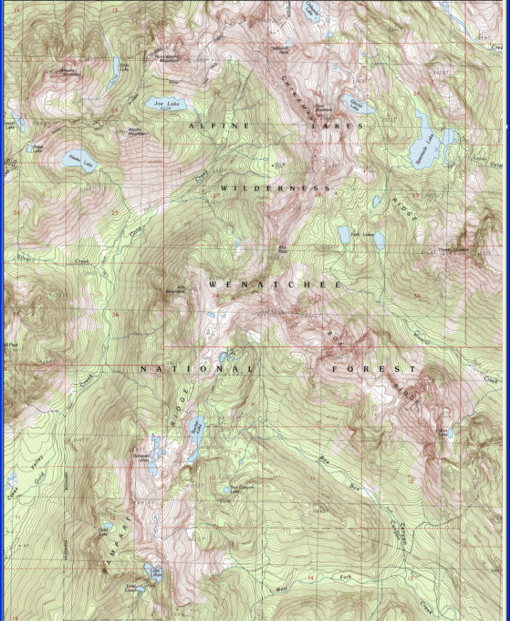
Topographic Maps
Familiarization:
Trace trip
Study terrain
Alta Pass
Park
Lakes
Alta Mtn.
Rachel Lk.
Box Canyon
trailhead
4/16/2018
30
Notes:
Using Topo’s – Trip Planning
-- Familiarize self:
-- start point and goal of trip
-- general lay of land:
---- ridges → heights,
---- water → bottom

Slide 31
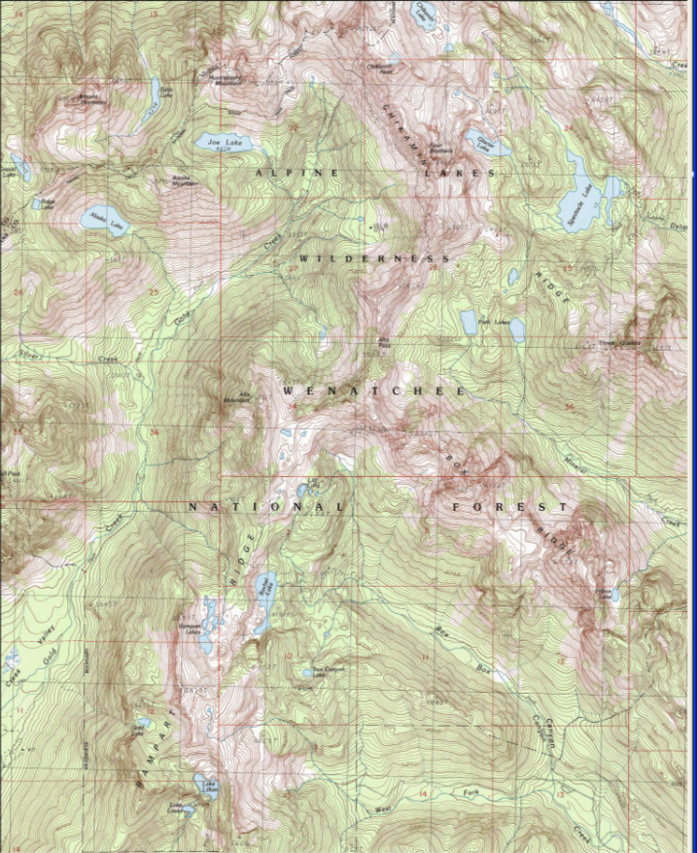
Topographic Maps
Familiarization:
Trace trip
Study terrain
Alta Mtn.
-- streams are low
-- ridges are high
Rachel Lk.
trailhead
4/16/2018
31
Notes:
Using Topo’s – Trip Planning
-- Familiarize self:
-- start point and goal of trip
-- general lay of land:
---- ridges → heights,
---- water → bottom

Slide 32
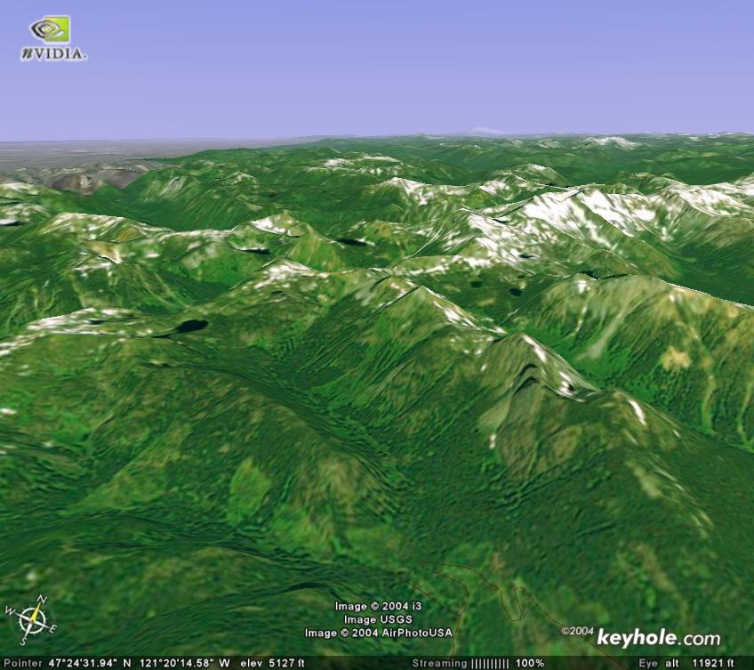
Topographic Maps
Alta Mtn.
Box Canyon
trailhead
4/16/2018
32
Notes:
Using Topo’s – Trip Planning
-- Familiarize self:
-- start point and goal of trip
-- general lay of land:
---- ridges → heights,
---- water → bottom

Slide 33
Topographic Maps
Map “SIZE”
15 min.
7 ½ min.
4/16/2018
33
Notes:
First example was 7 ½ minute
Another common SIZE covers 15 minutes
RED LINE: Note the relationship

Slide 34
Topographic Maps
Map “SCALE”
Map ←→ World
1 : 24,000
1” = 24,000”
= 3/8 mi.
1 : 69,500
1” = 69,500”
= 1.1 mi.
4/16/2018
34
Notes:
<click > < “map scale” >
“Map Scale”-- map length to real distance
<click > < Map ←→ World >
1” on map → 24,000”;
<click > divide by 12 → 2000’;
a bit less than half-mile
<click x2 > < 1 : 69,500 >
Another common scale for wilderness maps

Slide 35
Topographic Maps
Map “SCALE”
1 : 24,000
1 : 69,500
1 : 69,500
7 ½ min.
15 min.
7 ½ min. Map “SIZE”
4/16/2018
35
Notes:
Just saw two scales
Another map at 1 : 69,500 …
Ask – what’s different with larger 1 : 69,500?
<click > < minutes … >
Answer: Map Size

Slide 36
Topographic Maps
Colors
Contour Lines
Symbols
Distance
Direction
Terminology:
Map Scale 1 : 24,000
Map Size “7 ½ minute”
7.5 MINUTE SERIES
SCALE 1 : 24,000
4/16/2018
36
Notes:
<click1, 2 > < “map scale” & legend >
“Map Scale”-- map length to real distance
1” on map → 24,000”; divide by 12 → 2000’;
< half-mile
<click3, 4 > < “map size” & legend >
“Map Size”-- how much area maps covers
“minute”, latitude & longitude
DEMO -- show Green Trails map
– same SIZE 7.5 min; diff SCALE, 1:69,000

Slide 37
1
.5
0
1
Lake Trail
Correy Creek
Intersection Trail & Creek
Fellows Mountain
Mountaineer Hut
Map courtesy of Tim Kirk
Measurement Animation – K Welton
4/16/2018
37
Notes:
Get familiar with map
<click each> <
Lake Trail
Correy Creek
intersection
Fellows Mtn
Mountaineer Hut
<click Next Slide>

