Slide 1
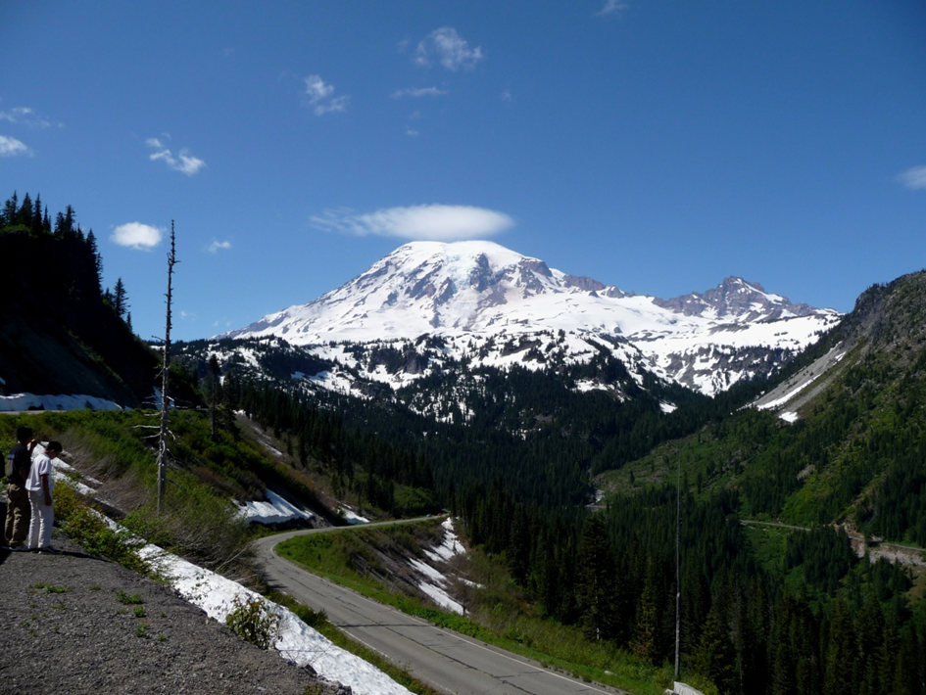
Declination
Using the earth’s magnetic field to find direction

Slide 2
Declination
What is declination?
Declination is the angle between magnetic north and true north.
Why does it matter?
Because compasses align with magnetic north and maps align with true north.

Slide 3
Declination
What else is important?
Declination is complex
Declination changes with time
What if you don’t have an adjustable compass?
You have to add or subtract the adjustment
Based on east or west declination
Based on compass to map, or map to compass

Slide 4
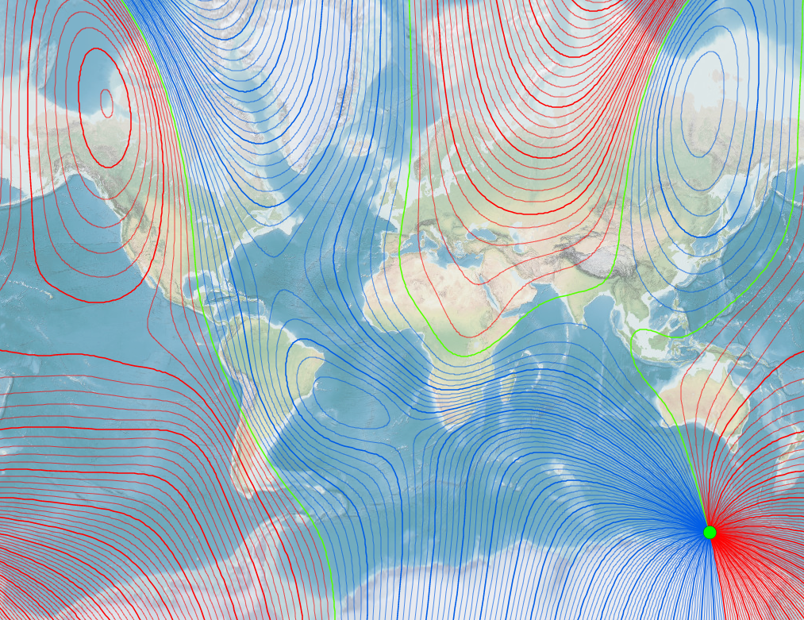
World Declination: 2018

Slide 5
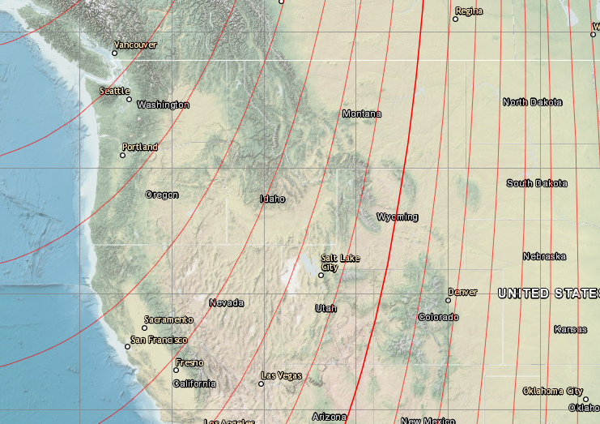
Declination: Western US 2018

Slide 6
Current Declination: Community Center
15.62° E, changing by 0.1° W per year
http://www.ngdc.noaa.gov/geomag-web/#declination
Or search for “magnetic declination”

Slide 7
How do You Correct for Declination?
Do the math
Mnemonics
“Set it and forget it.”

Slide 8
Do the Math: Correcting a Magnetic Bearing for East Declination
TN
Δ
TB = Δ + MB
MB
TB
Pt. B

Slide 9
Mnemonics:
Declination East, Compass Least
Mag to True, add East
Empty Sea add Water
Declination West, compass best
True to Mag, Subtract East

Slide 10
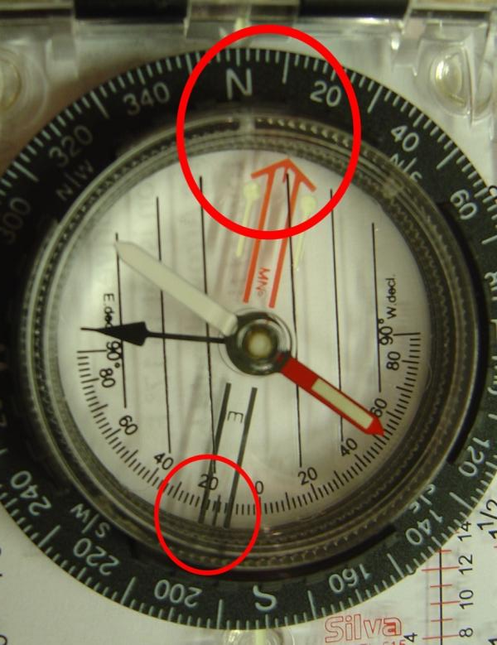
“Set it and Forget It” How to Set Declination
Use screw driver to twist adjustment screw.
Set to 16° E. Use the line in the middle of the south end of the orienting arrow.
The orienting arrow should point east of north.

Slide 11
Questions?

Slide 12
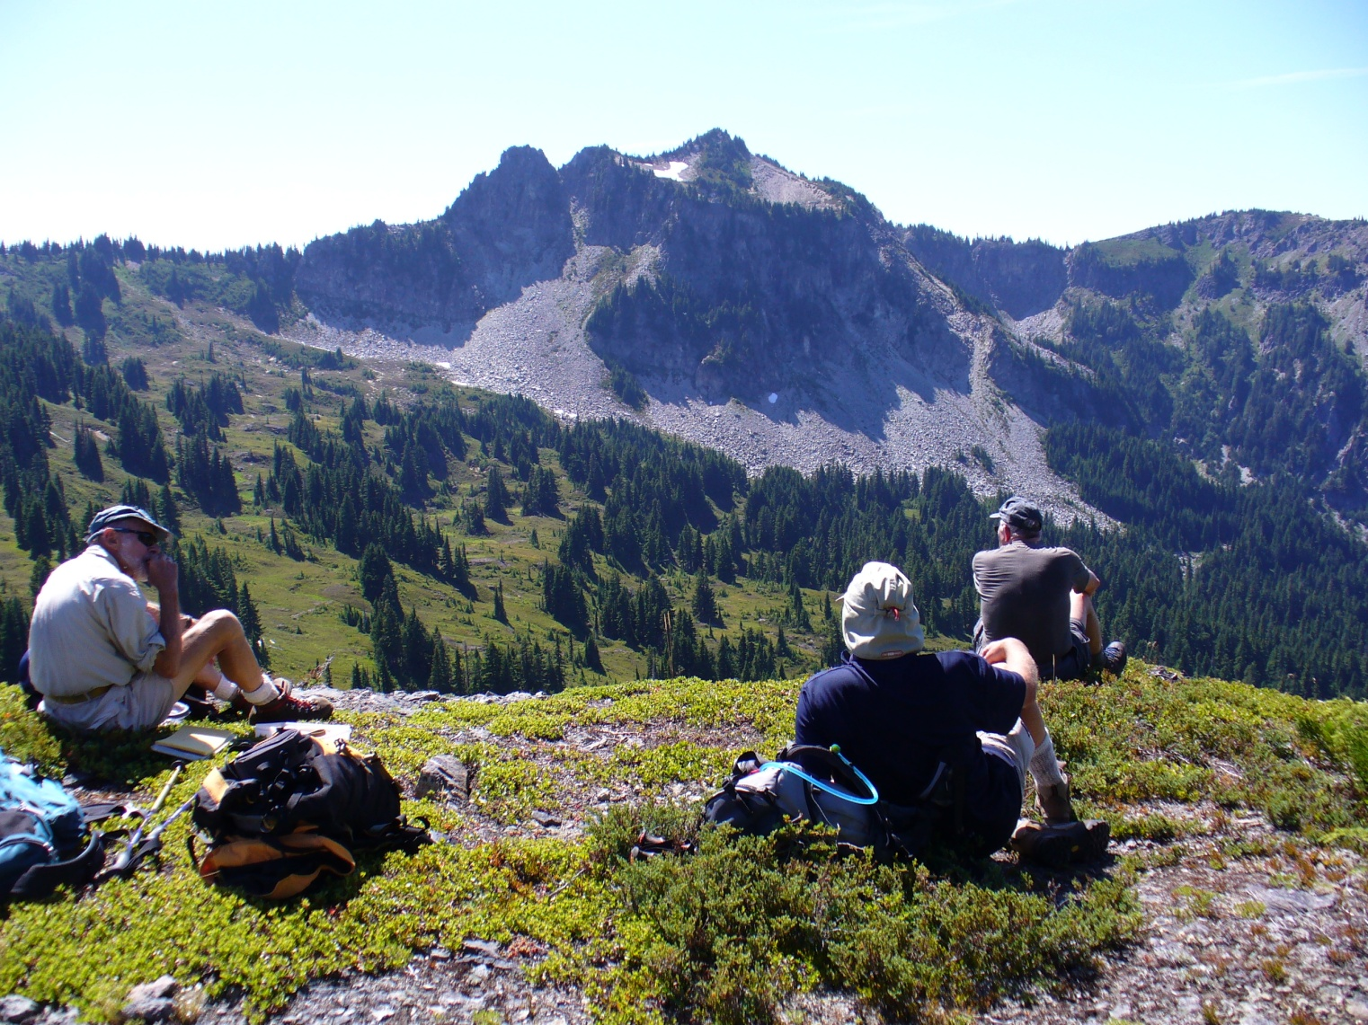
Break Time

Slide 13
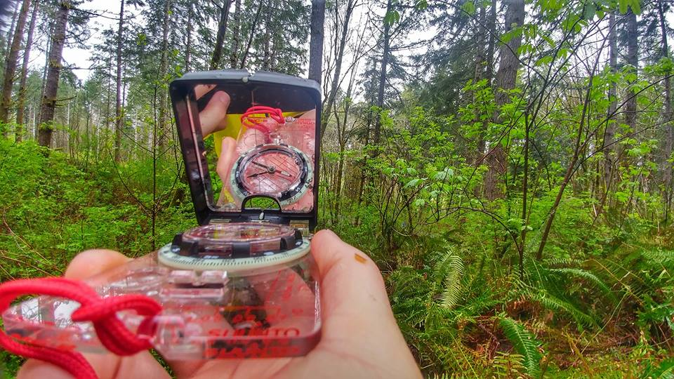
Compass use
How to enhance your sense of direction with a tool

Slide 14
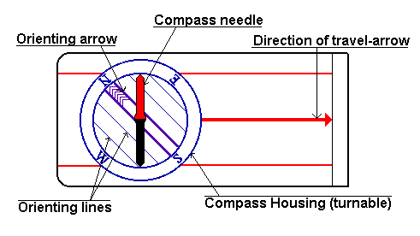
Compass

Slide 15
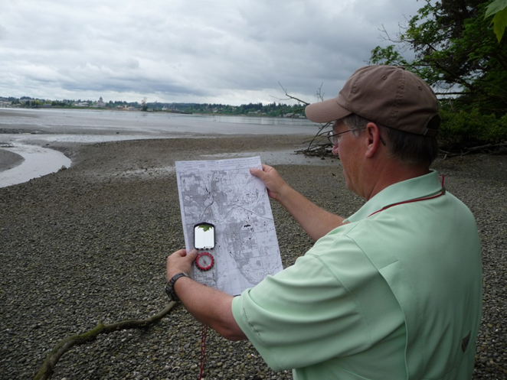
Compass: Parts and Use
Sighting mirror
Base plate
Rotating bezel with azimuth ring
Direction of travel arrow
Orienting lines
Needle with box

Slide 16
Compass: Bearing to an Object
Point the direction arrow toward the object, holding the compass level, and sighting along the sight lines.
Twist the dial until the magnetic needle lines up with the orienting arrow.
Read the bearing in degrees by looking at the tick on the dial at the direction pointer.

Slide 17
Compass: Bearing onto a Map
With your compass set to the bearing you took – use 185° – put it on the map.
Line up one of the straightedges with your position or a known landmark. Use Paradise Visitors Center.
Turn the baseplate, keeping the straightedge on your point, until the north on the graduated dial points to the map’s true north.
Follow the straightedge to the destination.
Notes:
Denman Peak is the destination or target.

Slide 18
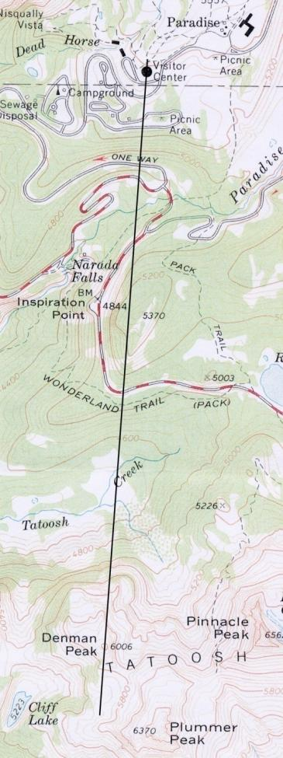
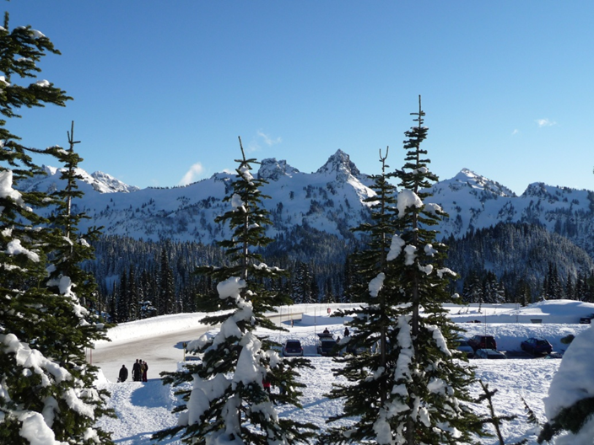
Compass: Bearing onto a Map
Notes:
Should be Denman Peak

Slide 19
Compass: Bearing from a Map
Put your compass on the map, lining up a straightedge so that both your starting point and the destination lie along it. Use Paradise Visitors Center and Sluiskin Falls.
Twist the graduated dial, keeping the straightedge on both points, until the north on the graduated dial points to the map’s true north.
Read the bearing in degrees by looking at the tick on the dial at the direction pointer.

Slide 20
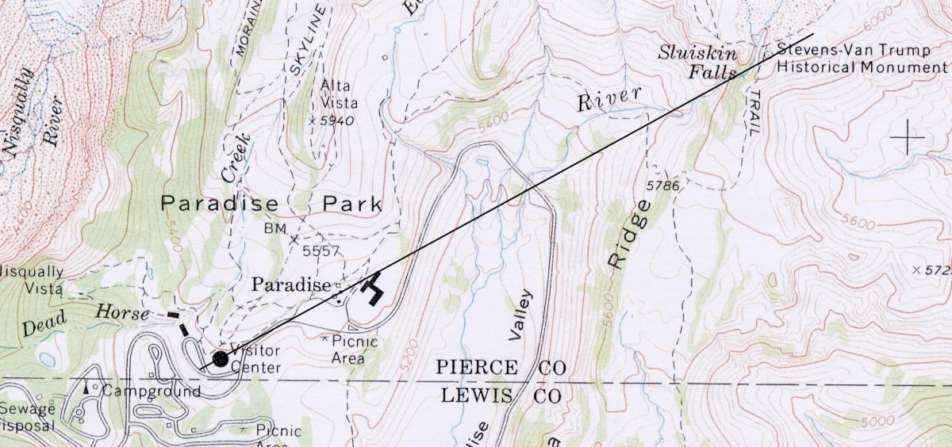
Compass: Bearing from a Map
Notes:
Should be 60°

Slide 21
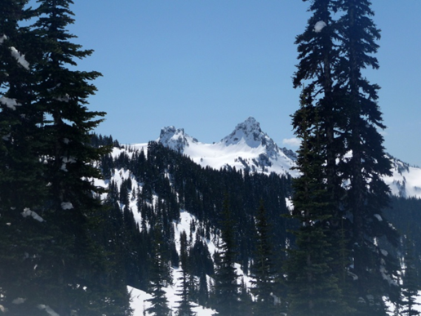
Compass: Triangulation
Triangulation is using the intersection of two lines to find your location.
What kinds of lines on might work?
Contour lines, if you know your elevation
Ridges, valleys, and creeks
Trails, roads, power lines, etc.
One or more compass bearings

Slide 22
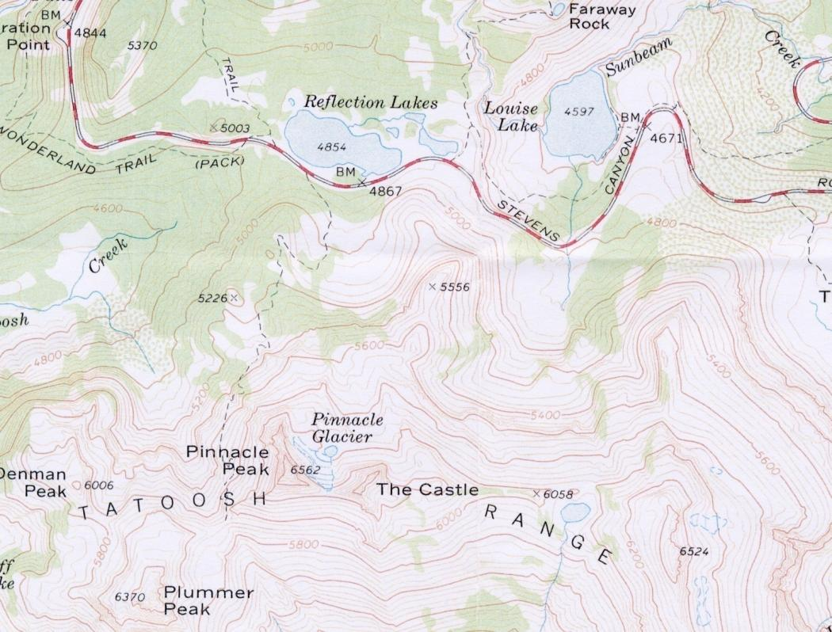
Compass: Triangulation Exercise
Notes:
Use 325° to west shore of Reflection Lakes and 12° to the east shore of Louise Lake.

Slide 23
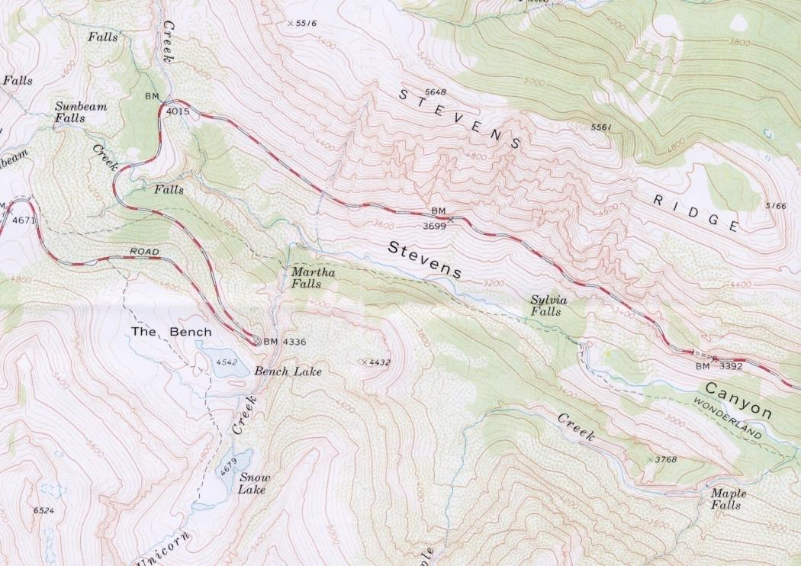
Compass: More Triangulation

Slide 24
Compass: Orient a Map
Set the graduated dial so that north lines up with the direction pointer.
Line up one of the compass’s straightedges so that it’s lined up with a north-south line on the map.
Keeping the map and compass pressed together, so they don’t shift relative to each other, turn the map until the compass needle is lined up in the orientation arrow.

Slide 25
Compass: Follow a Bearing
Distance using time
Time yourself to a point with known distance
Keep track along the way
Distance using your pace
Step is 30 – 35”
Pace is two steps, around 5’
Speed and incline affect pace length

Slide 26
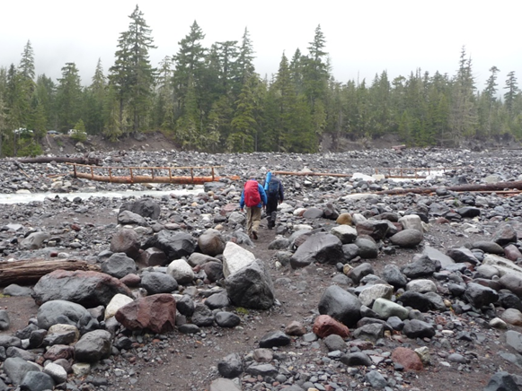
Compass: Follow a Bearing
Procedures
Sight on a nearby object and walk to it.
Sight on a partner and walk to him or her.
Use back-bearings.
Communicate
Repeat.

Slide 27
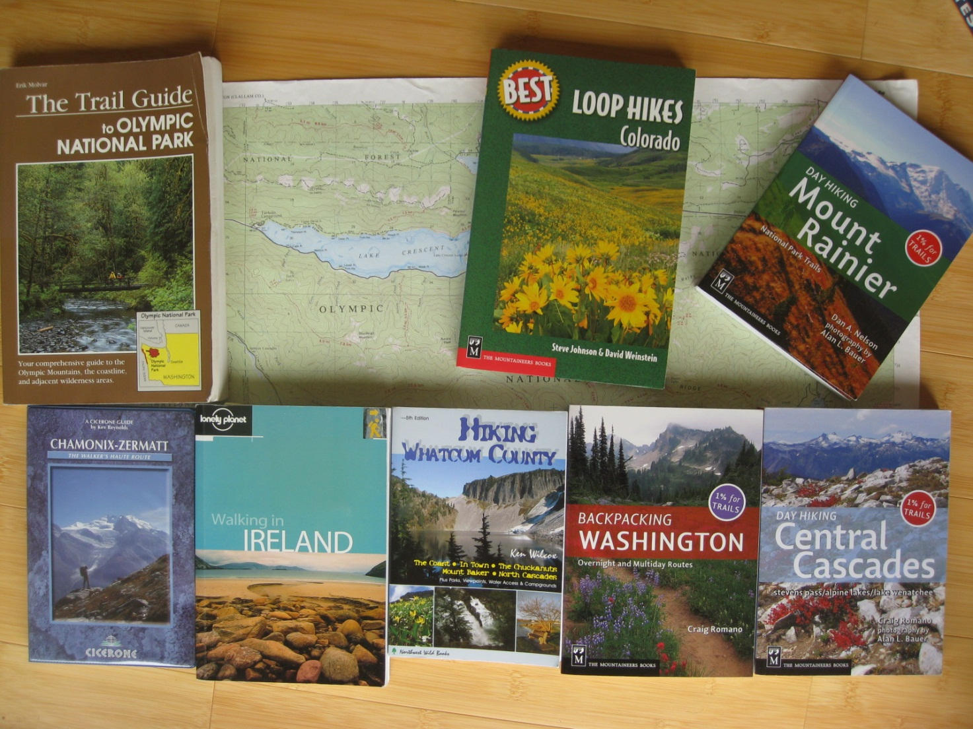
Plug for our Library

Slide 28
Extra Slides

Slide 29
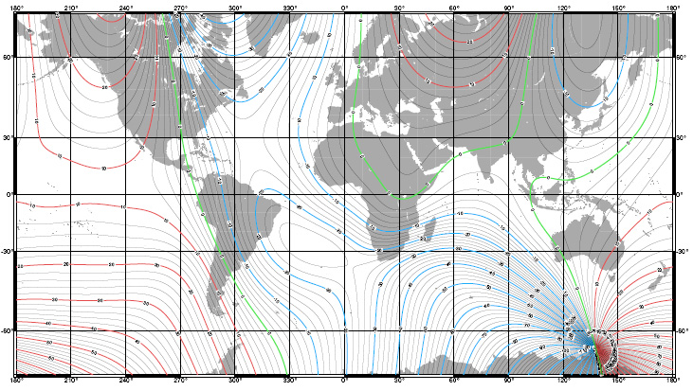
Declination: World

Slide 30
Declination: US 2015

Slide 31
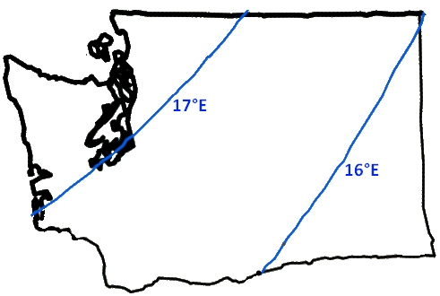
Declination: Washington 2010

