Slide 1
Adding to your Leadership Quiver
NOLS: Leadership Model

Slide 2
Expeditionary Leadership at NOLS
4-7-1 Leadership Model
4 Roles
7 Leadership Skills
1 Signature Leadership Style

Slide 4
Expeditionary Leadership at NOLS
4-7-1 Leadership Model
– 4 Roles

Slide 5
Designated Leader

Slide 6
Designated Leader
Head Architect
Guardian of the group process
Can delegate, but should collaborate when possible
Cannot abdicate responsibility or accountability

Slide 7
Designated Leader
Complex, potentially risky, tough decisions are best with a Designated Leader at the helm

Slide 8
Active Follower

Slide 9
Active Follower
Following the leadership of others
Seek clarity, give input, respect the plan, help out

Slide 10
Active Follower
Actively participate in the process, assist Designated Leader where needed
Try not to blindly follow

Slide 11
Peer Leadership

Slide 12
Peer Leadership
Present in our living relationships
Sees what needs to be done, does it, regardless of hierarchy
All members assure quality completion of group tasks, functions, and goals

Slide 13
Self Leadership

Slide 14
Self Leadership
Who you are, and how you can influence others
Leadership through character and judgment
Ex. Keeping up with hydration/calories on a climb. Keeping from getting sunburnt by applying sunscreen and bringing appropriate clothing, etc.

Slide 15
Designated Leader Active Followership
Peer Leadership
Self Leadership

Slide 16
Expeditionary Leadership at NOLS
4-7-1 Leadership Model
– 7 Leadership Skills

Slide 17
Expedition Behavior

Slide 18
Expedition Behavior
An awareness and attention to all relationships that influence an experience
A set of behaviors that keep a group moving together
Generous energy towards the group and it’s goals

Slide 19
Expedition Behavior
Prior: Communicating Roles, Goals, and Expectations
During: Establishing and maintaining a Positive Learning Environment, managing group development
– Forming, Storming, Norming and Performing, Transforming
After: Debriefing, receiving feedback

Slide 20
Expedition Behavior
Ubuntu
“I am, because we are”

Slide 21
Expedition Behavior
How can I support you?

Slide 22
Competence

Slide 23
Competence
Knowing what you know
Organization and management skills
Technical Skills
Physical Abilities
Knowing what you DON’T know

Slide 24
Competence
Unconsciously Incompetent
Novice
Consciously Incompetent
Beginner
Consciously Competent
Competent
Unconsciously Competent
Proficient

Slide 25
Competence
Novice
Beginner Competent Proficient
Youngling
Padawan
JEDI Knight
JEDI Master

Slide 26
Additional Level
Expert-
Only reached after extensive experience and student in a specific discipline.
Rely on Intuition Comfortable “winging it”
May not be best to teach beginners, can be hard to create educational processes

Slide 27
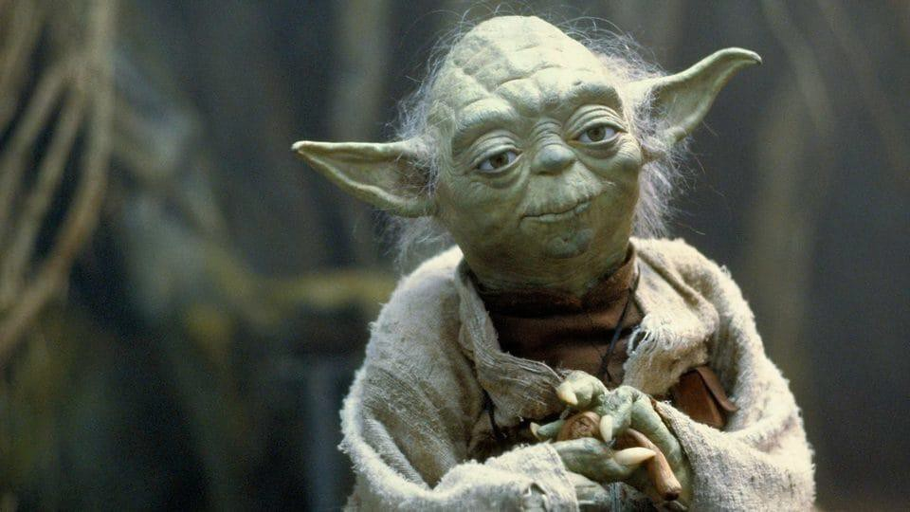
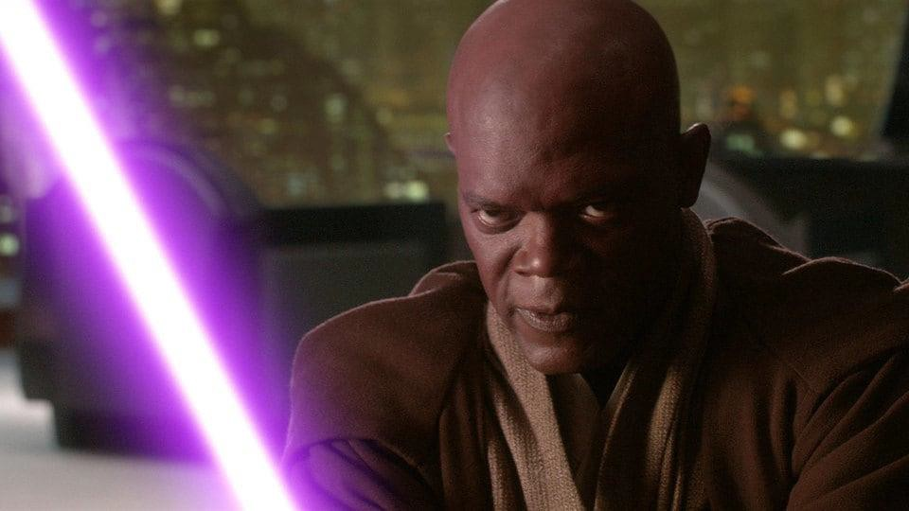

Slide 28
Communication

Slide 29
Communication
“a process of information exchange with a goal of shared meaning”

Slide 30
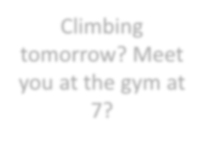
Communication
Sender
Climbing tomorrow? Meet you at the gym at 7?
Receiver

Slide 31
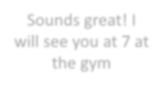
Communication
Sender
Receiver
Sounds great! I will see you at 7 at the gym

Slide 32
Communication
Sender
Receiver

Slide 33
Interpersonal Gap
Blah Blah Blah
The IMPACT on me
is…
My INTENTION is…
Person A Filter
Person B Filter

Slide 34
Effective Feedback
Vague
Crap
Fluff
Discouraging
Encouraging
Specific Crap
Effective
Specific

Slide 35
Judgment &
Decision Making

Slide 36
Judgment & Decision Making
Experience
Predict
Reflect

Slide 37
Judgment & Decision Making
Developing Judgment
Through experience
Debrief with Mentors
Natural feedback loop
Through other’s experience
Incident reports
Accidents in North American Mountaineering
Campfire stories

Slide 38
Judgment & Decision Making
Learning not just only happens in the tensions of opposites, but also what went well, both require proper debriefs and reflection

Slide 39
Decision Making Matrix
YELLOW
RED
Likelihood
YELLOW
GREEN
Consequence

Slide 40
Judgment & Decision Making
Consensus
Level of Group Involvement
Vote
Consultative II
Consultative I
Delegate
Directive
Leader Decides Group Decides
Group Ownership and Time

Slide 41
Tolerance for Adversity
and Uncertainty

Slide 42
Tolerance for Adversity & Uncertainty
Resiliency
Hardiness
Grit
The ability to deal

Slide 43
Tolerance for Adversity & Uncertainty
Survival Traits
Curiosity
Mental & Emotional Flexibility
Sense of Humor
Seeking Meaning
Optimism- this is temporary
Playfulness
Thrive vs. Suffer

Slide 44
Tolerance for Adversity & Uncertainty
Things I care about
Things I care about I can INFLUENCE
Things I care about I can DIRECTLY control

Slide 45
Tolerance for Adversity & Uncertainty
“the trick is what we emphasize, we either can make ourselves miserable or we can make ourselves strong. The amount of work is the same”
-Carlos Castenada

Slide 46
Vision & Action

Slide 47
Vision & Action
Setting goals and actively working to attain them
S pecific
M easureable
A ttainable/Ambitious
R ealistic
T imely

Slide 48
Vision & Action
Creating structure/curriculum to deliver content and goals
Support/Coach/Delegate/Direct as needed
Briefing and debriefing team members

Slide 49
Self Awareness

Slide 50
Self-Awareness
Who I am?
What are my strengths, weaknesses?
Where do I excel?
What do I believe?
How do I interact with the other skills and roles?

Slide 51
Self-Awareness
Emotionally Cool
I hesitate to state my opinions
Analyst & Architect
Driver
I state my opinions openly
Relationship Master
Spontaneous Motivator
Emotionally Hot

Slide 52
Expeditionary Leadership at NOLS
4-7-1 Leadership Model
– 1 Signature Leadership Style

Slide 53
“1” Signature Style

Slide 54
Signature Style
What is the sum of your previous paths?

Slide 55
Signature Style
Are you a morning person/night owl?
How do you communicate? Take feedback?
How are you under stress?
Deal Breakers?
What do you need present for success?
Think about what you uniquely bring to a group

Slide 56
Vision & Action
Communication
Expedition Behavior
Competence
Judgment & Decision Making
Tolerance for Adversity & Uncertainty
Self Awareness

Slide 57
Vision & Action
Self
Communication
Expedition Behavior
Competence
Judgment & Decision Making
Tolerance for Adversity & Uncertainty
Self Awareness

Slide 58
Vision & Action
Self
Communication
Expedition Behavior
Peer
Competence
Judgment & Decision Making
Tolerance for Adversity & Uncertainty
Self Awareness

Slide 59
Vision & Action
Self
Communication
Expedition Behavior
Peer
Active Follower
Competence
Judgment & Decision Making
Tolerance for Adversity & Uncertainty
Self Awareness

Slide 60
Vision & Action
Self
Communication
Expedition Behavior
Peer
Active Follower
Designated
Competence
Judgment & Decision Making
Tolerance for Adversity & Uncertainty
Self Awareness

Slide 61
Vision & Action
Communication
Expedition Behavior
Competence
Judgment & Decision Making
Tolerance for Adversity & Uncertainty
Self Awareness

Slide 62
4-7-1
Designated Leader
Active Follower
Peer Leader
Self Leader

Slide 63
4-7-1
Expedition Behavior
Competence
Communication
Judgment and Decision Making
Tolerance for Adversity and Uncertainty
Vision and Action
Self Awareness

Slide 64
4-7-1
Signature Style

Slide 65
Thank you!

