Slide 1

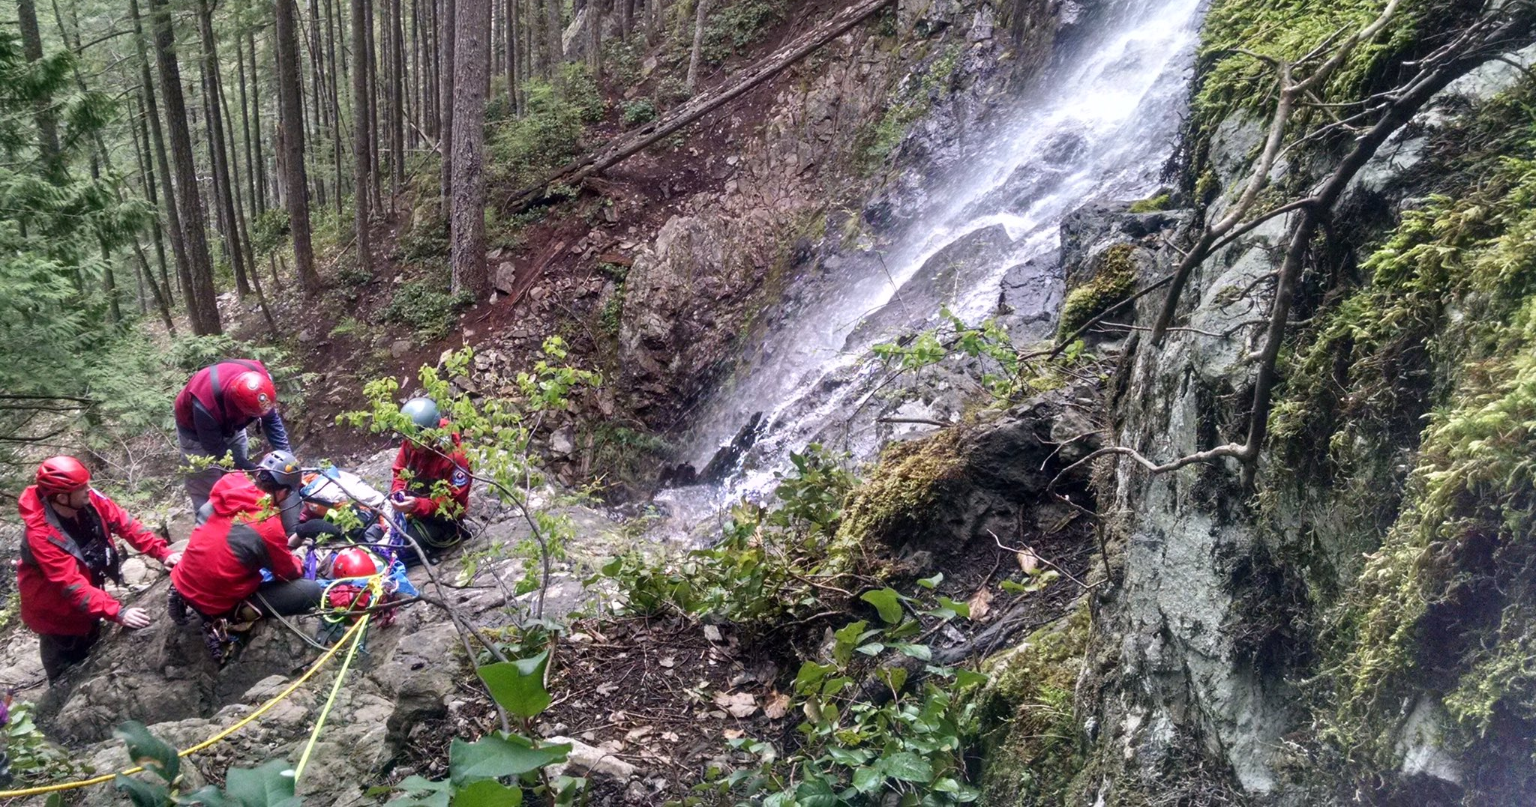
Small Party Rescue
Version 4
2023-08-09

Slide 2
Outline
Introduction
Tools of Alpine Rescue
Roles in the Rescue System
Running the Rescue
Teamwork, Leadership & Followership
Calling for Help

Slide 3
Definitions
High angle – Terrain ~>60°
Steep Angle – Terrain ~> 35° ~ 60°
Subject – Injured/Unresponsive person
Personal Load – 1 person on a rope (1 kN)
Rescue Load – 2 people on a rope (2 kN)
Safety Margin – Ratio of your load and rating your gear’s weak point
Notes:
Subject – receive care per a protocol
Patient – receive individualized care

Slide 4
Goals of Small Party Rescue
Develop teamwork, leadership and followership.
Learn the tools of alpine rescue.
Develop the skill and confidence to creatively solve the problems needed to affect a rescue in steep alpine terrain.
Note: this is geared towards a “single pitch” alpine rescue scenario, but it can be used for multipitch rescue. The focus is to get everyone to a safe location to await further help, and not to get back to the cars

Slide 5
Rule #1 of Rescue
Do NO MORE DAMAGE to:
  Yourself
  Your teammates
  Your subject

Slide 6
The Seven Steps to Accident Response
1. Take Charge!
2. Scene Size Up
3. Perform Emergency Rescue and Urgent First Aid
4. Protect the Subject
5. Assess the Subject (and Situation)
6. Make a Plan
7. Execute the Plan
Notes:
Talk about scene size up

Slide 7
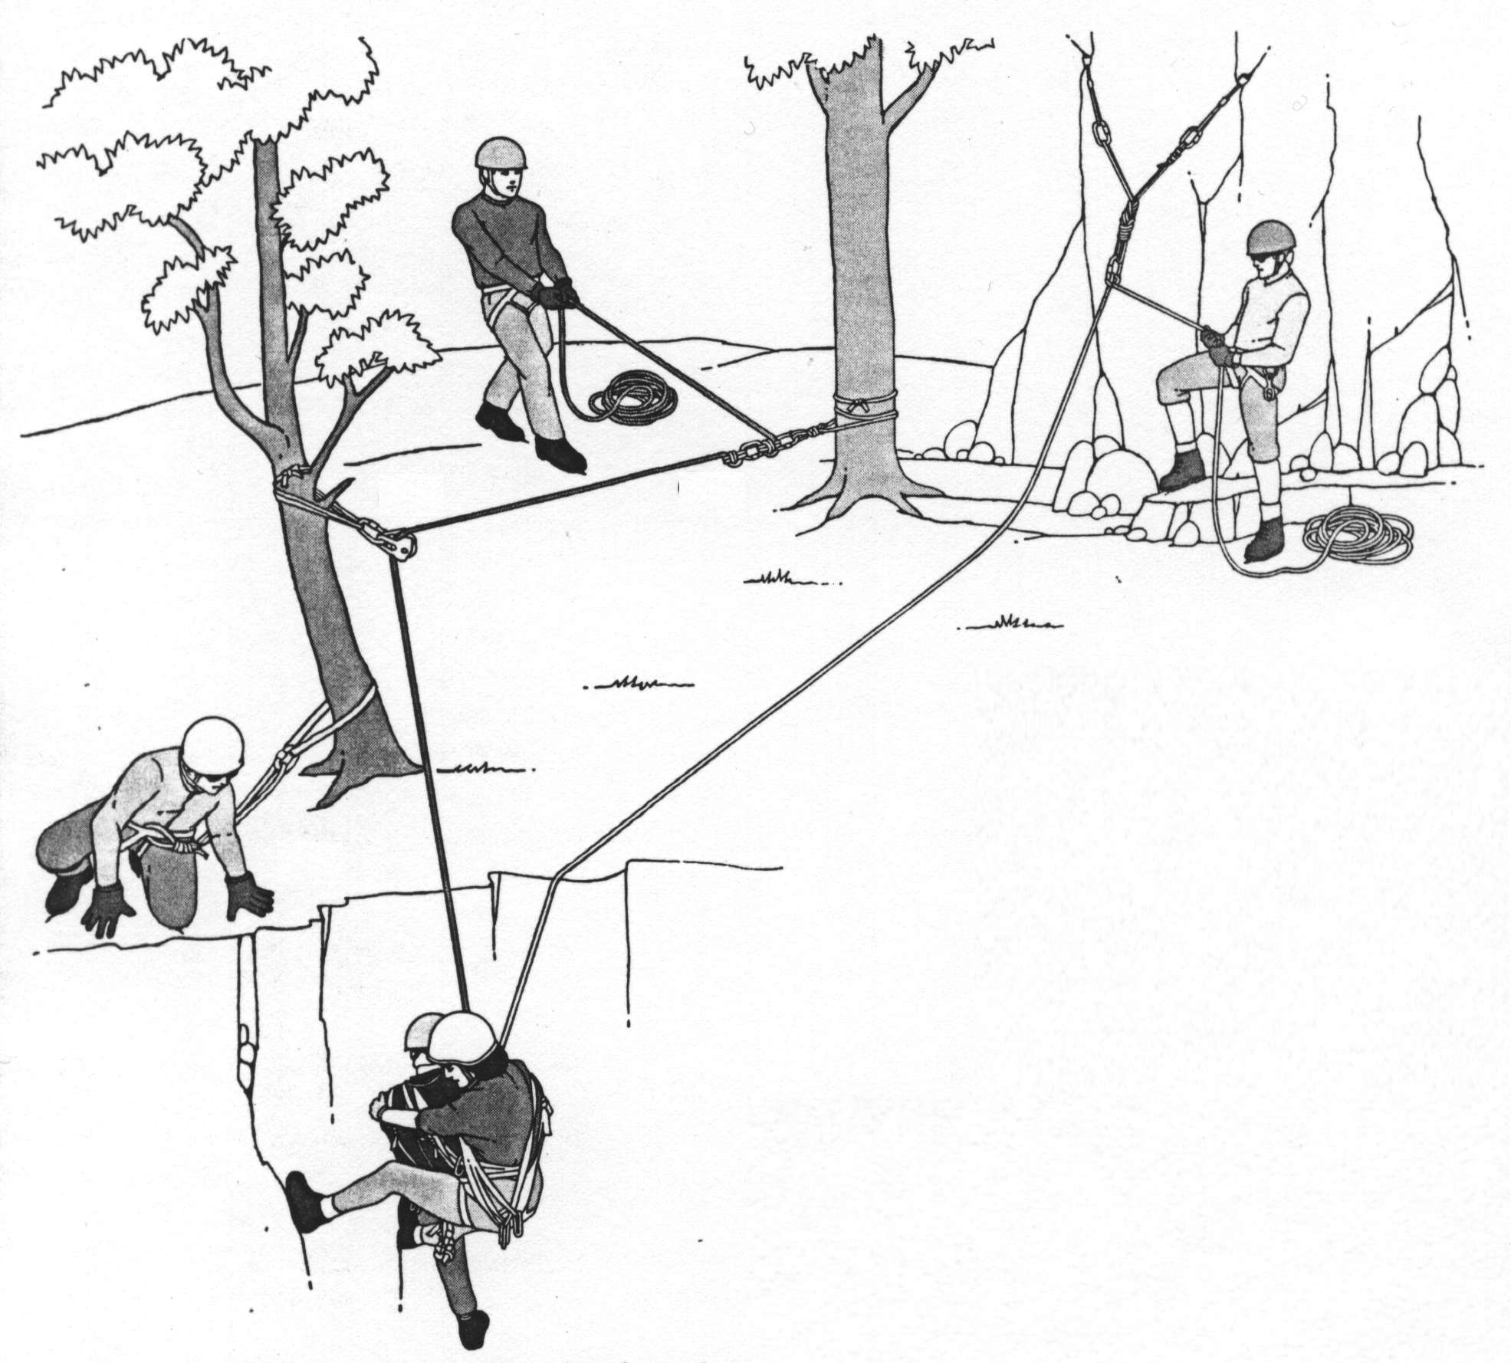
Rescue System Overview
Main 1
Belay or Main 2
Attendant

Slide 8
Rescue System Safety Tests
Component Analysis?
  Do all of the rescue system components do what we intend them to do?
Critical Point Examination?
  Are all components backed up by other system components so that failure of any one point (gear or personnel) would cause a serious accident?
Whistle Test?
  If a whistle sounded and every rescuer let go of the system, would the system still protect the rescuers and subject from catastrophe?
Notes:
Highlight for critical points – emphasis 2 points of connection when on slopes greater than 35 degrees
Components > System > Operators

Slide 9
Outline
Introduction
Tools of Alpine Rescue
Roles in the Rescue System
Running the Rescue
Teamwork, Leadership & Followership
Calling for Help

Slide 10
Tools of Alpine Rescue
Anchors
Belay Systems
Load Release Hitches
Lowering Systems
Raising Systems
High Directional
Attendant-Subject Tie-in
Static vs. Dynamic Ropes
Material Strengths

Slide 11
Anchors
Natural Protection
  Trees, Rock Features
  Wrap-3-Pull-2 or Wrap-2-Pull-1
  Basket Hitch
  Frost Knot
Artificial Protection
  Bolts, Cams, Nuts, Hexes, pitons, etc.
  Ice Screws, Pickets, V-threads
Single vs. Multi-point
  S-E-R-E-NE
  Solid (bombproof) most important!

Slide 12
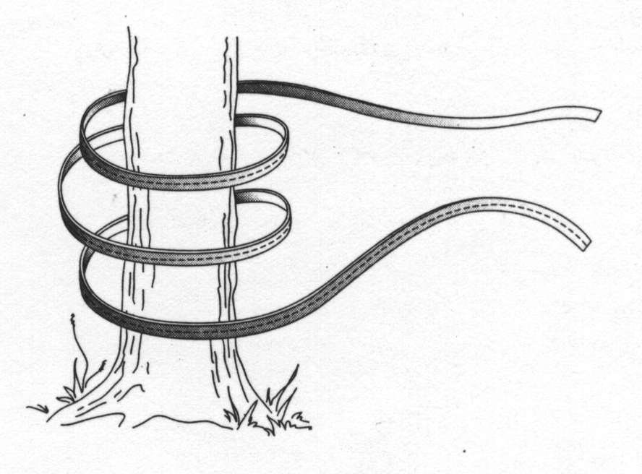
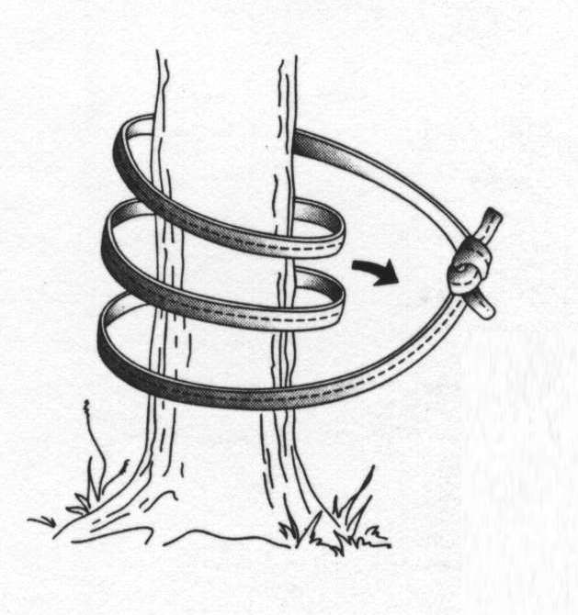
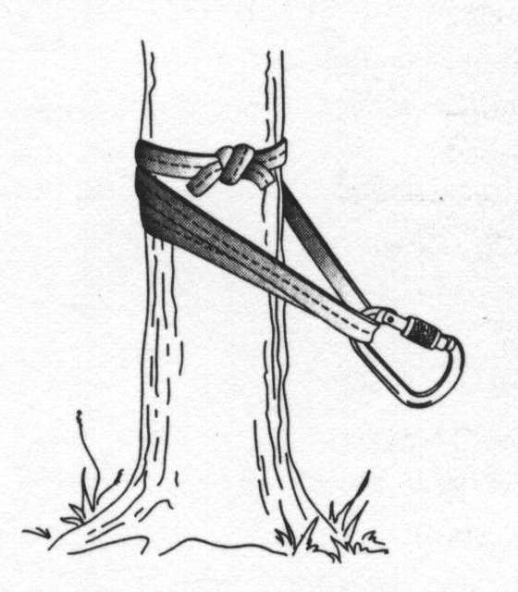
Wrap-3-Pull-2 Anchor
Notes:
Could also use cordalete

Slide 13
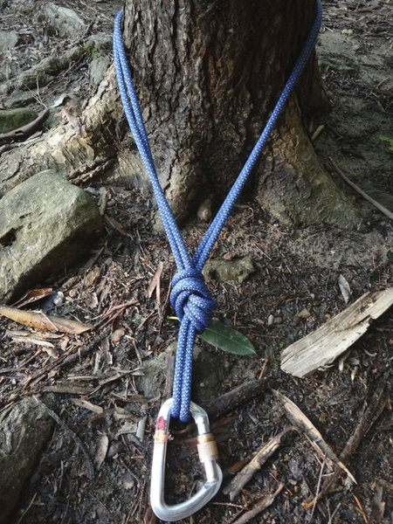
Masterpoint Anchor
Notes:
Why a wrap 3 pull 2?
Single strand holds 20kN
Wrap 3 pull 2 strength = 20*2*2 = 80KN = 18,000 lbs

Slide 14
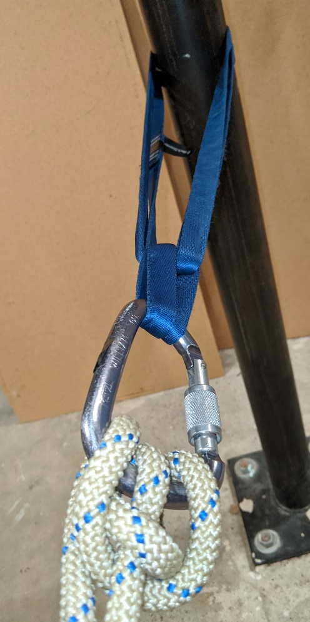
Basket Hitch
Notes:
Be careful not to cross/tri load the carabiner.

Slide 15
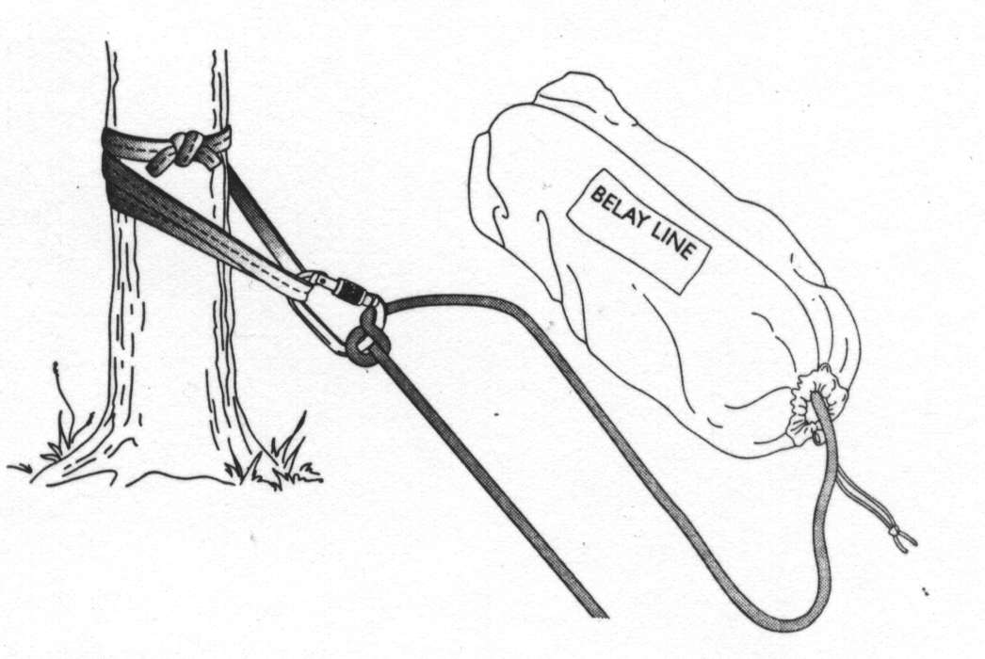
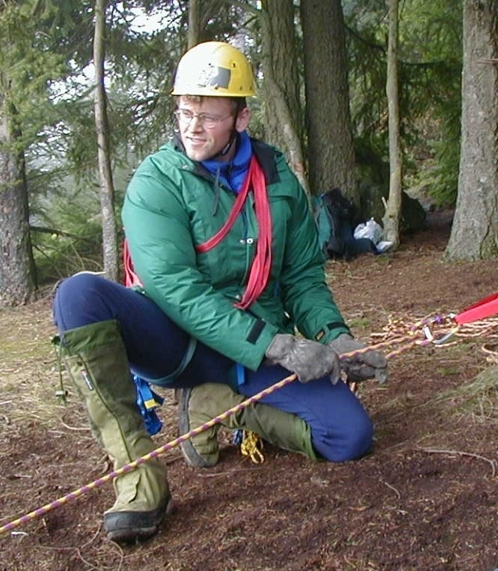
Munter Hitch Belay
Photo: Dave Shema

Slide 16
Load Release Hitches
Munter-Mule
  Climbing Rope or Cord
  Best for belay tie-off and belay escape
Munter-Mariner’s Hitch
  Cord - can be pre-tied or tied when needed
  Best for rescue load tension transfers
Mariner’s Hitch
  Cord or Webbing
  Best if tied when needed and pre-tensioned

Slide 17
Load Release Hitches
When to use a load release hitch?
A L W A YS **
Unless you use a V-T prusik!
Anytime a rope (or friction hitch) is loaded, a “device” which allows the load to be released or transferred MUST be used.
Use for belay escape, knot passes and raise-to-lower system changeovers.

Slide 18
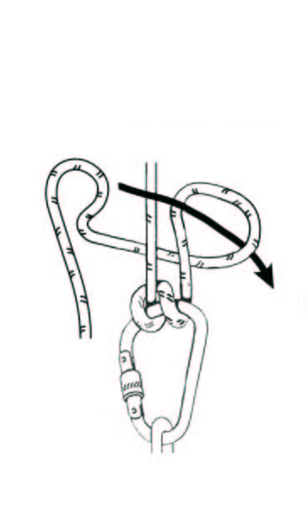
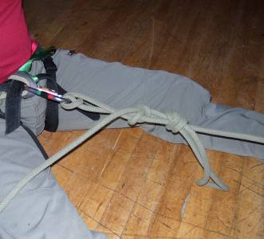
Munter-Mule

Slide 19
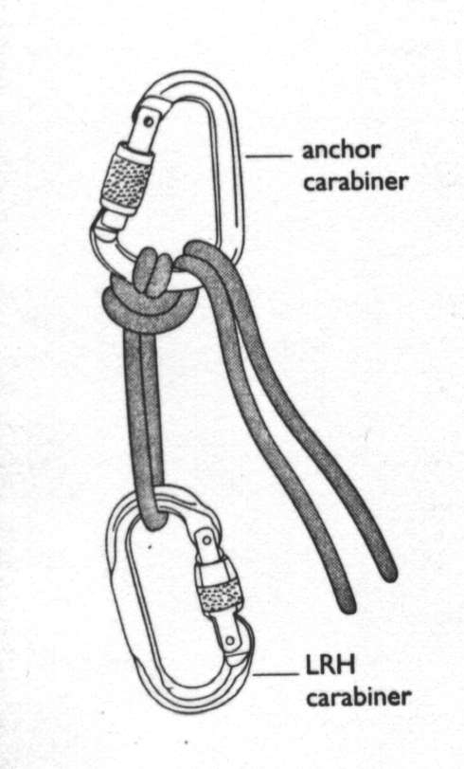
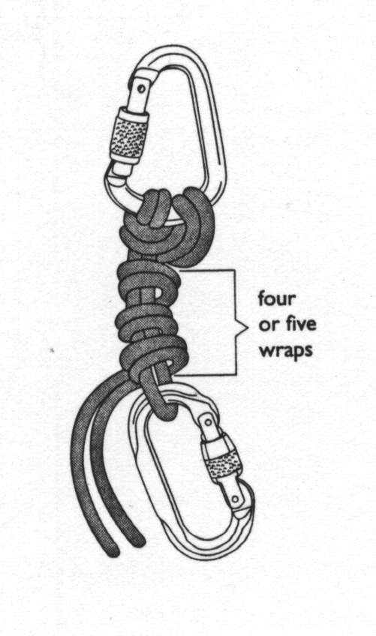
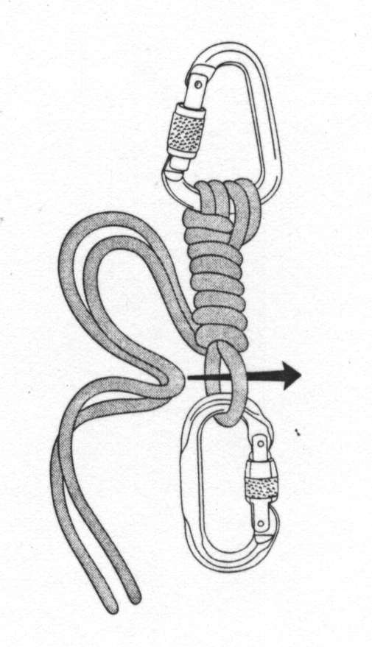
Munter-Mariner Hitch

Slide 20
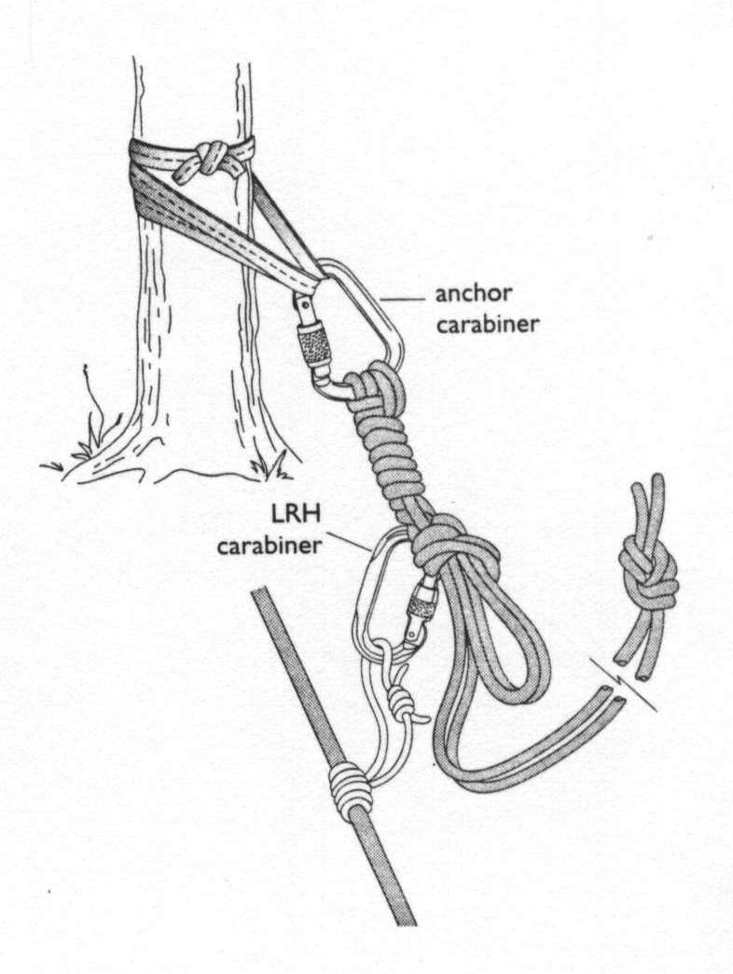
Munter-Mariner’s Hitch In Use

Slide 21
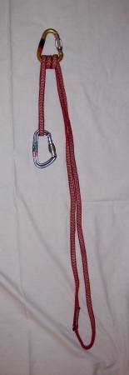
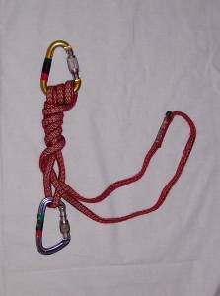
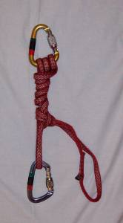
Mariner Hitch

Slide 22
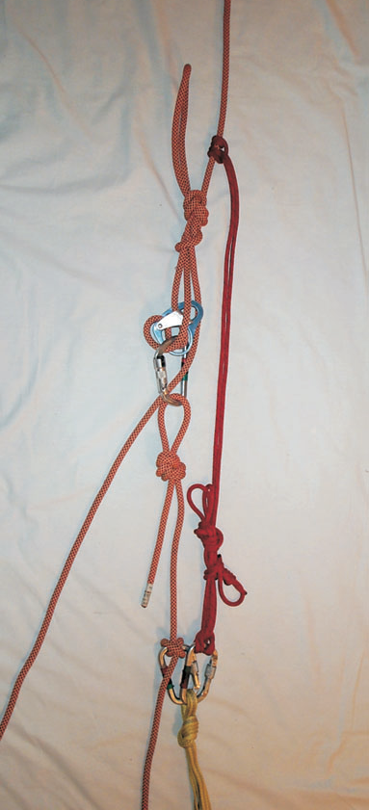
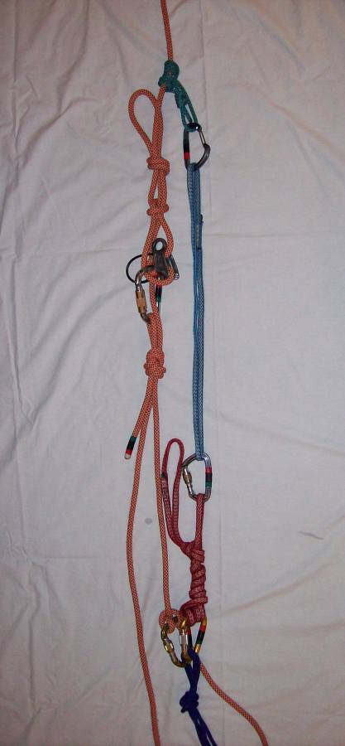
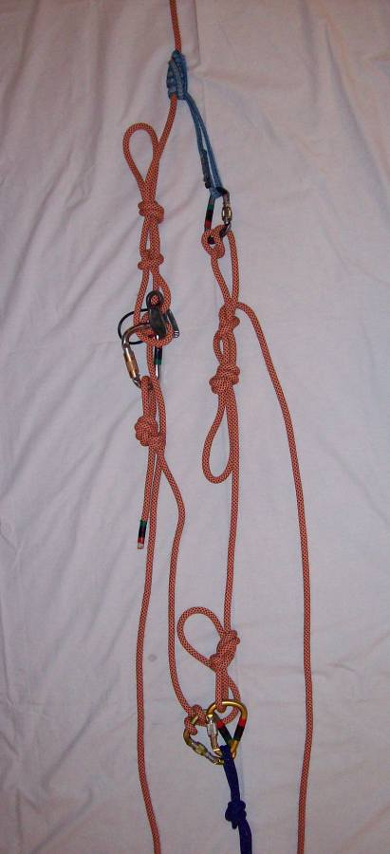
Belay Escape – Other Options
Cordelette
Mariner’s Hitch
Kleimheist

Slide 23
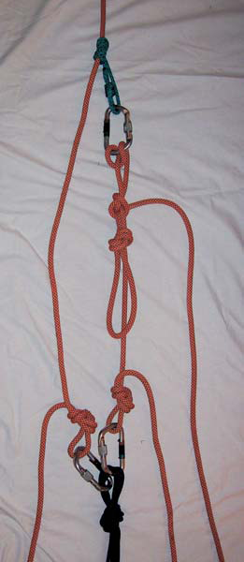
Belay Escape to Rescue System
Nothing, Leave “As Is”
Lowering System
Raising System
Belay System

Slide 24
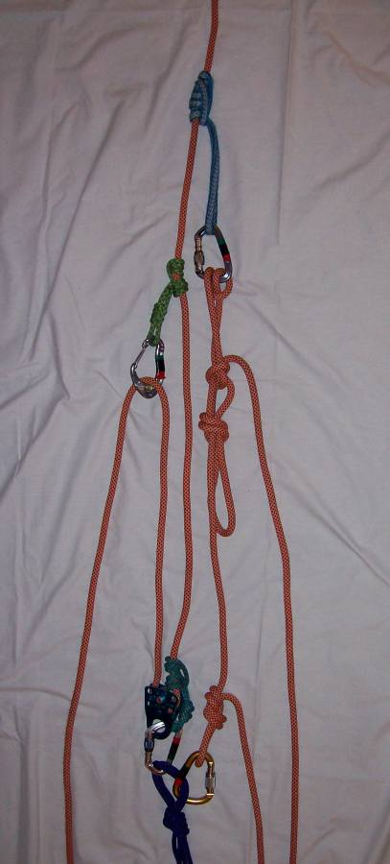
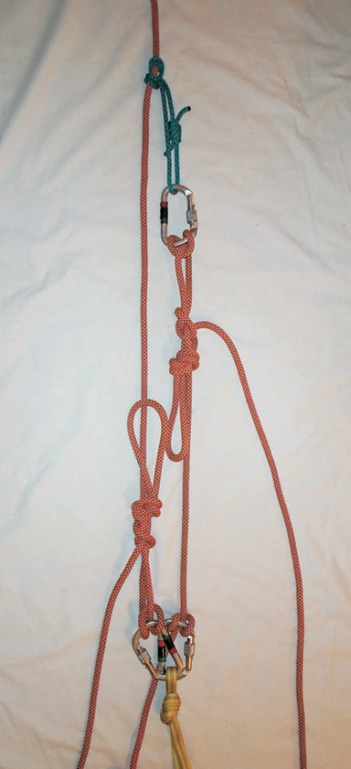
Belay Escape to Rescue System
3:1 Z-Pulley
Munter-Mule

Slide 25
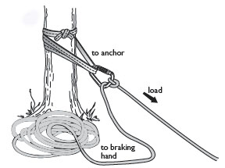
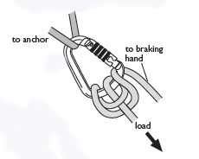
Double Munter Hitch
Double Munter Hitch
Munter Hitch

Slide 26
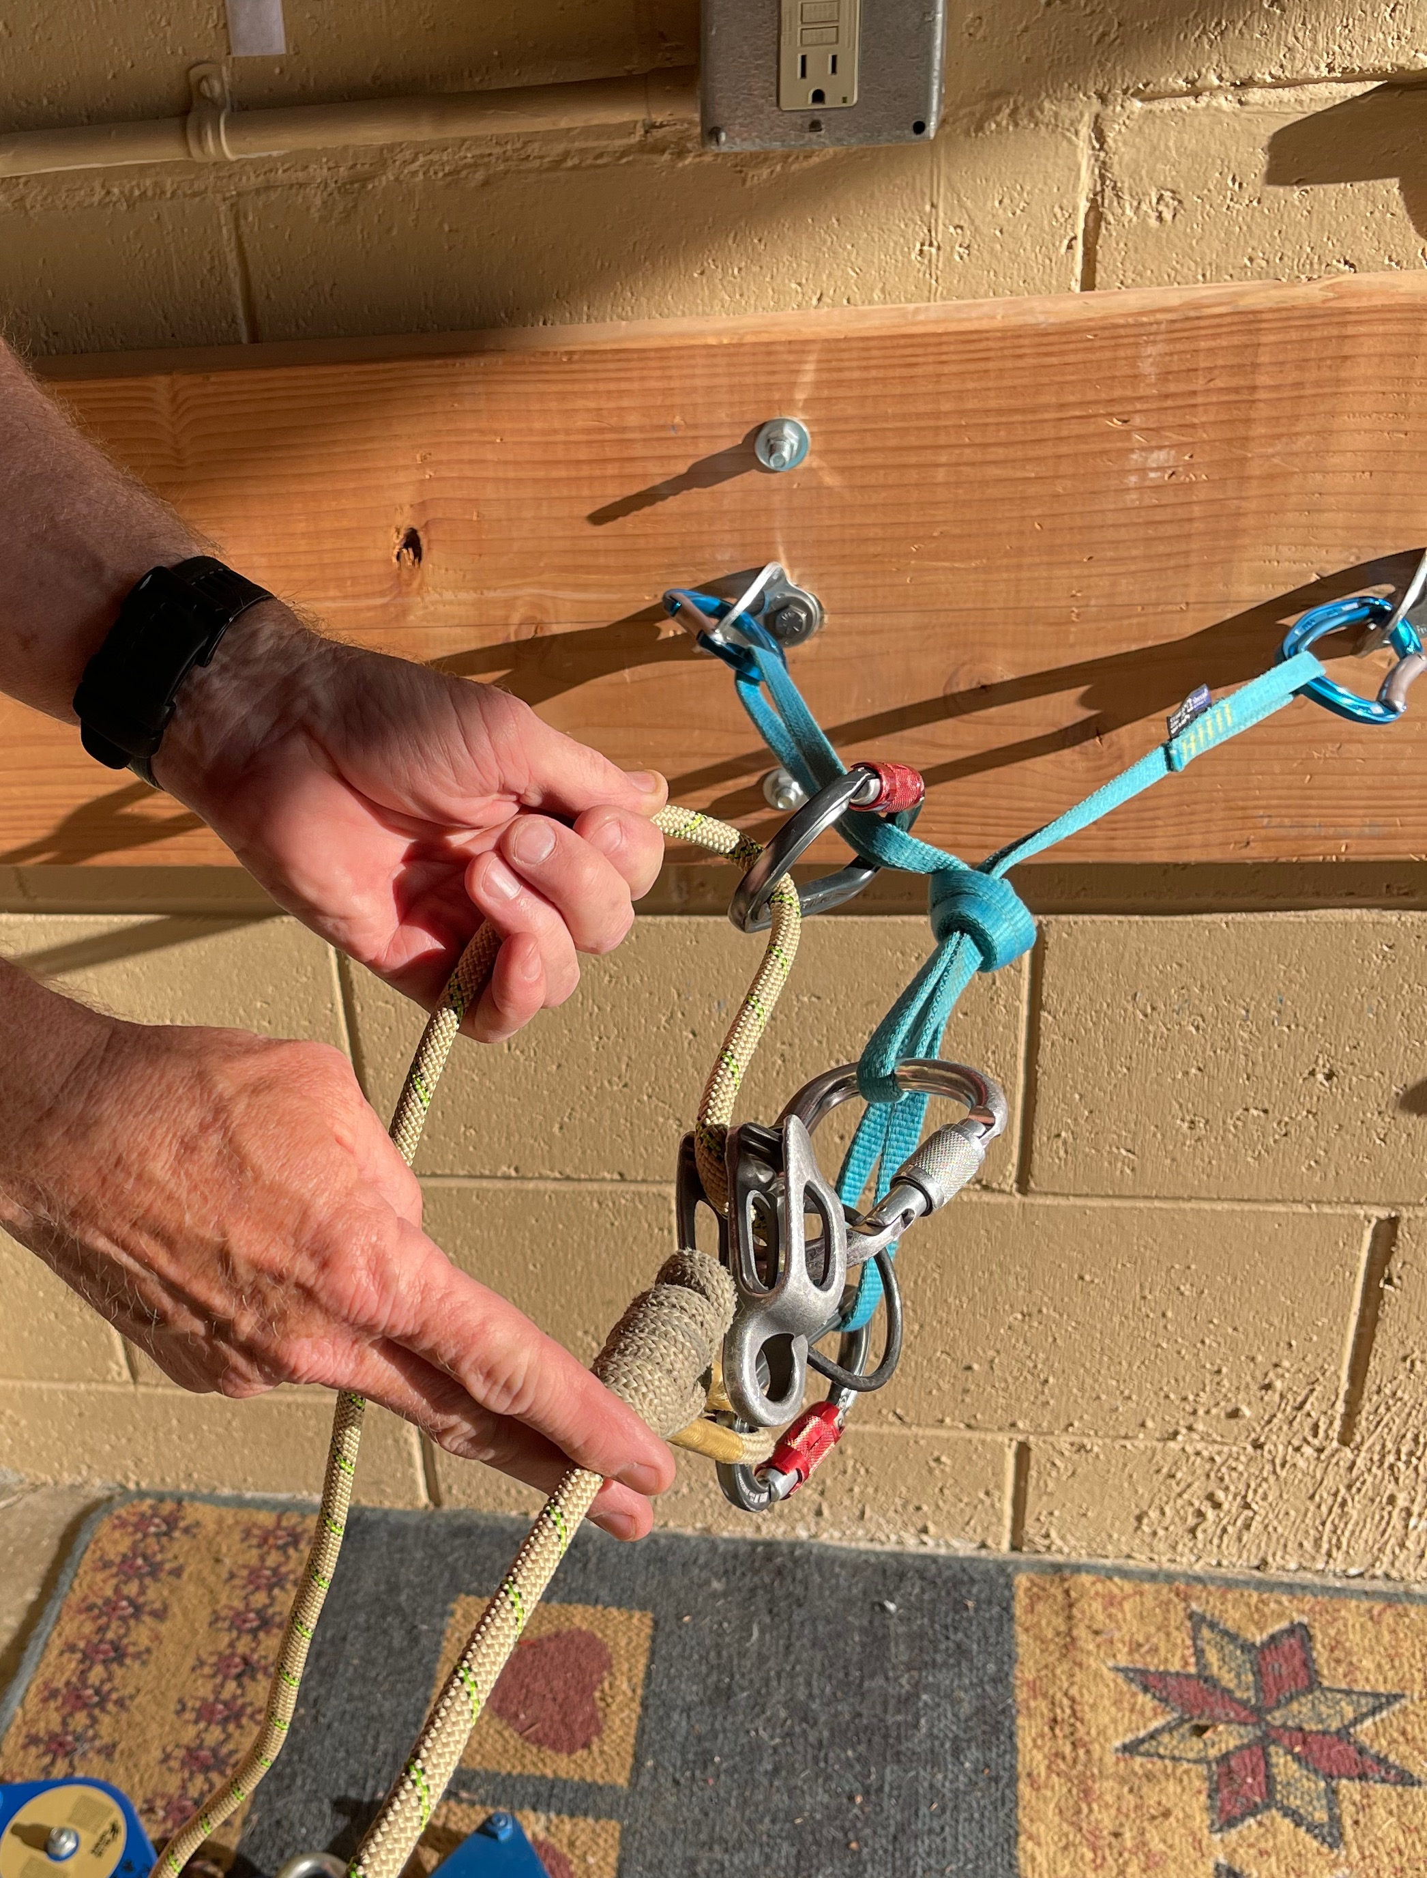
Redirected ATC
ATC Redirected
V-T Prusik
Notes:
Note: kleimheist isn’t typical

Slide 27
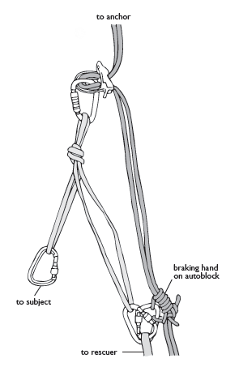
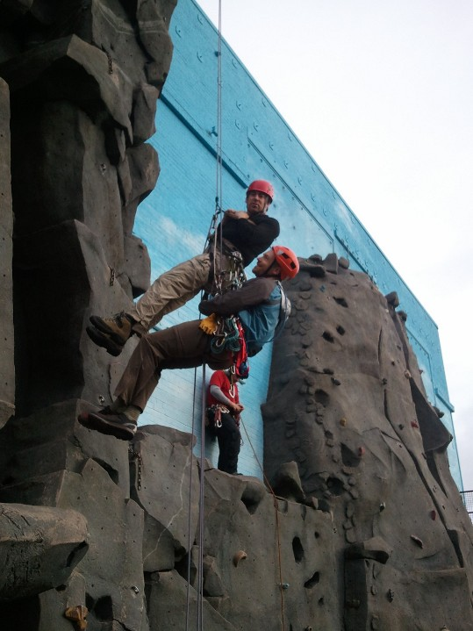
Tandem Rappel
Notes:
High Angle terrain only – not for steep angle
Most effective for multipitch rescue

Slide 28
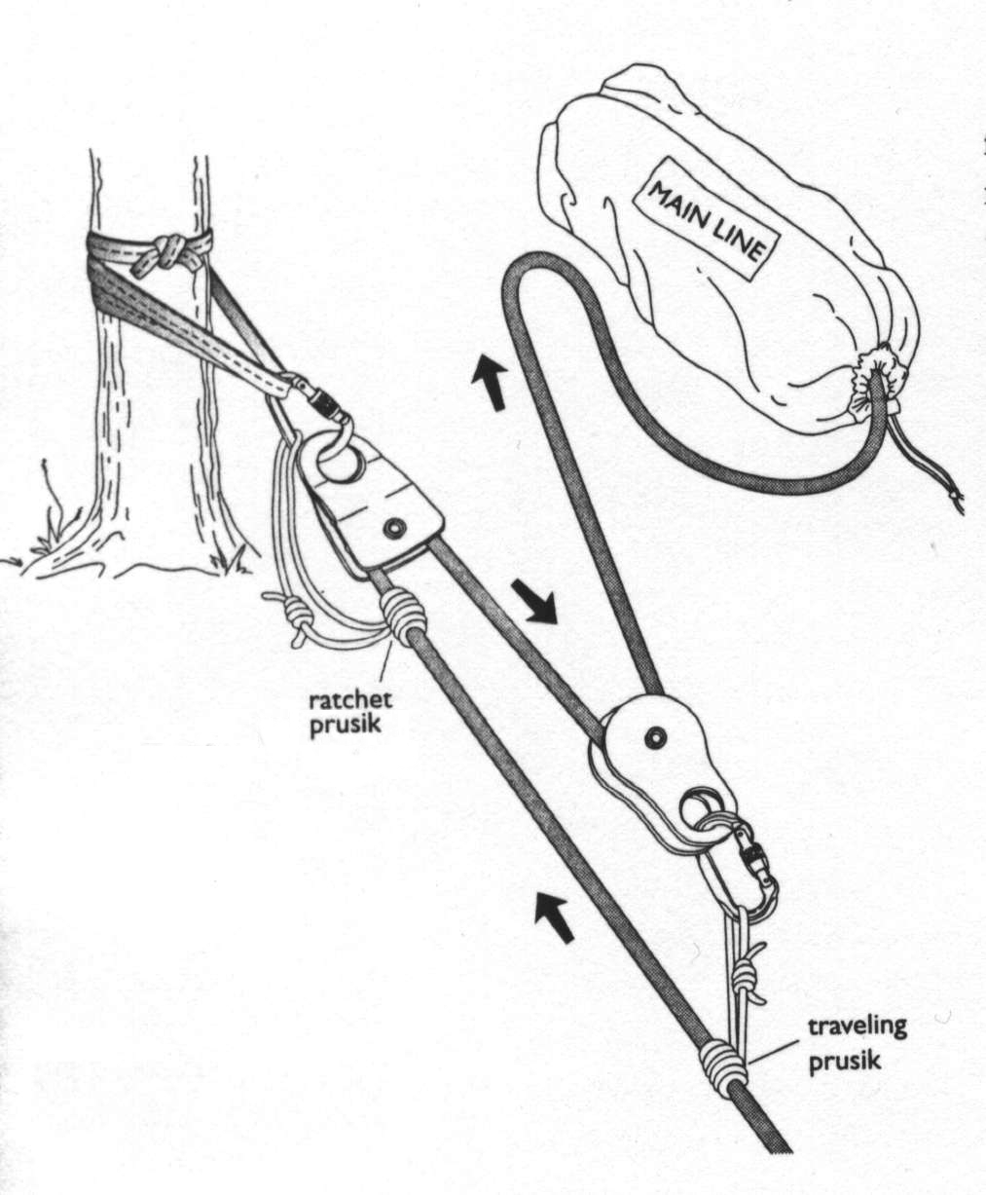
3:1 “Z-Pulley” Raising System

Slide 29
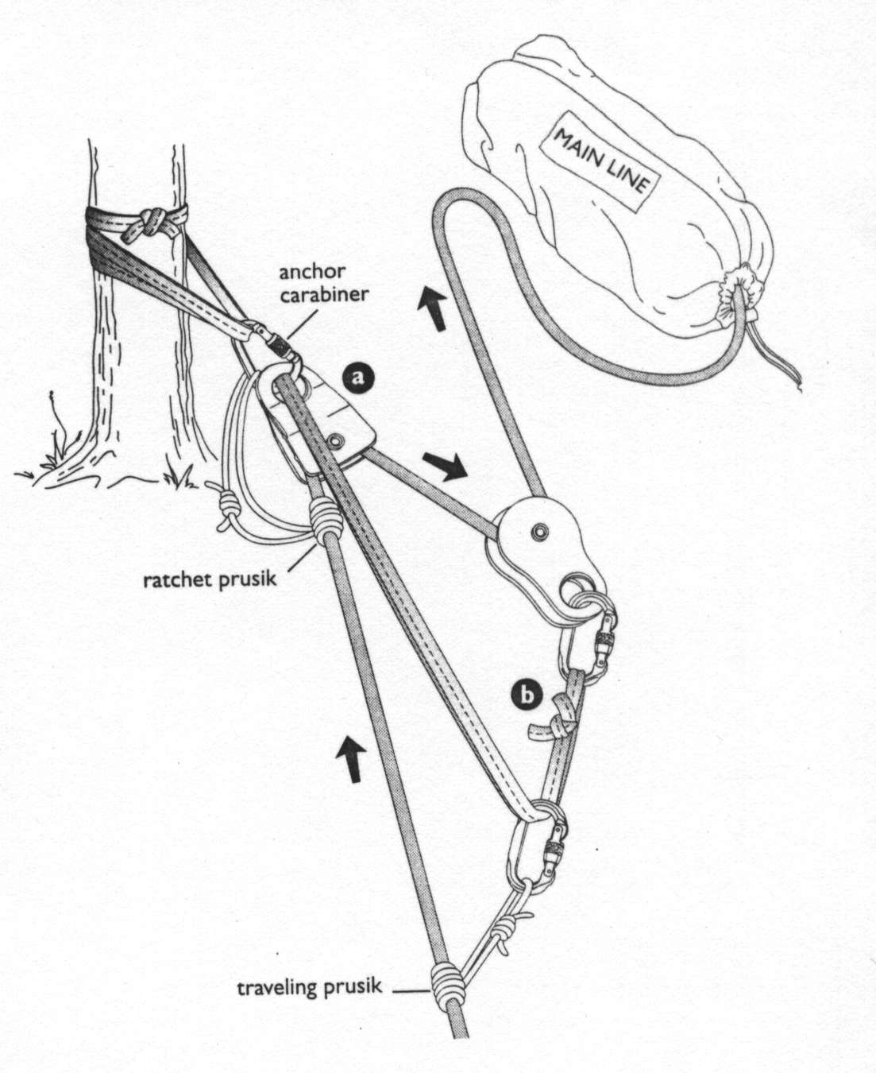
5:1 Raising System

Slide 30
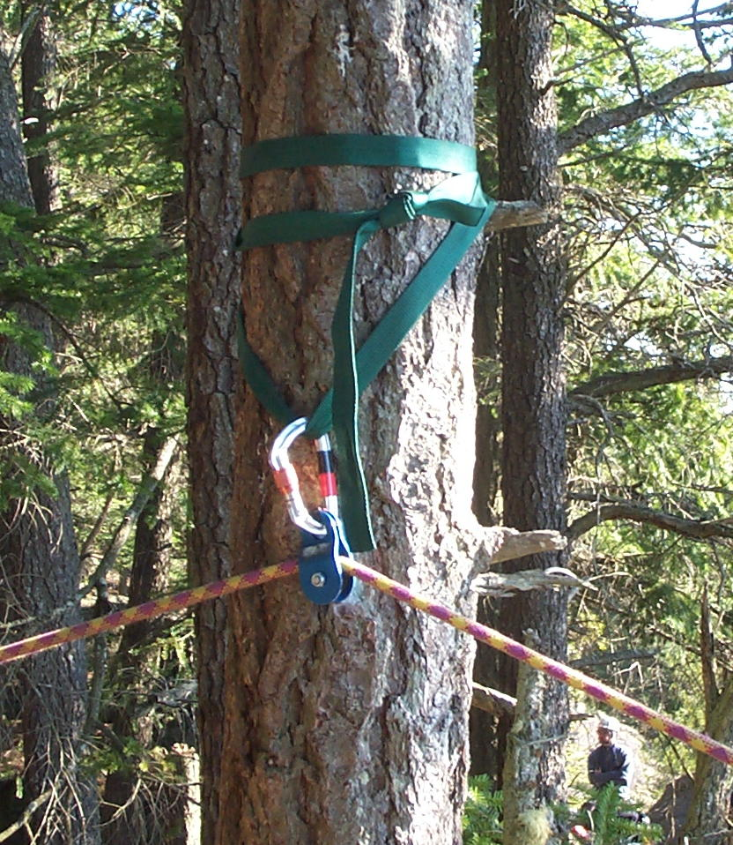
High Directional
Notes:
High directional used to prevent rope from dragging over edge and to provide a “top rope effect”

Slide 31
Attendant-Subject Tie-in
Small Party System
  Rescuer connected to BOTH ropes
  Subject connected to BOTH ropes
How to achieve
  Attendant: Longtail bowline to main line, prussik to belay line
  Subject: Figure 8 from bowline to main line, prussik to main line, figure 8 to belay line

Slide 32
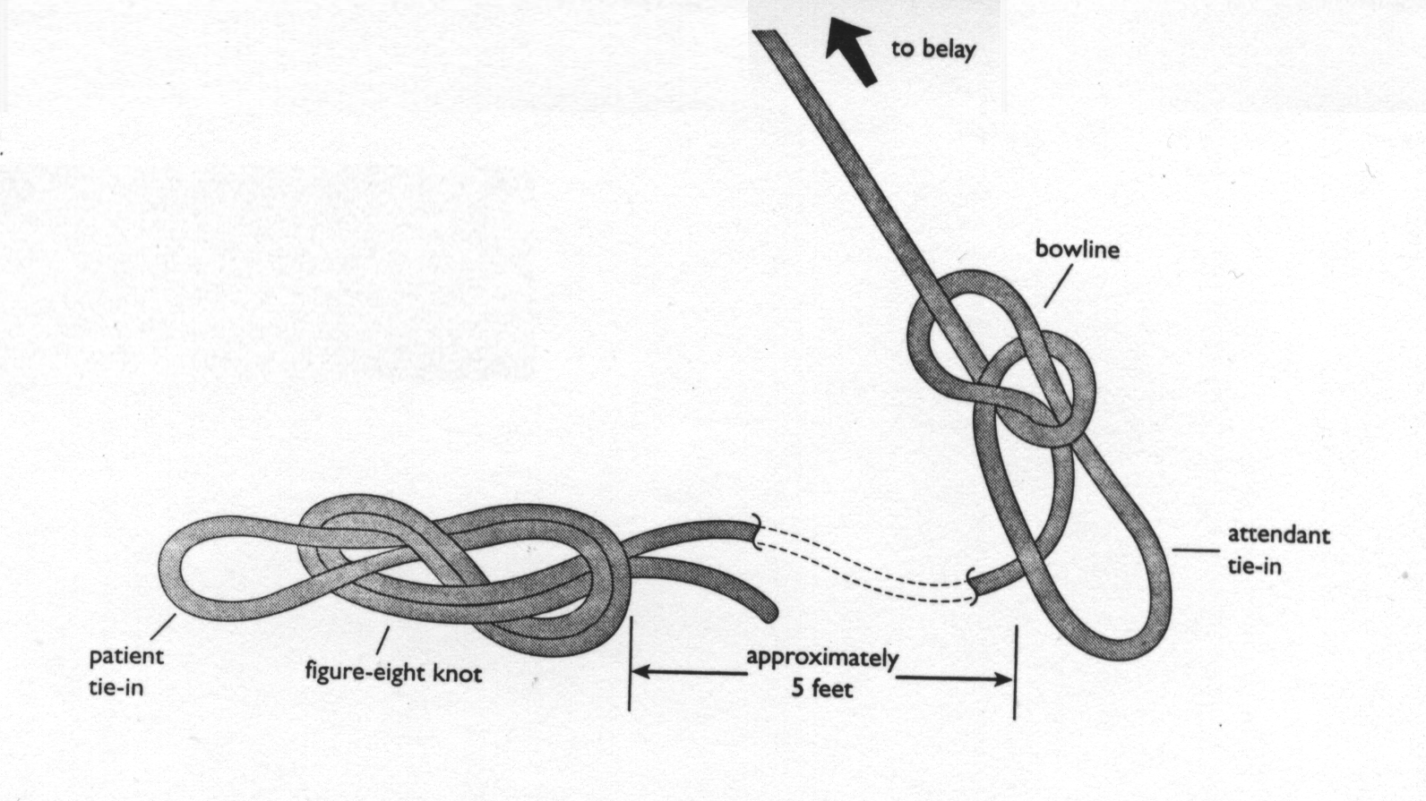
Longtail Bowline
subject

Slide 33
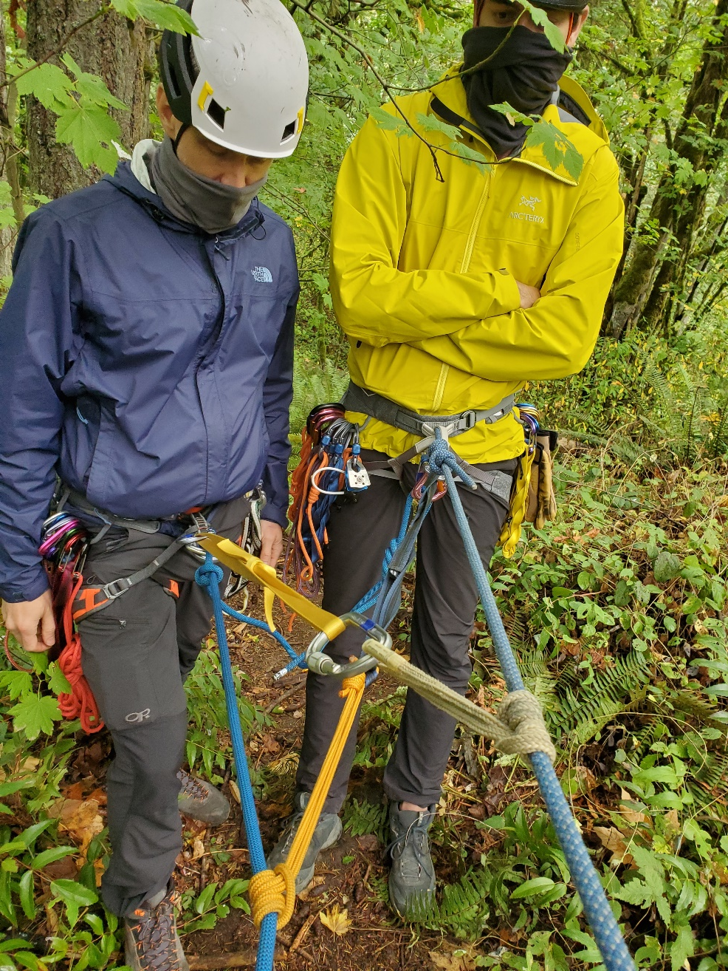
Attendant & Subject Tie-in
Long Tail Bowline
Figure 8 from “Main Line”
Prusik on Belay to Attendant
Prusik on Main To Subject
Fallen Climber/”Belay Line”
“Main Line”

Slide 34
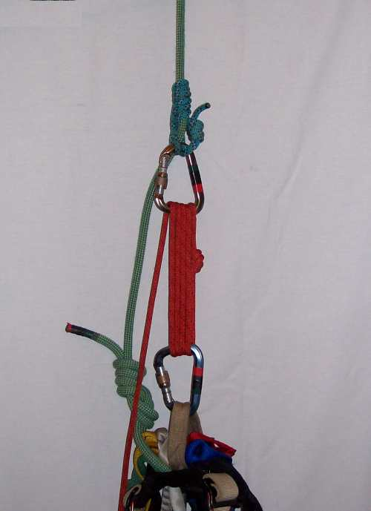
Carabiner Block-and-Tackle
A simple pulley system.
A method of extracting a subject from loaded accident rope.
Raise subject just enough to release the tension on their tie-in knot.
An efficient “wall pick-off.”
Doesn’t work well for everyone.

Slide 35
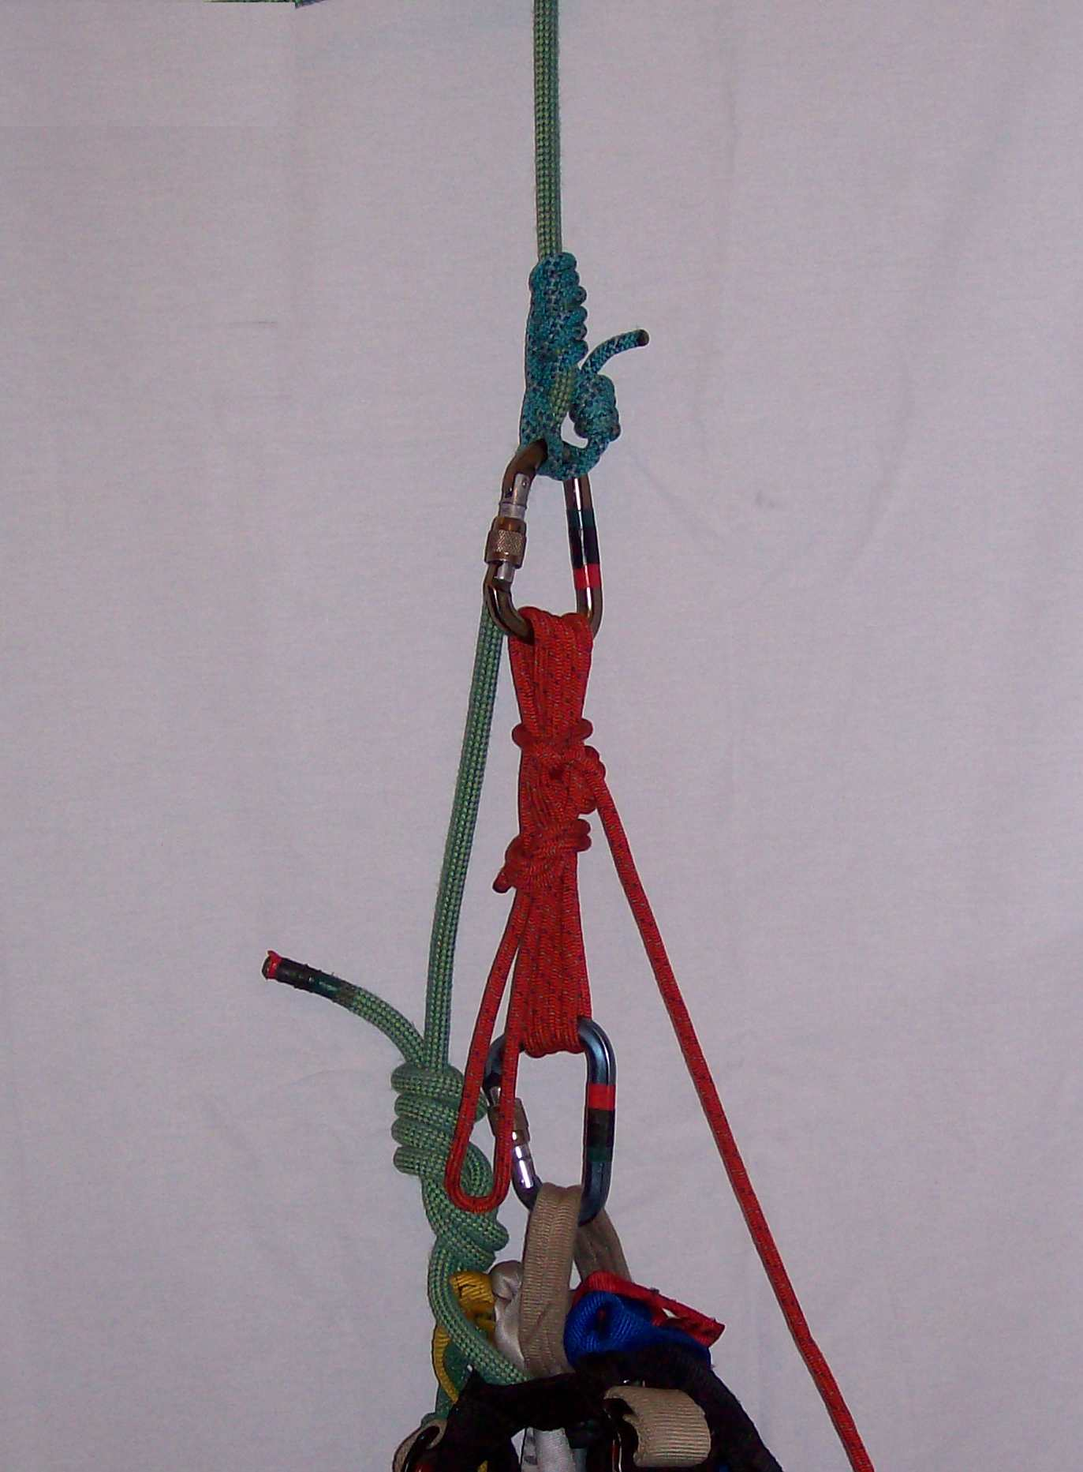
Carabiner Block-and-Tackle
Carabiner block-and-tackle tied off with a Mule knot and Overhand back-up.

Slide 36
Static vs. Dynamic Rope
Dynamic Rope
  Climbing rope
  8-10% elongation (static), up to 30% dynamic
  60 m of rope  6 m fall if main line fails!
  Keep lowers and raises short!
Low-stretch “Static” Rope
  Rescue rope, Haul line
  1-2% elongation
  100 m rope  2 m fall if main line fails
Notes:
Static line here is listed for reference. Not used in alpine climbs. If aid climbing, you may have static lines, but you also have a bazillion other tools you can use

Slide 37
Material Strengths
Rescue Load (2 people and gear) ~ 2 kN
9mm Dynamic Rope ~ 20 kN
10.5mm Dynamic Rope ~ 28 kN
1-inch Webbing ~ 20 kN
9/16-inch Webbing ~ 11 kN
12mm Spectra ~ 11 kN
8mm Cord ~ 15 kN
6mm Cord ~ 8 kN
5.5mm Spectra ~ 18 kN
Carabiners ~ 20-30 kN
Pulley ~ 10-20 kN
Stopper ~ 5 kN
Hex ~ 10 kN
Cams ~ 10 kN
Bolts ~ 18 kN T, 25 kN S
Ice Screw ~ 11 kN
V-thread ~ 13 kN-H, 16kN-V
Picket ~ 1-12 kN
Notes:
Note: dynamic ropes aren’t tested for breaking in static pull test

Slide 38
Outline
Introduction
Tools of Alpine Rescue
Roles in the Rescue System
Running the Rescue
Teamwork, Leadership & Followership
Calling for Help

Slide 39
Focus in the Rescue Roles
Rescue Leader  focus on the “Big Picture”
Safety Leader  focus on Safety
Controller  focus on running the Rescue System
Medic/EMT/First Aid  focus on Subject
Attendant  focus on Subject and Rescue Route
Belay Line Operator  focus on Belay Line
Main Line Operator  focus on Raise/Lower
Notes:
This a list of all roles

Slide 40
Roles vs. Party Size
5+-person Rescue Team
  Rescue Leader
  Controller/Safety
  Belayer
  Main Line Operator
  Attendant/First Aid

Slide 41
Roles vs. Party Size
Three-person Rescue Team
  Rescue Leader/Safety/Belayer
  Main Line Operator/Controller
  Attendant/First Aid
Two-person Rescue Team
  Main Line Operator/Safety
  Attendant/First Aid/Safety/Self-Belayed/Controller
One-person Rescue Team
  Take the Self-Rescue Course

Slide 42
Outline
Introduction
Tools of Alpine Rescue
Roles in the Rescue System
Running the Rescue
Teamwork, Leadership & Followership
Calling for Help

Slide 43
Running the Rescue System
Main
Belay
Controller
Attendant

Slide 44
Running the Rescue System
Main
Belay
Controller
Attendant

Slide 45
Getting Ready – Scene Size Up
Rescue Leader (somebody) needs to confirm
  Where the subject is
  Where the “hot zone” is, ie area where if you fall you fall over the edge
  Mark the hot zone
  Identify anchors and route for attendant
Notes:
These commands are for a “perfect scenario”. In reality, you probably won’t remember these exact commands. Just talk in your team and agree on a plan and your commands before sending someone over the edge.

Slide 46
Getting Ready – Assemble the System
Everyone gets assigned their tasks and builds their part of the system
Someone else should safety your system when possible
Tell Rescue Leader when you’re ready

Slide 47
Commands: Getting Ready
Controller  “Belay (Blue) Line Ready?”
Belayer  “Belay (Blue) Line Ready!”
Controller  “Main (Green) Line Ready?”
Main Line Operator  “Main (Green) Line Ready!”
Controller  “Attendant Ready?”
Attendant  “Attendant Ready!”
  This command sequence should precede the start of a lower or a raise and after any long pause in the action.
  REPEAT this ENTIRE command sequence if a glitch interrupts it for more than a few seconds.

Slide 48
Commands: Running the Rescue
Controller or Attendant Calls these Commands:
For a Lower
“Down Slow!”  lower slowly (~0.5 ft/sec)
“Down!”  lower a little faster (~1 ft/sec)
“Down, Down!”  lower fast (~2 ft/sec)
For a Raise
“Up!”  steady raise
“Up, Up!”  raise as fast as the haulers can
For traveling prusik reset: no commands to the entire group, main line operator issues commands to the haulers.

Slide 49
Commands: STOP!
Anyone  “STOP!”
EVERYONE  “STOP!”
Controller  “Why Stop?”
Person who called stop explains.
Continue rescue when ready, remembering to start with the “getting ready” commands.

Slide 50
Tips for Running a Rescue
Take time to create a plan.
Keep things neat!
  Stow equipment and packs together out of work area
  Flake ropes and organize rescue gear
  Clear debris from work area
Everyone wears harness and helmet so everyone is ready to respond quickly and can take on any role.

Slide 51
Tips for Running a Rescue
Place anchors as far from edge as possible to give lots of working space.
Be deliberate!
  Speed and efficiency will come with practice.
  Rushing usually leads to a mistake that costs significant time and effort.

Slide 52
Outline
Introduction
Tools of Alpine Rescue
Roles in the Rescue System
Running the Rescue
Teamwork, Leadership & Followership
Calling for Help

Slide 53
Leadership During a Rescue
Focus on the BIG Picture
Little to No “Hands On”
Gather information from your team
Take responsibility for the plan
Explain the plan clearly
Give direction and let your team perform
Give specific instructions and expectations
Notes:
“Perfect Scenario”

Slide 54
Followership During a Rescue
Take direction from the leader
  Repeat instructions for verification
  Perform tasks quickly and efficiently
Give information and status to leader
Before speaking ask yourself...
  Can it wait? Does it matter?
  Safety Issue  Just yell STOP!
Keep Quiet  No “chit chat”

Slide 55
Remember the Subject
Make contact
Keep contact CONSTANT!
Reassure the subject
Explain the plan to the subject
Allow the subject to have input to the plan
Where practical, use the subject’s gear

Slide 56
Outline
Introduction
Tools of Alpine Rescue
Roles in a Rescue System
Running a Rescue
Teamwork, Leadership & Followership
Calling for Help

Slide 57
Severely Injured Subject
Do perform necessary first aid
For suspected neck or back injury
  Do NOT move subject
  Wait for a rigid litter
  Exceptions:
    Subject in a stream or moat
    Rockfall or icefall danger
    Avalanche danger
    Subject free-hanging in harness

Slide 58
Dealing with Fatalities
Give urgent first aid until you are convinced there is no chance of the subject recovering.
Take pictures of the subject and accident site.
Everyone write a report immediately.
Follow any instructions from legal authorities.
Legal Requirements: Deceased’s Name,
Time, Date, and Location of death.
Used deceased’s equipment if needed to keep your party safe.

Slide 59
Calling for Help
Call and report a climbing accident...
  911  County Sheriff SAR coordinator
  National Park Emergency Phone Number
  Information: name, age, injury, medical information, location, contact information, and your plan.
Call The Mountaineers...
  Emergency Phone Number
  Information: what happened, your plan, family/friend emergency contact names and phone numbers.
Everyone individually write a description of what happened as soon as possible.

Slide 60
Cell Phones
Always try 911 even if you do not have a signal!
  If your carrier provides no 911 coverage, another might
Always try a text as well – best chance to go thru even if no signal indicated
When a 911 call goes through:
  Be very clear and relay all information that you can in case this is your only contact with a 911 operator
  Do this to the first person you speak with in case your call is lost in transfer
Satellite Phones
  A nice, but expensive luxury
  Great for remote expeditions

Slide 61
InReach, SPOT, PLB, ELT...
NOT a substitute for good judgment
Often better than a cell phone for calling for help – satellite vs cellular reception
Some have non-emergency transmission to keep family and friends informed
Learn how to use yours properly
The 11th essential

Slide 62
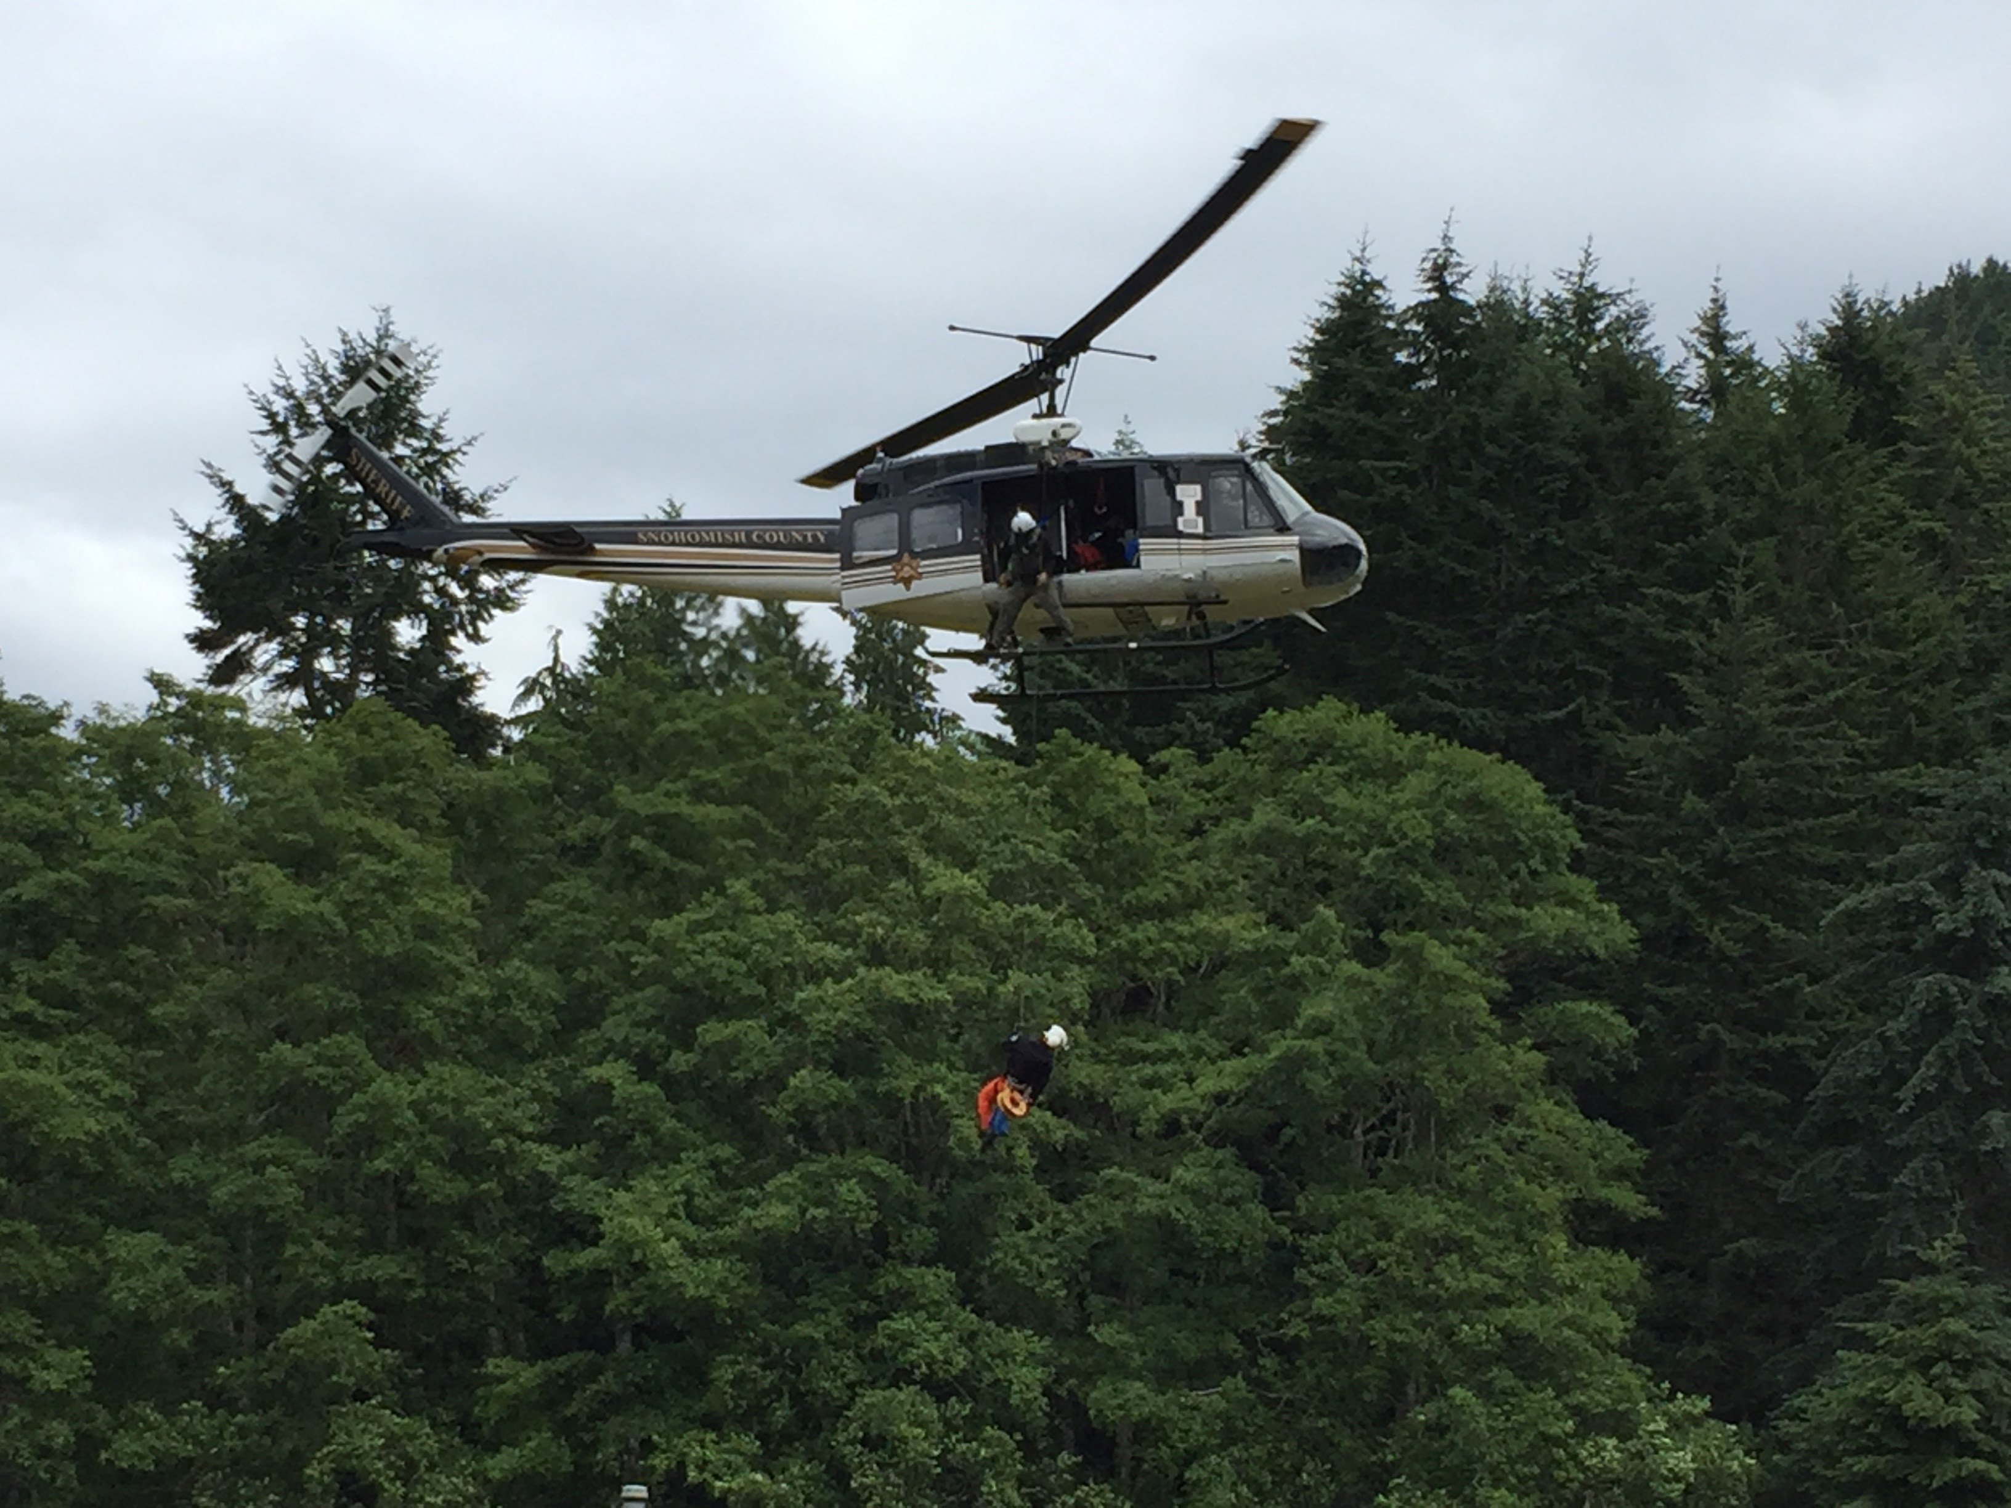
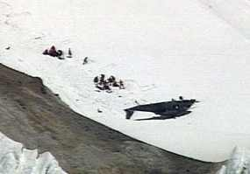
Working Around Helicopters
Helicopters are COOL!
Helicopters are
DANGEROUS!

Slide 63
Helicopter Response
Expect a minimum of a 2-3 hour wait – military are coordinated thru the National Emergency Response Coordination Center
Helo authorized if: Loss of life/limb/sight is at risk (and others based on risk)
Most helos in Washington will not fly if there is no visibility; many do not fly at night
Be as descriptive as possible of conditions
  Wind (strength and direction it’s coming from)
  Conditions (hot, cold, humid)
  Terrain (trees, rock face, size of features, etc)

Slide 64
Working Around Helicopters
Locate yourself as far from the helicopter landing zone as possible.
Clear area of debris as best you can.
Secure all loose gear and clothing.
Helmets, wind and eye protection for everyone, especially the subject.

Slide 65
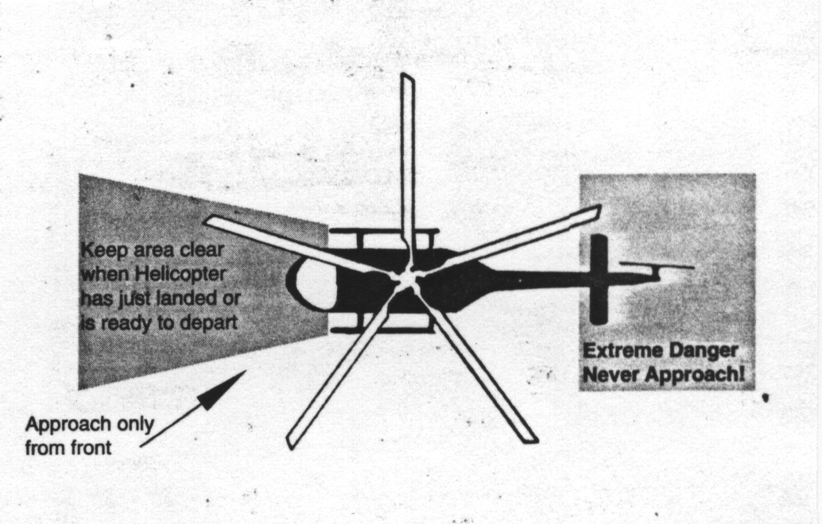
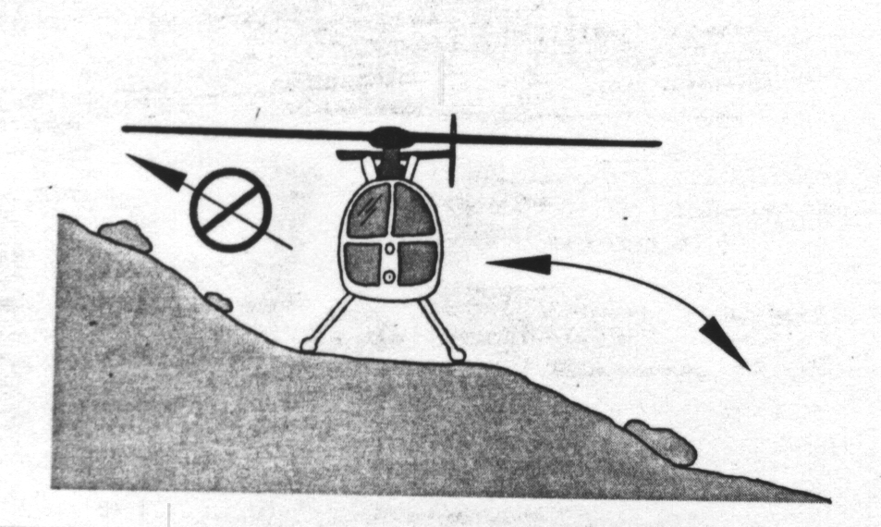
Working Around Helicopters
Approach from
Downhill
Safe Approach and
DANGER Zones depend
on helicopter
∅
✓

Slide 66
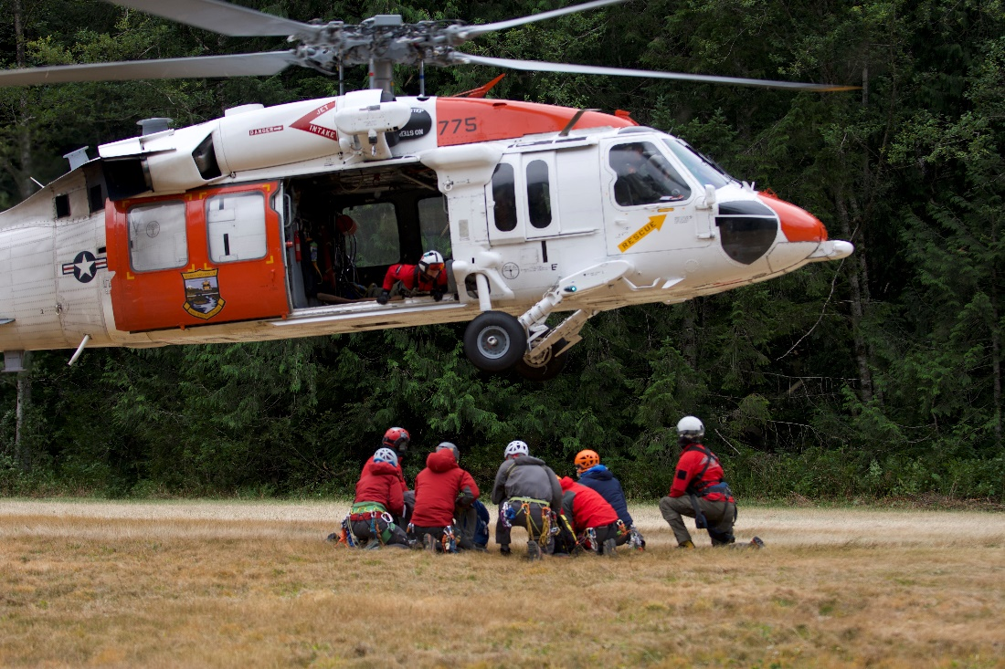
Working Around Helicopters
Do not approach until the crew chief gives a signal
Keep your head down and stay low
Protect the subject’s face

Slide 67
Ground SAR Response
SAR response is not waiting at home for your call. Expect a 4-6 hour wait or more
SAR will bring their own equipment to do the rescue
Take direction from them as best as possible

Slide 68
Field Trip
Skills
Scenarios
Make sure your knots are dialed – see handout for list
Know the full belay escape
We’ll spend some time practicing skills
  Scene Size Up
  Building Main and Belay/Main 2
  Attendant Set up and Pick off
  Converting from Lower to Raise
  Converting from Raise to Lower
  Knot Pass
Raise
Lower
Raise to/from Lower

Slide 69

Questions

