Slide 1

Mountaineers
Nordic (Cross-country) Ski Course - Everett - 2022
Equipment Overview

Slide 2
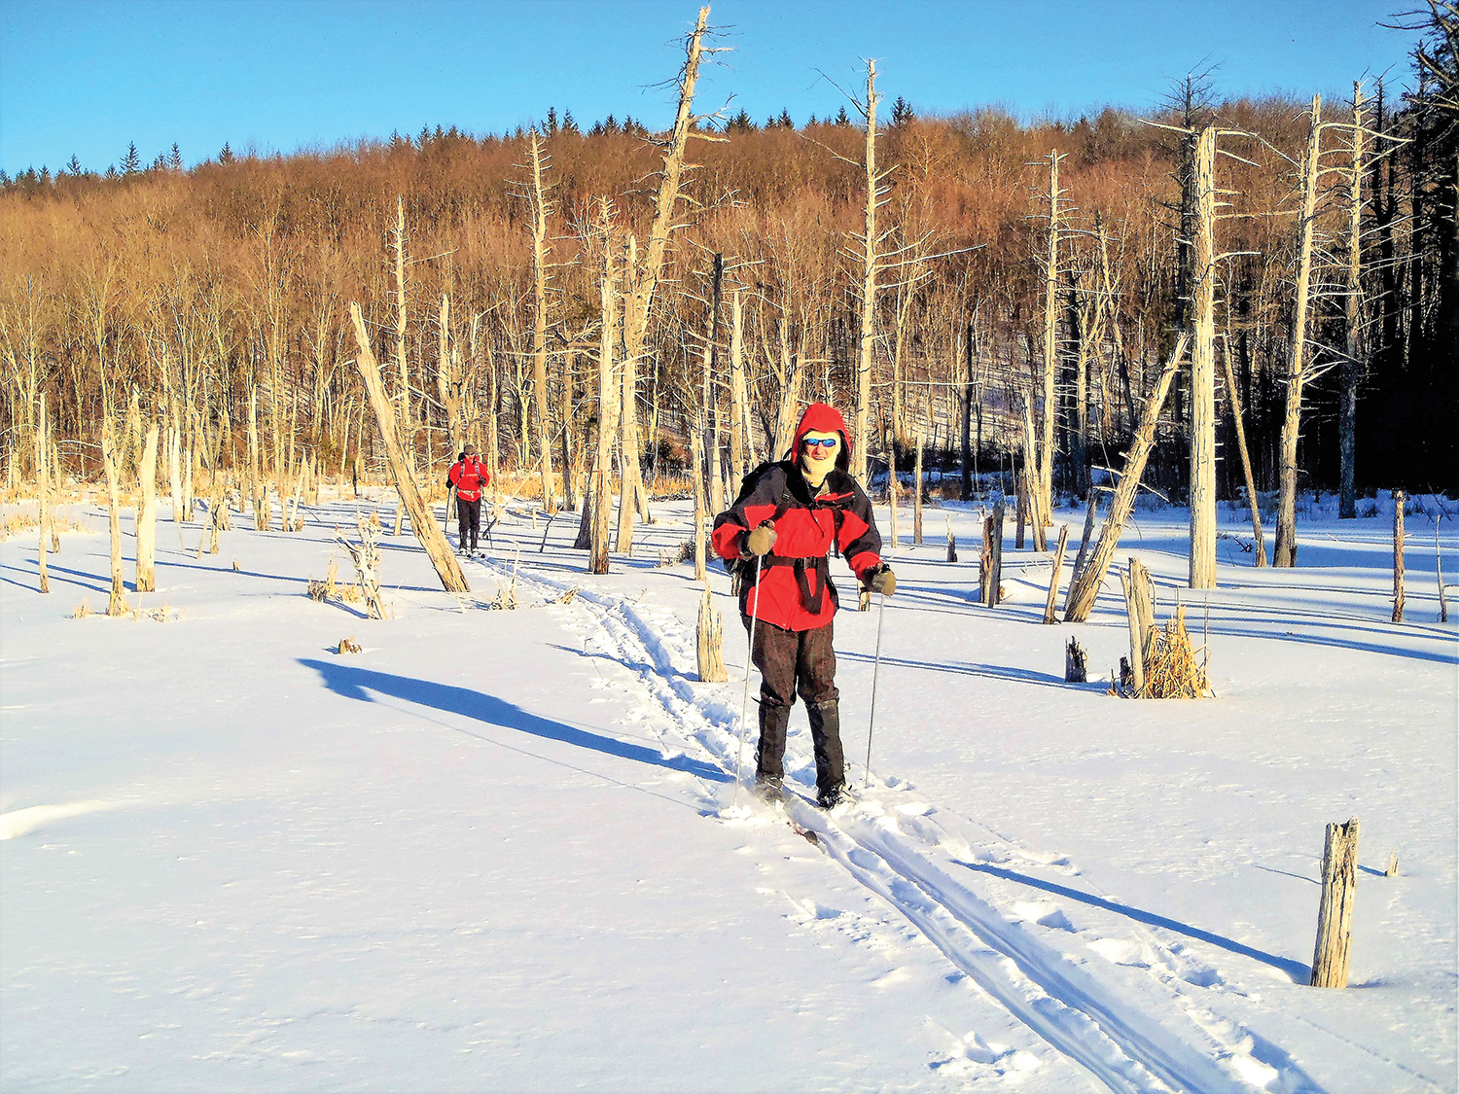
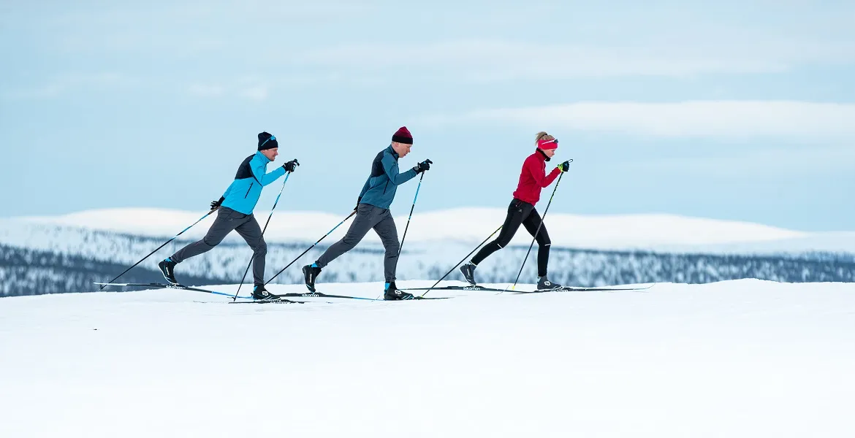
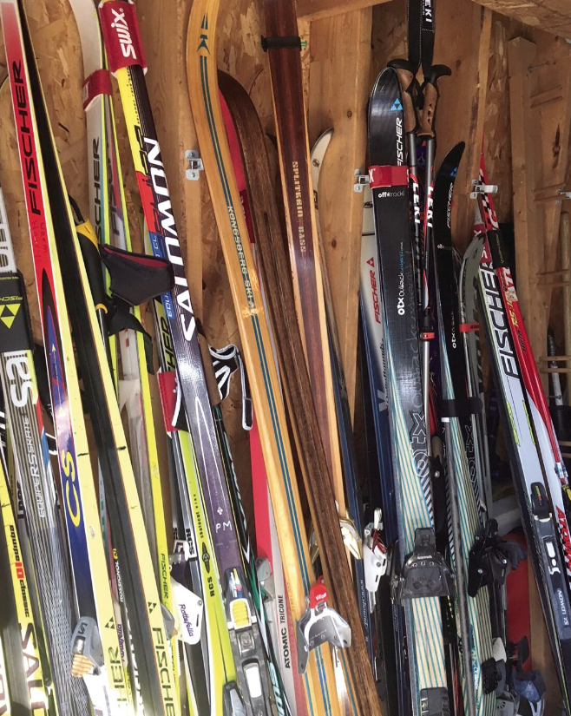
Ski types
Notes:
Different disciplines of skiing require different equipment, and just within Nordic classic there is a large spectrum from which to choose. Different skis may be more appropriate based on:
Track vs ungroomed
Ability level of skier
Snow conditions
Flexibility for exploring different types of terrain in same trip
Budget

Slide 3
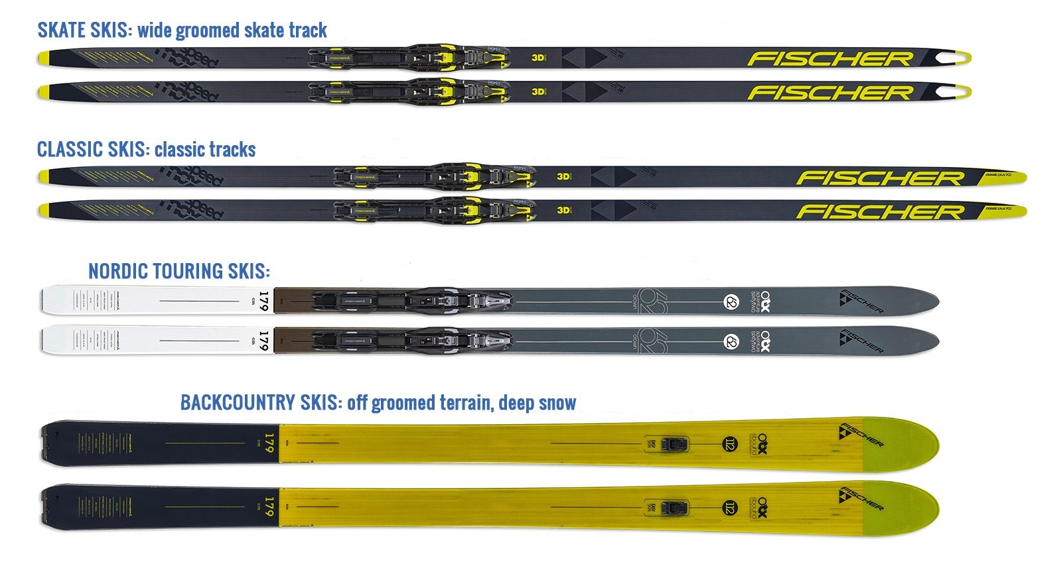
Ski types
Width (wide vs narrow)
Notes:
One of the major decisions in choosing equipment will be the width of the ski. Skinnier skis are lighter and will allow for easier and faster movement on groomed tracks, while wider skis will be better for ungroomed conditions. Note that in loose snow, even the widest Nordic skis may struggle to keep you afloat.

Slide 4
Ski types
Width (wide vs narrow)
Notes:
For this course, you should use narrow classic track skis or slightly wider classic skis, often market as "Nordic touring", "Nordic backcountry" or something similar. Skate skis and heavy backcountry skis used for telemark or alpine touring are not appropriate

Slide 5
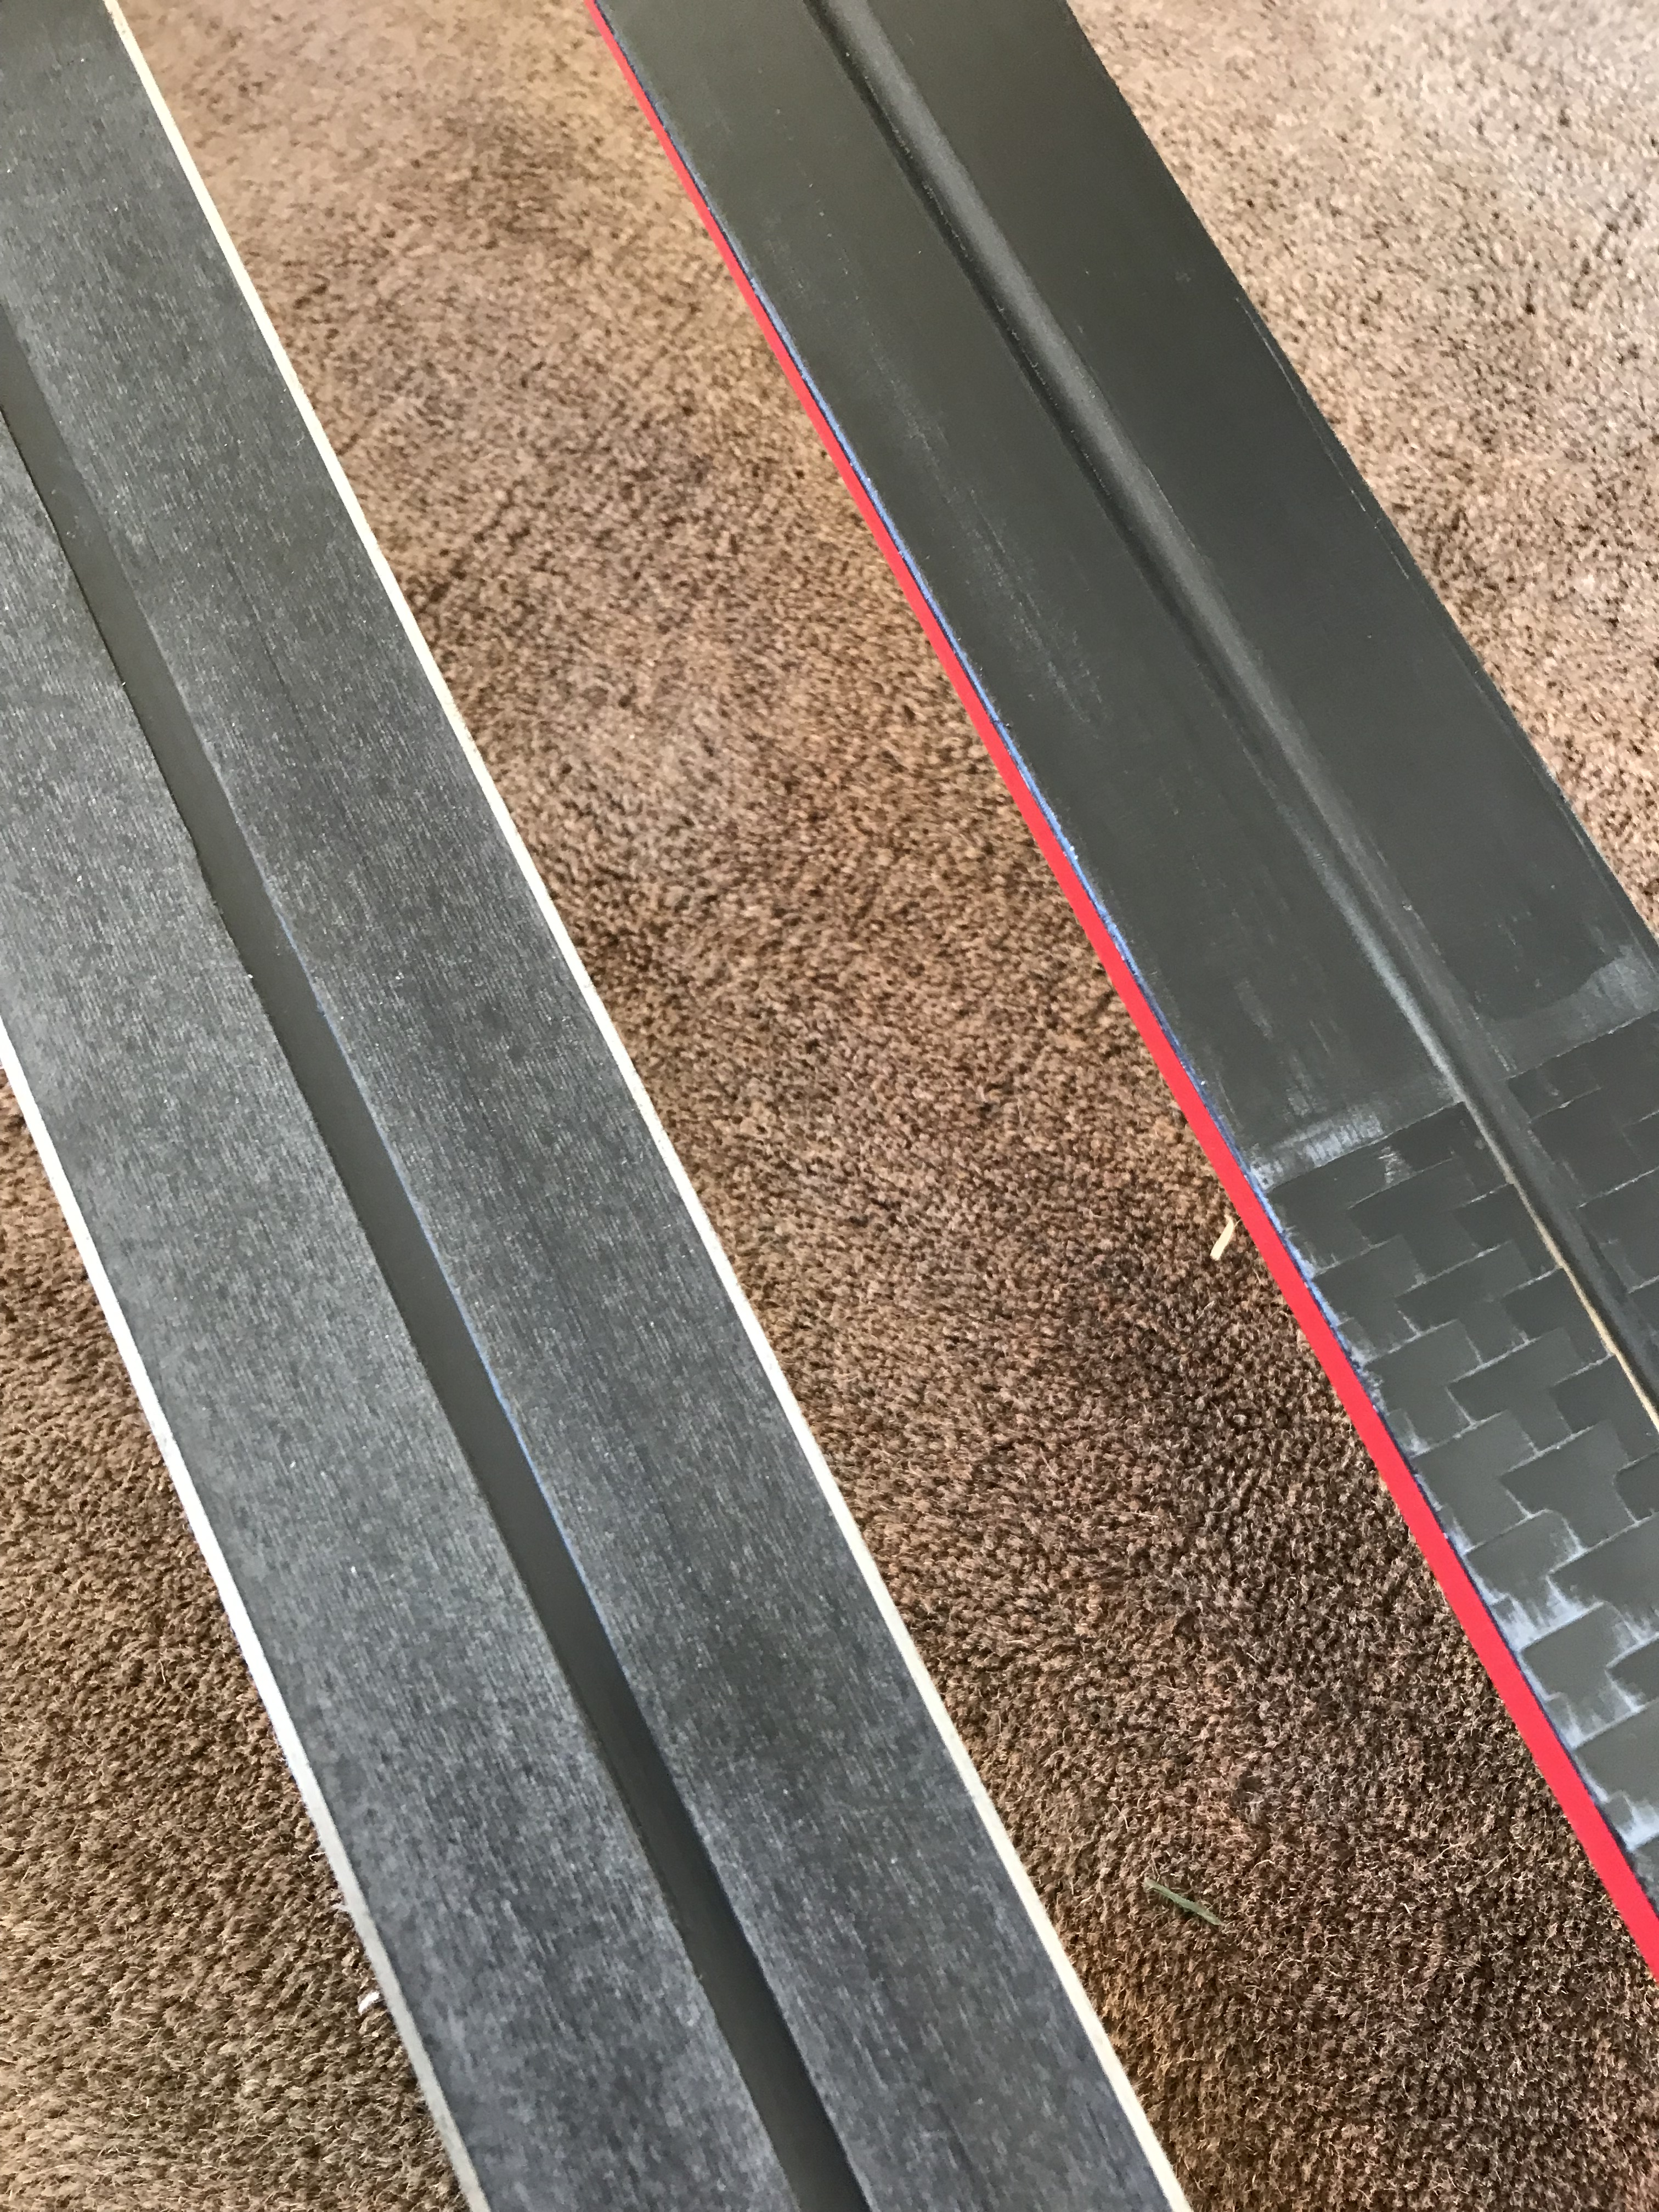
Ski types
Width (wide vs narrow)
Edges (metal vs non-metal)
Notes:
Narrow track skis do not have metal edges, but wider Nordic touring skis may. Metal edges make the skis heavier, but they may be absolutely necessary in certain icy conditions and can help on steep downhills

Slide 6
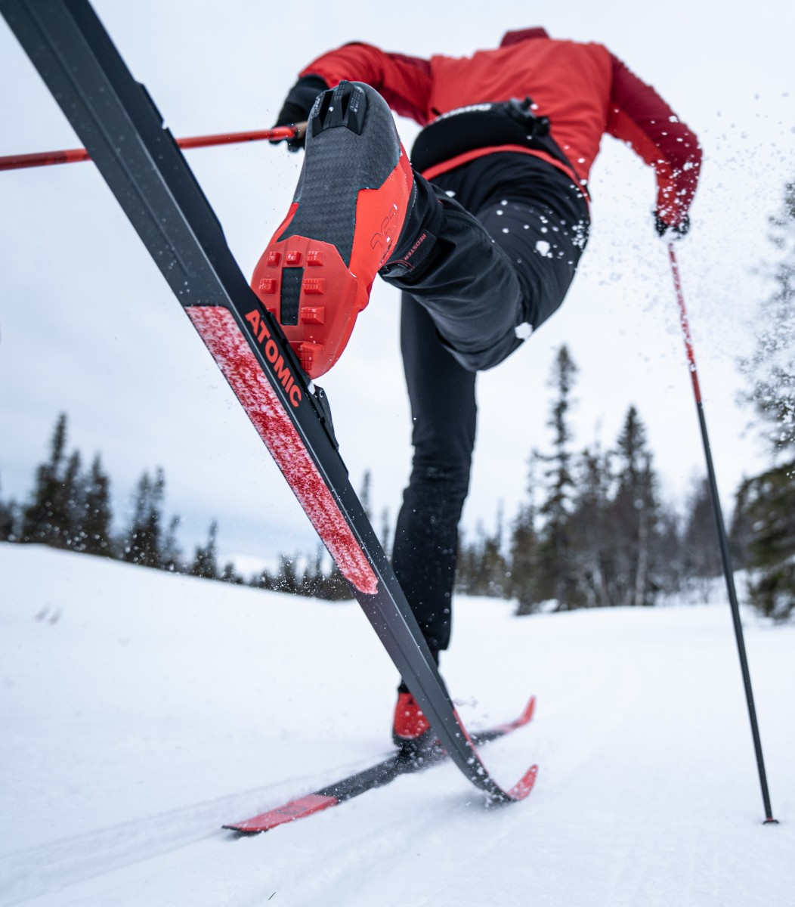
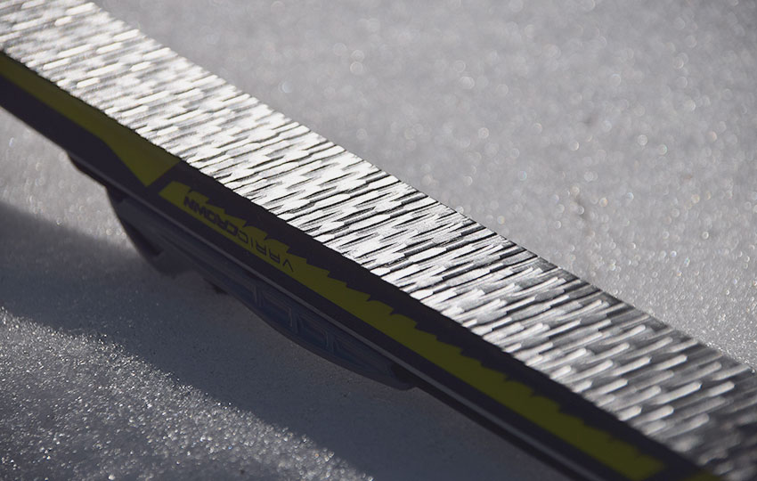
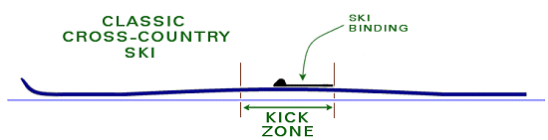
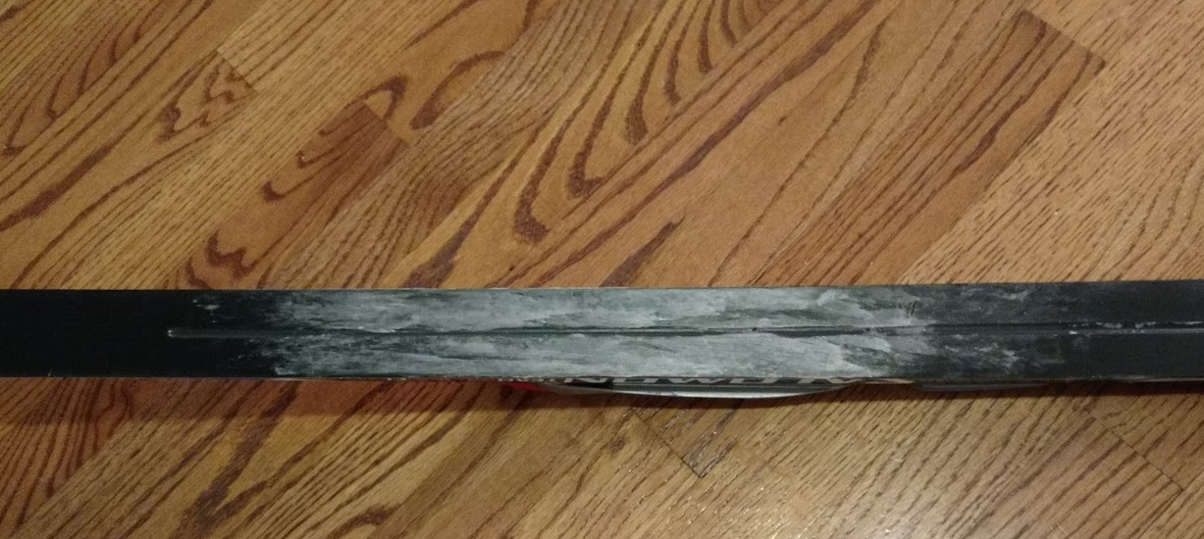
Ski types
Width (wide vs narrow)
Edges (metal vs non-metal)
Wax pocket (waxless vs skins vs waxable)
Notes:
A classic cross-country ski is bowed or "cambered", with the boot and center of the ski raised over the level of the snow. The trick in classic skiing is to apply pressure to the middle section, known as the "kick zone" or "wax pocket", to flatten it against the snow, providing the necessary friction to propel oneself forward and glide on the unweighted ski. Ski manufacturers have come up with three methods to generate the friction:
A fishscale pattern on the bottom of a waxless ski
Skins with hairs pointed in a backwards direction
Grip wax appropriate to the given snow conditions
Each of these styles is available for both track and nordic touring skis.

Slide 7
Ski types
Width (wide vs narrow)
Edges (metal vs non-metal)
Wax pocket (waxless vs skins vs waxable)
Notes:
For this course, we recommend either fishscale/waxless skis or skin skis. Choosing the appropriate grip wax for waxable skis is most difficult in temperatures hovering around freezing, which is often the case with our Pacific Northwest winters.

Slide 8
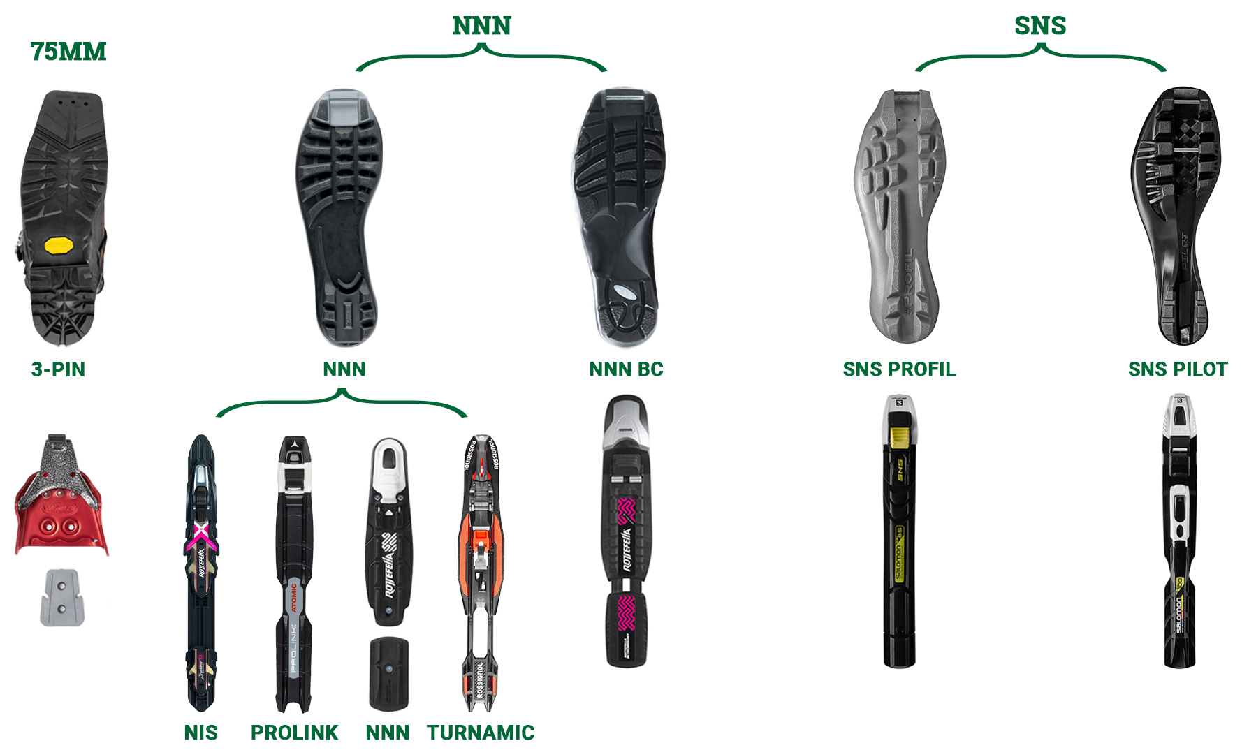
Ski types
Width (wide vs narrow)
Edges (metal vs non-metal)
Wax pocket (waxless vs skins vs waxable)
Binding (3-pin vs NNN vs NNN-BC vs SNS)
Notes:
There are several binding systems, which can lead to confusion if you are looking to buy or borrow used gear. The main key is to make sure your boots and bindings match
NNN bindings are the most common and is the standard used by most manufacturers other than Salomon and Atomic (although Salomon Prolink is compatible with NNN).
There is a separate system called NNN-BC, which uses a larger bar and is used on many Nordic touring skis
There are two additional Salomon (SNS) systems—one of which has a second bar further down the boot.

Slide 9
Ski types
Width (wide vs narrow)
Edges (metal vs non-metal)
Wax pocket (waxless vs skins vs waxable)
Binding (3-pin vs NNN vs NNN-BC vs SNS)
Notes:
If you are buying new, we recommend you opt for NNN or NNN-BC due to the better availability of compatible boot options.

Slide 10
Ski types
Width (wide vs narrow)
Edges (metal vs non-metal)
Wax pocket (waxless vs skins vs waxable)
Binding (3-pin vs NNN vs NNN-BC vs SNS)
Racing vs general usage skis
Notes:
One final note regarding ski selection that is most relevant for waxable skis, but may also apply to some manufacturers' skin ski models. Each ski manufacturer has a range of models at various price ranges. The most expensive skis will be geared towards racing and, and these will be narrower with a smaller kick zone and stiffer flex. These require advanced technique and often a higher rate of speed to be used effectively. As a beginning skier, you will be better off with a less expensive model that sports a more relaxed flex.

Slide 11
Ski Length
Importance of wax pocket/flex
Notes:
Now that you've chosen the model of ski you want to buy, you'll want to know which length to get. If you are buying new, you should buy from a shop that specializes in cross country skis (such as Winthrop Mountain Sports or Webcyclery/Webskis in Bend), where you can rely on the salesperson to help you size correctly. If you are buying used, here are some general principles to consider:
The most important aspect in the choice of ski will be matching the flex of the ski to the weight of the skier. If you have a too stiff ski, it will be difficult to exert enough pressure to get traction and generate kick. If you have a too relaxed ski, you won't glide and will expend extra energy for any given distance.
In general, a longer ski allows for a heavier skier, but stiffness can also vary from ski to ski within the same model and length. A knowledgeable salesperson which check the exact pair of ski you are purchasing to ensure proper fit.

Slide 12
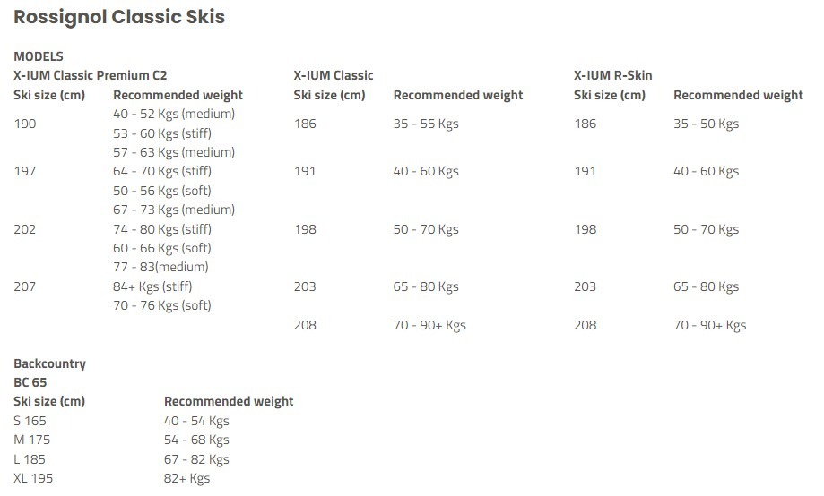
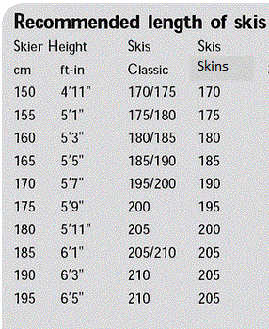
Ski Length
Importance of wax pocket/flex
General sizing guidance
Notes:
That said, there are some general principles you can reference to put you in the right range based on skiers height and weight. Here are some examples based on height and weight from Madshus and Rossignol. You can try to find other manufacturers' recommendations online. If the tables you are referencing point towards different size recommendations based on height vs weight, weight is more important. If caught between sizes, the shorter ski will be more maneuverable and probably a better choice for a beginner.

Slide 13
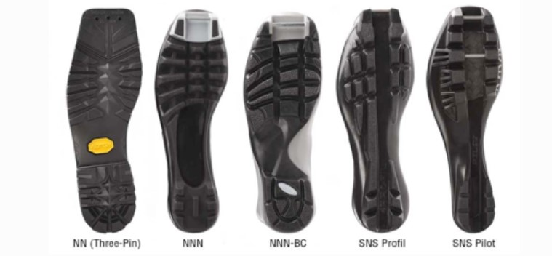
Boots
Notes:
The most important aspect in boot selection is matching your boots to your bindings. As discussed earlier, the various standards can be confusing, so confirm before purchasing or showing up at Kahler Glen with mismatched gear.

Slide 14
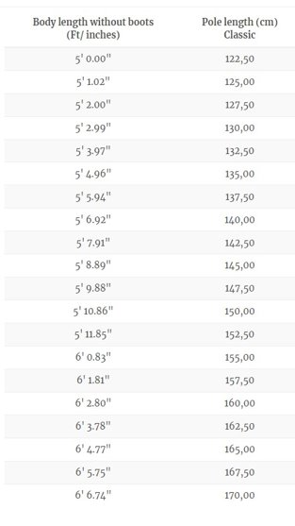
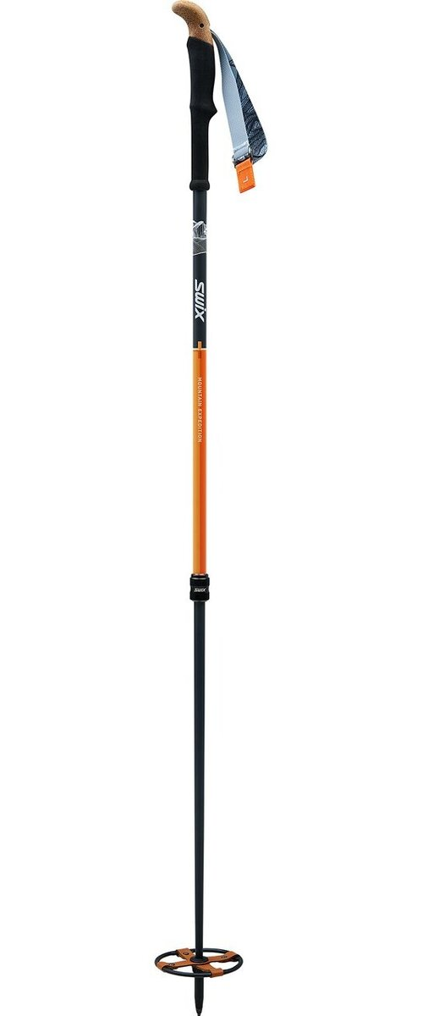
Poles
Length
  Track skiing: ~30cm shorter than skier height (typically in 5cm increments)
  Ungroomed: adjustable w/ large basket
Notes:
For track skiing choose a pole 30cm shorter than your height. This is much simpler than using other recommendations, such as "top of the strap reaching the armpit" e.g. The lighter and stiffer the pole, the easier poling will be.
For ungroomed skiing, you will want a shorter pole with larger basket. Often it is advantageous to have an adjustable length pole, as you will sink into the snow to different depths based on snow conditions.

Slide 15
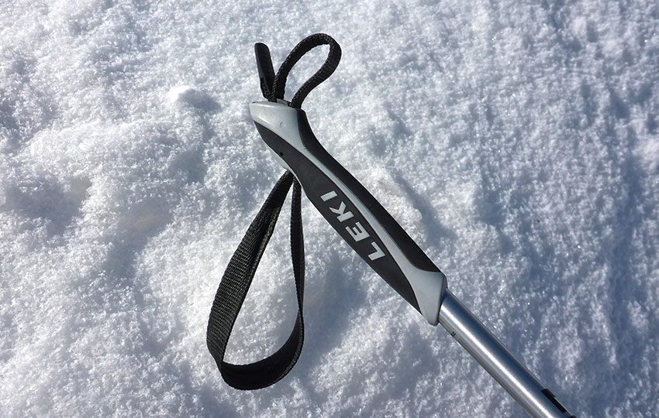
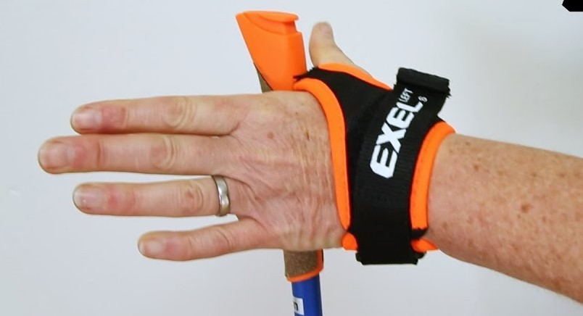
Poles
Length
Strap styles
Notes:
Pole straps come in two styles: a simple loop and one with velcro. Either will work for classic skiing

Slide 16
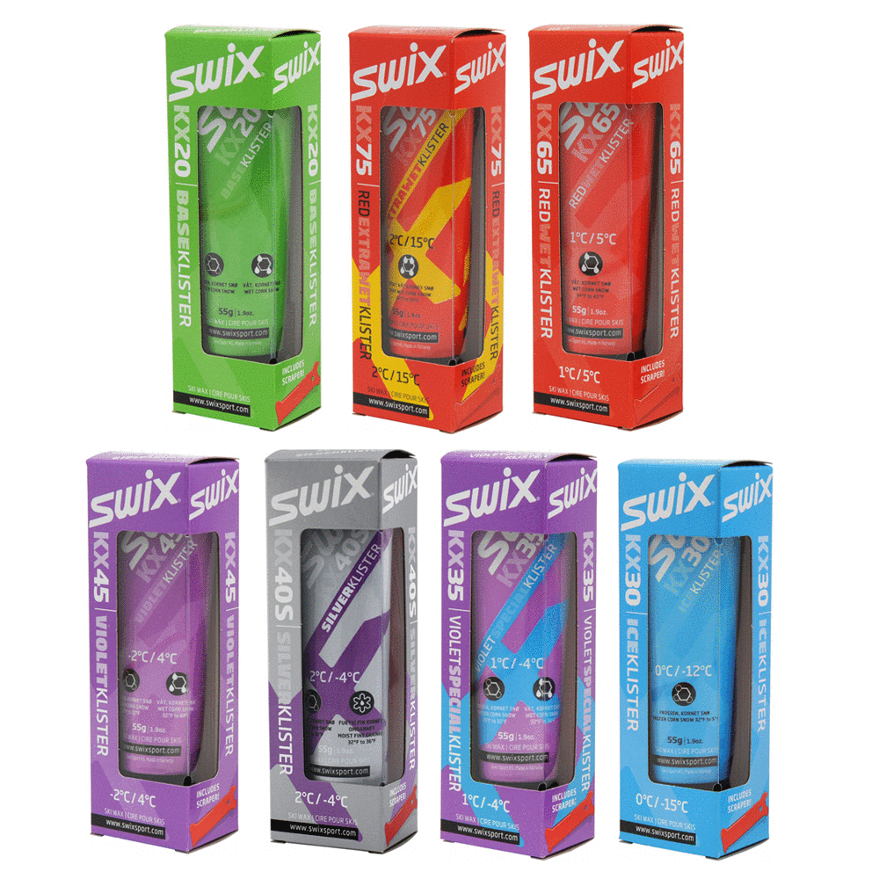
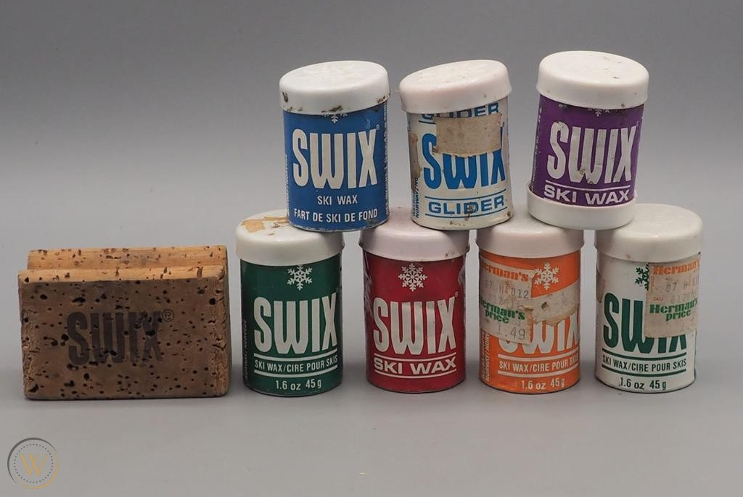
Waxing
Grip wax
Notes:
"Waxless" skis do not mean no wax. "Waxless" only refers to the kick zone, and means you can do without grip wax and klister

Slide 17
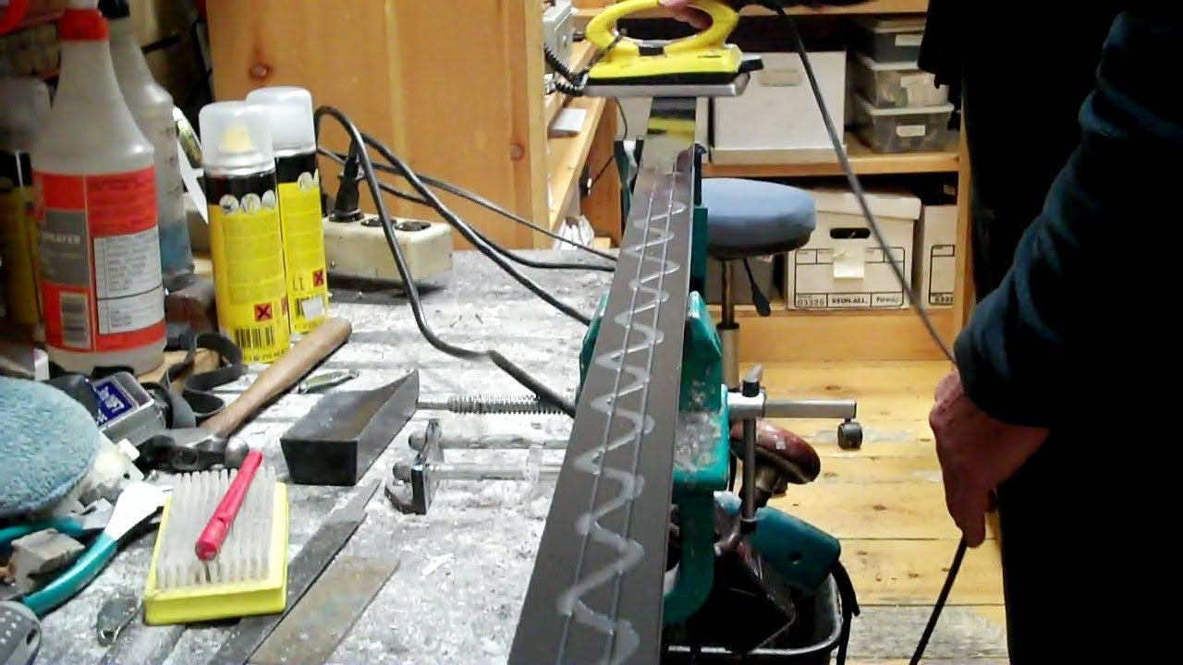
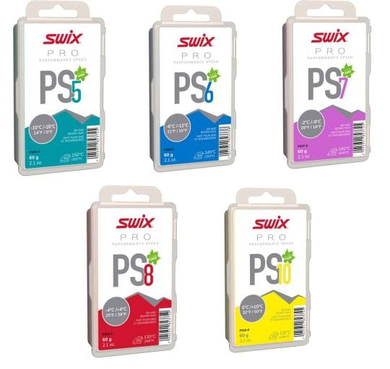
Waxing
Grip wax
Glide wax (hot)
Notes:
All skis, waxless and otherwise, will benefit from using glide wax. You will use less energy per given distance with skis waxed with proper glide wax. For simplicity, you can wax with a hard, cold wax such as Swix blue only a couple of times a season and see better, longer lasting performance than with a universal or warmer wax, even during warmer temperatures.

Slide 18
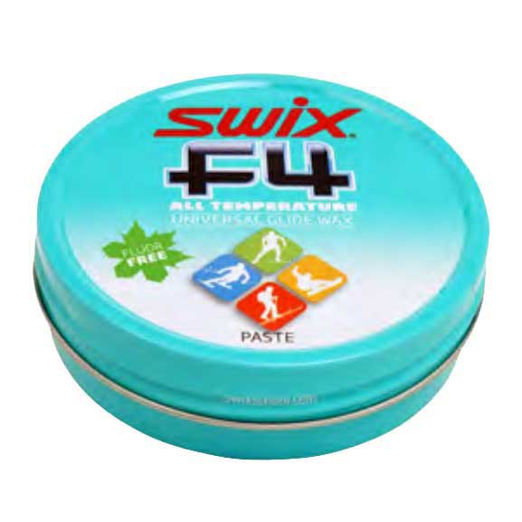
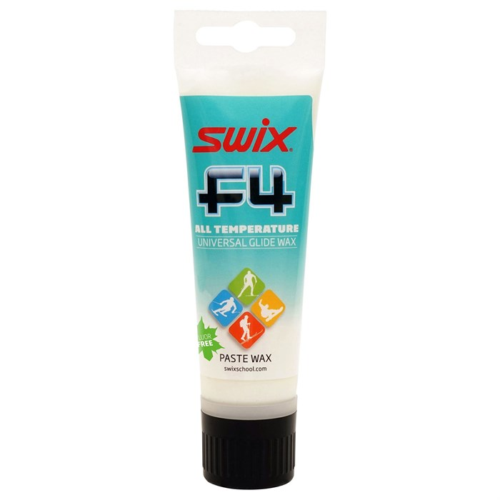
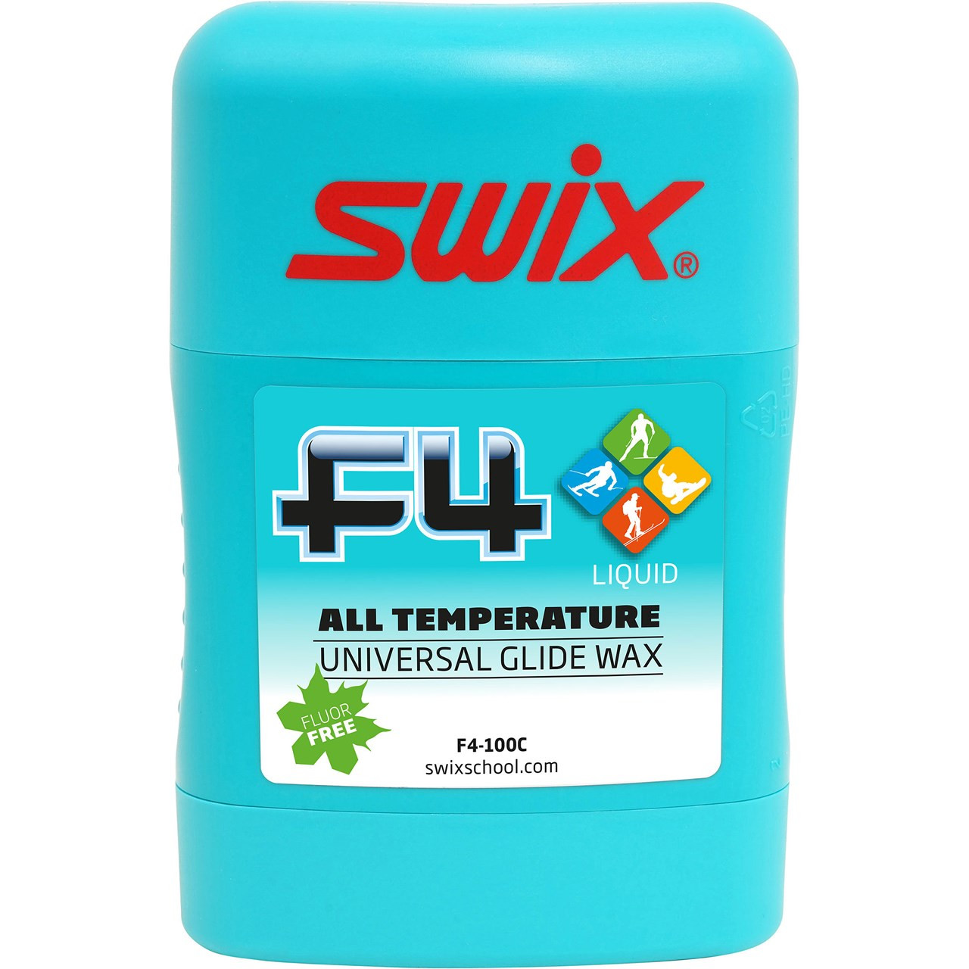
Waxing
Grip wax
Glide wax (hot)
Glide wax (liquid & paste)
Notes:
A simpler option is to use a liquid or paste glide wax. You won't see the same performance or longevity as with a hot wax, but it is better than neglecting your glide zones completely. You can also use these products in the fishscale pattern to avoid the dreaded...

Slide 19
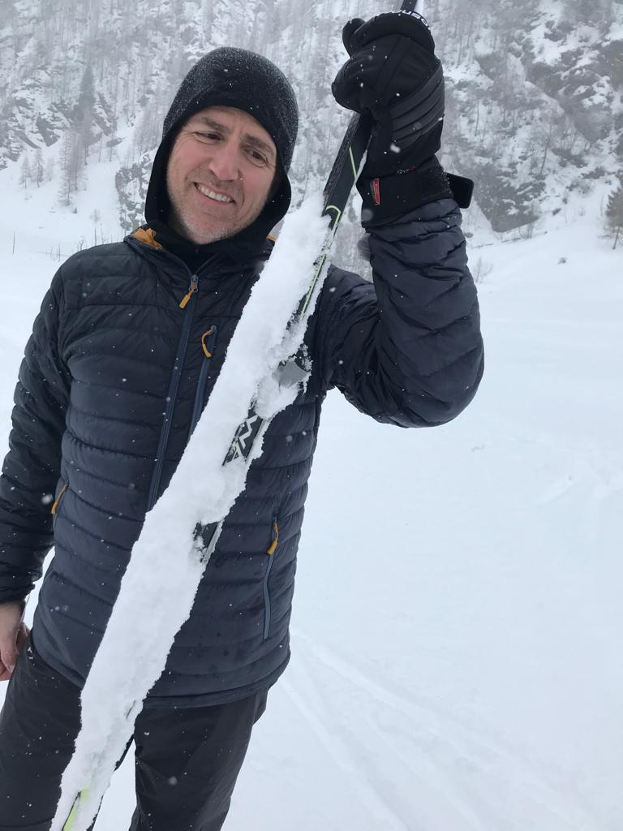
Waxing
Grip wax
Glide wax (hot)
Glide wax (liquid & paste)
Glop
Notes:
Glop! This is the dreaded experience of getting a cake of snow formed under your ski when you travel from wet to drier snow conditions. This can often happen as new snow is falling at around freezing level, or if you are traveling up a hill from warmer to cooler temperatures. The skis become unstable to walk on and offer zero glide

Slide 20
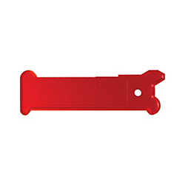
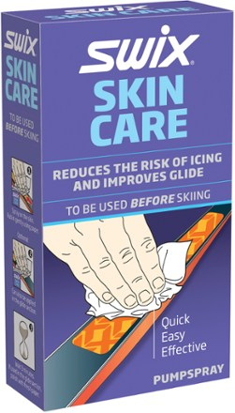
Waxing
Grip wax
Glide wax (hot)
Glide wax (liquid & paste)
Glop
Notes:
We recommend carrying a scraper to remove the chunks of snow and ice, and some liquid glider or skin treatment depending on your style of skis.

Slide 21
Mountaineers
Nordic (Cross-country) Ski Course - Everett - 2022
Equipment Overview

