Slide 1
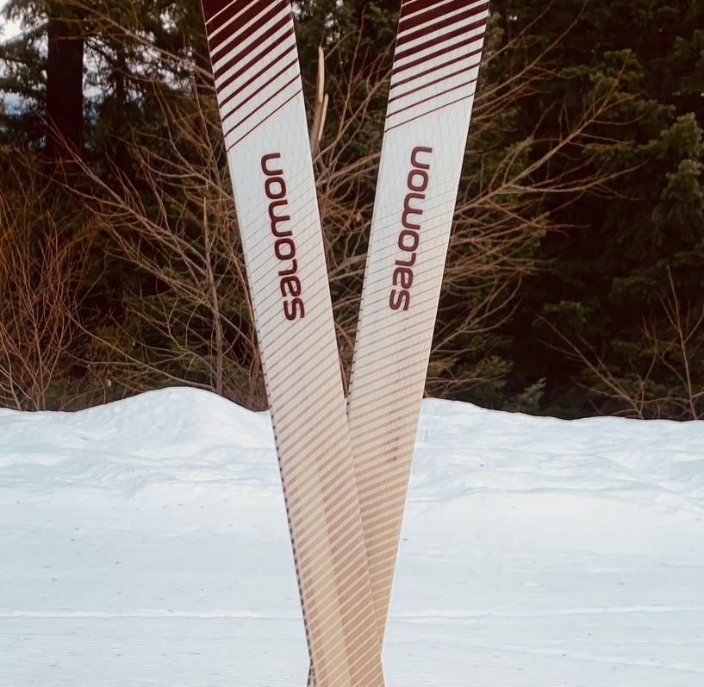
Field Trip Information

Slide 2
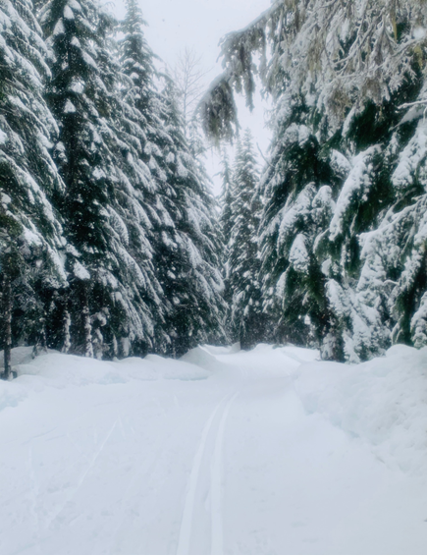
Be Prepared to Ski
Arrival times are:
Kahler Glen: 9:00 AM
Stevens Pass: 9:00 AM
Crystal Springs: 9:00 AM
If you can’t make it,
please text
Leilani 206-407-7750
Rachel 206-890-8881

Slide 3
What to Bring on Field trips:
Required equipment for all Field Trips:
Name tag and ski booklet (given to you at lecture)
Ten essentials (most of list)
Lunch (We will be eating on the trail.)
Water
Snacks
Warm clothes for breaks
Money for carpool driver and to share in Sno-Park fees
Recommended to improve comfort:
In your pack
Rain gear
Ski wax, Maxiglide or similar product
In your car
Change of clothes
Money for dinner
Extra water and food

Slide 4
Special notes for field trips vs a ski trip
Extra gloves
Warmer clothes for morning (more standing)
Everything should fit in your pack when you take off your warmer layers
Extra snacks (you will eat more than you think)
Insulate water bladder or use water bottles inside your pack

Slide 5
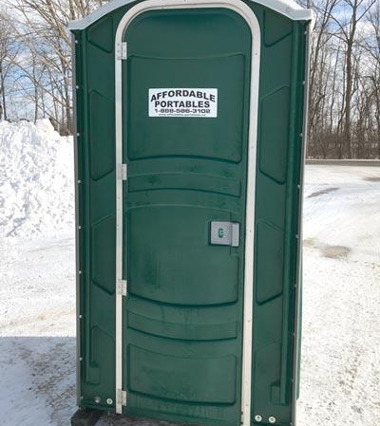
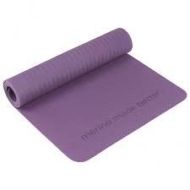
A couple of reminders
Porta Potties ☹
BYOTP and Hand Sanitizer
No Indoor Seating
Bring your sit pad, sleeping pad, an old yoga pad, etc…

Slide 6
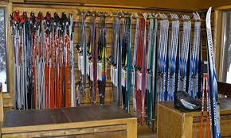
The challenges of renting…
Reserve in advance. Supply doesn’t always meet demand.
If you’re going to Kahler Glen, Erling Stordahl, and Gold Creek. Rent your gear the Friday before.
Check to make sure poles are the right size.
You can rent gear at Stevens Pass, get there with enough time to get sized and rent your gear.

Slide 7
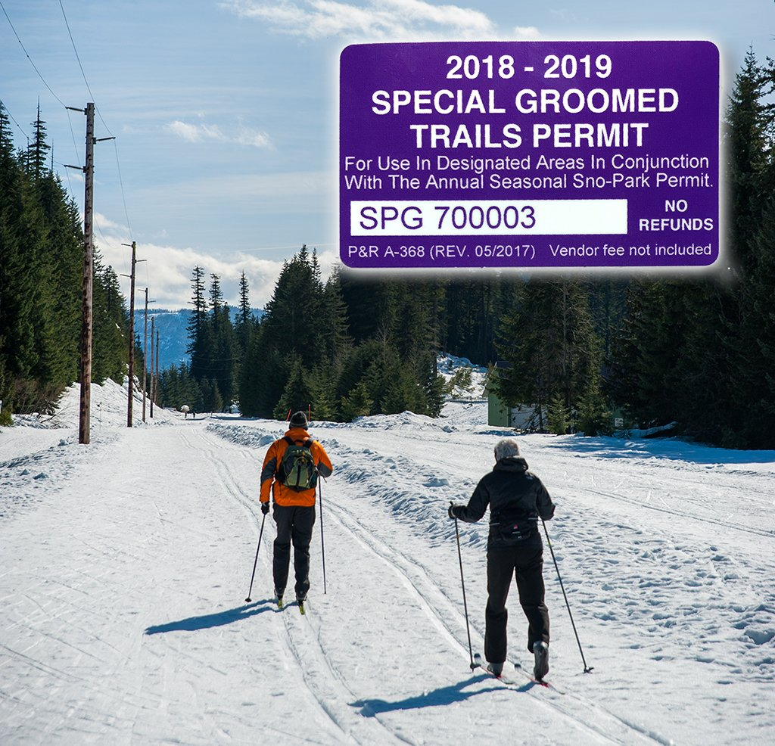
Parking and Trail Passes
Permit Type | Purchased from State Parks | Purchased from Retail Vendor | Purchased Online
One-Day | $25 | $27 | $25
Seasonal | $50 | $52 | $50
Special-G Groomed Trail Seasonal & Groomed $120 | $70 | $72 | $70

Slide 8
Leaders are expected to send participants home if they:
Do not have adequate personal gear for the activity.
Are refusing to comply with Mountaineers policies

Slide 9
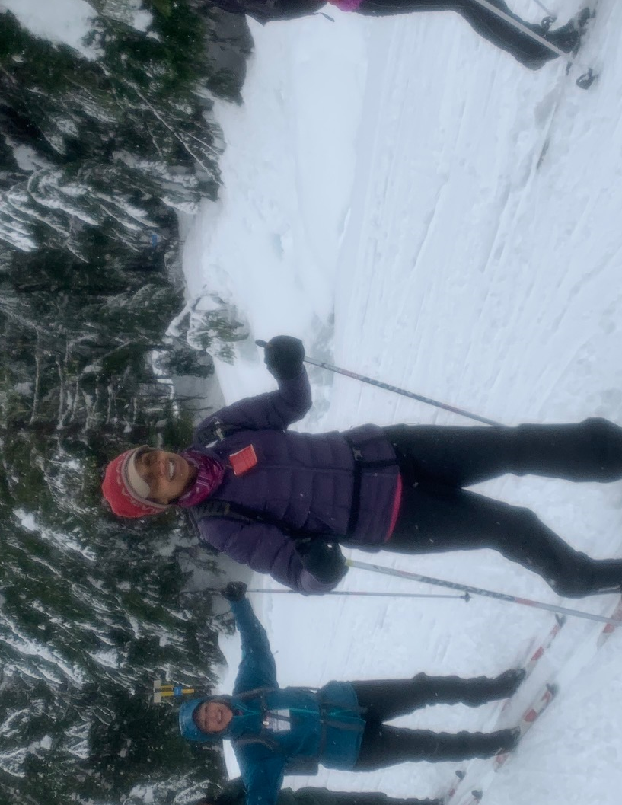
Questions?

