Slide 1
Welcome to Everett
Cross Country Ski Class
Please rename your self with your first and last name. You may also add your pronouns if you with.
Notes:
Quick welcome by Rachel

Slide 2
Welcome to Everett
Cross Country Ski Class
Course Coordinator:
Rachel Shafer 206-890-8881
Notes:
Quick welcome by Rachel

Slide 3
Lecture Coordinator: Stacey Sambrook
Notes:
Rachel Introduces Stacey

Slide 4
Mission:
Inspire people of all ages and abilities to learn, develop, and grow in the sport of cross country skiing.
Provide opportunities for beginners to advanced skiers to engage in exhilarating and health-promoting fun for while experiencing the natural beauty of the outdoors.
Notes:
Stacey talks

Slide 5
Who Are We?
Volunteers who love to share and have fun
Passionate about building a supportive, welcoming ski community
Notes:
Stacey talks

Slide 6
Your Responsibilities:
Come prepared for learning
Ask questions (no silly questions)
Speak up if you are uncomfortable
  Cold, hungry, tired, confused, etc.
Be safe
Have FUN!!
Notes:
Stacey talks

Slide 7
Introductions:
Please have camera on for introductions
Name
Experience skiing
Reason for taking class
Something fun about you (or not so fun)
Notes:
Stacey talks

Slide 8
Graduation Requirements:
Attend lecture and 3 field trips
1 club ski trip
Low Impact Recreation Course
Avalanche Awareness Course
Notes:
Rachel talks

Slide 9
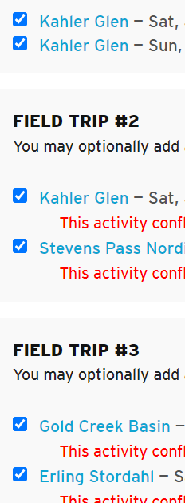

Manage Registration:
Notes:
Rachel talks

Slide 10
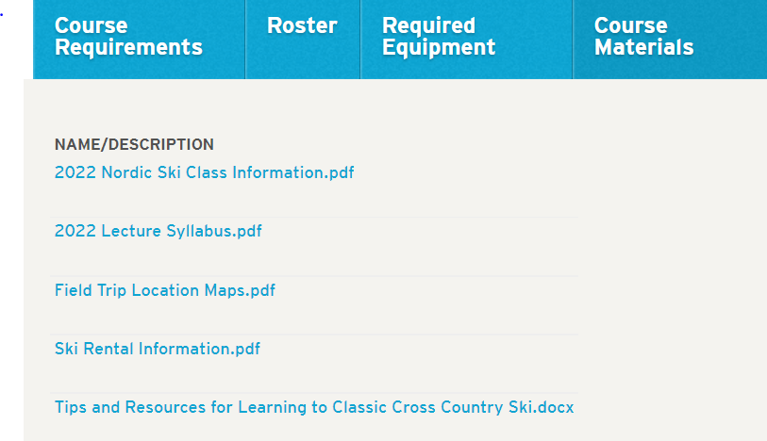
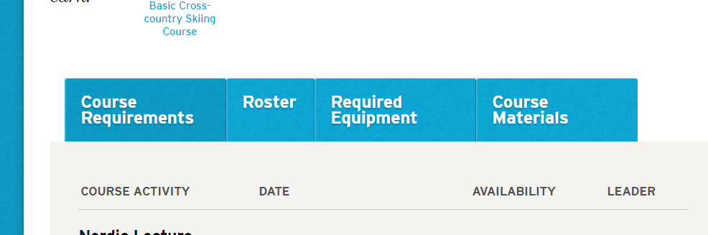
Course Materials:
Notes:
Rachel talks

Slide 11
Presentations:
Format:
Approximately 30 minutes per presentation
Questions:
  Put questions in chat
  Will be answered at end of presentation
Lectures will be posted under “course materials”
Notes:
Stacey talks

Slide 12
Clothing and More Presentation:
Presenters:
Beth Crispin
Chris Opie
Rin Stone
Notes:
Stacey introduces the presentation
Switch to Beth, Chris and Rin’s presentation media

Slide 13

CLOTHING, 10 ESSENTIALS & HYPOTHERMIA
EVERETT CROSS COUNTRY SKI COURSE – JANUARY 2021
RIN STONE, BETH CRISPIN, CHRIS OPIE

Slide 14
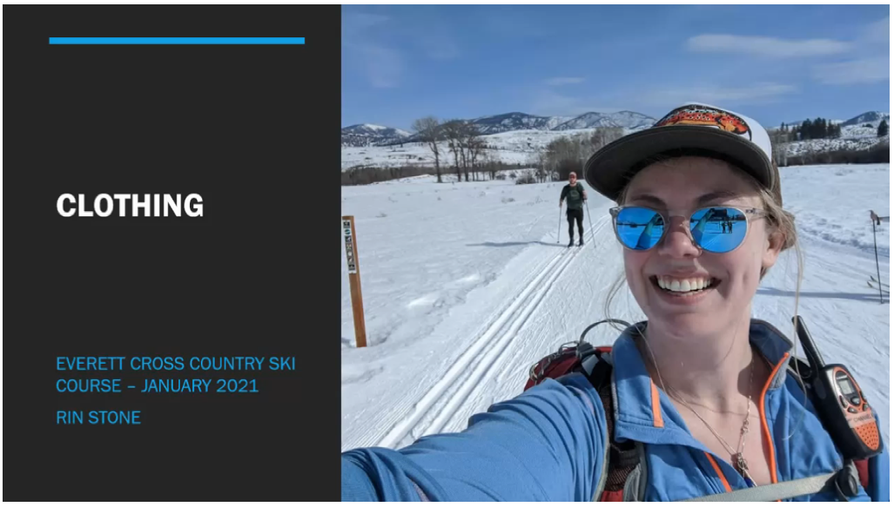

Slide 15


Slide 16


Slide 17
Clothing: https://www.youtube.com/watch?v=CsBLy86dcpo
10 Essentials: https://youtu.be/gH4FxmgqZEo
Hypothermia: https://youtu.be/YW2J9WleAM0

Slide 18

Clothing and More Lecture:
Notes:
Stacey moderates questions

Slide 19
Skis, Boots, Poles:
Presenter:
Erik Tuvey
Notes:
Switch to Richard, Kevin, Shyam’s media

Slide 20
Skis, Boots, Poles:
Notes:
Stacey moderates

Slide 21
Field Trip Coordinator: Leilani Cramer
Field Trip Information
Covid Protocol
Skill Surveys
Parking and Trail Passes
Rental Information
Communication Plan
Notes:
Rachel introduces leilani
(leilani decides if to add her slides her or make her own slidedeck)

Slide 22
Field Trips:

Slide 23
Signing up for Ski Trips:

