Slide 1
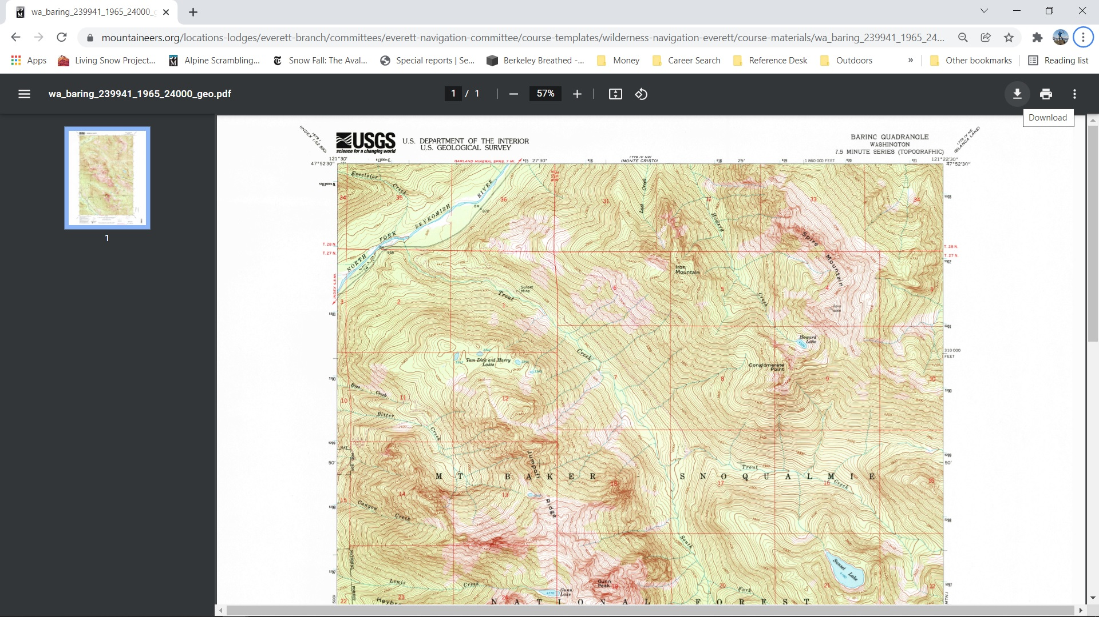
Clicking the WA_Baring_239941_1965_24000_geo.pdf link in Course Material should produce this.
(I’m using the Google Chrome browser: Version 97.0.4692.99 (Official Build) (64-bit))
Click Download.

Slide 2
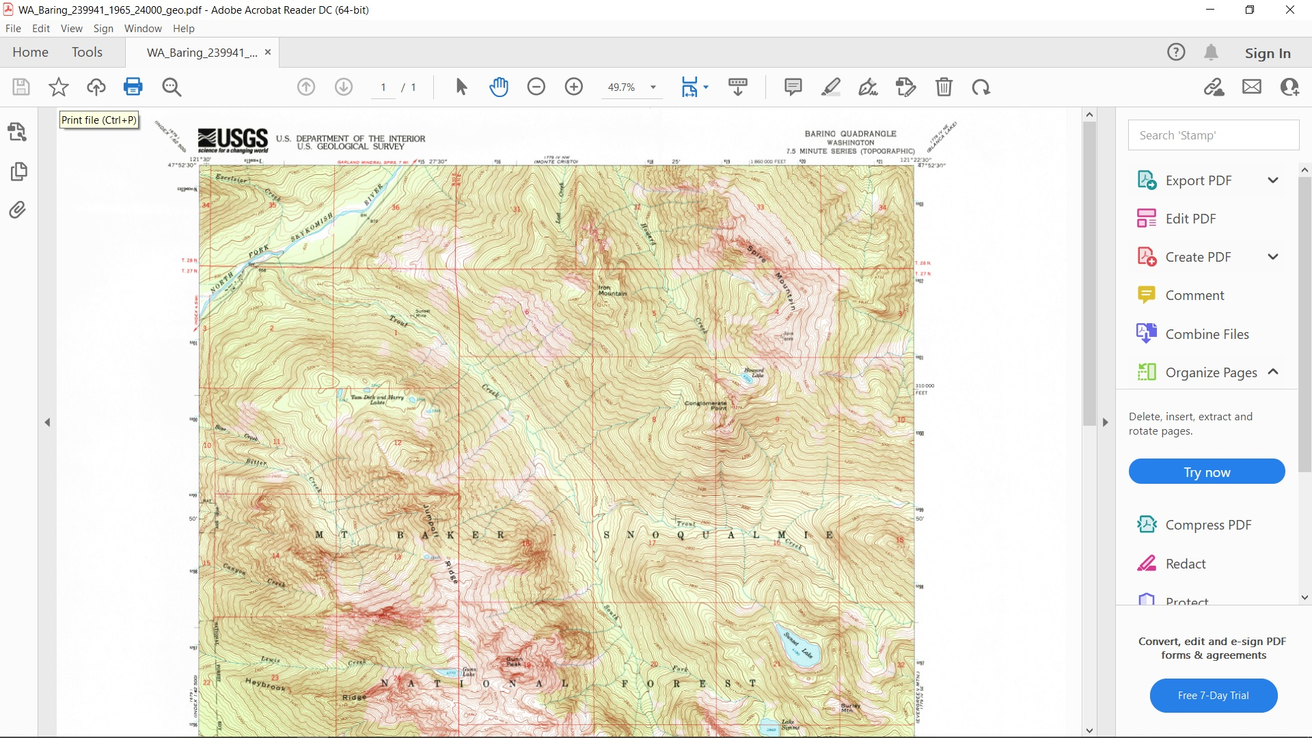
Opening the downloaded file should show something like this.
(I’m using Adobe Acrobat Reader DC: Version 2021.011.20039|64-bit)
Click the Printer button.

Slide 3
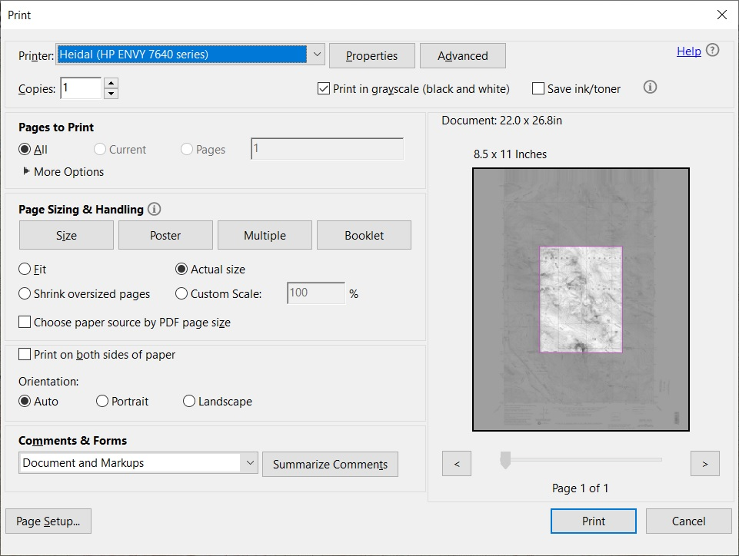
The print options page should look something like this.
(I’m using an HP ENVY 7640 series printer)
Note that it is set to “Print in grayscale (black and white)”. Click there to unselect it.

Slide 4
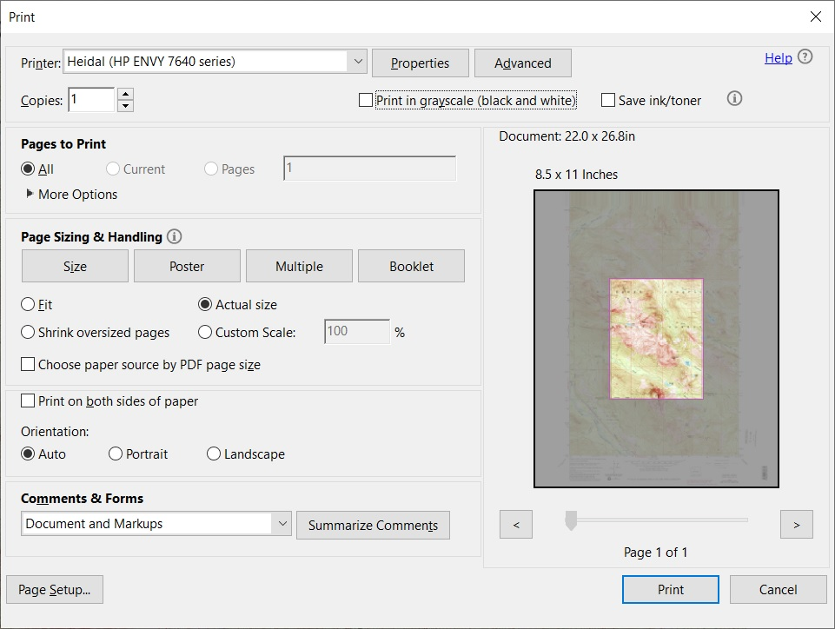
Note it has Document: 20.0 x 26.8in. But the paper we have is 8.5 x 11 inches.
We are going to print in Actual size.

Slide 5
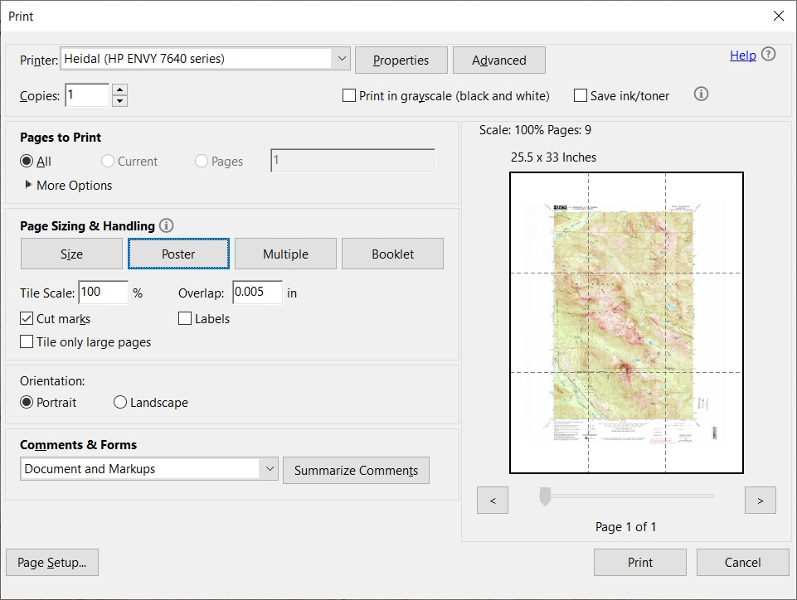
We now select Poster. Note the Overlap:0.005 in.
Either cut this off or it must be folded and aligned correctly before taping the 9 pages together.
Finally click Print.

