Slide 1

Ten Essentials
A Functionable System Approach
Everett Mountaineers
Scrambling Course 2019

Slide 2
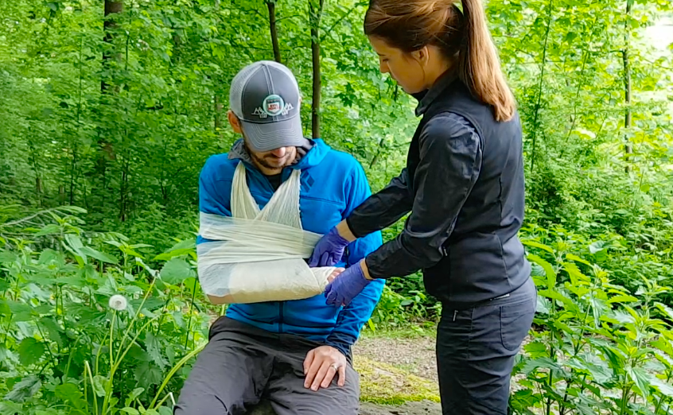
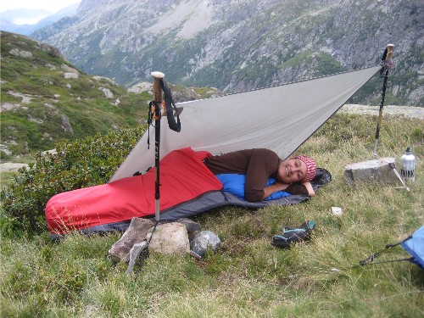

Purpose of the Ten Essential List
Can you prevent emergencies and respond positively should one occur?
Can you safely spend a night or longer outdoors?

Slide 3
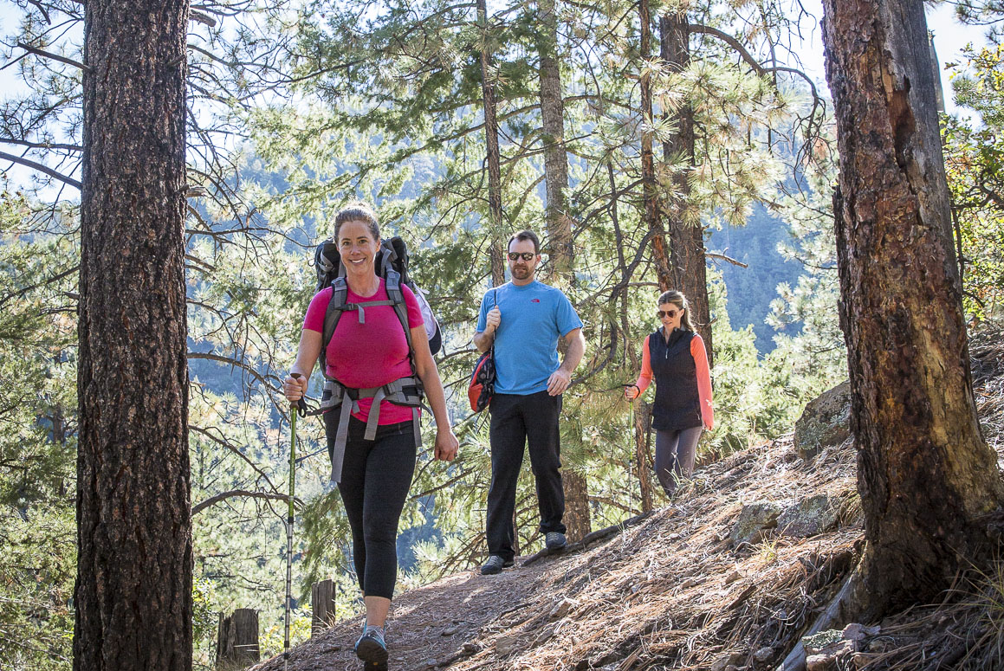
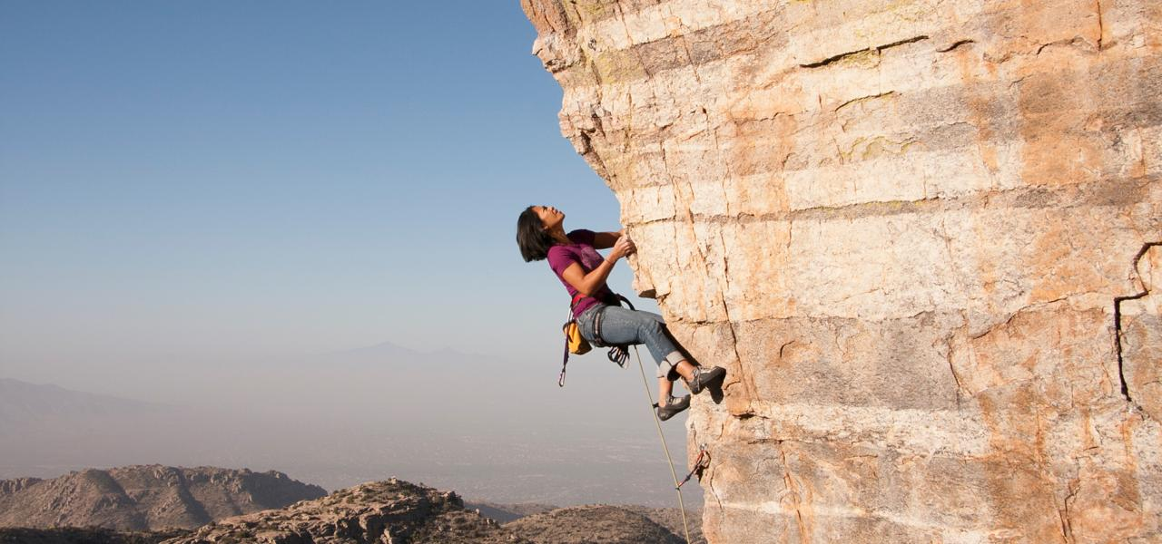
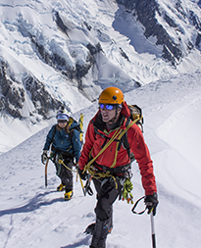
What are the Ten Essentials?
Guideline of functional systems
Not an exact list
Should be tailored to the nature of your hike, season and conditions
Notes:
a widely-accepted concept for being prepared.
carry much more importance for scrambling & off-trail travel, compared to day-hiking
probably need to re-examine & adhere to the list with more scrutiny now

Slide 4
The Ten Essentials
To prevent emergencies and respond positively should one occur
To safely spend a night or longer outdoors
Navigation
Headlamp
Sun Protection
First Aid Supplies
Knife and Repair Kit
Fire
Shelter
Extra Food
Extra Water
Extra Clothing

Slide 5
Evolution of the Ten Essentials
Evolved from a list of individual items…
To a list of functional systems that satisfy certain needs.
What you bring is for you only and to answer the two key questions.
Can you prevent emergencies and respond positively should one occur?
Can you safely spend a night or longer outdoors?

Slide 6
 | Freedom of the Hills, 9th ed/ REI | FOH 8th / WTA | Classic
 | To prevent emergencies and respond positively should one occur
1 | Navigation | Navigation | Map (1) Compass (2)
2 | Headlamp | Illumination | Headlamp/Flashlight (3)
3 | Sun Protection | Sun Protection | Sunglasses/Sunscreen (4)
4 | First Aid Supplies | First Aid Supplies | First Aid Supplies (5)
5 | Knife | Repair Kit and Tools | Knife (6)
 | To safely spend a night or more outside
6 | Fire | Firestarter | Firestarter(7) Matches(8)
7 | Shelter | Emergency Shelter
8 | Extra Food | Nutrition (extra) | Extra Food (9)
9 | Extra Water | Hydration (extra)
10 | Extra Clothing | Insulation/Rain Gear (extra) | Extra Clothing (10)
Notes:
List may have changed over the years but basic concept has not
This illustrates the changes

Slide 7
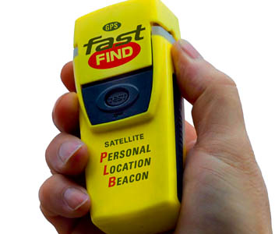
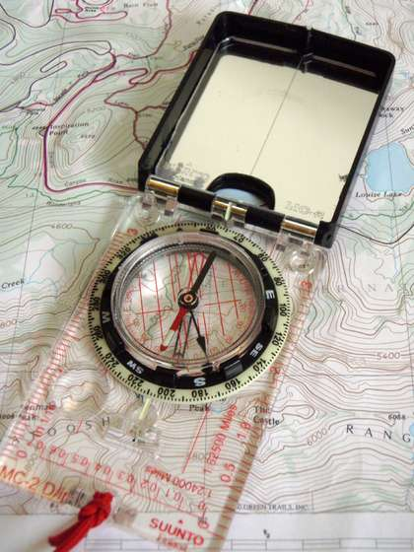
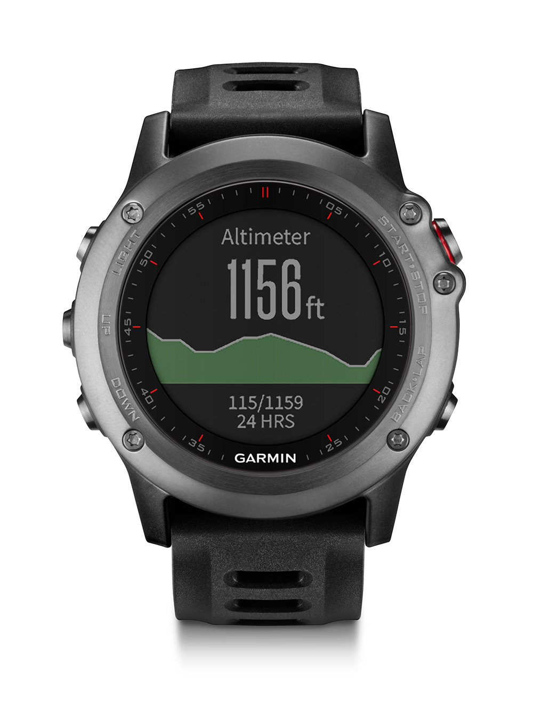

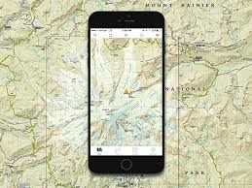
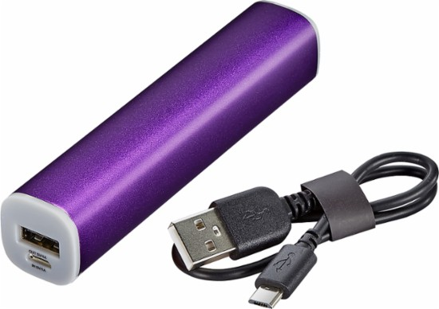
Navigation
Know how to use a compass
Map
Altimeter
Compass
GPS
Personal Locator Beacon (PLB)
Notes:
Map in Ziploc bag or covered in packing tape both sides
altimeter better for locating when dark or cloudy, phones lose power, watches getting cheaper
compass with mirror
gpps can be phone, bring extra battery power, reg phone no work off grid
PLB is more nec for very off grid scrambles and only one per party
In general, map and compass is sufficient for group simple scrables
But everyone can carry a smartphone with gaia (free to mountaineers)

Slide 8
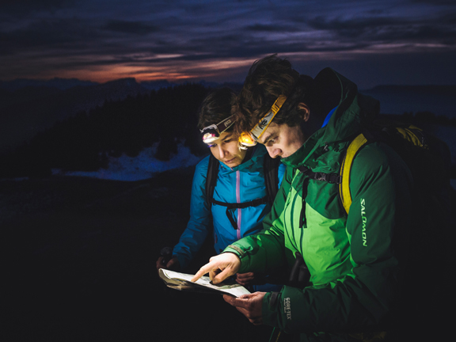
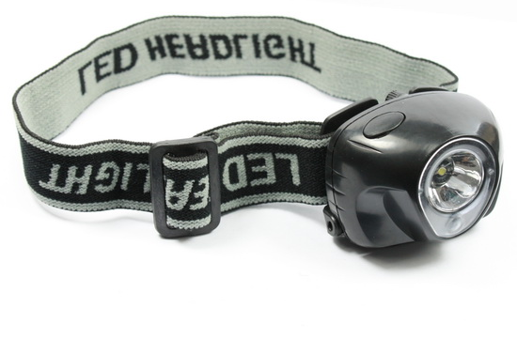
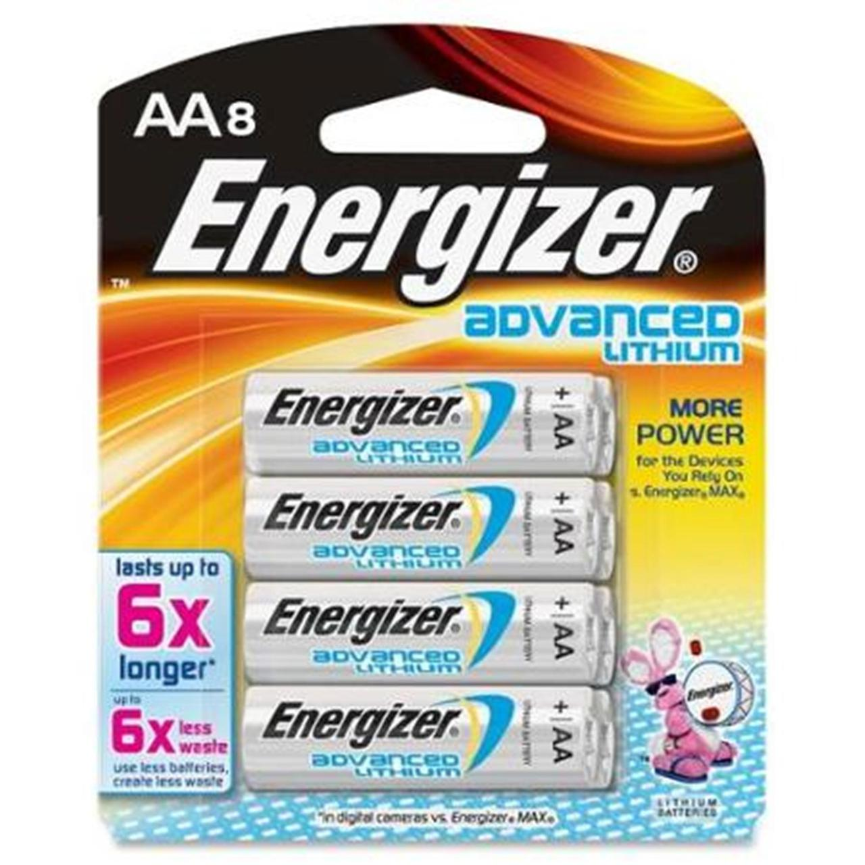
Headlamp
Headlamp
Extra lithium batteries
Keep all electronics warm
Notes:
Waterproof
lithium batteries
store in warm place
sleep with all electronics
For scrambling, many hikes begin before dawn and end after dark

Slide 9
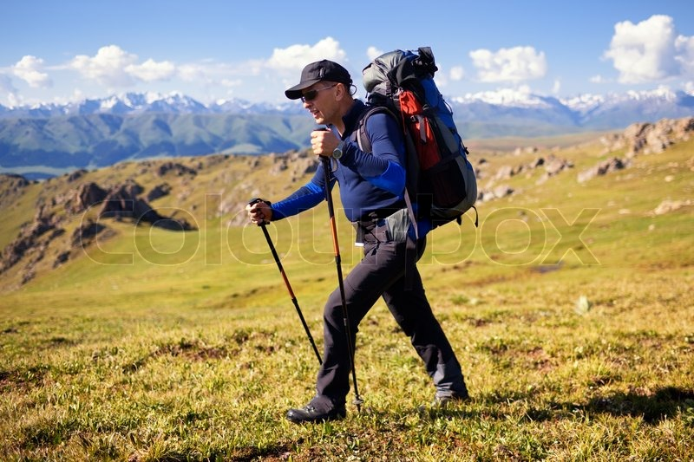
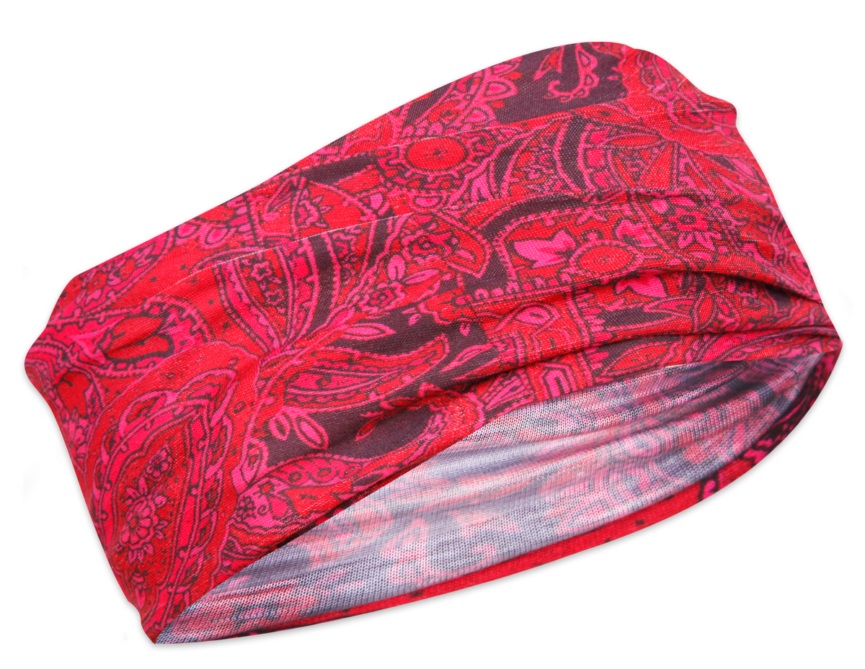
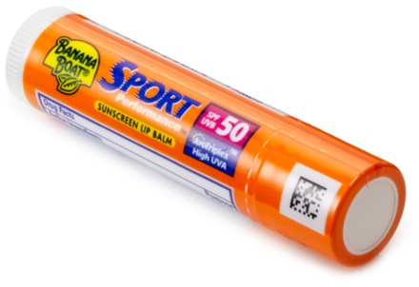
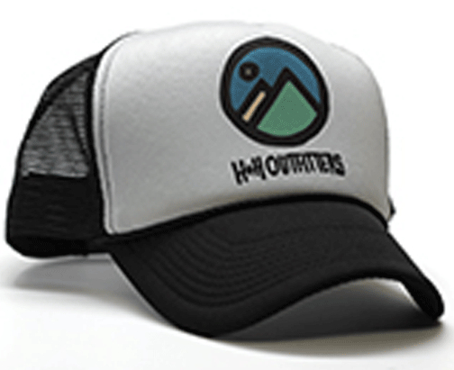
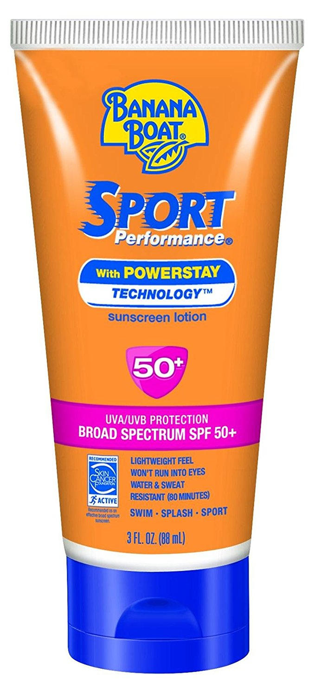
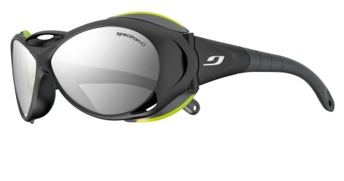
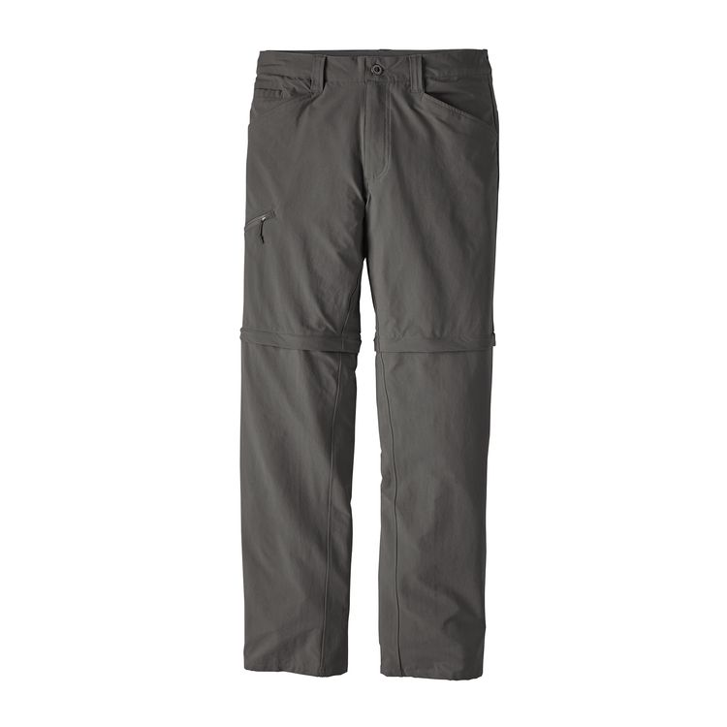
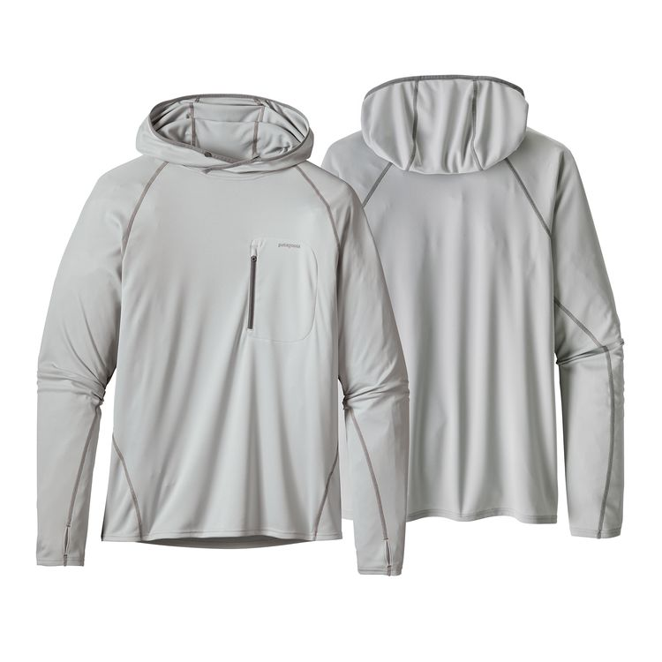
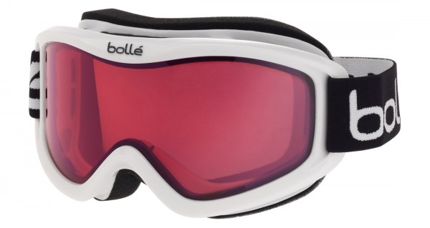
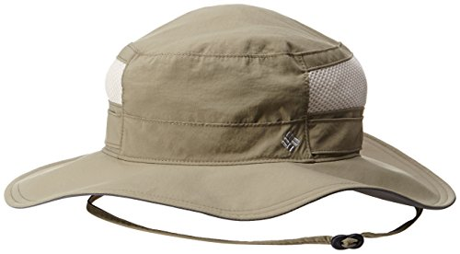
Sun Protection
Sunglasses, wrapping
Sunscreen
Lip Balm
Clothing
Hat
Notes:
Snow blindness is real, exp on Kili, even in clouds,
slop on sunscreen and lip protection,
clothing is first line of defense, zip off pants, ls hooded sunshirt, bandana or buff for neck

Slide 10
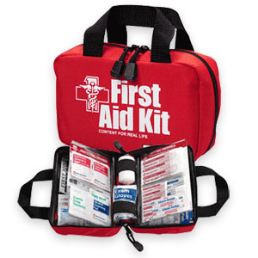
First Aid Kit
Know how to use a first aid kit
Bandages
Skin closures
Gauze pads and dressings
Roller bandages
Tape
Antiseptic wipes
Antibiotic ointment
Bug bite ointment
Blister prevention
Gloves
Tweezers
Needle
NSAIDs
Immodium
Benadryl
Notes:
Knowing what it do is more important than any kit,
take a class,
pack your own, waterproof bags

Slide 11
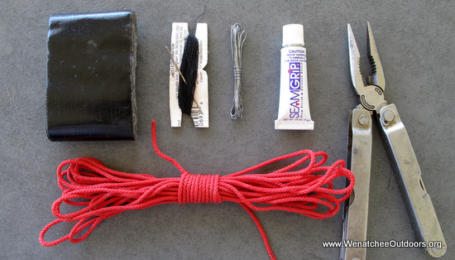
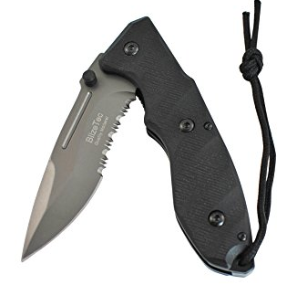
Knife (Repair Kit)
Knife, with saw
Pliers
Screw driver
Duct Tape
Cordage
Sewing needle and thread
Safety pins
Zip ties
Replacement parts
Notes:
What is essential is being able to do repairs, knife most important tool
List is endless, some items specific to nature of trip

Slide 12
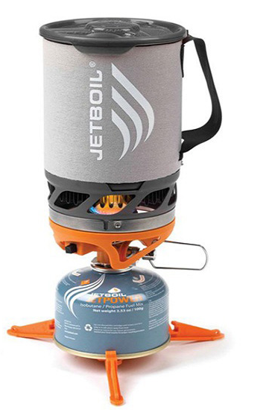
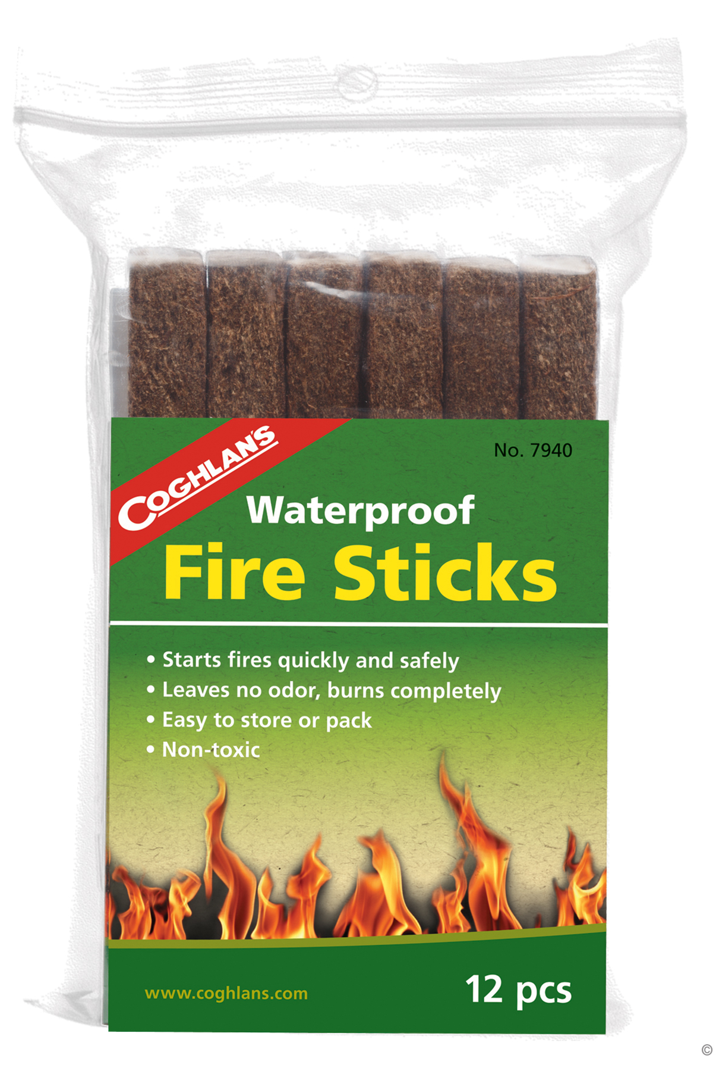
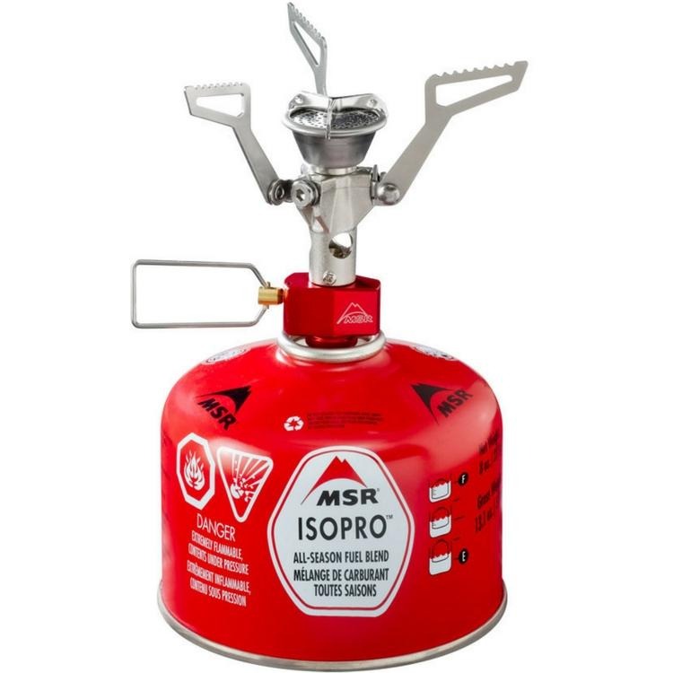
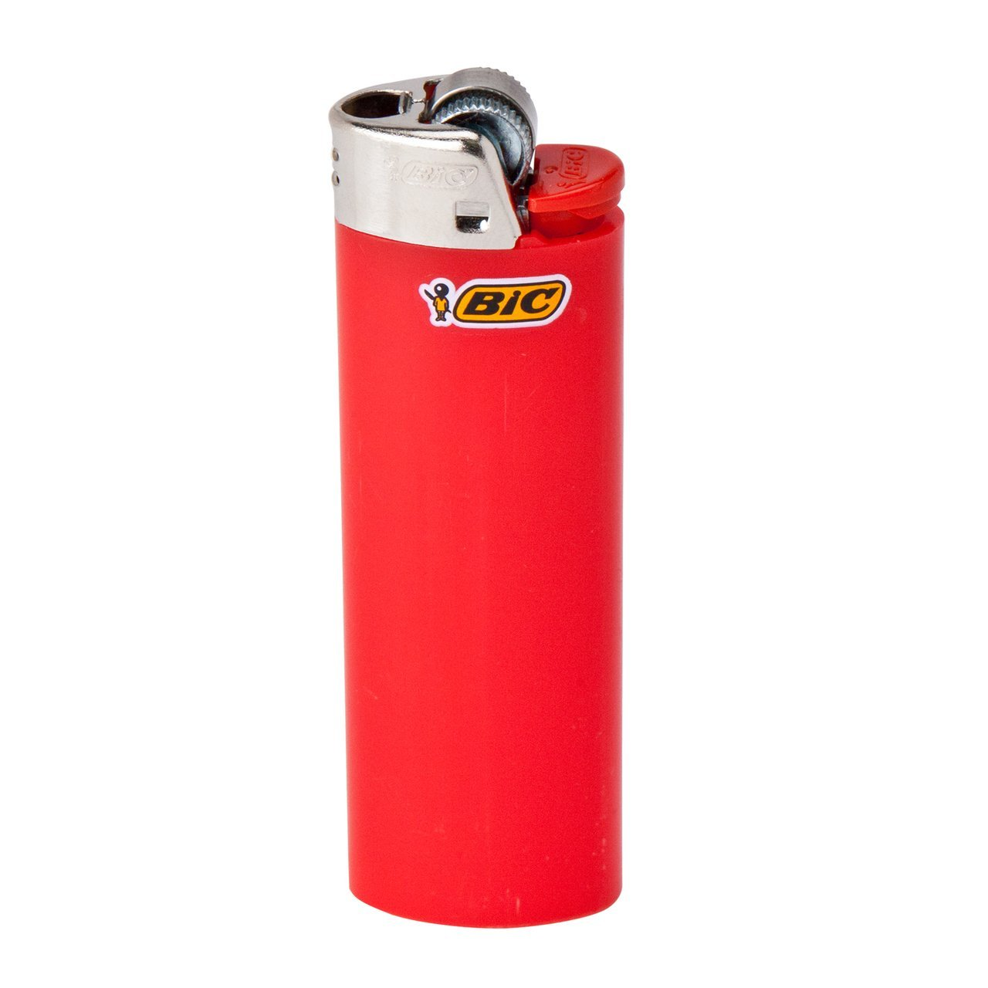
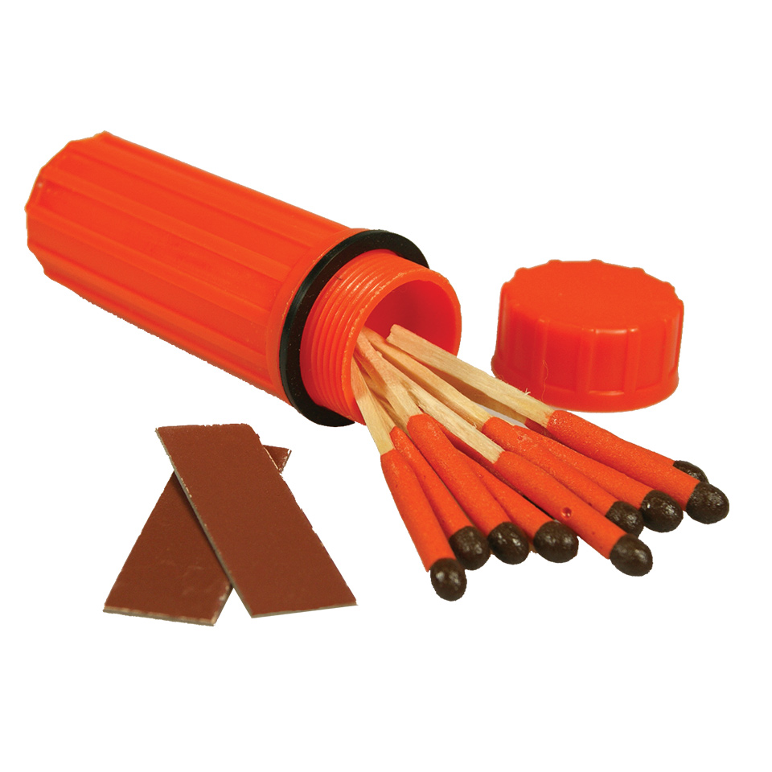
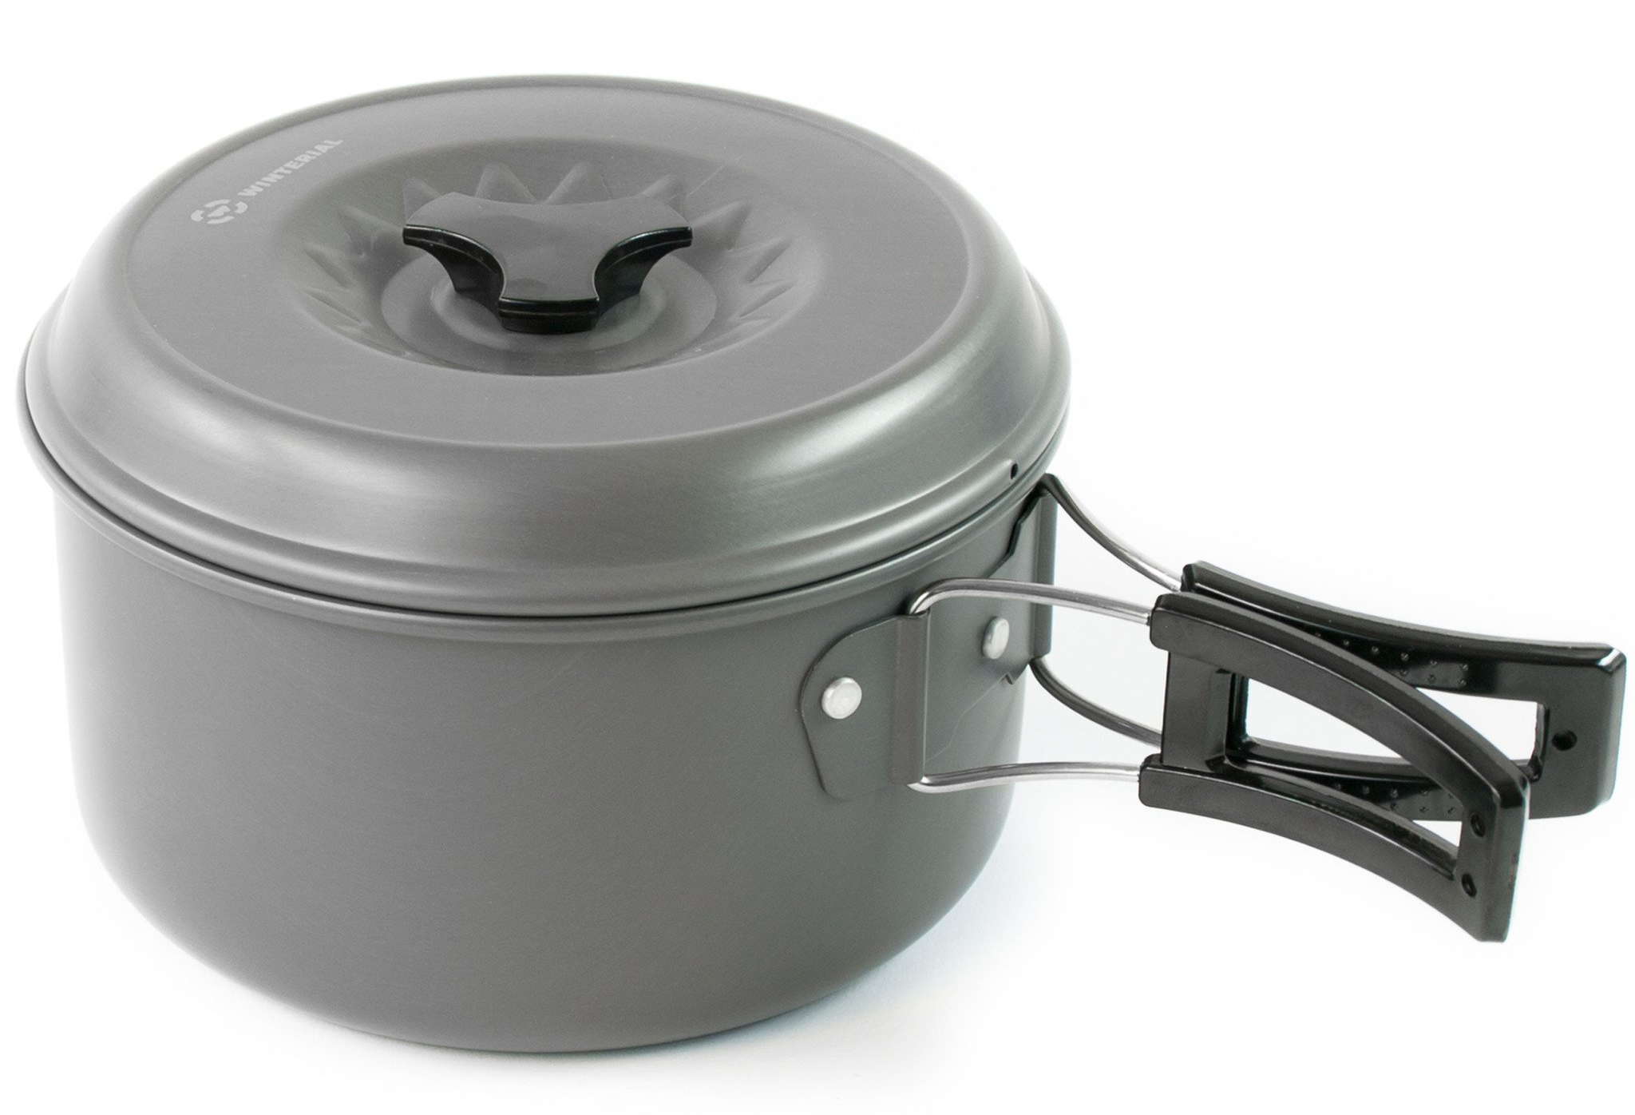
Fire
Carry the means to start and sustain a fire
Lighter
Waterproof matches
Firestarter sticks
Stove, pot, fuel
Notes:
Store in Ziploc bag for added precaution
I have foil in my first aid kit and can use as a make shift pot in emergency
On a snow scramble, prob wont find wood to burn

Slide 13
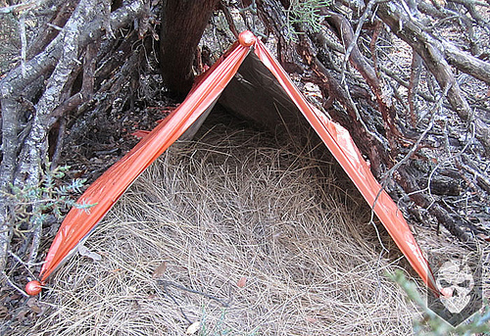
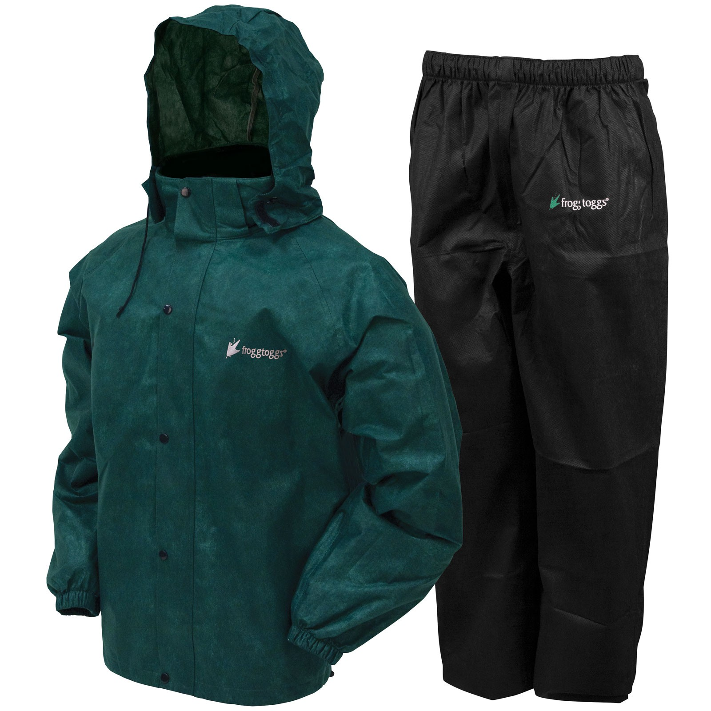
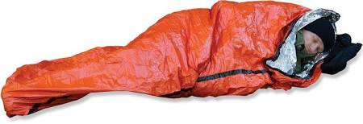
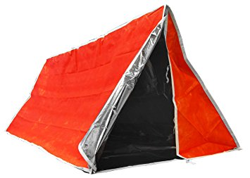
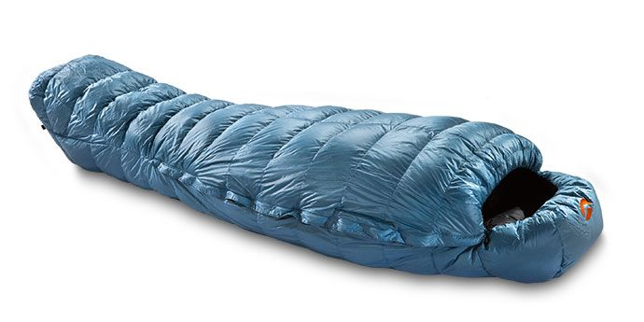
Shelter
Rain jacket and pants
Bivy sack
Plastic tube tent
Sleeping bag
Notes:
Rain gear, esp PNW, SOL emergency bivy and pole tent $20, depends on weather and location

Slide 14
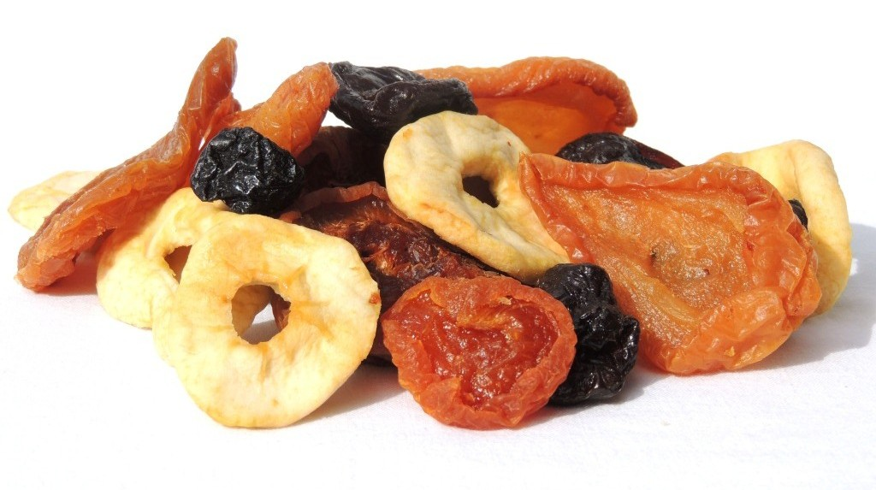


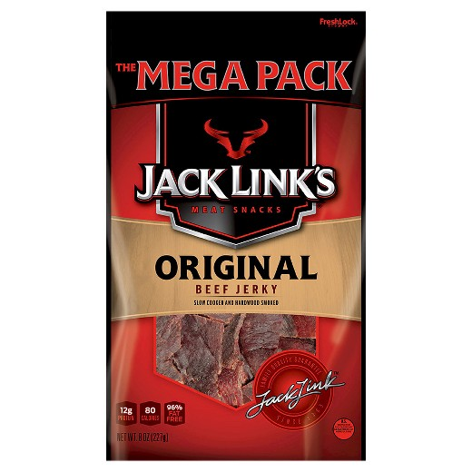

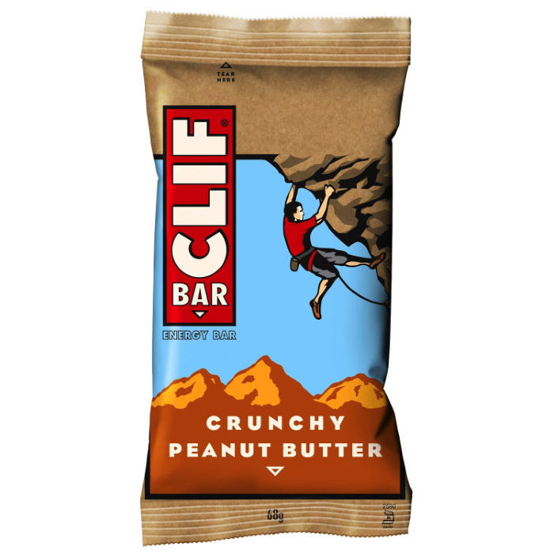


Extra Food
Should have one extra day of food
Easy to eat
Easy to store long periods of time
No cooking preferred

Slide 15
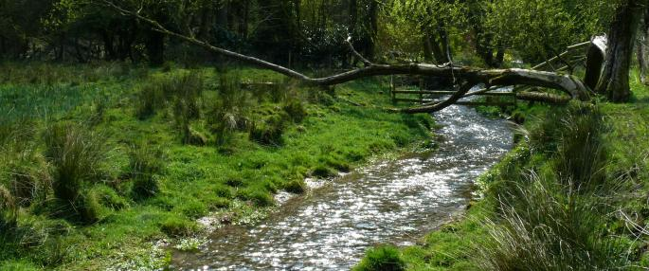
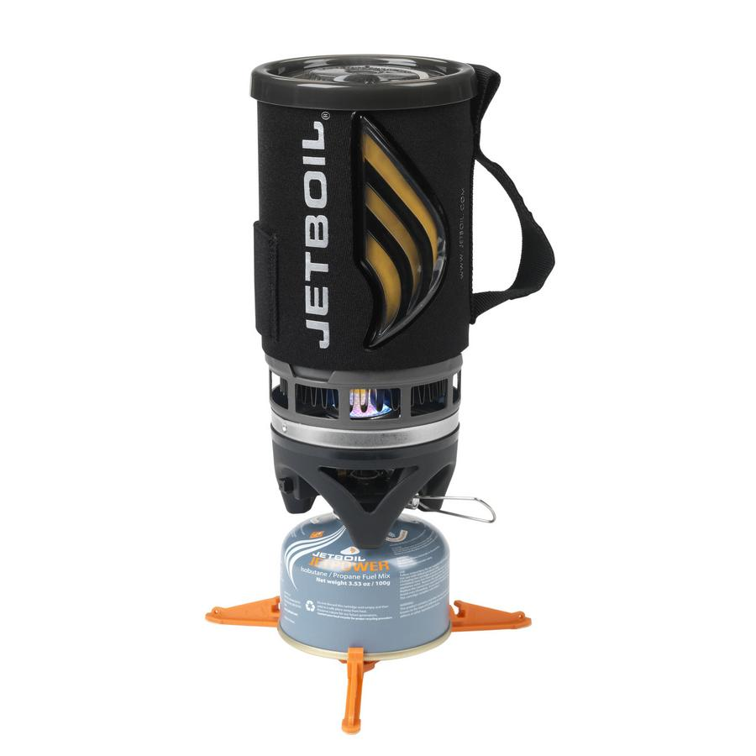
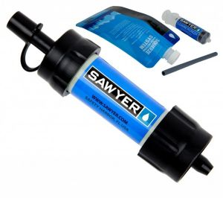

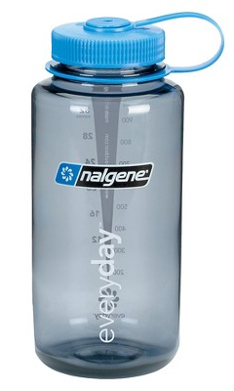

Extra Water
Have the skills and tools required to obtain and purify additional water
Refillable wide mouth bottles
Iodine Tablets
Purify system
Boil system with pot
1.5 – 3L per day/person
Up to 6L if super hot

Slide 16
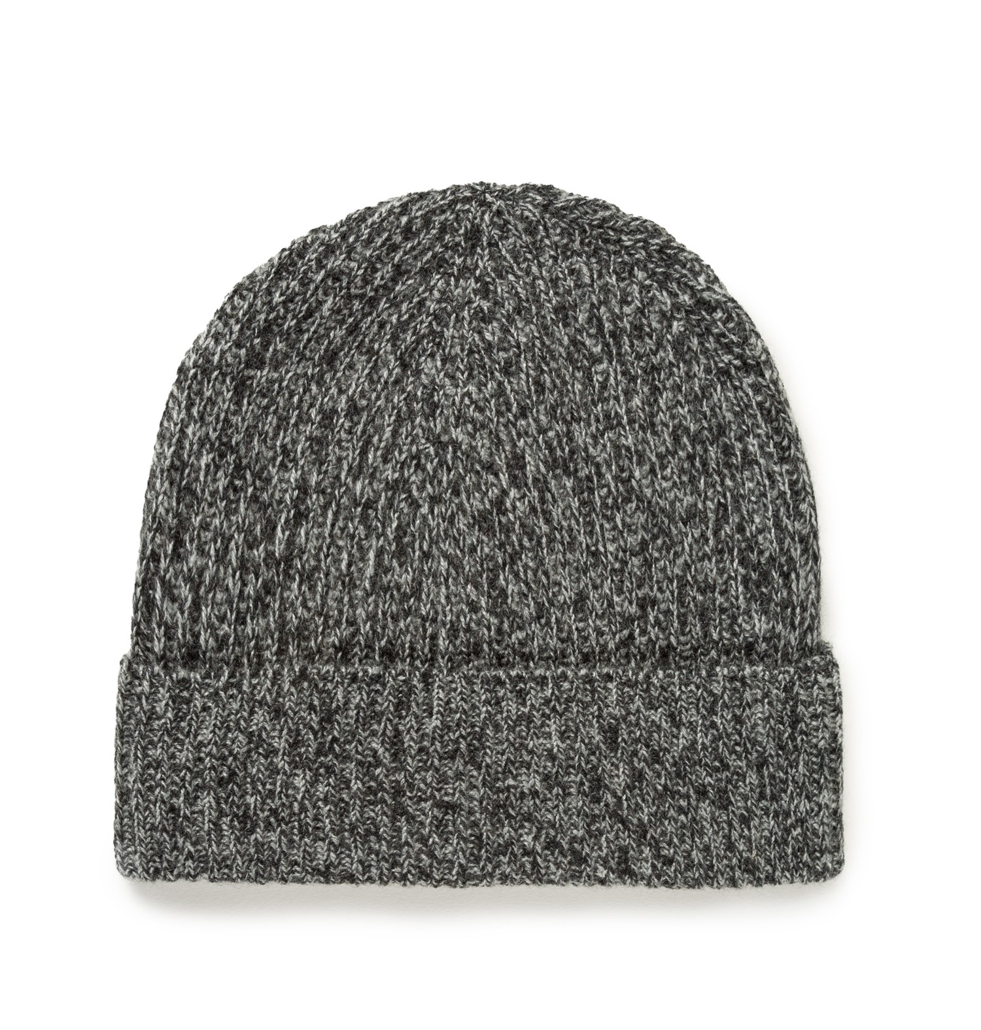
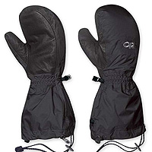
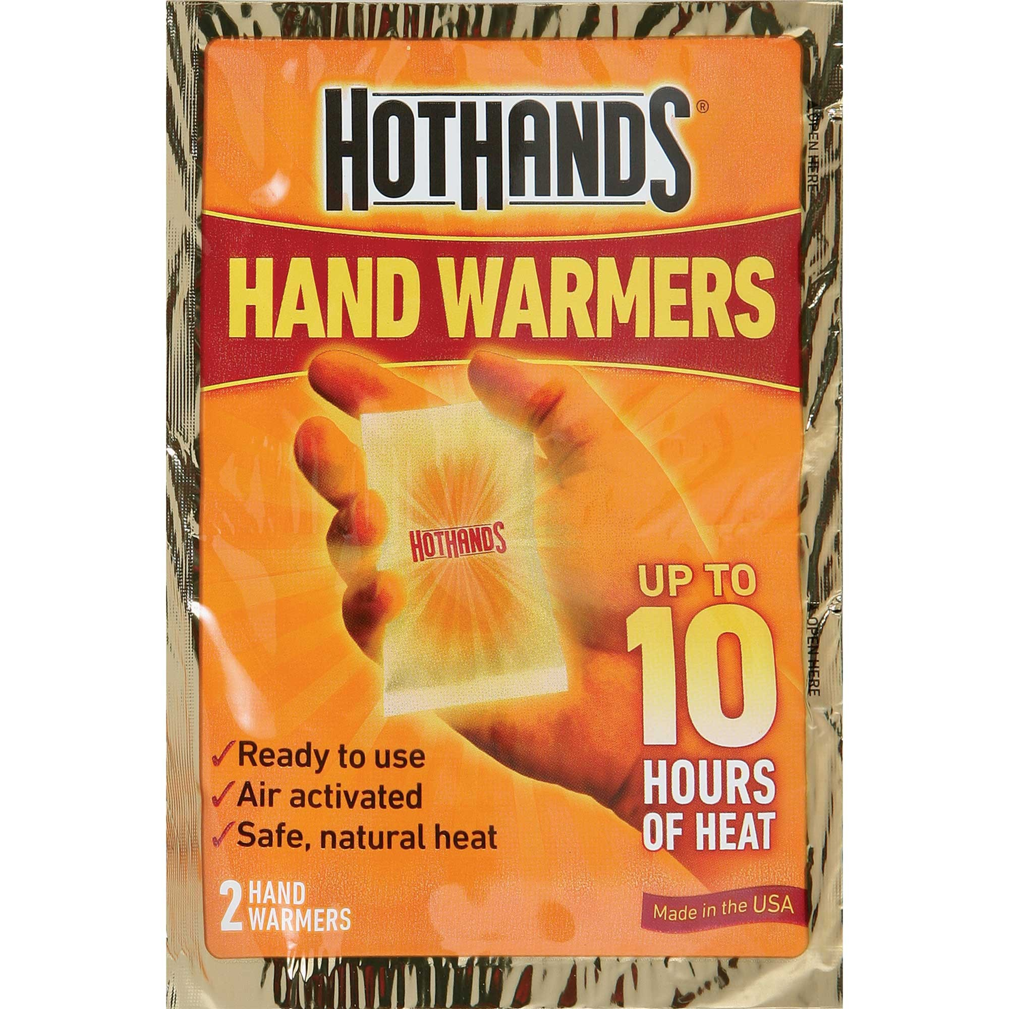
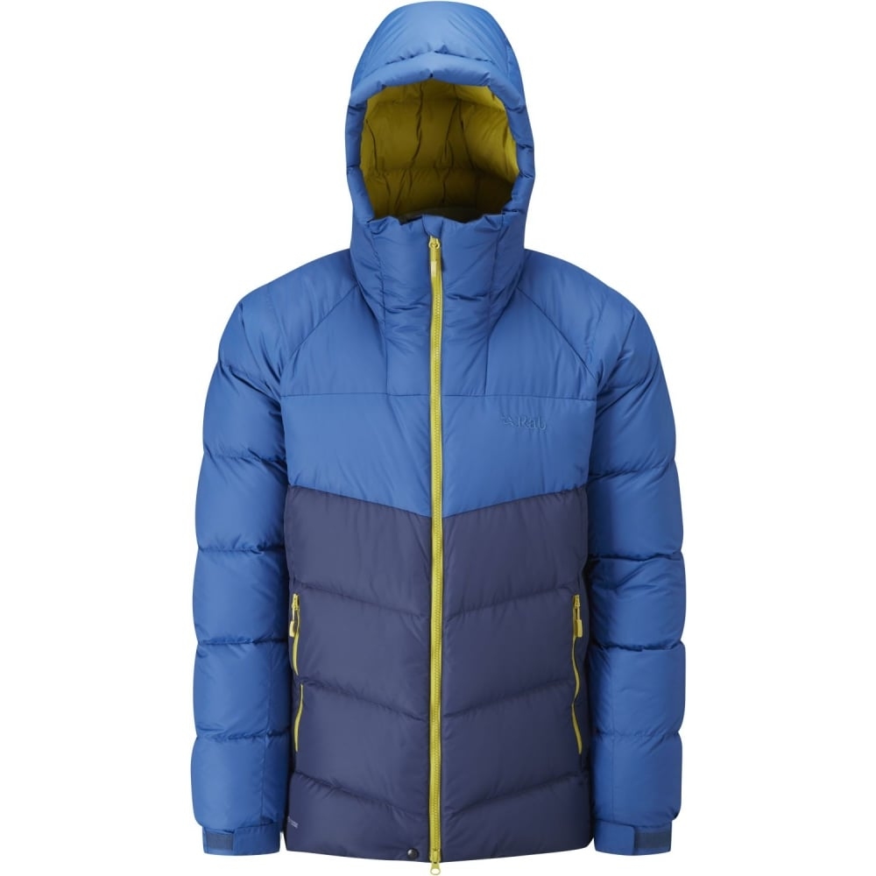
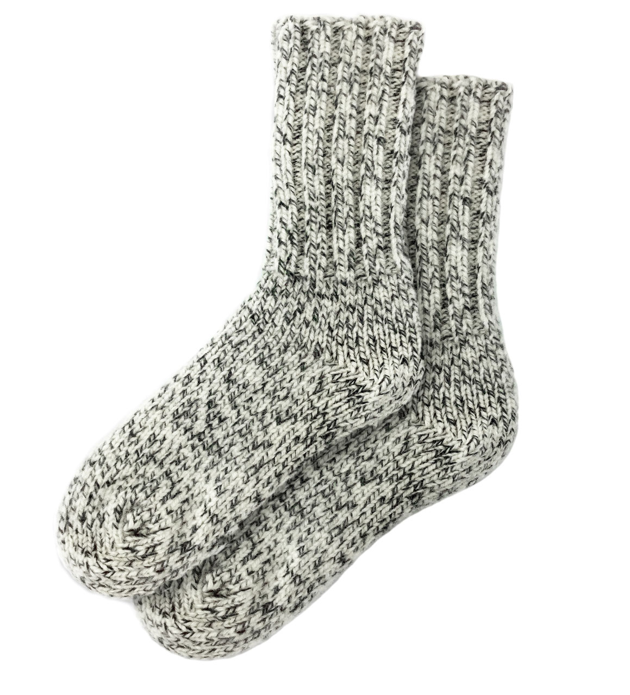
Extra Clothes
What extra clothes are needed to survive the night in my emergency shelter in the worst conditions that could realistically be encountered on this trip?

Slide 17
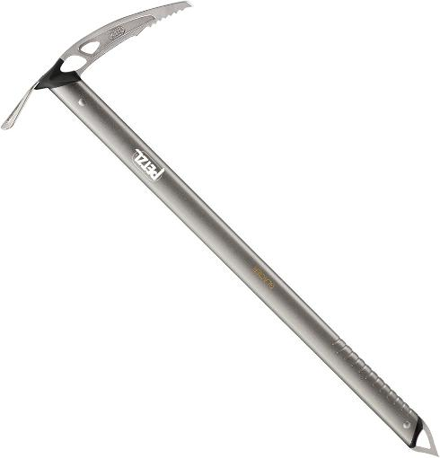





Other Items for Scrambling
Ice Ax and Helmet
Blue Bags or shovel
Whistle
Hasty Harness
Bug spray
Notes:
Extra essentials really depend on type of scramble, location, weather
Trekking poles for after class is over

Slide 18
Experience is Knowledge
With experience, every scrambler develops their own preferences (go light and fast, or carry more gear).
Every scrambler has an opinion about what items are necessary.
Engage brain and think ahead. Envision scenarios and unexpected circumstances.
Know the people you are scrambling with and what type of packer they are.

Slide 19
The Ten Essentials
To prevent emergencies and respond positively should one occur
To safely spend a night or longer outdoors
Navigation
Headlamp
Sun Protection
First Aid Supplies
Knife
Fire
Shelter
Extra Food
Extra Water
Extra Clothing

Slide 20
How do we remember the Ten Essentials?
To prevent emergencies
Know where I am going (navigation)
Protect myself from sun and night danger (sun protection and headlamp)
To respond to an emergency
Fix people (first aid kit)
Fix stuff (repair kit/knife)
If I have to stay the night
Warmth (Fire, Shelter and Clothing)
Sustenance (Extra Food and Water)
One needs to navigate thru the light and the dark to fix the people and things they require for warmth and sustenance.

