Slide 1
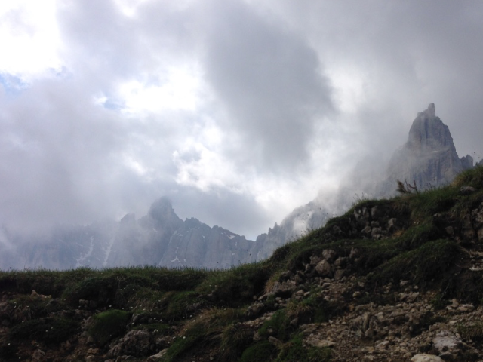

Walking the Wild
January 23, 2019
Dolomites Via Ferrata AV2 Trek 2016
Peter Hendrickson & Emma Agosta

Slide 2
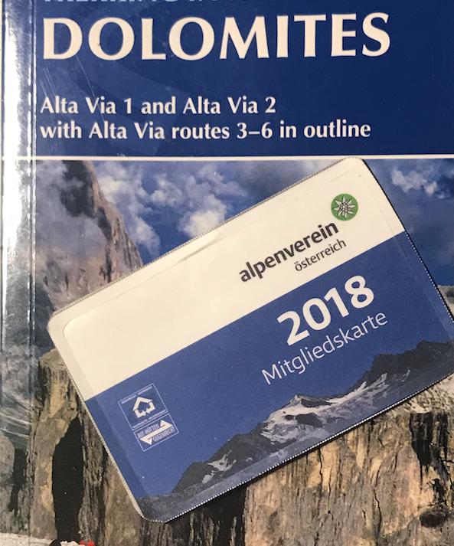
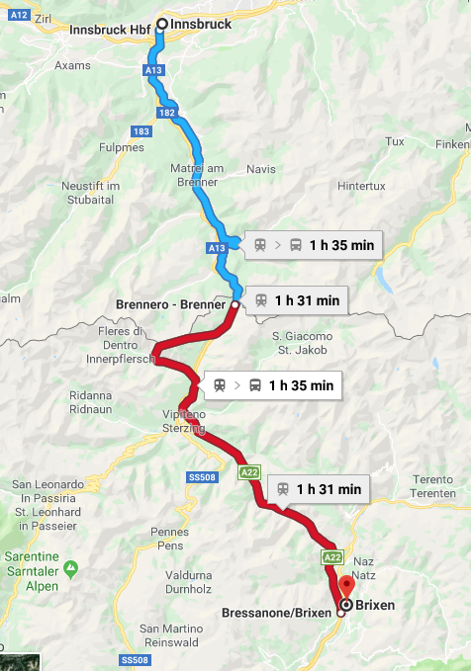
Cicerone, Alpenverein (UK) & Area Map –Essential Tools
Innsbruck, Austria
Brenner Pass, 1375m
Bressanone, Italy
Notes:
Second Punic War 218 BC Romans declared war on Carthage again. Romans mastered the seas so Hannibal planned to do the unthinkable and attack the homeland from the north travelling east from Catalonia – Spain to France with 25,000 mercenaries and a 37battle elephant train. Five months and they were hypothermic on a high alpine pass looking down into Italy. Different Pass!
>>Roman road 2nd century. Almanini 268AD but stopped. Railway Austrian Empire 1867 for troop movement. See B-26 railway brodge bombing run Ernie Yonovitz & Irv Goldberg Nov1944. End WWI Italy & Austria – occupied by Italian troops. WWII Hitler met Mussolini 18 March 1940 to celebrate Pact of Steel. Still working on a tunnel.

Slide 3
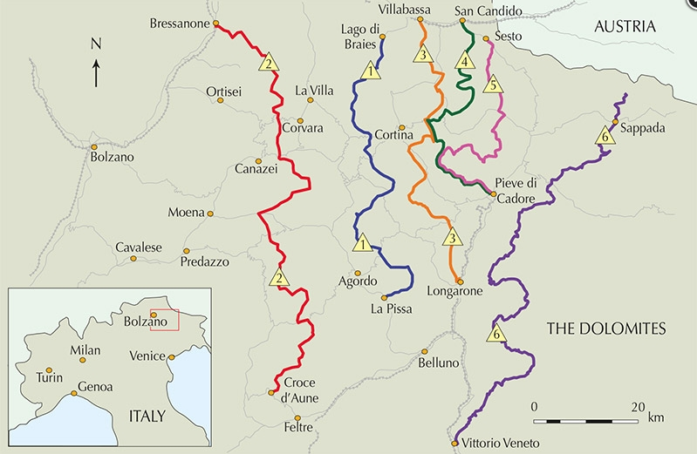
Notes:
There are 9 national parks and a national monument and they overlap UNESCO World Heritage site – about 95% protected in national, regional, or provincial parkland. There is reputed to be a Stati Uniti d”American Circolo Trentino di Seattle, one of many ex-pat orgs around the world.

Slide 4
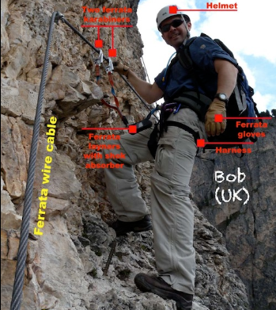
Via Ferrata in Dolomites
~600 routes
8 years old to >75 years
Iron & steel cables, steps & ladders
Anchors 3, 5,10 meters
Helmet, Harness, Gloves
Via Ferrata Rig
“Bad to fall”

Slide 5
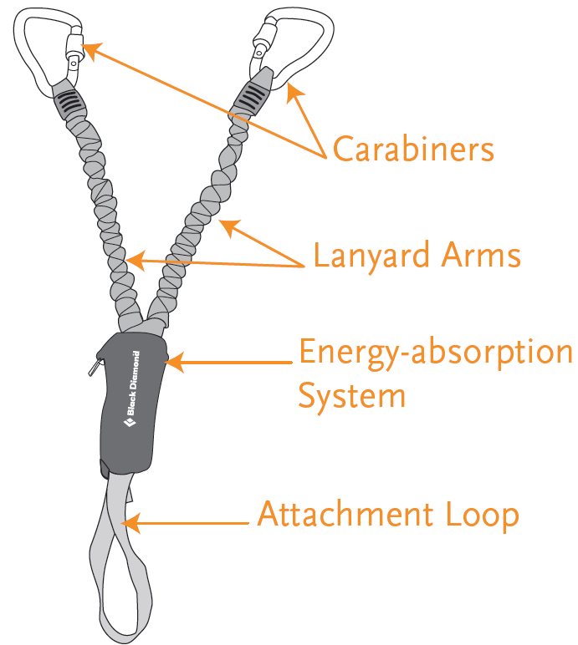
BD Design: 80kg climber, 5m fall
First rule: Don’t fall
Biners auto lock
Lanyard structural webbing
Energy absorbing system – tear away
Attachment loop girth hitch to harness
Unclip one, reclip, repeat
~$150
“Bad to fall.”

Slide 6
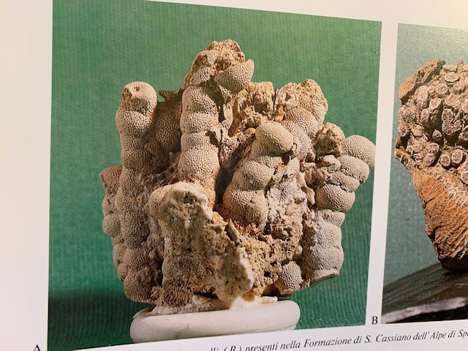
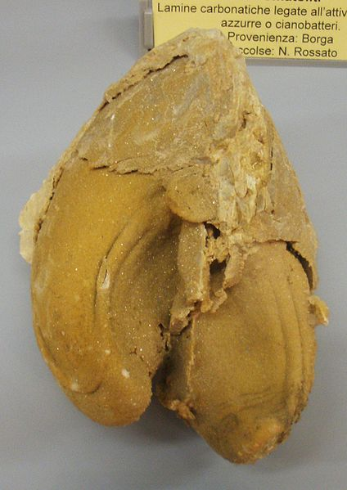
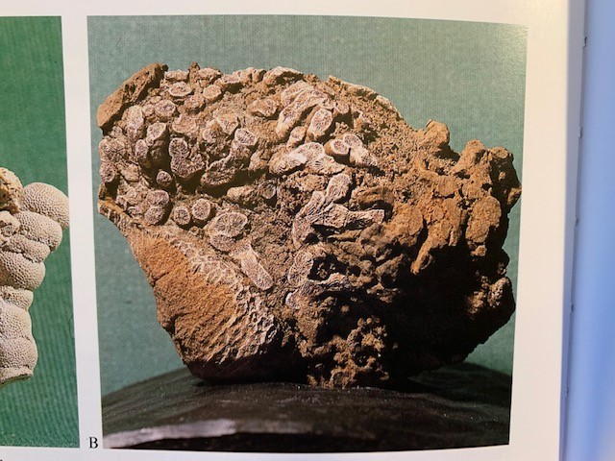
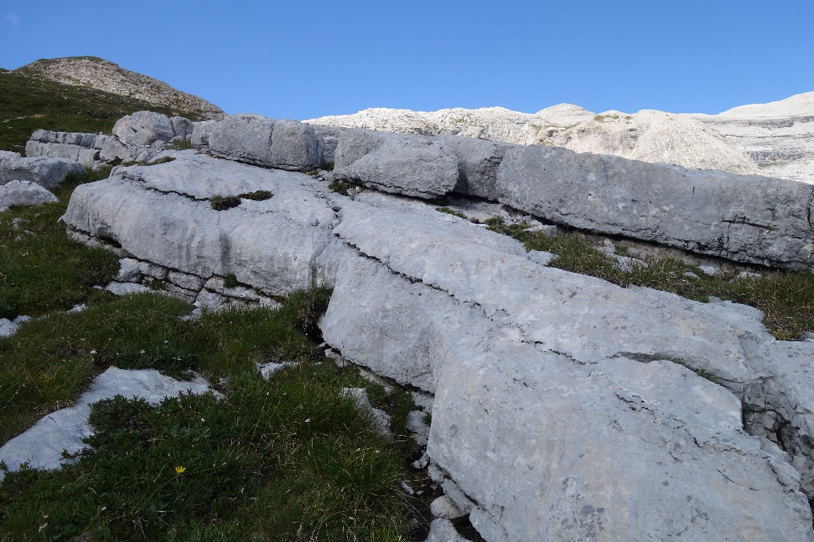
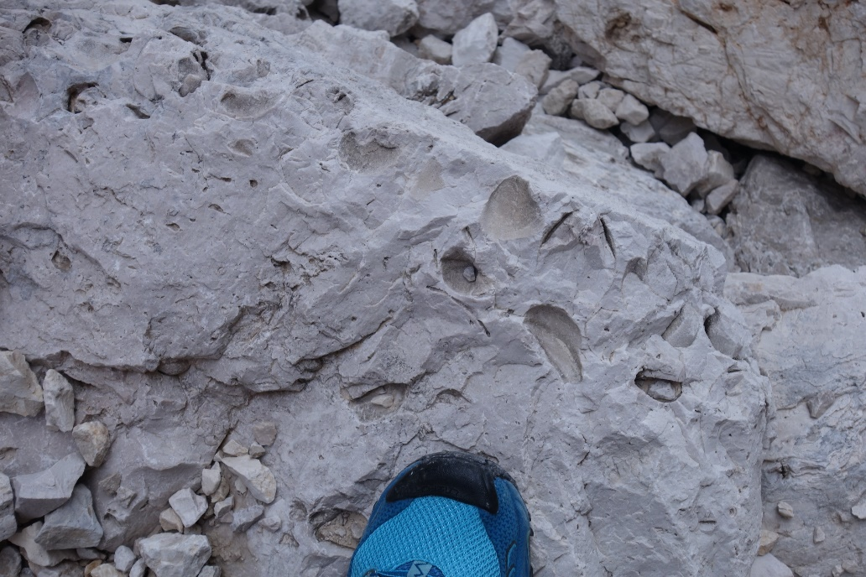
The rock
Common Fossils
Sponges
Dolomite, AKA"dolostone" & "dolomite rock," is sedimentary rock primarily dolomite, CaMg(CO₃)₂.
Neomegalodon (bivalve mollusk)
Corals

Slide 7
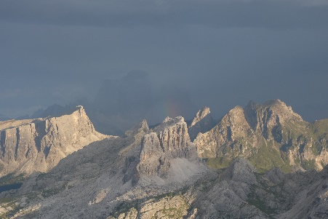
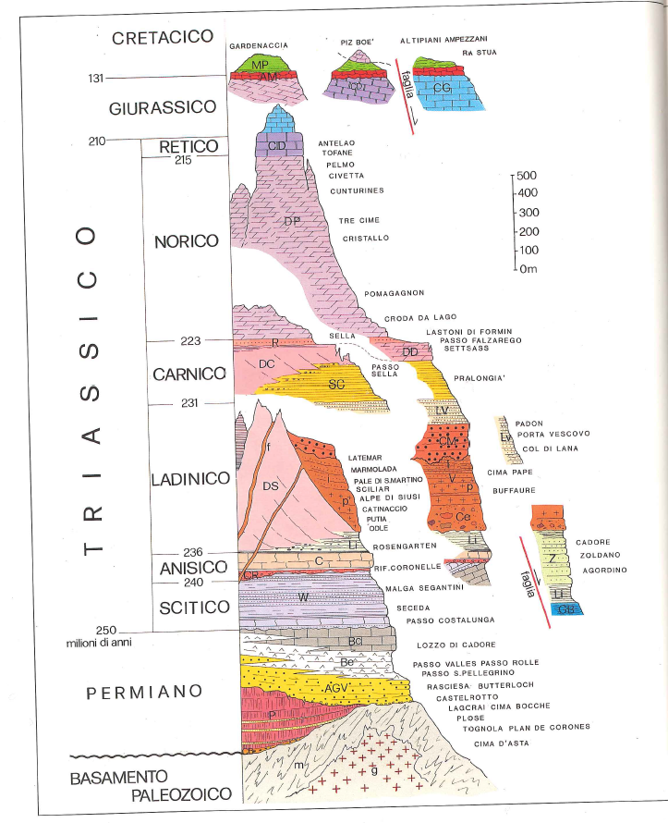
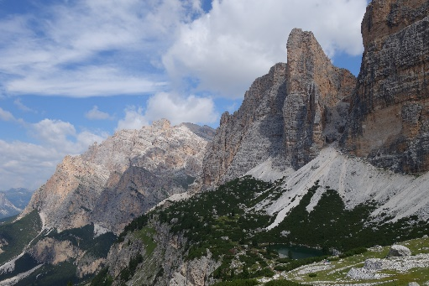
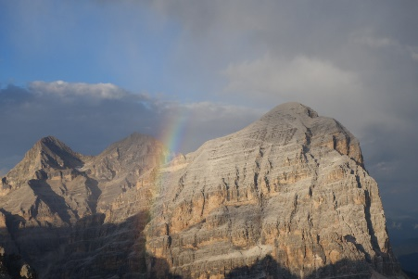
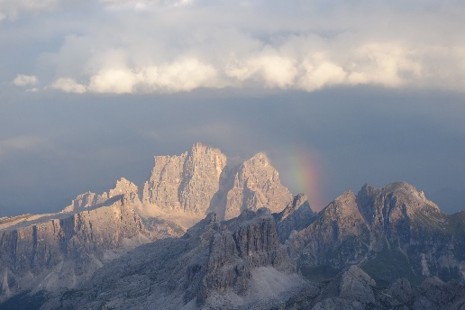
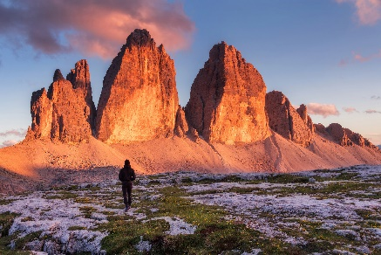
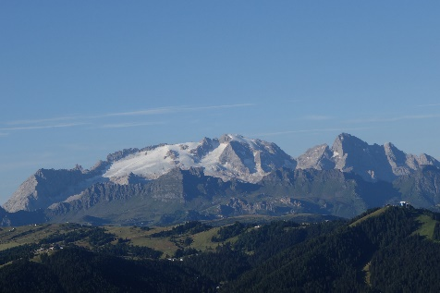

Slide 8
AV1 Emma & AV2 Peter/Nancy 2016
Alta Via Uno August 2016
Alta Via Due June/July 2016
>>Monday Aug 15
Lift >Rif Sasso della Croce
>>Tuesday Aug 16
Rif Sasso d Croce > Rif Laverella Stage 2 Fanes National Park
>>Wednesday Aug 17
Rif Laverella > Rif Lagazuoi atop Lagazuoi Stage 3
>>Thursday Aug 18
Rif Lagazuoi > Rif Nuvolao atop Nuvolau Stage 4
>>Friday Aug 19
Rif Nuvolau > Rif Venezia Stage 5/6
>>Saturday Aug 20
Rif Venezia > Rif Tissi atop Col Real see Mount Civetta NW face St 6/7
>>Sunday August 21
Rif Tissi > Alleghe (exit)
>>Sunday/Monday June 26/27
SEA> LHR> Zurich> Bressanone
>>Tuesday June 28
Brixen> Rif Citta de Bressanone
>>Wednesday June 29
Rif Citta de B> Rifugio Genoa
>>Thursday June 30
Rifugio Genoa> Rifugio Puez
>>Friday July 01
Rifugio Puez> Rifugio Pisciadue
>>Saturday July 02
Rifugio Pisciadu> Passo Pordoi >Bressanone
>>Sunday July 03
>Bolzano & Ötsi

Slide 9
Dolomites AV1 or AV2 Treks?
Compare | AV1 Alta Via Uno | AV2 Alta Via Due
Technical Difficulty | Well marked, cables. Moderate exposure | Numerous aided & exposed sections, Via Ferrata rig
Strenuous | Class 3 Fairly strenuous alpine walk, 4 -8 hr/day | Class 4 Experience in mountainous terrain
Elevation gain | ~6665m; ~21,833 ft | ~12,000m; ~39,400 ft
Km/Miles travelled | ~120 km, (75miles), 10 or 11 days | ~160 kM (100 MILES) , 13 days
Highest Pass | 2752m | 3300m, travel @ 2900m
Crowds | More | Less

Slide 10
When to Hike? Navigation?
June wet, snow, avy?
July 1...waterfalls, flowers
August...fine weather, t-storms, festivals, busy
September...early to mid, best weather, quiet , cheaper air fare from U.S.
Valleys north, south
Map, altimeter, compass, smartphone
GPX track GPSies
Red, White flashes
Signposts landmarks, times for 2 hikers
Guidebook
Tabacco 1:25,000 maps
Notes:
Gaia Italy layer not available 11Jan2019

Slide 11
Weather, Water, Weight & Rescue
Weather
Dolomitimeteo (South Tyrol), Meteoblue
Box & Whiskers
Long range – Hah!!
Snow any month
Rescue Insurance
Austrian Alpine Club (UK)
2019: SEN £40, Adult £52
Water
Rifugios
Few natural sources
Lotsa sheep, cows
Giardia less than U.S.?
Purification tabs
1 liter? 2 liters?
Pack Weight? Puny so more food & water

Slide 12
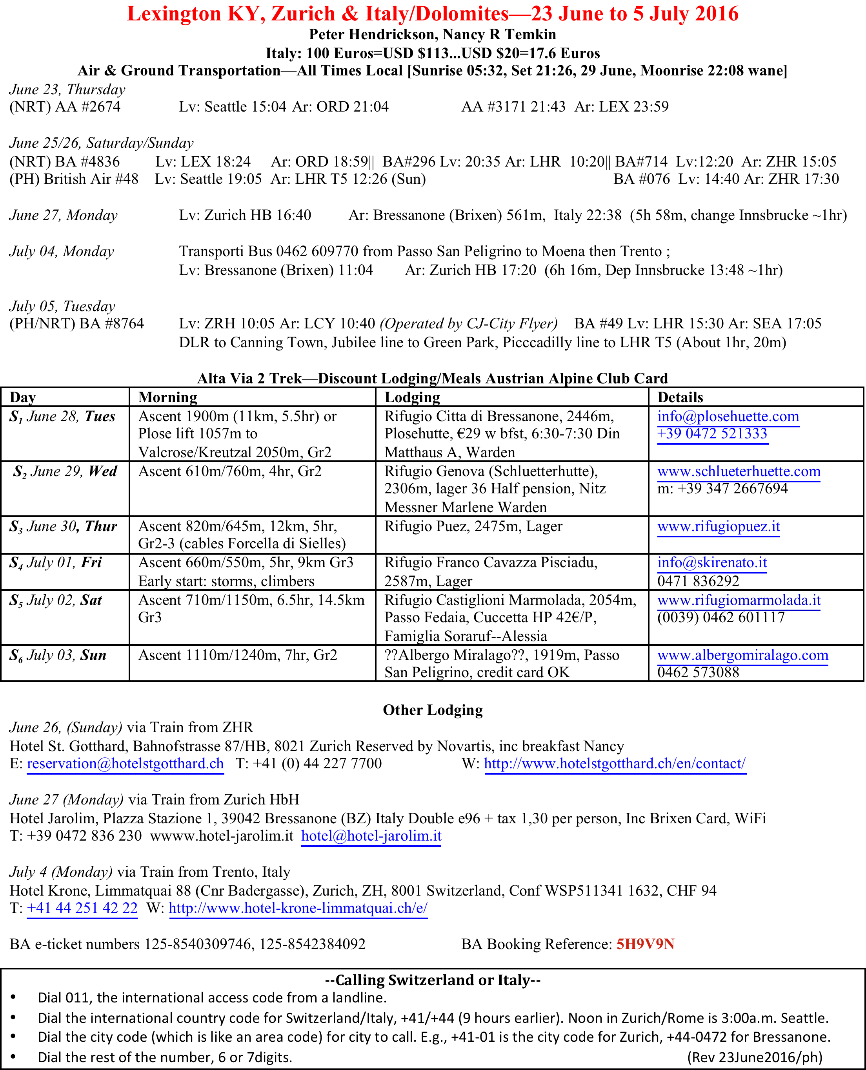

Slide 13
Emma Links Alta Via 1
Marmot marmotpost.wordpress.com
  Alpine hut, Alta Via 1 six days, Essential Kit
Infodolmiti.it
  Strong technical details on AV1
Tabacco Maps & App 1:25K & 1:50K
  http://tabaccomapp-community.it/en/#
Adventures Unguided
  http://www.alpenventuresunguided.com/reviews

Slide 14
Photo Credits & Web Overviews
Gruppo Emma
2016
Emma Agosta
AV1 Outfitter Review
https://www.alpineexploratory.com/walking-guides/alta-via-1.html
Gruppo Peter/Nancy
2016
Peter Hendrickson
Trek Encountered Folks
The Web! K Pozzi,
https://www.youtube.com/watch?v=ITLRoA5T1_Q
Av2 Go Hike Alps Review
https://gohikealps.com/2017/01/alta-via-2-planning-guide/

Slide 15
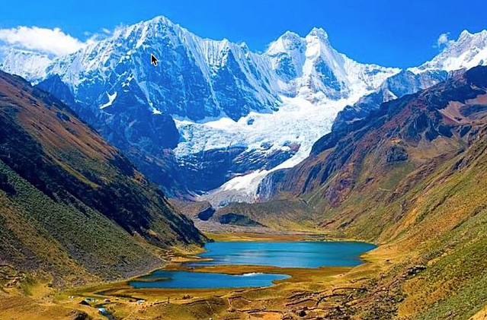
La Cordillera Blanca y Huayhuash WtW April 24 Cheryl Talbert
Notes:
Siula Grande, Huayhash Range, Peru 6,344m Touching the Void (Joe Simpson 1988; Summit 1995, with Simon Yates; Movie 2003) Granddaughter Siula Rose, b. 2010. Grandson Cayesh b 2006

